Slide 1
Top-Up Injection for a Higgs Factory
John Seeman,
SLAC
November 15, 2012

Slide 2
Topics for Top-up Injection for Higgs Factory
Briefly: PEP-II /BaBar top-up injection
Required injection parameters for a Circular Higgs Factory
Rough injector parameters
Detector masking

Slide 3
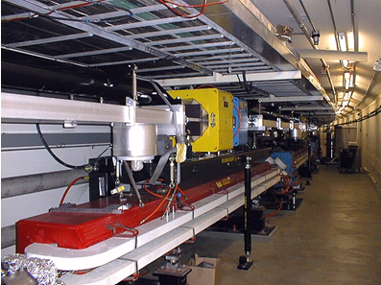
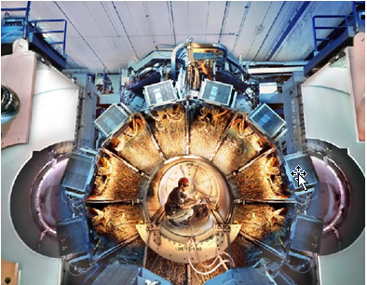
PEP-II / BaBar Top-Up (Trickle) Injection
Energy = 3.5 x 9 GeV
Circumference = 2200 m
One collision point (IR) at Lum = 1.2 x 10³⁴
Full energy injection from Linac+Damping Rings
Number of bunches = 1732 / ring
Beam currents = 2.1 A x 3.2 A
Particles = 1.0 or 1.5 x 10¹⁴ / beam (HER/LER)
Lifetimes:
Vacuum = ~10 hours
Touschek = ~3 hours (LER)
Luminosity = ~1 hour
Lost particles per second = 4.2 x 10¹⁰ / second
Top-up injection = one bunch / pulse
Injection rate: ~3-15 Hz (30 Hz max)
Particles per injection: 3 to 9 x 10⁹ / pulse
Bunch injection controller: pick the lowest bunch
Injection efficiency = ~ 80%
Injection kicker pulse length = 0.4 μsec
Ring path length = 7.3 μsec
PEP-II
BaBar

Slide 4
PEP-II/BaBar Top-Up Injection (Accelerator)
Improved peak and average luminosity.
Before Top-Up Injection
After Top-Up Injection

Slide 5
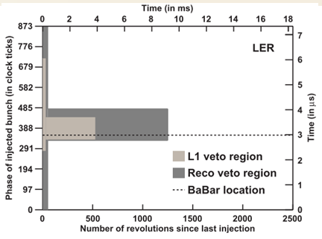
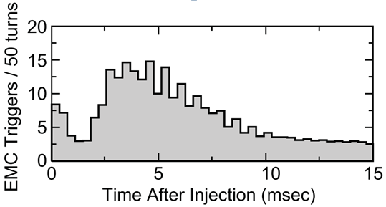
PEP-II/BaBar Top-Up Injection (Detector)
One
turn
BaBar trigger masking:
Mask all of ring a few tens of turns.
Mask injected bunch area for 1250
turns or about 0.9 msec.

Slide 6
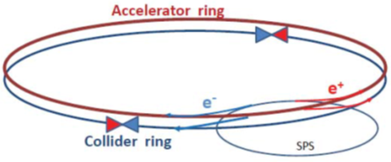
Circular Higgs Factory Ring Parameters for Injection (TLEP-H)
Energy = 120 x 120 GeV
Circumference = 80 km
Two collision points (IR)
Full energy injection
Number of bunches = 80 / ring
Particles = 4.1 x 10¹³ / beam
Particles = 5.1 x 10¹¹ / bunch
Lifetimes:
Vacuum = ~10 hours
Touschek = ~15 hours
Luminosity = ~0.53 hour
Lost particles per second = 2.1 x 10¹⁰ / second per ring
Injection efficiency = ~ 80%.
→ Needed for injection: e+ and e- at ~2.6 x10¹⁰ / second at full energy.
A. Blondel
F. Zimmermann

Slide 7
CHF Injection Phase Space
Septum blade
Stored Beam Orbit
Injection orbit
β_{x} at injection septum (stored) = ~200m
β_{x} at injection septum (injection) = ~30m
ε_{xstored} (stored) =9.4 nm
ε_{xinj} (injected) =50 nm
σ_{xstored} at septum (stored) = 1.4 mm
σ_{xinj} at septum (injected) = 1.2 mm
X_{s} = Septum blade thickness =~ 5 mm
X_{c} = septum clearance distance = ~6σ_{x}
Xinj < A_{x}
Xinj = 4Xσinj+X_{s}+Xc = ~18 mm
A_{x} = machine aperture > ~20 mm
Stored beam
Injection bump on
Injection bump
x_{c}
Injected beam
(+/- 2 σ_{xinj})
x_{inj}
A_{x}
Injection bump off
(~one turn later)
x_{inj}

Slide 8
Positron Production
CHF needs ~2.6 x10¹⁰ e+ / second at full energy.
CERN: LEP injection complex delivered ~10¹¹ e+ per second.
SLAC: SLC injection complex delivered ~6 x 10¹² e+ per second.

Slide 9
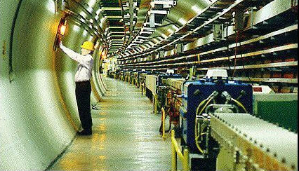
“Ramped Storage Ring” as a CHF Injector
Top-up injection = 80 bunches / pulse / beam
Injection rate: Once every 4 minutes.
Particles per ring injection: 6.2 x 10¹² / pulse
Particles per injected bunch: 7.8 x 10¹⁰ / pulse
Bunch injection controller: Fill all bunches at once
Ring path length = 267 μsec
Injection kicker pulse length = 267 μsec.
Kickers = 13 stronger than PEP-II but long flat top.
→ Luminosity varies from 100% to 70% over 4 minutes.
CERN LEP: 26.7 km
Ramping speed is 0.5 GeV/sec
→ 120 GeV in 4 minutes.
120 GeV
DR 1.5 GeV
3 GeV
Injector
SR
e-
CHF
Linacs
e+

Slide 10
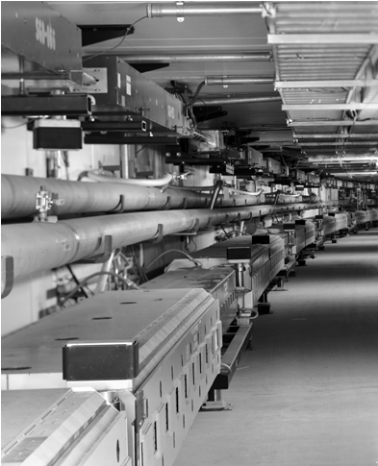
“Ramped Main Ring” as a CHF Injector
Top-up injection = 80 bunches / pulse / beam
Injection rate: Once every 4 seconds.
Particles per ring injection: 1.1 x 10¹¹ / pulse
Particles per injected bunch: 1.3 x 10⁹ / pulse
Bunch injection controller: Fill all bunches at once
Ring path length = 267 μsec
Injection kicker pulse length = 267 μsec.
Kickers = 13 stronger than PEP-II but long flat top.
→ Luminosity stays constant to ~0.5%.
FNAL Main Injector: 3.3 km
Ramping speed is ~60 GeV/sec
--> 120 GeV in 2 seconds.
120 GeV
DR 1.5 GeV
3 GeV
Injector
Rapid SR
e-
CHF
Linacs
e+

Slide 11
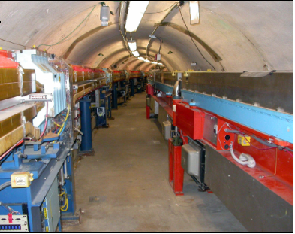
“Synchrotron” as a CHF Injector
Top-up injection = 1 bunch / pulse
Cycle rate = 60 Hz
Injection rate: 20 Hz e+, 20 Hz e-, 20 Hz e- to make e+
Particles per injection: 1.3 x 10⁹ / pulse
Bunch injection controller: Pick the lowest charge bunch
Injection kicker pulse length = 6.7 μsec (= 2 km)
Kickers = 13 stronger than PEP-II but 15 times slower.
Ring path length = 267 μsec
→ Luminosity stays within 0.1% of the peak.
Cornell synchrotron: 768 m
Sine wave magnet excitation
0.2 GeV to 12 GeV in
8.3 msec at 60 Hz.
Does not affect CESR 2 m
away.
120 GeV
2 GeV
DR
CHF
Synchrotron
e-
e-
e+

Slide 12
Detector Masking
Detectors for CHF need to mask injection bunches.
Ramped storage ring injector:
Mask entire ring for ~10 msec every 4 minutes.
Ramped “Main Injector” style:
Mask entire ring for ~10 msec every 4 seconds.
Synchrotron injector:
Mask 1/80 of ring for ~10 msec at 20 Hz.
All these masking durations produces much less than 1% loss in integrated luminosity.

Slide 13
Conclusions
Top-up injection will work for a Circular Higgs Factory.
A full energy injector is needed.
A synchrotron injector will work the best but is more than is needed. (60 Hz)
A rapidly ramped storage ring is likely adequate. (4 sec)
A slowly ramped storage ring injector doesn’t make the luminosity constant enough.
The detectors will need to mask out the buckets with damping injected bunches during data taking.

