Slide 1
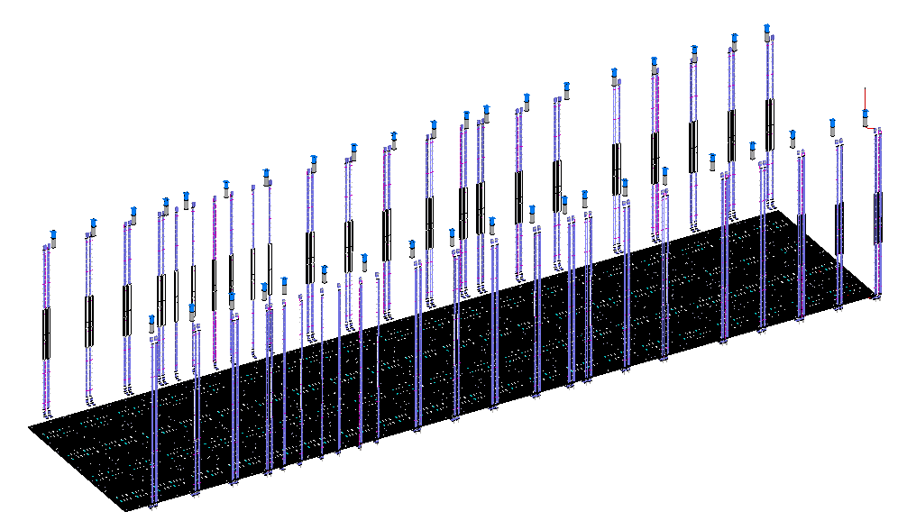
FD2 BDE Cabling and Penetrations

Slide 2
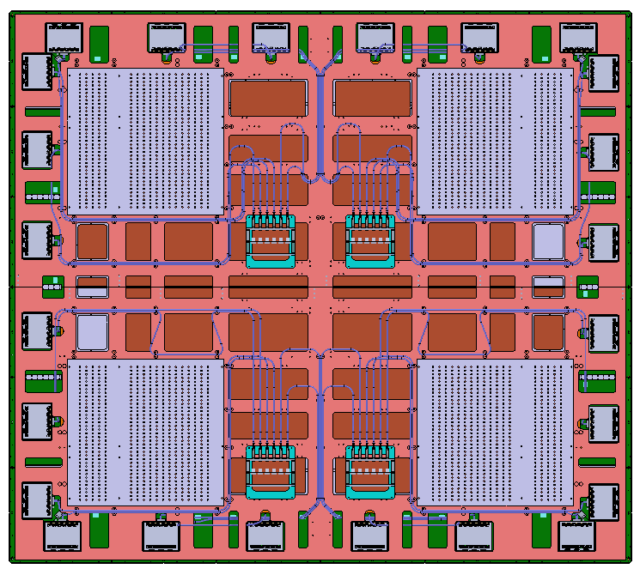
CRP cable routing
Four patch panels on each full CRP with two on each half CRP.
Patch panels are located toward the TCO.
Each patch panel connects to 6 CE boxes.
2.5m short cables routed from the CE boxes to the patch panels.
Cables are secured on the CRP composite frame with cable ties.
25m long cables will connect the patch panels to the penetration on the cryostat roof.

Slide 3
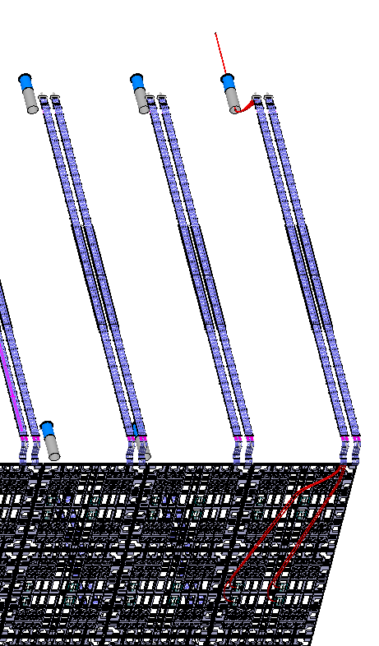
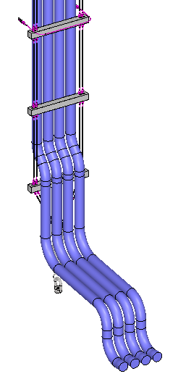
Cable routing from patch panels to penetration
25m long cable bundles are installed before CRP installation.
Long cable bundles are supported in ladder cable trays and positioned along the cryostat walls.

Slide 4
Offsets between cable trays, penetrations and patch panels
Penetrations
Cable trays
Bottom CRPs

Slide 5
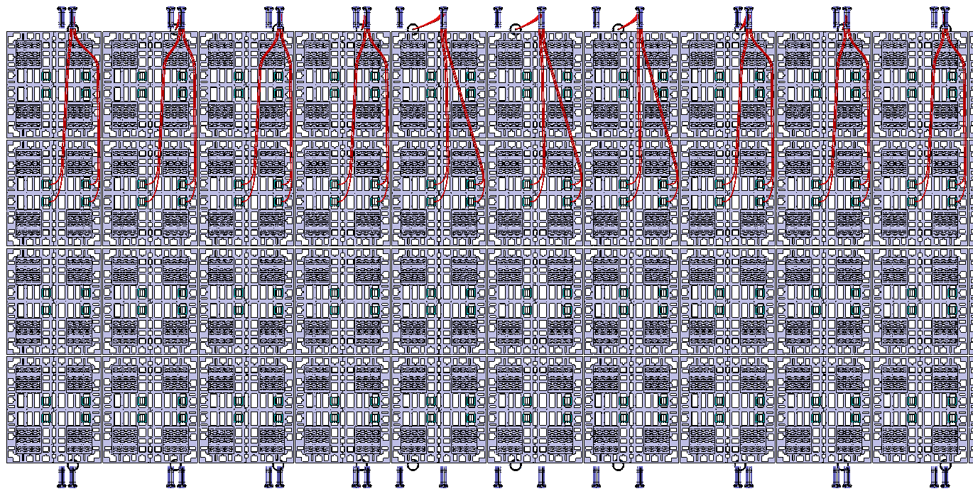
Modeling of cable bundles from penetrations to patch panels on the central north CRPs
Row #1
Row #2
Row #3
Row #4
Row #5
Row #6
Row #7
Row #8
Row #9
Row #10

Slide 6
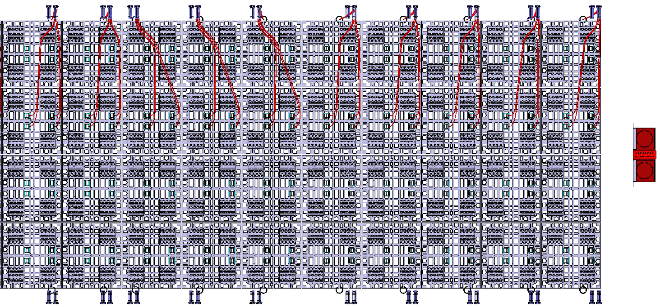
Modeling of cable bundles from penetrations to patch panels on the central north CRPs
Row #11
Row #12
Row #13
Row #14
Row #15
Row #16
Row #17
Row #18
Row #19
Row #20
TCO

Slide 7
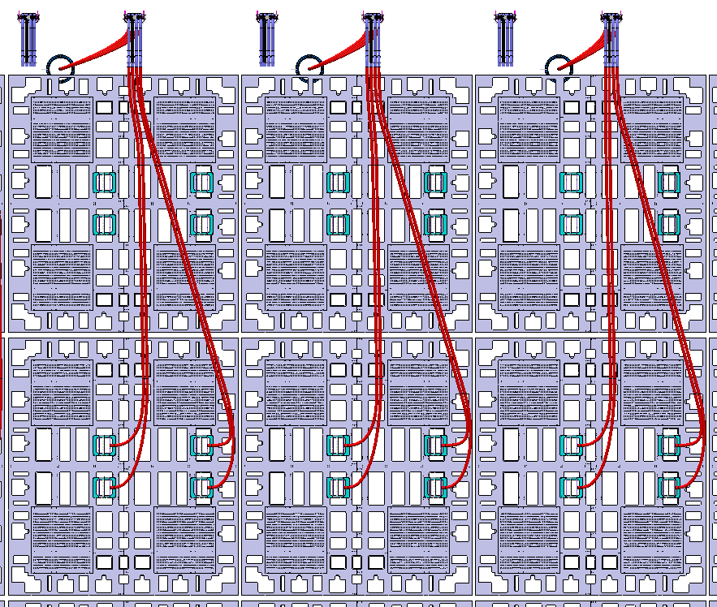
Modeling of cable bundles from penetrations to patch panels on the central north CRPs
The longest minimum required cable length is 24.5m at Row #5.
Row #5
Row #6
Row #7
P1
P3
P2
P4
24.5m
24.4m
24.3m

Slide 8
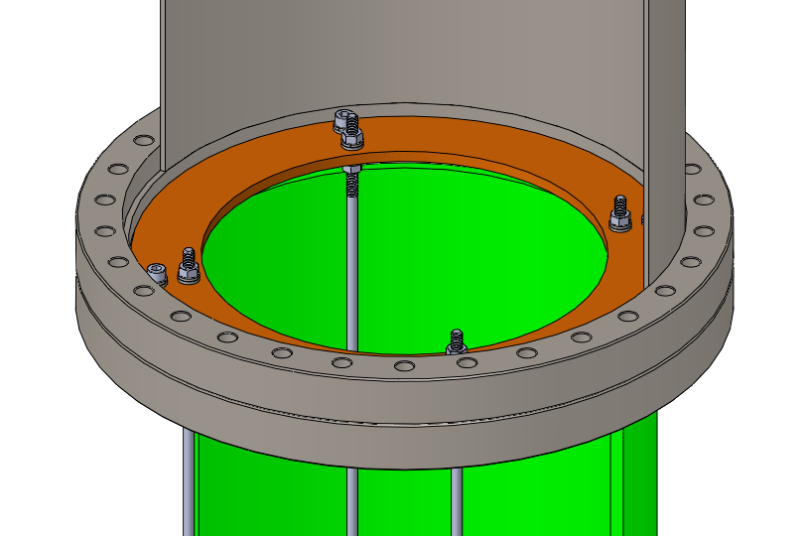
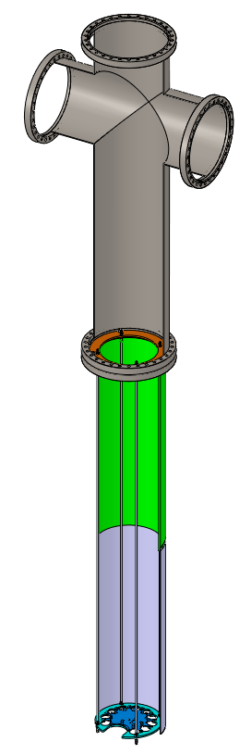
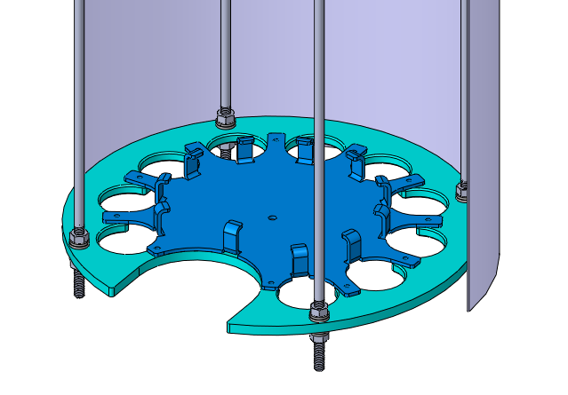
BDE/PDS penetrations
Each penetration provides two side flanges for BDE and top flange for PDS.
BDE/PDS cables are strain relieved at the cable clamp/lock plates at the bottom of the penetration.
CSSP
Support plate
Support rods
Cryostat crossing tube
Cable clamp/lock plates

Slide 9
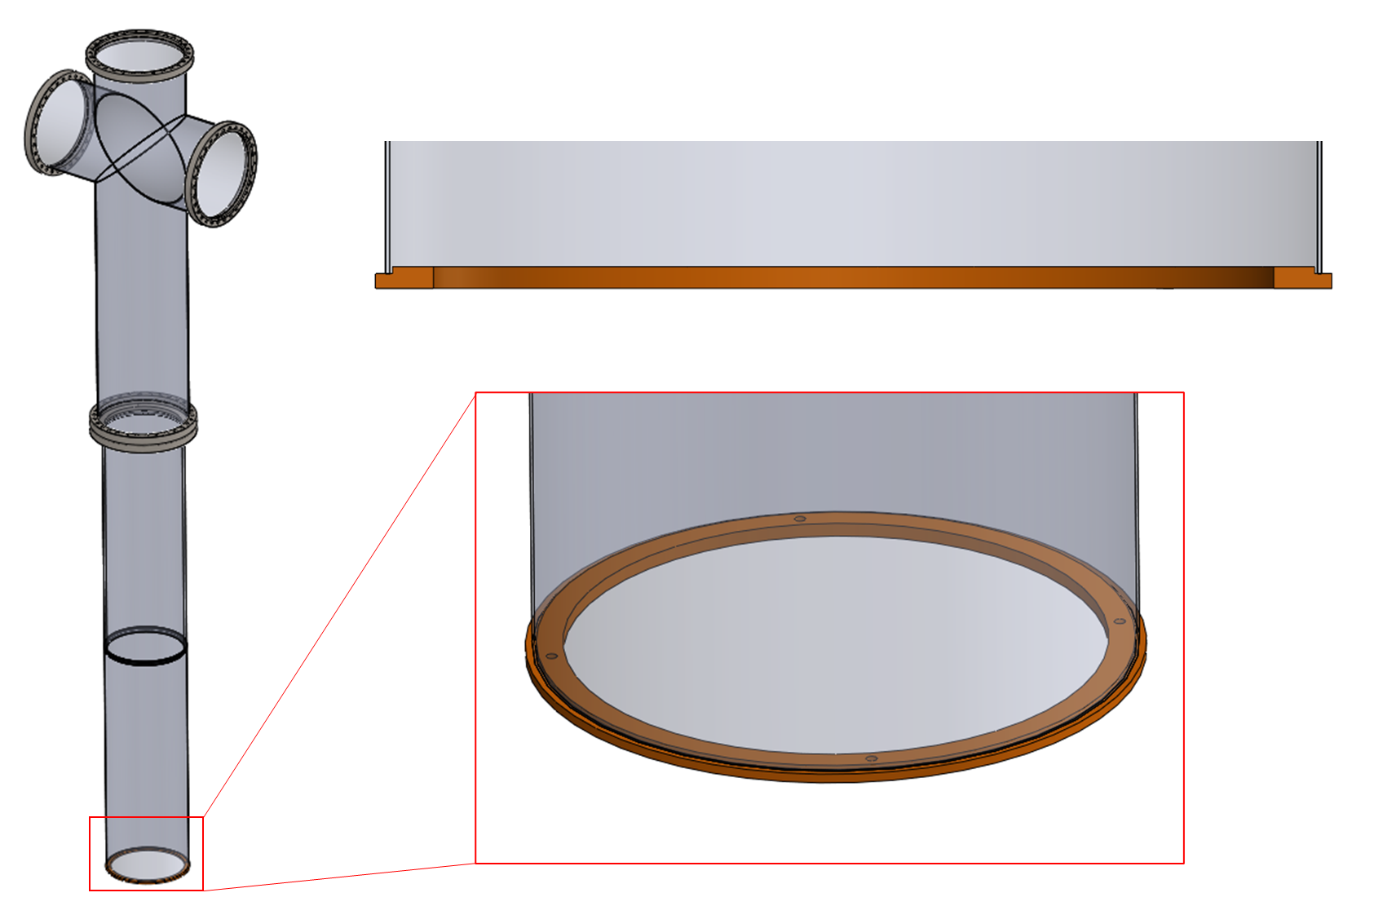
BDE/PDS penetrations – Alternative design
Another design idea is to mount the cable clamp/lock plates to the bottom of the cryostat crossing tube. Therefore, the strain relief design can be simplified with the support plate and rods eliminated.
A proposal of directly welding the CSSP to the cryostat crossing tube is being discussed. No flange on the cryostat crossing tube will be available for the support plate to mounted.

Slide 10
Backup slides

Slide 11
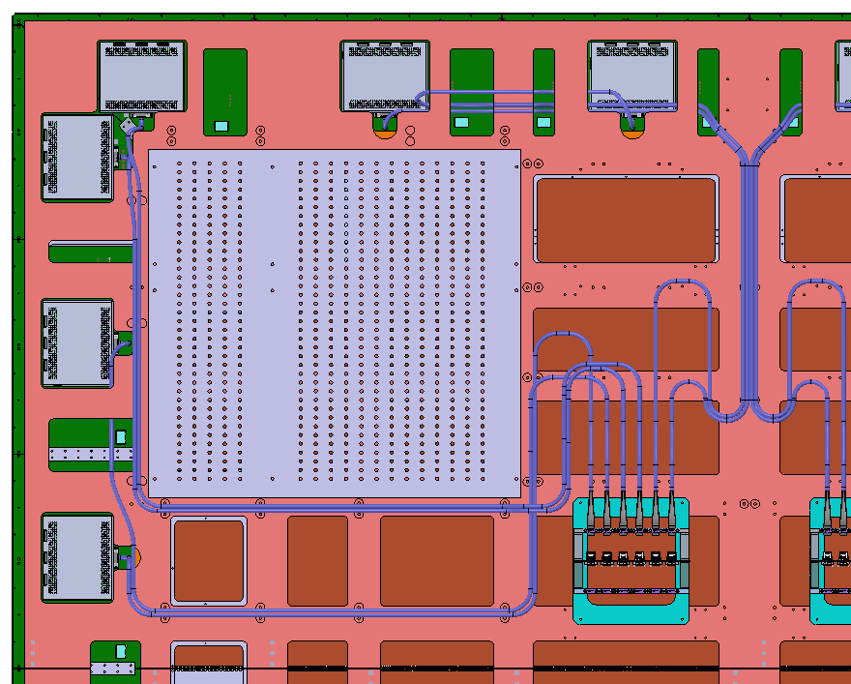

Slide 12
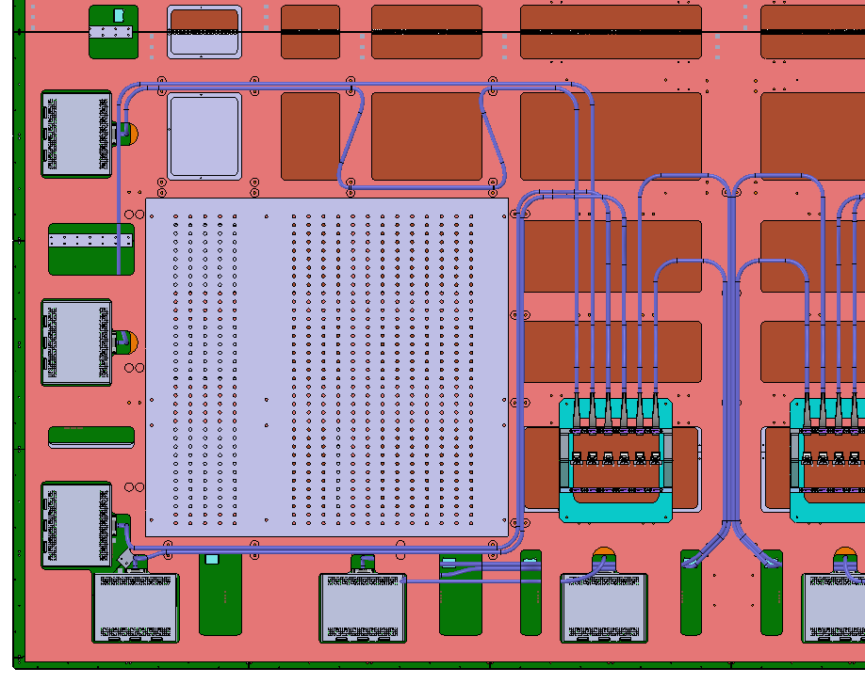

Slide 13
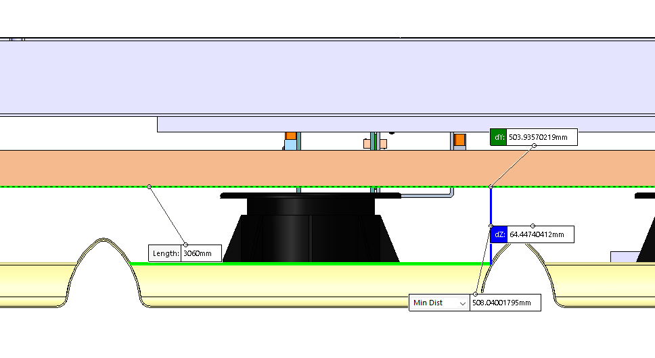
Gap between floor and low ridge of membrane is 64mm
Gap between floor and high ridge of membrane is 42 mm.
Bottom CRP
Wood floor
42.4mm
F40
Membrane

Slide 14
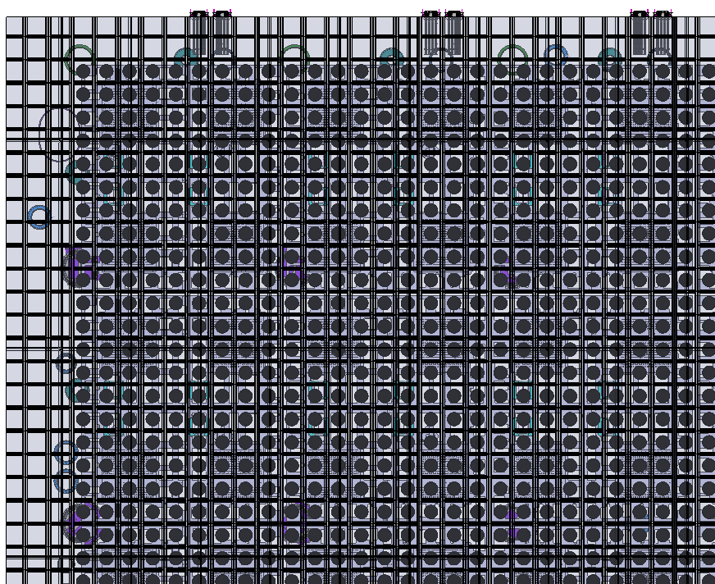
Cable bundles pre-routed underneath the floor.

Slide 15
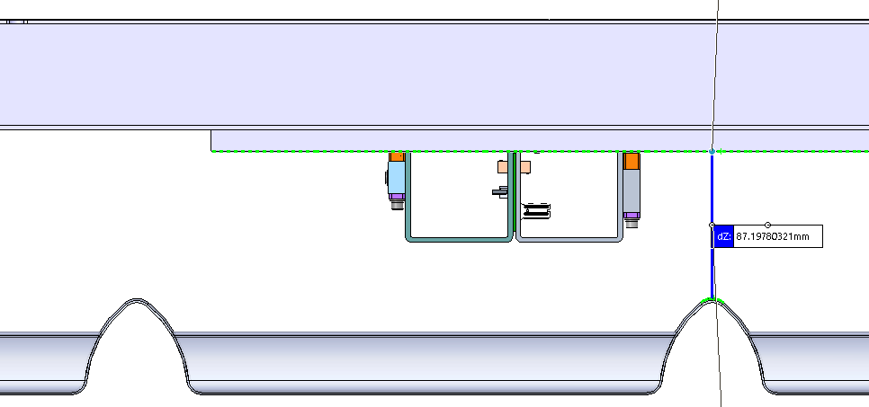
CRP composite frame
87mm gap between CRP and membrane
CRP patch panel

Slide 16
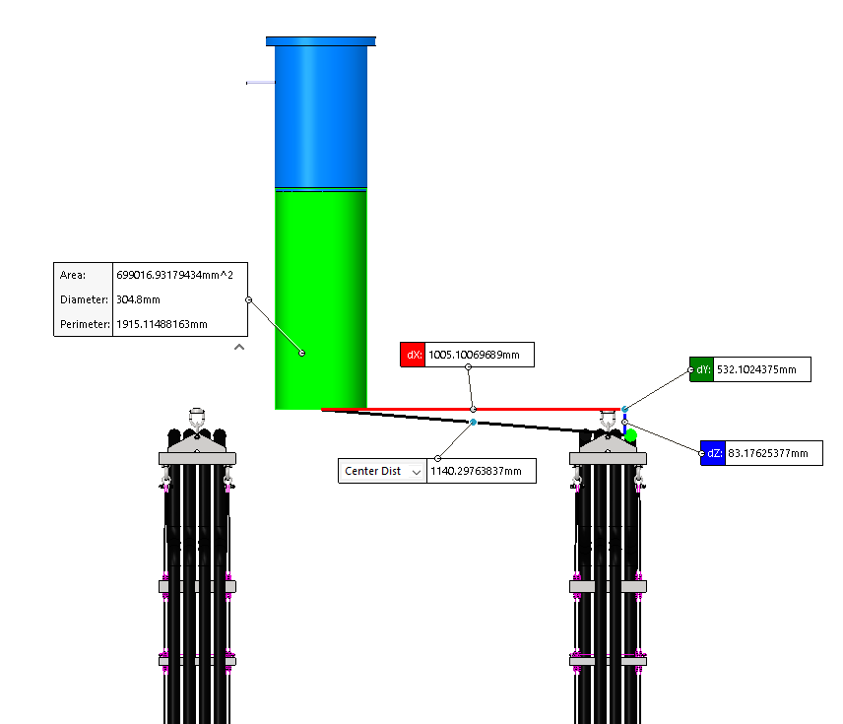
Cable length from cable tray to penetration = 1.2m
Cable length inside penetration = 3m

Slide 17
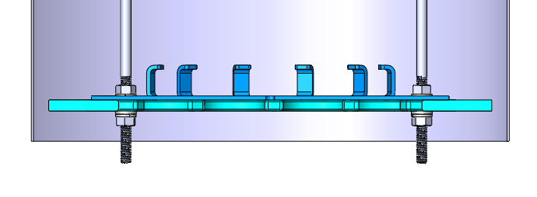
VD Chimney Cable Strain Relief
CSSP
Support plate
Support rods
Cable clamp/lock plates
Cryostat crossing tube

Slide 18
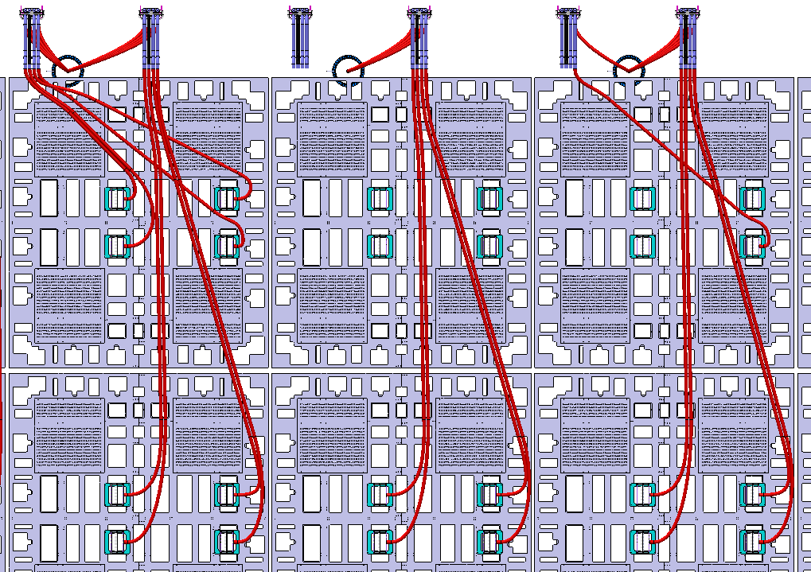
Row #5
Row #6
Row #7
21.5m
21.6m

