Slide 1
CSAID Roadmap - EAF
Burt Holzman 2 Mar 2023

Slide 2
Been a while since the last Roadmap/Projects update

Slide 3
Analysis Facility Team
Maria Acosta: technical lead for applications
Chris Bonnaud: technical lead for infrastructure
Joe Boyd
Elise Chavez
Glenn Cooper
Farrukh Khan
Ed Simmonds
BH

Slide 4
The ultimate goal:

Slide 5
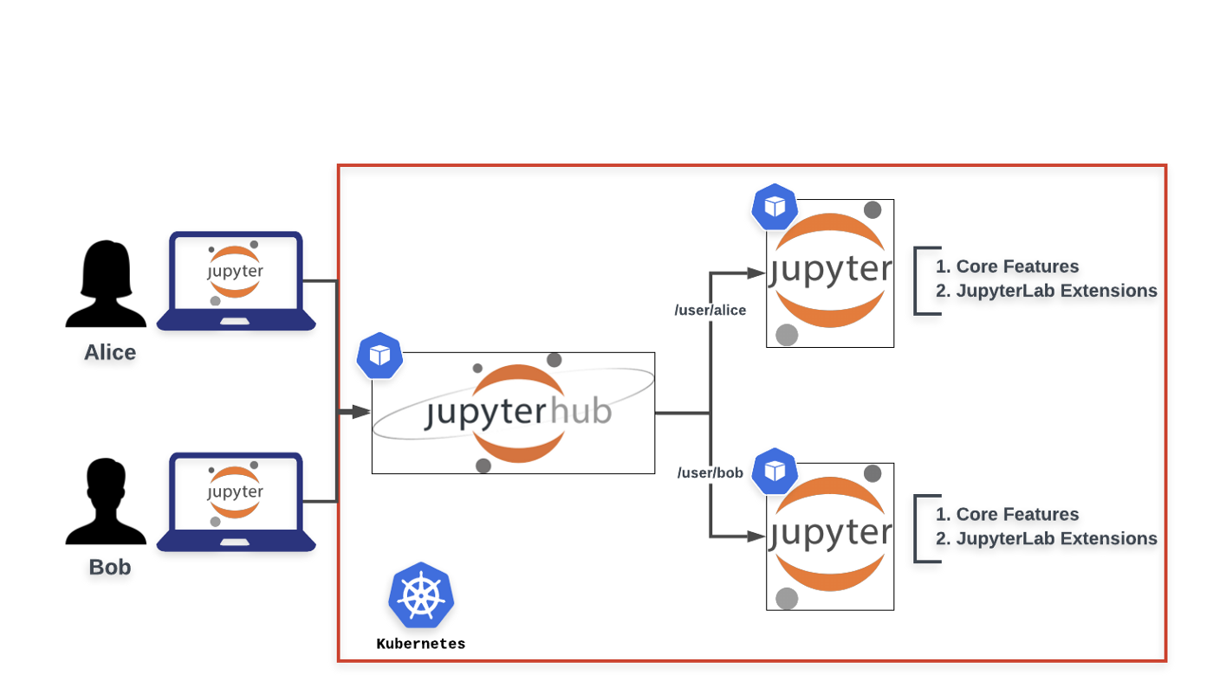
A JupyterHub-based deployment
Originally standalone Jupyter Notebooks.
Evolved to a self-hosted, multi-user platform for hosting multiple notebooks, kernels and highly customizable environments.
Can be deployed in multiple platforms including Cloud, on prem and Kubernetes.
Implements authentication, login pages and token-based roles
Tracks activity and does effective resource management
Proxying is done behind the scenes

Slide 6
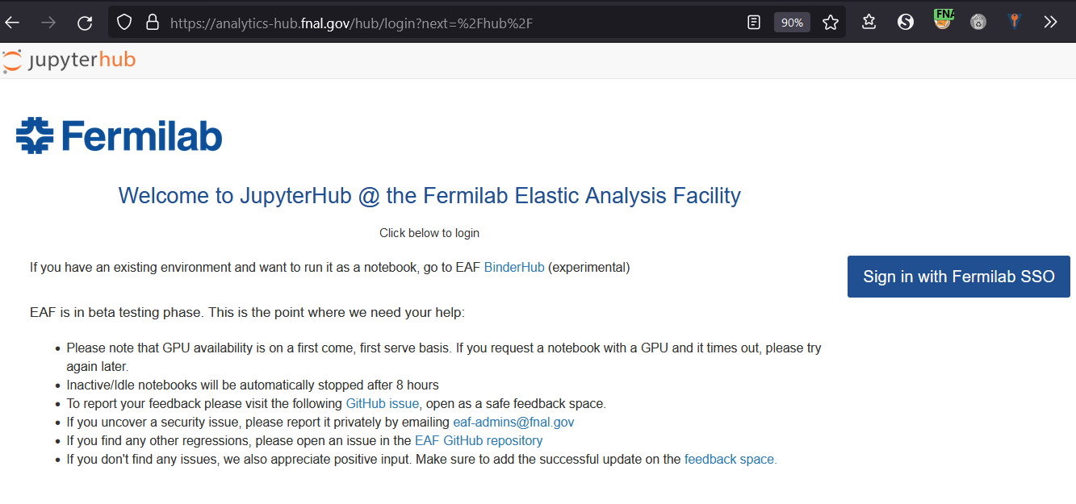
A JupyterHub-based deployment - Login and Auth
Accessible from the Lab network or via VPN
Login with SSO
UID/GID will be propagated to the notebook in order to preserve permissions

Slide 7
Some updates since September
Moved to production – 8x5 support, SNOW
Mounted user home areas (NASHOME)
Environment customization
Preamble scripts (via custom kernel) – similar to LSST
Jupyter-conda plugin
Onboarding A100 GPUs (with Multi-Instance GPU)
Took much longer to get them delivered than configured
Revising MiG configuration as needed
Changed Jupyterhub authorization to Fermilab SSO
Enhanced and consolidated monitoring
Updated to OKD 4.10

Slide 8
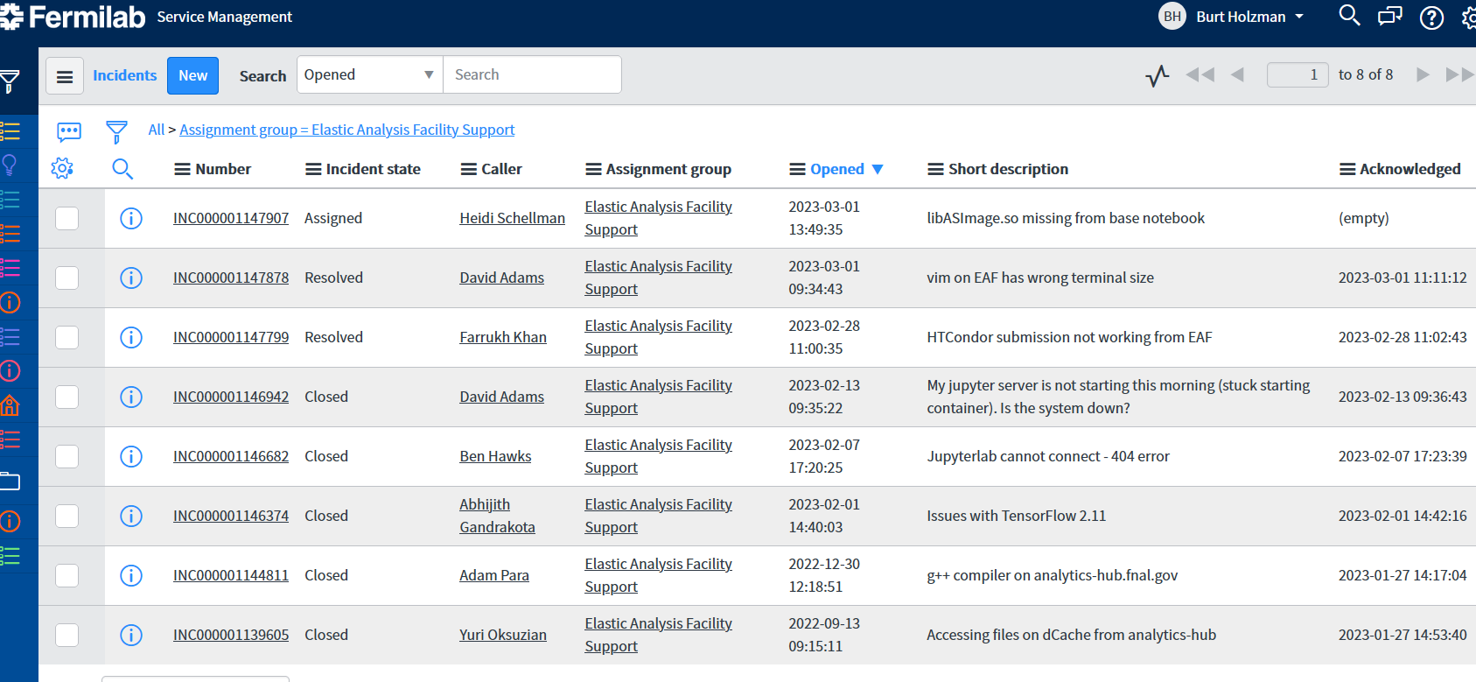
Some updates since September
Moved to production – 8x5 support, SNOW
Environment customization
Preamble scripts (via custom kernel) – similar to LSST
Jupyter-conda plugin
Onboarding A100 GPUs (with Multi-Instance GPU)
Took much longer to get them delivered than configured
Revising MiG configuration as needed
Changed Jupyterhub authorization to Fermilab SSO
Enhanced and consolidated monitoring

Slide 9
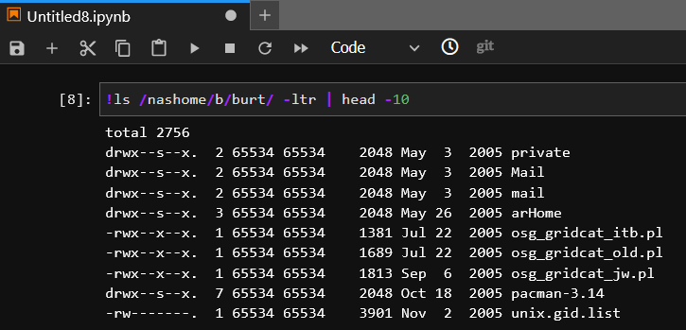
User home areas mounted on /nashome

Slide 10
Environment customization – preamble scripts

Slide 11
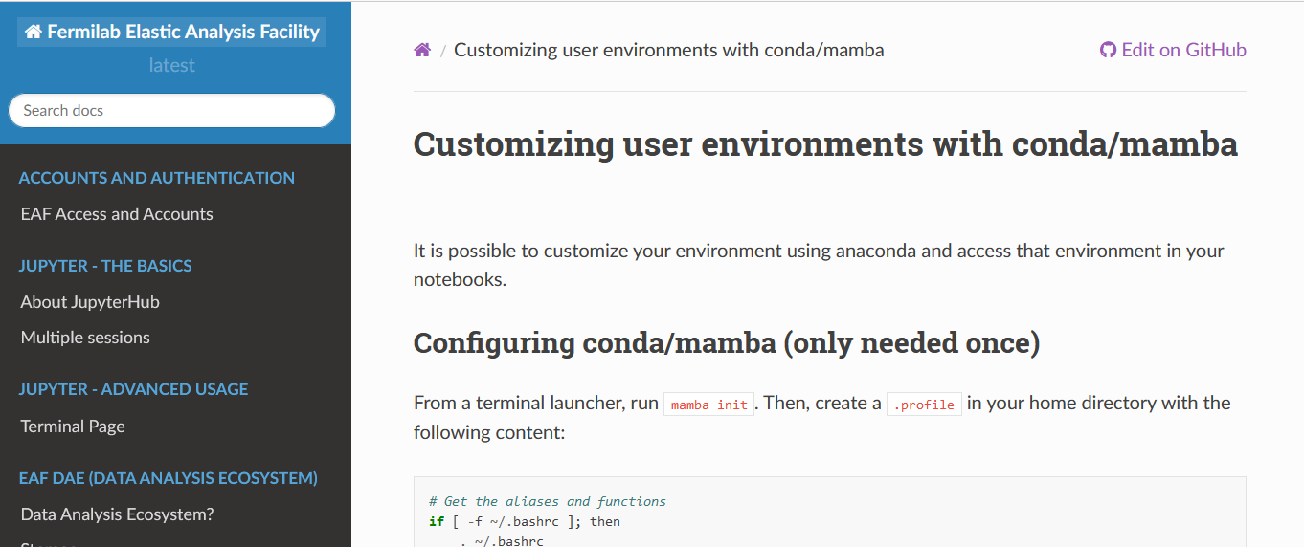
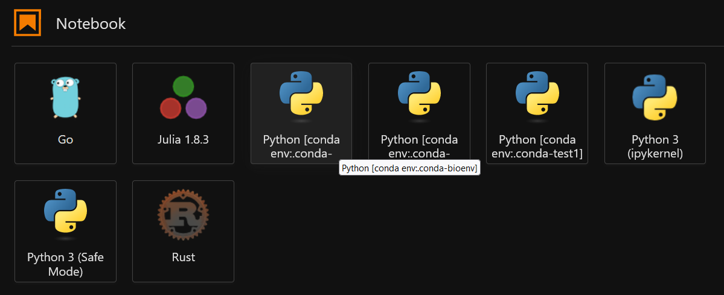
Environment customization – mamba/conda

Slide 12
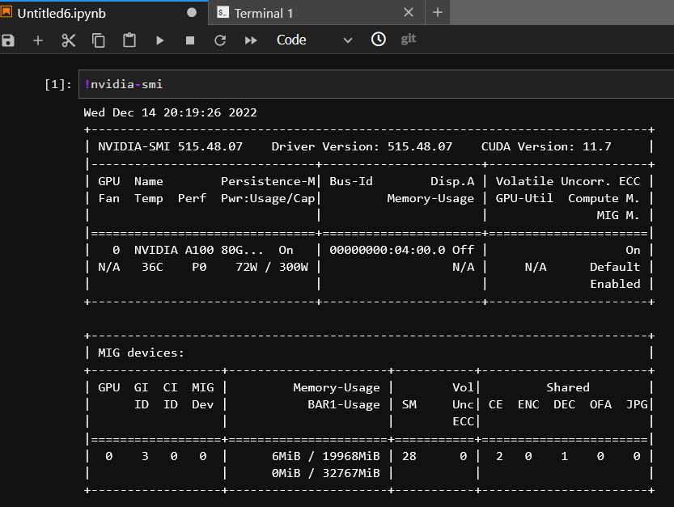
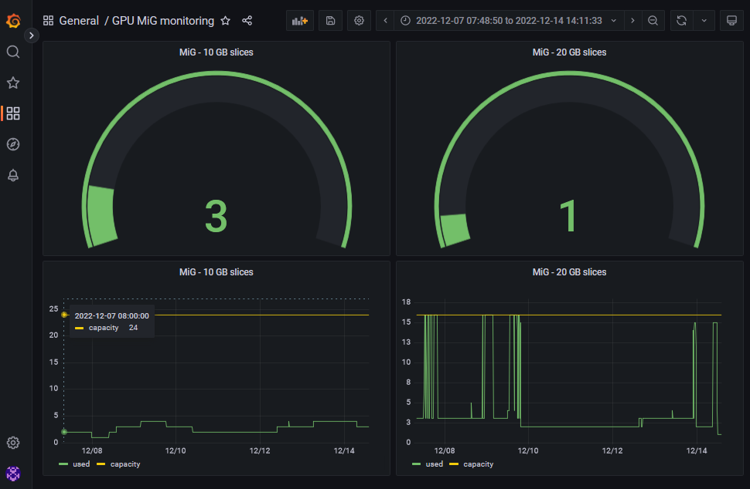
A100s onboarded

Slide 13
Login via Fermilab SSO

Slide 14
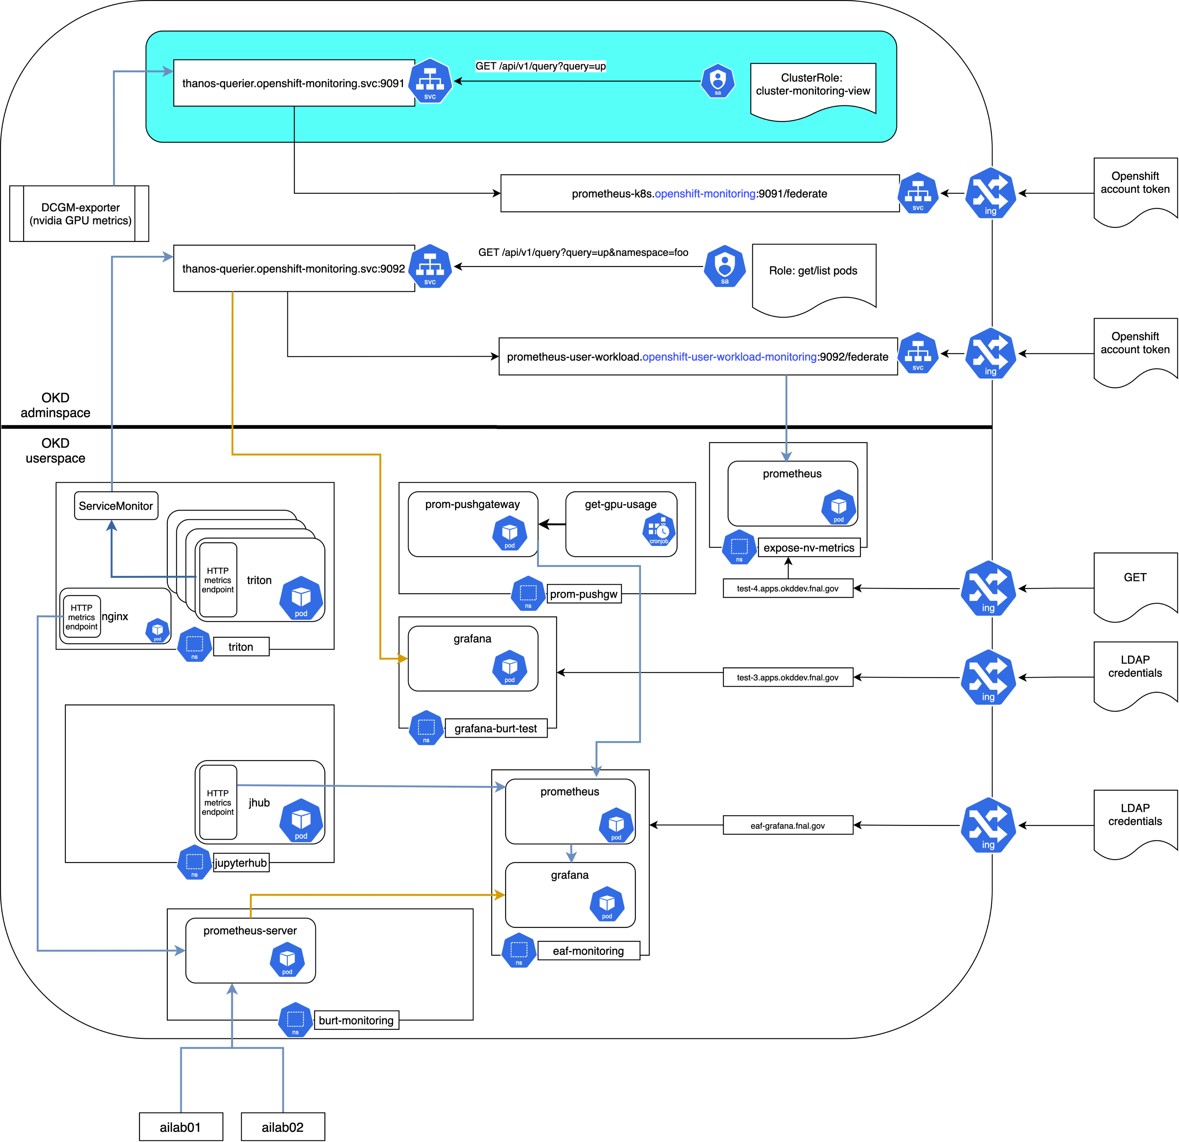
Monitoring – how it started

Slide 15
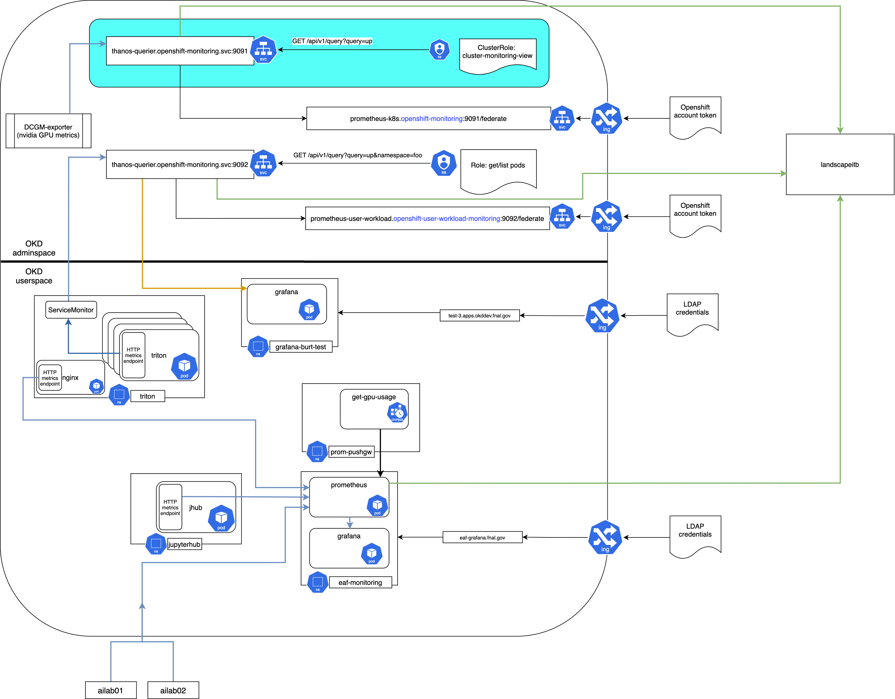
Monitoring – how it's going
https://landscapeitb.fnal.gov

Slide 16
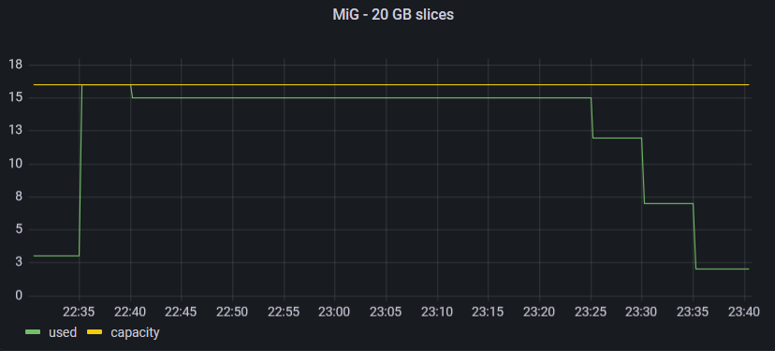
More updates since September
Autoscaling Triton inference server on demand based on avg queue time per inference
Updated to JupyterHub to latest version in helm chart
Mounting home directories on GPU nodes

Slide 17
More updates since September
Autoscaling Triton inference server
Updated to JupyterHub to latest version in helm chart
Mounting home directories on GPU nodes
Enabling Alien-cache for CVMFS (on ITB)
Dask-gateway enhancement merged into mainline
Added explicit protection against starting notebooks as UID==0
Rescue images (e.g. if you go over quota or mangle your environment)

Slide 18
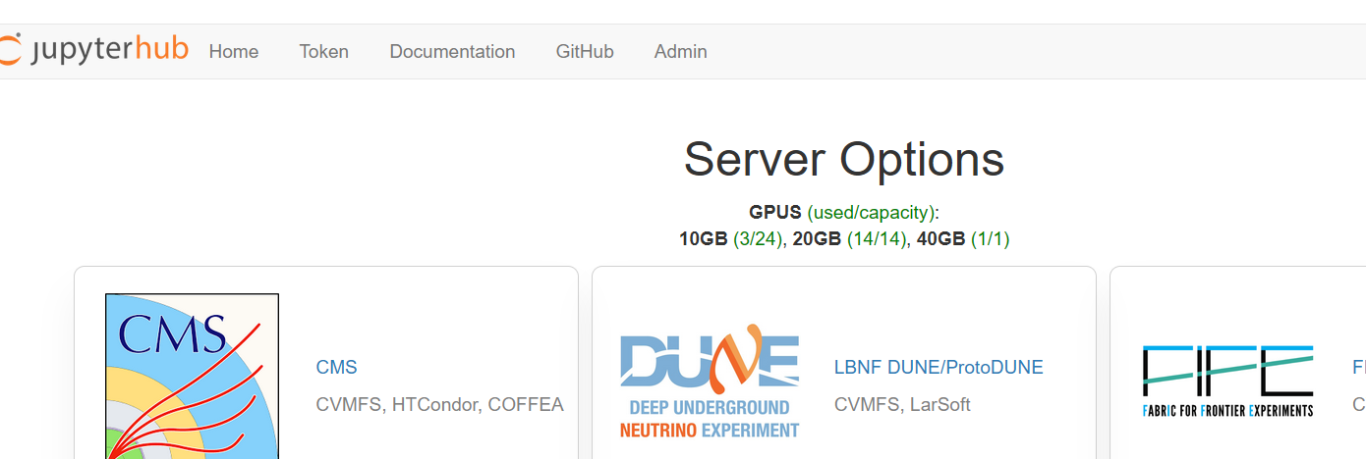
Coming soon
Add GPU availability to server selection screen

Slide 19
Coming soon
Add GPU availability to server selection screen
Meeting with CSBoard on opening site firewall for analytics-hub.fnal.gov
Better documentation on what packages are included in images
Dynamic server selection (e.g. don't see DUNE choices if you are CMS)
Disable default user pip path
Documentation, example dask-gateway notebooks

Slide 20
Coming a bit later
Mounting experiment NFS areas
ServiceX updates
Triton authentication proxy
Further investigate apptainer/singularity support
Batch submission to GPGrid
Investigate sharing of CVMFS alien cache

