Slide 1
HEPCloud Roadmap
HEPCloud Leadership Team
CSAID Roadmap Meeting
Mar 2, 2023

Slide 2
Quick Summary
First a quick summary of performance of HEPCloud….
  HEPCloud is providing CMS, DUNE, NOvA, Mu2e, g-2, and short baseline neutrino experiments with cycles at grid and HPC sites.
  There is also integration with Quantum computing sites.
  Minimal use of Cloud cycles at this time

Slide 3
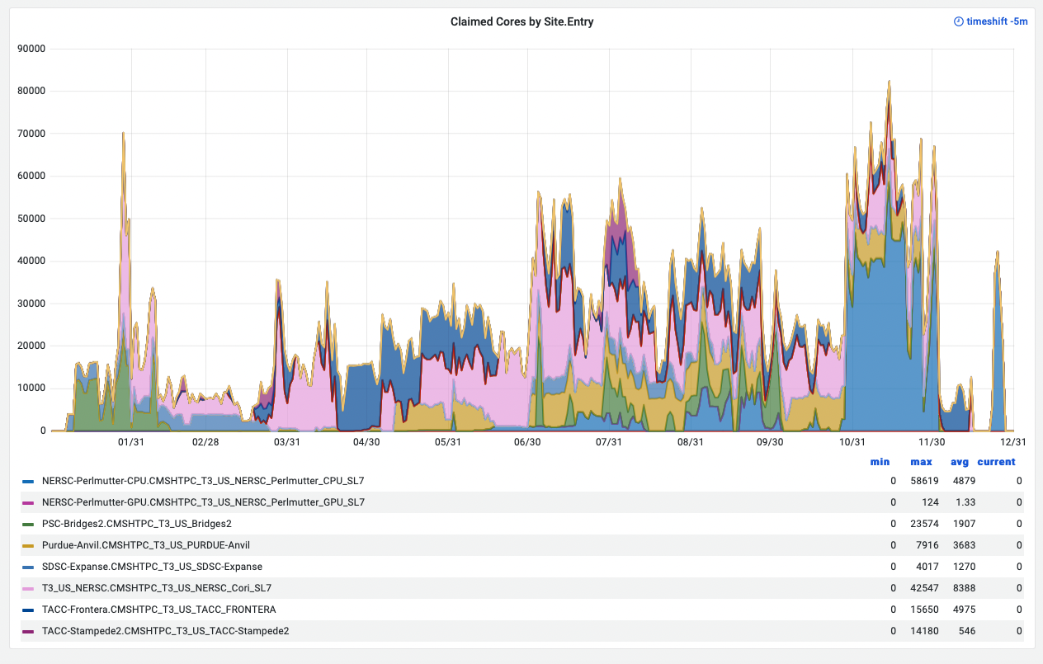
USCMS HEPCloud Jobs CY 2022
Avg 25649 cores DC

Slide 4
NERSC Numbers
In 2022 NERSC was a huge portion of our computing:
  Both CMS and FIFE used their entire allocations and received large supplemental awards in late Oct.
    These awards were used in their entirety before the 2022 reset
    These are “NERSC Node Hours”
    (very rough conversion is 400x to grid core hours)
  We used over 925k real hours on NERSC in 2022
    Details to come in Steve’s talk
  Neutrino experiments took advantage of Perlmutter early access using 76k hours and exhausting their GPU allocations!
Project | Total Hours | Actual Hours | Raw Hours | GPU Hours
FIFE | 191,000 | 243,265 | 843,616 | 13,764
CMS | 606,291 | 606,291 | 1,391,578 | -
Neutrino (Perlmutter Free) | 241 | 76,261 | 76,161 | -
Total HEP | 797,532 | 925,817 | 2,311,355 | 13,764

Slide 5
Roadmap
6 Months
  Factorization of split-starter topology
  Implementation of channel architecture 2.0
    this is matched to the new decision engine design and allows multiple types of channels to run simultaneously
    First 2 channels (HTC and Split-Start)
  Onboarding of ORNL Summit
12+ Months
  Onboarding of ALCF Aurora (?)
  Implementation of direct submit MPI channel

Slide 6
Observations
On paper HEPCloud assumes that the user is able to make their data accessible to a site they wish to run at.
  In reality, getting the data to be accessible (at scale) is the primary roadblock for most experiments w.r.t. site onboarding
  Example: Data to isolated sites (ALCF), Data to sites with limited protocols (NERSC)
The bar needs to be lowered on getting data to and from sites
  This can be edge services provided by us, by the site, etc…
  This can be supporting standard data transfer services/protocols
  We [HEPCloud] need coordination with storage teams and a plan for how this will be architected

Slide 7
Observations
Ceph roadmap?
  Will we have high I/O channels and access
    What will the ingress/egress paths look like?
  (and when and how and how does this change our assumptions we have made in HEPCloud)
Sites w/ novel architectures are coming on online
(i.e. ARM64)
  What is the support plan? Is this in or out of scope? How do we want to handle this type of heterogeneous computing?

Slide 8
FNAL Site Roadmap & Compute
What role do we want to pursue w.r.t. on-site cluster integration?
  Original plan was the Inst. Cluster
    What is the current plan?
  We have the capability [today] to access all
  on-site clusters via HEPCloud
    They are not integrated into a single pool
    Do we keep Wilson separate? LQCD?
    What are the plans for the new GPU resources?
  We need guidance on how to treat our on-site clusters and what the policies are that govern these.
    This would be useful to have on a ~few month time scale so we can plan.

Slide 9
Discussion

