Slide 1
48 Hour Summary
Spencer Schiefelbein
January 11, 2023

Slide 2
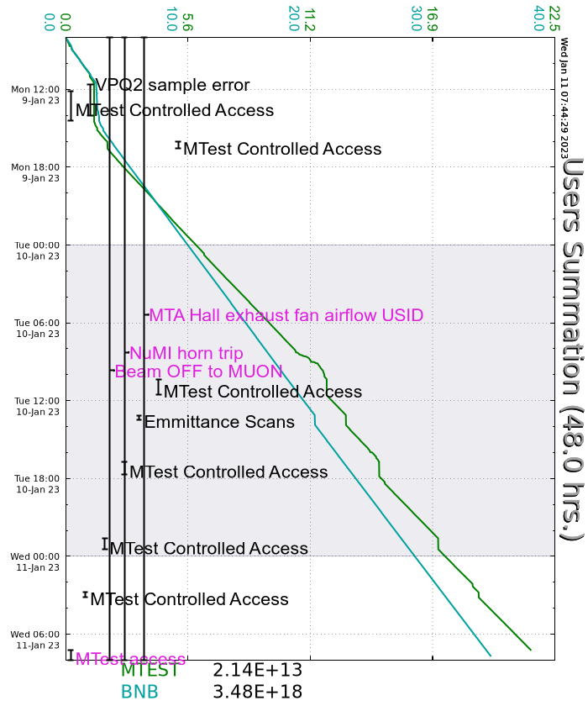
Since Monday
Ongoing NuMI Horn Stripline Investigation
Ongoing Delivery Ring Access for Vacuum Work
Ongoing Source Tuneup
Monday:
Muon Extraction, Del Rings, M4 LOTO’d prepared for Access
Extraction – Controlled Access
Delivery Ring – Supervised Access
M4 – Controlled Access
Muon MC1 in Open Access
AP10 Fire Alarm for burnt out HVAC motor
Locked off supply and Cleaned fire head
400 MeV rad trips due to erroneous Autotune BPM sampling from source sparking
Tuesday:
NM2 PS interlock testing
F:NM2Q1 polarity issue resolved by EE Support
RR Studies
Pre-Acc Scans
MS2 towers breakered back on by Duty personnel
MI60 BLM testing
CUB Column 3 crashed
Today:
MT61,2 in Open Access
Currently:
Beam to BNB at 5Hz, 15.2 turns

