Slide 1
IOTA/FAST Dept. Meeting Updates
Jonathan Jarvis
Scientist @ FNAL Accelerator Division
Jan 13, 2022

Slide 2
Random updates and comments
New org structure is now live in WorkDay
New performance management system rolling out soon; specific dates TBD
Changes to training tools: training will be moved into WorkDay; schedule and specifics TBD
Changes to holiday pay: There is an external review underway(?) of the recent attempted rollout; new rollout schedule and approach TBD
Charging time: If you are working on any projects, make sure the time is being coded properly in Kronos.
FYI, there are two new admins in AD: Shannon “Gage” Whittington (MSD) and Diana Wilson (Controls/Instr.)
Property loss: New self-service reporting for property loss (https://news.fnal.gov/2023/01/self-service-property-new-process-for-reporting-property-loss/)

Slide 3
Safety slide
Thanks, everyone, for your active participation in the lab-wide safety pause
We may elect to have a small (departmental) version of the same exercise periodically
Several instances of slips/falls lately
….

Slide 4
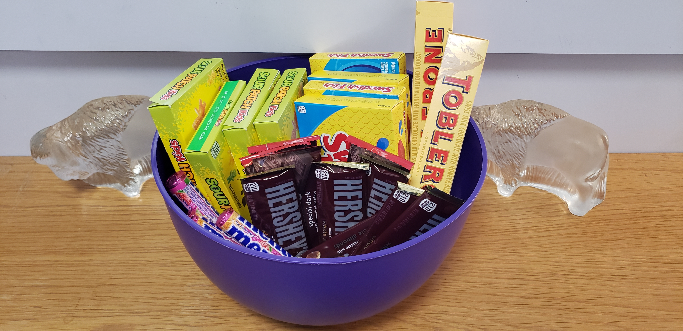
Safety Candy...be safe, get candy!

