Slide 1
IOTA Nonlinear Integrable Optics Experiment: Landau Damping (NIOLD)
Nathan Eddy, R. Ainsworth, A. Valishev, A. Burov,
B. Fellenz, A. Semenov, O. Mohsen
Run 4 Status Update
13 January 2023

Slide 2
Goals for Run 4
Continue program to study Landau Damping with Octupoles
Setup machine with negligible chromaticity (|ξ|< 0.1 for nominal beam parameters)
Record raw waveforms -> longitudinal motion
Study both vertical and horizontal planes
Plan to measure Stability Diagram as demonstrated at LHC (Antipov)
Measure the stability threshold for a sequence of phases
Requirements
Transverse tunes well separated
Non-linearity primarily in one plane
Octupoles should be dominant part of Landau Damping
Gain threshold should be linear with Octupole strength
The measured Stability Diagram can be used to reconstruct the beam transverse distribution function in the measured plane
Requires beta functions at the Octupoles to be known
Study Non-linear magnet if available

Slide 3
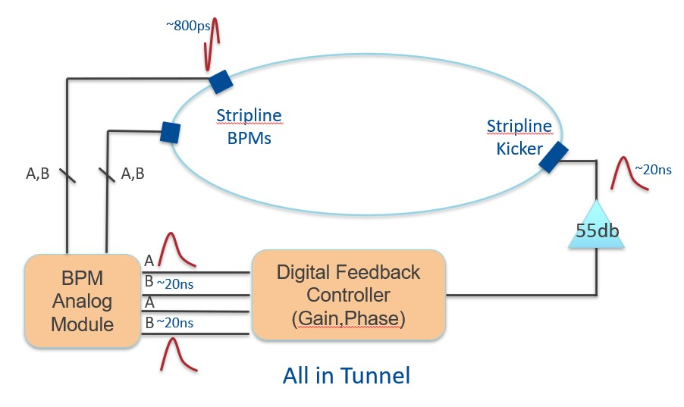
Run 4 Experimental Apparatus
Install 3 striplines (2 pickups, 1 kicker)
Replace Analog System with Digital Feedback Controller
System delay of 5 turns

Slide 4
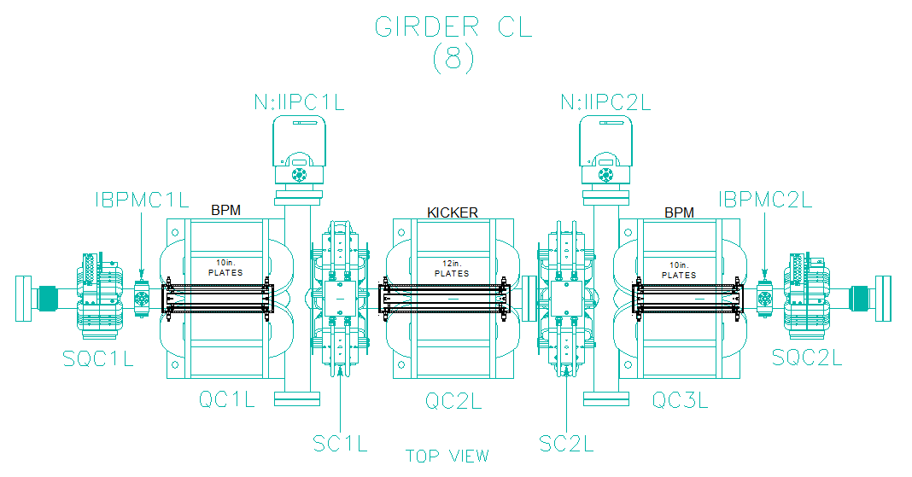
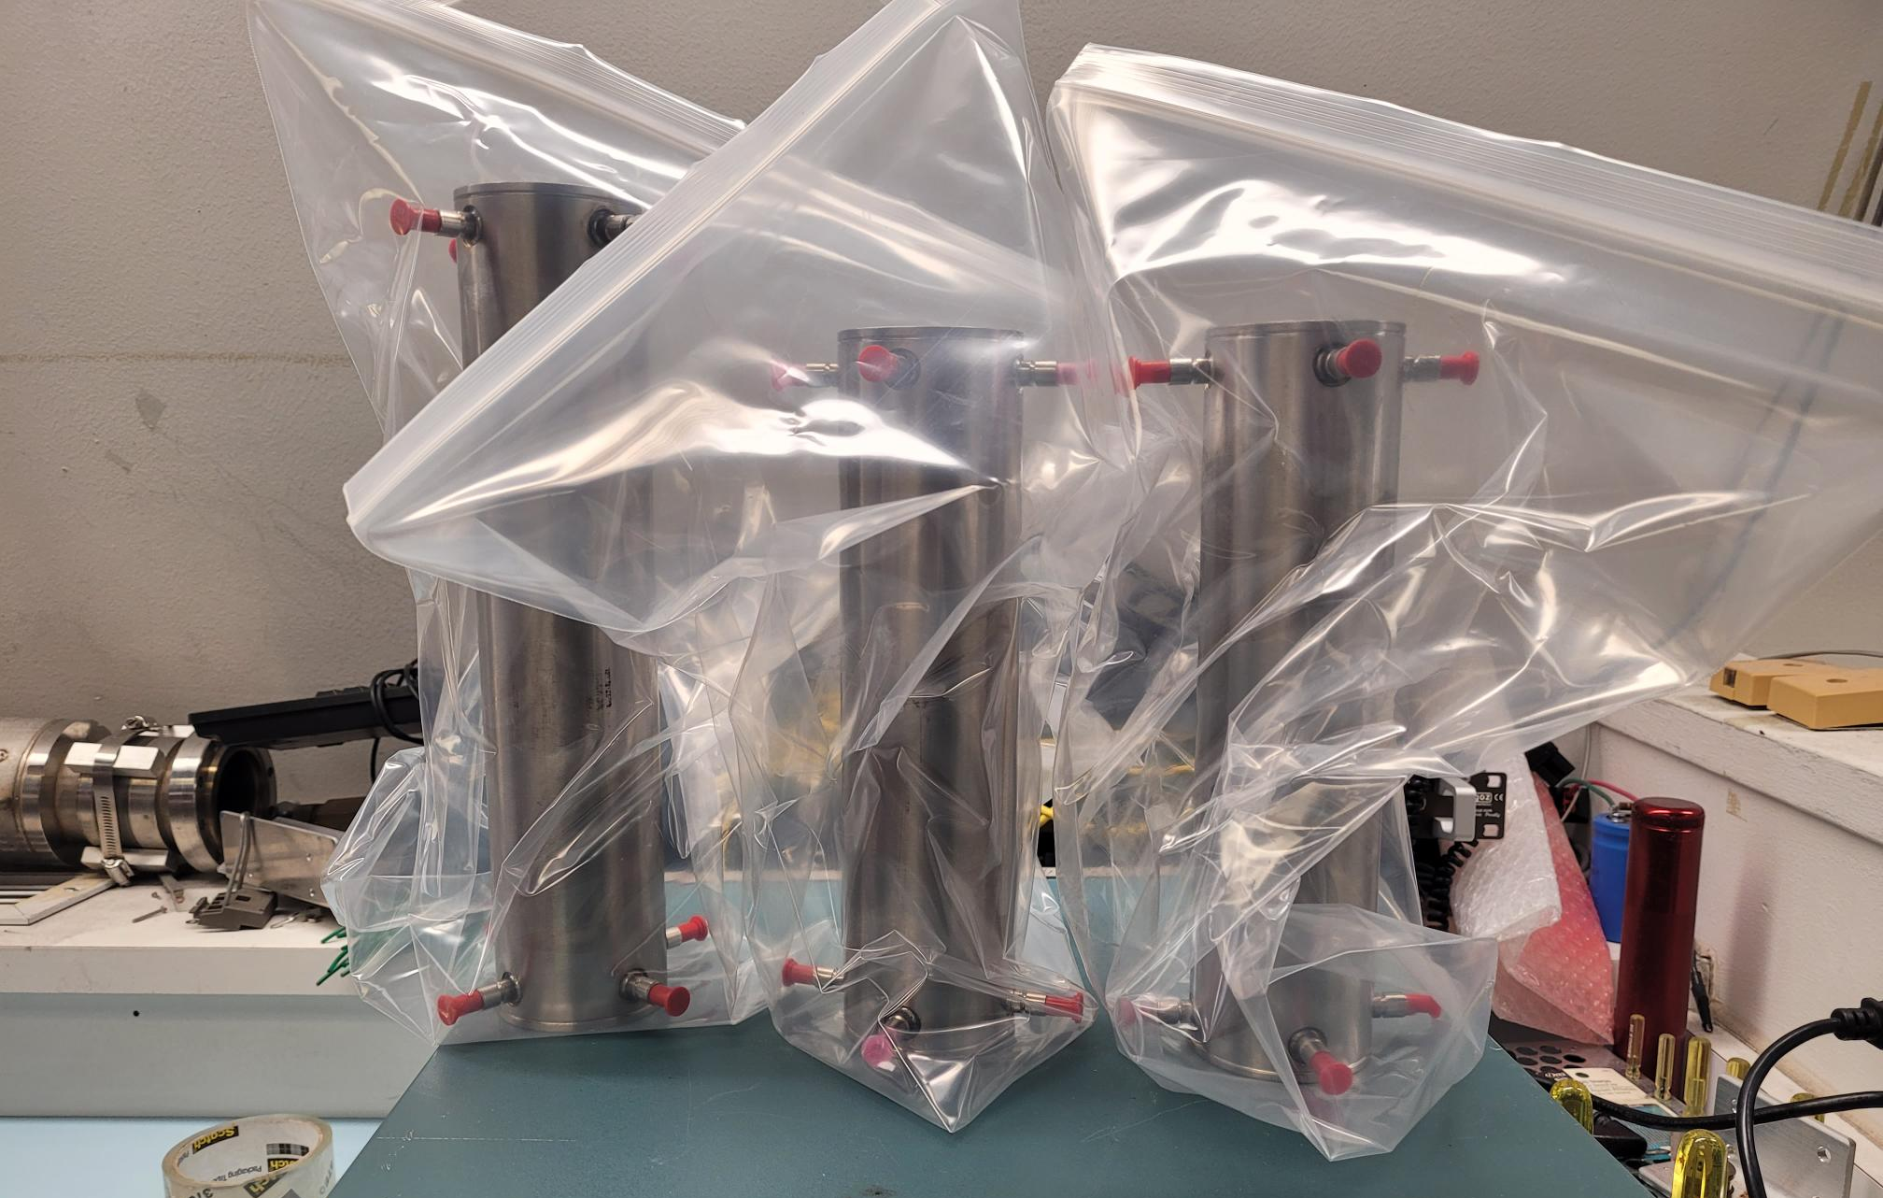
Strip-Lines Installation in C-Left
2 strip-line pickups (~60 increase in sensitivity over buttons)
Low intensity tunes and ability to measure proton tunes
1 strip-line kicker (comparable to single plate on Horizontal)
Strip-lines assembled and leak checked in March 2022
Original plan to cut existing CL section and weld pickups in

Slide 5
Build New CL section
Acquired button pickups and feedthroughs from A0 (Summer)
Bought new pipe and had it de-gassed (Summer and Fall)
Had pipe machined for crosses (Went out before Thanksgiving, done just before Christmas)
All components delivered to MSD Vacuum group (January 9)

Slide 6
CL Assembly
Procedure being overseen by Vacuum Group (B. Dymond)
Parts currently being cleaned
Stainless parts without feedthroughs will be ultrasonically cleaned
Other parts will be cleaned with alcohol
Each sub assembly will be aligned, welded and leak checked
All sections will be aligned, welded, and then final leak check
They don’t foresee issues with alignment (Brian Fellenz will verify before welding)
Final assembly will be tested to 2e-10 leak rate
Procedure will be time consuming due to sub assemblies
Current Estimate is 3 weeks, but will depend on resource availability

Slide 7
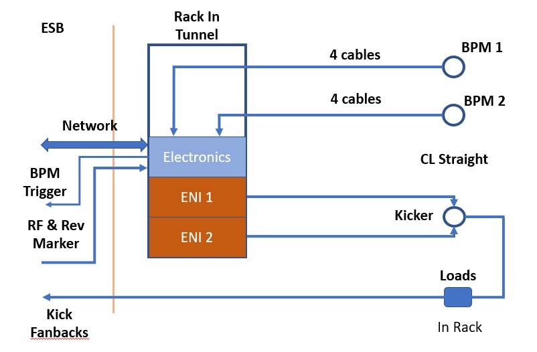
Infrastructure
Rack inside ring – will be attached to 8020
3 electrical circuits installed
2 ENI 200W amps (110V 15A each)
1 circuit for electronics
Need 2 network connections for damper & analog controller
Ports available in the tunnel?
Can pull if needed
Cables pulled to ESB
4 ¼” heliax for 30Mhz, 7.5Mhz, and kicker fanbacks
2 RG58 for sync signals to BPM System
Pull during CL installation
Initial installation for 1 plane
Can swap cables to switch planes

Slide 8
Summary
If all goes smoothly, new CL section ready for installation in February
Suggestions?

Slide 9
Backup Slides

Slide 11
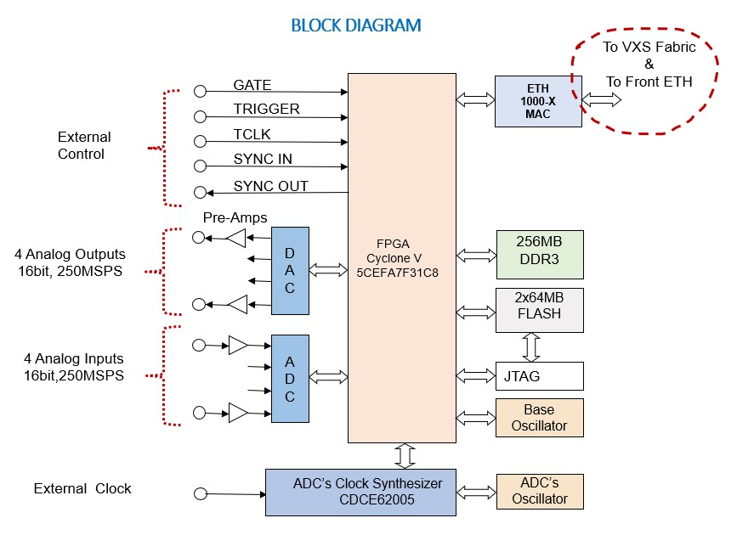
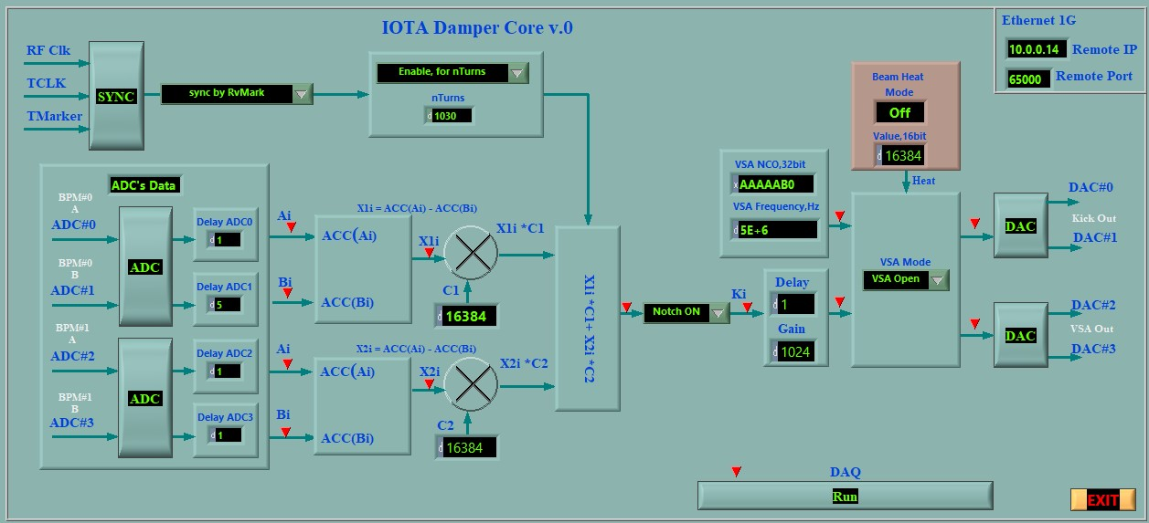
Digital Controller
Use custom Fermilab Digital Feedback Board
Used in Booster and Recycler Waker
Ethernet control
240MS/s locked to RF
Store ADC and turn by turn for 50k Turns
Ability to control gain & phase (2 pickups)
Built in BTF measurement
Put in the tunnel to minimize delay
520ns board delay from ADC/DAC
Provide same delay as Analog System
Design complete and bench tested (Feb 22)

Slide 12
Experimental Run Plan
Commission new pickups parasitically (1 week)
Commissioning with beam (3 shifts)
1 shift to setup and test corrected chromaticity lattice (Valishev)
2 shifts to commission the new digital feedback system
Data Collection with Digital System (8 shifts)
2 shifts to study stability vs octupole strength (1 shift per plane)
6 shifts to measure stability diagrams (3 shifts per plane)
Measure stability vs feedback phase in 15º steps
Measurements with octupoles at 0,1,2 amps
Measurements at a minimum of 2 different beam intensities
Data Collection with Analog System - corrected chromaticity (2 shifts if available)
1 shift to commission the old analog system
1 shift to study stability vs octupole strength

