Slide 1
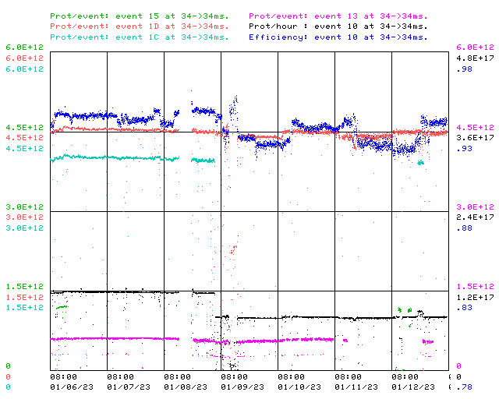
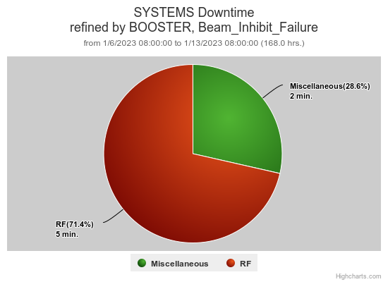
Booster Operations 01/06/23 – 01/13/23
F
F
Sa
Su
M
Tu
W
Th
F
Source Change B -> A
Total Downtime: 7 minutes
Minor RF Trips
Minor loss trips
Also:
Tuning and adjustments following source change.
Seeing a bit more variability in beam intensity and positioning.
Looking at GMPS regulation, effects of sagging line voltage on beam position
Planning for upcoming studies
Efforts at E4R for 20Hz testing underway
Thanks to Ops for diligence & tuning on the off shifts
This week:
Booster running pretty well.
Beam to BNB $1D’s @ 4.5E12 per pulse @ 5Hz ~8.1E16P/Hr
Beam to Muon as requested, $1C’s $ 4.0E12/pulse for >1E12POT
Beam to SY as requested
Beam to MI/RR for studies as requested.

