Slide 1
Crew Chief 48 Hour Summary
Spencer Schiefelbein
Friday 09:00 Meeting
Jan 13, 2023

Slide 2
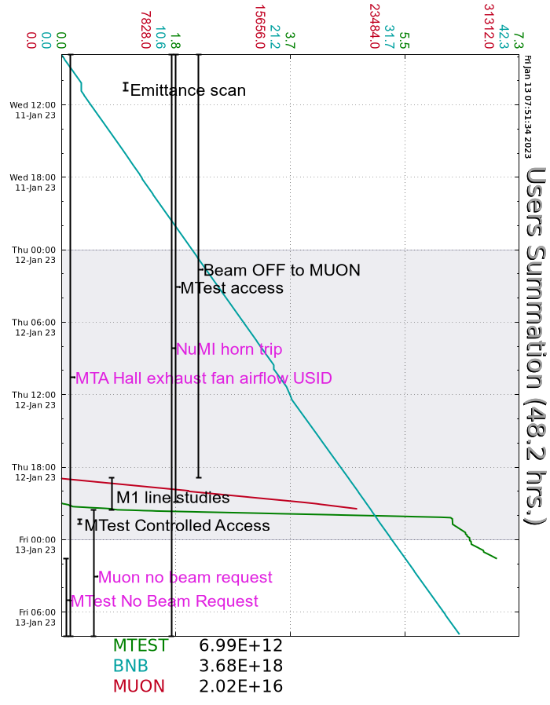
Wednesday
D20 Muon vacuum work continued
Linac/Booster tuneup for lower Extractor Voltage
G2 vacuum CIA crate breaker replaced by EES
D:VHA05 internal LCW leak repaired by EES
MS2 LCW system empty nitrogen bottle replaced by MSD
Thursday
Few instances of MI10 Upper VCB opening
F:NM2Q1 output drifting up – ongoing EES troubleshooting
F2 air compressor trip
Main compressor repaired and back to operational
M03 prepared for Controlled Access
Installation of experiment on motion table with PWC
Booster beam/loss variation troubleshooting
RR Studies
Work on NuMI kicker by EES
S:V420 supply repaired by EES
Fire alarm coded for D0 Target Hall and Assembly Building
Leftover pressure from earlier testing
D20 Muon vacuum work complete
Secured Delivery Ring
Un-LOTO’d Delivery Ring, Extraction, and M4
Muon M1 Studies
MT6-1 and MT6-2 Secured
Beam established to Mtest following ORC
Friday
NS2 air compressor blowdown valve stuck open – Ops cleared locally
Current Conditions
Beam to BNB, Mtest
Ongoing 8GeV Muon studies

