Slide 1
ICARUS
Commissioning and Operations
C. Montanari
FNAL – INFN Pavia
SBN Oversight Board Meeting – March 10, 2023

Slide 2
Detector status
  The ICARUS detector is running in excellent and stable conditions since the end of last year.
  The free electrons lifetime has stabilized to about 8 ms in the WEST module (liquid filters regenerated) and about 4 ms in the EAST module.
  Neutrino data are being collected with high efficiency.
  Some activities have been completed before Christmas:
    PMTs gain calibration;
    Replacement of some readout boards for horizontal wires with modified boards with an additional filter for coherent noise mitigation;
    Recovery of part of the bottom CRT (DAQ integration is still in progress).
  Other calibration activities take place routinely during beam off periods.
  A power glitch occurred on March 8, around midnight, causing the stop of DAQ servers, of some electronics (PMTs) and of the LAr pumps: the standard run conditions were recovered in the afternoon of March 9.

Slide 3
Free electrons lifetime trend in the WEST module
  The free electron lifetime in the WEST module has reached a value of about 8 ms and remains stable since the beginning of 2023.
  Periodic venting is still required though the venting rate has been halved wrt the first months of purity recovery.
  A simple recirculation model, based on the measured values of recirculation speed and impurities input (with venting) correctly interprets the data.
Free Electrons Lifetime (ms)
● - Data
● - Calculated from simple recirculation model
No venting
Elapsed time (hours)
Nov 6, 2022
Jan 1, 2023
Mar 12, 2023

Slide 4
Free electrons lifetime trend in the EAST module
  The free electron lifetime in the EAST module has flattened at a value slightly above 4 ms and remains stable since the beginning of 2023.
  Periodic venting is still required though the venting rate has been halved wrt the first months of purity recovery.
  A simple recirculation model, in order to approximate the data, very low recirculation speed and low impurities input → filters require regeneration.
● - Data
● - Calculated from simple recirculation model
Free Electrons Lifetime (ms)
No venting
Elapsed time (hours)
Nov 6, 2022
Jan 1, 2023
Mar 12, 2023

Slide 5
Run2 accumulated statistics
Data Collection Efficiency:
BNB: ε = 0.96
NuMI: ε = 0.98
Jan 1, 2023
Feb 1, 2023
Mar 1, 2023

Slide 6
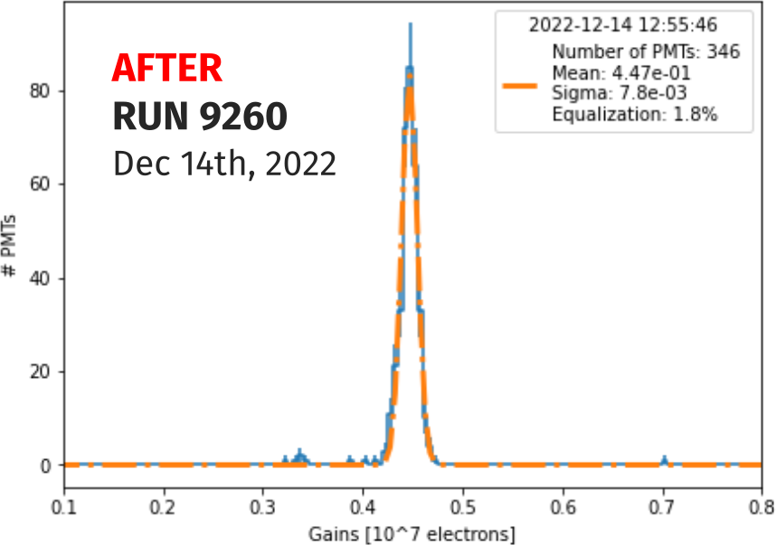
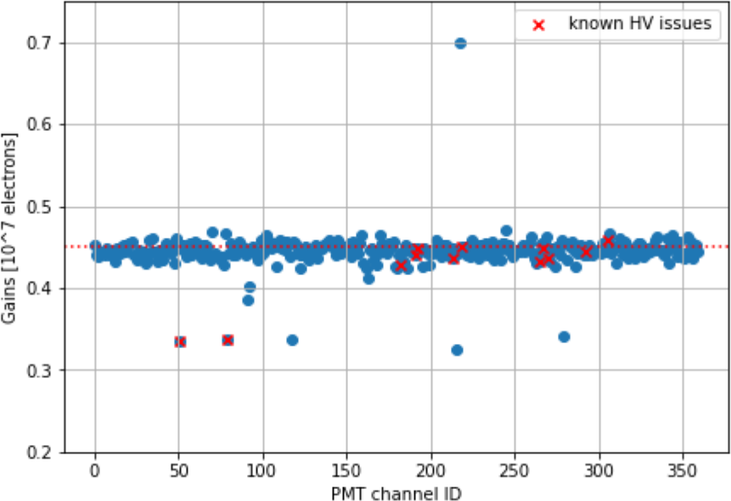
PMT Gain Calibration
A new PMT calibration campaign was carried in view of the start of RUN2 (fall 2022) data taking.
The PMT gain was set to an average value of G=4.5x10⁶ with an equalization of 1.8%. This gain value allowed a minimal intervention of the PMT voltages (within ±25V).
PMTs requiring a manual adjustment
The gain measurement/equalization was based on a semi-automatic procedure using single photoelectrons signals from background. For few PMTs a manual adjustment was required.

Slide 7
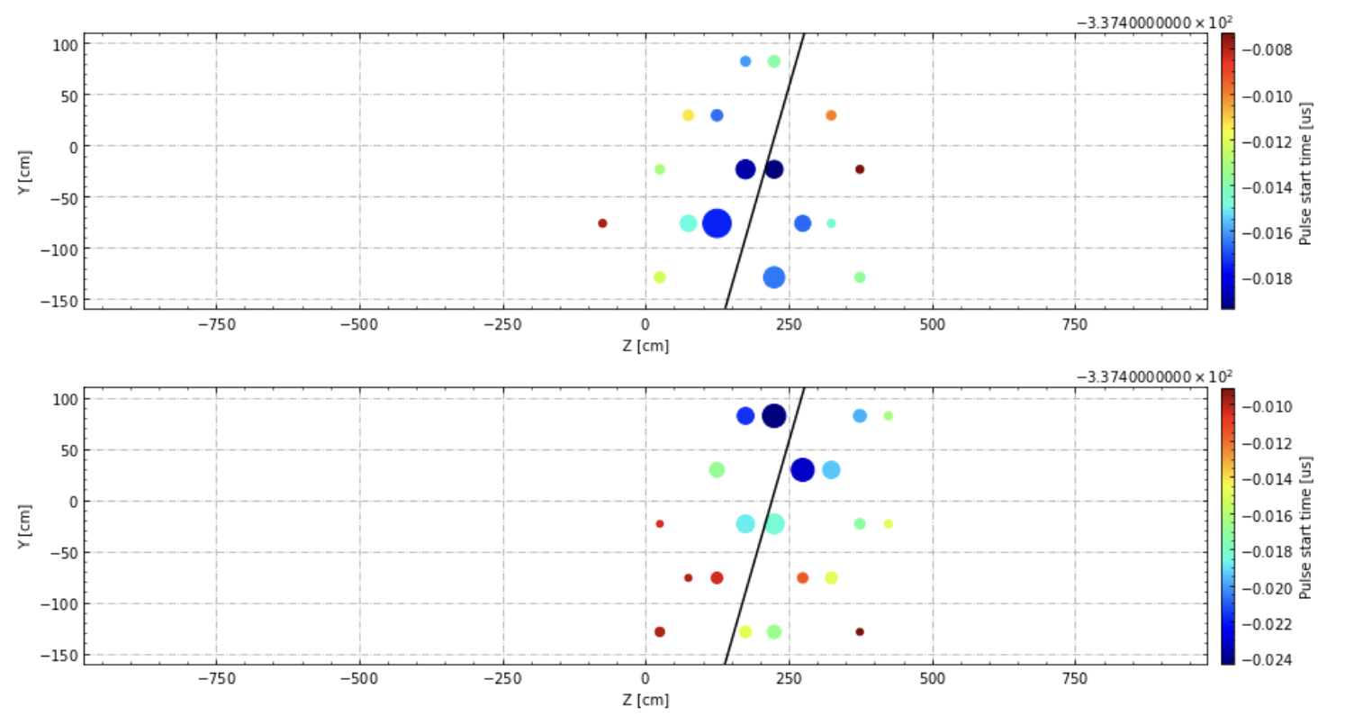
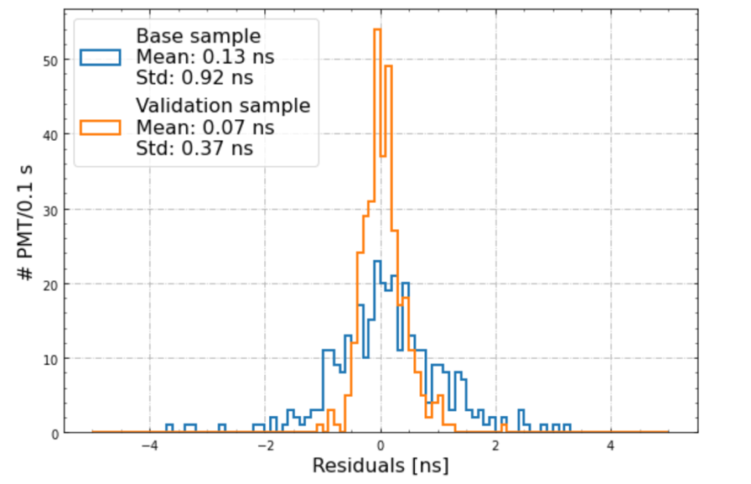
PMTs Timing Calibration
late
East
Up
A PMT time resolution of ~1 ns is crucial to exploit particle TOF and the bunched structure of BNB spill.
The transit time of each PMT is obtained by flashing it with a laser and measuring the delay w.r.t. the reference laser start time.
This time reconstruction is checked with ~vertical cosmic muons, by performing a linear fit of time vs. y (drift) coordinate. The residual of each PMT w.r.t. the fit is then computed.
Down
early
late
West
Up
Down
early
Z coord. (cm)
Base μ sample:
<>=0.13 ns
σ=0.9 ns
Validation
sample:
<>=0.07 ns
σ=0.37 ns
These residuals are then used for a finer correction (σ ≈ 1ns) of each PMT’s transit time
Iterating the procedure on another independent cosmic muon sample, the resolution improves to ~0.4 ns
# of PMTs/0.1 ns
Average residuals from μ procedure (ns):

Slide 8
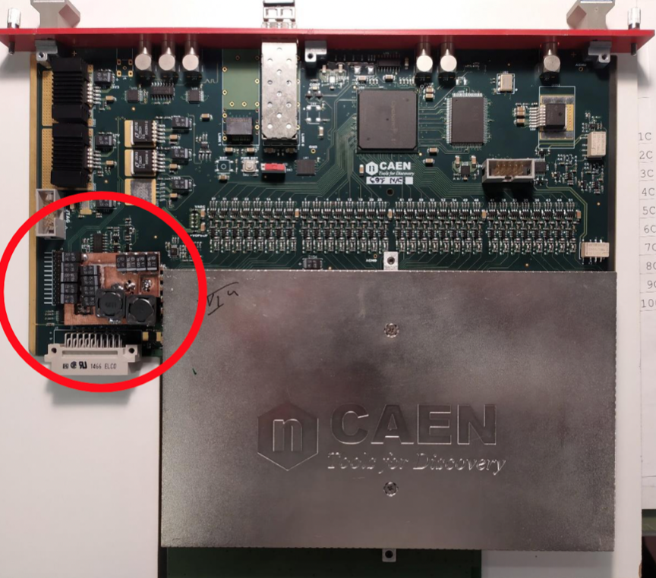
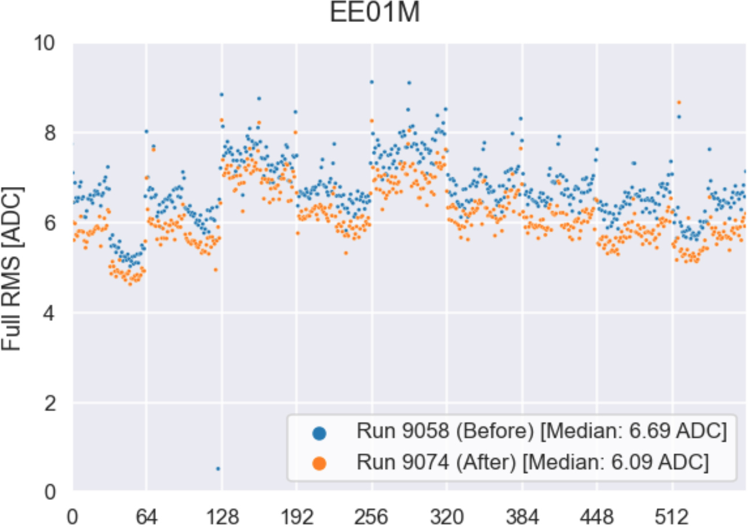
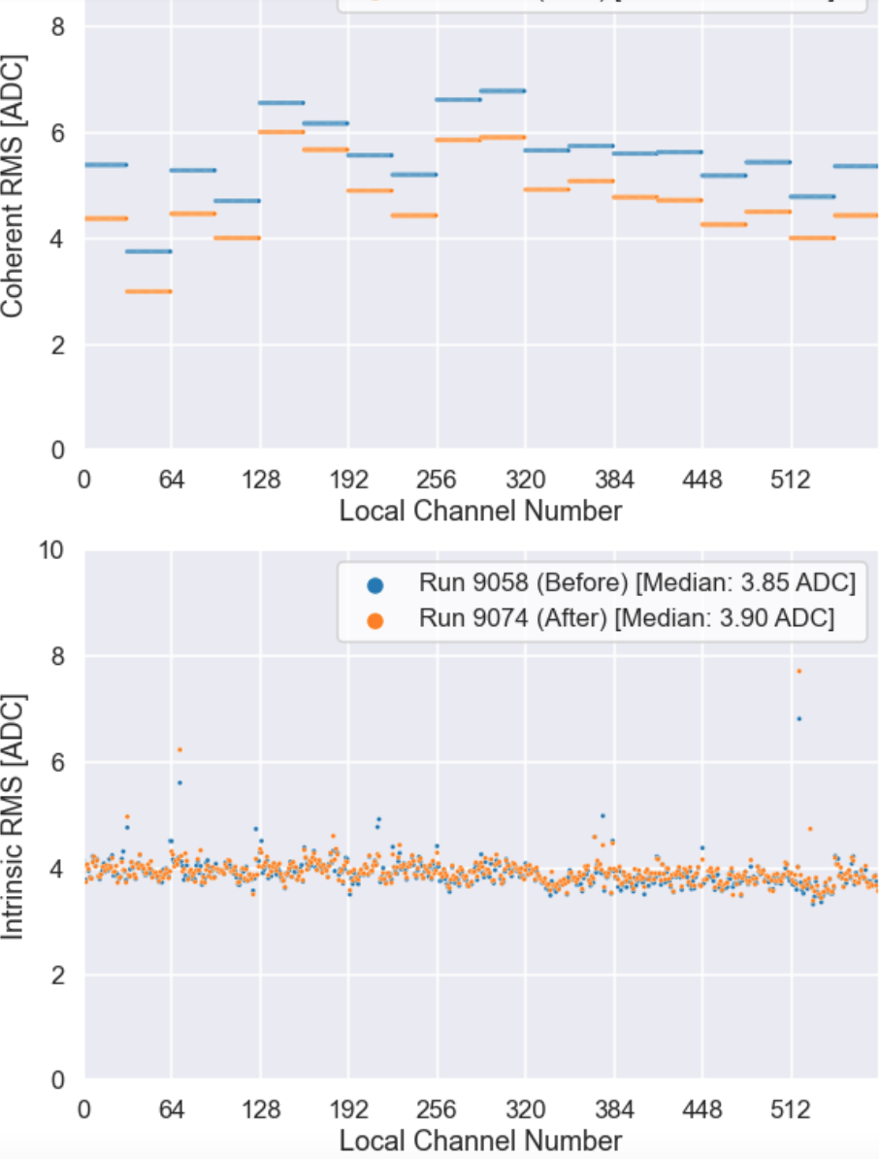
Further reducing the TPC wire noise
After the successful campaign performed in 2020-21 to reduce the anomalous electronic noise in the TPC, a further study was done to mitigate the coherent noise in the A2795 TPC readout boards.
A 5th order Chebyshev low-pass filter was designed for +7 V frontend supply of the A2795 TPC readout boards to reduce the 32-channels coherent noise propagating into the boards through +7 V line.
Without/
With filter
Total noise- 9 boards -576 chs
Coherent noise
50 % of Induction-1 boards affected by larger noise due to 9 m wire length, were equipped:
~ 0.9 ADC # coherent noise reduction, leaving virtually unaffected the intrinsic one
Intrinsic noise

Slide 9
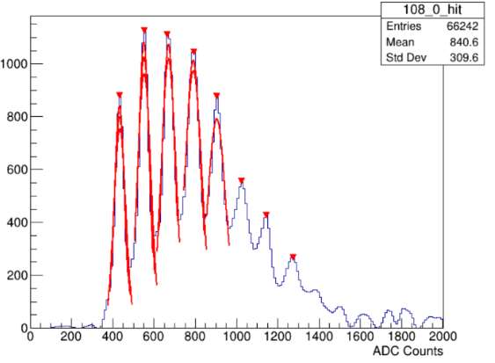
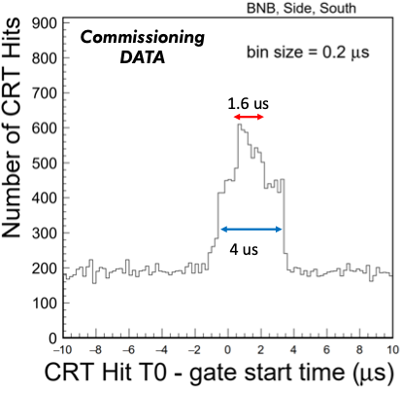
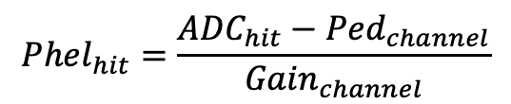
CRT Calibration and Timing
Progress in 2022 includes: accurate timing measurements, calibration and validation of CRT hit reconstruction with data.
Each CRT channel was calibrated in terms of corresponding gain and pedestal.
The CRT hit timing was measured relative to the neutrino beam spill start time.
Gain fit from the quantized photoelectron peaks
CRT hit time relative to the neutrino gate start time
Photoelectron conversion
$${Phel}_{hit}=\frac{{ADC}_{hit}−{Ped}_{channel}}{{Gain}_{channel}}$$

Slide 10
Conclusions
  The ICARUS detector is running in excellent and very stable conditions since the end of 2022.
  Data are being collected with high efficiency both of BNB and NuMI, the latter recently brought back into operation after the replacement of the horn.
  All residual calibration and optimization activities on the detector have been successfully completed before Christmas.
  No other activities that would interfere with neutrino data taking are planned before the end of the present neutrino run.

