Slide 1
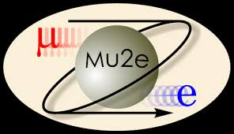
Workshop on a Future Muon Program at Fermilab: Mu2e-II Tracker Research Topics
James L. Popp
03-27-23
Mu2e DocDb-xxxxx
Updated: 03/25/23

Slide 2
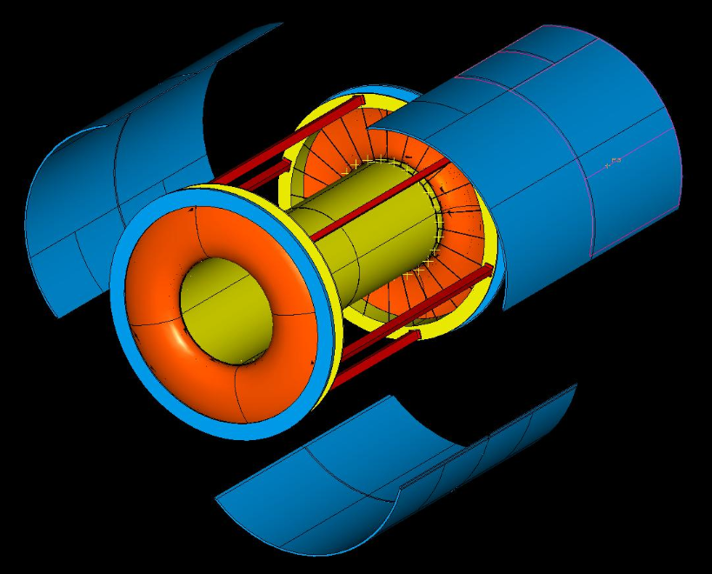
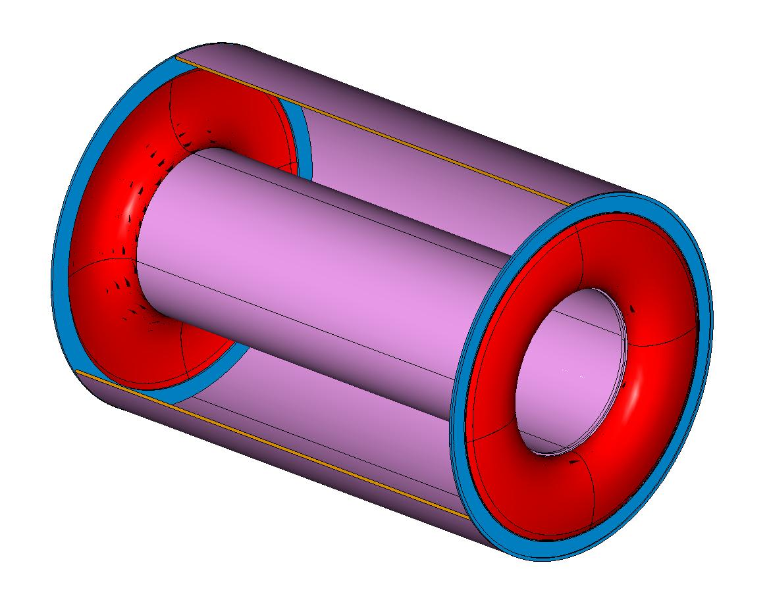
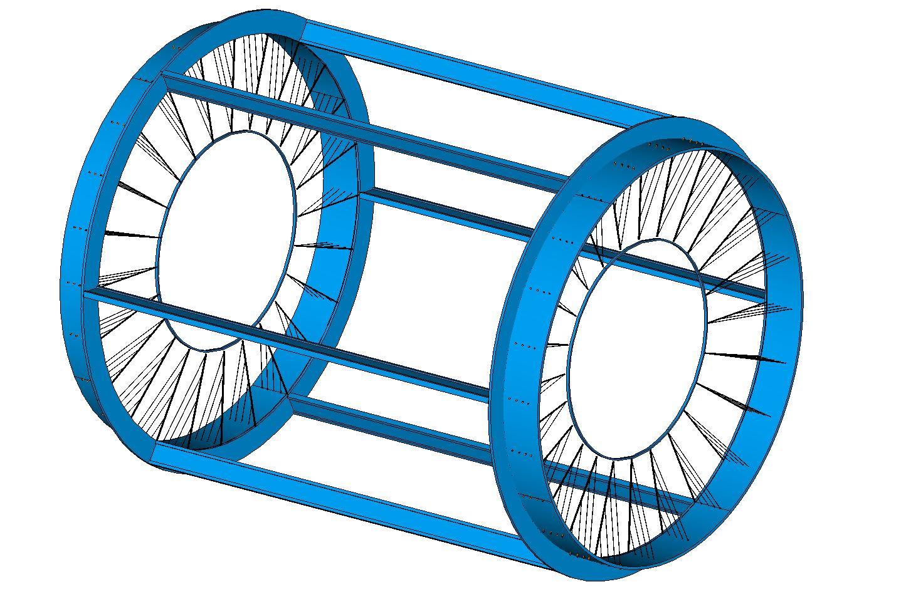
Two Tracker Alternatives: I-Tracker
Mu2e Docdb-2450
Gas Volume
Wire Support Frame
Detailed Exploded View

Slide 3
Two Tracker Alternatives: T-Tracker
Mu2e Docdb-888
18 Stations (36 planes)
15 Brass Shielding Rings
The remainder of this talk will focus on the T-Tracker simply because we have much more documentation and recent experience with this Tracker.
Bronze Upstream stiffener ring
AL Support Beams.
Also carry utilities
Bronze Rings interfacing to rail system
Bronze Downstream Stiffener Ring

Slide 4
Initial R&D List
This talk is meant to serve as a discussion starter to advance and refine a program of R&D projects for the Mu2e-II Tracker.
Here we focus on materials and mechanical design issues
Electronics will have its own session
Pattern recognition is also presented in a separate session
All three of the R&D areas above feedback on each other
Many of our ideas have already appeared in public form
For example: arXiv:2203.07569v2 [hep-ex] 16 Mar 2022
Better momentum resolution means: reduce the g/cm² seen by conversion electrons traveling from the Stopping Target to the end of the Tracker….
Also, reducing the mass and/or Z of all components will reduce the number of spurious hits from gammas, neutrons, protons, deltas, etc.
However there are structural constraints on mechanical stability

Slide 5
Tracker System is Composed of Three Components
Material and geometry of the
Muon stopping target
Stopping target proton absorber
Tracker
Consistent with the original proposal for Mu2e-II
Assume no change in the magnetic field
Greater muon intensity & sensitivity leads to critical issues
Improving momentum resolution
Managing detector occupancy
Coping with higher radiation rates

Slide 6
Some Topics for Investigation at Higher Intensities
Can the stopping target be modified to reduce CE scattering & dE/dx
While obtaining the required higher stopping rate
Similarly, can the proton absorber impact on CE momentum resolution be reduced, while controlling the muon-capture proton rate in the tracker?
Tracker materials radiation aging studies; particularly for straw properties
Straw wall mylar thickness can be reduced to 8 μm (D. Ambrose).
Metallization required
creep studies under tension IN VACUUM (low humidity) (?)
Tension relaxation (?)
Sag under gravity (?)
Different gasses: need faster drift speed (>.5 mm/ns) & control leak rate (?)
Can we improve Plastic Inner Ring Manifold & Straw Terminations (?)

Slide 7
Discussion
The previous list just scratches the surface
Some R & D has made progress
Much more to do………

Slide 8
Indigo Home Page: Cal Tech Meeting March 27-29, 2023
Home Page: https://indico.fnal.gov/event/57834/

