Slide 1
PIP-II Accumulator Ring (PAR) Proposal
Ben Simons
Workshop on a Future Muon Program At Fermilab
Wednesday, March 29, 2023

Slide 2
Presentation Overview
The motivation for PAR
Initial design consideration/requirements
General features of the present working lattice
Show preliminary tracking studies
Capabilities of PAR:
PIP2-BD
Possible AMF scenario
Summary

Slide 3
Selected PAR Collaboration Members
Bill Pellico: Lead Proponent, RF Systems, Hardware
Cheng-yang Tan: Head of Proton Source Department
John Johnstone: Lattice Design
Dave Johnson: Injection Design
Meiqin Xiao: BTL Interface to PAR
Chandra Bhat: Longitudinal Capture, RF Systems
Ben Simons: Space-charge & Nonlinearity
Jeff Eldred: Intensity Upgrades
Phillipe Piot: Physics Consultant
Carol Johnstone: Lattice Consultant
Kiyomi Seiya: Injection Consultant
Matt Toups: Dark Sector Experiment
Bob Bernstein: CLFV Experiment
Dave Harding: Magnets
Steve Dixon/Ernesto Alcaraz: Civil Logistics
Matt Toups/Jacob Zettlemoyer: DS Physics requirements
Curtis Baffes/Marina Simon: PIP-II

Slide 4
Motivation for PAR
The PIP-II Linac is meant to improve FNAL Booster performance and increase beam power to the DUNE/LBNF long baseline neutrino program
Linac designed to be CW-capable, leaving a large portion of beam power available for new GeV-scale experimental programs
PAR has been proposed to better enable both roles
Improve performance of Booster
Provide a platform for new experimental, HEP dark sector (DS) programs
Image from the PIP-II Reference Design Report

Slide 5
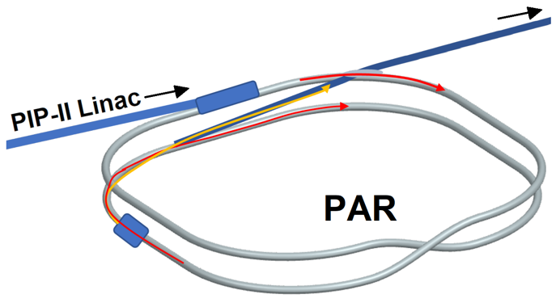
Proposed Accumulator Ring: PAR
PIP-II Accumulator Ring (PAR):
0.8-1.0 GeV proton storage ring
Total circumference matches that of the Booster (474m, though it is a “folded figure-8”)
Booster-MI Program:
Does not interfere with PIP-II Booster commissioning, but enables a later 1 GeV upgrade to Booster
Dark Sector:
100kW hadron-absorber beam dump program that sets new exclusion limits
Image adapted from B. Pellico
Notes:
Although not part of the PIP-II project, if PAR were constructed on an aggressive timeline, a more rapid delivery of proton power benchmarks for DUNE/LBNF may be possible
Other benefits that PAR provides for booster performance would be that PAR would have a longer uninterrupted insertion for H- injection and a longer straight section between bending sections
This would allow for unstripped H- particles to be extracted to a beam dump rather than sent to an inline absorber, like it is currently
It would allow for injection at higher energies (~1GeV proposed) and it would allow the circulating protons that scatter off the injection foil to be directed into a dedicated injection collimator.
and PAR would allow the PIP-II beam to be accumulated at a fixed energy, rather than requiring orbit correctors to compensate the ramping gradient magnets over the 0.6ms duration of the injection process.
PAR will also adapt the PIP-II linac beam to serve low duty factor GeV-scale experimental programs, such as the proposed PIP-II Beam Dump (PIP2-BD) program, which would set new exclusion limits in the search for dark matter
The initial beam power estimate to a DS program like PIP2-BD is >100 kW
DS → PIP2-BD program
Beam power limited by stripping foil heating

Slide 6
PAR Design Parameter Considerations
PAR will accommodate two extraction scenarios:
Extraction to BTL → Booster at a 20 Hz extraction rate
Extraction to DS at a 100+ Hz extraction rate
Will also accommodate two RF systems:
Beam designated for Booster needs 44 MHz capture
DS desires high intensity short bunches, planning for ~ <10 MHz

Slide 7
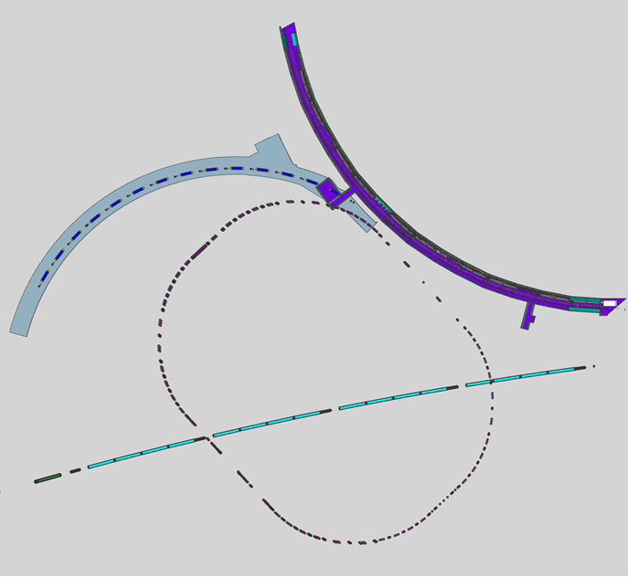
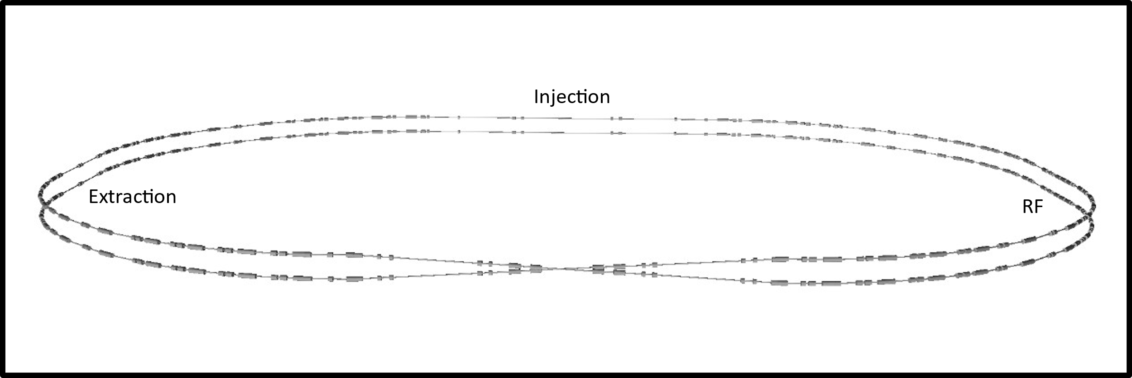
Present PAR Site Location
*From W. Pellico, ACE Workshop 2023
Folded ring design allows placement between BTL, Booster, and PIP-II service buildings
Room for DS and waste beam dumps
Booster
PAR Extraction
DS Related
PAR Injection
MI X2
MI X1

Slide 8
PAR Lattice Features
A 10m uninterrupted injection straight
Allows for ability to safely extract unstripped ${\text{H}}^{−}$ particles
Injection chicane suitable for higher energy beams, at least 1GeV
28m dipole-to-dipole injection straight with ~π/2 phase advance
Leaves room for collimation downstream of injection
Long crossover straight with a 12” shift
This means there is no shared beampipe required in the crossover region
Phase Trombone
A cluster of quadrupole magnets allow the tune to be changed +/- 75 degrees without impacting the beta functions at other locations around the ring

Slide 9
PAR Lattice Feature Locations
Phase Trombone
Injection Chicane
Extraction Sections
Collimation
RF Sections
Cross-over region
*CY Tan

Slide 10
Beam Distribution – Painted Injection
Initial beam distribution is within the +/- 40mm apertures
Nonlinear tracking with full machine apertures shows good stability within a large range of tunes
DS mode will have a beam at least 50% larger
Notes:
Beam distribution AFTER painted injection into PAR.

Slide 11
PAR Tune Diagram
Preliminary tracking provides a large region of stable tunes within the range of the phase trombone
The current working point (red dot)
Avoids the most dangerous resonances from quadrupoles and dipoles
Avoids the sextupole resonances

Slide 12
Initial Tracking is Stable

Slide 13
PAR RF Options
PIP2-BD
AMF
*C.Bhat, ACE Workshop 2023

Slide 14
PAR Power Modes – Nominal (To Booster)
 | Low Value | High Value
Intensity (p) | 8e12 | 16e12
Energy (GeV) | 0.8 | 0.8
Rep. Rate (Hz) | 100 | 100
Power (kW) | 100 | 210
Pulse length | 2μs | 2μs
Exp. duty factor | 2e-4 | 2e-4
1 GeV PAR | Low Value | High Value
Intensity (p) | 12e12 | 24e12
Energy (GeV) | 1 | 1
Rep. Rate (Hz) | 100 | 100
Power (kW) | 190 | 380
Pulse length | 2μs | 2μs
Exp. duty factor | 2e-4 | 2e-4

Slide 15
PAR With h=4 rotation: PIP2-BD
 | Low Value | High Value
Intensity / pulse (ppp) | 1e12 | 2.5e12
Energy (GeV) | 0.8 | 0.8
*Rep. Rate / pulse (Hz) | 200 | 400
Power (kW) | 30 | 130
pulse length (s) | 385ns | 170ns
Exp. duty factor | 7.7e-5 | 6.8e-5
1 GeV PAR | Low Value | High Value
Intensity / pulse (ppp) | 1.5e12 | 4e12
Energy (eV) | 1 | 1
*Rep. Rate / pulse (Hz) | 200 | 400
Power (kW) | 50 | 260
pulse length (s) | 38.5μs | 17μs
Exp. duty factor | 7.7e-3 | 6.8e-3
*2 – 4 pulses per fill

Slide 16
PAR with single-bucket extraction: AMF
 | Low Value | High Value
Intensity / pulse (ppp) | 0.1e12 | 0.2e12
Energy (GeV) | 0.8 | 0.8
*Rep. Rate / pulse (Hz) | 400 | 800
Power (kW) | 5 | 21
pulse length (s) | 22ns | 18ns
Exp. duty factor | 0.9e-5 | 1.4e-5
1 GeV PAR | Low Value | High Value
Intensity / pulse (ppp) | 0.15e12 | 0.3e12
Energy (GeV) | 1 | 1
*Rep. Rate / pulse (Hz) | 400 | 800
Power (kW) | 10 | 38
pulse length (s) | 22ns | 18ns
Exp. duty factor | 0.9e-5 | 1.4e-5
*4 – 8 pulses per fill

Slide 17
PAR Pulse Schemes
2-4 pulses per fill, each pulse with
1e12 – 2.5e12
PIP2-BD mode:
Up to 800 Hz single pulse extraction
0.1e12 – 0.2e12 per fill
AMF mode:

Slide 18
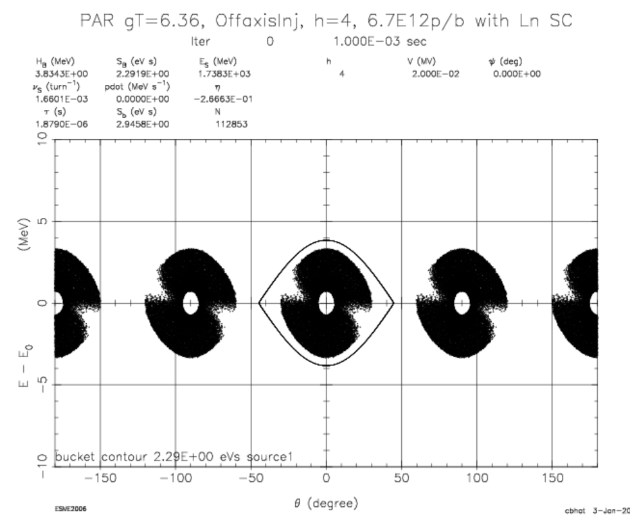
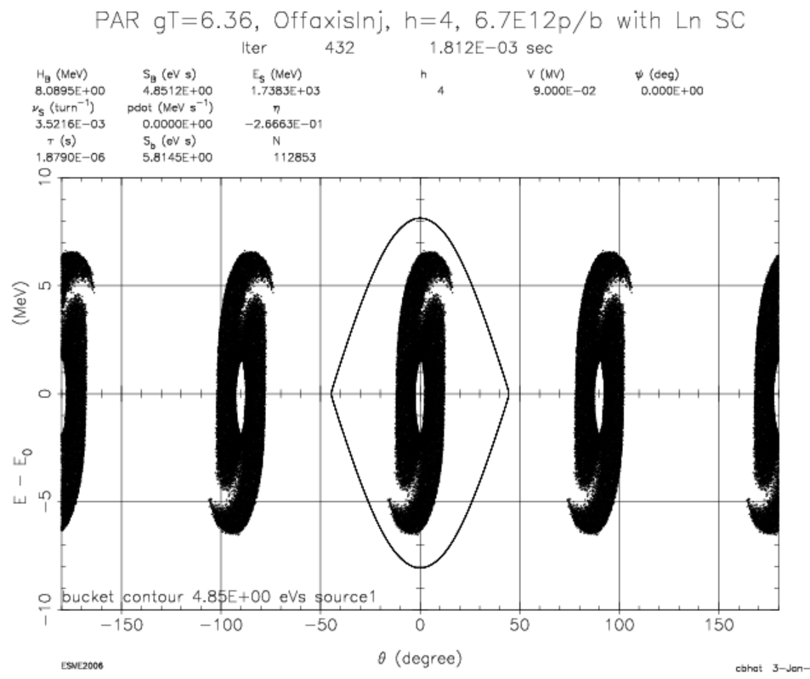
h=4 Injection and Snap Bunch Rotation
End of Injection
End of Bunch Rotation
Will combine longer bunches, rotate them to be shorter and then can extract them as individual pulses, which gives the option for extracting pulses from PAR shorter than 1.8 μs, ~400ns long as shown here
*C. Bhat
Notes:
This is an important point because doing this makes the beam suitable for a Dark Sector program, whether it be for a PIP2-BD or for AMF. With AMF we are going to do individual ~20ns bunches extracted one at a time, but we could explore such ideas as combining three 20ns pulses, rotating them back to 20 ns, and then extracting them one at a time.

Slide 19
Summary
PAR offers an opportunity for FNAL to make a significant contribution to DS HEP, and would provide a consistent platform for new and exciting accelerator R&D development

Slide 20
Thank you for your time!
Questions?

Slide 21
Extra Slides

Slide 22
PAR Will Alternate Between Booster and DS Pulses
.6 sec/12 Booster Cycles
Booster Beam
Booster
Beam
50 ms
Booster Cycles
20 Hz
*From W. Pellico, ACE Workshop 2023
PAR
Booster Load
100 Hz Option
PAR
Booster Load
PAR
DS Load
10ms
PAR
DS Cycles
Cycle rate for filling PAR will depend upon hardware limitations and injection region capability

