Slide 1
CPAR Concept Compact PIP-II Accumulator Ring (for AMF proton compressor)
J. Eldred (building off work by Eric Prebys, also PAR group)
Workshop on a Future Muon Program at Fermilab
Mar 29th 2023

Slide 2
2
2
Prebys Design of
Proton Compressor
2
Jeffrey Eldred | CPAR Concepts
Notes:
2
2
2
2
2
2

Slide 3
3
Prebys Design of Proton Compressor
AMF Snowmass 2022 paper
“A New Charged Lepton Flavor Violation Program at Fermilab”
gives a proton compressor design by Eric Prebys.
Prebys sets the core design strategy for AMF proton compressor,
works backwards from “1MW at 0.8 GeV” vision.
Overcoming the space-charge limit in rings:
Number of bunches
Particles per bunch
Relativistic βγ factors
Transverse emittance
(prop to beam-size squared)
3
Jeffrey Eldred | CPAR Concepts
Notes:
3
3
3

Slide 4
4
Prebys Design of Proton Compressor
Number of bunches
Particles per bunch
Space-charge
limit in rings:
Relativistic βγ factors
Transverse emittance
(prop to beam-size squared)
bunch length
Particles per bunch
at Space-charge limit:
Transverse emittance
revolution time
Relativistic βγ factors
Strategy 1: With a fixed beam energy, bunch length,
a compact ring maximizes the bunch charge.
4
Jeffrey Eldred | CPAR Concepts
Notes:
4
4
4

Slide 5
5
Prebys Design of Proton Compressor
Strategy 1: With a fixed beam energy, bunch length,
a compact ring maximizes the bunch charge.
A ring with a circumference of 100m, performs x5 better!
Strategy 2: Increase beam emittance to accommodate space-charge.
5
Jeffrey Eldred | CPAR Concepts
Notes:
5
5
5

Slide 6
6
Prebys Design of Proton Compressor
Strategy 1,2 : With a fixed beam energy, bunch length,
a compact, wide-aperture ring maximizes the bunch charge.
But we still have some ways to go!
Compare, SNS full norm. beam emittance is ~217 π mm mrad
- For proton compressor with same beam size, in a 100m ring,
that corresponds to ~405kW
- SNS ring is 248m, for same circ & beam size, only ~163 kW.
6
Jeffrey Eldred | CPAR Concepts
Notes:
6
6
6

Slide 7
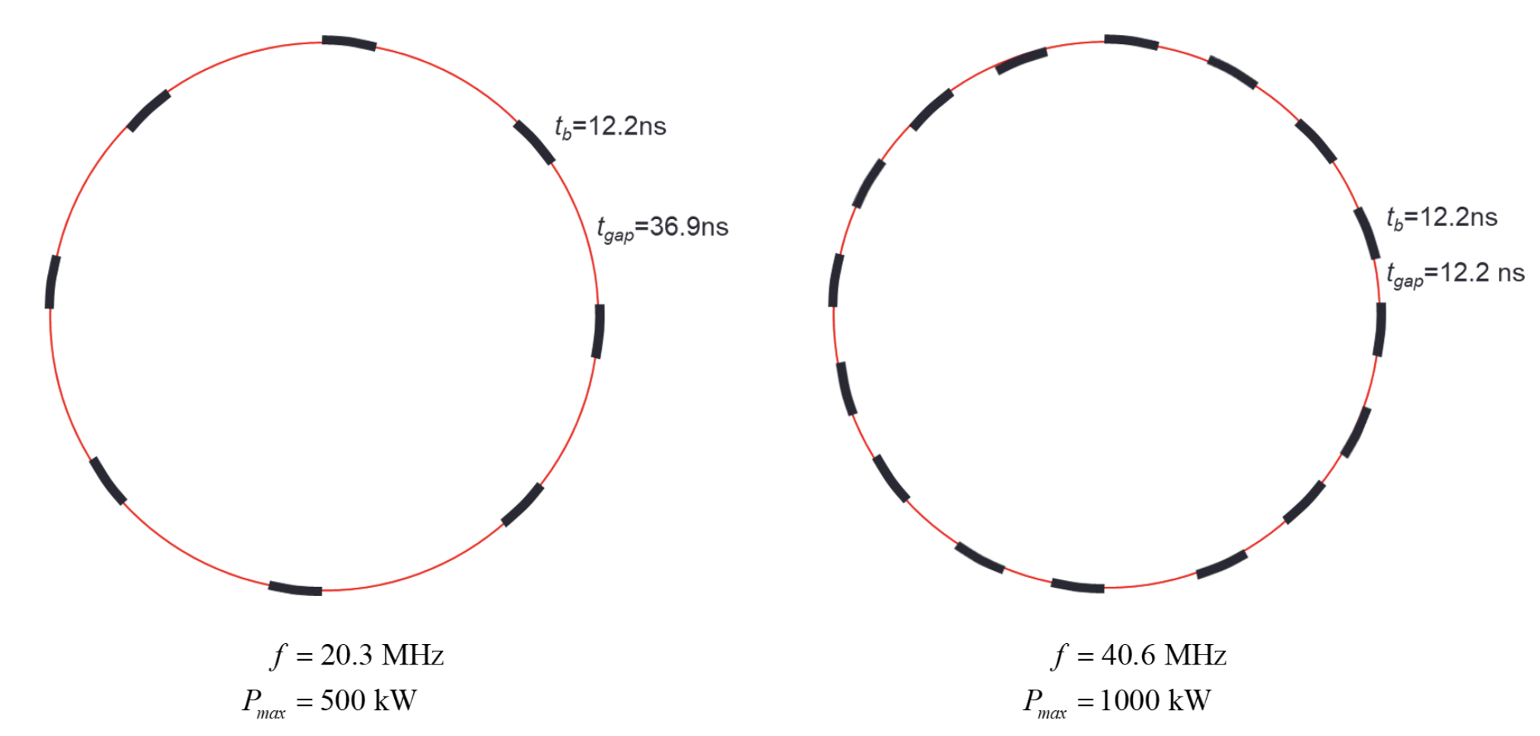
7
Prebys Proton Compressor - Extraction
Fill every bucket, every other bucket, or every X buckets.
Extract each bunch one at a time, using extraction kickers with 10-30ns rise/fall time (should be possible, compare 60ns Booster kickers).
Single-bunch extraction at a rate of 100 Hz (compare SNS 60 Hz).
7
Jeffrey Eldred | CPAR Concepts
Notes:
7
7
7

Slide 8
8
Prebys Proton Compressor – Injection
The PIP-II Linac designed to provide an average of 2mA, obtained from 4mA beam with ~50% chopping to match Booster buckets.
- It’s not capable of injecting 60mA with ~97% chopping.
Consequently Linac has to fill ~16 bunches every 6.25 Hz, with near continuous duty factor (i.e. 100ms pulses for 1MW operation).
But if we are using foil injection, this scheme is not possible because the H- foil would degrade rapidly (limit is between 3-20 ms).
Solutions (i.e. what I’d propose):
- Need to use a linac with ~60mA pulsed operation (with chopping).
- Compare to ESS linac which is 62.5 mA, 2.86 ms every 14Hz.
- Or develop H- laser stripping technology to replace foil.
- Being developed at SNS & J-PARC (optimistically 2035?)
- Or extract/inject at a much higher rate.
8
Jeffrey Eldred | CPAR Concepts
Notes:
8
8
8

Slide 9
9
9
C-PAR Design of
Proton Compressor
9
Jeffrey Eldred | CPAR Concepts
Notes:
9
9
9
9
9
9

Slide 10
10
C-PAR Concept
Ben Simons talked about PIP-II Accumulator Ring (PAR) design.
A compact variant named C-PAR is extrapolated from that.
C-PAR also delivers superior results for PIP2-BD program.
“FNAL PIP-II Accumulator Ring”
“PIP2-BD: GeV Proton Beam Dump at Fermilab's PIP-II Linac”
C-PAR Parameters
- Targeting a between 100 and 200m circumference.
- Beam energy at 1.2 GeV (modest extension of PIP-II).
- Beam emittance of only 24 pi mm mrad (very low-cost)
- Fill eight bunches every 100 Hz and extract one bunch at 800 Hz.
- Deliver 140 kW beam, 0.9e12 in 20ns every 1.25ms.
10
Jeffrey Eldred | CPAR Concepts
Notes:
10
10
10

Slide 11
11
C-PAR Extrapolate from PAR
PAR is 474m ring, designed to match Fermilab Booster.
- eliminate cross-over, results in 237m racetrack ring.
- Another ~44m can be obtain by reducing space in bending arcs, resulting in 193m (by eliminate dispersion-free requirement).
- Another 30-80m could be eliminated by increasing field strength of bending magnets and/or by using fewer FODO cells, 110-160m.
Compare LANL PSR is 90.2m, 800 MeV injection, 100 kW.
Unlike for PAR and PSR, we don’t have a detailed accelerator lattice with components laid out for CPAR concept.
11
Jeffrey Eldred | CPAR Concepts
Notes:
11
11
11

Slide 12
12
C-PAR Pulse Schemes
PIP2-BD mode:
4-bunch merge and
100 Hz extraction
Four 1.2e12 bunches
consecutive RF buckets
100 Hz fill
CLFV mode:
800 Hz single-bunch extraction
Eight 0.9e12 bunches
every other RF bucket
100 Hz fill
12
Jeffrey Eldred | CPAR Concepts
Notes:
12
12
12

Slide 13
13
C-PAR Design Principles
Strategy 3: Increase beam energy to alleviate space-charge limit
- Ring intensity increases by β²γ³, although circumference likely increases by γ, and energy increases by γ-1 (beam power).
- Bunch power goes up by factor of 1.8 from 0.8 to 1.2 GeV.
Strategy 4: Maximize beam extraction rate.
- If need, use a bank of extraction kickers which fire alternatingly.
- Increasing number of extractions for each injection reduces space-charge limit and H⁻ injection limit relative
to delivered beam power.
13
Jeffrey Eldred | CPAR Concepts
Notes:
13
13
13

Slide 14
14
14
Next Iteration of
AMF Proton Compressor
14
Jeffrey Eldred | CPAR Concepts
Notes:
14
14
14
14
14
14

Slide 15
15
Next Iteration of AMF Proton Compressor
Strategy 3: Increase beam energy to alleviate space-charge limit
- Should we go higher energy or greater aperture?
Strategy 4: Maximize beam extraction rate.
- What is a realistic extraction limit? incorporate kicker design and allocate real estate for kickers.
- Inflector from muon production to muon FFA also has to work!
Strategy 5: Reduce vertical aperture, increase horizontal aperture.
- Leads to FFA-like design for AMF proton compressor.
- Tracking codes and operational precedents change.
- Limiting vertical aperture keeps dipoles strong, ring compact.
- Increased horizontal aperture keeps bunch intensity high.
- Allows beam dispersion, which may allow more compact lattice.
- Alternatively, could consider bunch rotation schemes.
- Vertical extraction on side opposite injection straight?
15
Jeffrey Eldred | CPAR Concepts
Notes:
15
15
15

Slide 16
16
Outlook
Five Strategies to Maximize Bunch Power:
1) Compactness
2) Aperture
3) Energy
4) Extraction Rate
5) Horizontal-to-Vertical Ratio
Between the two preliminary design concepts, 100-500 kW seems feasible.
- The ring is between 100-200m, between 0.8-2 GeV, 100-800 Hz.
- Opportunity for greater optimization.
- Opportunity to make designs more realistic.
- Opportunity to make cost-benefit analysis of different approaches.
16
Jeffrey Eldred | CPAR Concepts
Notes:
16
16
16

