Slide 1
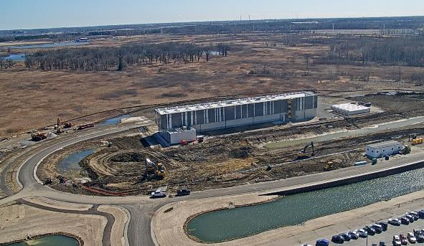
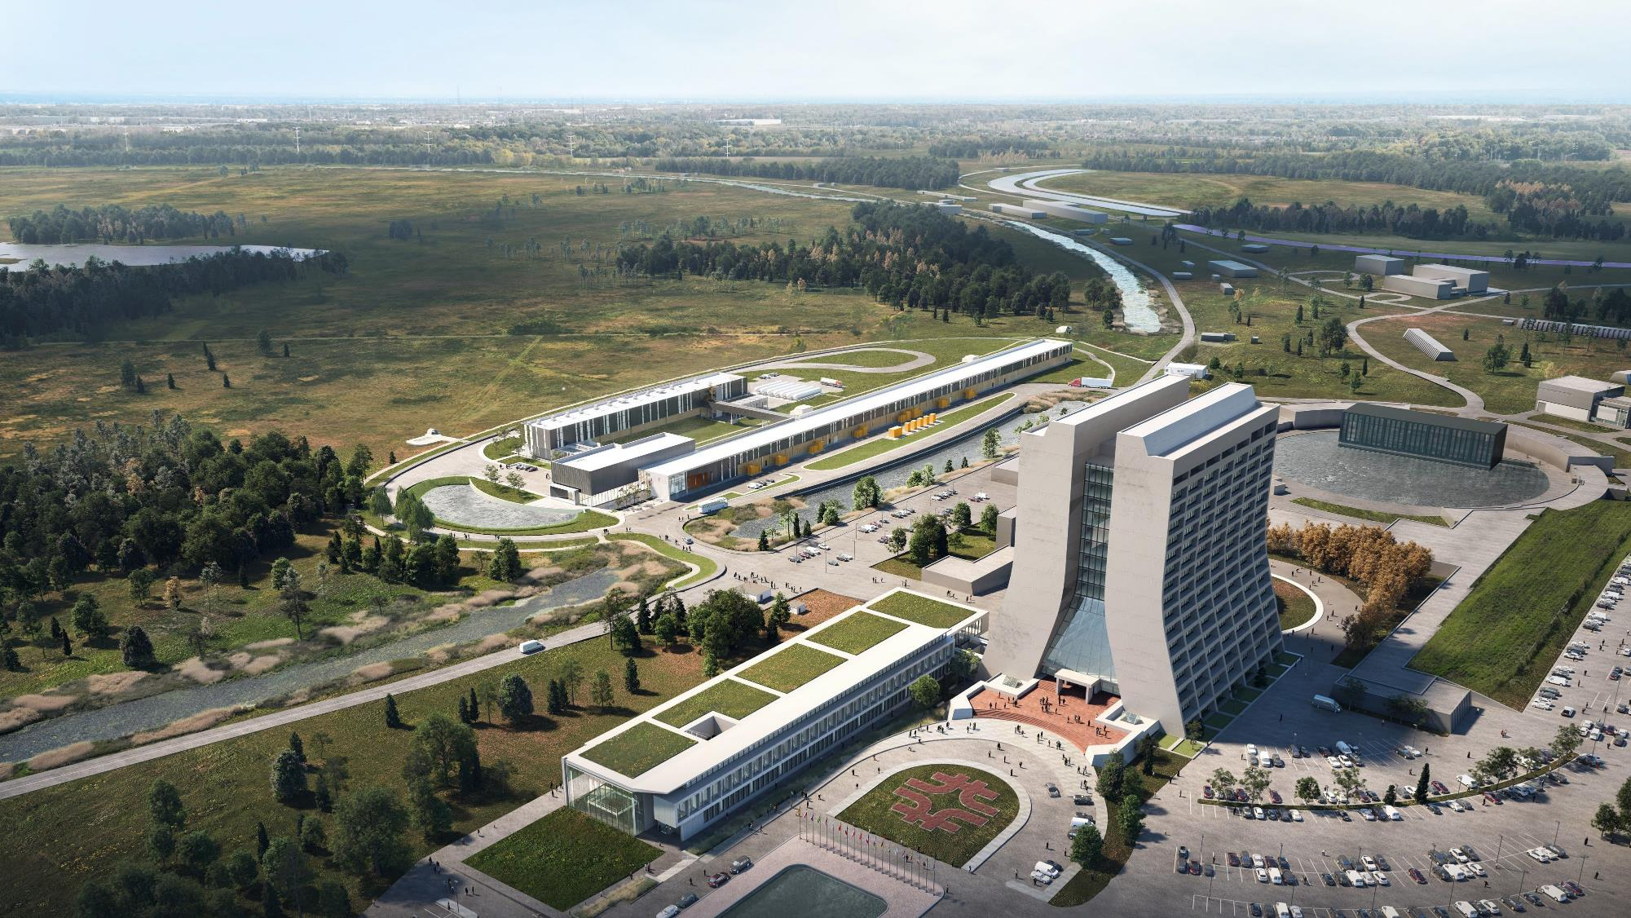
PIP-II beam for mu2e-II
2023
2028
David Neuffer
March 2023

Slide 2
PIP-II Performance Goals
Performance Parameter | PIP | PIP-II
Linac Beam Energy | 400 | 800 | MeV
Linac Beam Current | 25 | 2 | mA
Linac Beam Pulse Length | 0.03 | 0.55 | msec
Linac Pulse Repetition Rate | 15 | 20 | Hz
Linac Beam Power to Booster | 4 | 17 | kW
Linac Upgrade potential | N/A | 1.6 MW CW
Mu2e Upgrade Potential (800 MeV) | N/A | >100 | kW
Booster Protons per Pulse | 4.4×10¹² | 6.8×10¹²
Booster Pulse Repetition Rate | 15 | 20 | Hz
Booster Beam Power @ 8 GeV | 80 | 170 | kW
Beam Power to 8 GeV Program | 32 | 85 | kW
Main Injector Protons per Pulse | 4.9×10¹³ | 7.5×10¹³
Main Injector Cycle Time @ 60-120 GeV | 1.33* | 0.7-1.2 | sec
LBNF Beam Power @ 60-120 GeV | 0.7* | 1.0-1.2 | MW
LBNF Upgrade Potential @ 60-120 GeV | NA | >2.0-2.4 | MW
*NOvA operations at 120 GeV

Slide 3
PIP-II status
800 MeV-2ma cw-capable H⁻ linac
  Initially 17 ma (15 kW)
On trajectory toward construction –completion in ~2029
  CD-0 → CD-1 (6/2018) → CD2 (12/2020)→ CD3(4/2022)
  the major accelerator project for Fermilab
Purpose of PIP-II
  upgraded intensity of injector for LBNF/DUNE
    uses ~8--17 kW to produce > 1MW at 60—120 GeV
    with “PIP-III” (8 GeV RCS?) can provide >2MW at 60—120 GeV
  Platform for future high-intensity program
    upgradeable to ~1.6MW
  Could provide up to 100 kW beam for mu2e-II
    first identified user of high-intensity program

Slide 4
PIP-II and Next Generation Mu2e
Cryoplant with capacity for CW operations
PIP-II Source can produce arbitrary bunch structures with:
  Peak current ≤ 5 mA
  cw Average current ≤2 mA
  Can deliver 800-MeV protons directly to a second generation Mu2e
Mu2e-II
  Use PIP-II (800 MeV) as cw beam source
  Reuse as much as possible of the baseline Mu2e experiment
    Follow similar experimental scenario
    Improve if possible

Slide 5
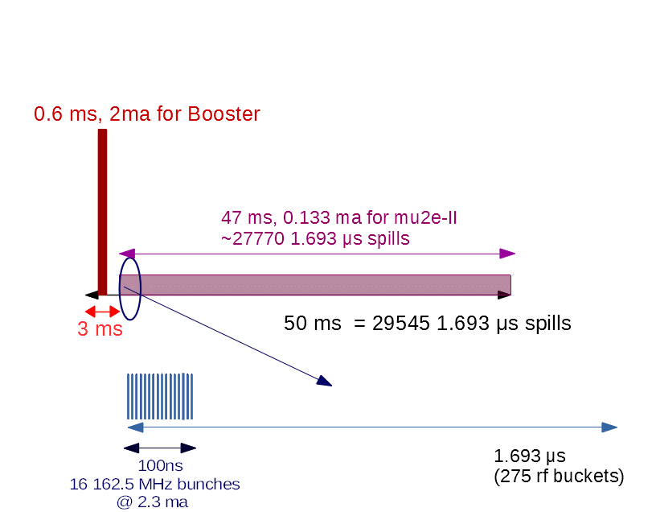
Mu2e-II Beam formation
Possible beam structure (100 kW):
  162.5 MHz chopped beam (~2 ×10⁸ /bunch @ 5ma)
  Pulse length:
    ~50 nsec (8 bunches) →100ns (16 bunches @ 2.3ma)
    Pulse rate: 1.69 μsec ⁻¹ →10^15 p/s
  Three-year run achieves >\single event sensitivity of 2×10⁻¹⁸
20 Hz

Slide 6
PIP-II → Mu2e-II
Requires PIP-II linac switch to cw operation
  Not in initial construction –
  Not very expensive (?) – E Pozdeyev
    New cw MEBT chopper
    Impact of operating CW on timing and triggering, beam intensity instrumentation .
    ~10M$ ?
  Non-trivial to implement
    Operation with simultaneous cw and pulsed for DUNE
  Some interruption to baseline operation (DUNE ?)
Requires PIP-II to Mu2e-II beamline
  Not included in PIP-II
  Fast Switching magnet
  Not expensive, but not cheap
    < 25—50 M$

Slide 7
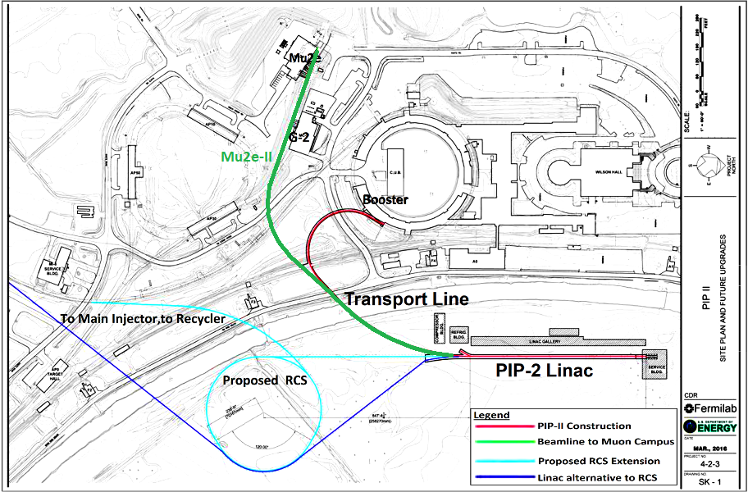
Accelerator beamline geography
Delivery Ring
For Mu2e
8 GeV Protons

Slide 8
Proton Intensity Upgrade and Mu2e-II
Fermilab exercise to discuss intensity upgrades after PIP-II
  Priority is beam to DUNE as fast as possible
    Mass ordering and CP violation phase
Fastest intensity upgrade is shortening MI cycle time
  1.2 s cycle → 0.9 →0.7 s (1.2 MW → 2.0 MW)
Possible upgrade scenario
  MI cycle time upgrade
    Keep Booster – add PAR ring (0.8 GeV ring)
  Later – Replace Booster by RCS or Linac
    Upgrade PIP-II to ~2 GeV; add RCS or extend Linac

Slide 9
MI beam power in numbers
 |  | PIP-II Booster Intensity
Scenario | Present | PIP-II | A | B
MI 120 GeV ramp time (s) | 1.333 | 1.2 | 0.9 | 0.7
Booster intensity (10¹²) | 4.5 | 6.5 | 6.5 | 6.5
Booster ramp rate (Hz) | 15 | 20 | 20 | 20
Number of batches | 12 | 12 | 12 | 12
MI power at 120 GeV (MW) | 0.865 | 1.25 | 1.666 | 2.142
Booster cycles for 8 GeV | 6 | 12 | 6 | 2
Available 8 GeV power (kW) | 29 | 83 | 56 | 24
Minimum cycle is 0.65 s
  Slip-stacking in the RR requires 12 20-Hz Booster ticks for 12 injections + 1 tick for slipping: 13×1/20Hz = 0.65s
  This leaves very little beam for 8 GeV program
  Only 1 tick for 8GeV with 0.7 s cycle

Slide 10
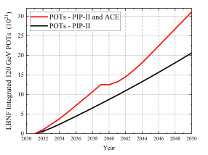
Time line comments
  Pre PIP-II until 2027
    Mu2e start 2026
  Long Shutdown
  ~2030 restart
ACE MI upgrade
  Will restrict 8 GeV beam
  Compete for beam with DUNE
  Mu2e (2030-2040)
Booster Replacement
  8 GeV RCS or Linac
  Probably with 2 GeV Linac
CW PIP-II
  Not in current plan?
  2040?

Slide 11
Accelerator upgrade geography
Delivery Ring
For Mu2e
8 GeV Protons
2 GeV to mu2e -II
2 GeV extension

Slide 12
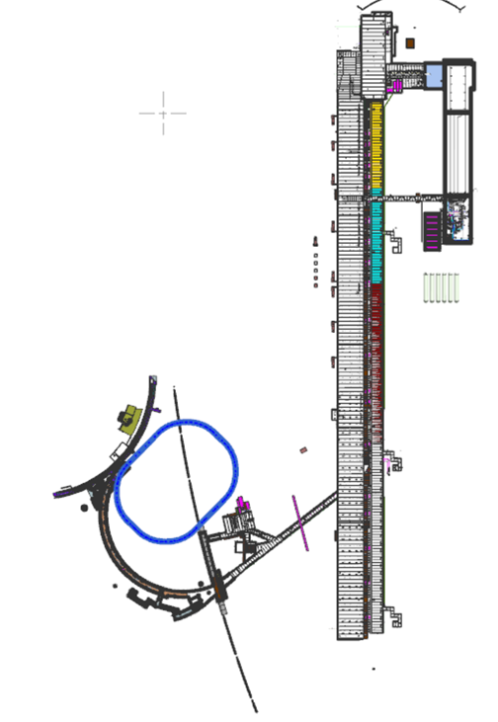
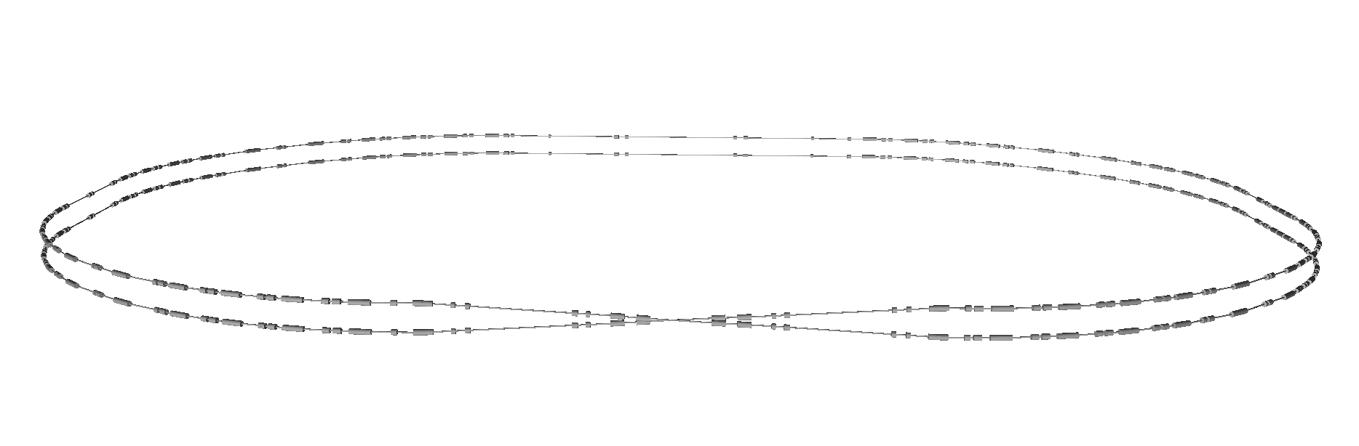
PIP-II Accumulator Ring (PAR)
A storage ring option that will utilize the PIP-II capabilities, help LBNF power ramp up, and enable a Dark Sector beam-based FNAL physics program.
Folded ring design
Injection
Booster
PAR
PIP-II
Extraction
RF
Needs to be commissioned at the same time as PIP-II if it is to improve LBNF power ramp up. Funding needs to start asap to be ready on this timescale
Booster
Transfer Line

