Slide 1
Tungsten as Target Material
Yongjoong Lee
Workshop on a Future Muon Program at Fermilab, March 28, 2023

Slide 2
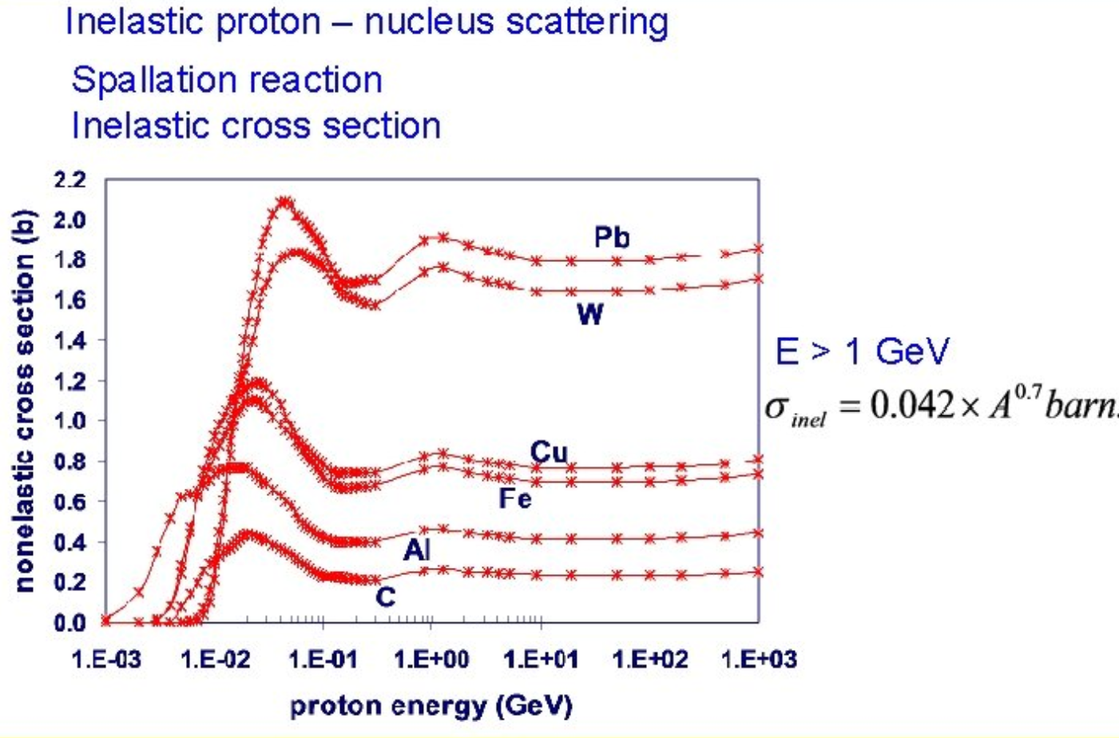
Tungsten as spallation material
High melting point
Good thermal conductivity
High Mechanical strength
High atomic/nucleon density
High nuclear reaction probability with proton beam
  High inelastic scattering cross section
Largely available commercially

Slide 3
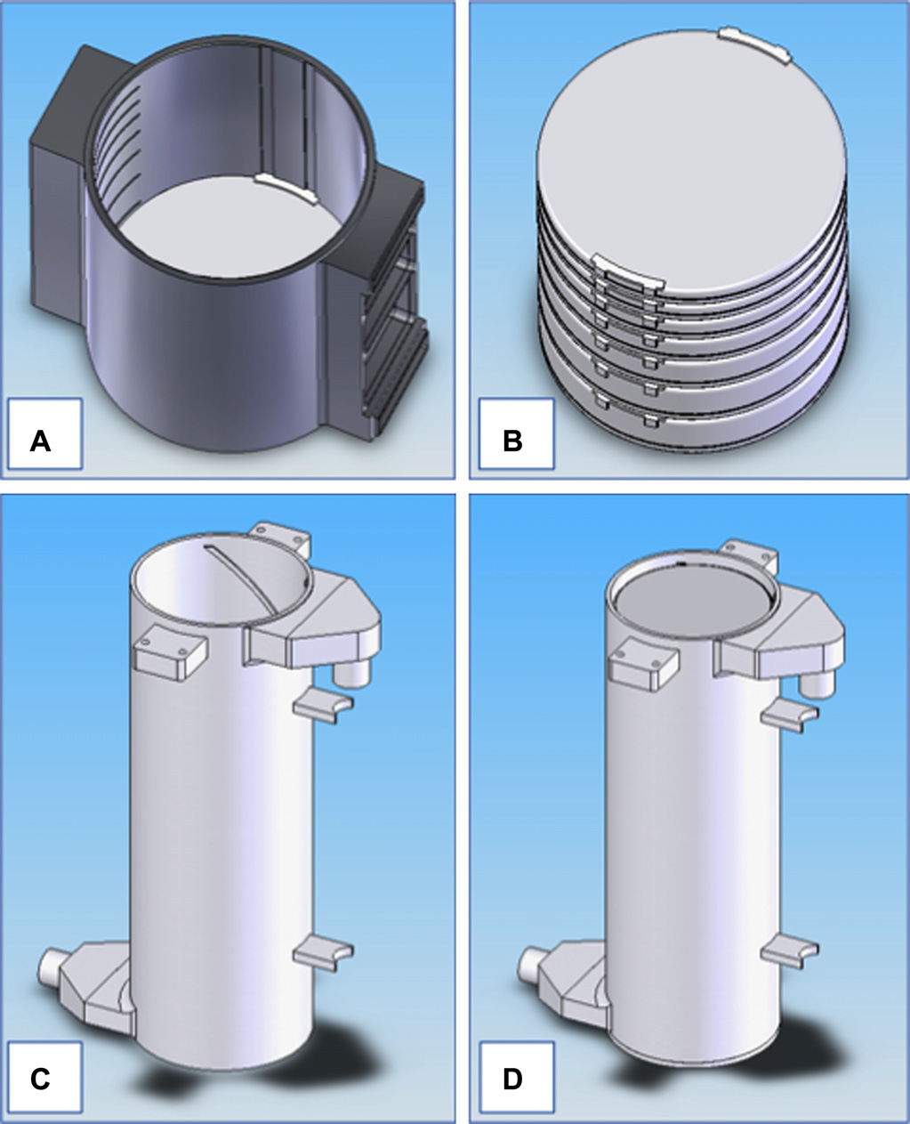
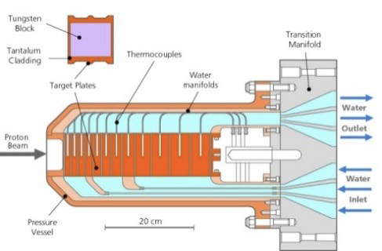
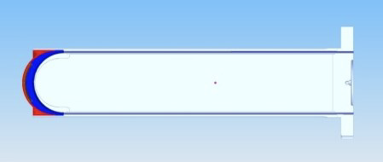
Tungsten spallation targets in operation
ISIS TS1 Target
  Water cooled tantalum clad target
  160 kW proton beam power
ISIS TS2 Target
  Water cooled tantalum clad target
  32 kW proton beam power
LANSCE Lujan Center Target
  Water cooled tantalum clad target
  100 kW proton beam power
CSNS target
  Water cooled tantalum clad target
  100 kW proton beam power
To remove heat deposited by proton beam,
tungsten volumes are volume-cooled by water
D. Wilcox, SNS Target Simulations Workshop
Apr 6, 2021
Nelson, A. T. et al.
J. of Nucl. Mat. 431 (2012)

Slide 4
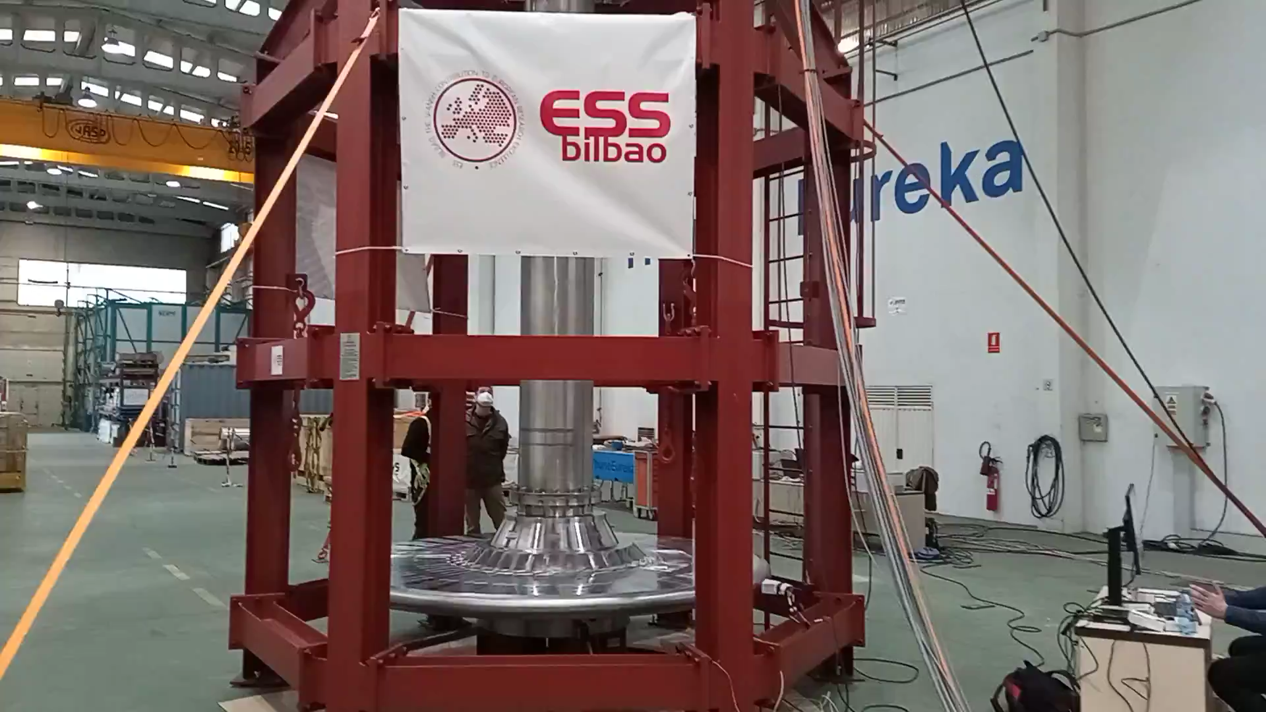
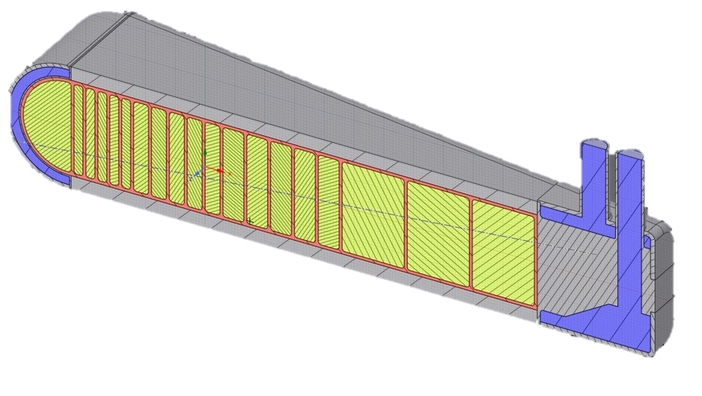
Tungsten spallation targets in design and construction
ESS Target
  Rotating helium cooled “naked” target
  5 MW proton beam power
STS Target
  Rotating water-cooled tantalum clad target with edge-cooling
  700 kW proton beam power
High power targets are rotating:
Distribute steady beam load
Distribute radiation damage rate
Large surface area for passive decay heat removal
Inconel 718
Copper
60mm
475mm
Tungsten
75mm

Slide 5
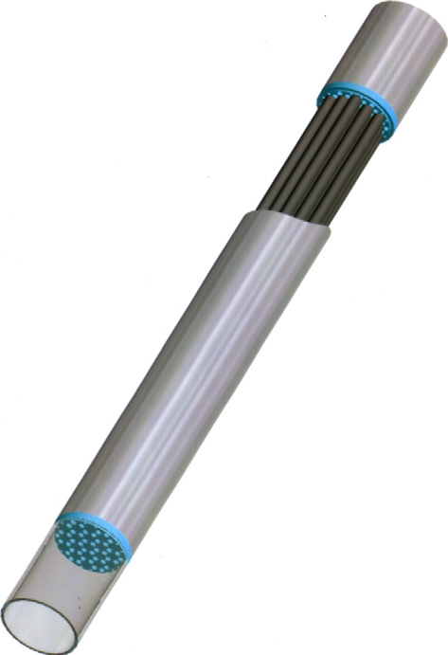
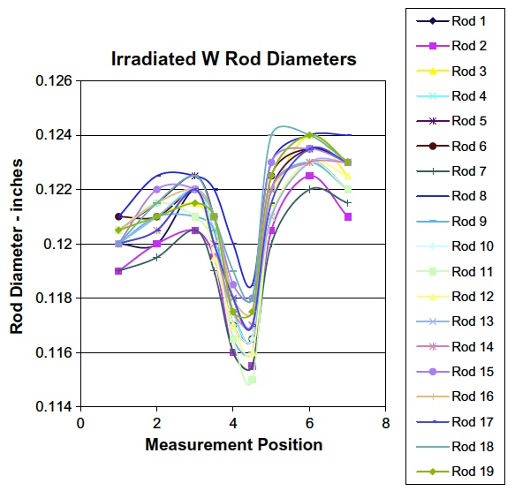
Target materials cooling - Water
Lower beam intensity
Tungsten erodes aggressively in water in accelerator and target environments
Tungsten block is clad or canned in ductile clothing material
  Protecting tungsten from erosion
  Crack arrest at the bimetallic interface
M. J. Baumgartner et al.
AccApp’03 (2003) 399
S. Maloy et al.
JNM 431 (2012) 140

Slide 6
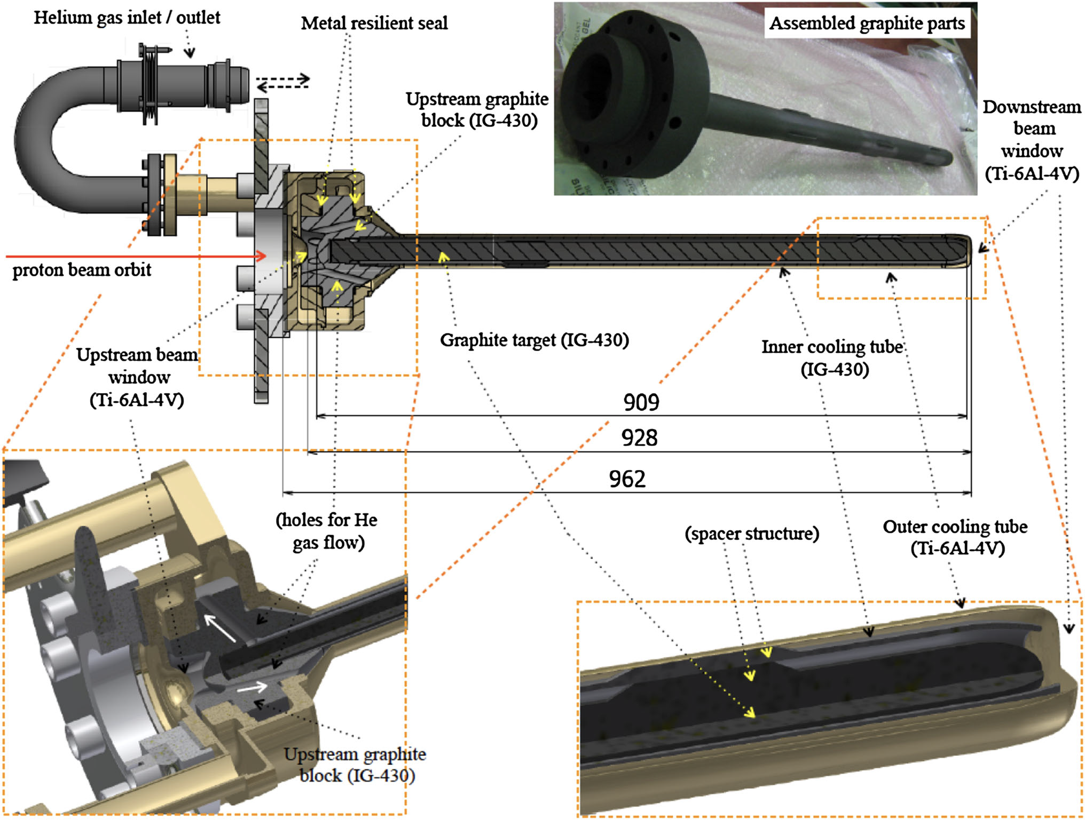
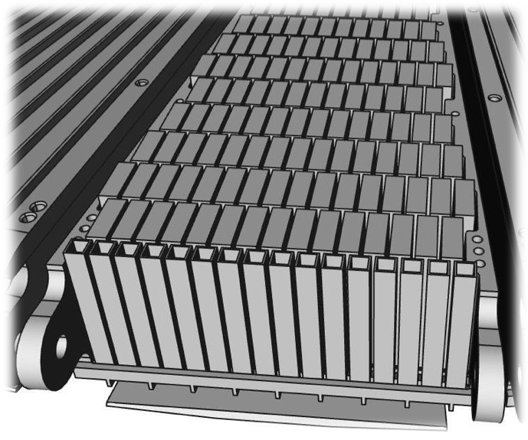
Target materials cooling - Helium
Advantages
  Low radiolysis product
  Reduced decay heat due to negligeable thermalization of neutrons in the coolant
Challenges
  Leak tight design
  Higher operational pressure than water
  Loop purification
J-PARC Neutrino Target – 750 kW@30 GeV
[T. Nakadaira, J Radioanal Nucl Chem 305 (2015) 777]

Slide 7
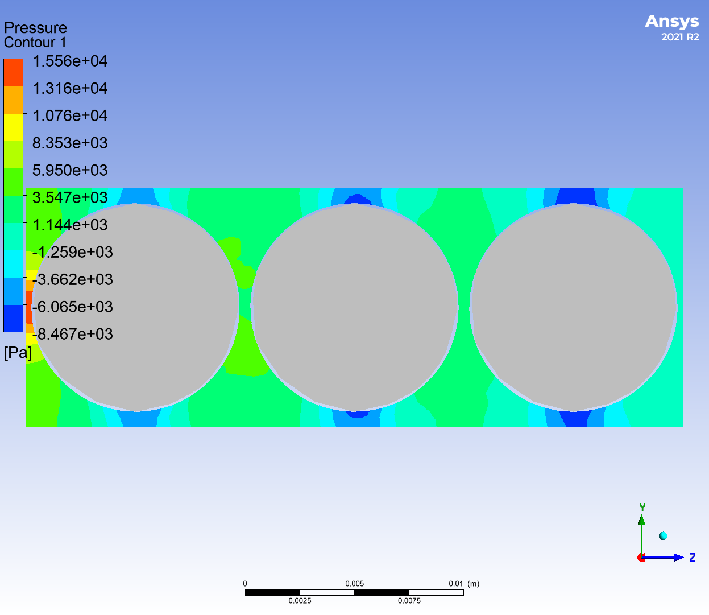
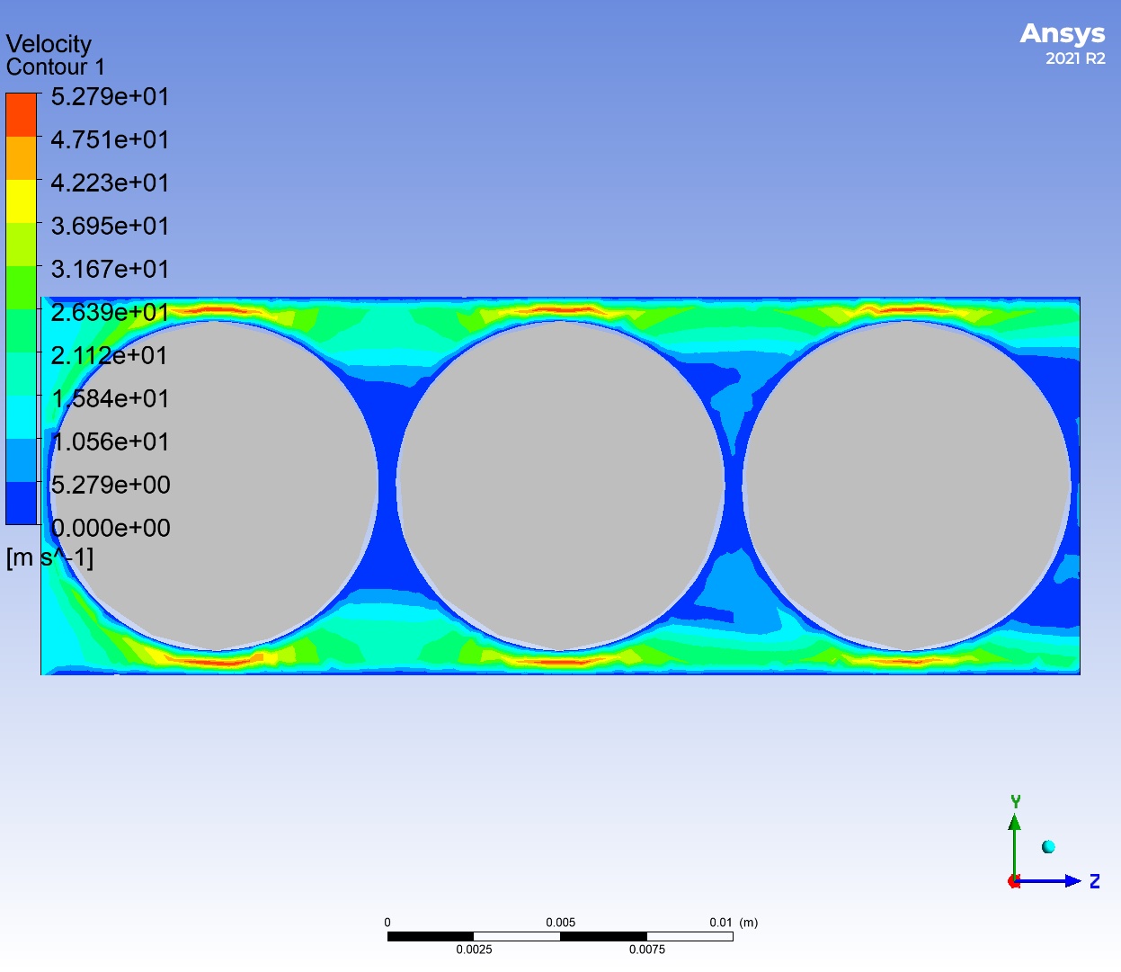
Some thoughts about gas cooled rolling W bearing Mu2e target concept
Target Configuration
  Stainless steel tube inner diameter: 0.43”
  WC bearing diameter: 0.375”
  Loop length: 8 m
  Flow rate: 2.35 cfm = 4.0 m3/h
  Filling pressure: 90 psi = 6.12 atm
For standing bearings:
  Total pressure drop in the loop: 14 bar
  Wall heat transfer coefficient: 1024 W/m2/C
For moving bearings at half the flow speed
  Total pressure drop in the loop: 3.8 bar
  Wall heat transfer coefficient: 624 W/m2/C
Concerns with:
  High pressure drop
  Not sufficient wall heat transfer coefficient

Slide 8
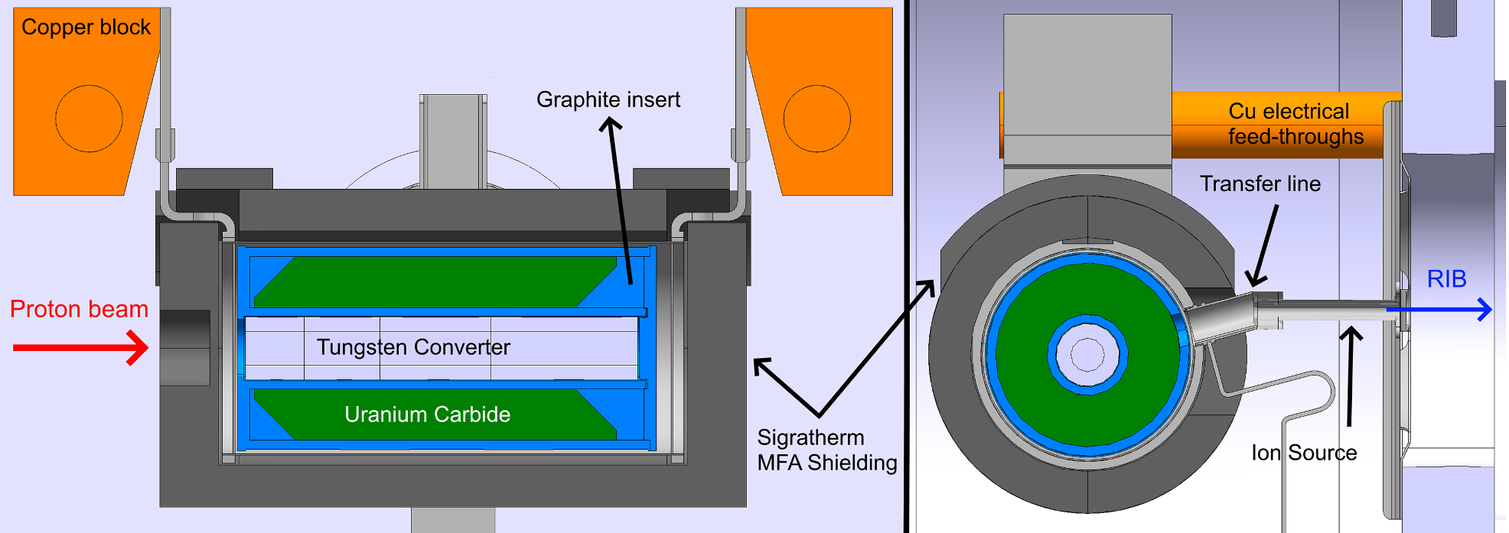
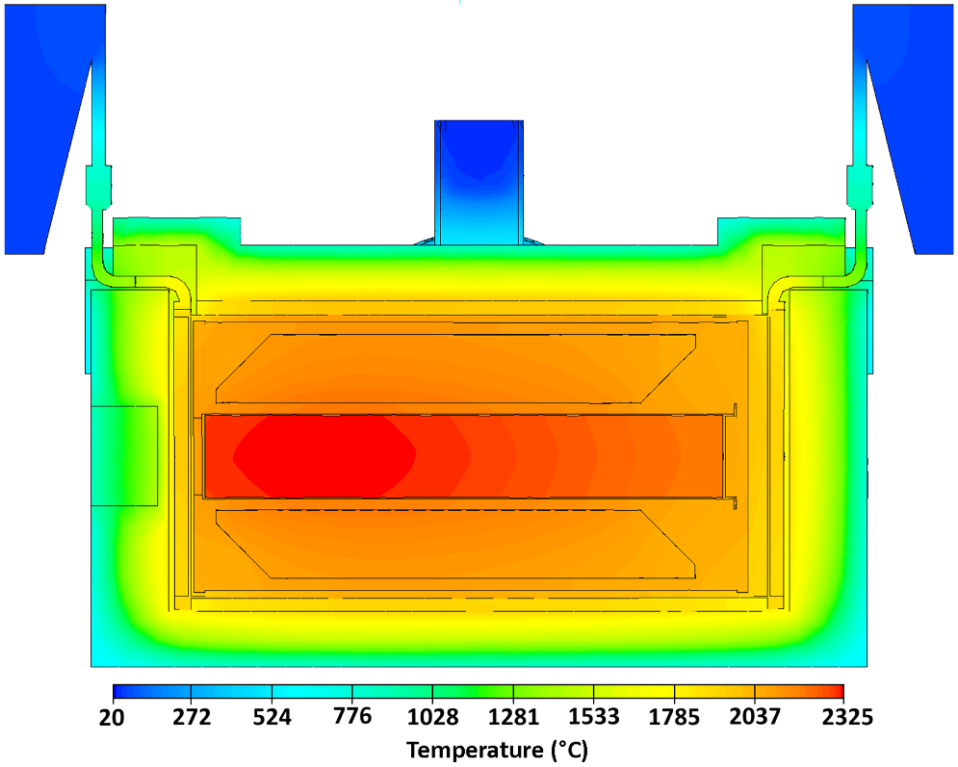
Target materials cooling – Passive radiation
High operational temperature
Simplified cooling configuration
Potential issues with oxidation and sublimation
CERN-ISOLDE spallation source
  1.4 GeV/2 uA proton beam (2.8 kW)
  567 W in W
  2300 C at W core
J. P. Ramos et al., Nucl. Inst. And Methods in Phys. Research B 463 (2020) 357

Slide 9
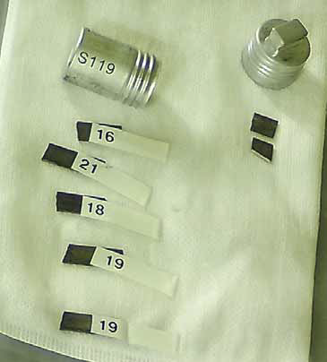
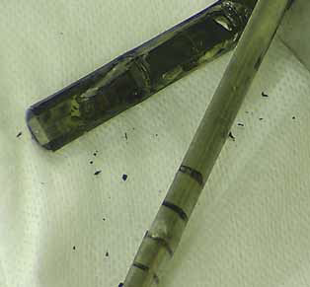
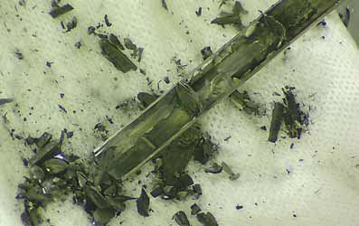
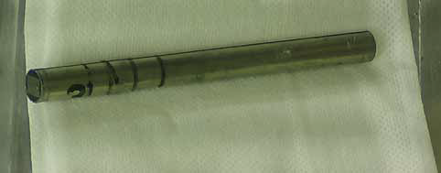
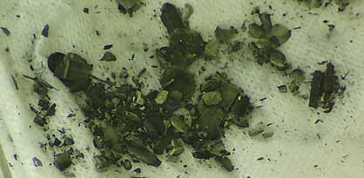
Tungsten with proton radiation damage
Main concerns with radiation damage
  Radiation induced hardening and embrittlement
    Some data available
  Radiation induced reduction in thermal diffusivity
    Some data available
  Radiation induced change of elastic modulus
    No data with dedicated tests
  Radiation induced change of fatigue endurance limit
    No data
  Decay heat and tungsten oxidation

Slide 10
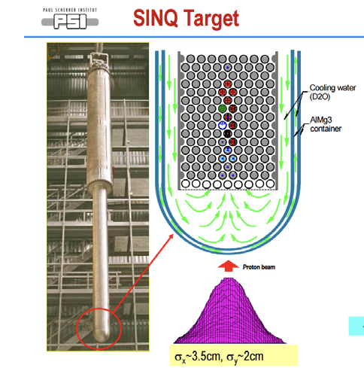
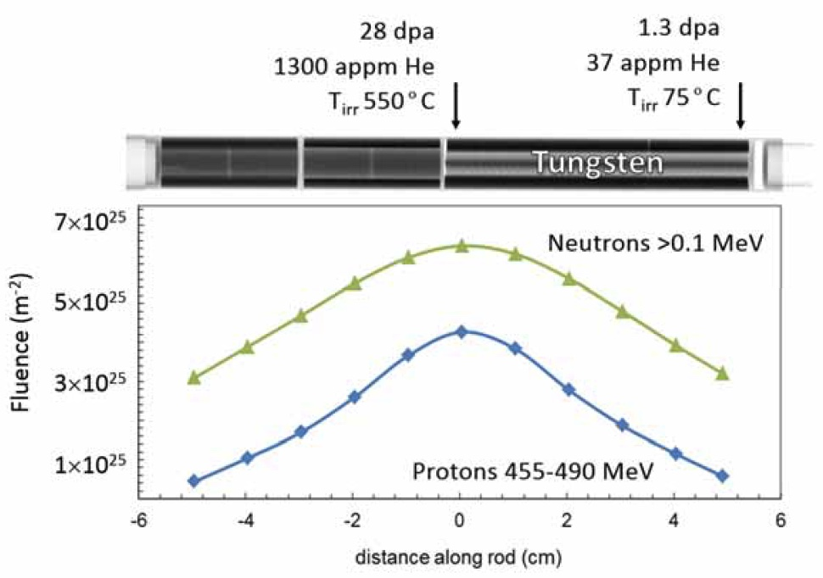
Proton irradiated tungsten - STIP
Schweizerische Intensive Neutronen Quelle (SINQ) Target Irradiation Program (STIP)
  560 MeV proton beam
Rolled tungsten samples were irradiated
  STIP-II (2000-2001): 10.2-35.0 dpa
  STIP-V (2007-2008): 1.3-28.0 dpa
Image: Y. Dai (PSI)

Slide 11
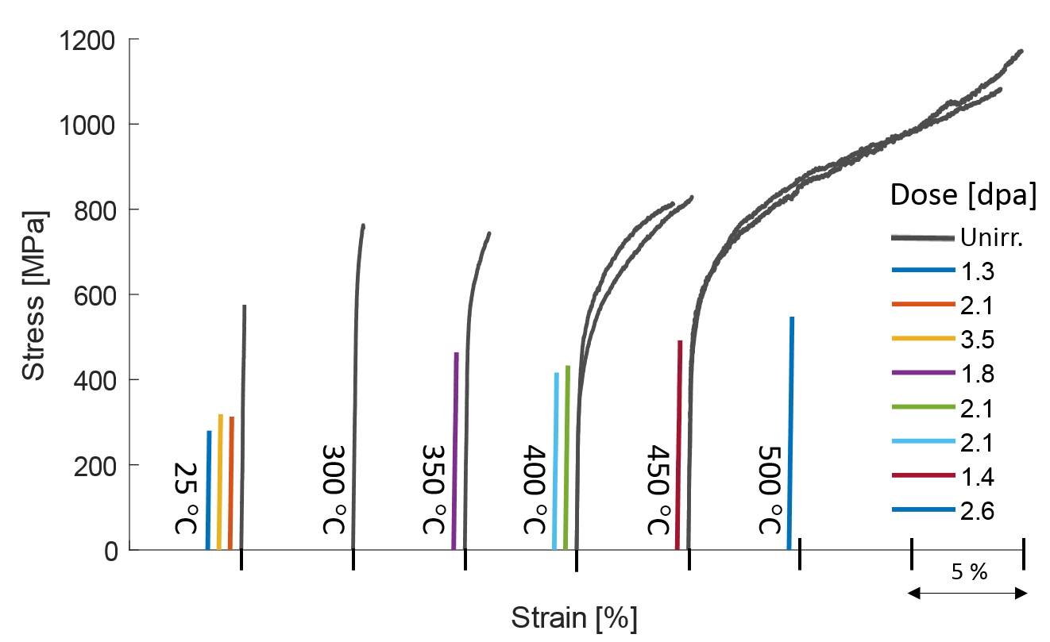
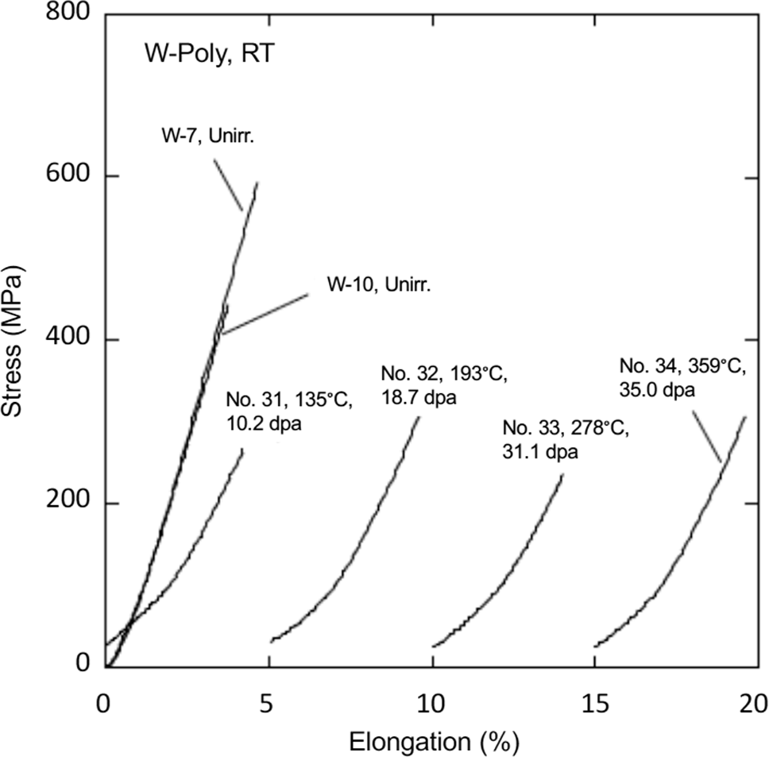
Radiation induced hardening and embrittlement
3-point bend tests (STIP-V):
  For > 1.3 dpa, DBTT is higher than 500 C
  Flexural strength reduces by ~1/2 for > 1.3 dpa
Tensile tests (STIP-II)
  For > 10.2 dpa, UTS is reduced by ~1/2
S. Saito et al.,
Nuclear Materials and Energy 34 (2023) 101338
J. Habainy et al.,
J of Nuclear Materials 514 (2019) 189

Slide 12
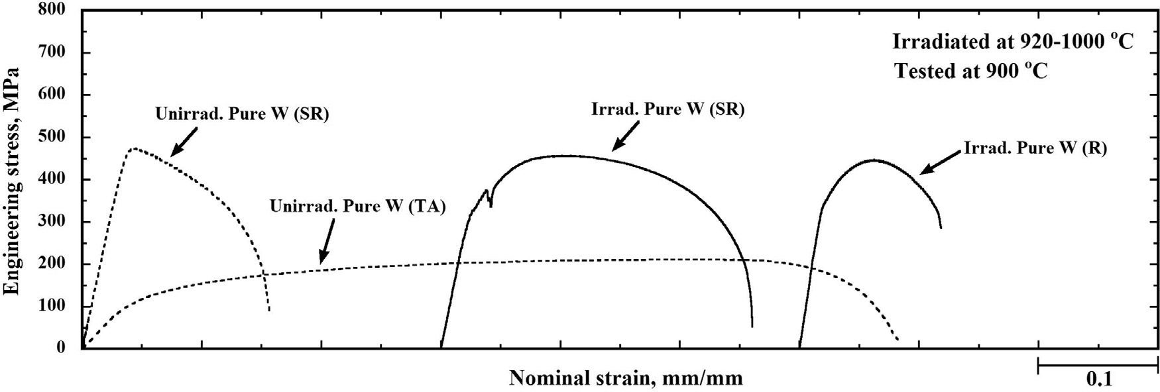
Neutron irradiation near recrystallization temperature
Tungsten irradiated in HIFR slightly below recrystallization temperature
  Gd thermal neutron shield
  Fast neutron fluence: 3.4-3.7e25 n/m² (0.7 dpa)
  0.7% Re transmutation
Irradiation at 1000 C did not induce hardening
  Decrease in UTS and increase in TE
  “Softening due to the recovery and recrystallization of SR W materials and hardening due to the formation of irradiation defect clusters were balanced during irradiation at 1000 °C, and ductility was exhibited without an increase in strength.” [T. Miyazawa et al., J of Nuclear Materials 542 (2020) 152505]

Slide 13
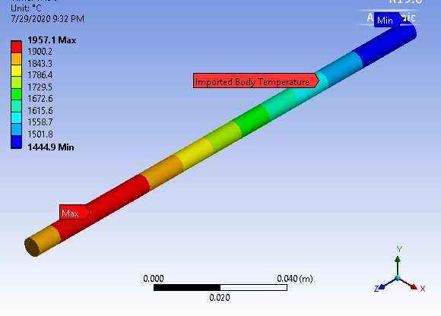
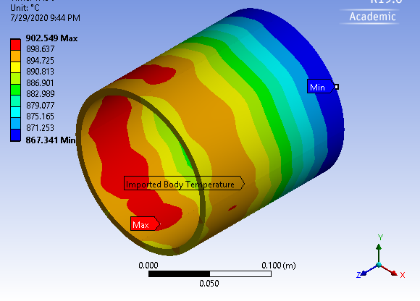
Thoughts about Mu2e target operating at sub-recrystallization temperature
Rotating hollow cylinder target:
  A hollow cylinder made of tungsten
  Outer cylinder diameter: 150 mm
  Wall thickness: 6.3 mm
  Length: 160 mm
10% loss in muon/pion yield compared to TDR target concept (ɸ6.3 mm x L160 mm)
Maximum steady temperature
  TDR: 1957 C
  Rotating hollow cylinder: 903 C
Peak maximum principal stress
  TDR: 16.1 MPa
  Rotating hollow cylinder: 8.3 MPa

Slide 14
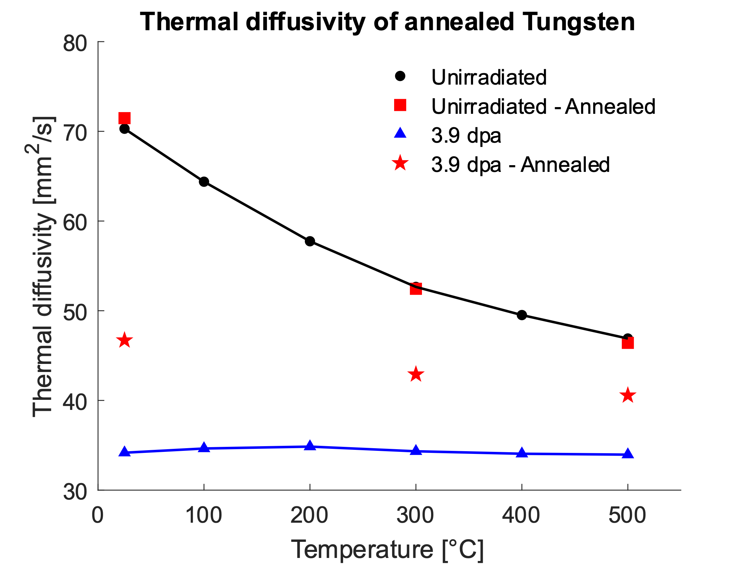
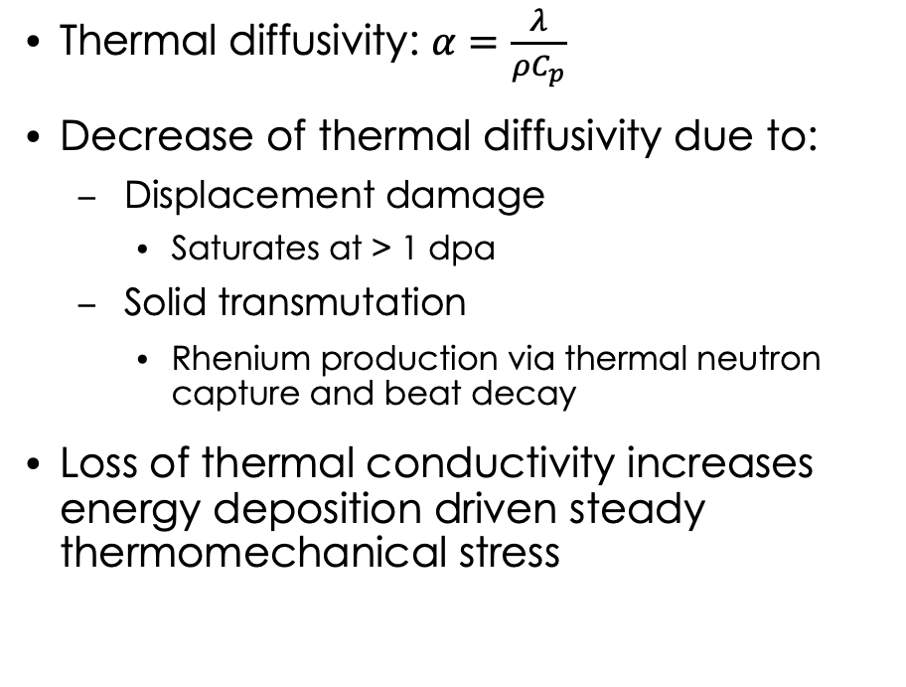
Radiation induced thermal diffusivity decrease
Thermal diffusivity: $α=\frac{λ}{ρC_{p}}$
Decrease of thermal diffusivity due to:
  Displacement damage
    Saturates at > 1 dpa
  Solid transmutation
    Rhenium production via thermal neutron capture and beat decay
Loss of thermal conductivity increases energy deposition driven steady thermomechanical stress
J. Habainy et al.
JNM 509 (2018) 140

Slide 15
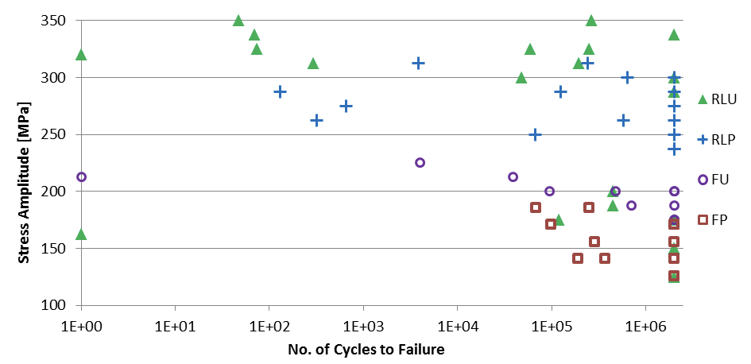
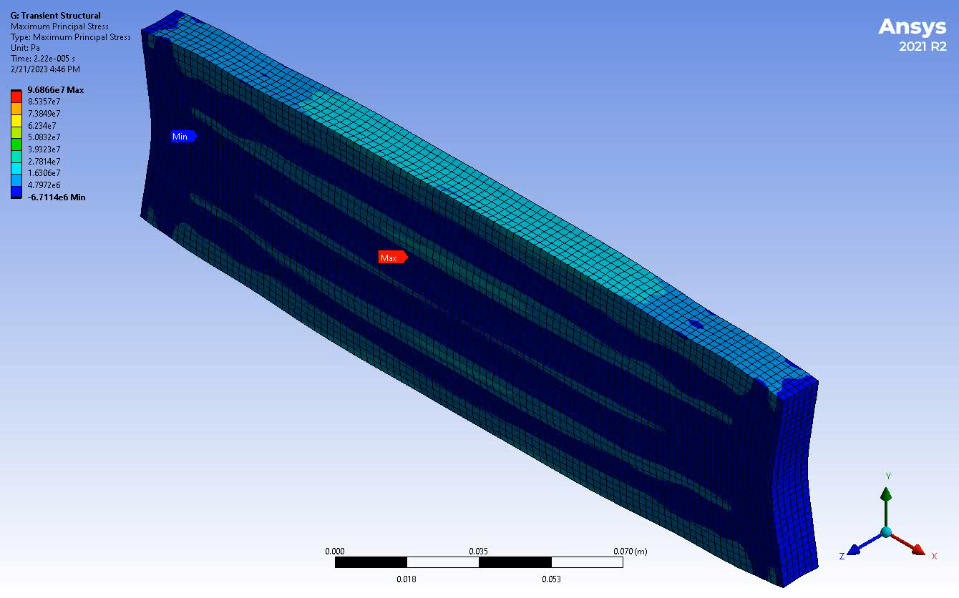
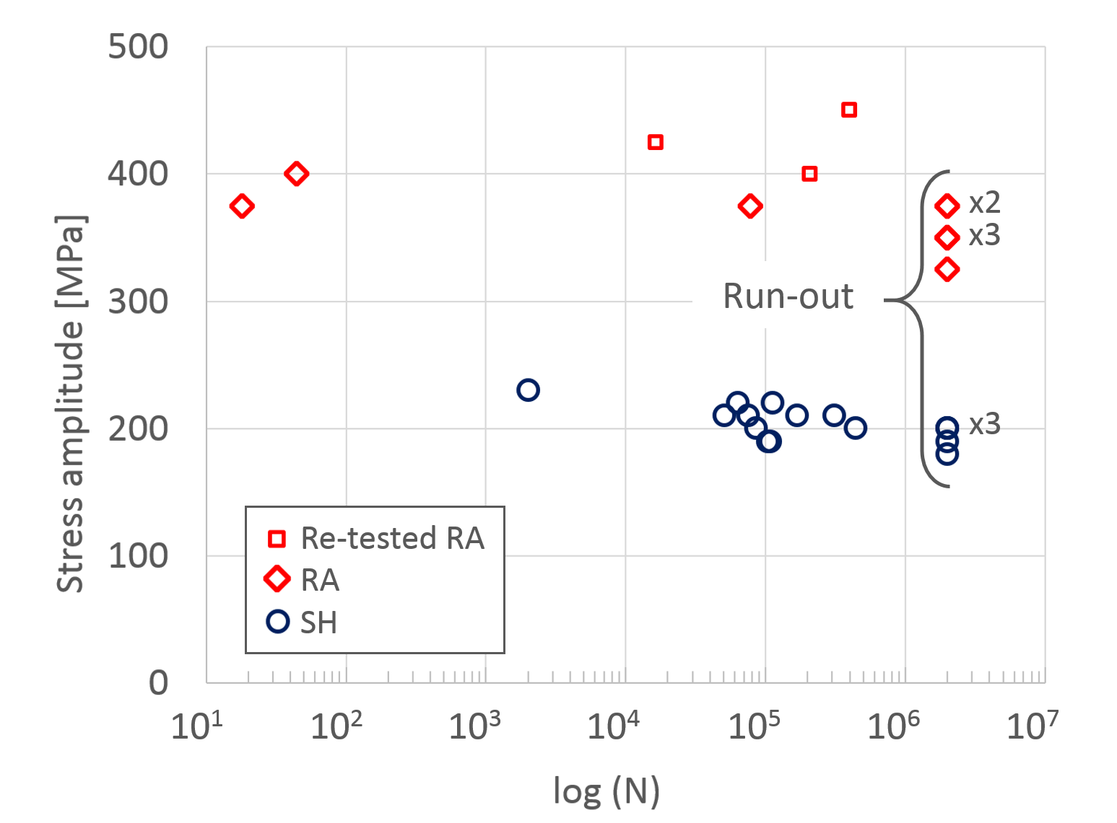
Tungsten Fatigue
The fatigue S-N curve data point are highly stochastic, posing challenges with lifetime estimates
J. Habainy et al.
JNM 465 (2015) 438
J. Habainy et al.
JNM 506 (2018) 83

Slide 16
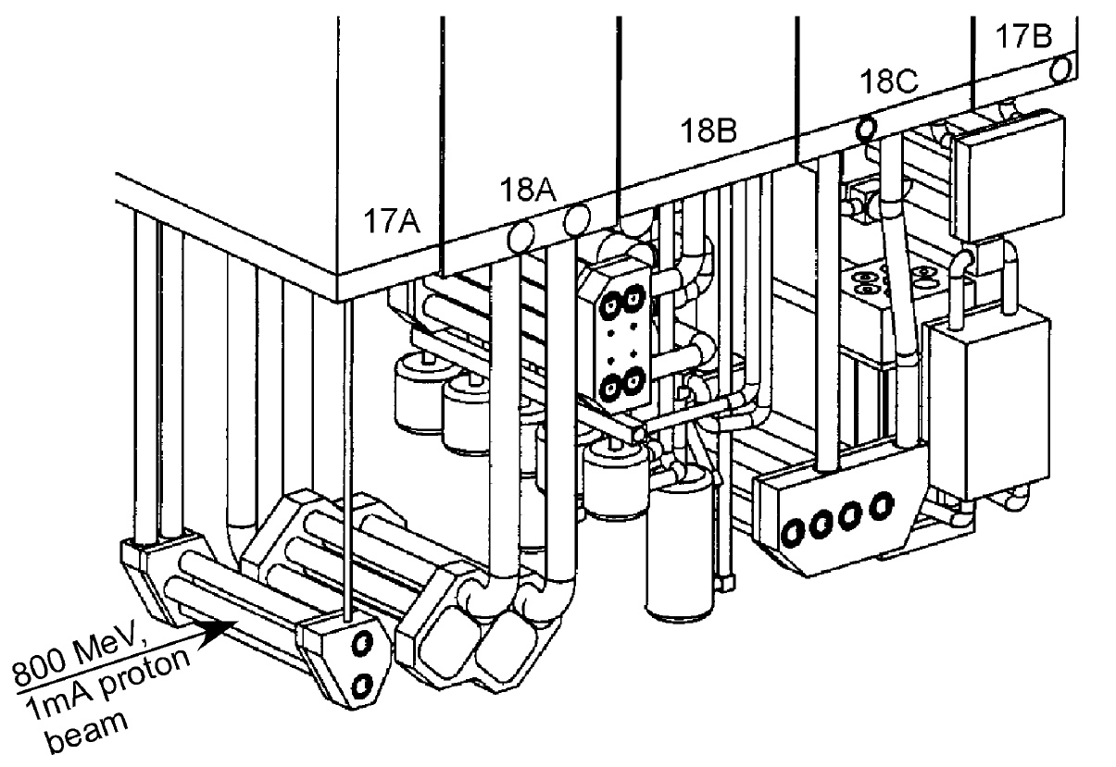
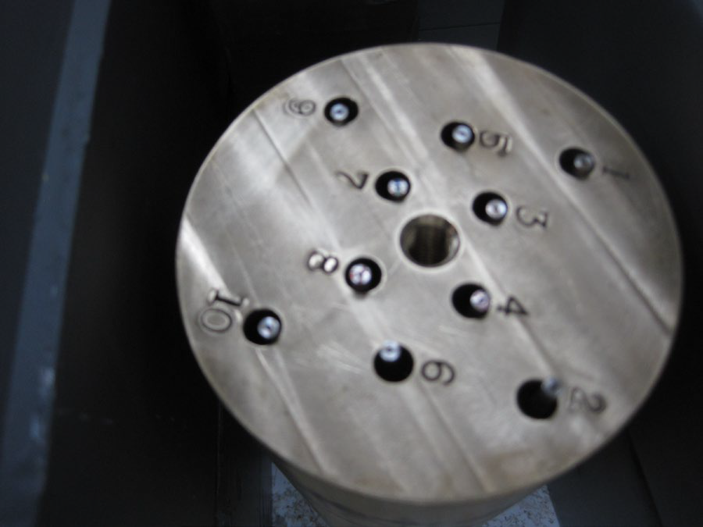
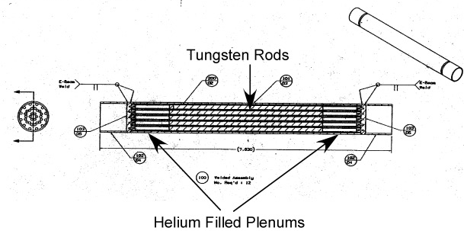
Proton Irradiated Tungsten Rods at LANSCE
Samples:
  Irradiated: 10 rods
  Control: 2 rods
Rod dimension:
  Diameter: 2.6 mm
  Length: 106 mm
More samples will be shipped

Slide 17
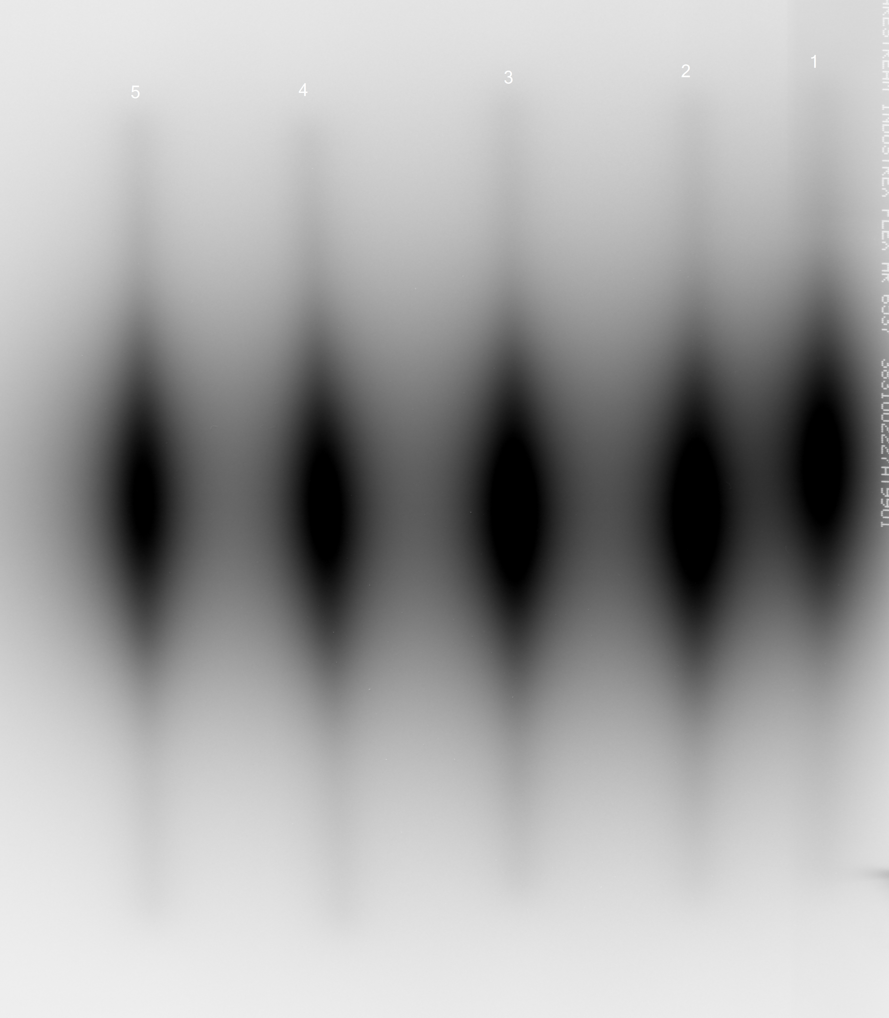
Radiation dose and temperature profile
Irradiation Profile:
  Max DPA: 25
  Max irradiation temperature: 271 C
  H(He)-appm/DPA = 447(83)
Pre-extraction autoradiography completed
Pre-extraction X-ray CT in progress
Elastic modulus measurement – Measurement on dummy rods to start soon

Slide 18
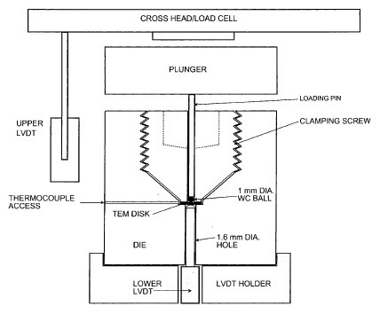
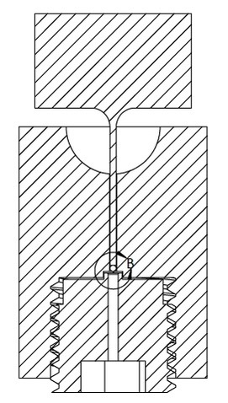
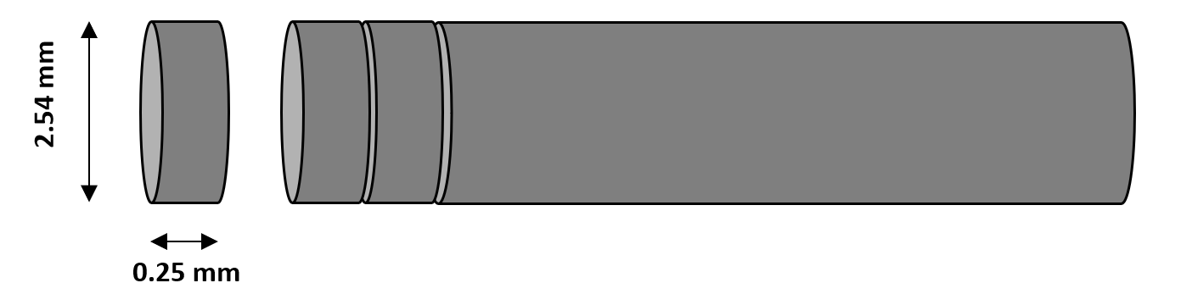
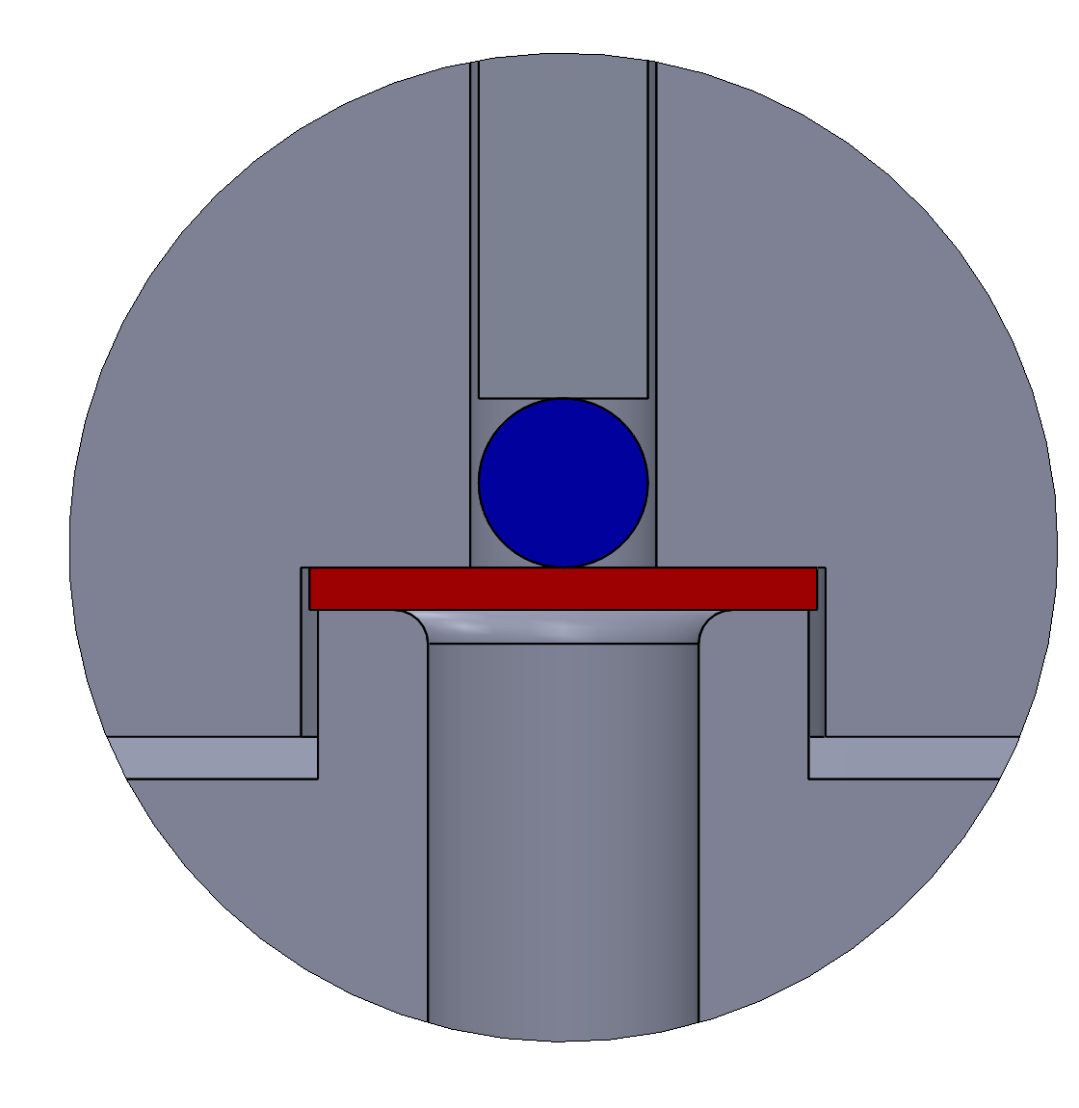
WC-ball loaded bend fatigue tests on miniature discs
Miniature disc samples can be cut from small diameter tungsten rods
  Each cut location correlates to different dpa => Large S-N data points

Slide 19
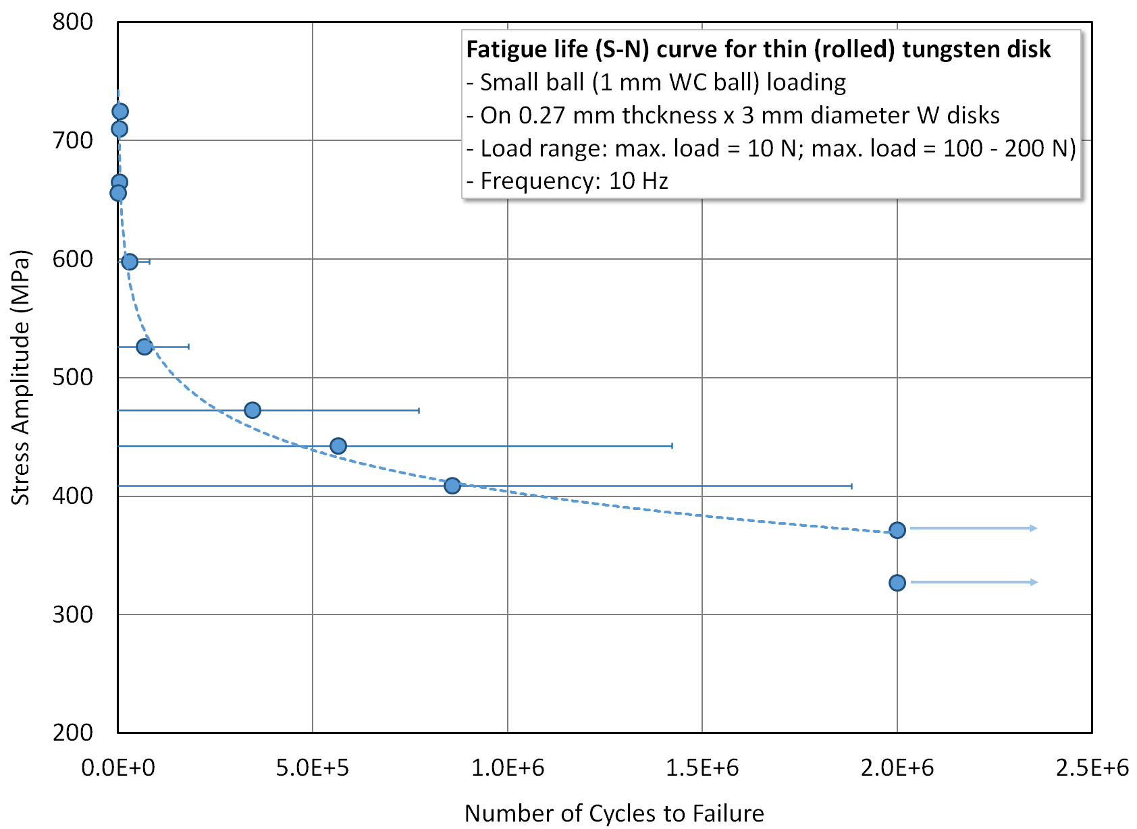
WC-ball loaded bend fatigue tests on miniature discs
Feasibility study with TEM sample

Slide 20
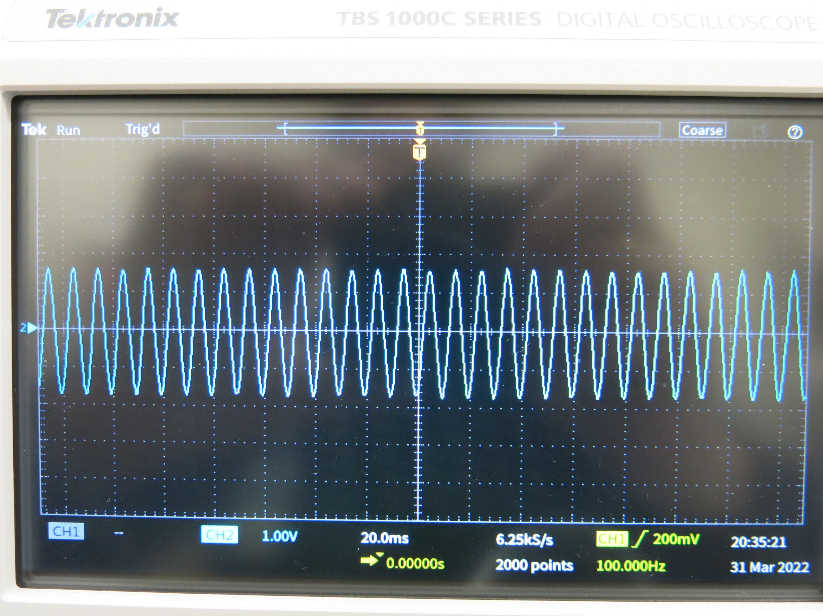
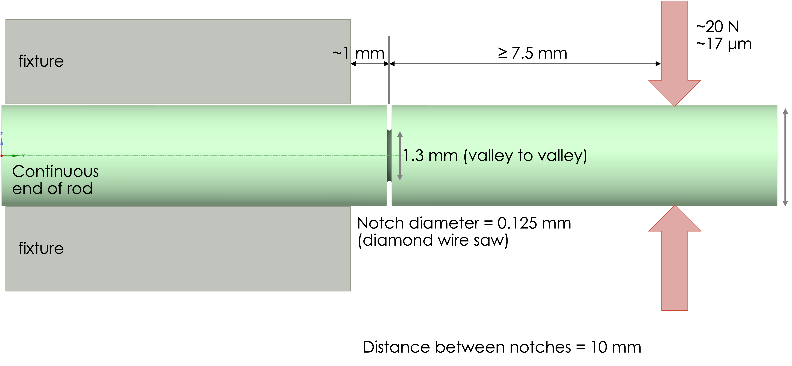
Bend fatigue tests with notched W-cantilever
Notches made with diamond wire saw
  Notch on chosen DPA points with 10 mm spacing
  About 18 data points per each chosen DPA
  Wire diameter: 0.125 mm
  Notch depth: 0.65 mm
Two actuators for fully reversible loads
  Piezo controller has max 75 Vdc excitation: corresponding to 0–30-micron displacement

Slide 21
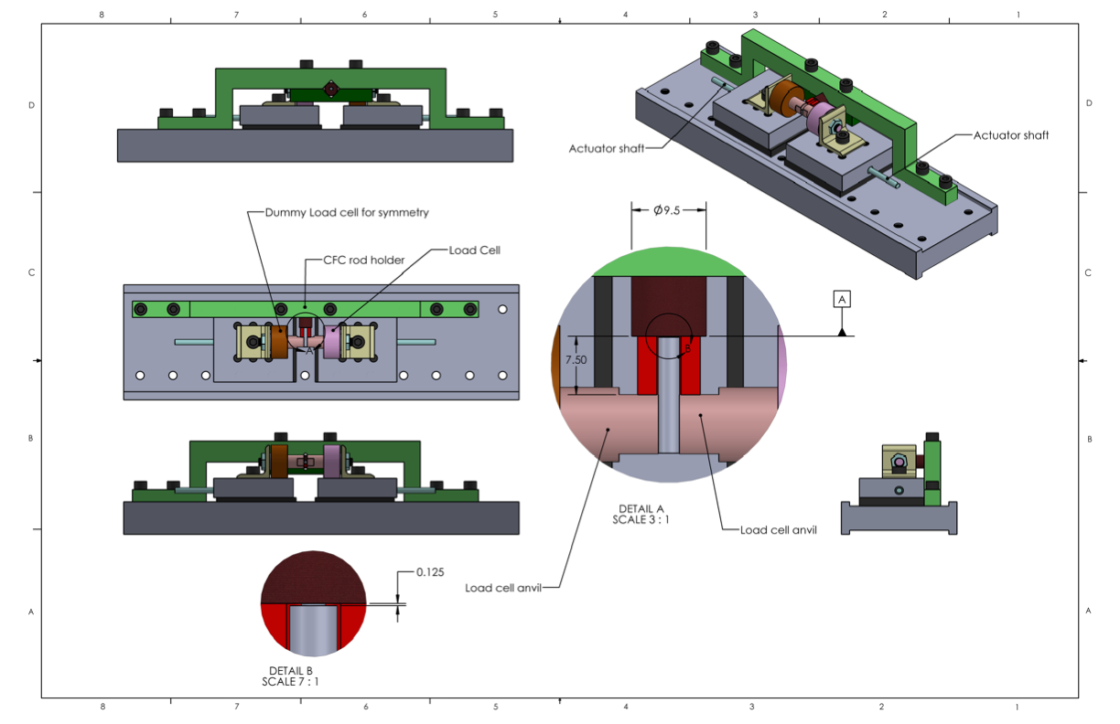
Bend fatigue tests with notched W-cantilever

Slide 22
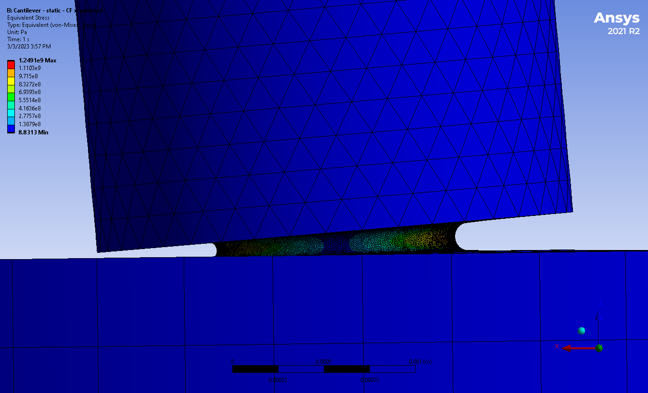
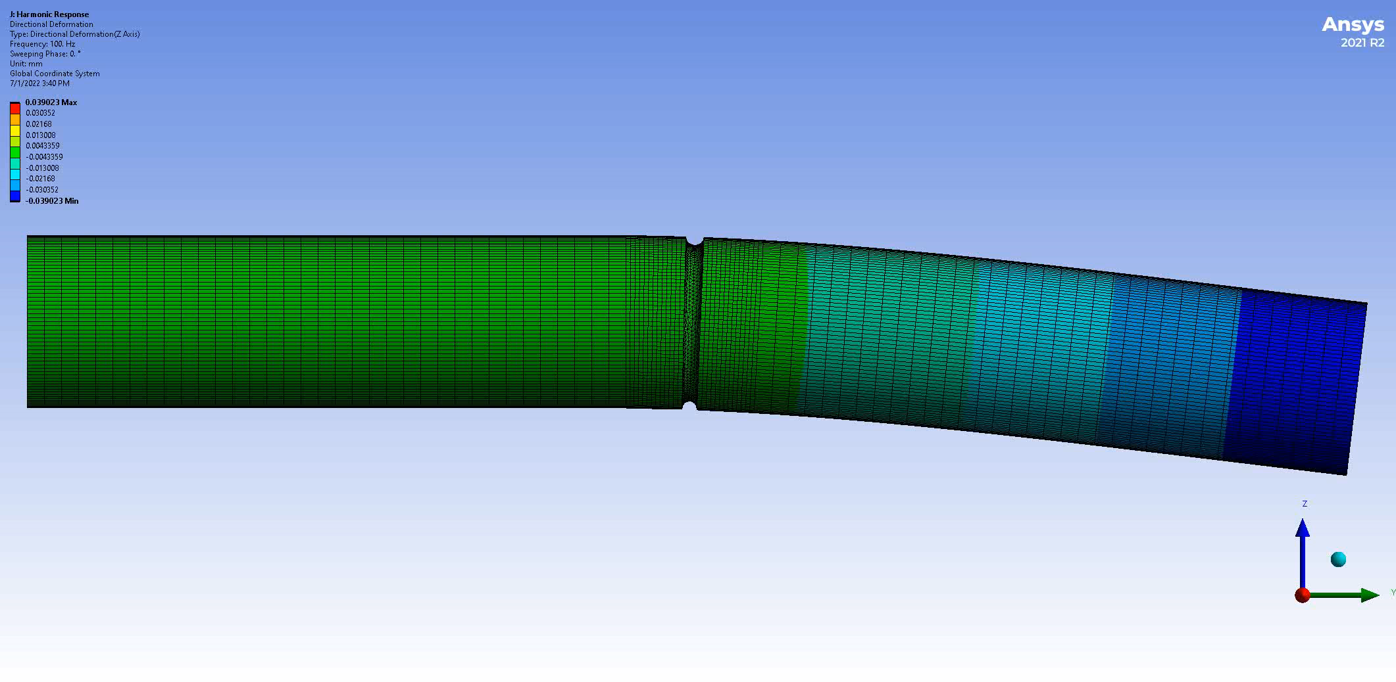
Bend fatigue tests with notched W-cantilever
20 um lateral displacement will yield >1000 Mpa tensile load on the notch

Slide 23
Summary
Characteristics of proton irradiated tungsten in accelerator environment are not well understood
  Radiation induced hardening and embrittlement
    Limited data available
  Radiation induced reduction in thermal diffusivity
    Limited data available
  Radiation induced change of fatigue endurance limit
    Fatigue tests will be performed on proton irradiated tungsten rods from LANSCE
      Notched tungsten cantilever rods with bending loads
      TEM disc sized samples with ball bending loads
Increasing set of PIE data will improve the predictability of high-power tungsten target designs for spallation neutrons and muon productions

