Slide 1
PIP PMG
Project Controls
Elmie Evans-Peoples

Slide 2
Project Controls – Agenda
FY12 Summary
Schedule Modification Process
FY13 Budget Process
RLS Summary
Tracking Progress
Schedule Updates
Budget & Effort Reports
Planned Budget vs Actuals
Going Forward
Notes:
Add FY12 labor and M&S year end, FY12 FTE by category chart (include comment about budget changes thru the year that cause us to redo RLS and the process we have to go thru everytime)

Slide 3
FY12 Summary – RLS Plan vs Actual
Notes:
For this summary slide, make sure I show all divisions even the ones at zero

Slide 4
Schedule Modifications
Strategically match new funding profile and refresh cost estimates
Revised sub-projects w/corresponding manager based on work to complete (FY13 and beyond)
Reviewing PIP labor/M&S needs as a whole and prioritizing resources to meet funding profile and FY13 budget upload allocations
Goal is to complete this effort in the next 2-3 weeks.
Funding Profile ($M)
FY13 | FY14 | FY15 | FY16 | FY17 | FY18
7.017 | 8.7 | 15 | 16 | 16 | 11
Notes:
Maybe add a slide that shows the process for figuring this out
Show what the labor and M&S breakdown is right now FY13 and beyond and mention we’re making progress

Slide 5
Schedule Modification Process
1-2 Weeks
2 Weeks
1 Week
3 Weeks
Strategically delay tasks based on priority due to funding constraints
Verify changes with managers
Upload new estimates & logic
Review cost estimates & logic with managers
Baseline RLS to use for reference in tracking progress
Delay M&S purchases w/lowest priority
Check if meets guidance (apply overhead)
Delay effort w/lowest priority
Check if meets guidance (apply overhead)
We are currently at this point
Notes:
Maybe add a slide that shows the process for figuring this out
Show what the labor and M&S breakdown is right now FY13 and beyond and mention we’re making progress

Slide 6
Current RLS Summary – Schedule Info
WBS | Name | Start | Finish | % Work Complete | M&S Overhead | M&S | FTEs | Labor | Labor Overhead | Total Costs
1 | PIP | Jun-05 | Dec-18 | 16% | $8,286,242 | $40,638,753 | 193.47 | $19,198,318 | $18,430,385 | $86,553,698
1.00 | Program Management | Oct-11 | Dec-18 | 15% | $37,518 | $184,000 | 12.63 | $1,654,217 | $1,588,048 | $3,463,783
1.01 | Linac | Aug-11 | Dec-18 | 7% | $4,461,804 | $21,882,315 | 46.47 | $4,879,677 | $4,684,490 | $35,908,286
1.01.01 | 200MHz RF Power System | Nov-11 | Dec-18 | 3% | $4,263,640 | $20,910,445 | 41.02 | $4,309,984 | $4,137,585 | $33,621,653
1.01.01.01 | High Level RF | Feb-12 | Aug-16 | 10% | $2,978,979 | $14,610,000 | 3.34 | $337,417 | $323,920 | $18,250,316
1.01.01.02 | Linac Modulator | Jan-12 | Dec-18 | 3% | $1,019,774 | $5,001,346 | 37.68 | $3,971,323 | $3,812,470 | $13,804,914
1.01.01.03 | 7835 Procurement | Nov-11 | Aug-14 | 94% | $264,886 | $1,299,099 | 0.01 | $1,243 | $1,193 | $1,566,422
1.01.02 | Accelerator Physics | Aug-11 | May-15 | 24% | $79,470 | $389,750 | 3.81 | $425,919 | $408,882 | $1,304,021
1.01.02.01 | Simulations and Studies | Oct-11 | May-15 | 34% | $0 | $0 | 1.60 | $181,151 | $173,905 | $355,056
1.01.02.03 | Linac Notch Creation | Aug-11 | Dec-14 | 16% | $79,470 | $389,750 | 2.21 | $244,769 | $234,978 | $948,967
1.01.03 | Instrumentation | Aug-11 | May-13 | 67% | $8,156 | $40,000 | 0.56 | $64,734 | $62,145 | $175,035
1.01.05 | Utilities | Nov-11 | Jan-14 | 63% | $110,538 | $542,120 | 1.08 | $79,041 | $75,879 | $807,579
1.02 | Booster | Jun-05 | Sep-18 | 17% | $3,729,522 | $18,290,938 | 130.36 | $12,251,107 | $11,761,063 | $46,032,630
1.02.01 | RF | Oct-11 | Sep-18 | 4% | $3,178,873 | $15,590,355 | 83.73 | $7,244,593 | $6,954,809 | $32,968,631
1.02.01.01 | Anode Supply | Oct-12 | Dec-13 | 0% | $142,730 | $700,000 | 0.60 | $66,613 | $63,948 | $973,291
1.02.01.02 | Bias Supply | Jan-12 | Jul-15 | 4% | $82,172 | $403,000 | 4.62 | $417,943 | $401,225 | $1,304,340
1.02.01.04 | Cavity Test Stand | Jan-12 | Jul-12 | 100% | $0 | $0 | 0.09 | $9,021 | $8,660 | $17,681
1.02.01.05 | Cavity & Tuner Refurbishment | Oct-11 | Apr-15 | 18% | $63,366 | $310,770 | 11.40 | $587,161 | $563,675 | $1,524,972
1.02.01.06 | New Tuners | Oct-11 | Dec-15 | 5% | $443,806 | $2,176,585 | 6.29 | $525,997 | $504,957 | $3,651,345
1.02.01.07 | New Cavities | Oct-11 | Sep-18 | 1% | $2,446,800 | $12,000,000 | 60.40 | $5,613,999 | $5,389,439 | $25,450,238
1.02.01.08 | Cavity 1013 | Dec-11 | Feb-13 | 8% | $0 | $0 | 0.34 | $23,860 | $22,906 | $46,766
1.02.02 | Accelerator Physics | Jun-10 | Sep-16 | 26% | $97,604 | $478,687 | 20.71 | $2,688,898 | $2,581,342 | $5,846,531
1.02.02.01 | Simulations & Studies | Oct-11 | Sep-16 | 19% | $14,273 | $70,000 | 14.83 | $1,903,471 | $1,827,332 | $3,815,076
1.02.02.02 | Alignment & Aperture | Apr-11 | Feb-14 | 48% | $2,039 | $10,000 | 1.10 | $267,474 | $256,775 | $536,288
1.02.02.03 | Booster Notcher | Oct-11 | Nov-14 | 56% | $78,030 | $382,687 | 2.59 | $236,233 | $226,784 | $923,734
1.02.02.04 | Booster Cogging | Aug-11 | Oct-14 | 18% | $1,223 | $6,000 | 1.54 | $211,258 | $202,808 | $421,289
1.02.02.05 | Booster Collimation | Oct-13 | Dec-13 | 0% | $1,020 | $5,000 | 0.31 | $37,482 | $35,983 | $79,484
1.02.02.06 | Radiation Shielding | Jun-10 | Jun-13 | 62% | $1,020 | $5,000 | 0.34 | $32,981 | $31,662 | $70,662
1.02.03 | Instrumentation | Oct-12 | Mar-16 | 0% | $25,895 | $127,000 | 5.38 | $526,729 | $505,660 | $1,185,284
1.02.05 | Utilities | Nov-11 | Dec-14 | 39% | $231,957 | $1,137,600 | 2.82 | $291,658 | $279,992 | $1,941,206
1.02.07 | Solid State Upgrade | Jun-05 | Jul-13 | 71% | $195,193 | $957,296 | 17.71 | $1,499,230 | $1,439,261 | $4,090,979
1.03 | RFQ Injector | Oct-11 | Dec-12 | 82% | $57,398 | $281,500 | 4.01 | $413,317 | $396,784 | $1,148,999
Notes:
Try to make this a process chart
Remove decimals for all except for FTEs

Slide 7
Current RLS Summary – Cost Overview
 | FY13 | FY14 | FY15 | FY16 | FY17 | FY18 | FY19
M&S | $2,782,201 | $5,781,091 | $7,049,507 | $8,720,371 | $10,145,935 | $758,437 | $0
M&S Overhead | $567,291 | $1,178,764 | $1,437,394 | $1,778,084 | $2,068,756 | $154,645 | $0
Total M&S | $3,349,492 | $6,959,855 | $8,486,901 | $10,498,455 | $12,214,691 | $913,082 | $0
Labor SWF | $2,489,561 | $3,347,830 | $3,153,852 | $2,607,813 | $1,669,790 | $2,669,844 | $112,699
Labor Overhead | $2,389,979 | $3,213,917 | $3,027,698 | $2,503,500 | $1,602,998 | $2,563,050 | $108,191
Total Labor | $4,879,540 | $6,561,747 | $6,181,550 | $5,111,313 | $3,272,788 | $5,232,894 | $220,890
Labor FTEs | 26.60 | 34.63 | 31.55 | 22.42 | 16.73 | 27.95 | 1.16
Total Direct Costs | $5,271,762 | $9,128,921 | $10,203,359 | $11,328,184 | $11,815,725 | $3,428,281 | $112,699
Total Overhead Costs | $2,957,269 | $4,392,681 | $4,465,092 | $4,281,584 | $3,671,755 | $2,717,696 | $108,191
Total Costs | $8,229,031 | $13,521,602 | $14,668,451 | $15,609,768 | $15,487,480 | $6,145,977 | $220,890
Funding Guidance | $7,017,000 | $8,700,000 | $15,000,000 | $16,000,000 | $16,000,000 | $11,000,000
Difference | -$1,215,031 | -$4,821,602 | $331,549 | $390,232 | $512,520 | $4,854,023 | -$220,890
Notes:
Try to make this a process chart

Slide 8
FY13 Budget Process
Extract M&S and Labor needs from RLS
Check RLS numbers w/managers
Provide budget sheet to D/S/C
Modify numbers as needed
SWF and M&S w/overhead
FTE % and names
OHAP Role in place of name
D/S/C provide PIP w/labor allocations by FTE%, name and OHAP category/role
Review labor allocations and provide modifications to D/S/C
Provide task codes for allocations to D/S/C
Upload allocations to RLS
Use names and FTE %
Schedule modification process (last steps)
Present FY plan to all stakeholders
Notes:
Try to make this a process chart

Slide 9
FY13 Budget vs RLS Overview
 | RLS Plan | Upload
M&S | $2,782,201 | $1,874,050
M&S Overhead | $567,291 | $853,209
Total M&S | $3,349,492 | $2,727,259
Labor SWF | $2,489,561 | $2,431,324
Labor Overhead | $2,389,979 | $1,858,417
Total Labor | $4,879,540 | $4,016,340
Labor FTEs | 26.60 | 23.28
Total Direct Costs | $5,271,762 | $4,305,374
Total Overhead Costs | $2,957,269 | $2,711,626
Total Costs | $8,229,031 | $7,017,000
High due to overhead to complete SSU.
Low due to special overhead for SSU labor.
Notes:
Try to make this a process chart

Slide 10
Tracking Progress - Monthly Updating Process
Day 1
Dump Data into Template
Distribute Template to Managers
Day 8
Return Templates to L2 Managers
Day 15
Return Templates to Project Controls
Day 22
Complete Schedule Update
1st Wednesday after Update
Present Updated Schedule at PIP Meeting
Save Current Schedule

Slide 11
Tracking Progress – Monthly Update Template
Kiyomi Seiya | 10 |  |  | Enter % Complete |  | ENTER REMAINING DURATION I | 12/1/2012 | ENTER ACTUAL START | ENTER NEW START |  | ENTER ACTUAL FINISH
Task ID | WBS | Task Name | Previous % Complete | Current % Complete | Duration | Remaining Duration | Start | Actual Start | Est New Start | Finish | Actual Finish | Comments/Concerns
2630 | 1.2.2.2 | Alignment and Aperture | 55% |  | 731 d |  | 4/1/2011 |  |  | 2/20/2014
2648 | 0 | FY13 M&S | 0% | #NAME? | 1 d | #NAME? | 10/1/2012 | #NAME? | #NAME? | 10/1/2012 | #NAME?
2760 | 1.2.2.4 | Booster Cogging | 32% |  | 681 d |  | 8/1/2011 |  |  | 4/11/2014
2761 | 0 | Develop FPGA and DSP code for FPGA board | 40% | #NAME? | 330 d | #NAME? | 10/3/2011 | 10/3/2011 | #NAME? | 3/29/2013 | #NAME?
2762 | 0 | Slot 0 card/ ACNET control support as needed | 40% | #NAME? | 420 d | #NAME? | 8/1/2011 | 8/1/2011 | #NAME? | 3/29/2013 | #NAME?
2763 | 0 | Beam studies | 10% | #NAME? | 260 d | #NAME? | 10/3/2011 | 10/3/2011 | #NAME? | 10/11/2012 | #NAME?
2764 | 0 | Control Unit Board | 54% | #NAME? | 167 d | #NAME? | 4/2/2012 | 4/2/2012 | #NAME? | 11/27/2012 | #NAME?
2766 | 0 | Fabricate CAMAC cables and connectors | 50% | #NAME? | 167 d | #NAME? | 4/2/2012 | 4/2/2012 | #NAME? | 11/27/2012 | #NAME?
2768 | 0 | Pull cables for control unit boards installation | 50% | #NAME? | 167 d | #NAME? | 4/2/2012 | 4/2/2012 | #NAME? | 11/27/2012 | #NAME?
2769 | 0 | Install control unit boards | 0% | #NAME? | 10 d | #NAME? | 11/12/2012 | #NAME? | #NAME? | 11/27/2012 | #NAME?
Notes:
delete last two columns can add comments

Slide 12
Tracking Progress – Budget & Effort Reports
Budget Reports
Issued on a monthly basis from AD Headquarters
Used to load M&S actuals into RLS at CTC level
Compare actuals to plan
Help managers track FY spending (M&S)
Effort Reports
Issued on a weekly basis from AD Headquarters
Compare labor effort to plan and verify SWF charges (people reporting appropriately)
Used to determine FTE % to compare to budget allocations to verify PIP receiving labor agreed to
Request more labor when FTE% low

Slide 13
Tracking Progress – Identifying Trends/Issues
FY12 Actual FTEs
FY12 Actual FTEs

Slide 14
Going Forward
Monthly Status Updates
Continue to streamline the process
Provide mechanism for management to analyze data
Create pivot table with all the data to make it easier to analyze the data through charts and graphs by just selecting one’s particular interest
Will require updating on a weekly basis (effort reports are weekly)
Budget and Effort Reports
Cater reports to meet PIP reporting and data analysis needs
Budget Reports will show overhead financial information starting this FY13
Complete Schedule Modifications
Ensure RLS labor and M&S inline with FY13 budget upload and funding guidance in the outer years (focus on FY14)

Slide 16
RLS – Baseline Summary
PIP Baseline Schedule Cost/Labor Summary
WBS | M&S | M&S - OH | FTEs | Labor | Labor - OH
1 PIP | $40,553,583 | $47,853,228 | 182.4 | $29,179,510 | $54,857,478
1.0 Program Management | $0 | $0 | 16.7 | $2,671,819 | $5,023,020
1.1 Linac | $21,564,066 | $25,445,598 | 35.1 | $5,611,315 | $10,549,272
1.1.1 200MHz RF Power System | $20,346,066 | $24,008,358 | 27.6 | $4,419,403 | $8,308,477
1.1.2 Accelerator Physics | $515,000 | $607,700 | 3.8 | $603,206 | $1,134,028
1.1.3 Instrumentation | $40,000 | $47,200 | 2.2 | $356,742 | $670,675
1.1.5 Utilities | $663,000 | $782,340 | 1.4 | $231,964 | $436,092
1.2 Booster | $18,708,017 | $22,075,460 | 126.8 | $20,290,405 | $38,145,962
1.2.1 RF | $16,086,472 | $18,982,037 | 81.6 | $13,060,677 | $24,554,073
1.2.2 Accelerator Physics | $601,790 | $710,112 | 21.1 | $3,379,953 | $6,354,312
1.2.3 Instrumentation | $127,000 | $149,860 | 5.3 | $843,446 | $1,585,679
1.2.5 Utilities | $1,185,820 | $1,399,268 | 2.2 | $347,152 | $652,646
1.2.7 Solid State Upgrade | $706,935 | $834,183 | 16.6 | $2,659,178 | $4,999,255
1.3 RFQ Injector | $281,500 | $332,170 | 3.8 | $605,970 | $1,139,224
PIP Baseline Schedule Major Milestone Summary
Milestone | Schedule Date
12 Hz Operation
15Hz Operation
Double Throughput
> 85% Reliability

Slide 17
Tracking Progress – Quarterly Reports
Quarterly Reports
1st report published in May 2012
Used to inform PIP stakeholders about the project status; budget and schedule

Slide 18
FY13 Budget Process
Using partially updated RLS and input from L3/L4 managers PIP Management provided labor and M&S budget requests to D/S/C as other projects due
D/S/C responded with FTE allocations, corresponding names and SWF; PIP responded with modifications or agreement (iterative process)
Currently updating the RLS; along with modifications mentioned above, to reflect actual labor allocations by D/S/C and M&S approved by AD
Goal is to complete this effort in the next two weeks
Notes:
Try to make this a process chart

Slide 19
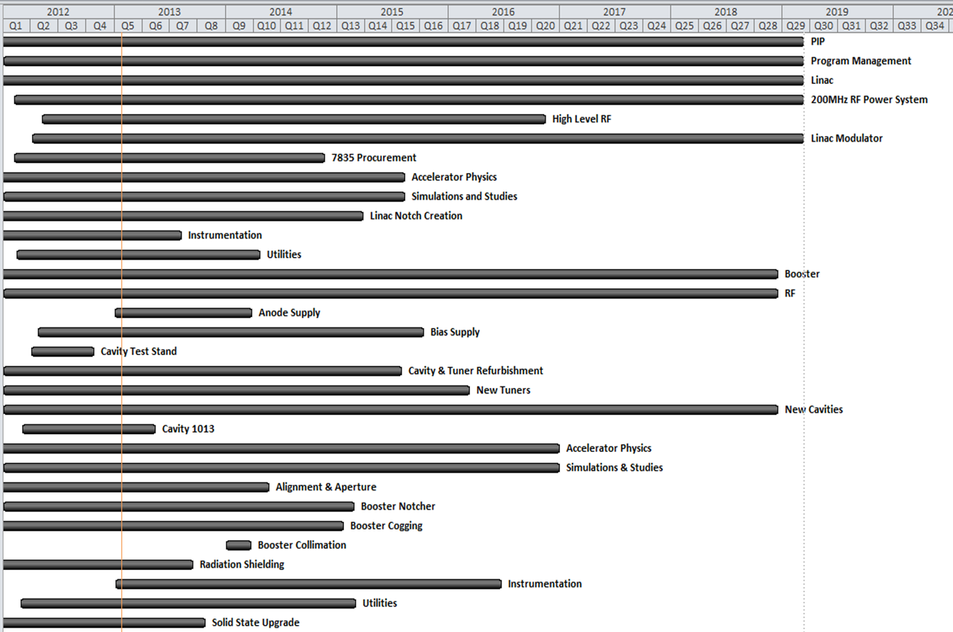
Current RLS Summary – Gantt Chart
Notes:
Try to make this a process chart

