Slide 1
MQXFA12 Bladder Failure - Missing Key NCR
G. Vallone, D. Cheng, P. Ferracin, L. Garcia Fajardo
January 19, 2023
Structure WG: MQFA12 Bladder Failure – Missing Key NCR

Slide 2
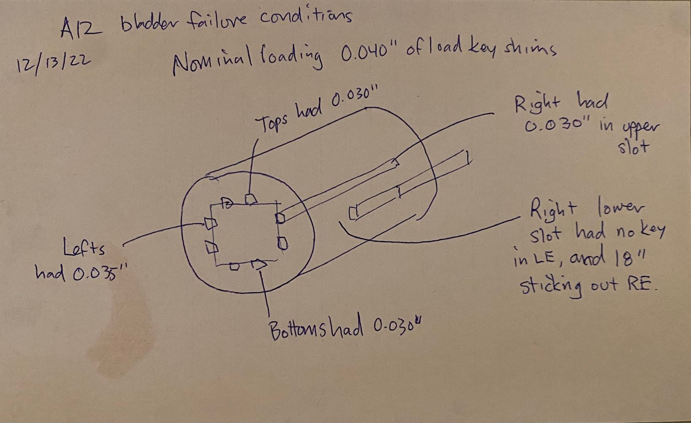
Introduction
Q2
Q1
Bladder failed during MQXFA12 disassembly
Right lower slot had no key in LE, and partially missing key in the RE (0.03” stack)
We want to verify the impact of this configuration on the coil stresses

Slide 3
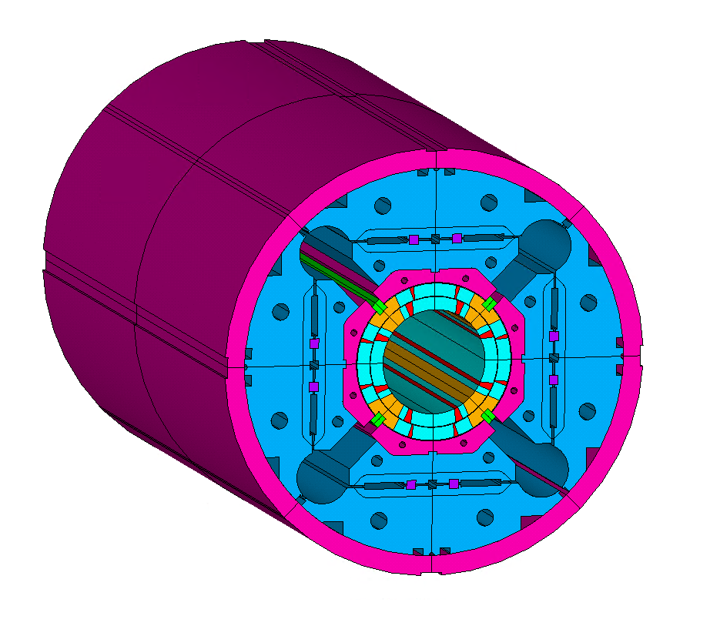
Model Description
3D full ‘extruded’ model
Model is not full length – we simulate only the two shells across the central discontinuity
Simulation in 3 steps:
Nominal loading condition (80 MPa on the pole)
Before bladder operation/key removal
Bladder operation at 28 MPa (right bladders)
Stuck with fully missing key in the bottom right slot
Conservative

Slide 4
Interference Values
Key size variation as ‘offset’ in the FE solution
Initial offset is a function of the actual coil pack size (shimming, coil size, etc.), not considered in FE model
 | Inches | mm | mm FE
Nominal | 0.04 | 1.016 | 0.5
Top | 0.04 | 1.016 | 0.5
Left | 0.04 | 1.016 | 0.5
Bottom | 0.04 | 1.016 | 0.5
Right Top | 0.04 | 1.016 | 0.5
Right Bot | 0.04 | 1.016 | 0.5
PreFailure
 | Inches | mm | mm FE
Nominal | 0.04 | 1.016 | 0.5
Top | 0.03 | 0.762 | 0.246
Left | 0.035 | 0.889 | 0.373
Bottom | 0.03 | 0.762 | 0.246
Right Top | 0.03 | 0.762 | 0.246
Right Bot | 0.03 | 0.762 | 0.246
Failure
 | Inches | mm | mm FE
Nominal | 0.04 | 1.016 | 0.5
Top | 0.03 | 0.762 | 0.246
Left | 0.035 | 0.889 | 0.373
Bottom | 0.03 | 0.762 | 0.246
Right Top | 0.03 | 0.762 | 0.246
Right Bot Front | 0.03 | 0.762 | 0.246
Right Bot Back | 0 | 0 | 0

Slide 5
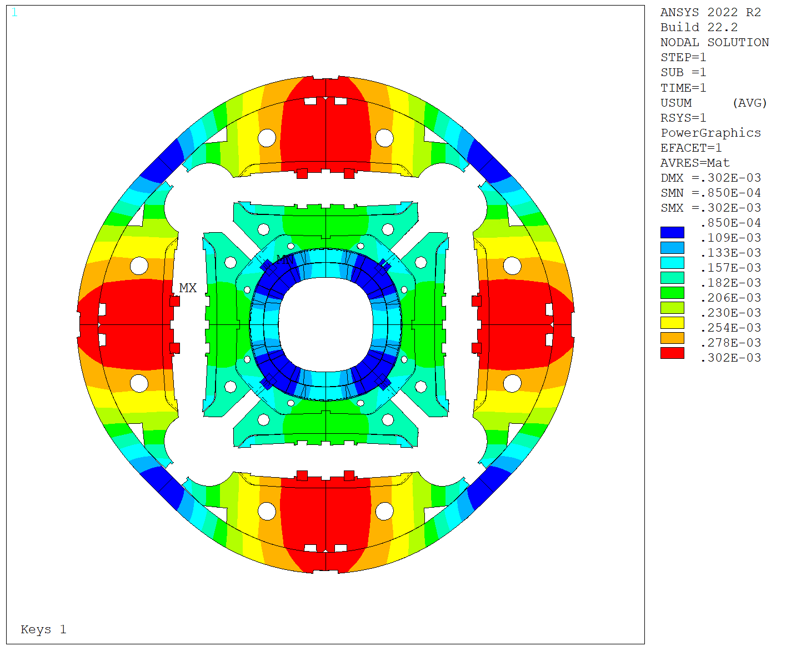
Deformation History
Step 1 - Nominal

Slide 6
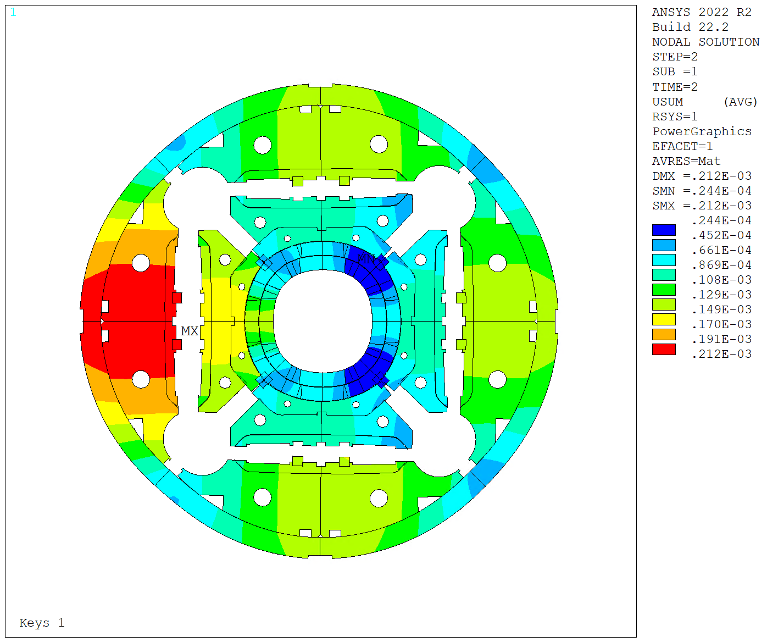
Deformation History
Step 2 – Before bladder operation

Slide 7
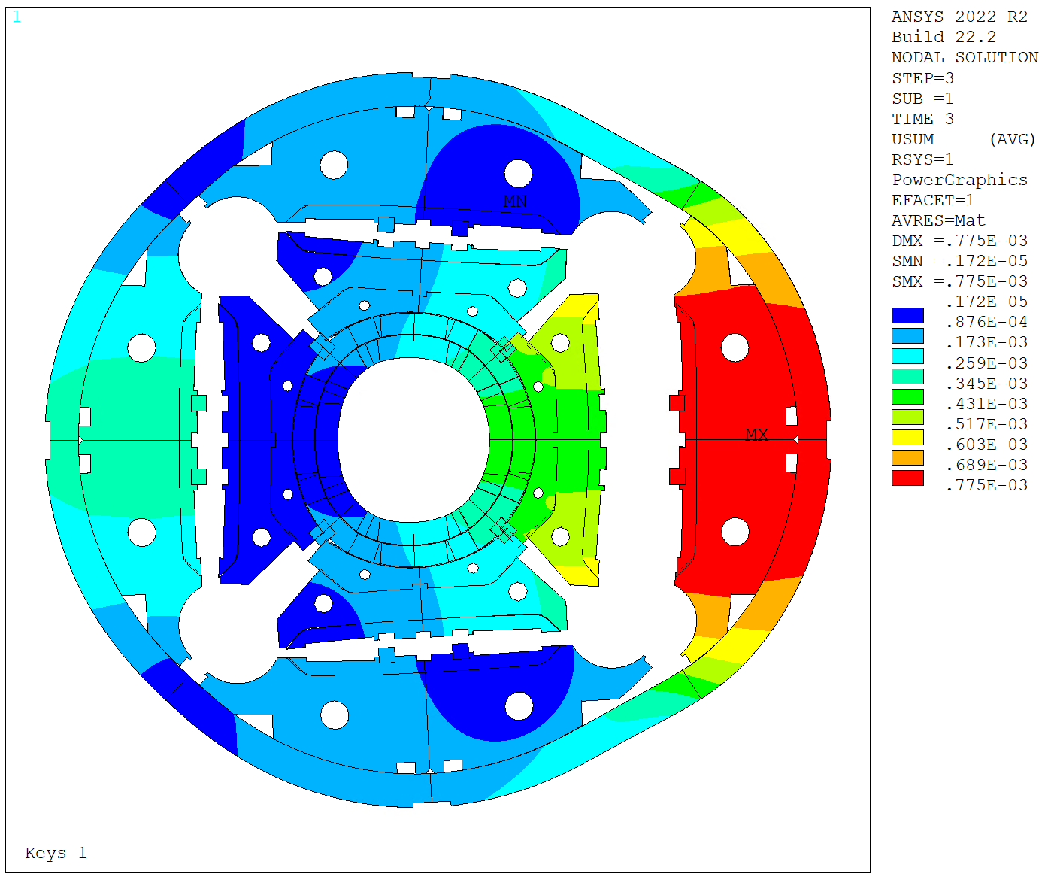
Deformation History
Step 3 – Bladder operation

Slide 8
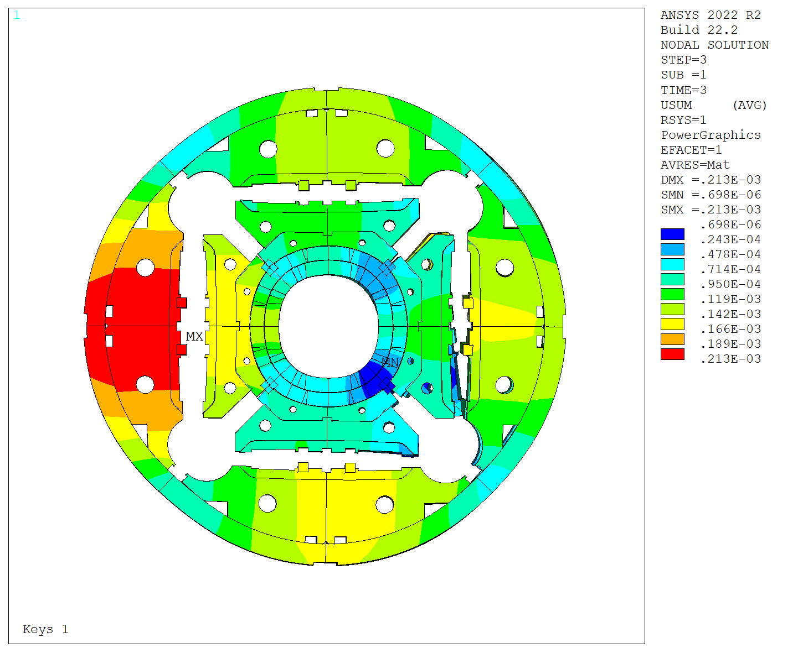
Deformation History
Step 4 – After bladder failure

Slide 9
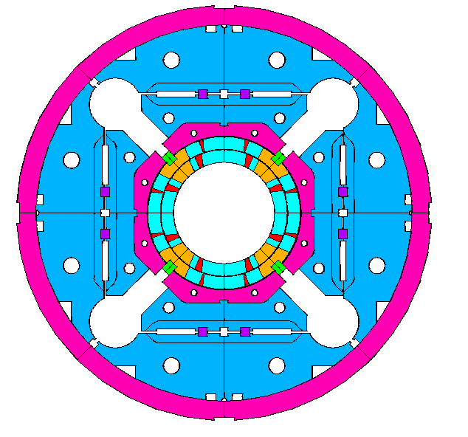
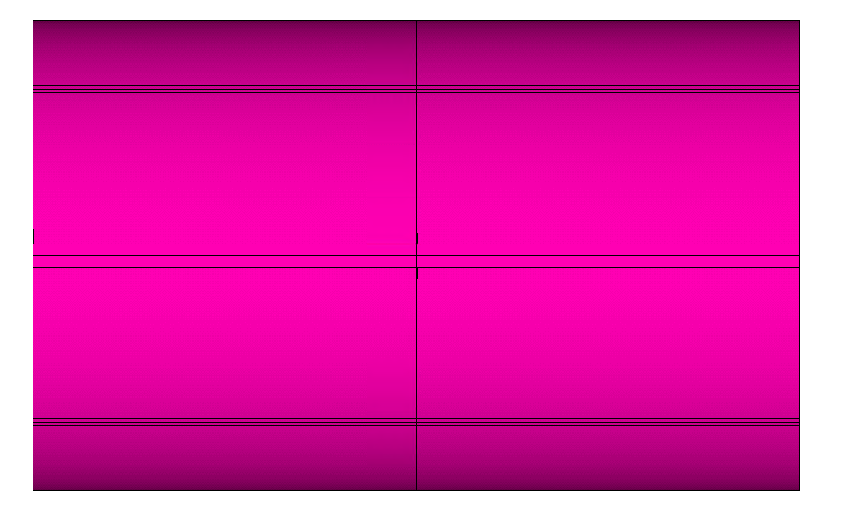
Pole and Shell Stresses
Q2
Q1
z-
Missing key
z+
Q3
Q4
FBG
L = 700 mm
FBG
L = 1900 mm
FBG
L = 3800 mm
LE
RE
Missing key region
L = 2741 mm
Strain Gauges
L = 3989 mm
Virtual and real gauge locations

Slide 10
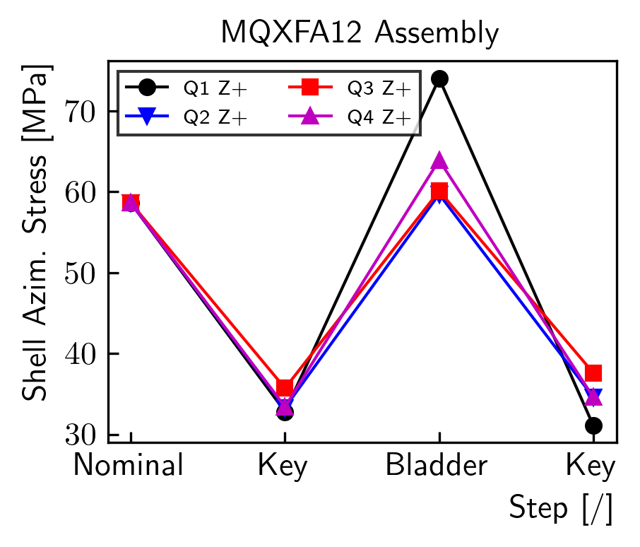
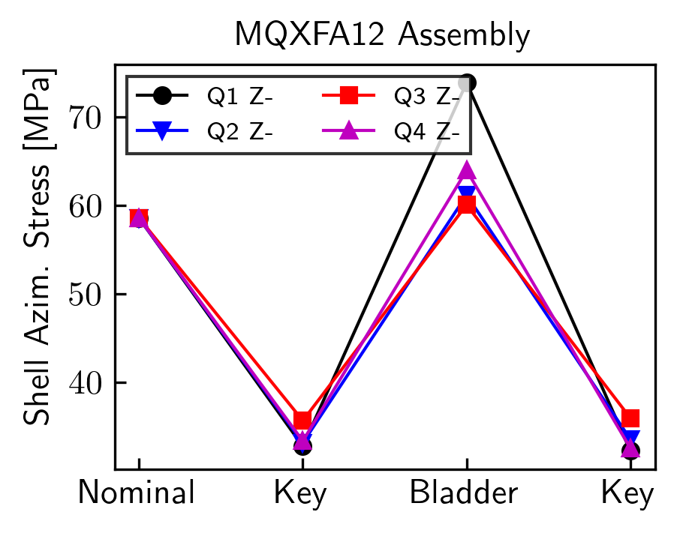
Shell Stresses
Small variations (<2 MPa)
Might be not visible in the strain gauge signals, even if it is a delta

Slide 11
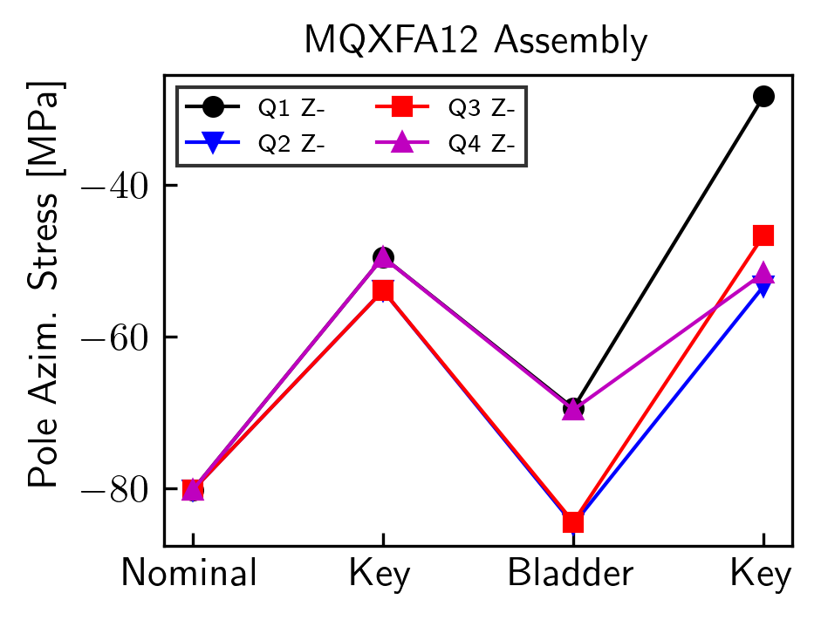
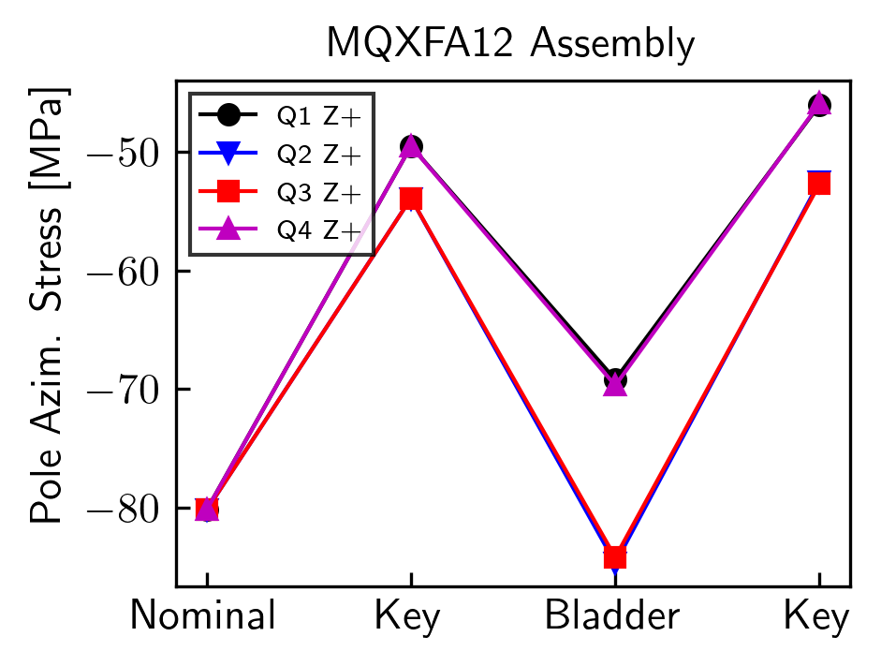
Pole Stresses
No effect on the pole stress for the Z+ side
Stress variation (Q1,2,3,4), between step 2 and 4:
+21.2, 0.6, +7.3, -2.1 MPa
Q1 variation should be visible on the measurements
Q3 also could be visible
Stress increase (compression) negligible

Slide 12
Pole Stresses - Measured
Strain measurements:
Step 1: Nominal
Step 2: Partially unloaded, before bladder failure
Step 3: Bladder operation
Step 4: Key, after bladder failure
No large (20 MPa) effect visible

Slide 13
Comparison
FBG
L = 700 mm
FBG
L = 1900 mm
FBG
L = 3800 mm
LE
RE
Missing key region
L = 2741 mm
Strain Gauges
L = 3989 mm
 | Delta Stress, MPa
 | Q1 | Q2
Model | 21.2 | 0.6
FBG 700 | 3.33 | -2.03
FBG 1900 | 1.18 | -5.46
FBG 3800 | 1.37 | -2.83
FBG on 700 mm and 1900 mm locations should see some effect due to the missing key
Some effect at FBG 700, but much smaller than the model
Probably the model is very conservative

Slide 14
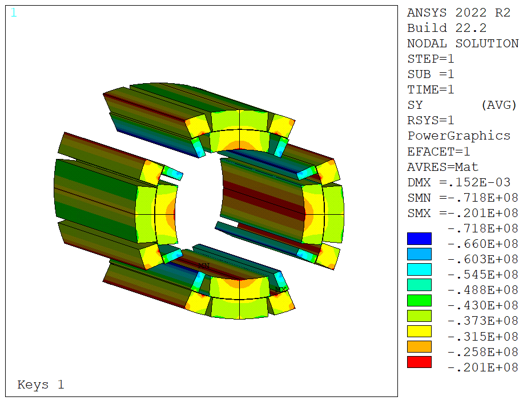
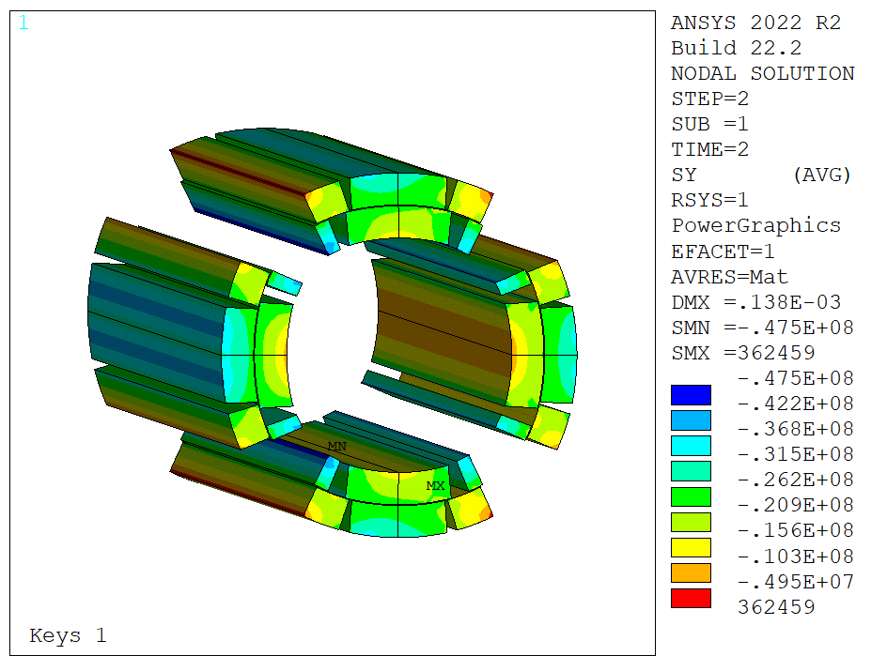
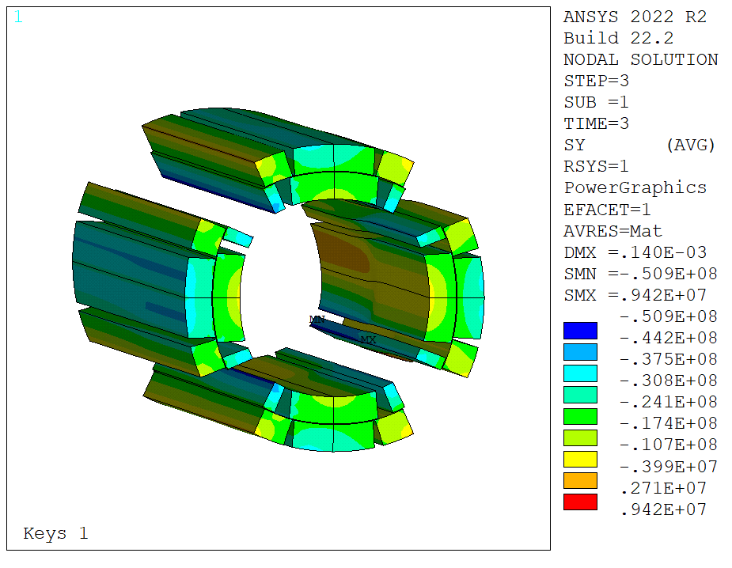
Coil Azimuthal Stress
Increase in coil stress on Q4 coil
From 47 to 51 MPa
Significatively below the ‘nominal’ stress peak (72 MPa)

Slide 15
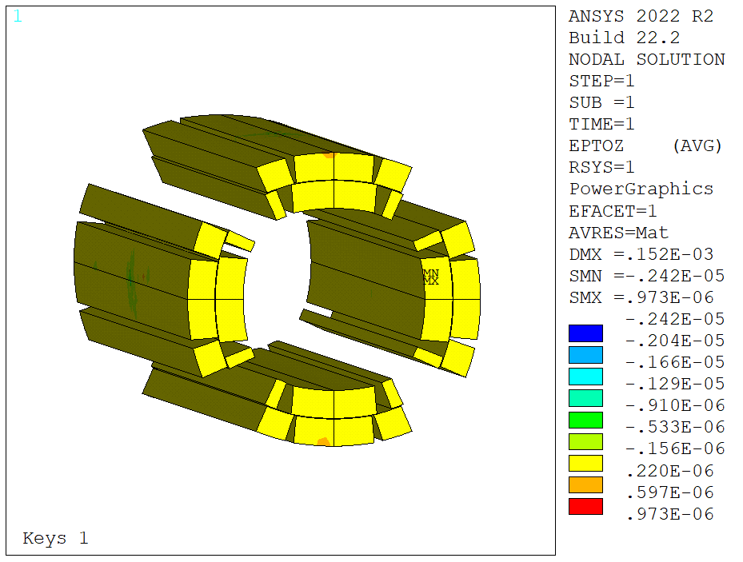
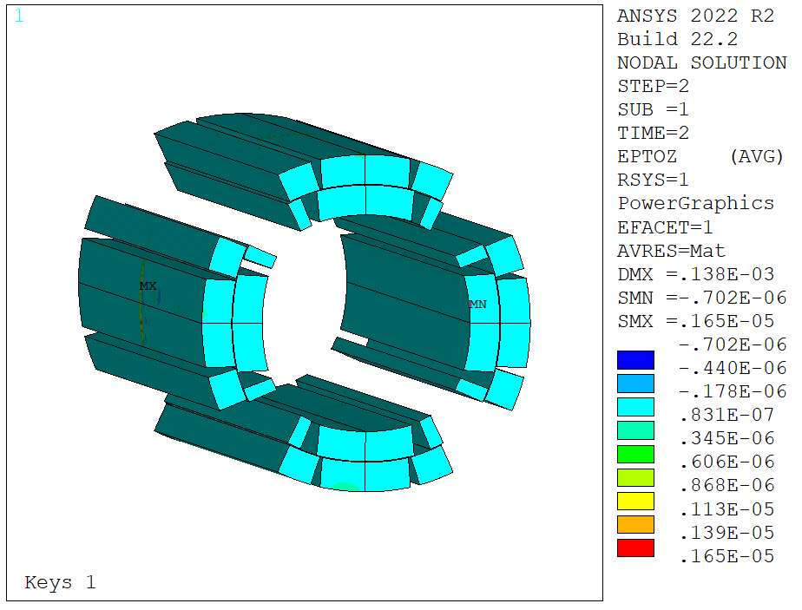
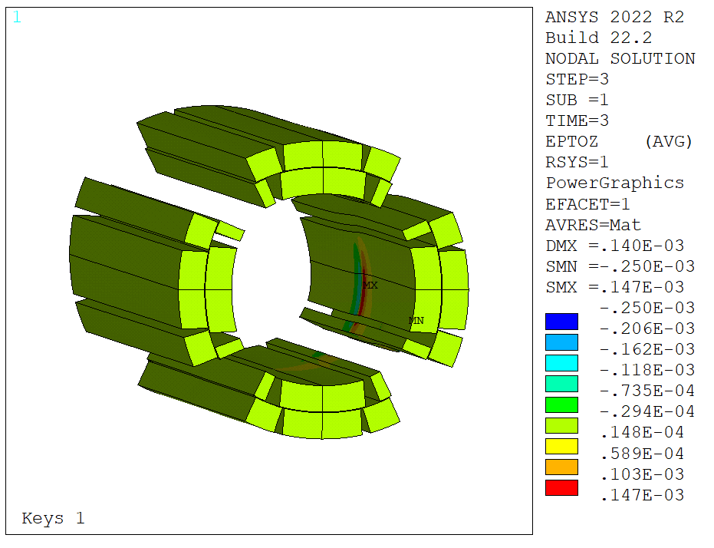
Coil Longitudinal Strain
Long. strain is negligible in the two initial steps
This is not a ‘true’ condition, as the ends are missing
Significant increase after key removal, up to 147 um/m in tension
Far from ‘dangerous’ territory

Slide 16
Conclusion
A FE model of the unloading operation with bladder failure was created
Conservative assumptions were used in order to catch the ‘worst case’ coil stress
Measurements show significantly smaller effect on the coil stress
FE model does not show a dangerous stress/strain increase on the coils

Slide 17
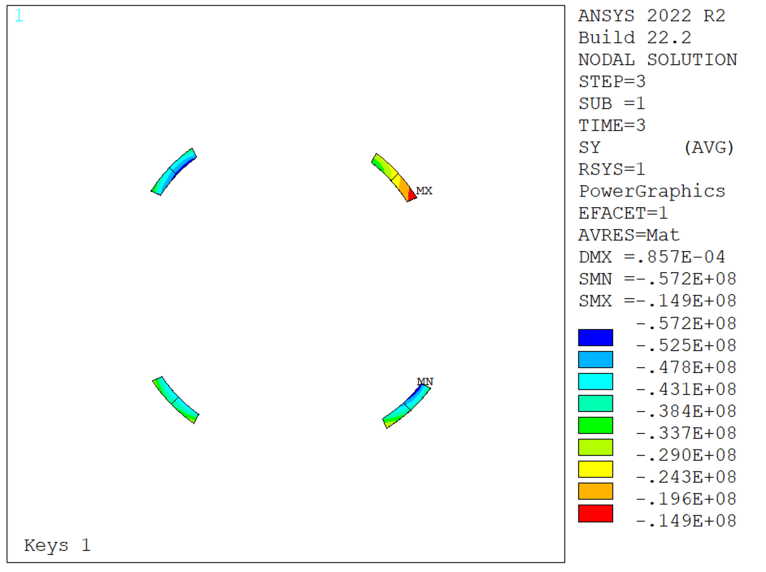
Back-up
FEA raw results

Slide 18
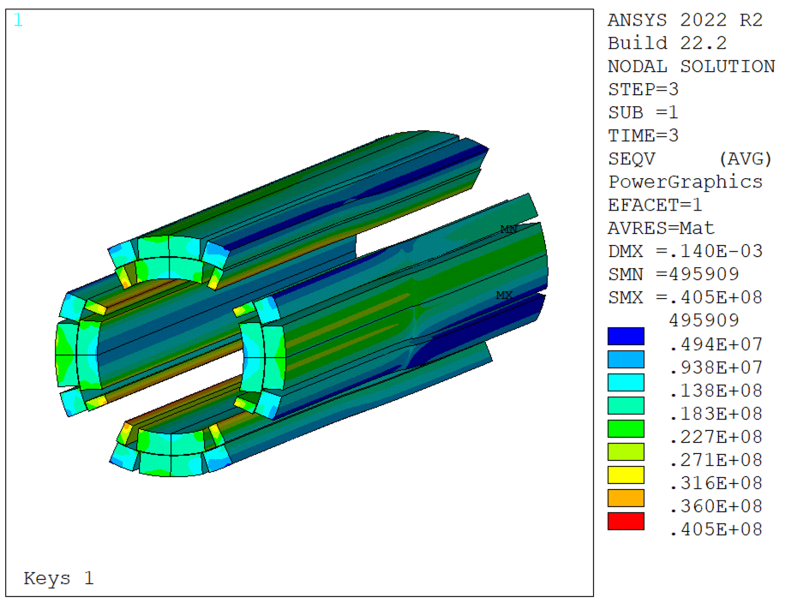
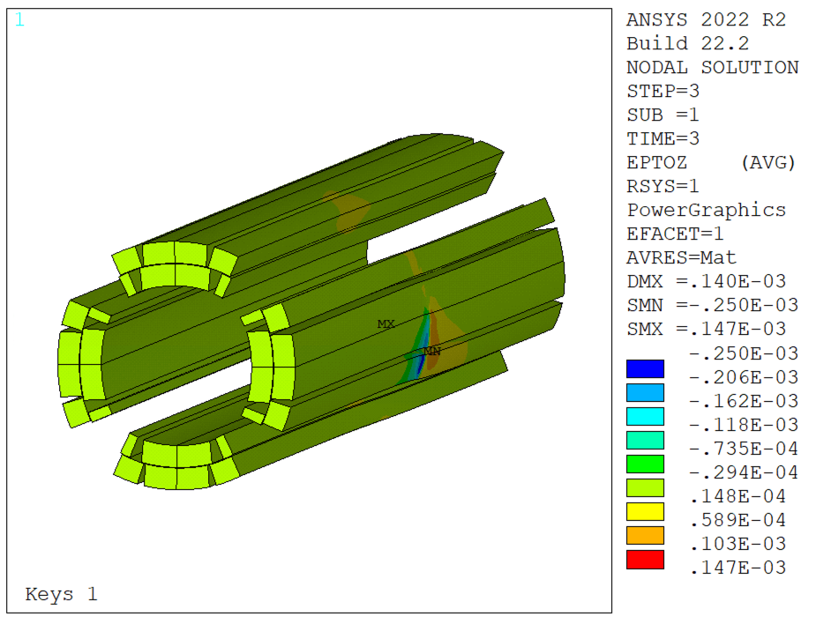
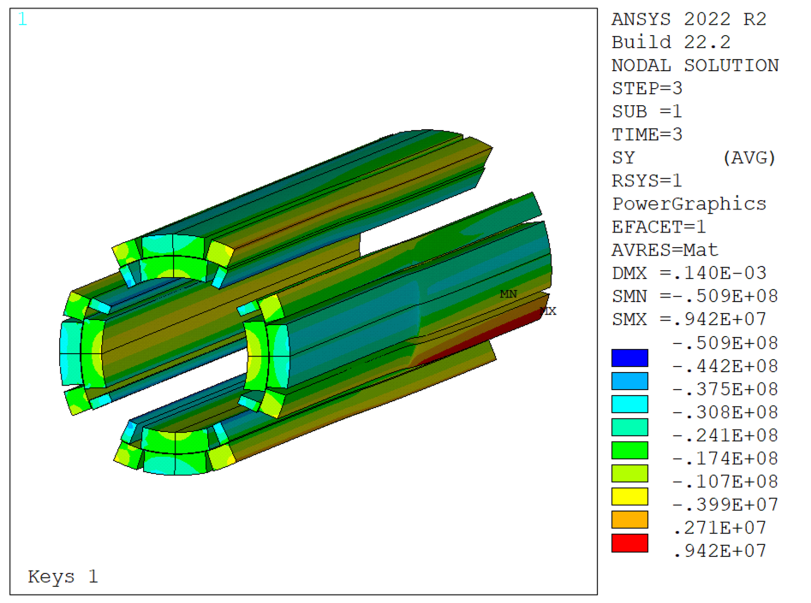
Back-up
FEA results

