Slide 1

News on MQXF magnet assembly
S. Izquierdo, J. Ferradas, P. Quassolo, A. Milanese, N. Lusa, S. Triquet, S. Straarup, M. Guinchard, S. Mugnier, K. Kandemir
… and many more. On behalf of the full MQXF team!
Based on internal report: https://indico.cern.ch/event/1217344/
CERN, 19 January 2023

Slide 2
CONTENTS
MQXFB:
  MQXFB02 Cold test results (Focus on mechanics)
  Highlights on MQXFBMT4 magnet assembly
MQXFS:
  MQXFS7g magnet assembly.
  MQXFS8 magnet assembly.

Slide 3
CONTENTS
MQXFB:
  MQXFB02 Cold test results (Focus on mechanics)
  Highlights on MQXFBMT4 magnet assembly
MQXFS:
  MQXFS7g magnet assembly.
  MQXFS8 magnet assembly.

Slide 4
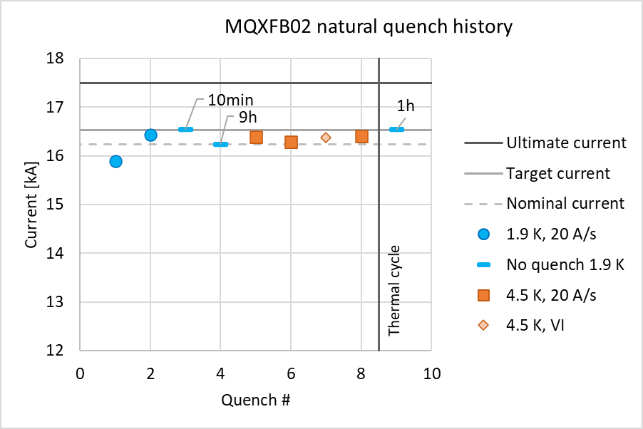
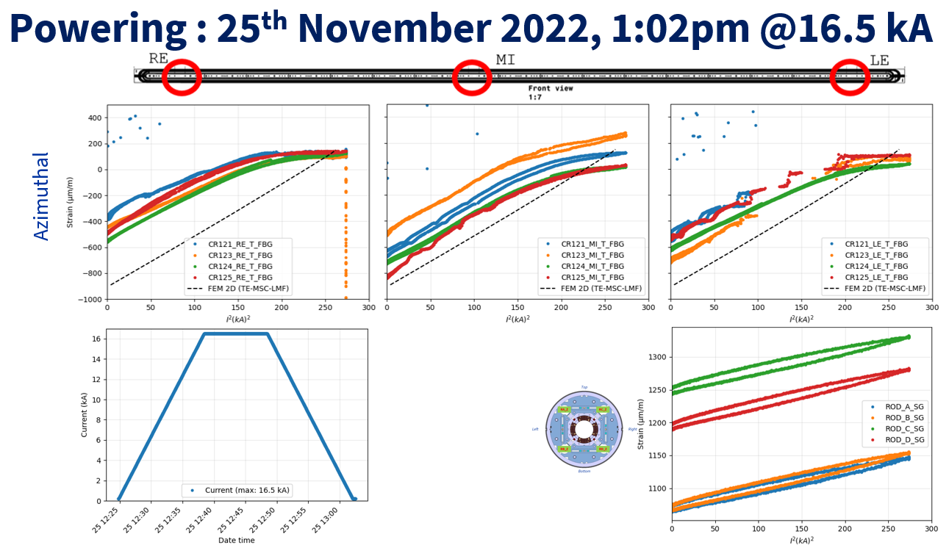
MQXFB02 – Cold tests
100% of the mechanical instrumentation (Optical for coils and Electrical for rods) is working well at 1.9 K and during the powering phases.
See https://indico.cern.ch/event/1213692/
Larger winding pole unloading in LE and RE measurement locations. Consistent with expectations (larger coil size / pre-load in the middle of the coils).
Target pre-load attained. Unloading at ~ 0.9 – 0.95 I_{nom}
M. Guinchard, S. Mugnier and K. Kandemir

Slide 5
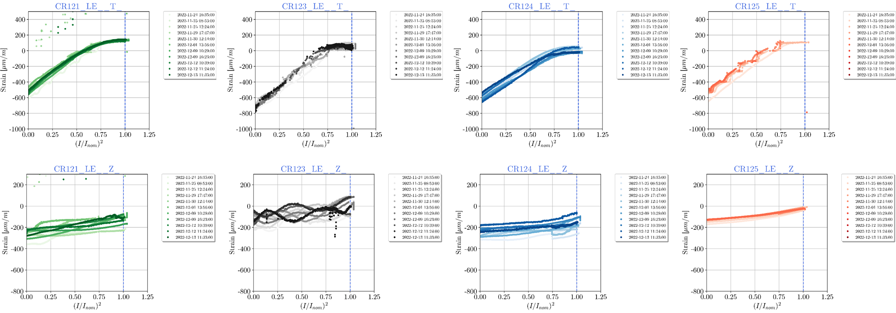
MQXFB02 – Cold tests
Detailed results:
Strain - Lead End
Noise seems an artifact from the holding current. Kinks may be related to the peak tracking. Under investigation.
Wavy z-signal not understood. Also under investigation.
M. Guinchard, S. Mugnier and K. Kandemir

Slide 6
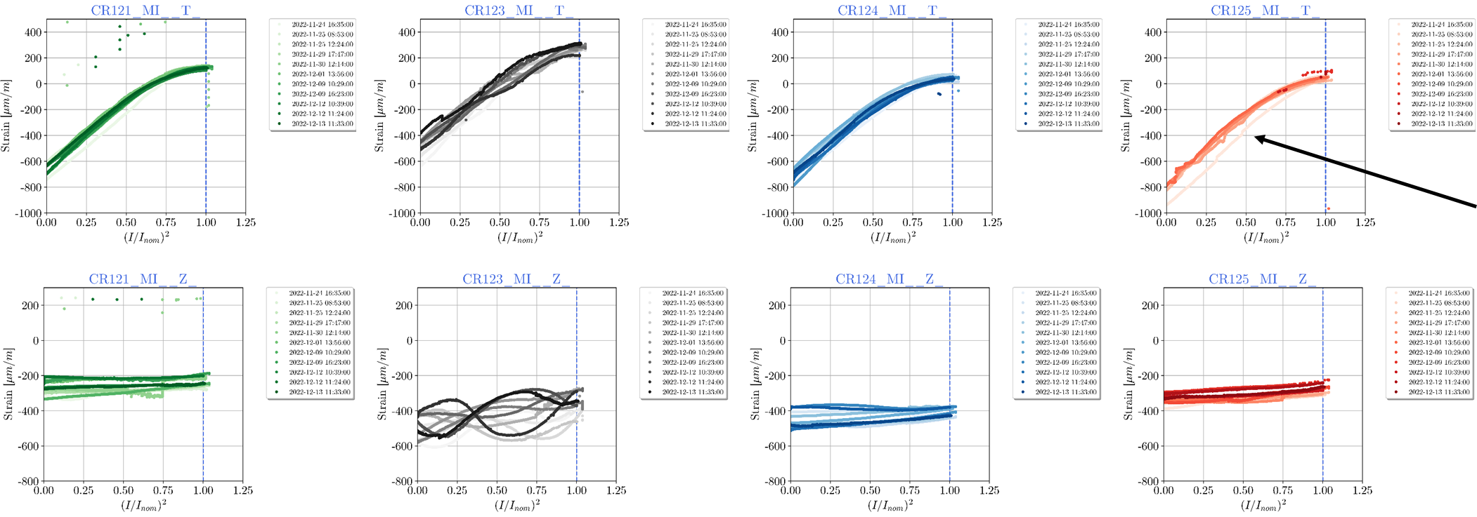
MQXFB02 – Cold tests
Detailed results:
Strain - Center
M. Guinchard, S. Mugnier and K. Kandemir

Slide 7
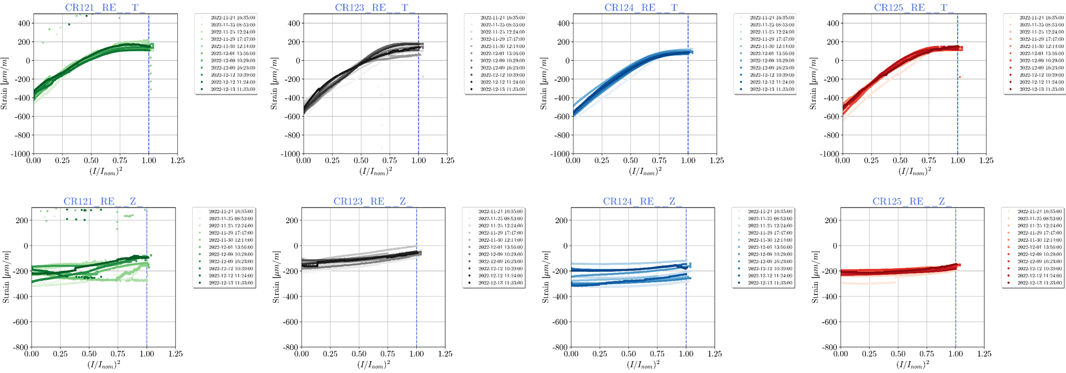
MQXFB02 – Cold tests
Detailed results:
Strain - Return End
M. Guinchard, S. Mugnier and K. Kandemir

Slide 8
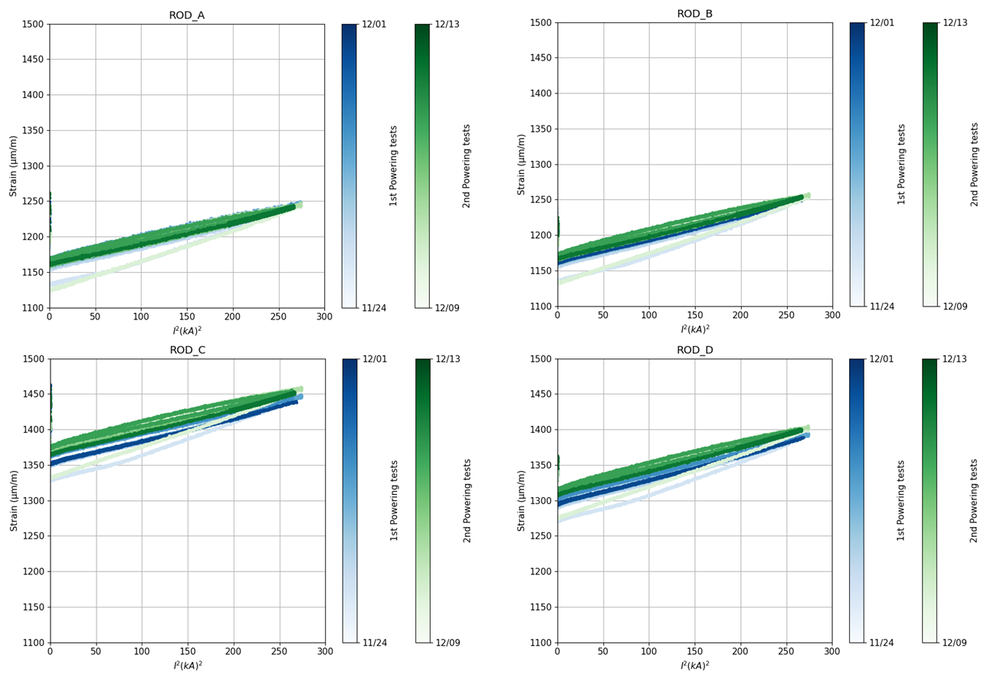
MQXFB02 – Cold tests
M. Guinchard, S. Mugnier and K. Kandemir

Slide 9
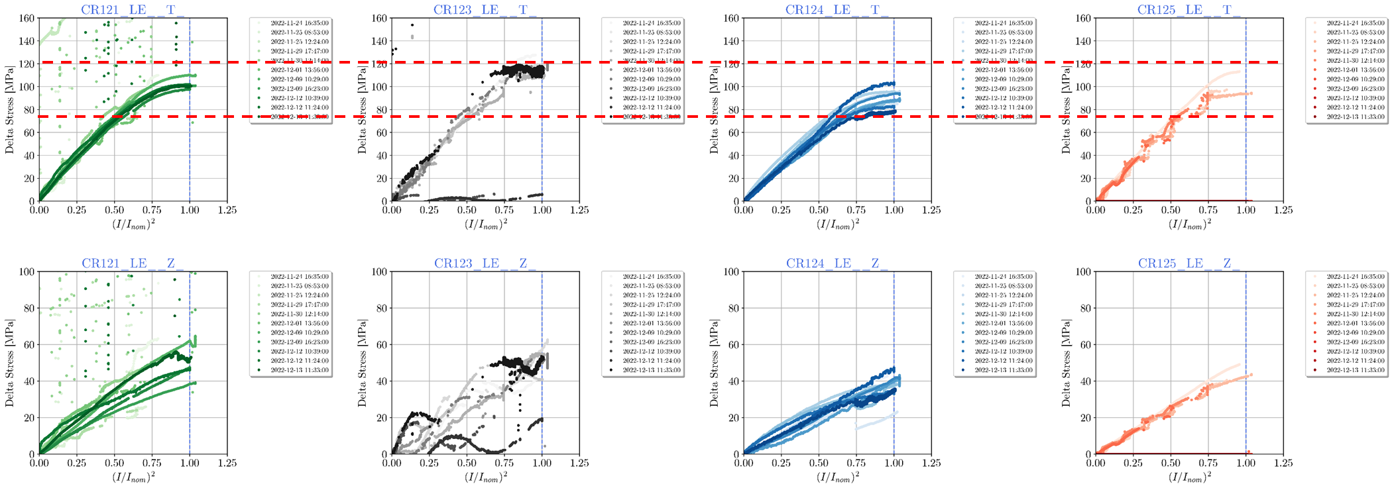
MQXFB02 – Cold tests
 | LE
 | CR121 | CR123 | CR124 | CR125
Avg | 102 | 120 | 91 | 113
Max | 110 | 128 | 102 | 113
Min | 98 | 112 | 78 | 113
 |  | Avg | 98
 |  | Max | 128
 |  | Min | 78
Detailed results:
Stress - Lead End
M. Guinchard, S. Mugnier and K. Kandemir

Slide 10
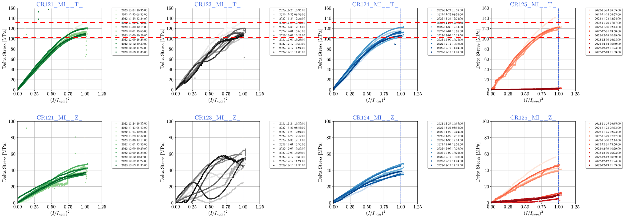
MQXFB02 – Cold tests
 |  | CE
 |  | CR121 | CR123 | CR124 | CR125
 | Avg | 115 | 116 | 111 | 132
 | Max | 128 | 131 | 123 | 142
 | Min | 106 | 107 | 104 | 123
 |  |  | Avg | 115
 |  |  | Max | 142
 |  |  | Min | 104
Detailed results:
Stress - Center
M. Guinchard, S. Mugnier and K. Kandemir

Slide 11
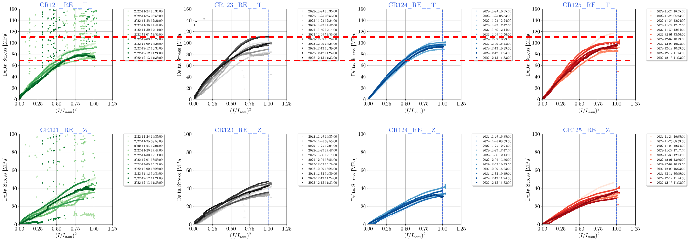
MQXFB02 – Cold tests
 | RE
 | CR121 | CR123 | CR124 | CR125
Avg | 87 | 103 | 97 | 100
Max | 98 | 110 | 105 | 117
Min | 75 | 95 | 89 | 92
 |  | Avg | 98
 |  | Max | 117
 |  | Min | 75
Detailed results:
Stress - Return End
M. Guinchard, S. Mugnier and K. Kandemir

Slide 12
MQXFB02 – Cold tests
Axial rods behaviour at cold in line with MQXFBP3.
Comparison to FE model:
Regarding the magnet cool-down, final rod tension is 15 % lower than expected.
Magnet globally behaves as iron. Rods increase their tension at cold.
What could help to come closer to measurements? Lower friction or lower long. stiffness of the structure.
During energization: larger elongation than predicted by the numerical model. Still, this is very low, in terms of electromagnetic forces we see 5% of F_{z} during powering vs 2% we expect to see based on ANSYS.
What could help to come closer to measurements? Lower friction or lower long. stiffness of the structure.
 |  | Δ Rod Strain CD | Δ Rod Strain 16.23 kA | Δ Rod Strain CD | Δ Rod Strain 16.23 kA
 |  | FEM | FEM | [µɛ] | [µɛ]
 |  | [µɛ] | [µɛ]
Magnet | MQXFBP1 | 670 | 35 | 452 | 70
 | MQXFBP2 |  |  | 461 | 55
 | MQXFBP3 |  |  | 517 | 75
 | MQXFB02 |  |  | 571 | ~ 75

Slide 13
CONTENTS
MQXFB:
  MQXFB02 Cold test results (Focus on mechanics)
  Highlights on MQXFBMT4 magnet assembly
MQXFS:
  MQXFS7g magnet assembly.
  MQXFS8 magnet assembly.

Slide 14
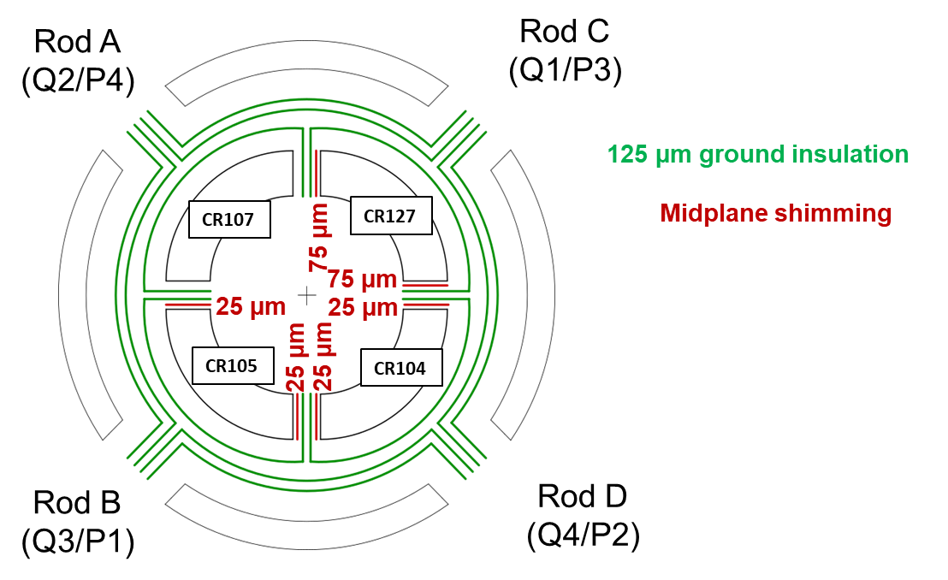
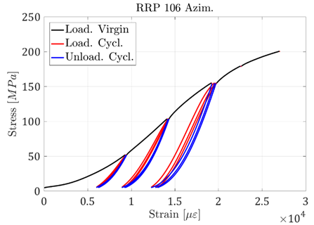
MQXFBMT4 – Assembly
MQXFBMT4 assembled with 3 (non-virgin) coils from MQXFBP1 and CR127 (Virgin).
Shimming plan defined based on the virgin coil measurements for all coils, targeting for the best geometrical compensation at cryogenic temperature. We assume a consistent decrease in size for the new coil.
Let’s consider it as BP1
After disassembly
G. Vallone, M. Guinchard et al.

Slide 15
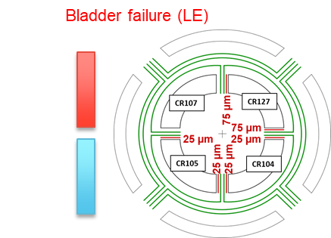
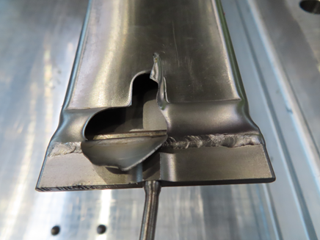
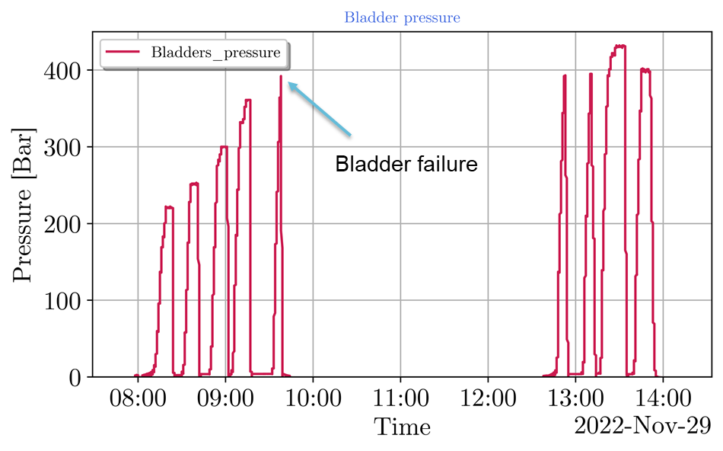
MQXFBMT4 – Assembly
Coilpack centering performed successfully (all operations went smoothly).
Magnet pre-loading (as well) smooth up to the insertion of the 13.7 mm loading keys.
Then, bladder failure occurred at 390 bar, when preparing for the insertion of the last 13.8 mm keys.
  All 13.7 mm keys were in place at the moment of the failure. All bladder circuits were connected ensuring continuity along the magnet longitudinal axis.
  Failure mode indicate that the bladder was out of the masters (not supported). Positioning was checked before starting the loading. A second bladder was replaced preventively for the same reason.

Slide 16
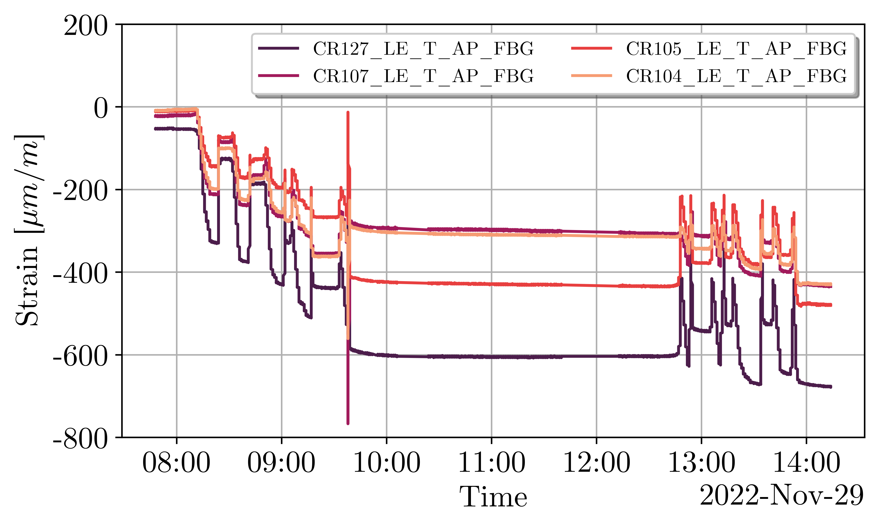
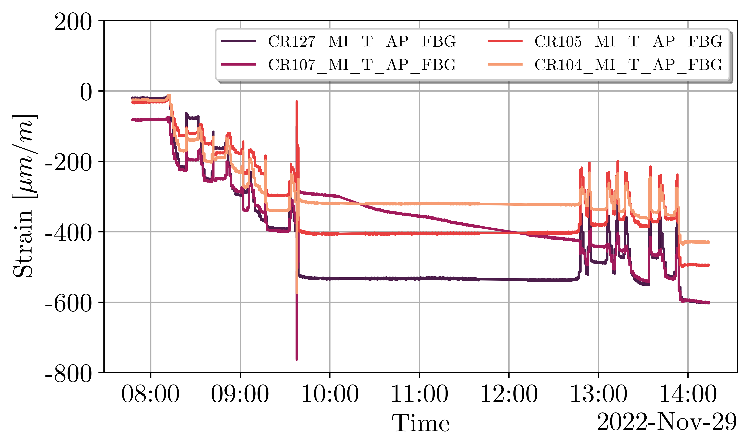
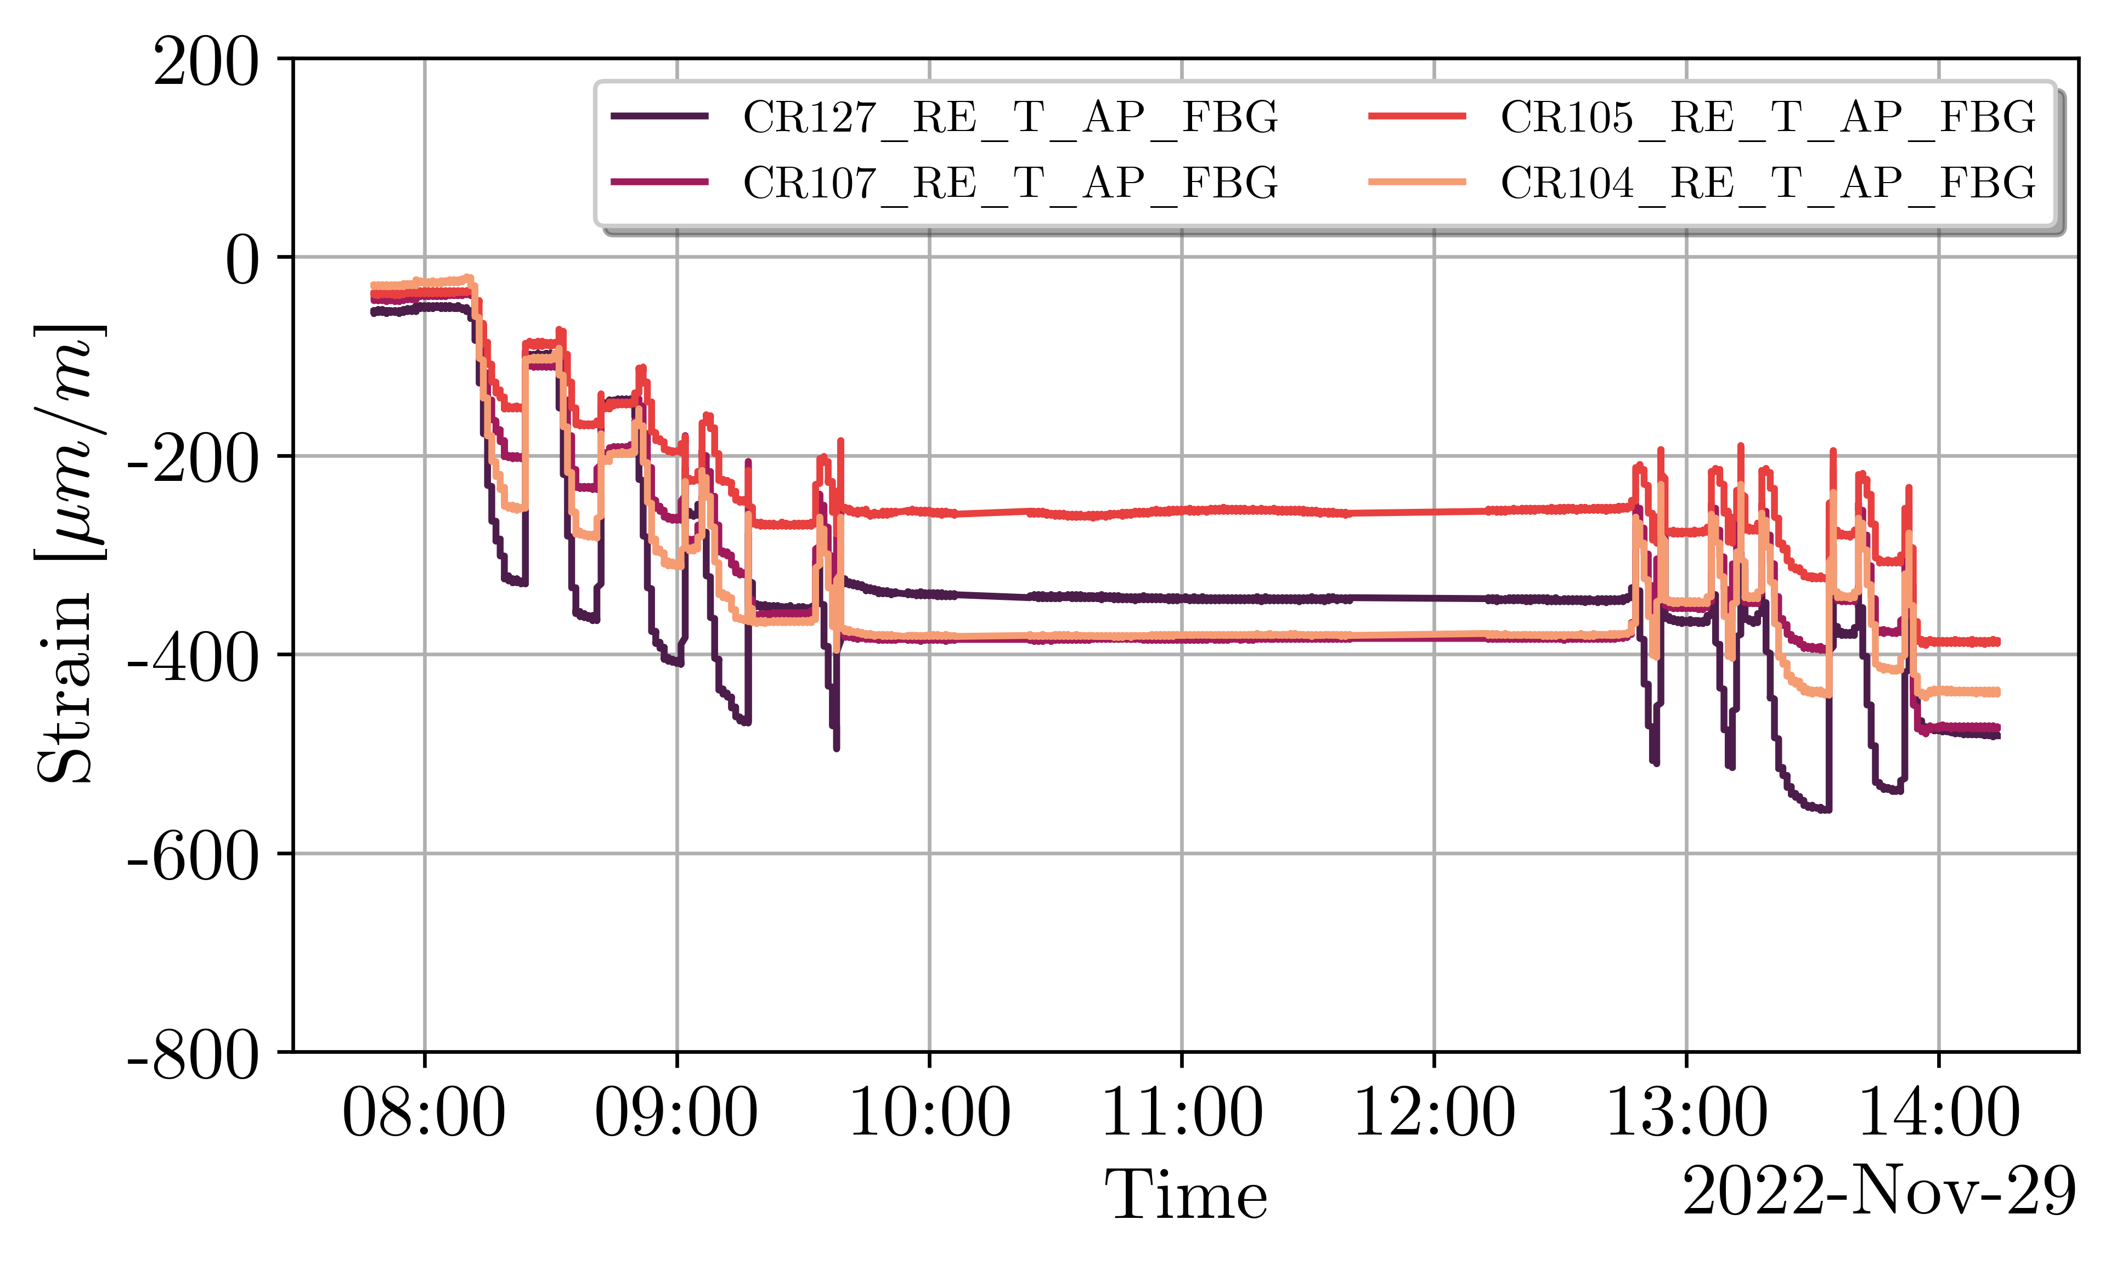
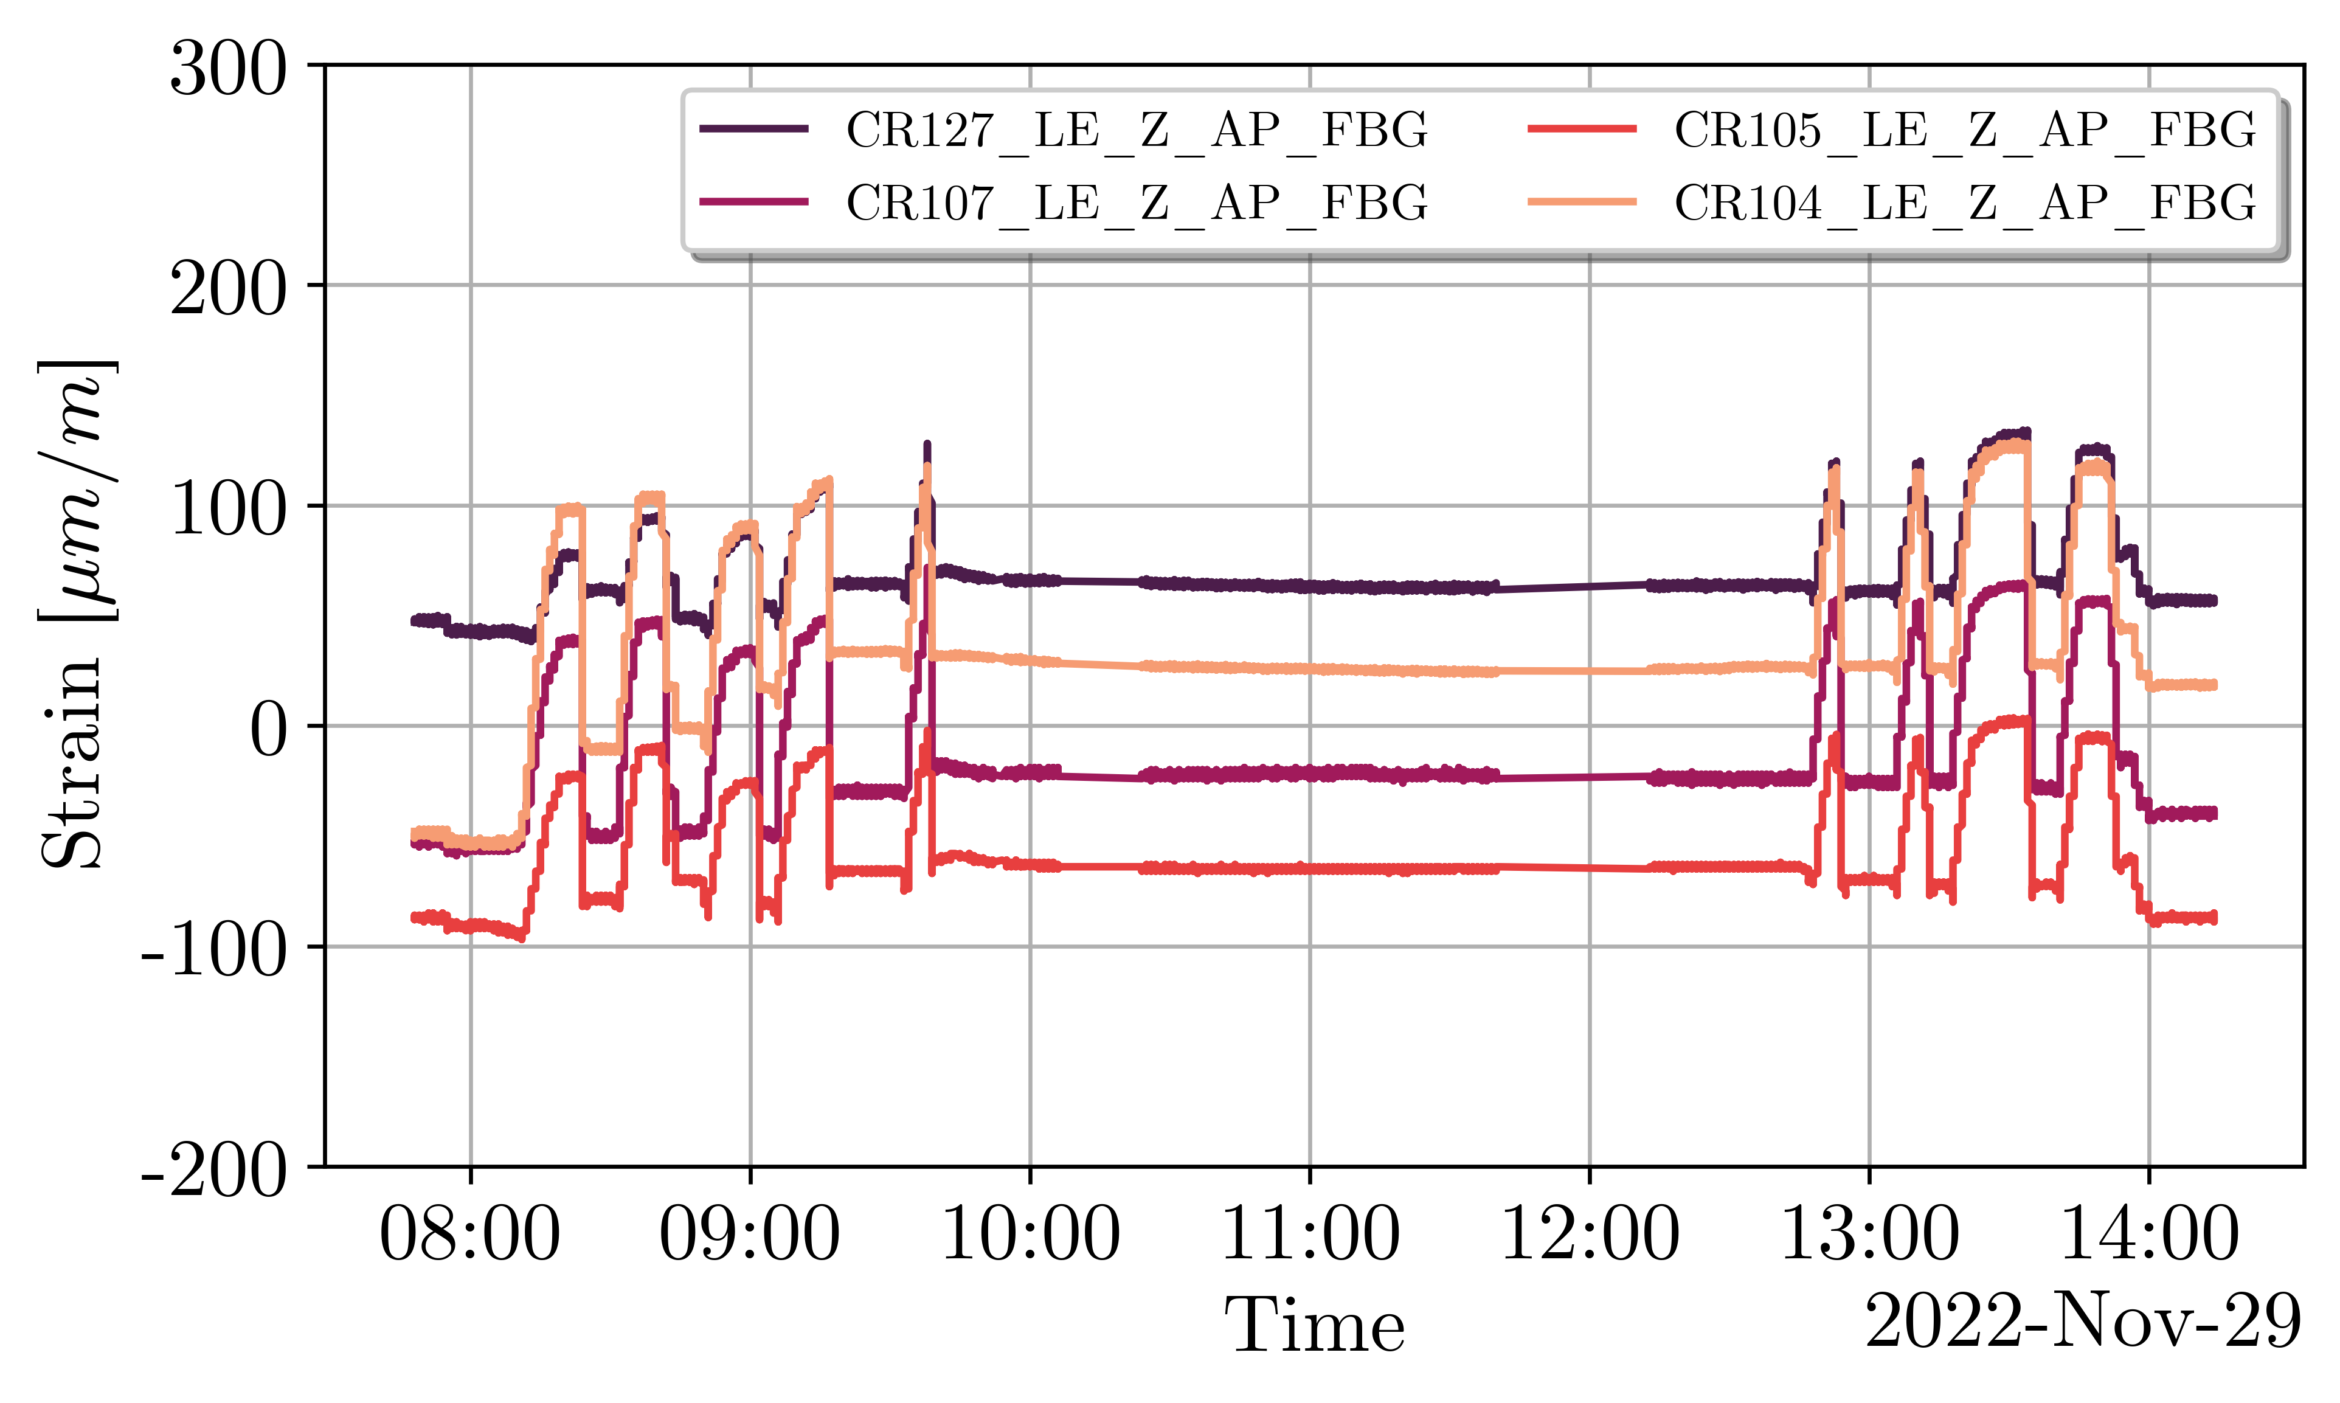
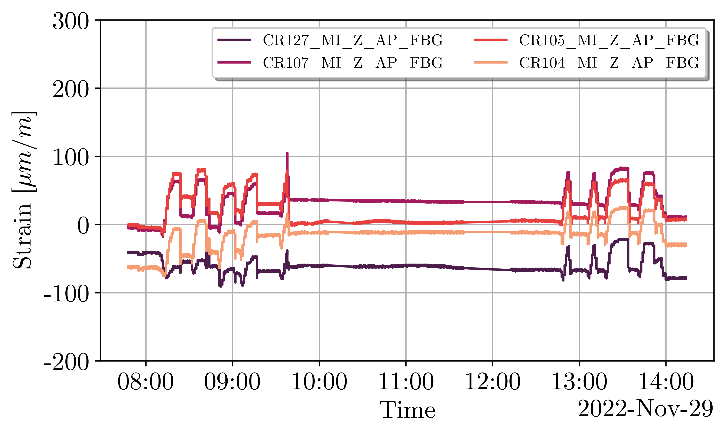
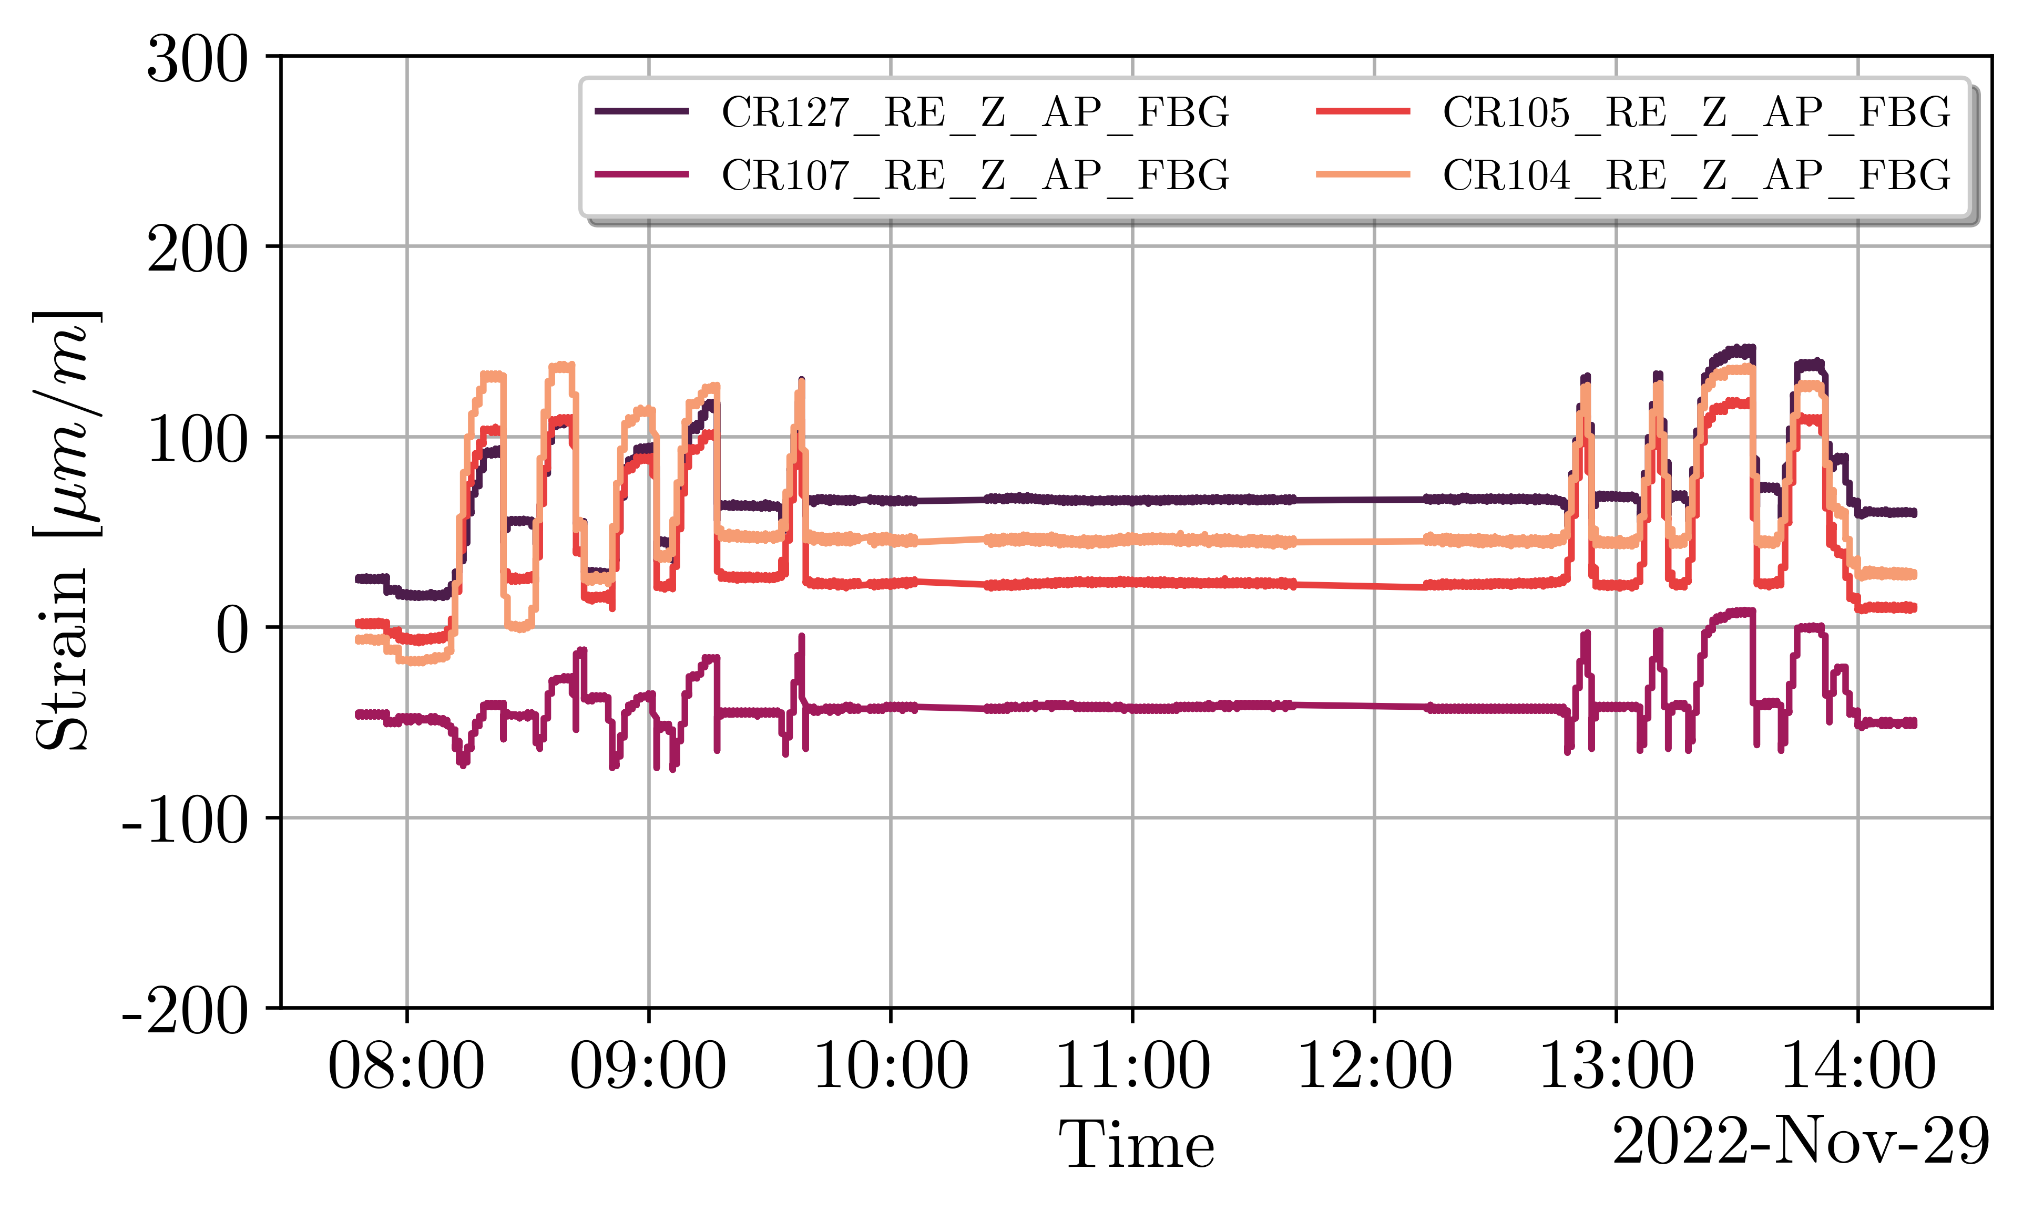
MQXFBMT4 – Assembly
Fast mechanical transient as a result of the sudden (and local) drop in pressure.
  Increase in comp. az. strain for CR107 and CR104 (diametrically opposite). Inverse effect for CR127 and CR105. Nothing seen on the RE side, covered by a different bladder.
  The strain/spread among coils increases (up to a factor of 2 in the MI station) after the failure.
LE - ε_{θ}
MI - ε_{θ}
RE - ε_{θ}
Bladder failure
LE - ε_{z}
MI - ε_{z}
RE - ε_{z}
M. Guinchard, S. Mugnier, K. Kandemir

Slide 17
MQXFBMT4 – Assembly
Non-Conformity report for the bladder failure in EDMS 2803022.
Two bladder cycles up to 390 bar performed upon restart of the pre-loading operations. Half of the created imbalance among coils could be recovered (see previous slide).
Loading completed with the insertion of 13.8 mm keys. Magnet is within specifications except for the coil peak stress. The latter happens in CR107, which has already seen larger stress values during MQXFBP1 assembly and cold test.
  Average shell stress (three stations): 58 MPa - Target: +58 ± 6 MPa
  Average coil stress (winding pole, three stations): -71 MPa - Target -70 ± 10 MPa
  Peak coil stress (winding pole, three stations): -107 MPa - Target -100 MPa

Slide 18
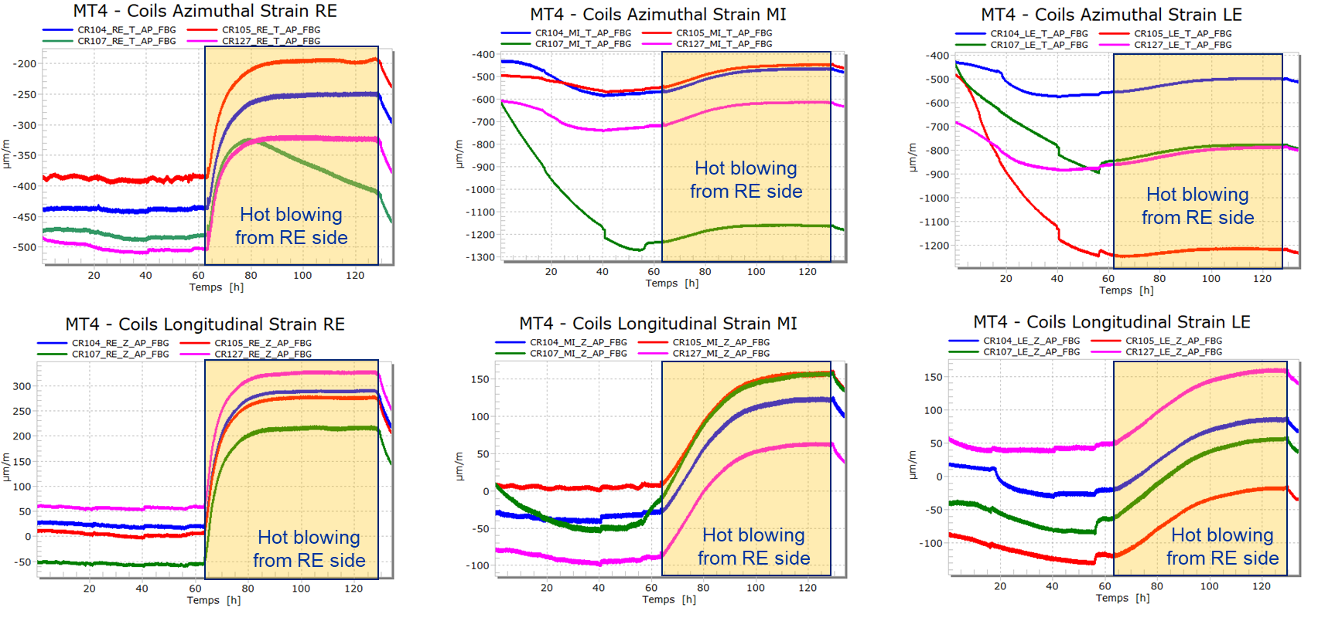
MQXFBMT4 – Assembly
As in MQXFBP1 and MQXFBMT2, a large drift in the FBG strain measurements follows after finishing the magnet pre-load (already seen during the break at lunch time, previous slide).
M. Guinchard, S. Mugnier, K. Kandemir

Slide 19
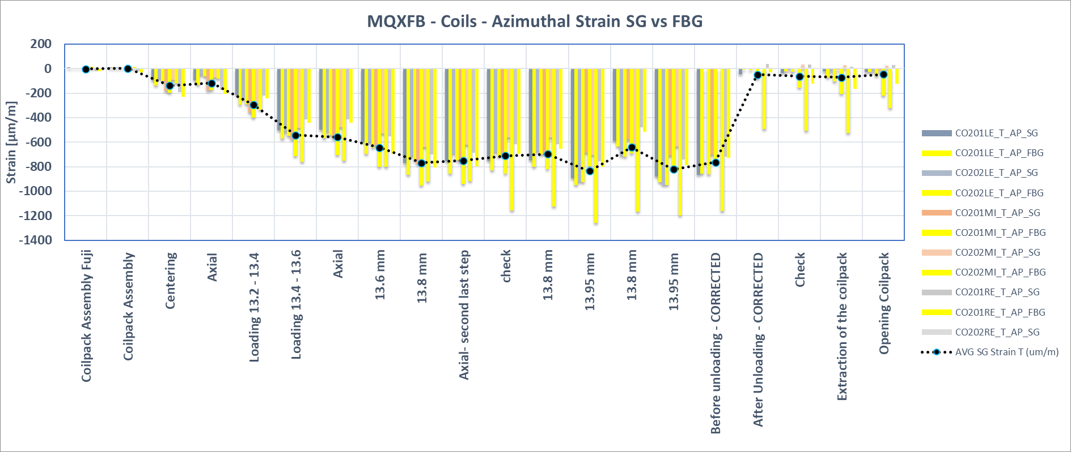
MQXFBMT4 – Assembly
In MQXFBMT2 it was proven that such a drift only happened for FBG (SGs, also present, were stable). Once unloaded, the offset remained in the strain readings.
Drift does not happen after bladder failure in short models. Inhomogeneous FBG loading along the length?
Interestingly, both in BP1 and MT4 the strain stabilizes at the same value. To be continued…
MQXFBMT2
M. Guinchard, S. Mugnier, K. Kandemir

Slide 20
MQXFBMT4 – Assembly

Slide 21
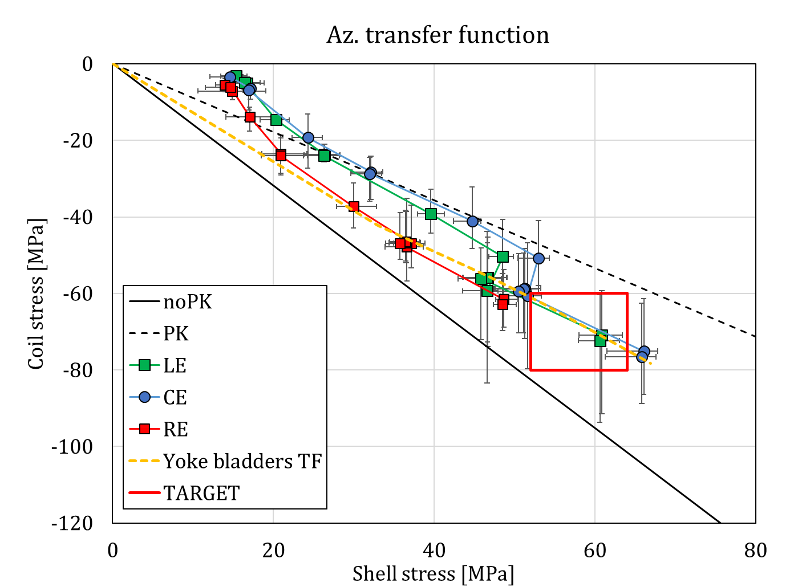
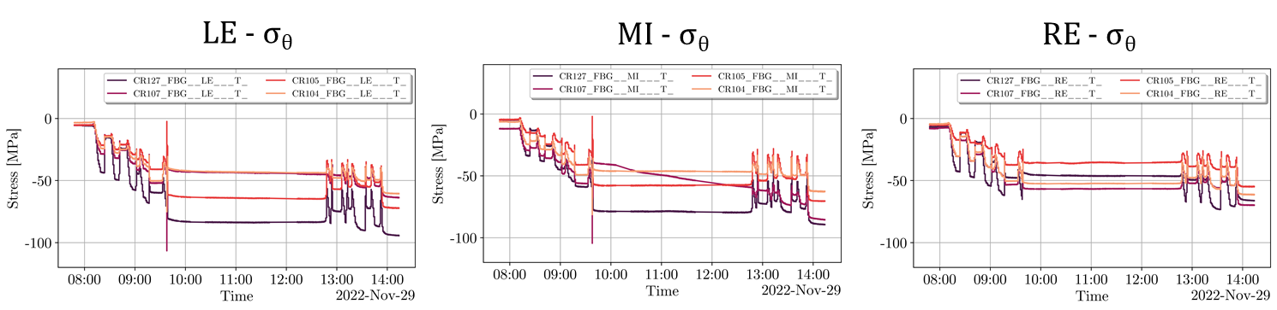
MQXFBMT4 – Assembly
Average shell stress (3 stations): 58 MPa
Average coil stress (winding pole, 3 stations): -71 MPa
Peak coil stress (winding pole, 3 stations): -107 MPa
Coil stress:

Slide 22
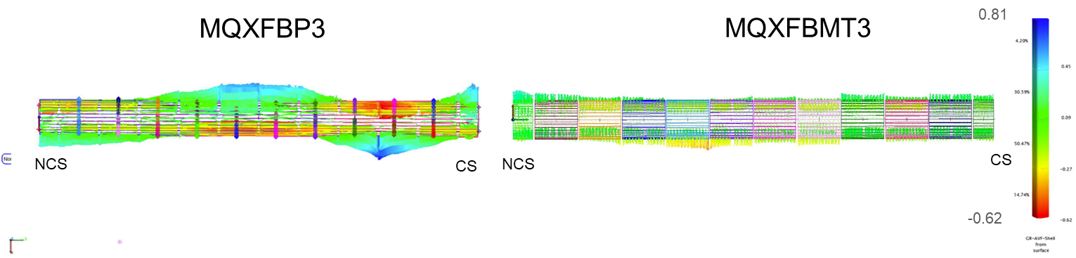
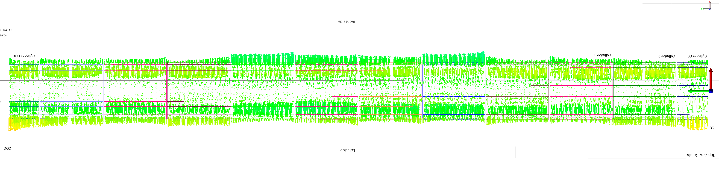
MQXFBMT4 – Assembly
Improved alignment of the mechanical structure following the lessons learnt from MQXFBP3 (already implemented in MQXFB02 and MQXFBMT3).
View from the top (alignment in the horizontal axis):
MQXFBMT4
NCS
CS
S. Straarup, M. Parent

Slide 23
CONTENTS
MQXFB:
  MQXFB02 Cold test results (Focus on mechanics)
  Highlights on MQXFBMT4 magnet assembly
MQXFS:
  MQXFS7g magnet assembly.
  MQXFS8 magnet assembly.

Slide 24
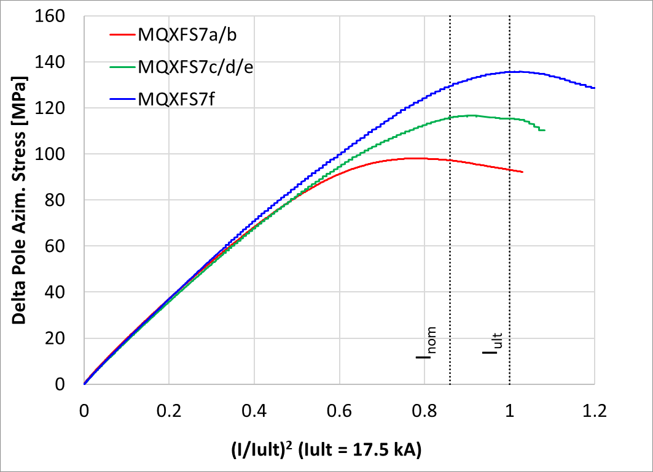
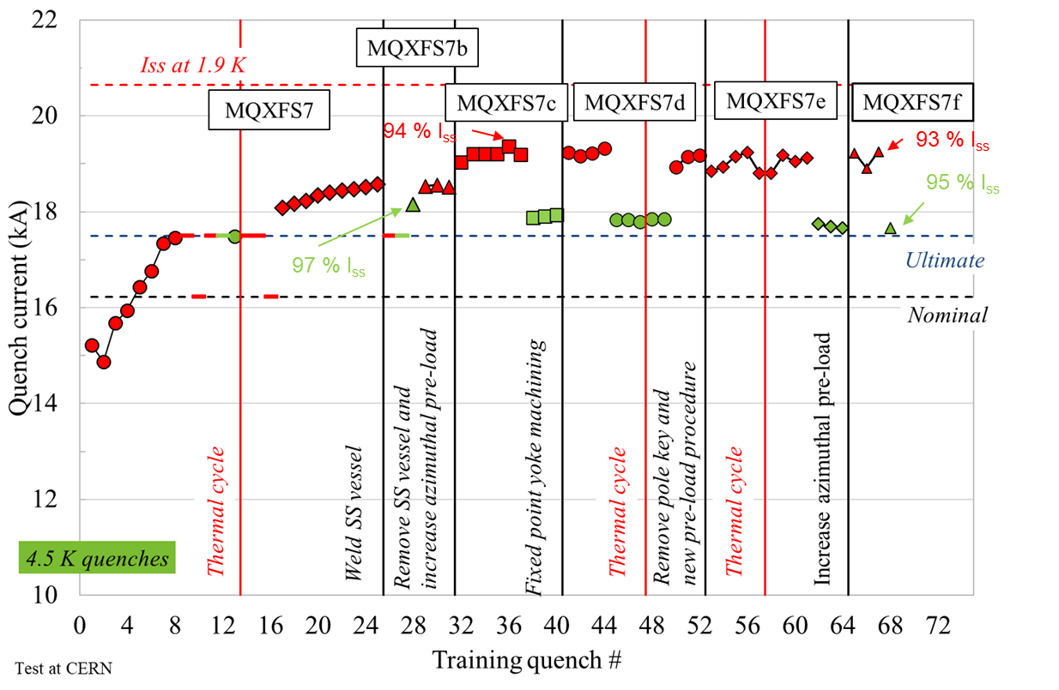
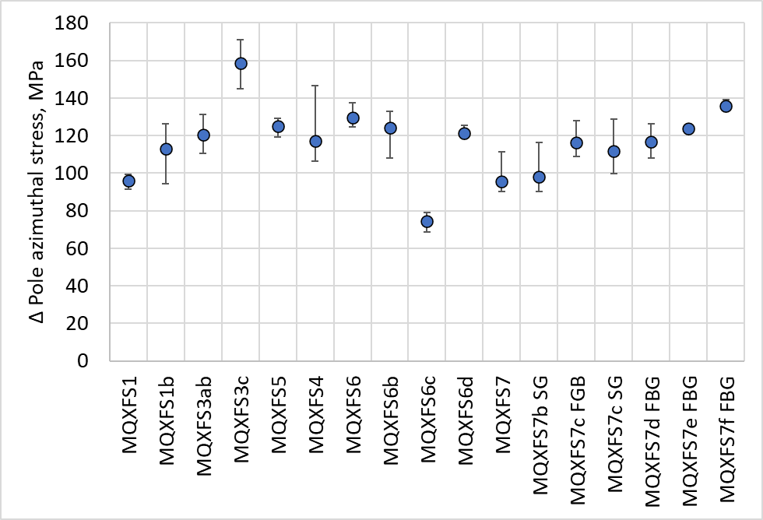
Before MQXFS7g…
Data: Salvador Ferradas Troitino, Franco Mangiarotti
MQXFS7f pre-load at cold ≈ 140 MPa
As expected, increase on pole azimuthal stress of 20 MPa

Slide 25
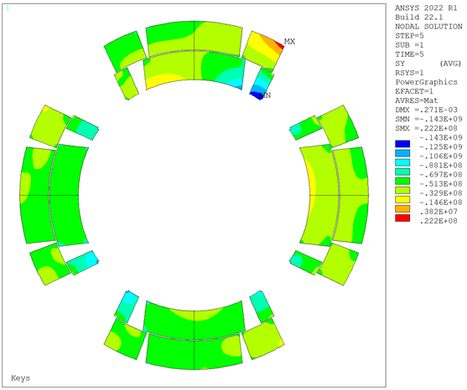
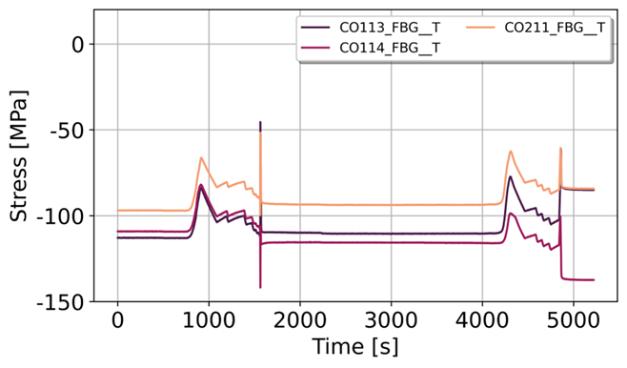
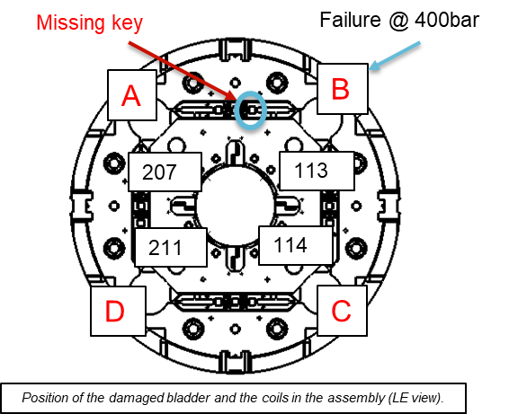
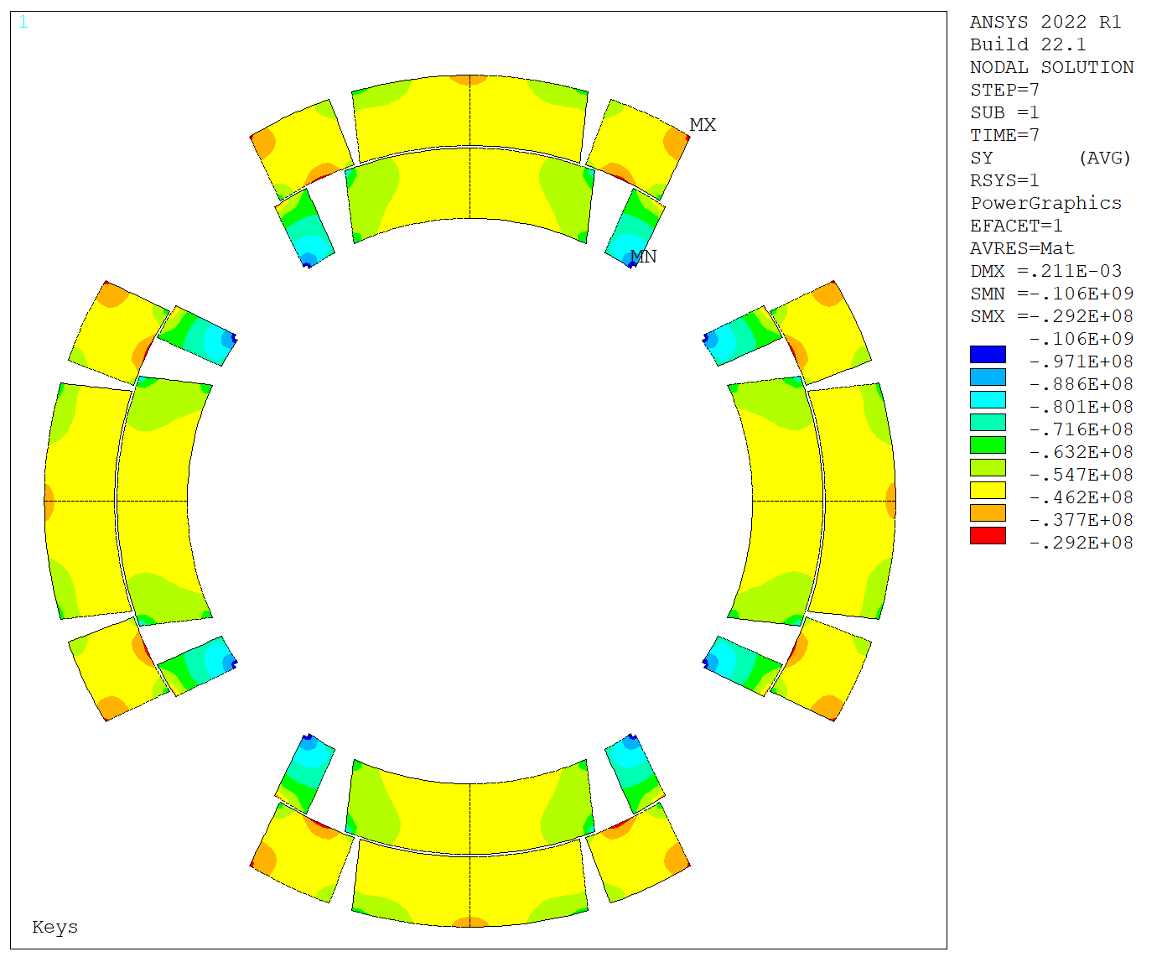
MQXFS7g – Assembly
New iteration on MQXFS7, increasing by 0.1 mm the thickness of the loading keys (to 14 mm)
Tubular bladders re-used from MQXFS8 (flattened).
Bladder failure at 400 bar, when inserting the last 14 mm key. Contrary to MQXFBMT4, one key missing all along the magnet length.
Measured peak az. stress ~ 145 MPa. Large coil imbalance upon completion of the pre-load.
NCR for the bladder failure in progress.
Key
missing
Bladder failure
Peak ~ 145 MPa
Δ ~ 40 MPa
Ref.
2D FE simulations for the failure case
(P. M. Quassolo)

Slide 26
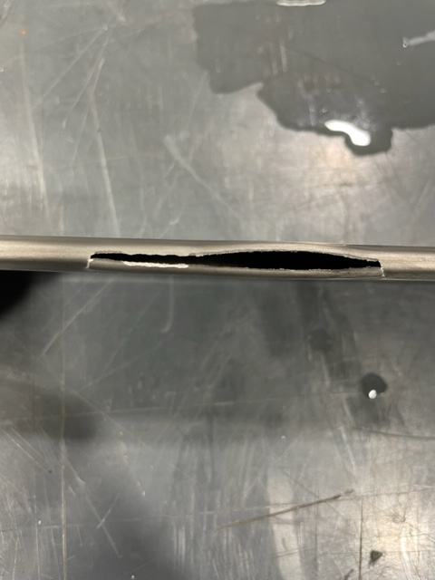
MQXFS7g – Assembly
In this case, the bladder failure mode seems to be related with a potential weakness induced by the re-flattening of already used bladders. Note that bladder stroke in the cooling hole channels is large.
Furthermore, 14 mm keys are obtained by shimming 13.5 mm keys with additional 0.5 mm. Difficult key insertion. Time under pressure was relatively long.
For long MQXFB magnets, bladders are re-used only for disassembly. In this case, they are not re-laminated. Instead, thinner shims are used.
Failure mechanism has been identified for MQXFBMT4 and MQXFS7g. Corrective actions will be adopted to minimize the risk of failure in the future.
Notes:
Insertion using the “train”

Slide 27
CONTENTS
MQXFB:
  MQXFB02 Cold test results (Focus on mechanics)
  Highlights on MQXFBMT4 magnet assembly
MQXFS:
  MQXFS7g magnet assembly.
  MQXFS8 magnet assembly.

Slide 28
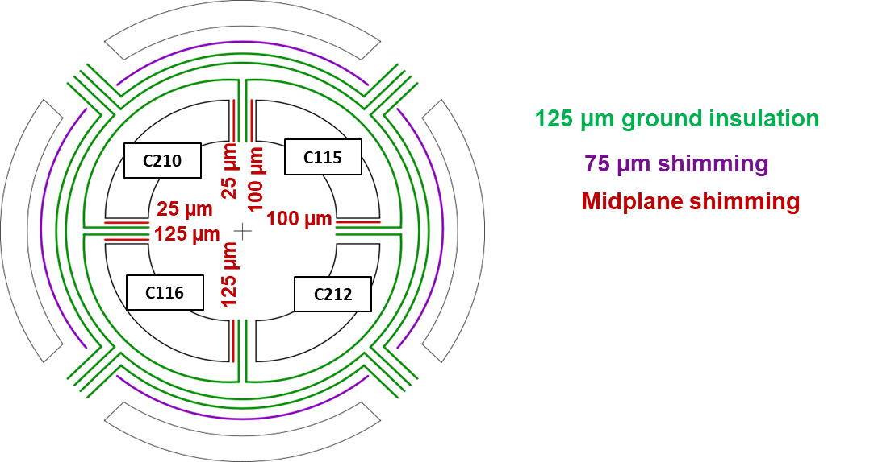
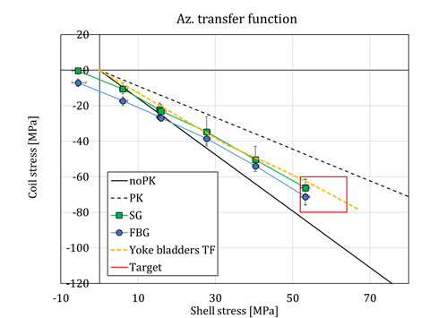
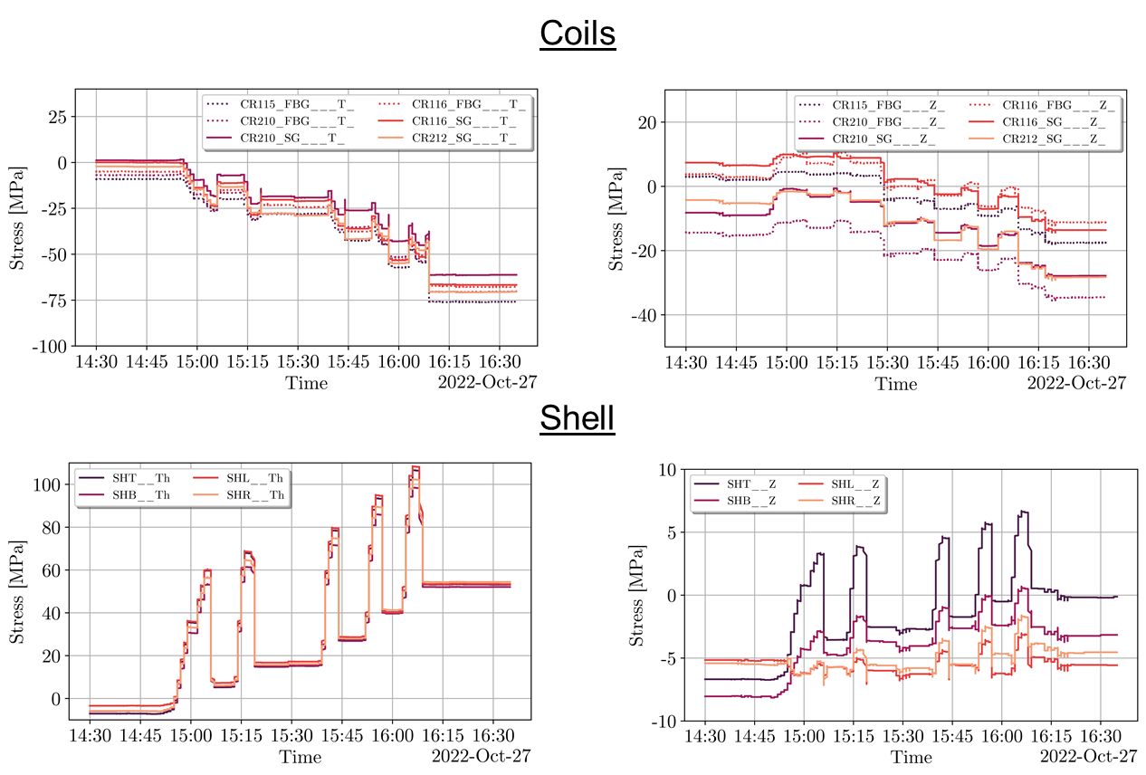
MQXFS8 – Assembly
MQXFS8 assembled with 2 non-virgin and 2 virgin coils.
All new tubular bladders used. Same procedure as MQXFB.
Centering and loading went extremely smoothly.
Pre-loading within specifications (rods not shown for simplicity).

Slide 29
Thank you for your attention!

Slide 30
ANNEX

Slide 31
MQXFB02: Coil Size
 |  | Average (Including ends) | Average (Excluding ends)
Azimuthal excess L+R [µm] | CR125 | -39 | -7 (0)
 | CR123 | -51 | -16 (0)
 | CR121 | -5 | 27 (+50)
 | CR124 | -117 | -100 (-100)
 | Shim
CR125 | 50
CR123 | 50
CR121 | 0
CR124 | 150

Slide 32
MQXFB02 -250 um shimming plan
Azimuthal size and expected stress variation along the length (w.r.t. average)

Slide 33
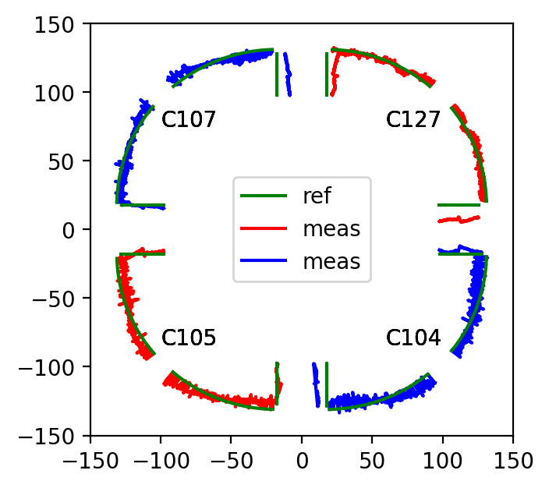
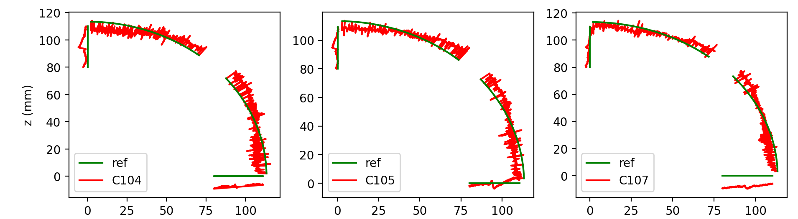
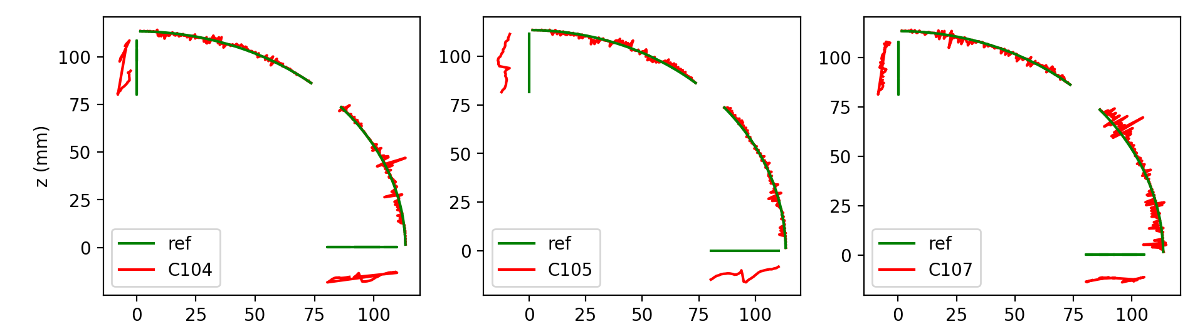
MQXFBMT4 – Assembly
“Tricky coilpack”. FUJI tests confirmed the expected mechanical contact with the collars:
  Larger contact towards the mid-plane for the virgin coil (CR 127). For the non-virgin coils, contact mostly towards the winding pole.
  The geometry of the new coil is “round”. The three tested coils have the typical “squarish” geometry after test.
After test:
Before test:
*Same behavior observed for MQXFS8 magnet (2 virgin / 2 non-virgin coils)

Slide 34
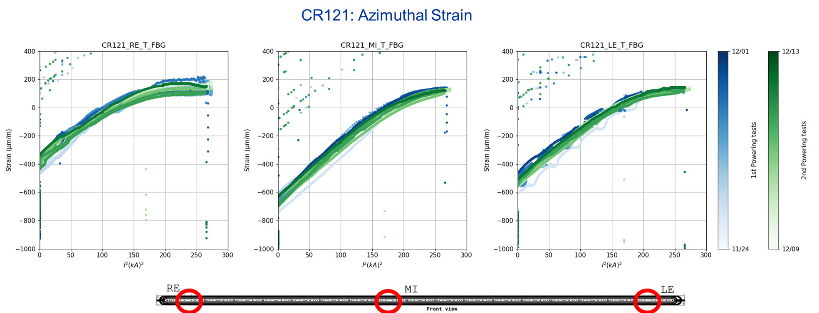
MQXFB02 – Cold tests
Noise seems an artifact from the holding current. Kinks may be related to the peak tracking. Under investigation.
Wavy z-signal (See annex) not understood. Also under investigation.
M. Guinchard, S. Mugnier and K. Kandemir

Slide 35
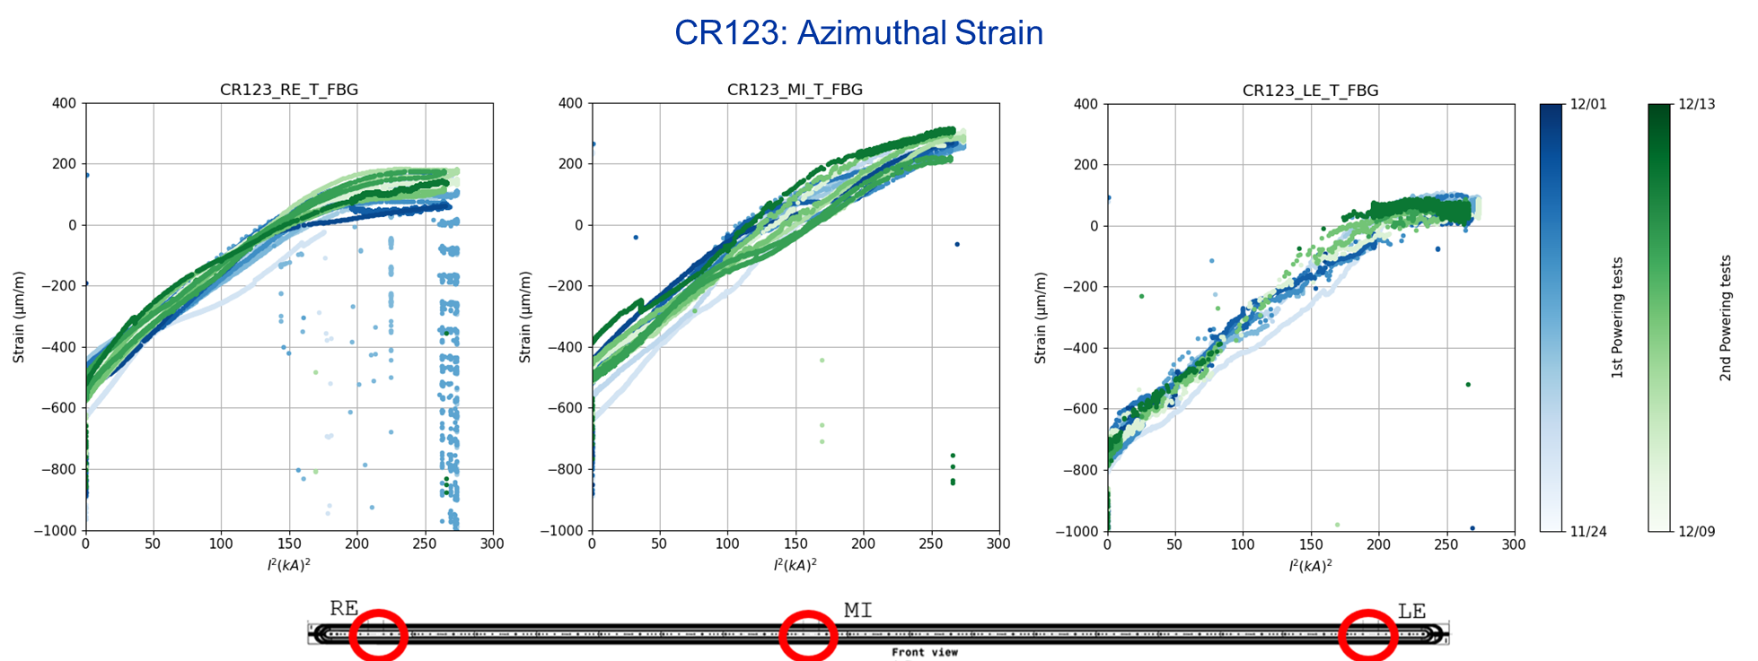
MQXFB02 – Cold tests
M. Guinchard, S. Mugnier and K. Kandemir

Slide 36
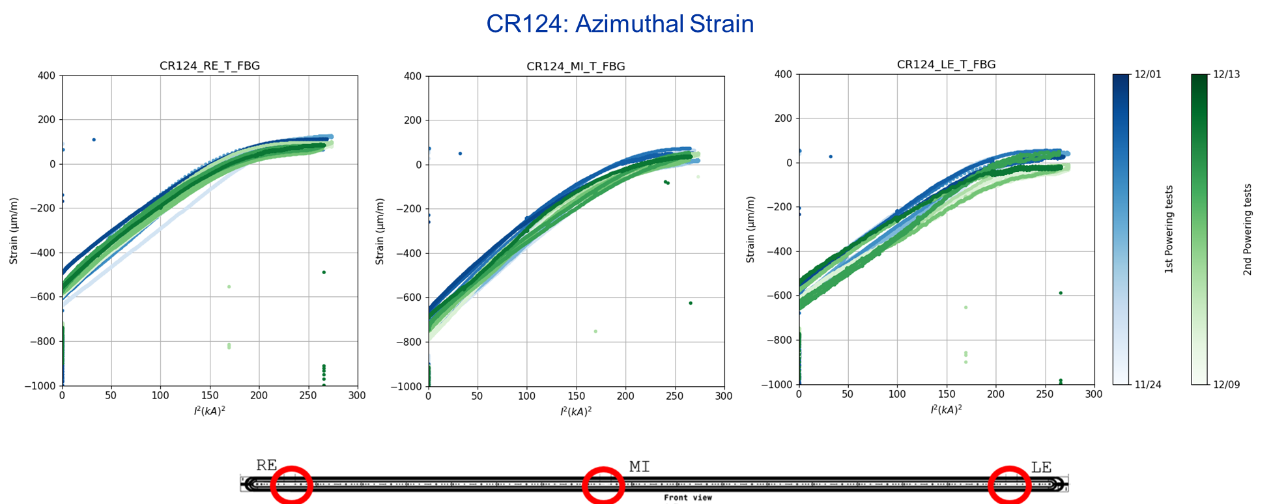
MQXFB02 – Cold tests
M. Guinchard, S. Mugnier and K. Kandemir

Slide 37
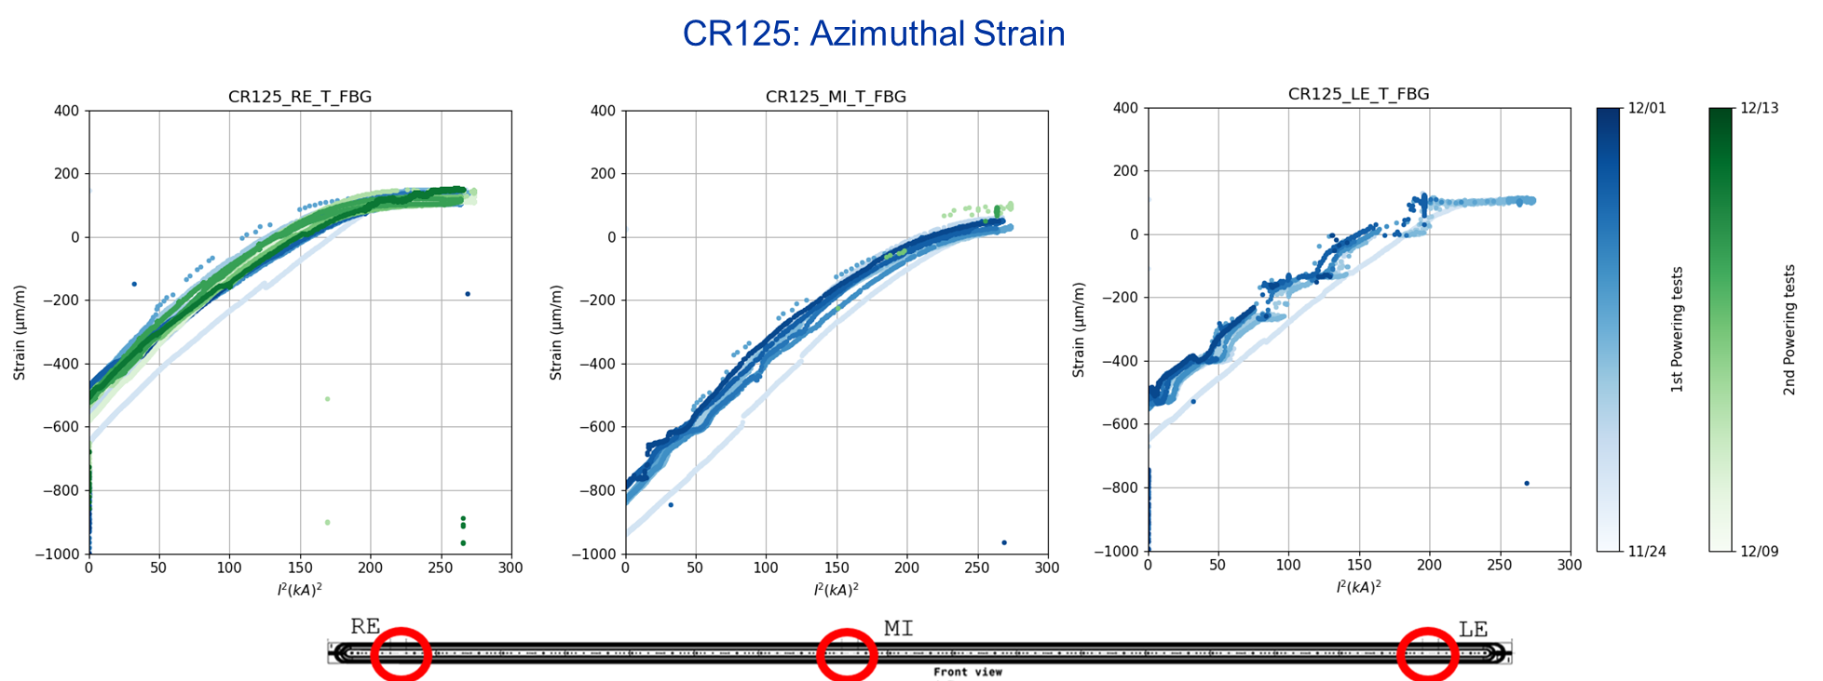
MQXFB02 – Cold tests
M. Guinchard, S. Mugnier and K. Kandemir

Slide 38
MQXFB02 – Cold tests
Quick recap: cold-mass welding preparation
Gain in azimuthal pole stress during welding: [0 MPa -5 MPa]
B02

Slide 39
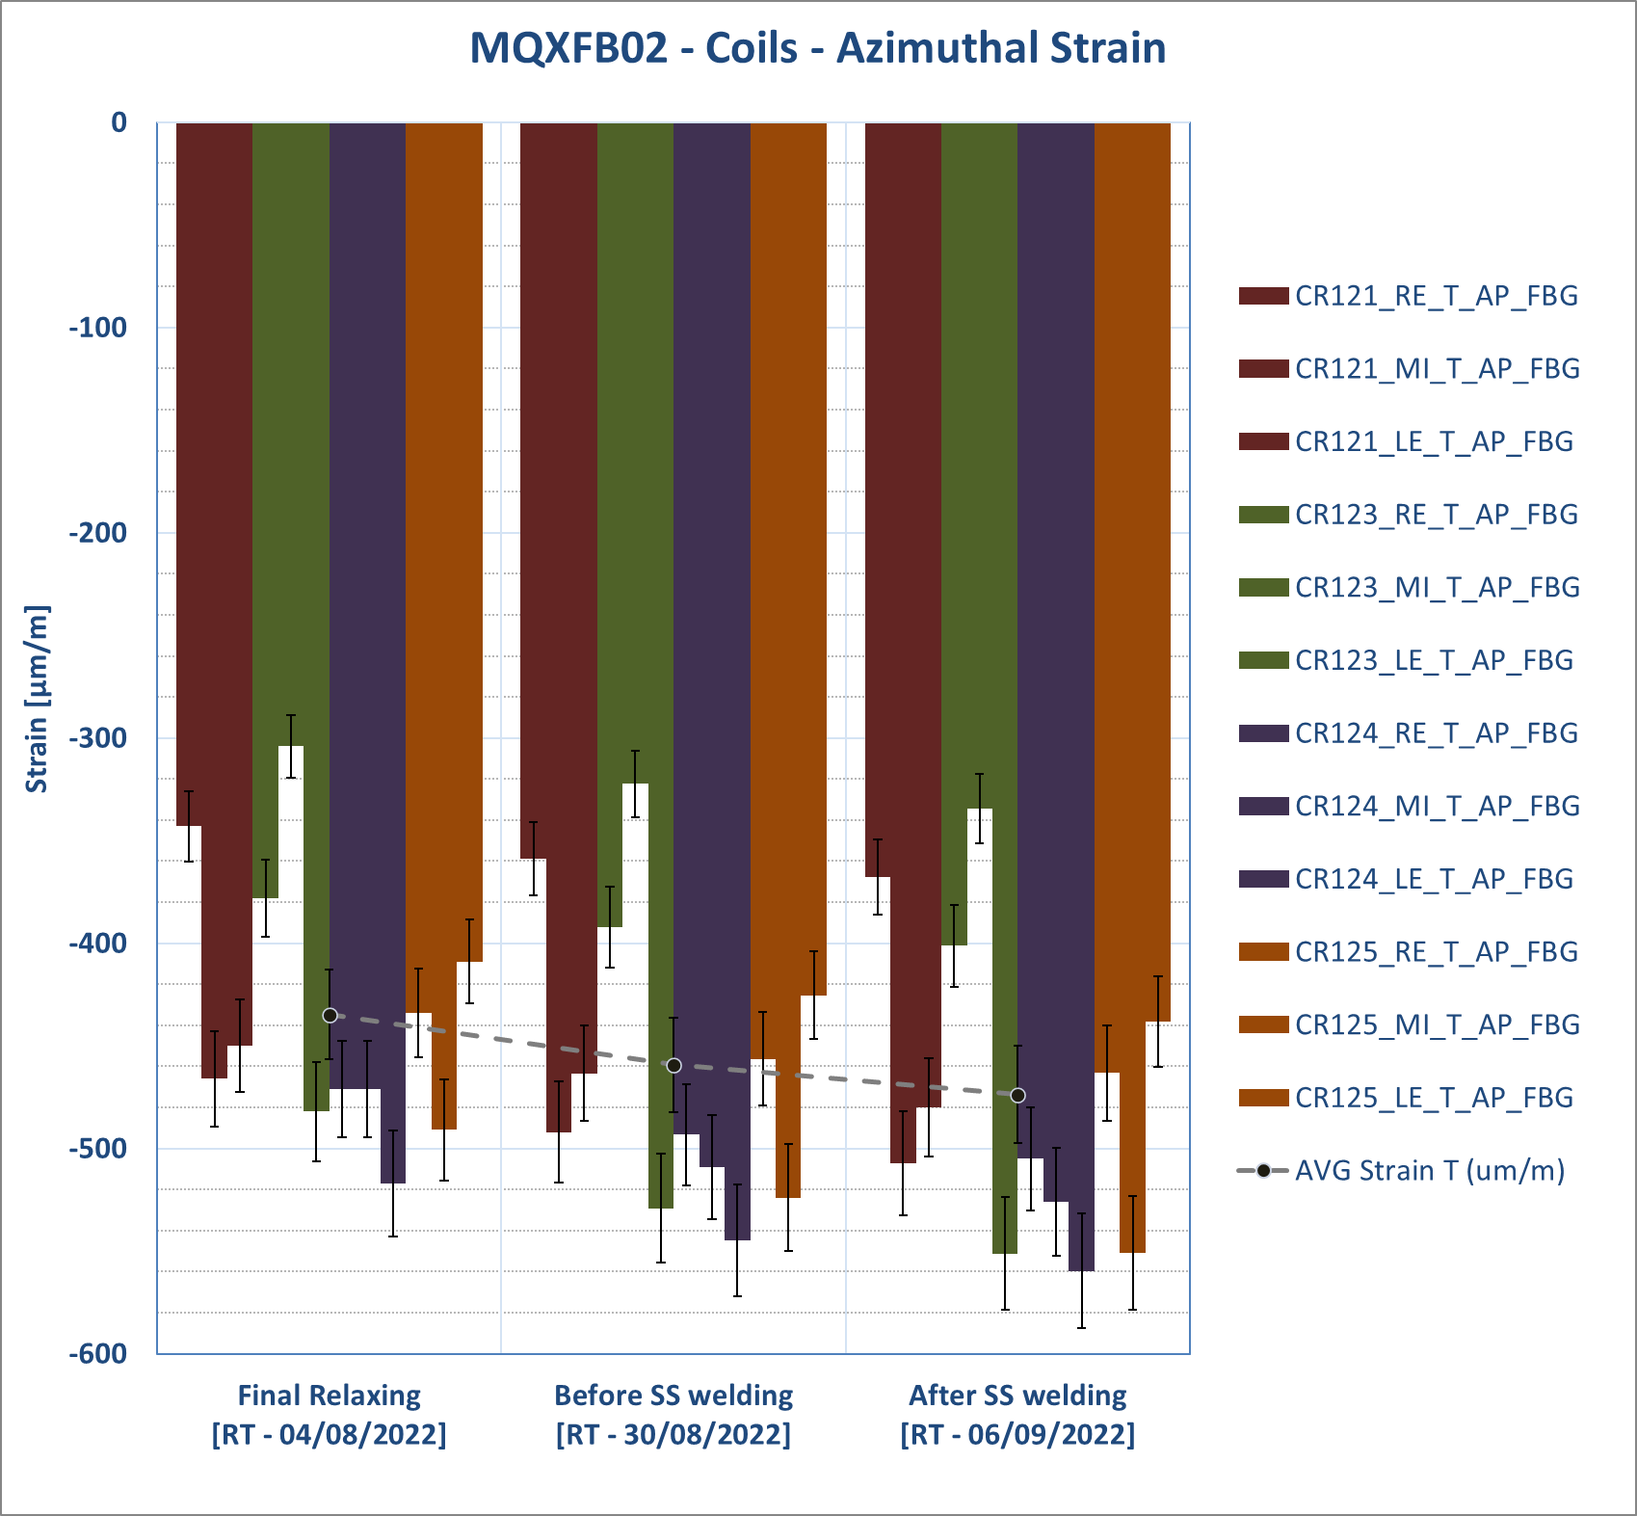
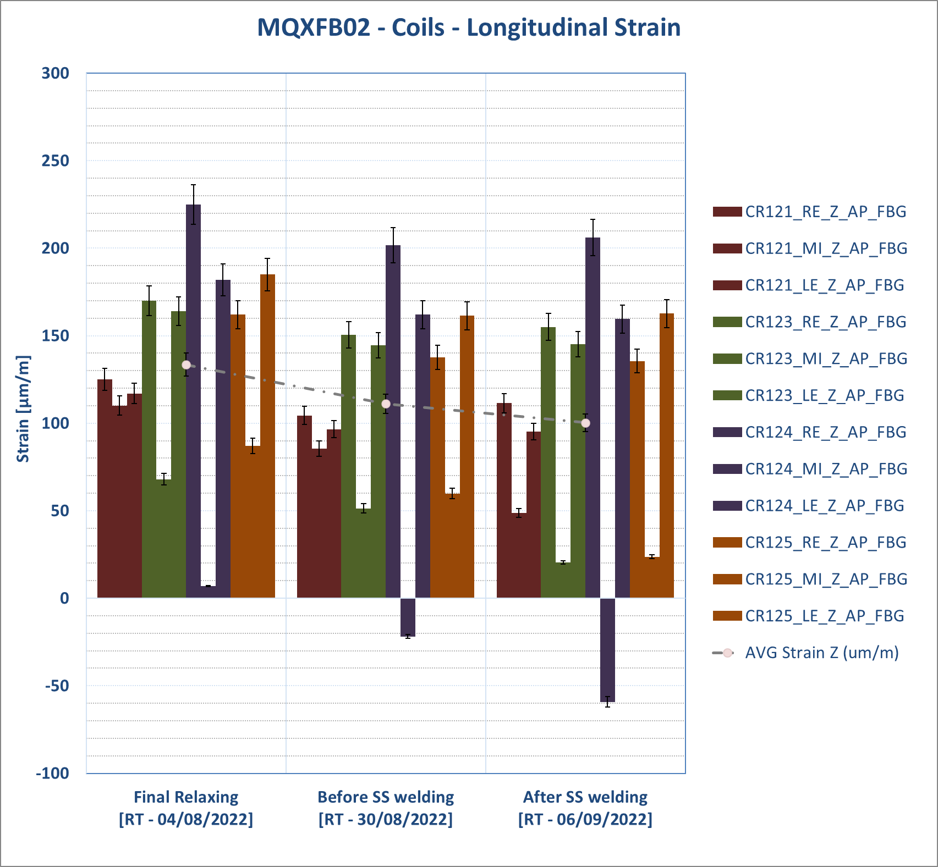
MQXFB02 – Cold tests
Quick recap: cold-mass welding preparation

Slide 40
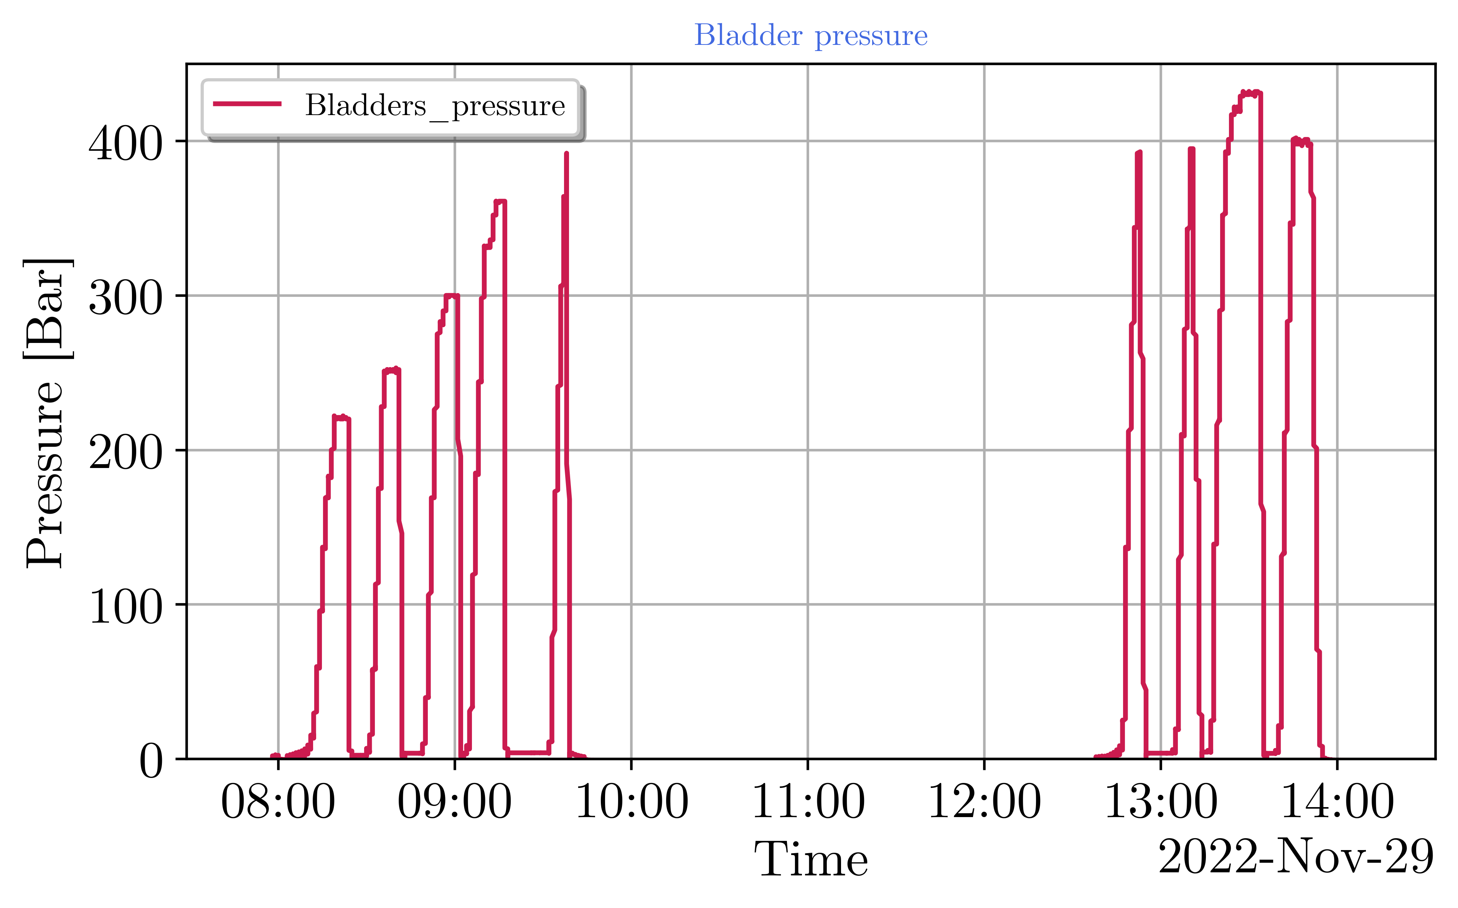
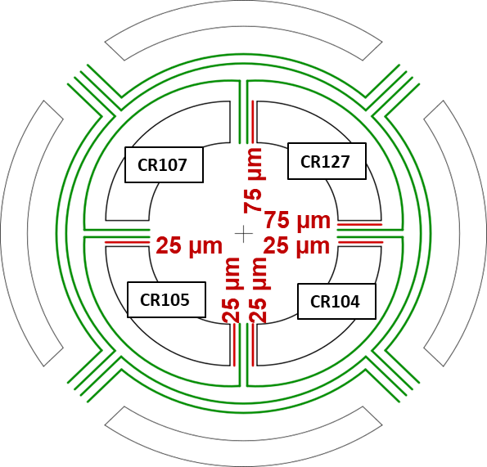
Bladder pressure
2 bladder cycles up to the same pressure to try to recover the imbalance created by the bladder failure
Non-conform keys.
Thicker than 13.8 mm and shorter in length.
Bladder failure
Bladder failure (LE)
When the bladder failed, 13.7 mm keys were placed in all quadrants. We were just creating the necessary gap to introduce 13.8 mm.

Slide 41
Coil strain
LE - ε_{θ}
MI - ε_{θ}
RE - ε_{θ}
Bladder failure
Strain drift for CR107
LE - ε_{z}
MI - ε_{z}
RE - ε_{z}
The bladder failure effect (happening in the LE side) is seen in the LE and MI stations.
In these two stations, the failure creates an imbalance among coils. CR127 is the most affected (virgin).

Slide 42
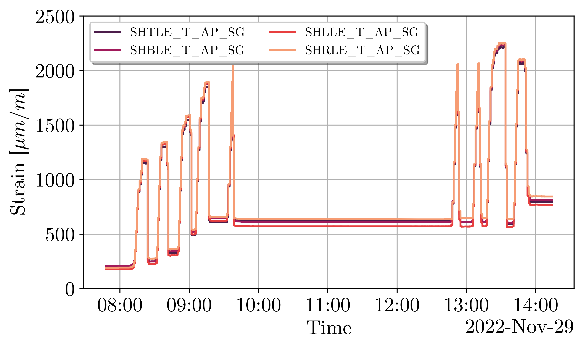
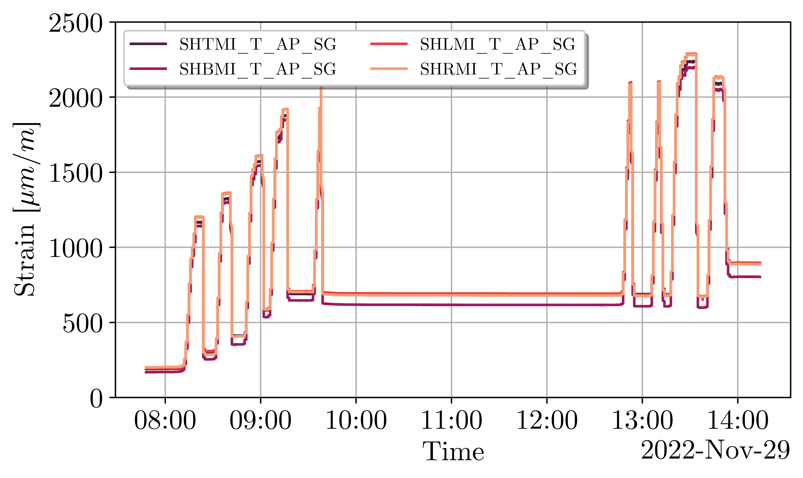




Shell strain
LE - ε_{θ}
MI - ε_{θ}
RE - ε_{θ}
LE - ε_{z}
MI - ε_{z}
RE - ε_{z}

Slide 43






Coil stress
LE - σ_{θ}
MI - σ_{θ}
RE - σ_{θ}
LE - σ_{z}
MI - σ_{z}
RE - σ_{z}
Transitory peak above 100 MPa for CR107, which saw already larger stress levels during MQXFBP1 assembly.

Slide 44






Shell stress
LE - σ_{θ}
MI - σ_{θ}
RE - σ_{θ}
LE - σ_{z}
MI - σ_{z}
RE - σ_{z}

Slide 45


Loading: Bladder bursting
Bladder bursting at 392 bars with 13,7 mm keys inserted
→ Bladder busted on the LE side near the rod A on the left side

Slide 46



Loading: Coil behavior during bladder bursting
Bladder bursting
Bladder bursting
Bladder bursting
→ Peak strain during bladder bursting: -768 µm/m

Slide 47
MQXFBMT4 – Assembly
Two bladder cycles up to 390 Bar performed upon restart of the pre-loading operations. Half of the created imbalance among coils could be recovered.
Loading completed with the insertion of 13.8 mm keys. Magnet is within specifications except for the coil peak stress. The latter happens in CR107, which has already seen larger stress values during MQXFBP1 assembly and cold test.
  Average shell stress (three stations): 58 MPa - Target: +58 ± 6 MPa
  Average coil stress (winding pole, three stations): -71 MPa - Target -70 ± 10 MPa
  Peak coil stress (winding pole, three stations): -107 MPa - Target -100 MPa
As in MQXFBP1 and MQXFBMT2, a large drift in the FBG strain measurements follows after finishing the magnet pre-load. Understanding on-going, but drift and absolute strain values are considered non-critical.
  In MQXFBMT2 it was proven that such a drift only happened for FBG (SGs, also present, were stable). Once unloaded, the offset remained in the strain readings.
  Drift does not happen after bladder failure in short models. Inhomogeneous FBG loading along the length?
  Interestingly, both in BP1 and MT4 the strain stabilizes at the same value. To be continued…

Slide 48



Before MQXFS7g…
S7f
Data: Salvador Ferradas Troitino, Franco Mangiarotti
Pre-load at cold ≈ 140 MPa
As expected, increase on pole azimuthal stress of 20 MPa

Slide 49


Rods

Slide 50


MQXFB rods
Rod relative behaviour during powering: Diﬀerence between FEM and measurements is roughly 2.5 fold.
In previous studies, a change of friction coeﬃcient of coil to collar surface from 0.16 to 0.13 led to a change in delta rod stress from 4.4 MPa to 6.9 MPa.
Changing the friction coeﬃcient in the current reference model between 0.2 and 0.3 doesn’t seem to lead to a large change in delta rod stress. A coeﬃcient of 0.16 seems already low (laminated aluminium, polyimide surface).
Instead, a variation of the axial elastic modulus in orthotropic approximation was tried for the laminated yoke. The modulus had to be lowered down to 40% (90 GPa) of the original in order to match the measured values.

Slide 51
Rods
MQXFB - RODS |  |  |  |  |  |  | MQXFB - RODS COLD |  |  |  |  |  |  | MQXFB - RODS POWERING
S | XG | YG | ZG | EZ | SZ |  | S | XG | YG | ZG | EZ | SZ |  | S | XG | YG | ZG | EZ | SZ
0.00E+00 | 9.72E-02 | 9.72E-02 | 3.76E+00 | 6.23E-04 | 1.20E+08 |  | 0.00E+00 | 9.72E-02 | 9.72E-02 | 3.76E+00 | 1.36E-03 | 2.86E+08 |  | 0.00E+00 | 9.72E-02 | 9.72E-02 | 3.76E+00 | 1.40E-03 | 2.93E+08
2.48E-02 | 1.22E-01 | 9.72E-02 | 3.76E+00 | 6.05E-04 | 1.17E+08 |  | 2.48E-02 | 1.22E-01 | 9.72E-02 | 3.76E+00 | 1.27E-03 | 2.67E+08 |  | 2.48E-02 | 1.22E-01 | 9.72E-02 | 3.76E+00 | 1.31E-03 | 2.75E+08
4.95E-02 | 1.22E-01 | 1.22E-01 | 3.76E+00 | 5.87E-04 | 1.13E+08 |  | 4.95E-02 | 1.22E-01 | 1.22E-01 | 3.76E+00 | 1.19E-03 | 2.49E+08 |  | 4.95E-02 | 1.22E-01 | 1.22E-01 | 3.76E+00 | 1.22E-03 | 2.56E+08
Average |  |  |  | 6.05E-04 | 1.17E+08 |  | Average |  |  |  | 1.27E-03 | 2.67E+08 |  | Average |  |  |  | 1.31E-03 | 2.75E+08
 |  |  |  | 605 | 117 |  |  |  |  |  | 1273 | 267 |  |  |  |  |  | 1308 | 275
 |  |  |  | µstr | MPa |  |  |  |  |  | µstr | MPa |  |  |  |  |  | µstr | MPa
 |  |  |  |  | DELTA CD |  |  |  |  |  |  | DELTA POWERING
 |  |  |  |  | 669 |  |  |  |  |  |  | 35

Slide 52

MQXFS – Experience from short magnets
As expected from the model, the rods only see 2 % for the electromagnetic forces during powering
Small differences observed in between the two types of structures:
  Structure 1&2 (thick laminations, large gap coil to collar): 1.4 % of F_{emz} in the rods, 0.16 friction coefficient needed to match the measurements
  Structure 3 (thin laminations, small gap coil to collar): 2.2 % of F_{emz} in the rods, 0.13 friction coefficient needed to match the measurements
Measurements confirm that coil elongation is independent of the pre-load level, since it depends on the system stiffness. The effect of the pre-load is to increase the contact pressure coil to pole in the end region.
Thin laminations, 5*0.125 mm gap between coil and collar, filled with polyimide
5 MPa ≈ 0.1 mm of coil elongation
Thick laminations, 13*0.125 mm gap between coil and collar, filled with polyimide or G10
Eelis Takala
G. Vallone, et. al., Mechanical analysis of the short model magnets for the Nb₃Sn low-beta quadrupole MQXF, IEEE Trans. Appl. Supercond., vol. 26, no. 4, 2016.

