Slide 1
QXFA153 DR13057 LE Saddle Holes Out of Position Tolerance Update/Close Out
Fred Nobrega
Miao Yu
AUP Coil WG Mtg, Jan 26, 2023

Slide 2
Solution 1a: Thread-locking Insert M6 to M3 Solution 1b: Increase Clearance Hole Diameter to 9.35 mm
M6 Thread-locking Insert
M3x0.5 socket head screw
#8 washer
Customized washer

Slide 3
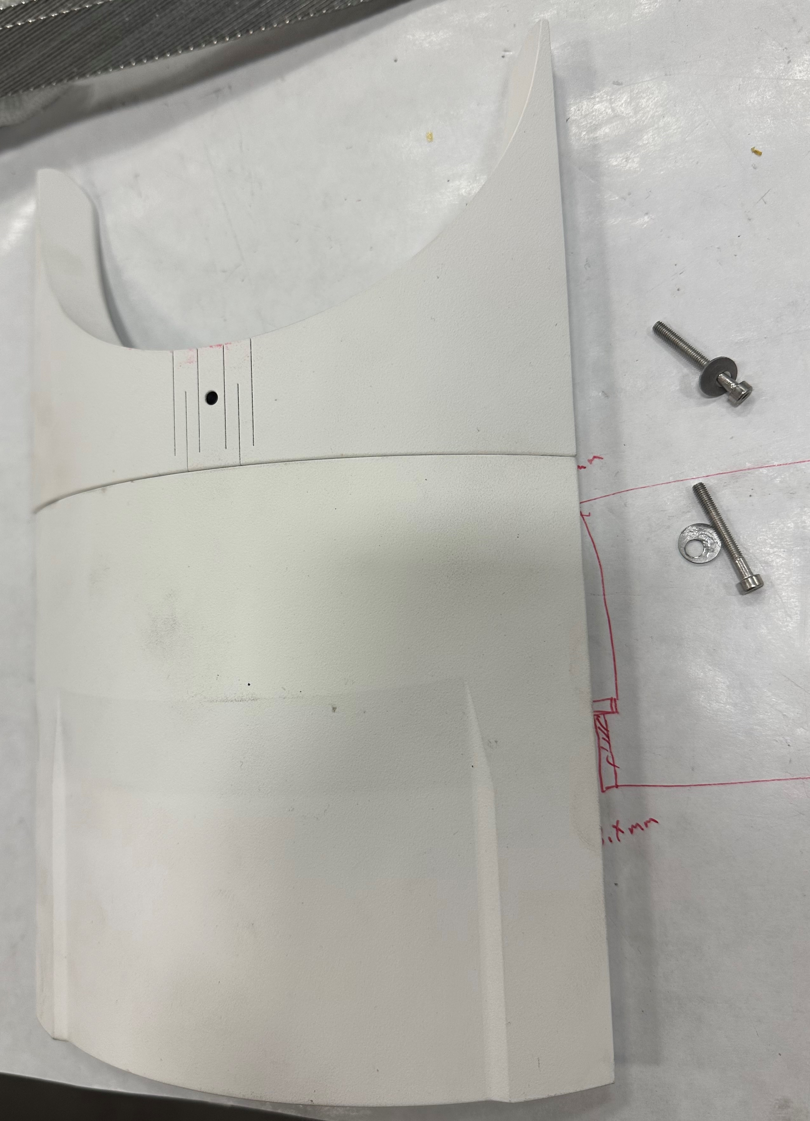
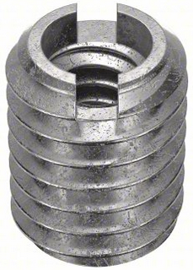
Customized washer
Dimensions in inches.

Slide 4
Plan
Fabricate the customized washers at FNAL VMS.
Open the clearance hole with the diameter of 7.5 mm on L1 and L2 splice block to 9.35 mm diameter (0.368” drill bit).
Order the key inserts (M6 OD, M3 ID)
Fit check the splice block and saddle assembly for each part kit.
Update Coil Configuration spreadsheet.
Update & close out DR13057

