Slide 1
SSR Status Update at Fermilab
SSRs team at Fermilab
January 26, 2022
ALL Partners Coordination Meeting

Slide 2
EPDM for PIP-II/SSRs scope
Engineering Process Documentation Management (EPDM) | Teamcenter No.
Prototype SSR1 | ED0001256
Production SSR1 | ED0011856
Pre-production SSR2 | ED0001257
Production SSR2 | ED0011912
The EPDMs listed contain all the references for the Design, Procurement, Fabrication, Assembly and Testing for all components and subassemblies for the cryomodule.

Slide 3
Flow-down of Requirement and Interface Specifications

Slide 4
Overall status and upcoming activities
Prototype SSR1 CM
Completed. Currently used to get residual magnetic field within the coldmass.
Pre-production SSR2 CM
Design completed. All POs awarded.
Planning incoming inspections and finalizing assembly phases.
A series of meeting is going to start this month between the design and assembly teams.
Production SSR1 CMs (Total 2)
Cavities fabrication is ongoing.
Finalizing design of CM and preparing procurement of major sub-assemblies. FDR in April.
Production SSR2 CM (Total 7)
Nb procurement is ongoing.

Slide 5
SSRs Niobium and Cavities
SPM: P. Berrutti
Presenter: M. Parise

Slide 6
Niobium
SSR1
Awarding second PO for CM2 to Ningxia
SSR2
RFP for Production Niobium is being prepared
Cavities
SSR1
PO 690591 with Zanon for the fabrication of 9 Production Cavities. Next milestone is the MRR to be scheduled early 2023.
SSR2
Fabrication and processing
3 ppSSR2 cavities (S2-ZA-001/2/3) were manufactured by Zanon. All cavities have been processed either by Zanon or IJCLab
Other 3 are expected to be completed (manufactured and processed) in spring 2023 by Zanon.
RI is working on the fabrication of 3 cavities. MRR was performed. First cavity (manufactured and processed) ready in late spring 2023.
ES&H Compliance
Eng note for S2-ZA-001 is approved and released in TC (EN08416)
Master Eng. Note for ppSSR2 is EN03693
Cold Testing of SSR2 #1 and #3 is ongoing at IJCLab.

Slide 7
SSRs Solenoids
SPM: Miao Yu
Presenter: Miao Yu

Slide 8
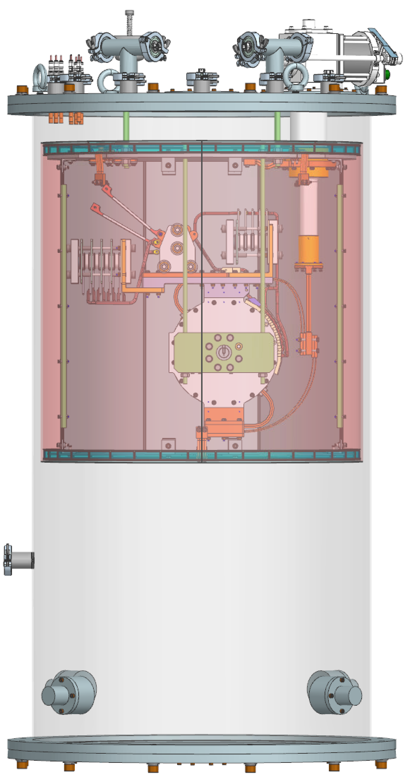
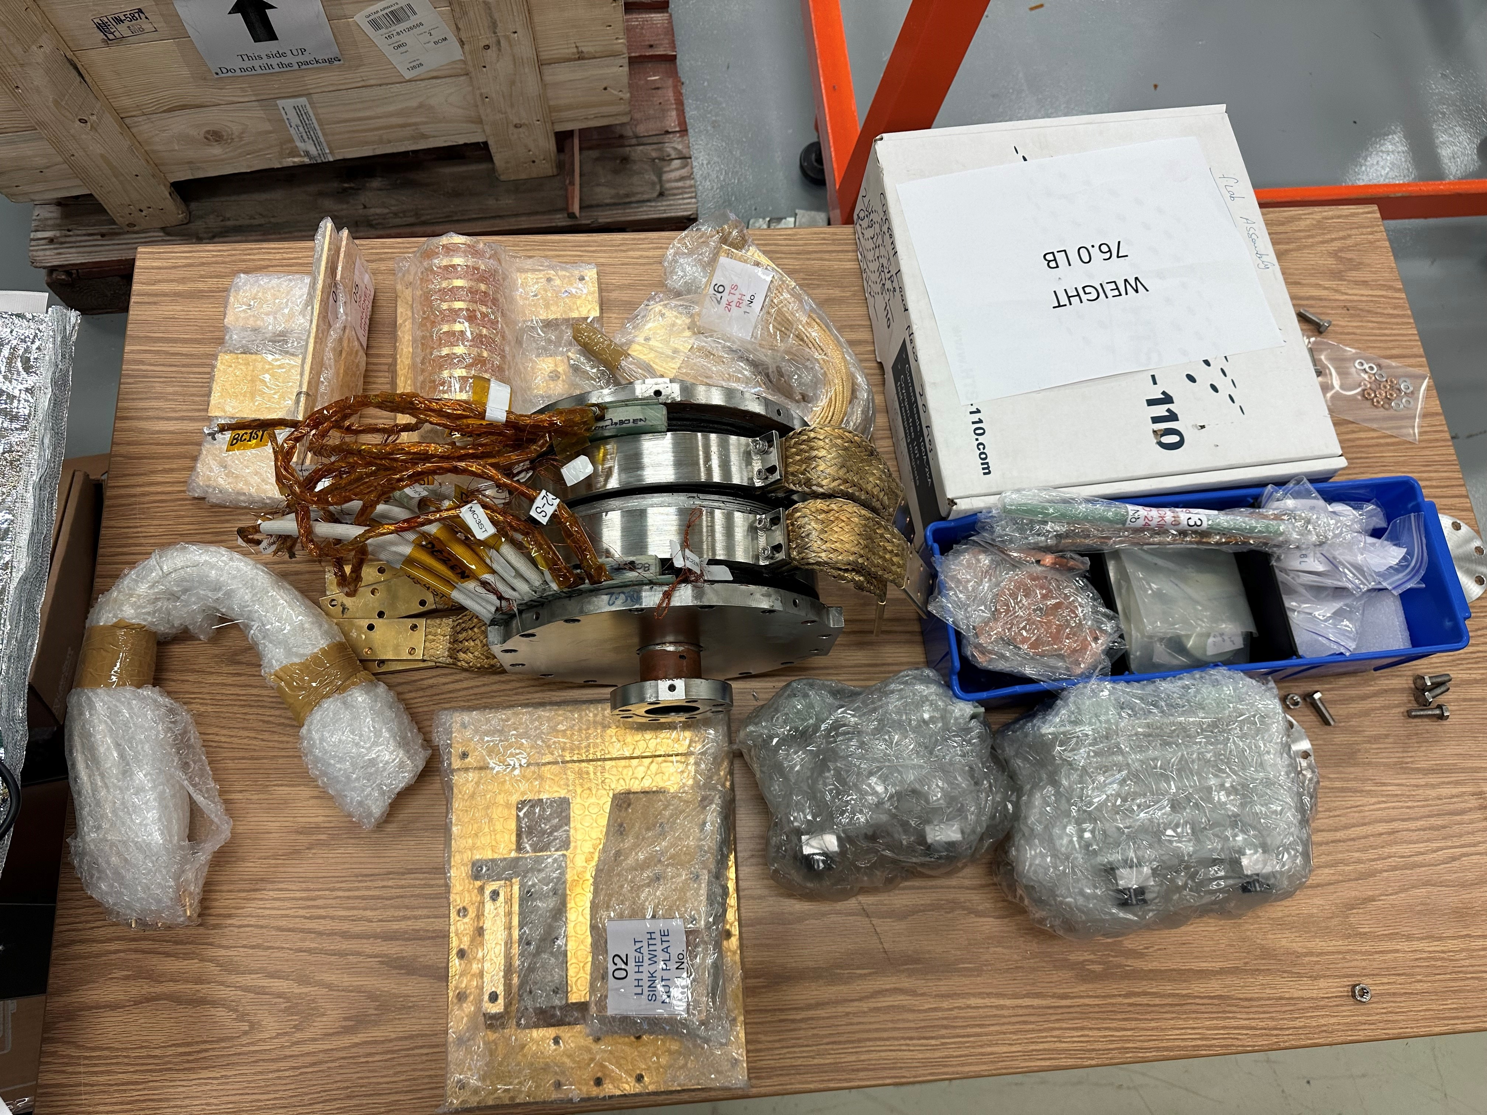
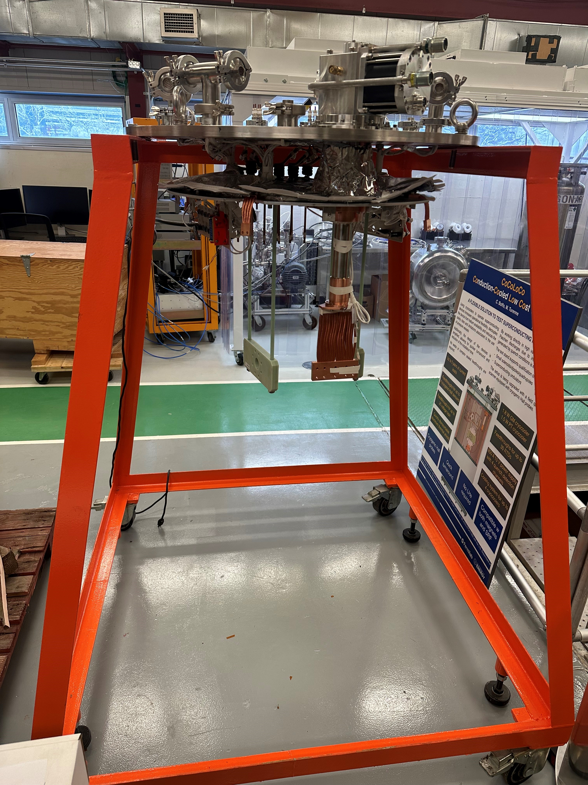
SSR solenoid status update – FNAL activities
Visual inspection on the prototype P2-SSR-BAR-A-PS-003 is completed, with two DRs issued (1. Surface scratch and 2. non-consistent hardware uses)
The magnet final assembly and mounting on the test stand is being planned. The work is expected to be started in early February.

Slide 9
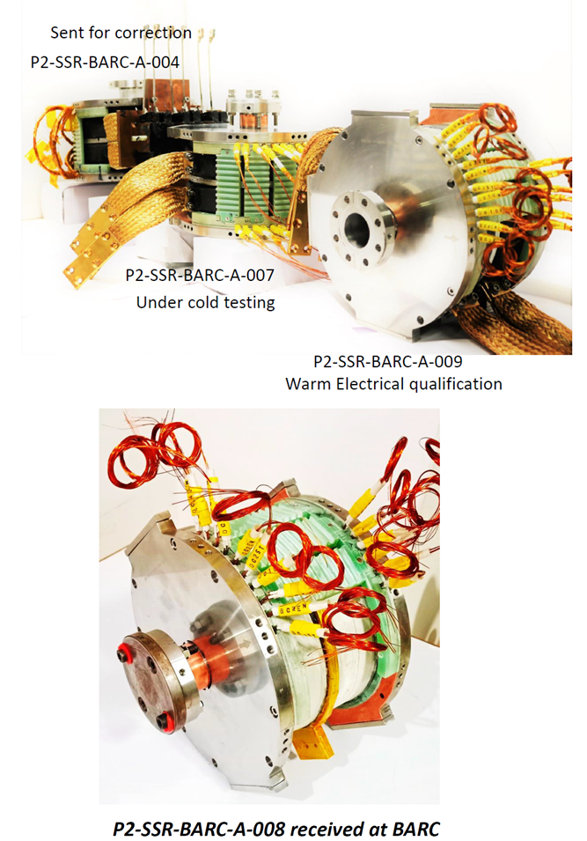
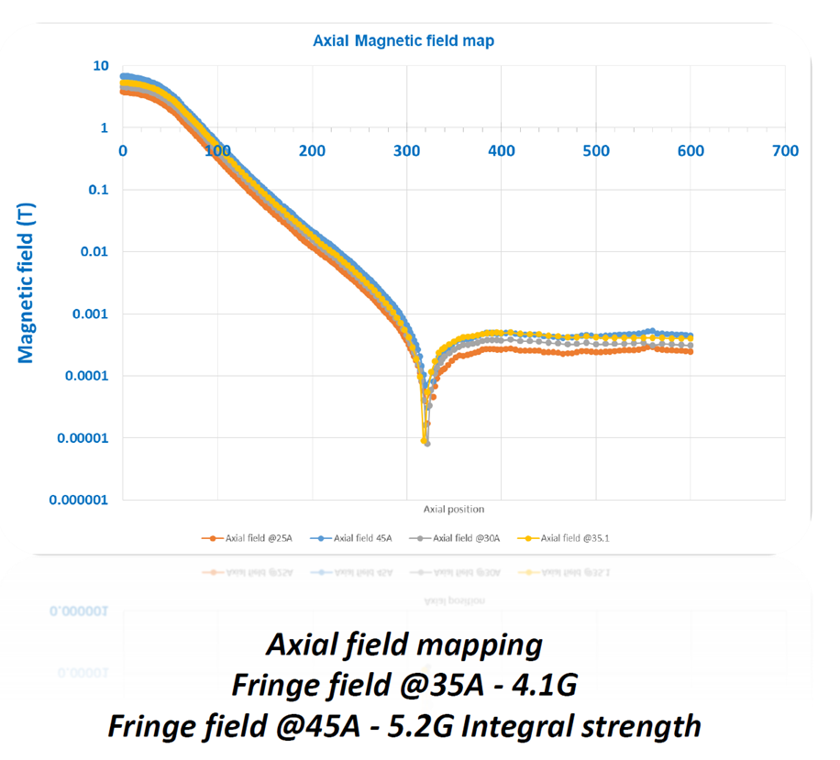
SSR solenoid status update – BARC activities
The pre-series magnet P2-SSR-BARC-A-004 was sent back to the vendor repair, replaced by another pre-series magnet P2-SSR-BAR-A-003.
The pre-series magnet P2-SSR-BARC-A-007 cold test is near completed.
Reach 5 T²m magnetic strength (6.45 T) at 45 A current on main solenoid coil (4.5 T²m in specification)
Total 8 quenches, each quench took ~1h for test stand recovery (the quench results are still under analysis for quench locations and possible causes) .
The fringe filed is 5.2 Gauss at 500 mm on axis at 45 A (<10 Gauss in specification).
The pre-series magnet P2-SSR-BARC-A-009 is being integrated with test stand.
The fourth pre-series magnet P2-SSR-BAR-A-008 was received at BARC.
The test on 007 and 009 is still aiming to be completed by the end of January, and the test on 008 and 003 by the end of February.

Slide 10
SSRs Couplers
SPM: N. Solyak
Presenter: N. Solyak

Slide 11
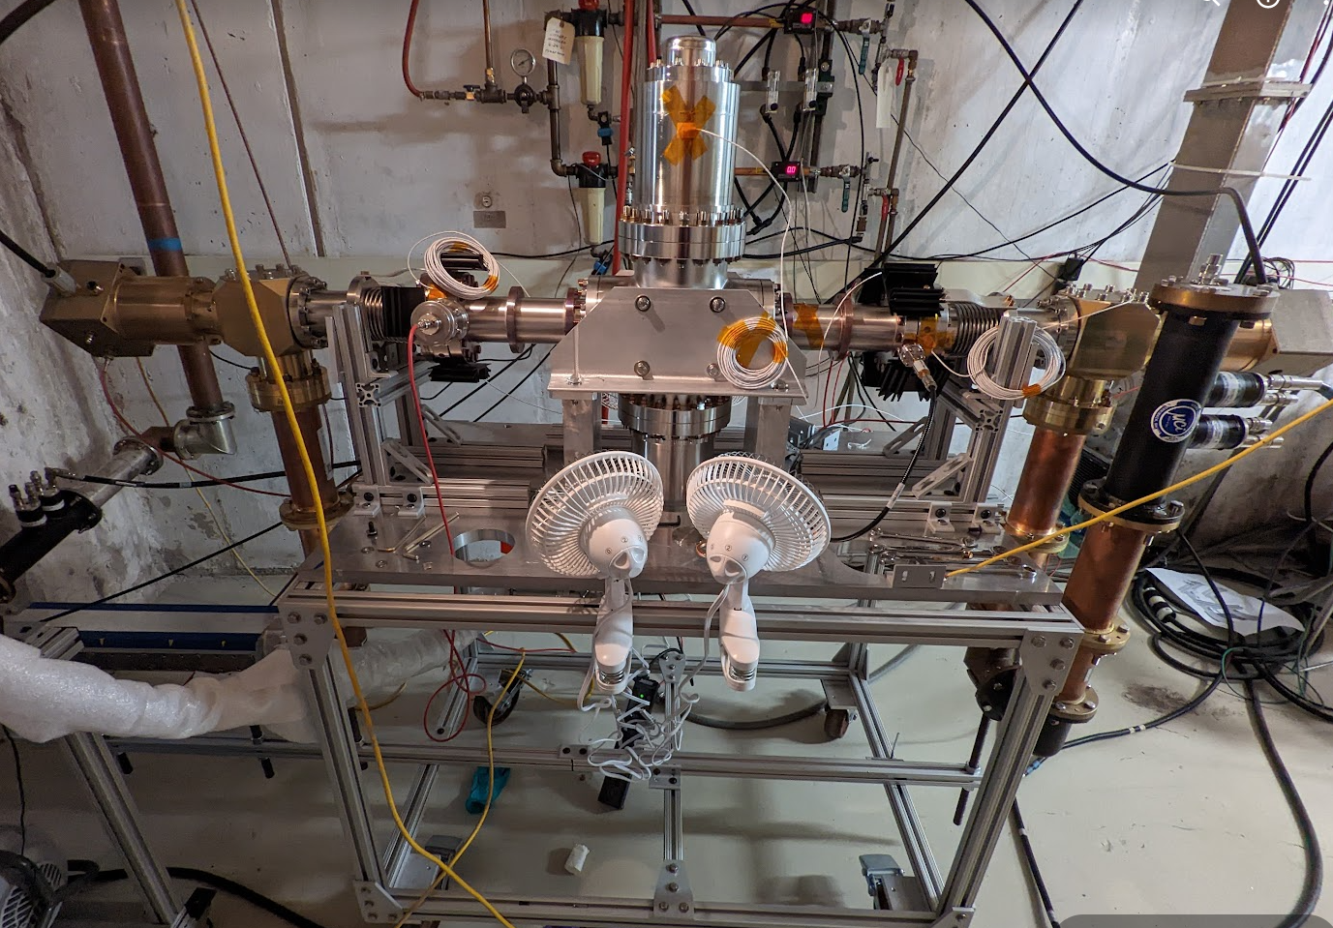
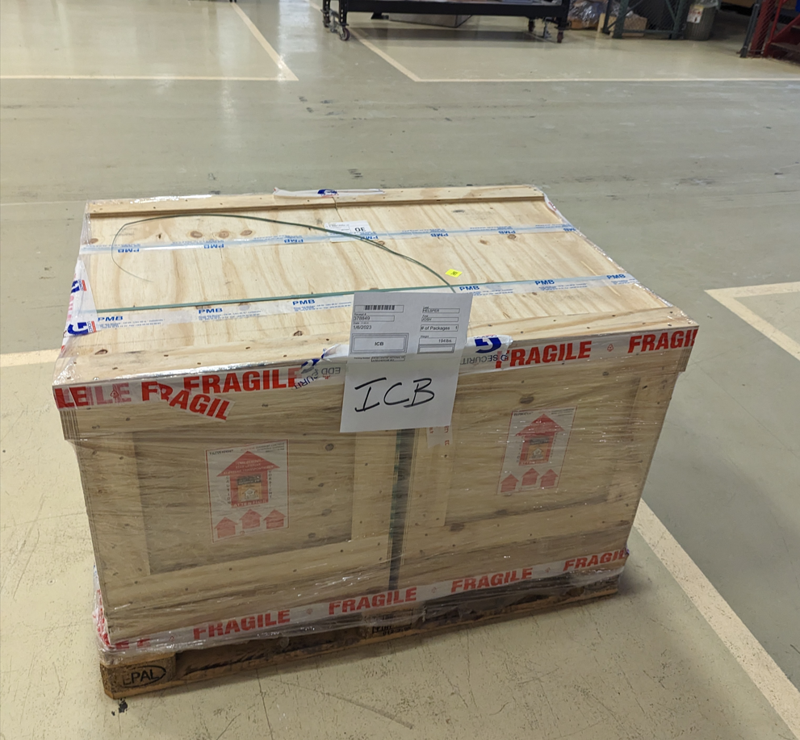
Couplers
Planning procurement of all (50+) production SSR couplers
Continue testing ppSSR2 couplers
Comparing behavior of couplers with TiN coated vs. non-coated ceramics
Received 2 IKC couplers from IJCLab

Slide 12
SSRs CM design
SPM: M. Parise Presenter: M. Parise

Slide 13
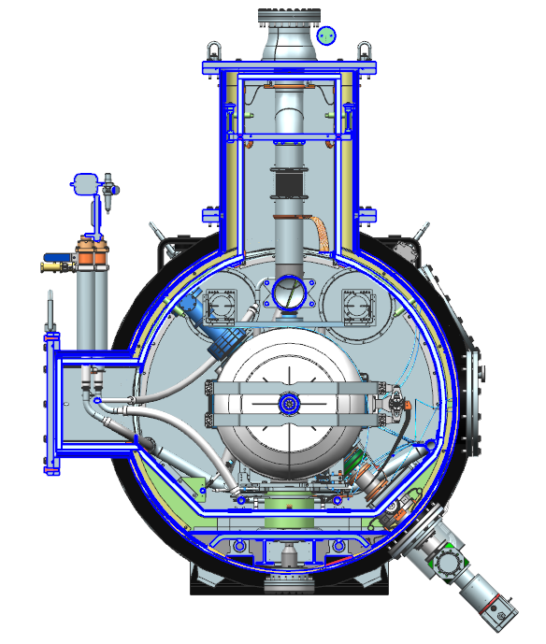
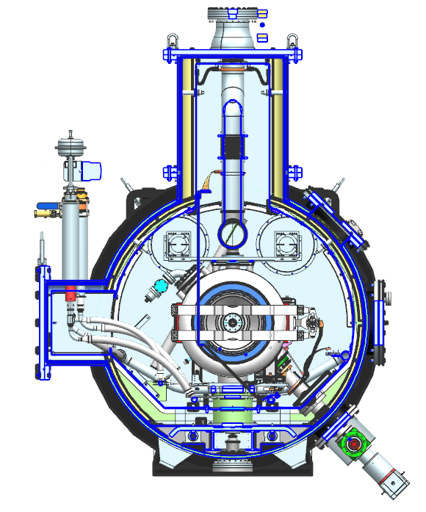
SSRs Cryomodule Cross-section
Pre-production SSR2 (F10138829)
Production SSR1 (F10142933)

Slide 14
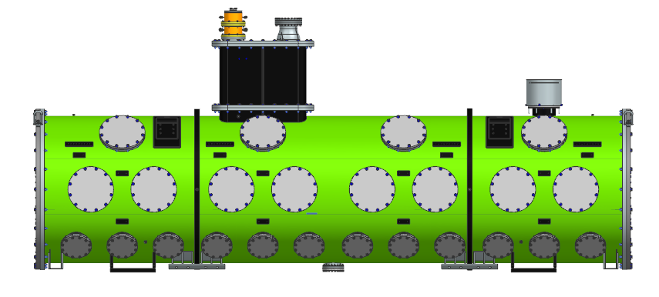
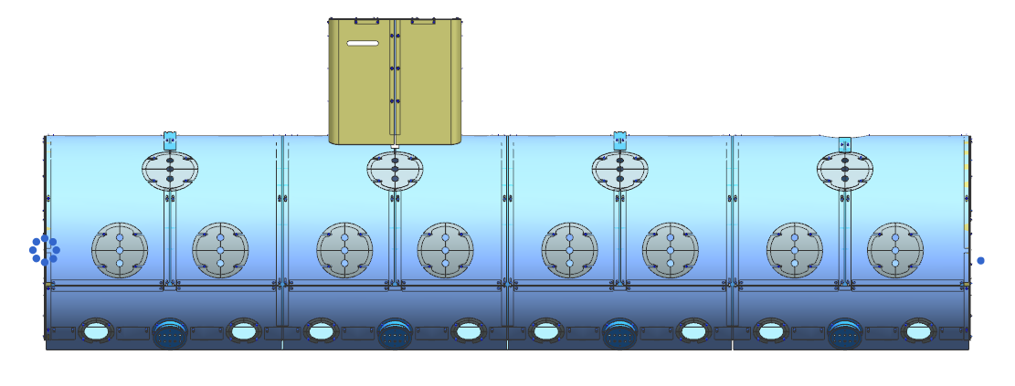
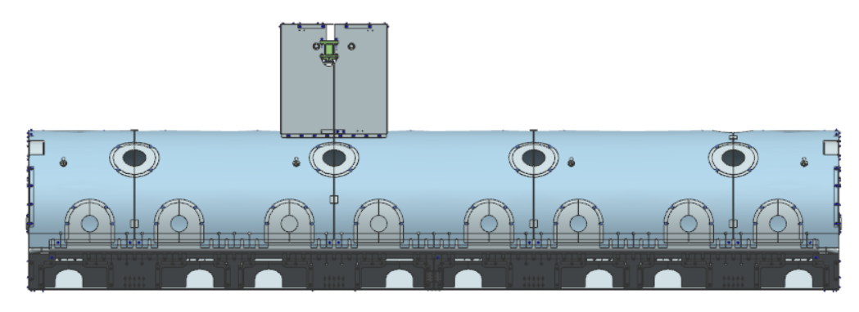
SSR1 Cryomodule Design
Vacuum Vessel and Strongback Tray: 3D model completed – Analyses completed – Drawings to be finalized
Global Magnetic Shield: 3D model completed – Analyses ongoing – Drawings to be finalized
HTTS: 3D model 90% completed – Analyses ongoing – Drawings to be finalized
CD line: 3D model 90% completed – Ready for drawing
LTTS: 3D model 90% completed – Ready for drawing
2-Phase He pipe: 3D model 50% completed – Analyses ongoing
Pumping line: 3D model 90% completed – Ready for drawing
F10187714
F10193985
F10191721

Slide 15
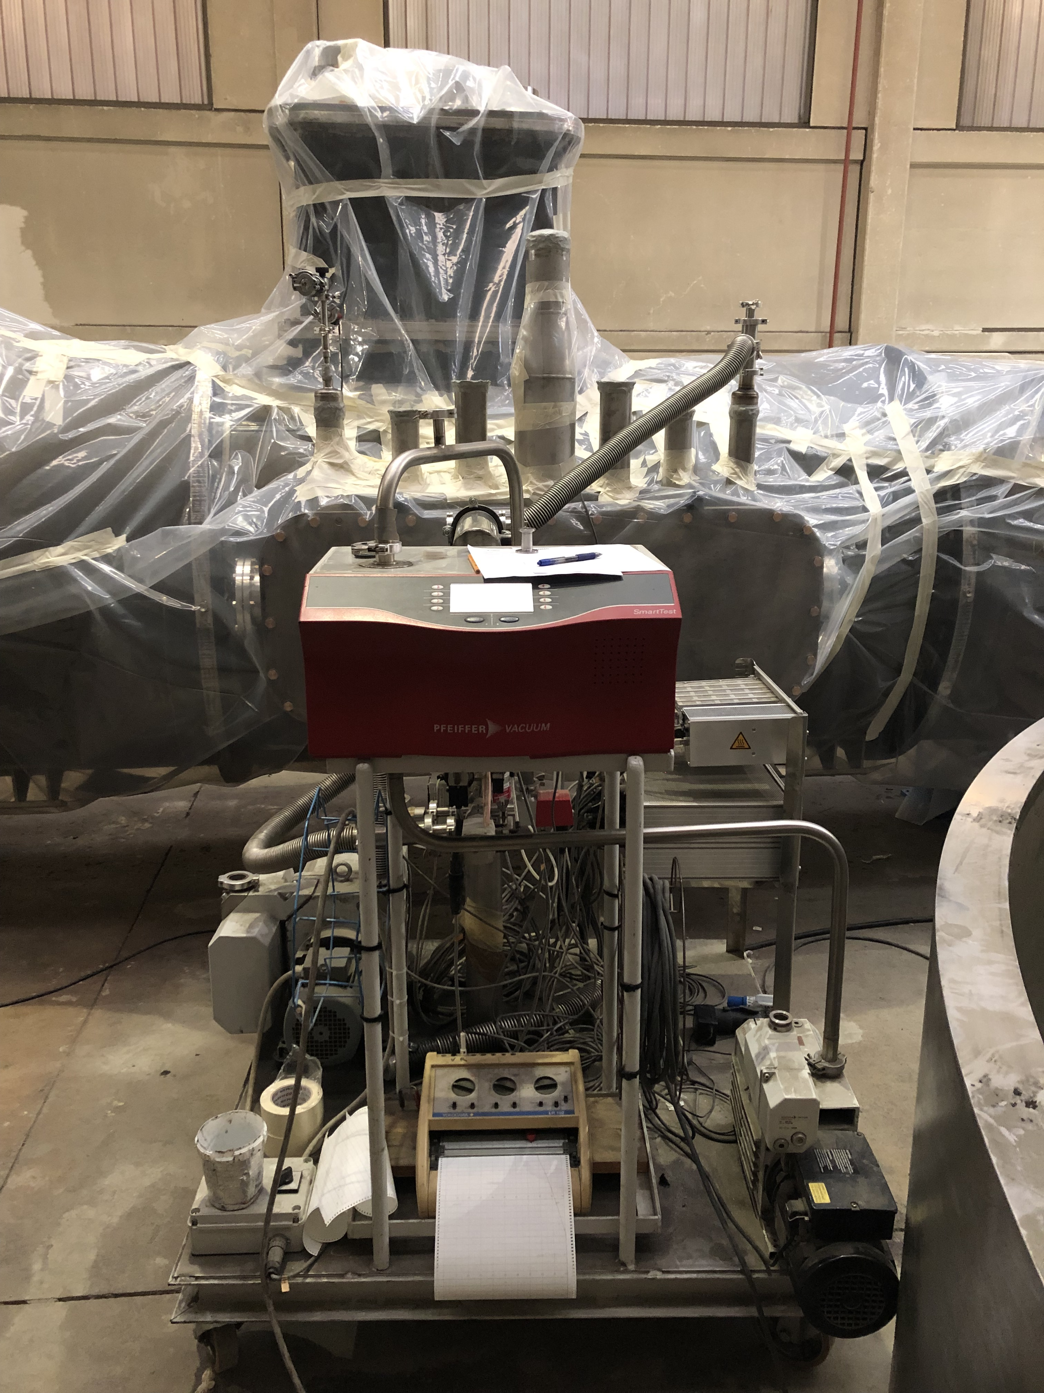
SSR2 Cryomodule Procurement
Vacuum Vessel final machined – dimensional inspection complete – first leak check complete
No leak above 6.$4{ x 10}^{−8}$ mbar x l / s was detected;
Pressure during the leak check was below 5${ x 10}^{−3}$ mbar.

Slide 16
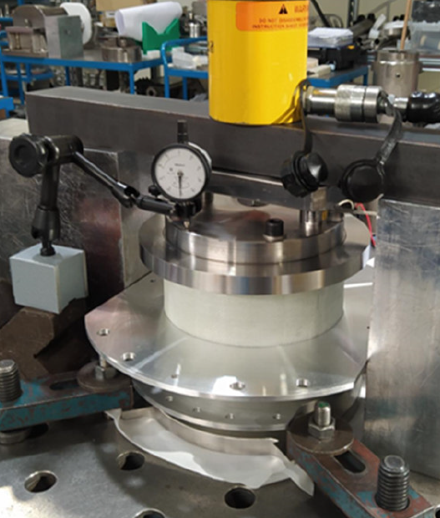
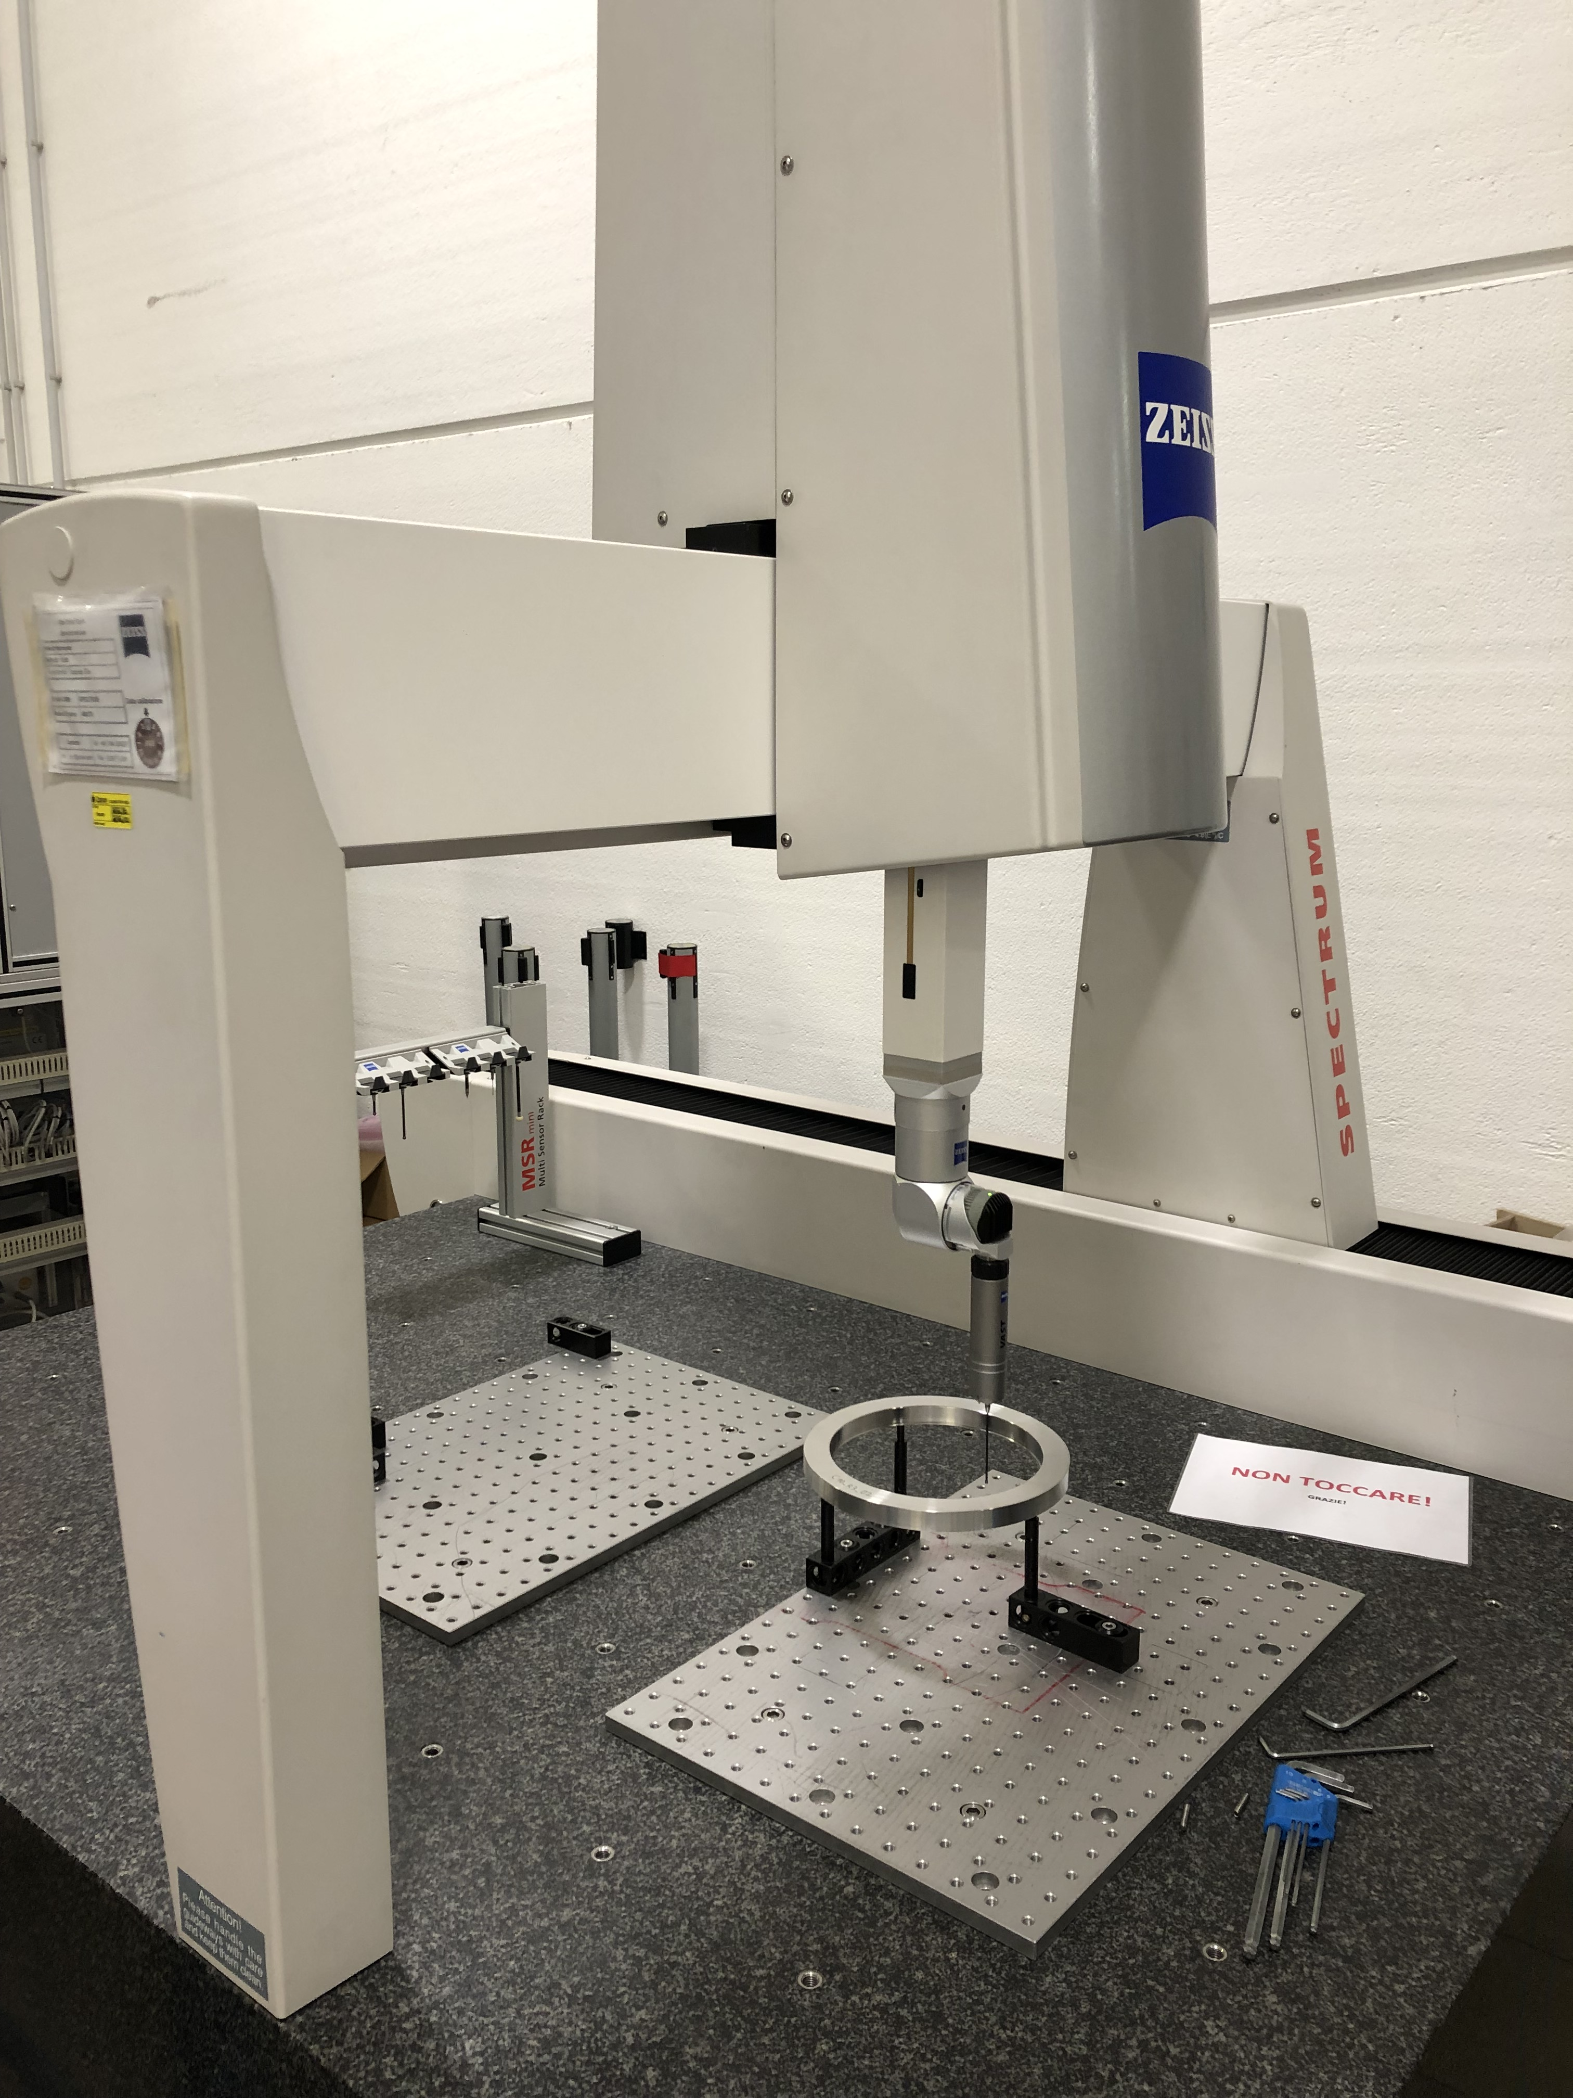
SSR2 Cryomodule Procurement
All support post SS 316 parts annealed to lower permeability below 1.02;
First support post traction testes, further tests to be done at the University of Pisa.

Slide 17
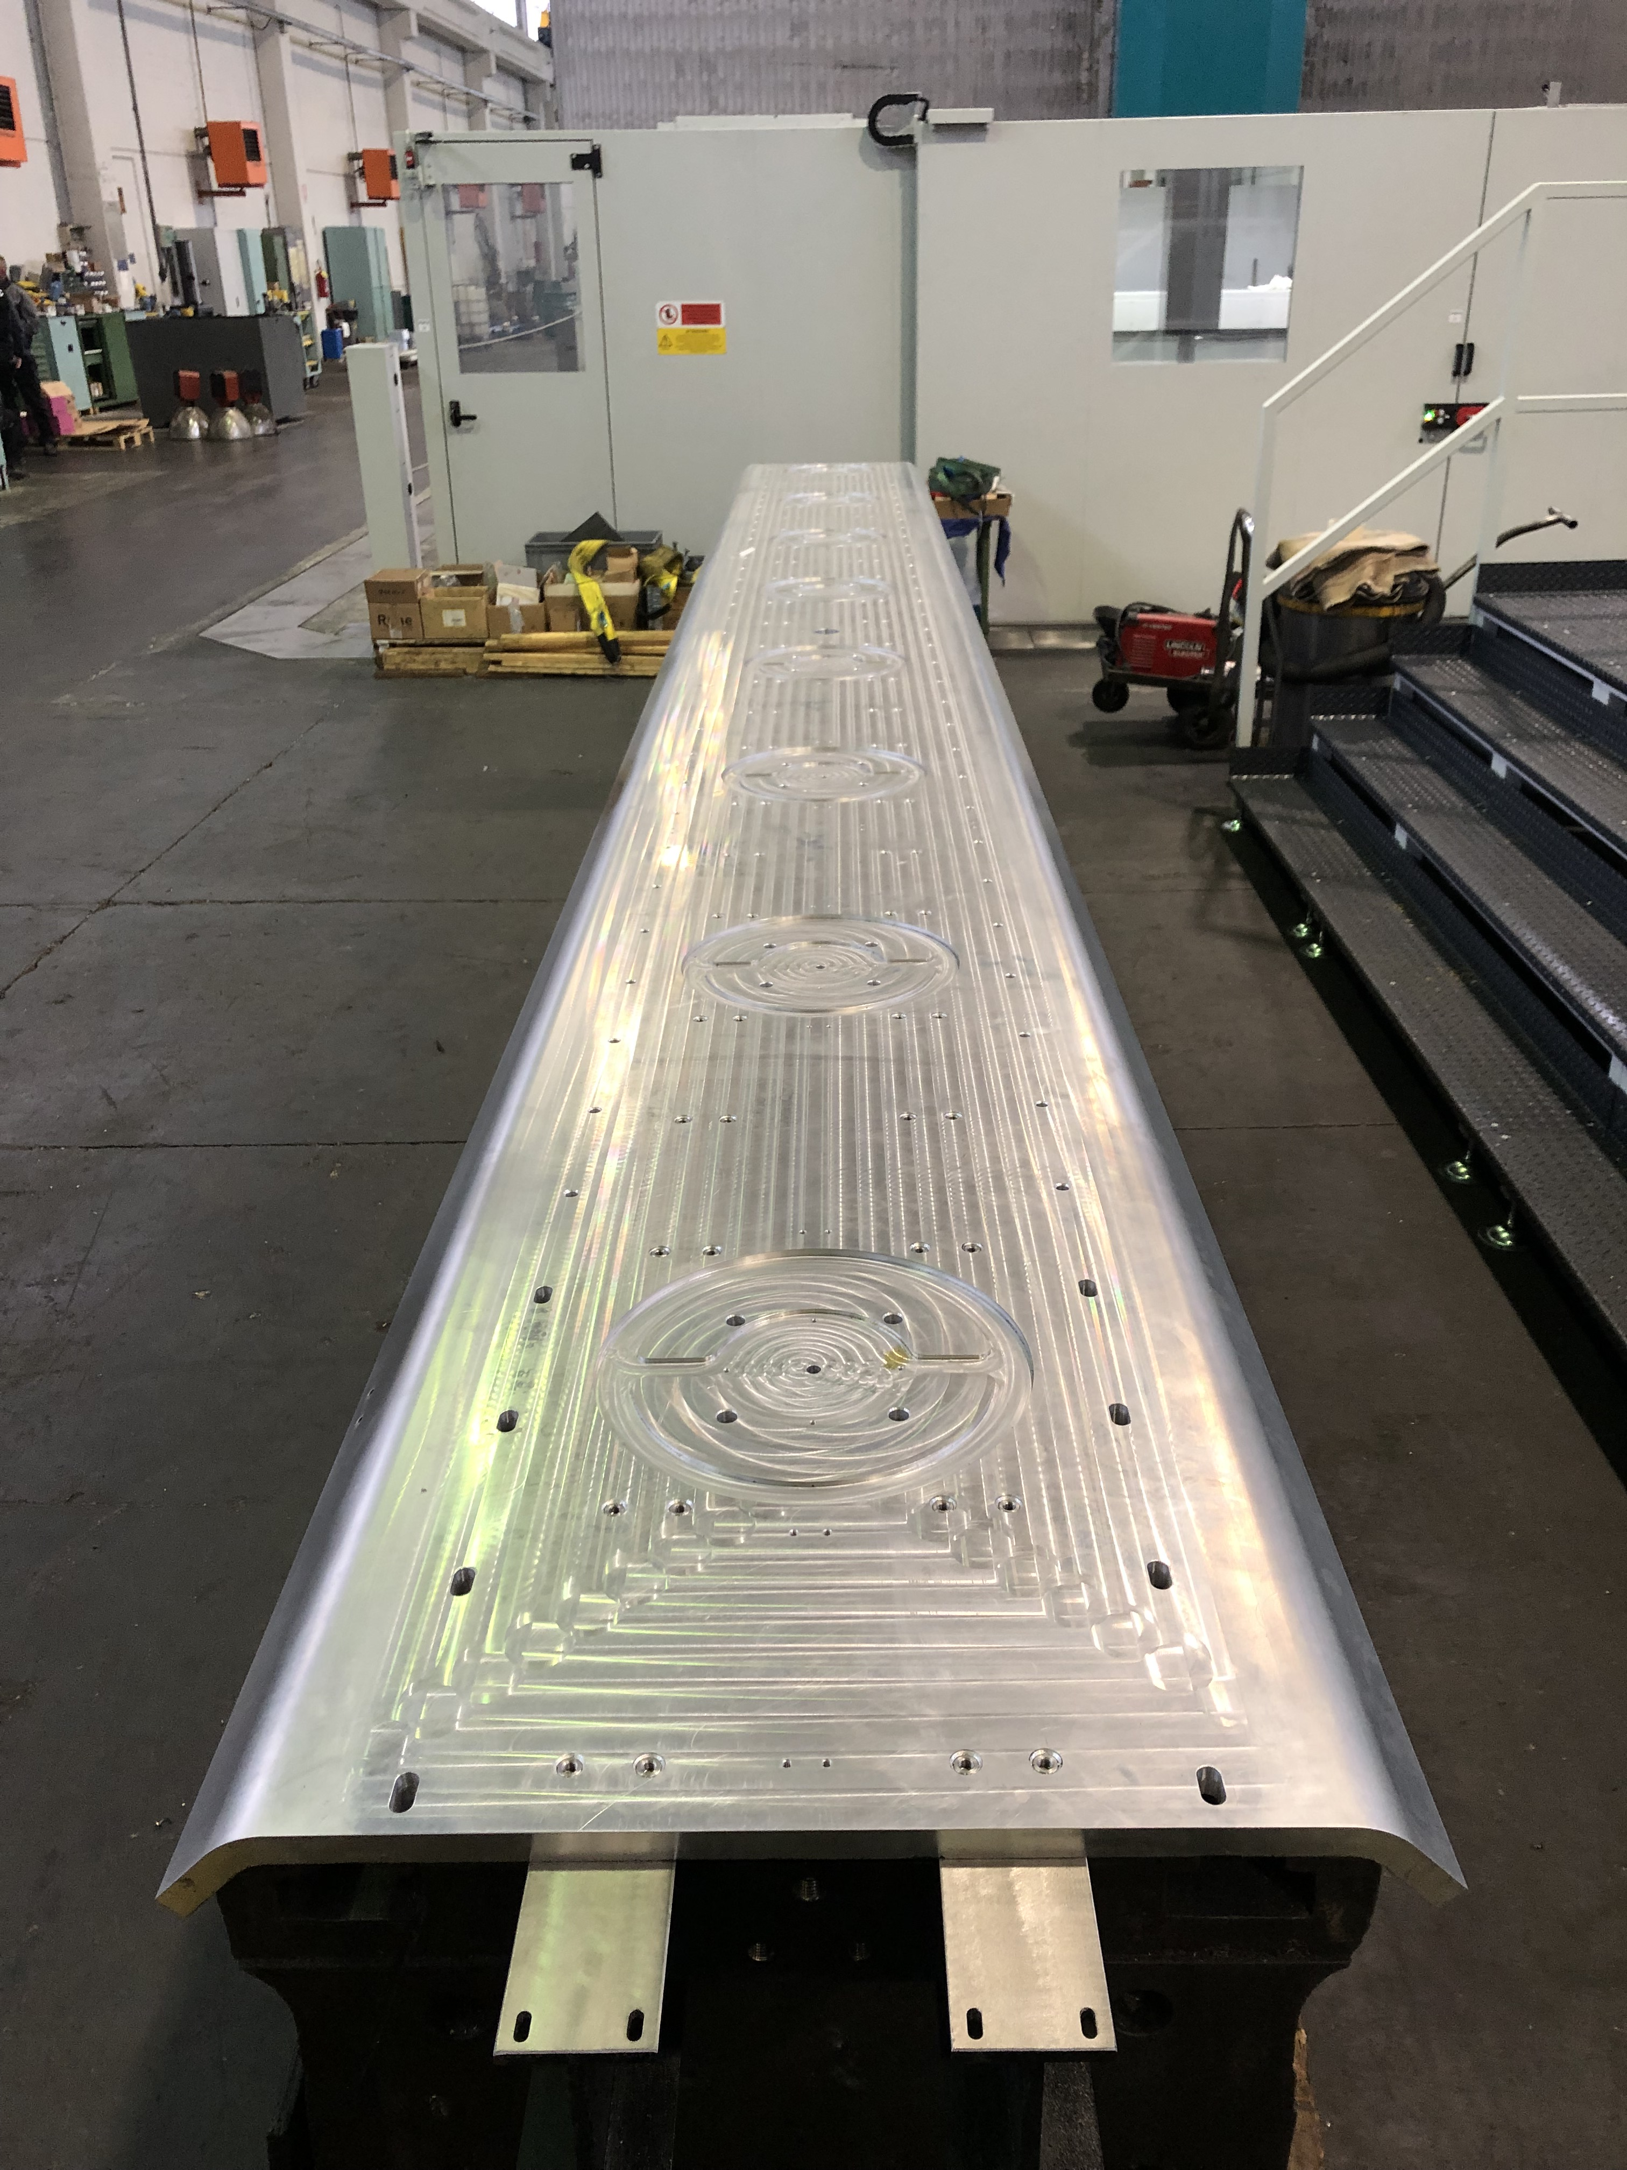
SSR2 Cryomodule Procurement
Strongback final machined and cleaned, rails and support posts to be assembled.

Slide 18
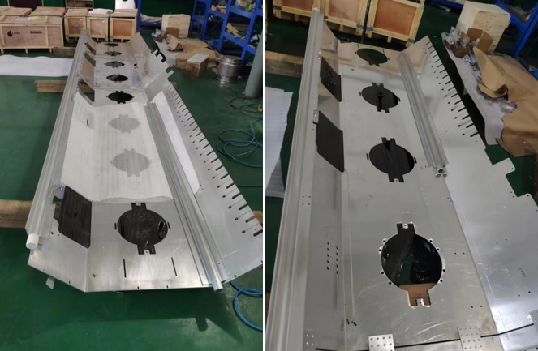
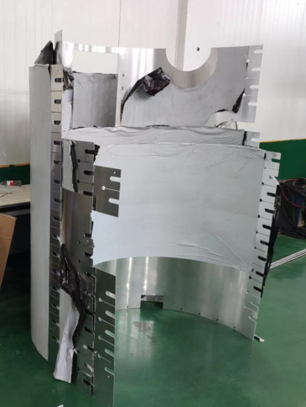
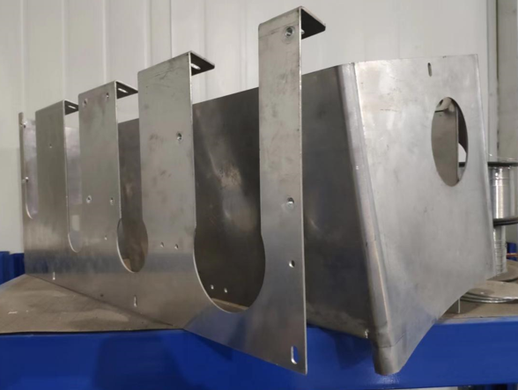
SSR2 Cryomodule Procurement
Vacuum Vessel final machined – Strongback final machined – 1st support post traction tested
Global magnetic shield manufacturing ongoing – 1st parts delivered and under QC
Thermal shield machining is ongoing – design changes were needed

Slide 19
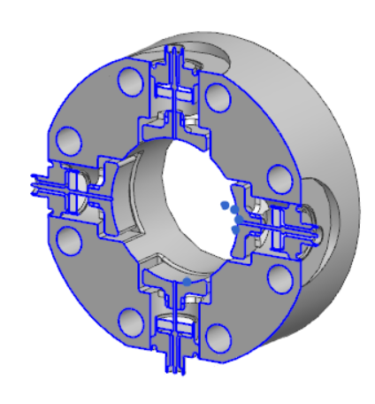
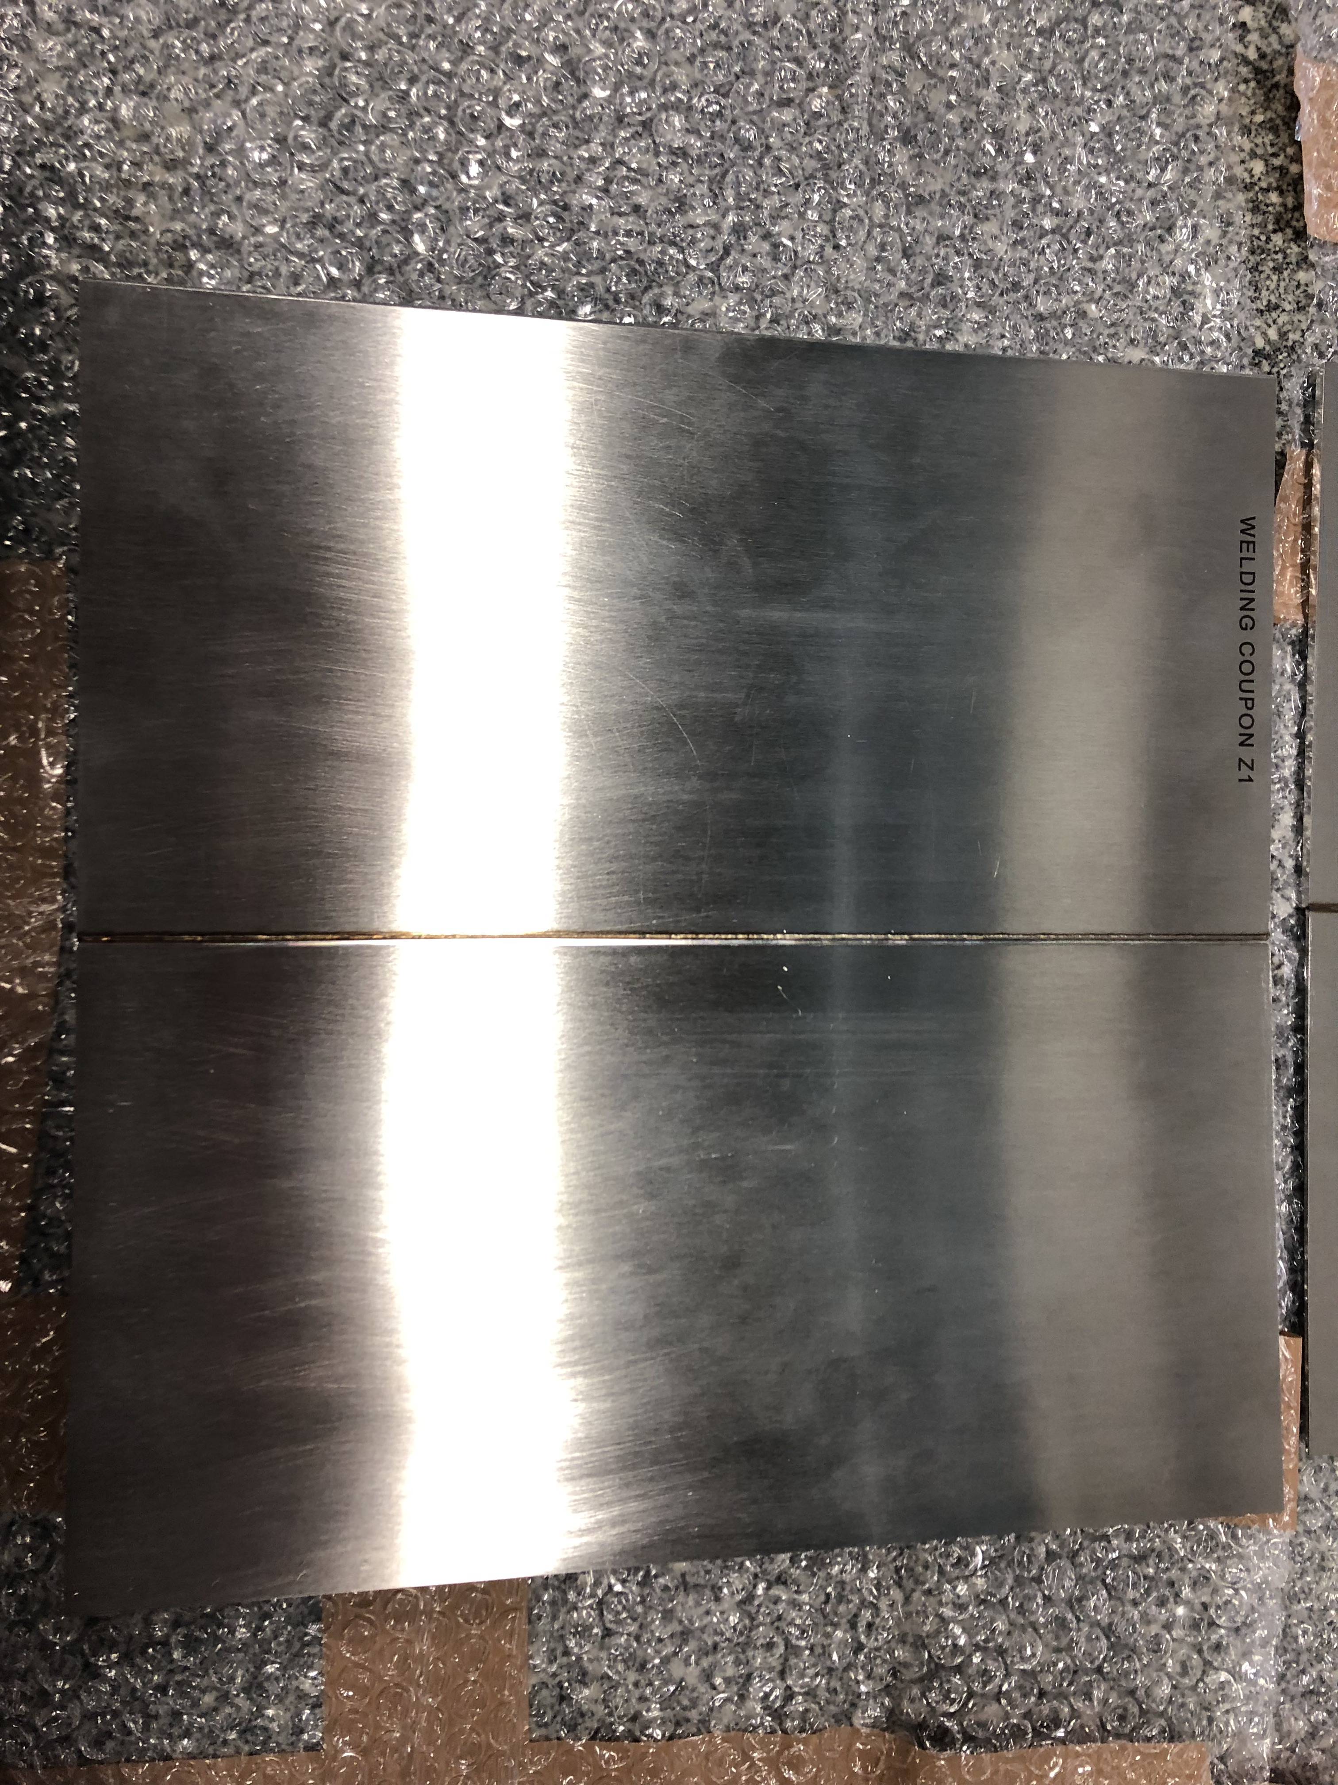
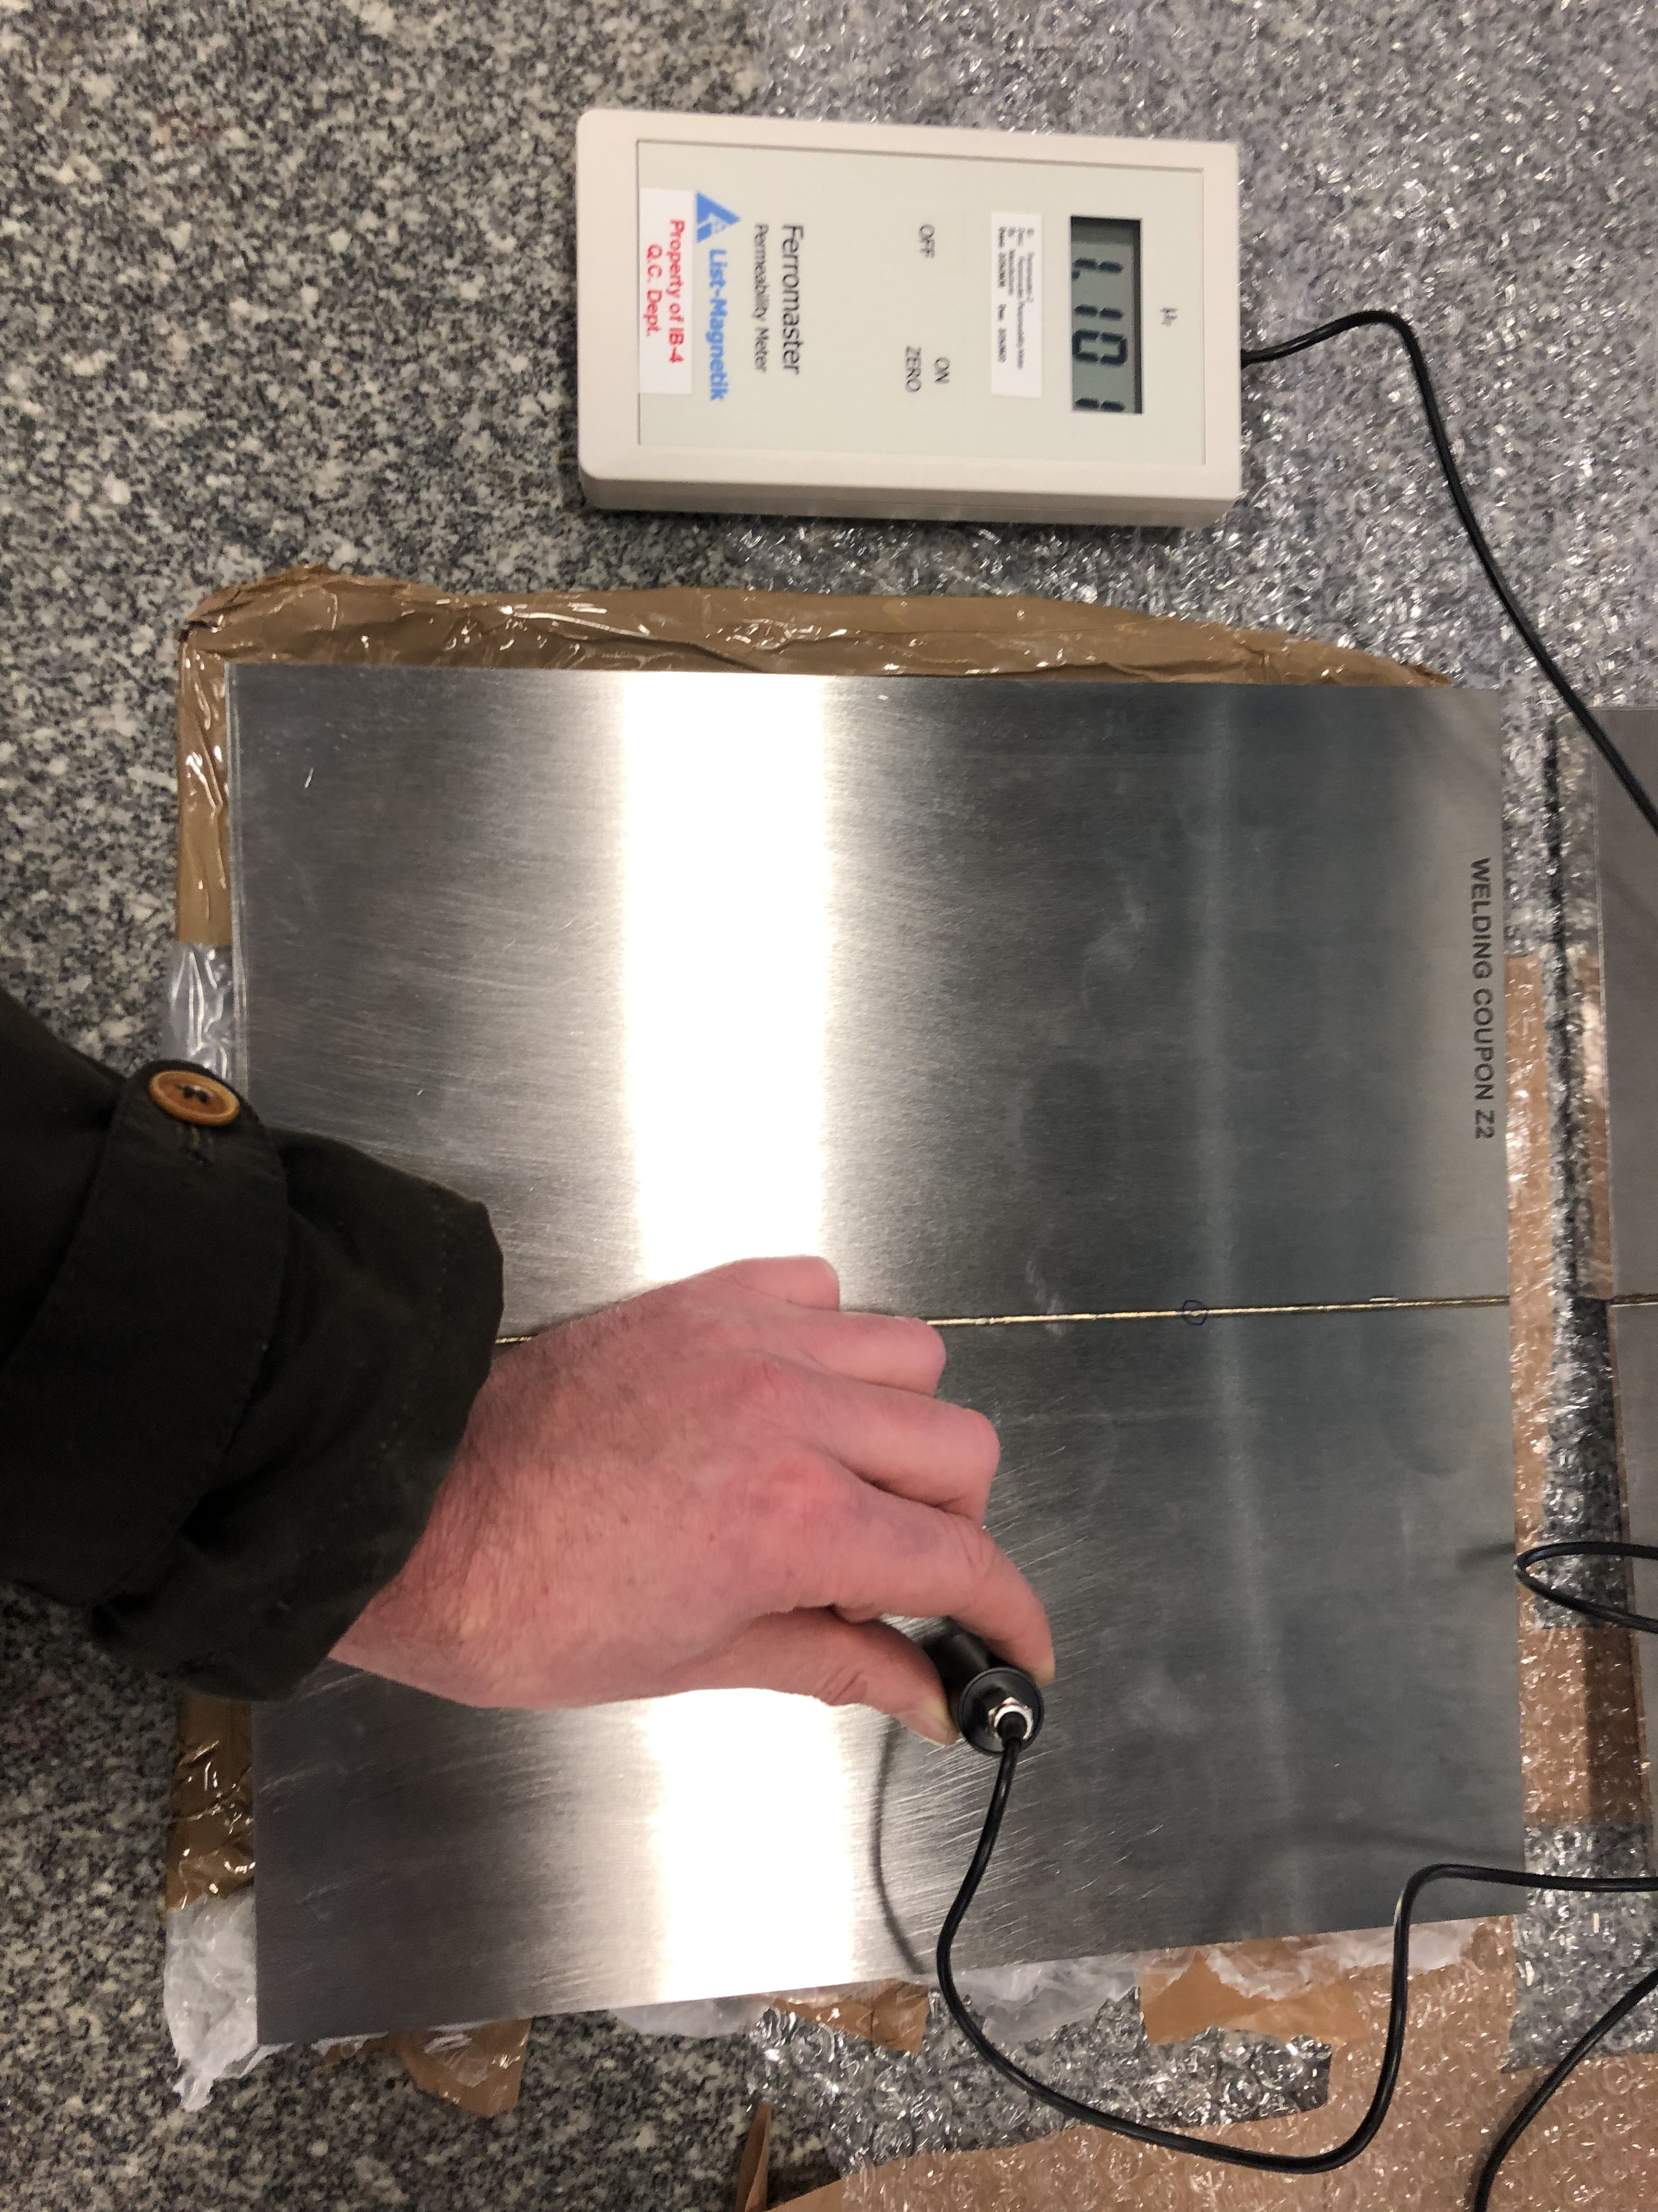
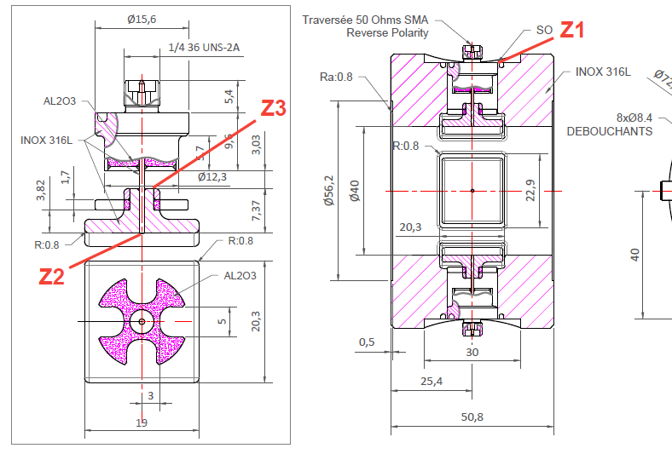
SSR2 Cryomodule Procurement
Welded coupons were received from the Manufacturer (Solcera), to be qualified to ASME IX

Slide 20
SSR2 Cryomodule - Next activities
Solenoid thermal straps
Design
Procurement
Tests (Electron beam welding, Annealing)
Design of strongback support during assembly process
FEA: Mechanical & Thermal analysis of the G11 post, with cavity plate, cavity and HBCAM targets.
Write assembly procedure
Torque spreadsheet

Slide 21
Action items from previous meetings
BARC: cavities tooling Technical discussion ongoing
BARC: Plan tuner Manufacturing Readiness Review Completed!
Release TRS/ISD for the SSR2 cryomodule Released!!!

Slide 22
Action Items

