Slide 1
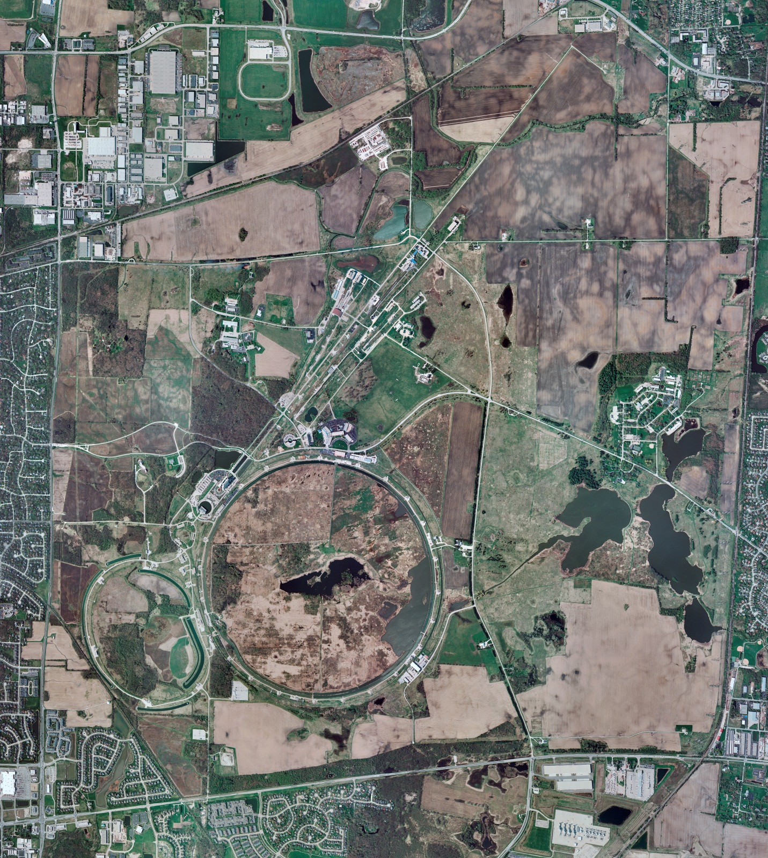
Helium Cryogenics
Status 1/20/2023 J.Makara
CMTF: SCP cold and running fine
CMTS: HECM23 cooled down to 4 K; to be pumped down to 2 K today
PIP2IT: SSR1 at RT
HB650 is in cave and connection work commencing
MCTF: cryo system warmed up to RT, shut down, and isolated
MDB/HTS: at RT
MDB/STC: at RT
MDB Magnet: at RT
NML/FAST: Cryo system cold and running fine
CC1: cold at 2 K
CC2: cold at 2 K
CM: cold at 2 K
IB1: cryo system cold and operating fine with test stands at 4 K or 2 K
Muon Campus: A0 comprs (3) online with MC-1 g-2 cryogenic system cold again after another short warmup due to magnet valve contamination plugging
Misc:.

