Slide 1
PIP-II Vacuum Integration FDR Introduction
Jeremiah Holzbauer, Accel Sys L2 Manager
Monday, May 13, 2024

Slide 2
Integration Review Description
From the PIP-II Technical Review Plan:
“…integration reviews assess the design and interface maturity of interrelated systems and their interdependencies with each other and also cover the overall integrated system scope and how this scope is distributed among subsystems, address design and operational dependencies and assumptions, and discuss interface maturity and the impact of interface changes on other systems. System installation plans and sequencing are presented and their impacts on the overall integrated system installation.”
This is a review focused on the Vacuum L3 scope and how it integrates into other systems’ scopes.
Interfaces, requirements, planning documentation (e.g., handoff documentation)
My interpretation: Are the teams talking? Is that communication systematically documented?

Slide 3
Introduction to PIP-II Reviews for Reviewers
PIP-II has maintained a process to help standardize technical reviews and documentation
Review Charge and Committee Report are standardized
Are included on the indico page
Integration Review will use the same tool
Committee is asked to provide:
Findings (factual statements about the design you thought were significant when drawing your conclusions)
Comments (sort of soft recommendations, something you want to say but don’t want to make a recommendation)
Recommendations (formal, actionable guidance on how to change/improve the design) that must be responded
Committee is requested to complete their report within 2 weeks
Committee report is a critical step in allowing the PIP-II milestone to be closed and work to proceed

Slide 4
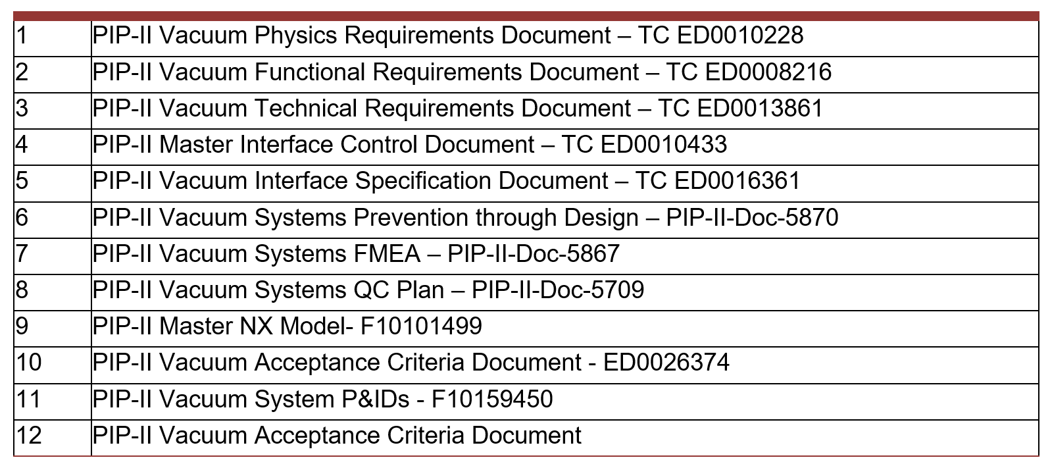
Deliverable Verification
Vacuum System Documentation List
Design document deliverables table above
Part of PIP-II planning efforts is identifying design documents will be presented
One of the Review Charges asks you, as a committee, to comment on this list in your report (Table 2 of the report)
Your comments on this list are critical for closing the loop for the project:
Are any documents missing from the list that should be there at this point?
Are any insufficient, under-developed for this stage of the design?
There are other coordination documents show clarifying L3 relationships

Slide 5
Review Etiquette Reminder
Please mute unless actively speaking
As this is an integration review, it is meant to be a more open forum
In general, let the speaker present with the committee asking questions to keep things focused.
Be respectful and timely with your questions, but system owners are asked to speak up if they think there is a gap or misunderstanding of scope.
The closeout time is tentative; the review coordinator will send out a reminder for the closeout once the time is confirmed.

Slide 6
Technical Integration Support
The PIP-II Technical Integration team works to maintain and update this review process
At least one member of the team will attend the review and is available for your comments, questions, and feedback
csbecker@fnal.gov or ext. 5582
jeremiah@fnal.gov (originator)

