Slide 1
PIP-II Technical Integration MICD Update Overview
Technical Integration Group
Chris Becker
Tuesday, May 7, 2024

Slide 2
What is the MICD?
Master Interface Control Document (MICD) is a living spreadsheet containing all interfaces between Level 3 systems
Each interface categorized by name, description, System A and B scope, “integrator” scope, and relevant interface detail documentation
Assignment of System A and System B does not matter. Unique numbering does
Integrator is not an official title, but captures the installation and/or verification of the mating of interfaces, and is typically an outside party (LI, BTLI, BldgI, etc.)
Interfaces listed in MICD are purposefully kept high-level as the detail is captured in the relevant and appropriately mapped Interface Specification Documents. Also limits number of revisions to MICD.
Original Revision written in December of 2019
Currently released version of MICD in Teamcenter as Revision AJ (ED0010433)

Slide 3
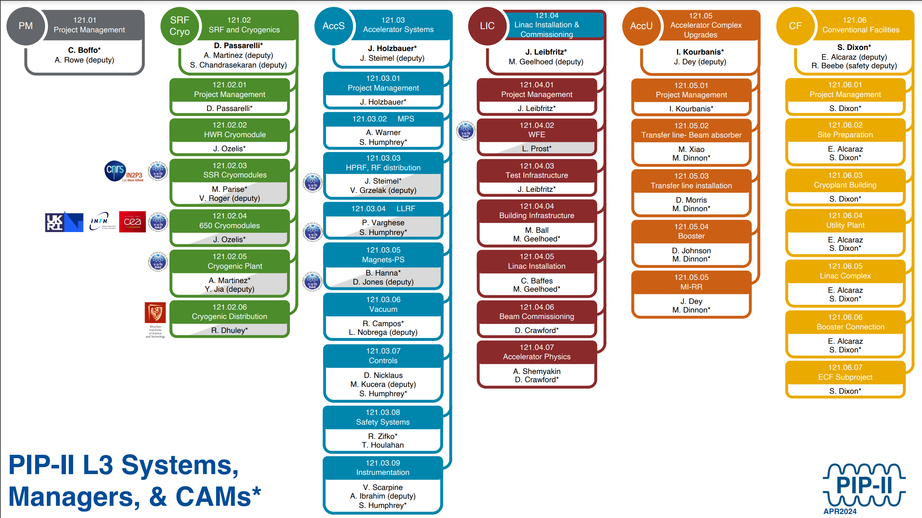
PIP-II Organization Chart
More context for L3 Systems and Project organization

Slide 4
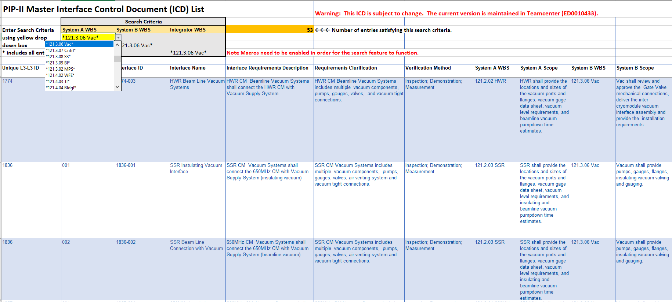
MICD Sample Interfaces
MICD Interfaces shown between Vacuum and Various Cryomodule L3 Teams
Sheet is sortable by L3 System

Slide 5
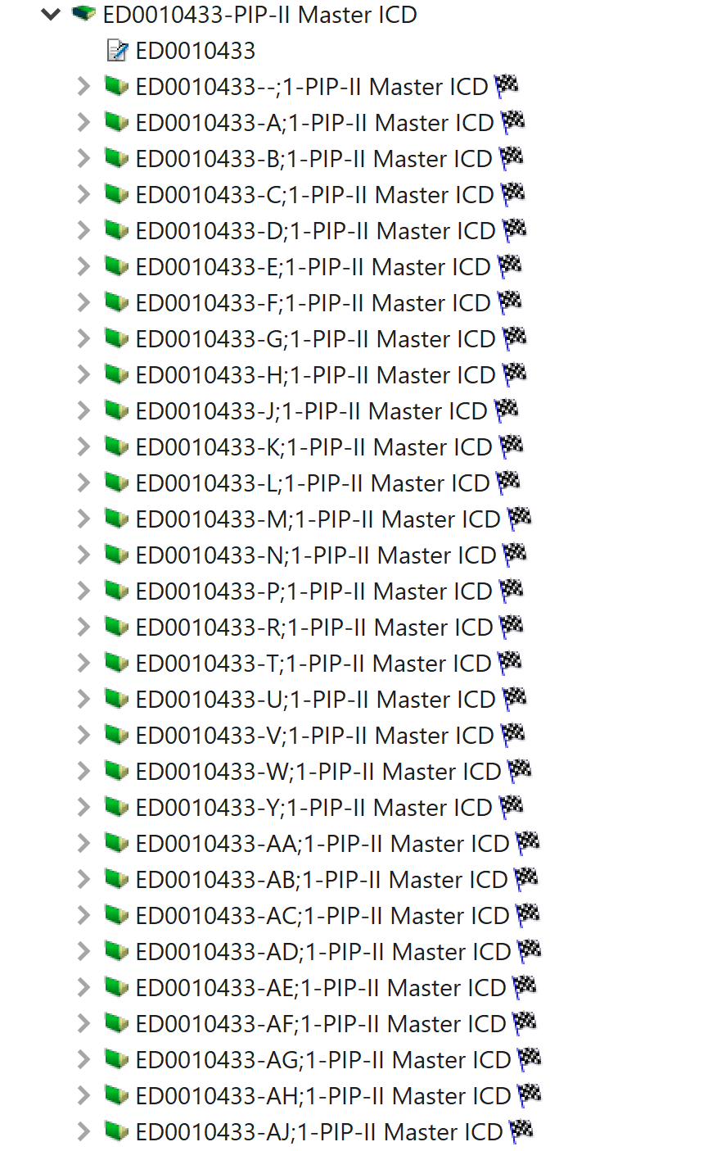
MICD Sample Interfaces Continued

Slide 6
Unique L3-L3 Numbering Map (ID Matrix)

Slide 7
Changelog for MICD

Slide 8
Goals: Preparing for Integration Review
Previously, Integration Reviews entailed auditing the MICD live during the review.
Series of meetings were scheduled so Vacuum could meet with all interfacing L3 systems in shorter meeting format
MICD is a convenient tool to show all interfaces and initiate discussion between L3s
Intent was to finalize scope between “System A and System B”.
Detail could be finalized in back end through ISD
Also could use meetings to identify missing scope and add interfaces or removal of redundant interfaces
Ultimate goal was to remove any ambiguity about interface scope ownership

Slide 9
Vacuum Interfaces
Vacuum has 46 total interfaces
Total number reflected in previous slide is incorrect
Seven Partner interfaces do not filter out which is being corrected currently.
Vacuum Interfaces with 18 different L3 systems across project
A batch-type approach to interfaces
Each interface covers a larger scope
For Example: Interface 1836-001 below covers pumps, gauges, valves, venting systems, and vacuum tight connections that connect between the last SSR2 CM and first LB650 CM

Slide 10
Complex Vacuum Interfaces
Other interfaces less straight forward
Talks with Beam Instrumentation need revisiting.
Connections are complex
Decent amount of back-and-forth handoff before handoff to installation
Vacuum team doing actual verification work under BI WBS
MagPS interfaces
Certain magnets under MagPS WBS own the beam tube embedded within
With others, Vacuum owns the beam tube inside of MagPS magnets
Non-Physical Interfaces
Signal Interfaces (MPS and Controls to Vacuum PLCs)
Booster and Vacuum had a Vacuum level interface

Slide 11
Results
All interfaces are understood
Only one L3 needs revisiting (BI)
Follow-up meeting scheduled post integration review to further discuss and negotiate Scope ownership
Scope A and Scope B for all interfaces in MICD now accurately reflect actual scope
Appropriate ISDs are now mapped in MICD
Discussions in MICD have led to better clarity of detail in ISDs
Most changes were clarification or shifting of scope
L3 teams have better understanding of where details of interfaces are stored

