Slide 1
PIP-II Vacuum Systems Installation Handoff Documentation
WBS 121.03.06
Lucy Nobrega, Ryan Crawford, Aisha Ibrahim, Kyle Kendziora, Denton Morris
PIP-II Vacuum Systems Integrated System FDR
May 13, 2024

Slide 2
Outline
Charge #1,7
Documentation Overview for Complex Handoffs
Handoff Details
Linac Installation
BTL Installation
Beam Instrumentation
Cables and Connectors
Summary

Slide 3
Documentation Overview for Complex Handoffs
QC Plan PIP-II-docdb-5709 covers
Acceptance
Cleaning/handling
Certification and other travelers
Nonconformance handling
Technician Qualification
New: considering QR code assembly tracking system
Installation Deliverables lists detail handoffs
PIP-II IDL VAC-LI (ED0011282)
PIP-II IDL VAC-BTLI (ED00XXXX)
PIP-II BI IDL (ED0011271)
PIP-II Cable Database
These include
Equipment list
Shipping configuration/location
Configuration at handoff
Quantity
Documentation
Additional details as required
Acceptance Criteria Document, ED00XXXX, will be attached to IDL’s to describe incoming deliverables.

Slide 4
Vacuum Hardware Hand-off to Linac Installation- VAC IDL

Slide 5
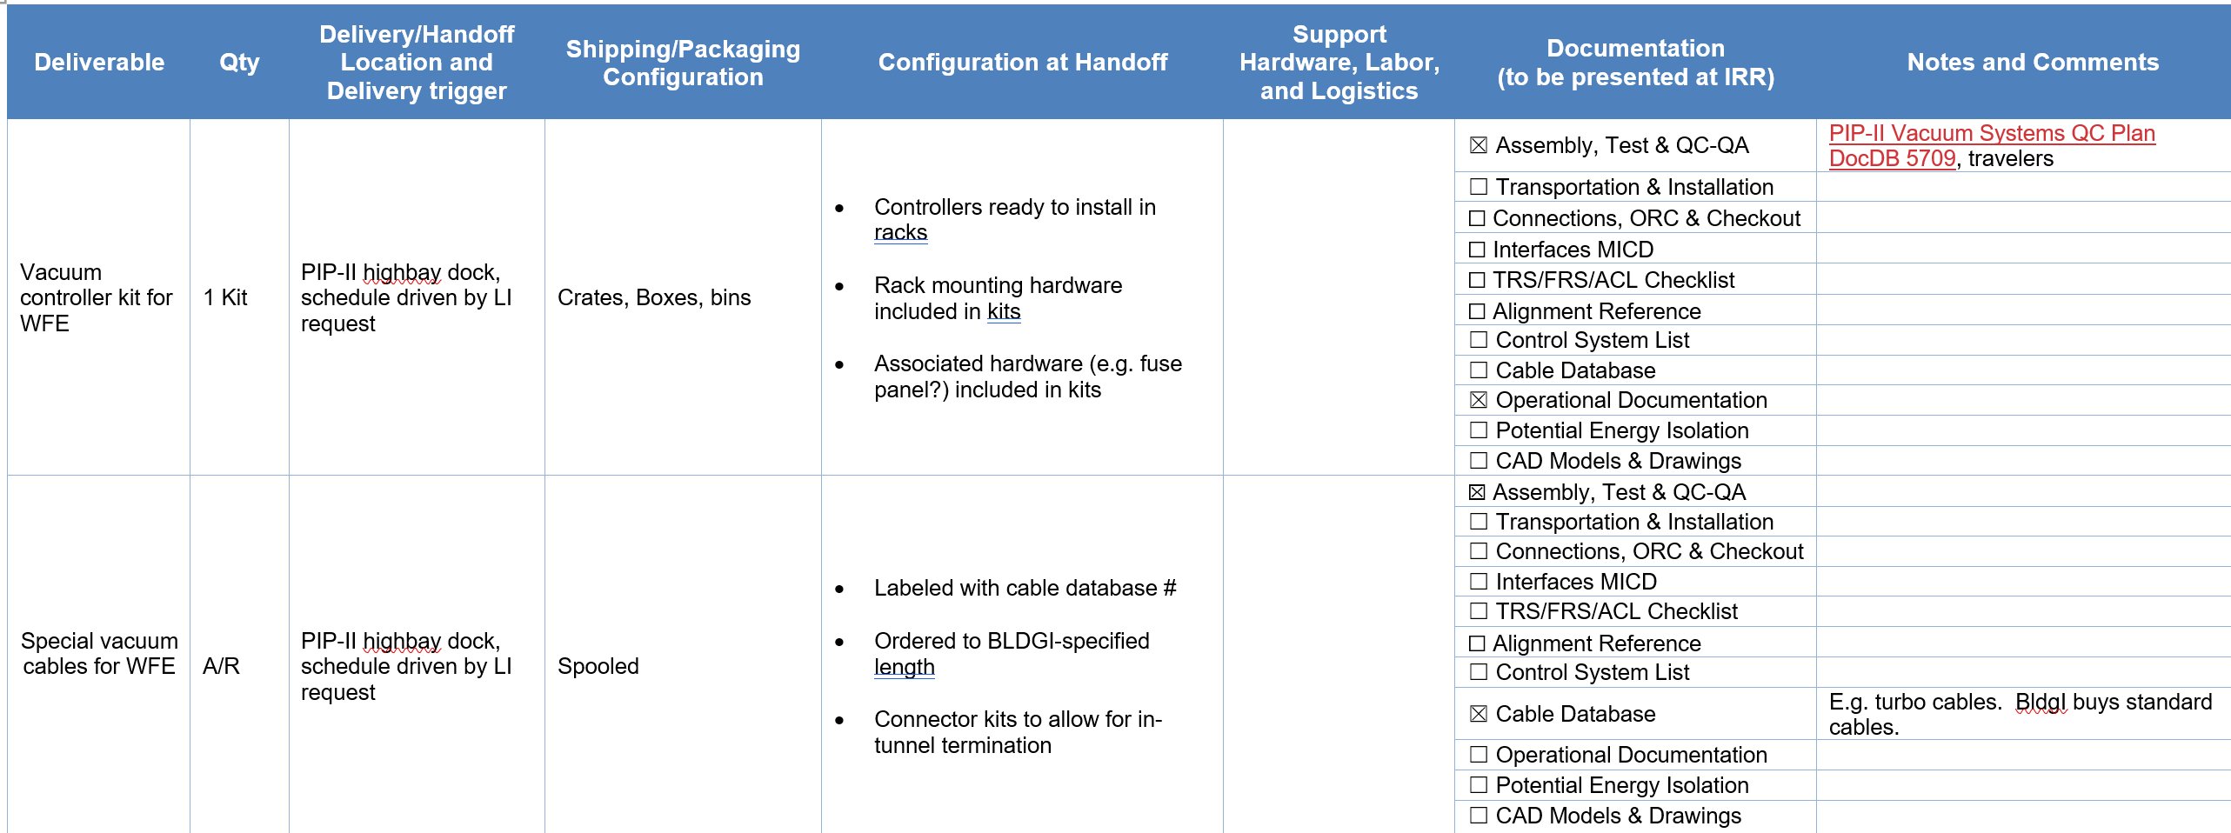
Vacuum Hardware Hand-off to Linac Installation- VAC IDL
Includes controllers and special cables only. Interface between VAC and Cntrls is connector on back of controller.

Slide 6
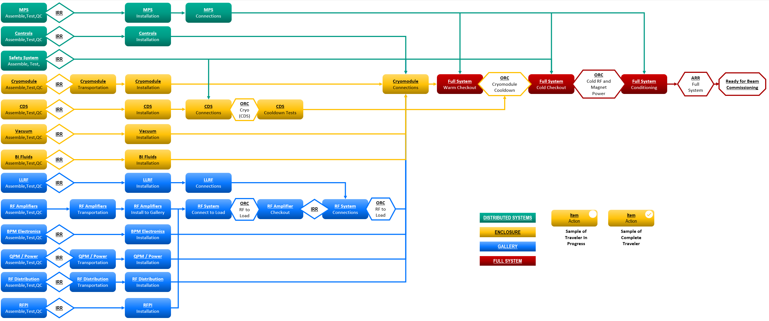
Quality Assurance- Traveler Tree
Work to be documented in travelers, utilizing FNAL’s Vector system
Hierarchical traveler tree reflects system build-up
Gates (e.g. Operational Readiness Clearance) identified and coordinated with Verification & Validation
ORC gate
Individual Traveler

Slide 7
BTL Installation Scope

Slide 8
BTL Installation Phases

Slide 9
BTL Installation Phases

Slide 10
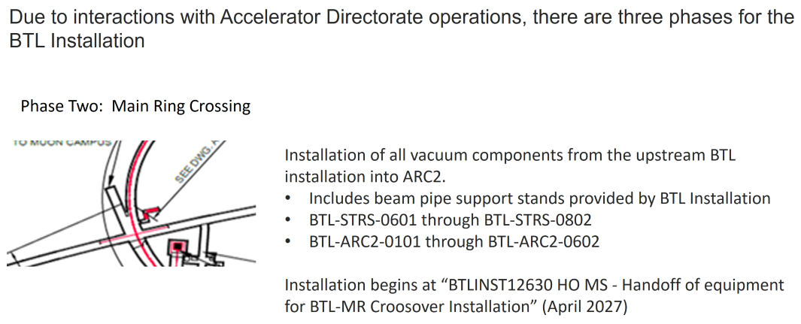
BTL Installation Phases

Slide 11
VAC – Beam Transfer Line Installation (BTLI) Handoffs

Slide 12
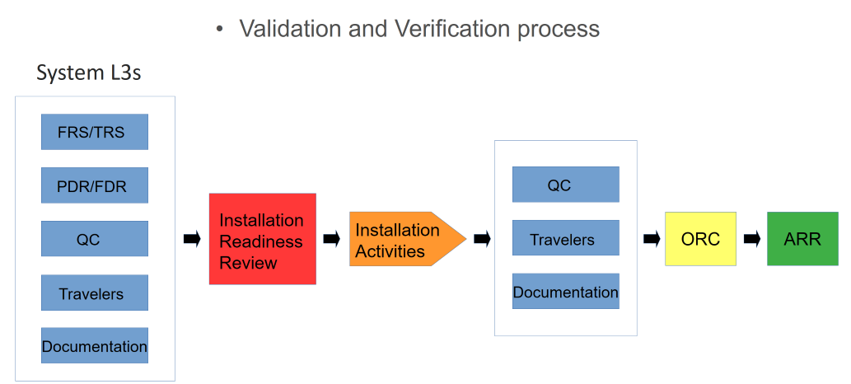
BTL Installation Hand-off
Notes:
The System L3s (Vacuum) come to the Installation Readiness Review (IRR) with the following:
Functional and Technical Requirement Specifications
Preliminary and Final Design Reviews
Recommendations
Responses to Recommendations
Quality Control Documentation
Non-conformities
Corrective actions
Travelers
Installation Deliverables List (IDL)
Installation drawings
Special handling procedures
Hazard Analysis (When needed)
LOTO procedures (When needed)
Following completion of all IRRs the Vacuum L3 WBS will be closed out and Vacuum efforts will be covered under the Installation WBS (121.05.03 BTL Installation)
BTL Installation will continue with QC., Travelers and installation documentation which will all be presented at the Operational Readiness Clearance prior to running the systems. Upon completion of the ORCs for all systems they will be presented to the Accelerator Readiness Review prior to the start of Commissioning.

Slide 13
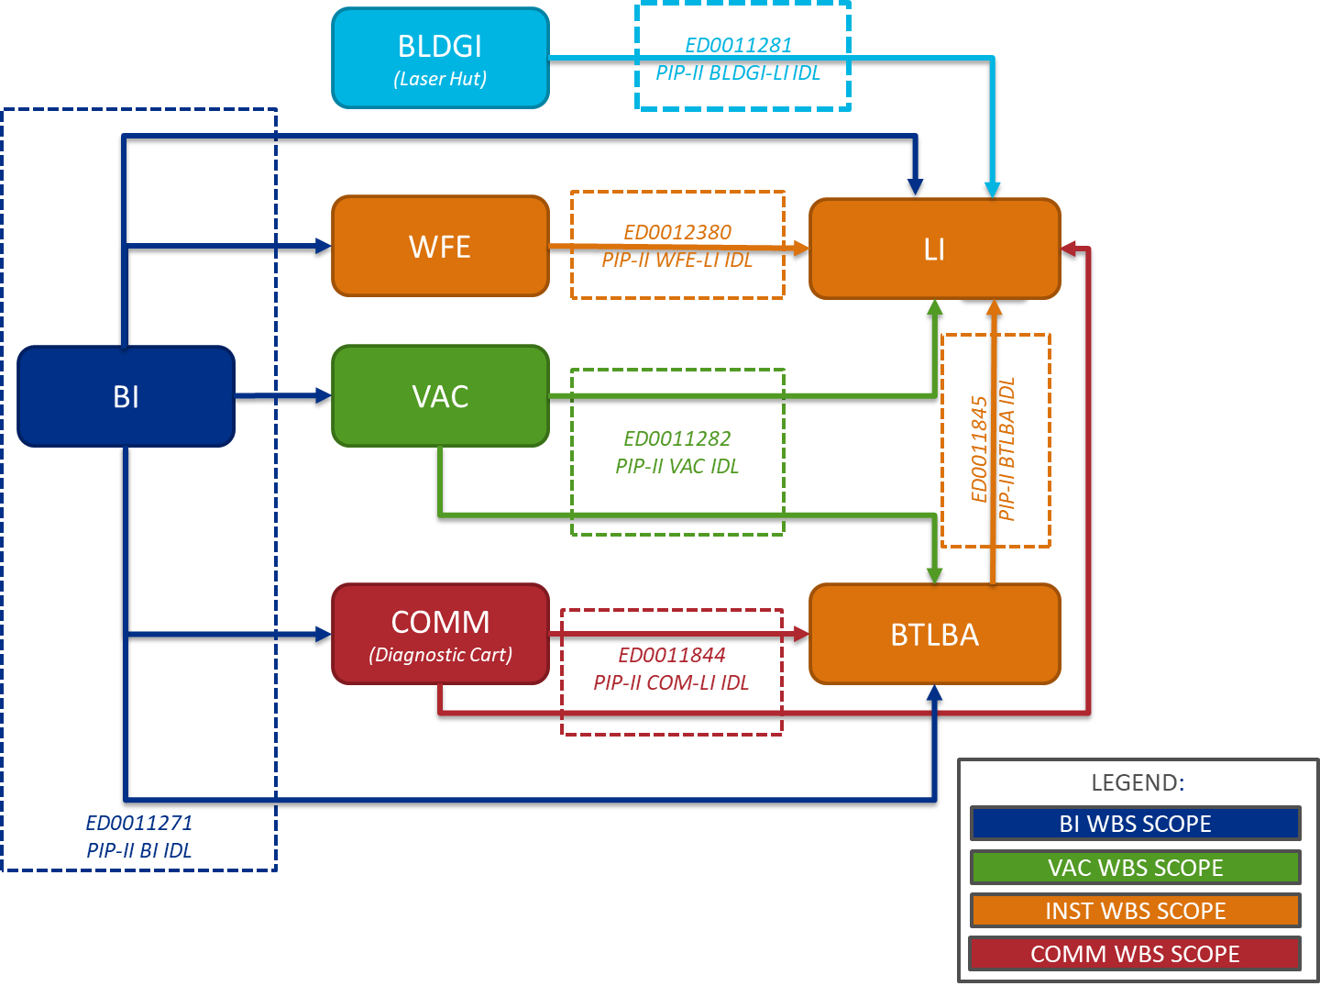
Beam Instrumentation Handoff Paths
BI Acceptance Documents will be BI’s QC Plan (PIP-II-Doc-5520)
BI Verification Plans will be listed in the BI’s QC Plan (PIP-II-Doc-5520)
Notes:
Green “HO MS”, in slide, ties to BI750440 – BPM Pickup Components Ready for Installation, which drives a vacuum activity chain that drives (orange MS) LI-17100 & LI-17110.
QUESTION:
How many procurement cycles are there for the BPM pickups?
RECOMMEND:
Remove BI7514025 and BI7514035 as predecessor to BI750440
Add HO MS for BPM installation in the BTL; Predecessor to new HO MS will BI7514025 and BI7514035; Successor will be an BTL installation activity

Slide 14
Quality Control Plan (PIP-II docDB 5520)
PIP-II Beam Instrumentation Quality Control Plan (PIP-II docDB 5520) host tables, in which all acceptance documents, verification procedures, and travelers are enumerated, for each BI system.
Example of how QA documents map against workflow and handoff milestones (HO MS)
Diagrams are available in BI Verification and Validation Plan (pip2-docDB #7517)

Slide 15
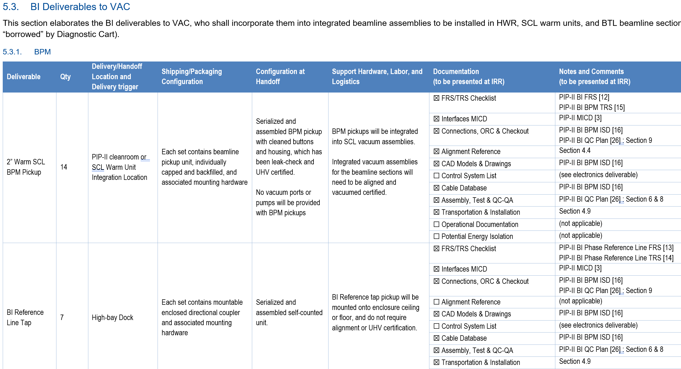
Beam Instrumentation Hand-off to Vacuum (BI-VAC IDL)
BI-VAC handoffs include
(14) BPM (SCL)
(7) BI Reference Line Tap
(56) BPM (BTL)
(2) Large Aperture BPM (BTL)
(2) ACCT (SCL)
(1) End of SCL ACCT
(1) End of SCL DCCT
(2) End of SCL TWS subassemblies
(16) TWS subassemblies (BTL)
(12) Laserwire subassemblies (SCL)
(12) Optical Mirror Box

Slide 16
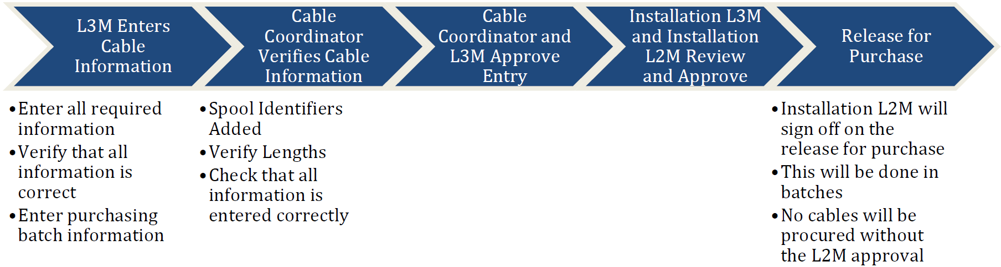
Cable and Connectors
Cable Documents
Standard Cable and Connector List - ED0014371
Needs some updating as we move forward with final designs
BldgI will procure cables included in this document
Cable Criteria - ED0014355
Details requirements for standard (BldgI procured cables) and specialty cables (procured by individual L3s)
Handoffs
Cable Plan - ED0014352
QC checks (Tracked via Travelers)
Hand off documents (Travelers, Cable DB entries, etc.)
Cable DB requirements (Cable type, Origin, Destination, etc.)

Slide 17
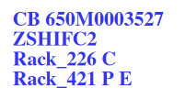
Cable and Connectors
Cable DB
Used to track all cable and connector information
Automatic label generation
Used successfully since MI era at Fermilab
Cable Type and DB ID
Function
Origin
Destination

Slide 18
Summary
Installation Deliverables Lists detail handoffs.
PIP-II IDL VAC-LI (ED0011282)
PIP-II IDL VAC-BTLI (ED00XXXX)
PIP-II BI IDL (ED0011271)
PIP-II Cable Database
Expectations and P6 handoffs are well understood and detailed in above documents
Remaining work – complete the following
VAC-BTLI IDL
Unfinished document deliverables (procedures, documents, travelers)
Acceptance Criteria Document for incoming off-the-shelf purchases and BI deliverables
Meet handoff goals
WFE assemblies to LI Q2 2025
BTL assemblies to BTLI Q1 2026
BAL assemblies to BTLI Q1 2027

Slide 19
THE FUTURE OF FERMILAB
Follow us:
http://pip2.fnal.gov/
@PIP2accelerator
/showcase/pip-ii/

