Slide 1
PIP-II Vacuum Interlocks
Vacuum System
A. Chen, L. Nobrega
Tuesday, May 13, 2024

Slide 2
Outline
System Layout Diagram
Interlock Documentation
PIP2IT Experience and Implementation
Permit logic
ACNET inputs
EPICS inputs

Slide 3
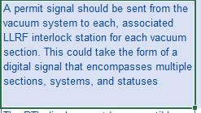
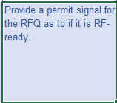
Vac, MPS, LLRF, HPRF System Interfaces Diagram
Vacuum Systems boundary
Controls System boundary
Vacuum controller connector type, Signal,
2551-001
Vacuum pump
Vacuum pump controller
LLRF System boundary
PLC
PLC to controller cable, control signal
Vacuum Level
Vacuum gauge
Vacuum gauge controller
Vacuum controller connector type, signal
PLC to controller cable, control signal
Gauge signal to FAV
Controller, FAV controller to FAV
2502-001
2502-002
Fast Acting Valve
HPRF System boundary
Fast Acting Valve Controller
Fast Acting Valve Status signal
EPICS Setting & Queries
Fast Acting Valve Sensors
Permit logic
(permit and alarm values)
Valve status
Pneumatic Gate Valve
MPS boundary
Valve closure signal
PLC only closes Gate Valves, PLC does not close FAV
2659-004

Slide 4
Interlock Documentation Workflow
MICD
Updated with all Stakeholders including needed signals
Another round of updates needed with refined language for Permits
Vacuum ISD
Align with updated MICD once done
Summarize all Permit entries and reference to Vacuum Permit Table
Vacuum Permit Logic Table
Aligns with MICD Permit entries, list all named required Permits
For each Permit, capture required logic (input signals and conditions)
(Add detailed of interlocks, specific name of interlock to align with Permit Table, ensure Controls is listed as integrator if appropriate)
Clearly document who will execute logic
Need to separate Physical/Signal interface with Controls from Permits with other L3
Document direct Controls interfaces here

Slide 5
Interface Documentation Workflow
Vacuum levels based on Vacuum pressure requirements
operational practice
Vacuum Systems ISD
Controls
Vacuum Permit Logic Table
(interlocks and trip levels)
PLC
Permit logic from other L3 Systems (RFPI, SRF, MPS, etc.)
Document: Vacuum ISD ED0016361
Controls owns official database (alarms, state machine requirements, etc.)
Communication protocol, connector types, and other details are in ISD
Vacuum Signals, Permits, actuation of Gate Valves
RFPI, MPS (FAV and Gate Valves closing triggers MPS)
Vacuum MICD, ISD, PRD, TRS, FRS requirements get
reviewed and approved by stakeholders
Note: ion pumps trip at ~e-5 Torr, we need to set values before ion pumps trip
e.g:
GV close while p>1E-5 mbar
GV near CM close while p>9E-9 mbar for cold CM

Slide 6
Reference – PIP2IT Permit Logic

Slide 7
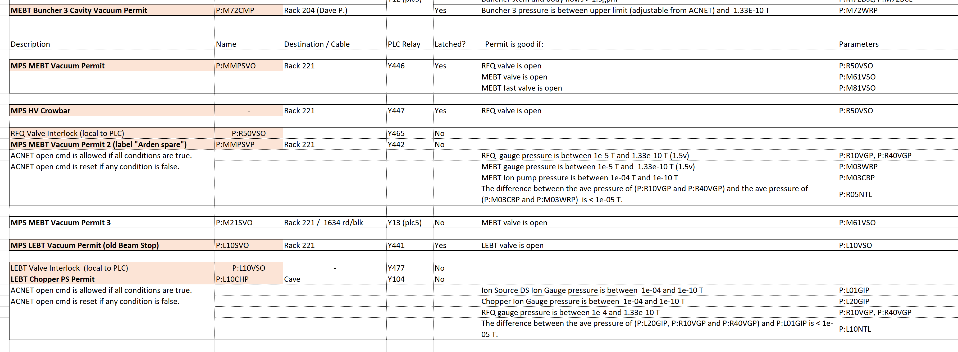
PIP2IT Vacuum Permit Table
VAC provides values setting for control actions
Description Name Destination PLC Relay Permit is good if:

Slide 8
Vacuum State Machine (HB650 examples)
VAC provides values setting for Alarms etc.

Slide 9
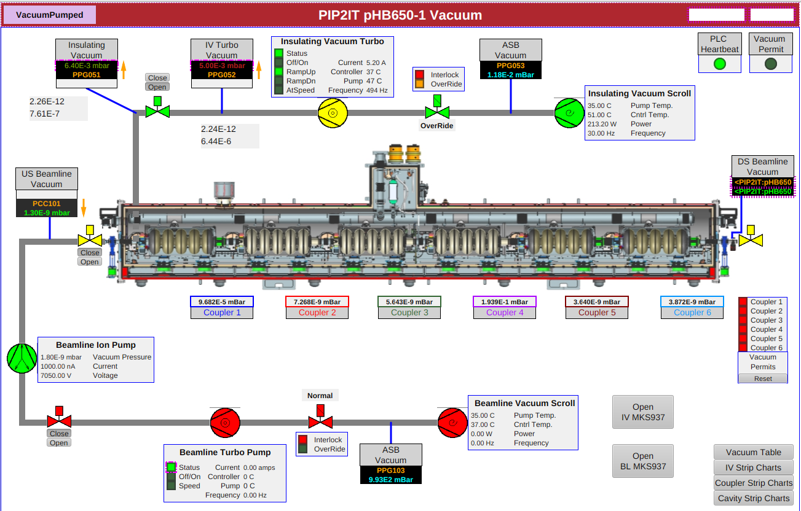
Vacuum EPICS Interfaces (HB650 examples)

Slide 10
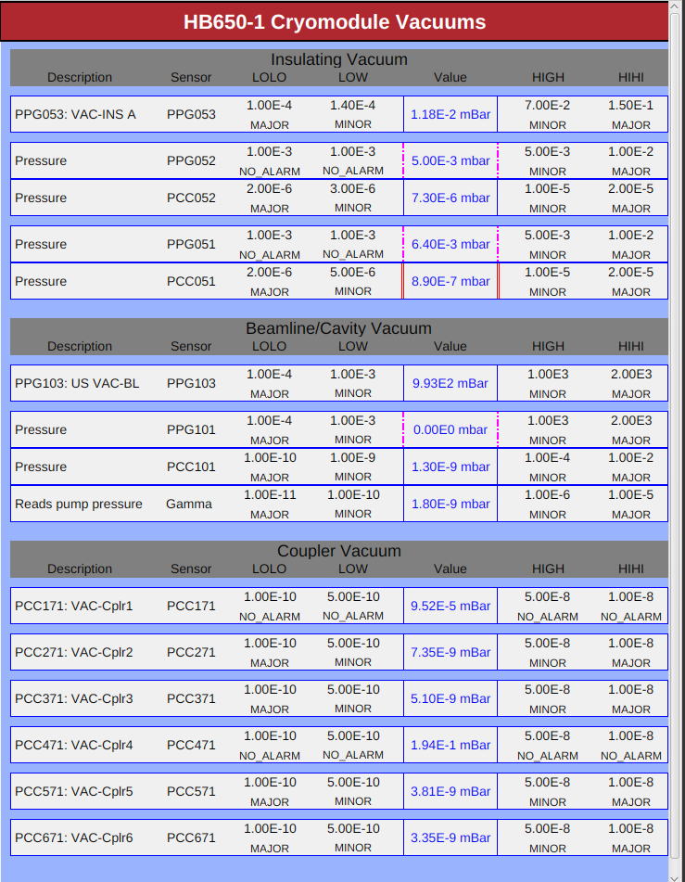
Vacuum EPICS Interfaces (HB650 examples)
VAC defines four states:
LOLO: Major,
LOW: Minor,
HIGH: Minor,
HIHI: Major,

Slide 11
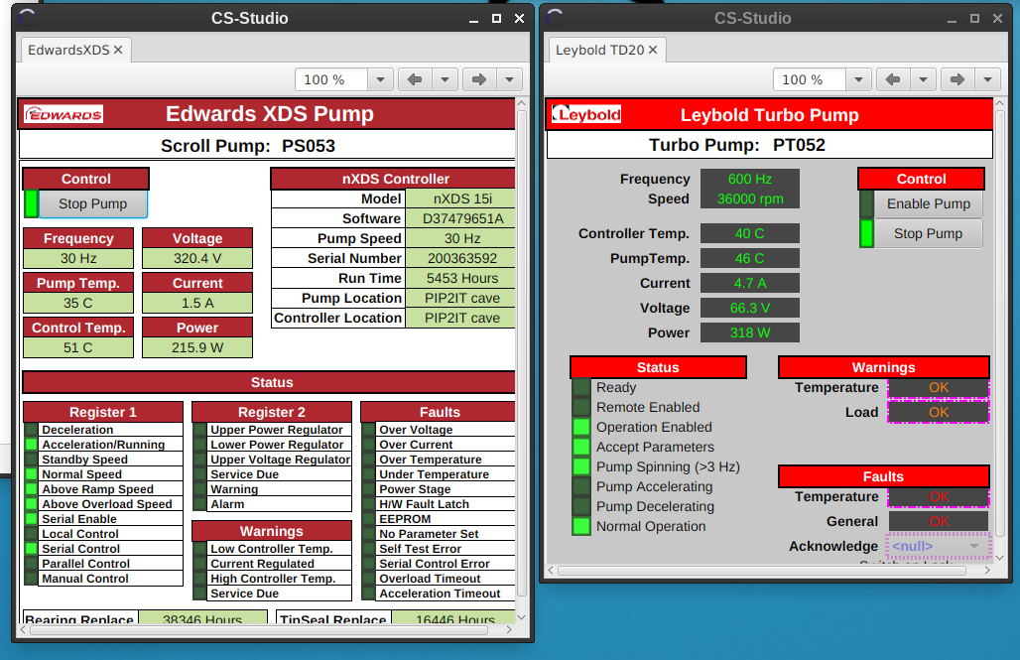
Vacuum EPICS Interfaces (HB650 examples)

Slide 12
Interlock Work to Do
MICD is refreshed, but need last pass to clearly define permit interfaces
Refine specific language to add
Execute changes with stakeholders
Vacuum ISD will be updated to reflect MICD changes (in addition to remaining punch list), including references to Permit Logic Table
Work with stakeholders to complete and release Vacuum Permit Logic Table (including Controls who will be mostly implementing)
Continue working with Controls at PIP2IT to refine alarm system and state machine implementation

Slide 13
Summary
Scheme for interlocks was validated at PIP2IT
Differential pumping, fast gate valves, etc.
Architecture of the system is well understood, communicated, and documented
Documentation structure is understood for populating, reviewing, and maintaining Vacuum Permit Logic Table
Needs systematic updating over next six months
Communication is ongoing with implementation of vacuum permits and alarms into EPICS at PIP2IT

