Slide 1
Commissioning Integration
Darren Crawford, PIP-II Beam Commissioning L3 Manager
PIP-II Vacuum System Integrated Systems FDR
May 13, 2024

Slide 2
Outline
Scope
Beam Commissioning Stages
Need for an Instrumentation Cart
Layout at 32 MeV
Layout at 177 MeV
Assembly, Installation, and Radiation Safety Planning
Installation Schedule
Layout of Commissioning Stages
2.1 MeV
32 MeV
177 MeV
800 MeV
BTL
Booster
Summary

Slide 3
Scope – Beam Commissioning Stages
WFE
SCL
Stage 4
700 MeV, 1.3E12 H-
0.55 ms@1 Hz
to straight-ahead dump
Stage 1
2.1 MeV, 1.3E12 H-
0.55 ms@20Hz
to MEBT (with air gap)
Stage 3
177 MeV, 1.3E12 H- through SSR2
0.55 ms@1 Hz
Stage 5
700 MeV, 1.3E12 H-
0.55 ms@20Hz
to BTL beam absorber
Stage 2
32 MeV, 1.3E12 H- through SSR1
0.55 ms@1 Hz
BTL
Stage 6
700 MeV, 2.5E12 per pulse
Booster circulation
Booster

Slide 4
Scope – Need for an Instrumentation Cart
PIP-II Beam Commissioning will be performed in 6 stages
CD2 review realized and recommended an instrumented cart be developed for the intermediate SCL commissioning stages
Need a method for determining beam parameters at intermediate stages of SCL commissioning
Scope of the instrumentation cart was added to Beam Commissioning WBS 121.04.06
121.04.06.03.04
Movable Instrumentation Cart
LIC
121.04
Linac Installation & Commissioning
AD Controls
AD Beam Instrumentation
AD Mechanical Support
AD Proton Source
AD Target Systems
J. Leibfritz
M. Geelhoed (deputy)
121.04.06
Beam Commissioning
D. Crawford

Slide 5
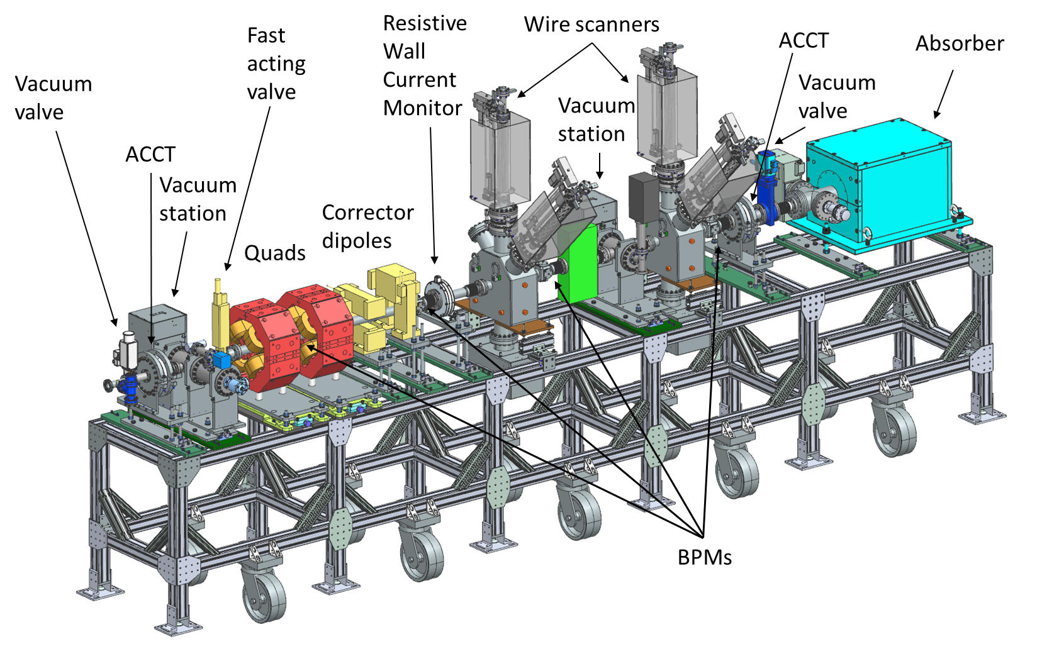
Scope – Layout at 32 MeV
Movable Instrumentation Cart is used for stage 2 and 3 of SCL beam commissioning
Design based off proven PIP2IT High Energy Beam Transport (HEBT) section
Instrumentation placed at optimal locations for emittance and energy measurements
Fast Acting Valve integrated into cart for protecting upstream cryomodule
Magnets, beam current monitors, and wire scanners borrowed from high energy section and Beam Transfer Line (BTL)
Majority of devices have gone through FDR process
Movable Instrumentation Cart details shown in 32 MeV Configuration

Slide 6
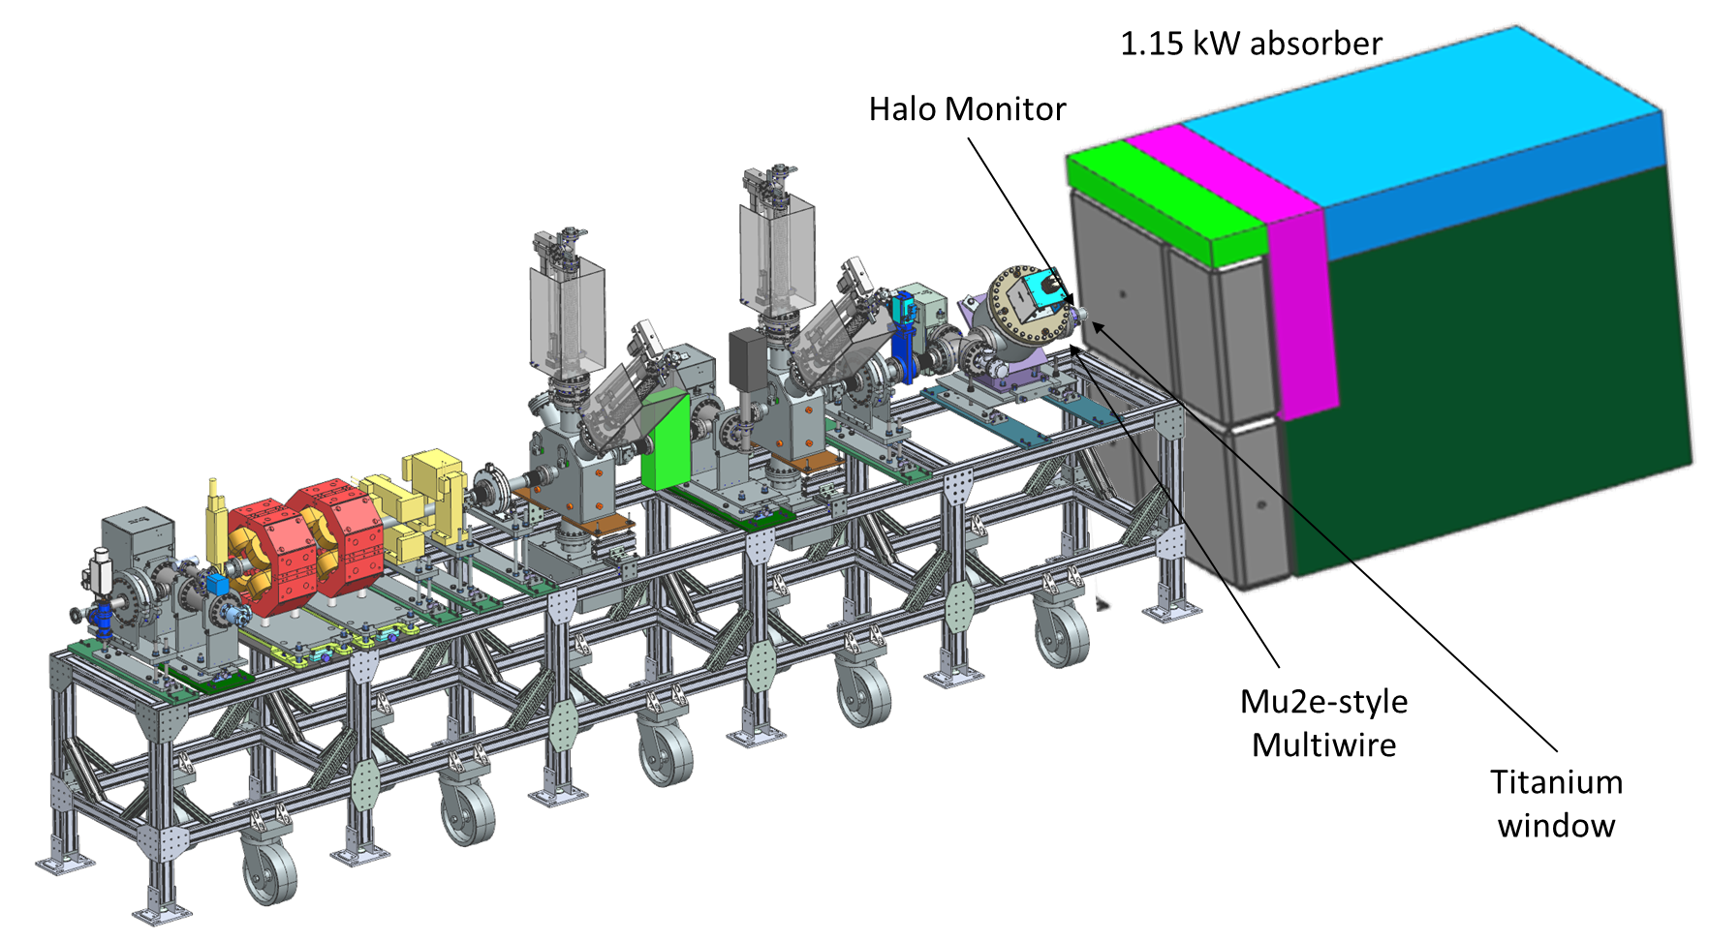
Scope – Layout at 177 MeV
Movable Instrumentation Cart is used for stage 2 and 3 of SCL beam commissioning
Design based off proven PIP2IT High Energy Beam Transport (HEBT) section
Instrumentation placed at optimal locations for emittance and energy measurements
Fast Acting Valve integrated into cart for protecting upstream cryomodule
Magnets, beam current monitors, and wire scanners borrowed from high energy section and Beam Transfer Line (BTL)
Majority of devices have gone through FDR process
Movable Instrumentation Cart details shown in 177 MeV Configuration

Slide 7
Scope – Assembly, Installation, and Radiation Safety Planning
Assembly will be at CMTF, utilizing cleanroom facility
Cart will be installed in stage 2 configuration prior to HWR/SSR1 RF testing (IDL, ISD)
Cart in the enclosure will be considered impacted after RF conditioning of SCL cavities
Stage 2 commissioning residual radiation will require cool down before reconfiguration
After stage 2 completion, we will work with the radiation safety organization to ensure adequate rad tech coverage during cart reconfiguration to stage 3 mode and transport
Once stage 3 commissioning is completed and with rad tech coverage
The absorber will be moved to its final location
Equipment from the cart will be reclaimed and installed in the downstream SCL and BTL
Cart stand may be utilized for instrumentation at the 2 kW absorber

Slide 8
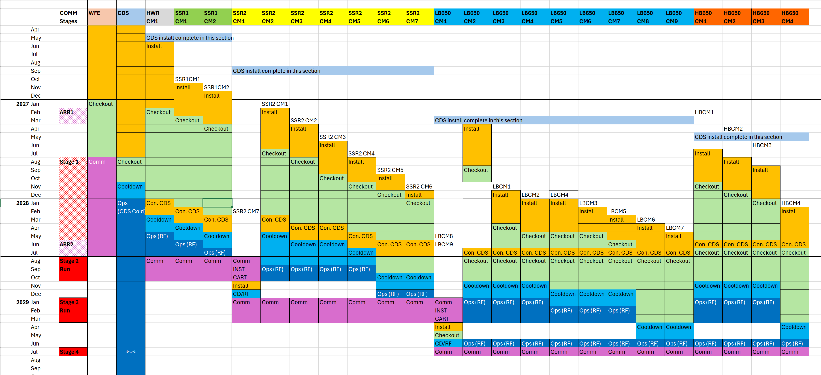
Installation Schedule
Machine Section
Time
Example transition (ODH)
Install
Cart
Install
Cart

Slide 9
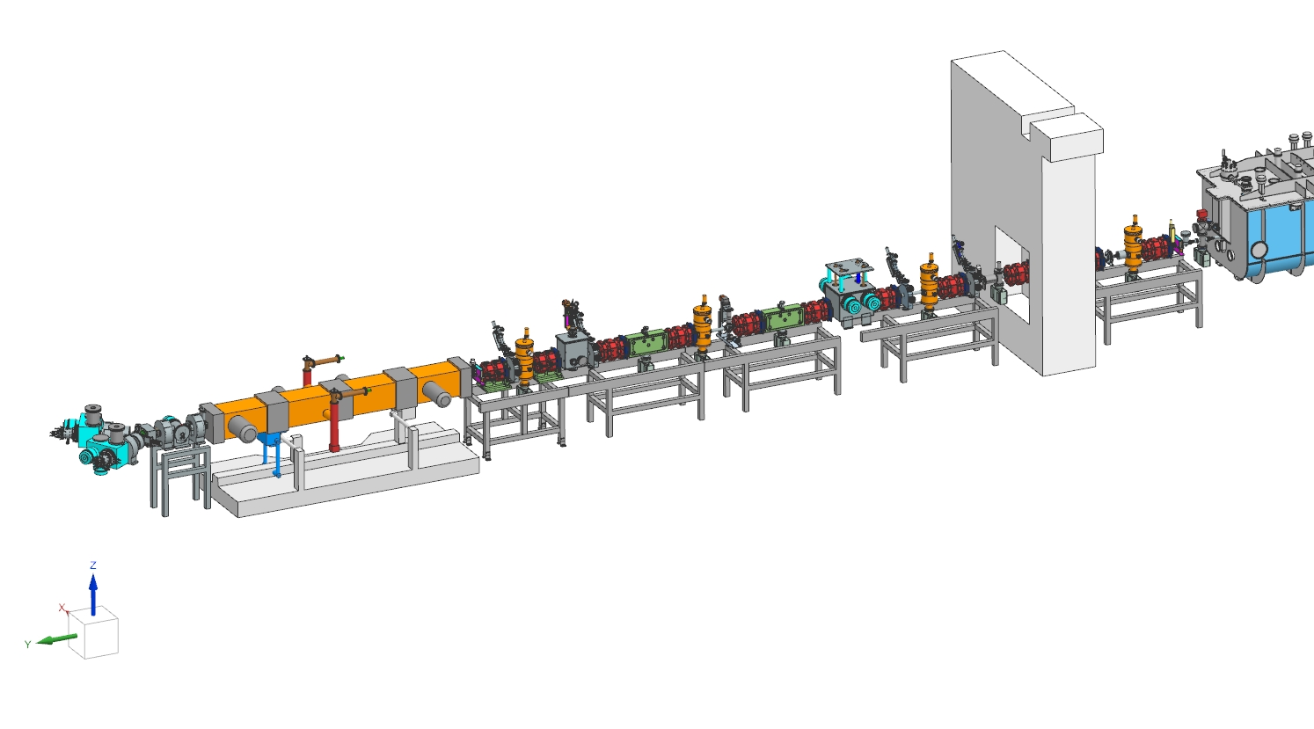
Staged Commissioning Approach - WFE
Charge #1
ARR1
STAGE 1
Re-commission the WFE, which was previously tested and verified at PIP2IT.
Beam will be commissioned from the ion source to the MEBT absorber.
The WFE beam line is terminated with an air gap to avoid propagating beam into the linac tunnel enclosure, where SRF installation activities occur.
Once Stage 1 commissioning is completed, the WFE beam line will be connected to the HWR CM.
Agreement with LI for 1 day/week access through WFE enclosure for cryomodule transport.
Parameter | Acceptance Criteria | Design Parameters
Beam Energy [MeV] | 2.1 | 2.1
Particles per pulse | 1.3E12 H⁻ | 6.7E12 H⁻
Repetition Rate with beam [Hz] | 20 | 20

Slide 10
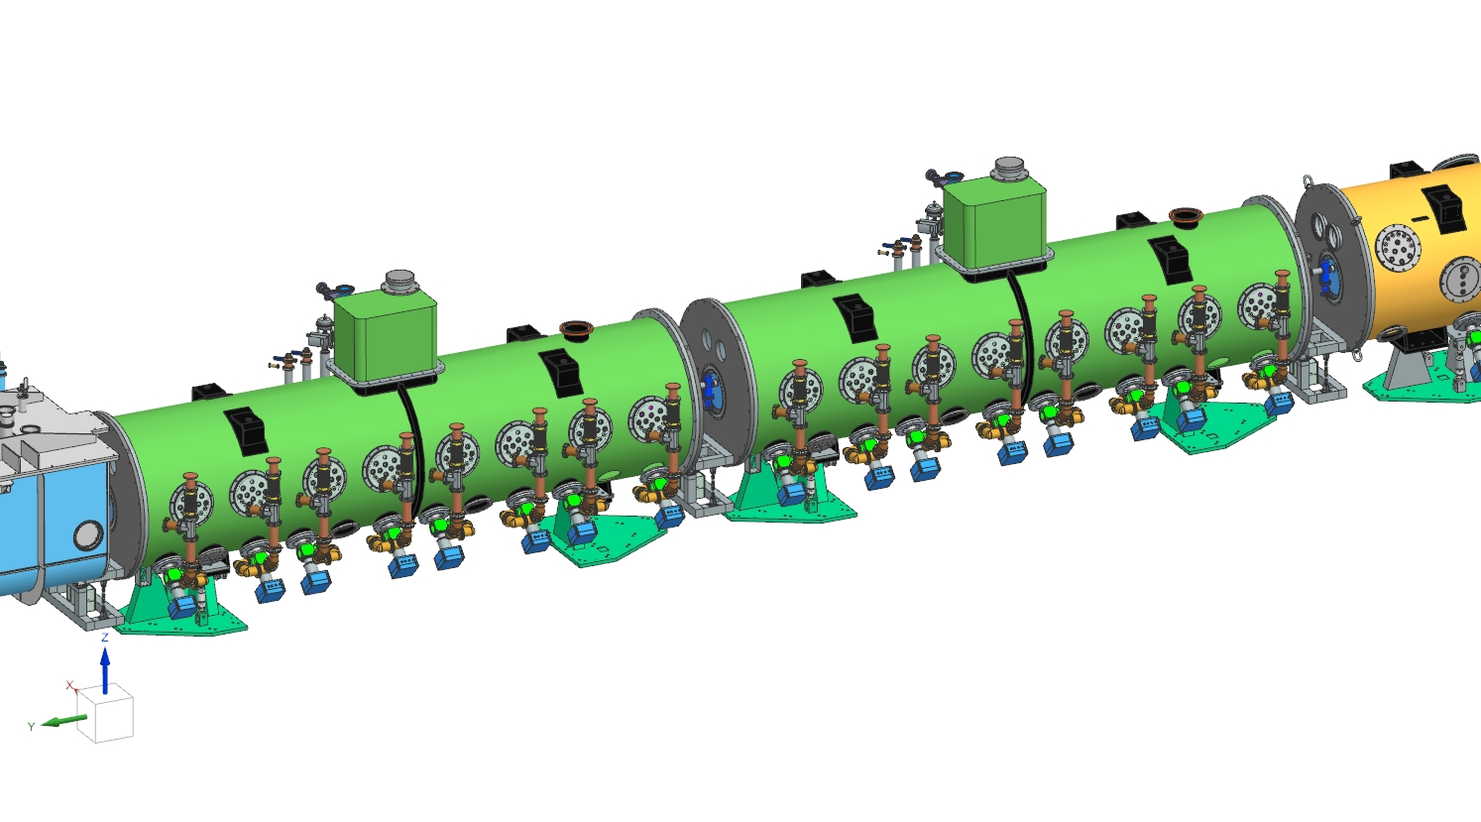
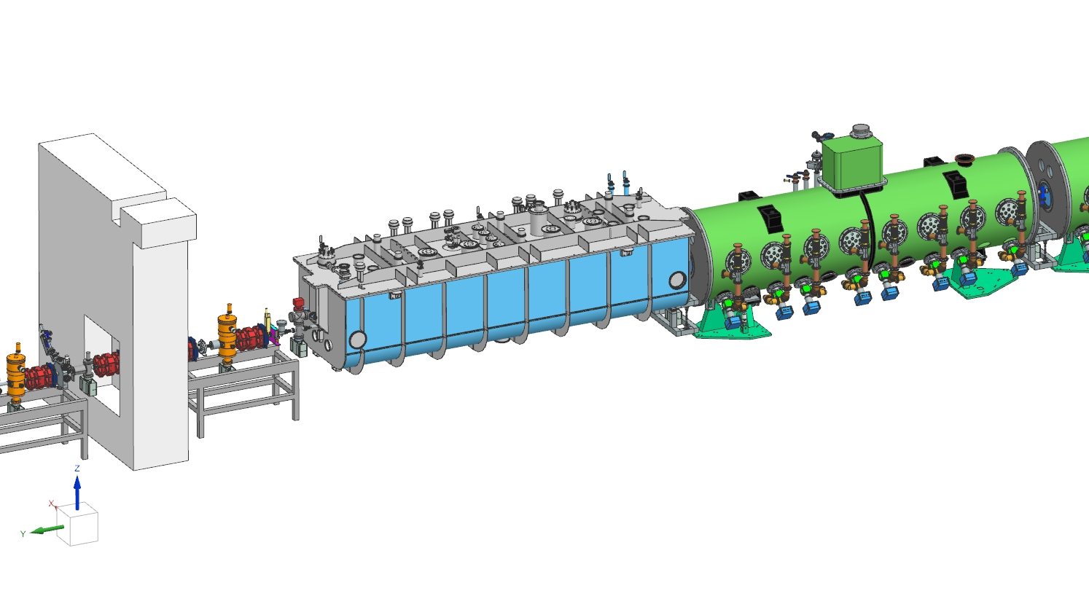
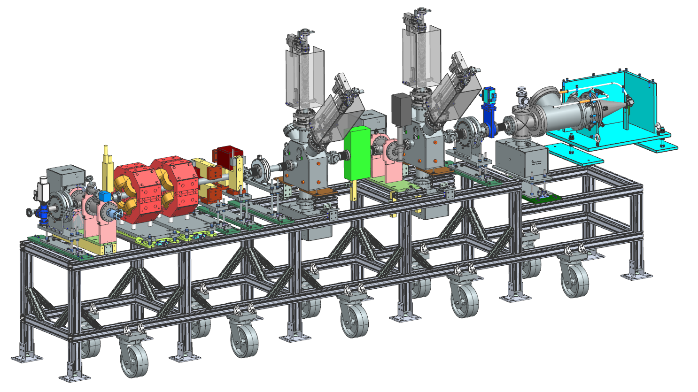
32 MeV Location
STAGE 2
The Cryoplant and Cryo Distribution System support individual CM cooldown, so HWR and SSR1 cryomodules will then go to 2 K.
The movable instrumentation cart will be installed in the SSR2-1 CM space.
This will allow characterization of the beam and inform the commissioning team of issues localized to HWR or SSR1 CMs.
Beam will terminate into a small absorber.
Parameter | Acceptance Criteria | Design Parameters
Beam Energy [MeV] | 28 | 32
Particles per pulse | 1.3E12 H⁻ | 6.7E12 H⁻
Repetition Rate with beam [Hz] | 20 | 20

Slide 11
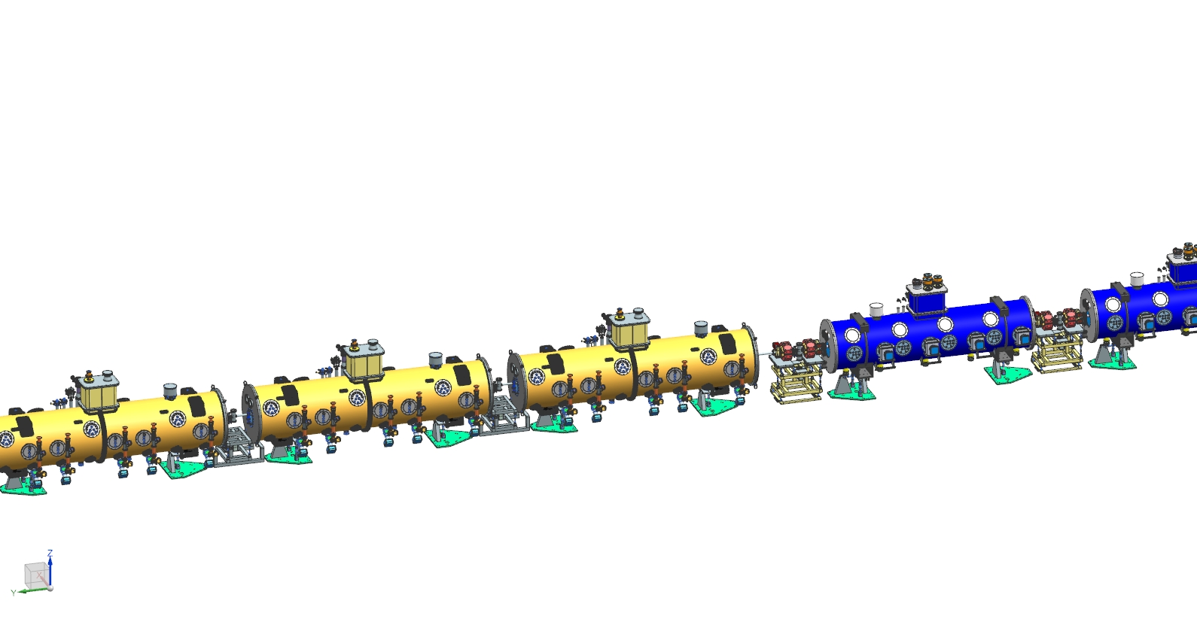
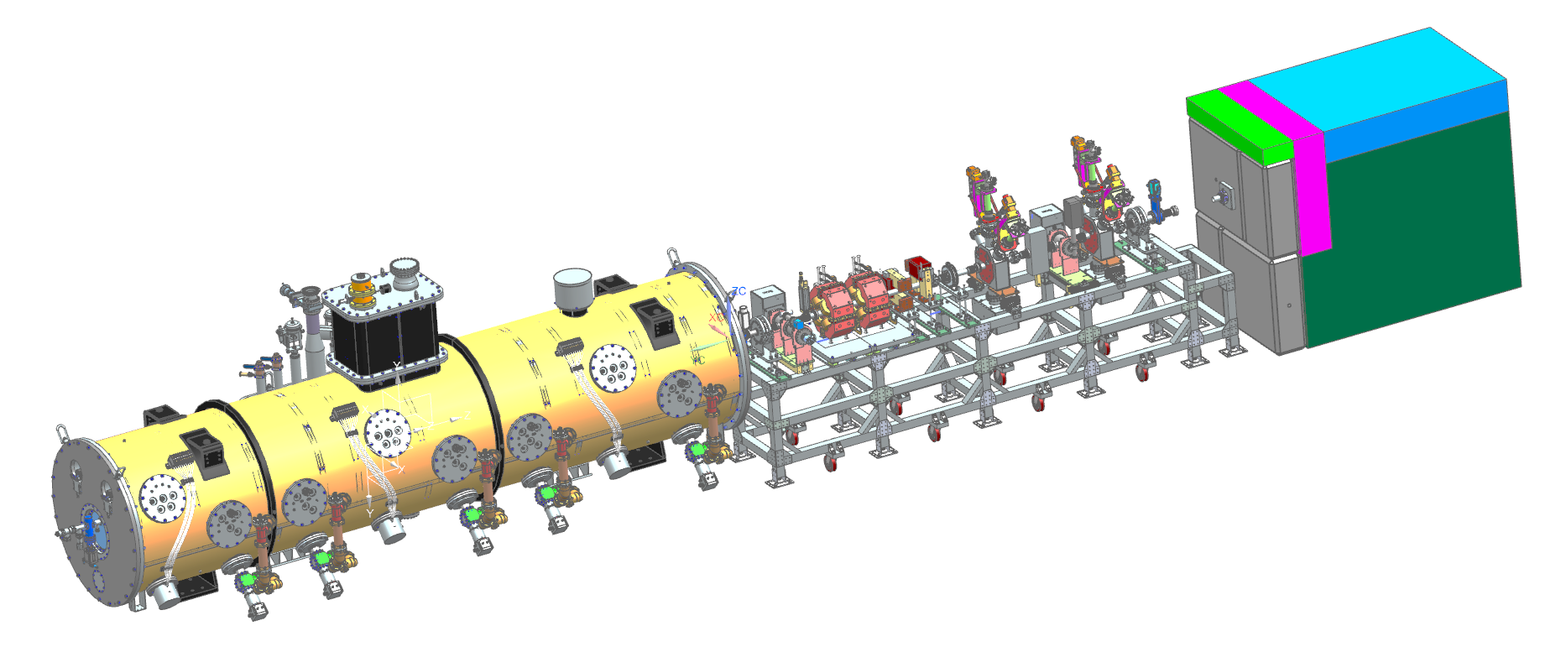
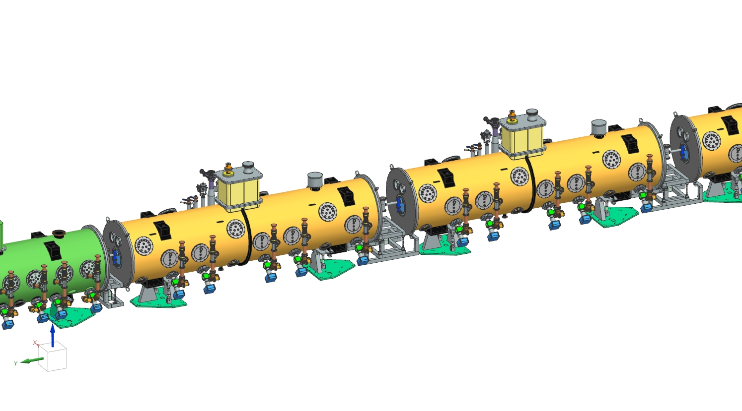
177 MeV Location
STAGE 3
The cart will be moved downstream to the LB650-1 CM space.
The small absorber will be removed and a 1.15 kW beam absorber will be installed downstream of the cart in the LB650-1 space.
SSR2-1 will be installed and the beam line will be contiguous from the WFE to the absorber.
Beam will be characterized through the cryomodules.
Parameter | Acceptance Criteria | Design Parameters
Beam Energy [MeV] | 155 | 177
Particles per pulse | 1.3E12 H⁻ | 6.7E12 H⁻
Repetition Rate with beam [Hz] | 20 | 20

Slide 12
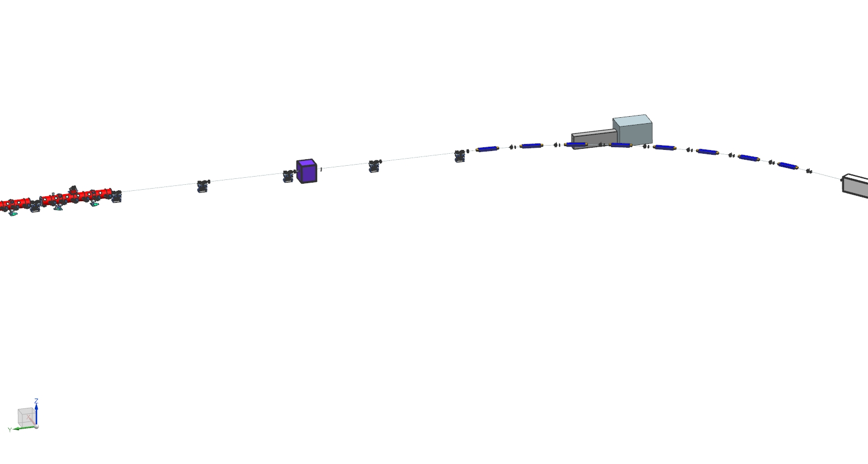
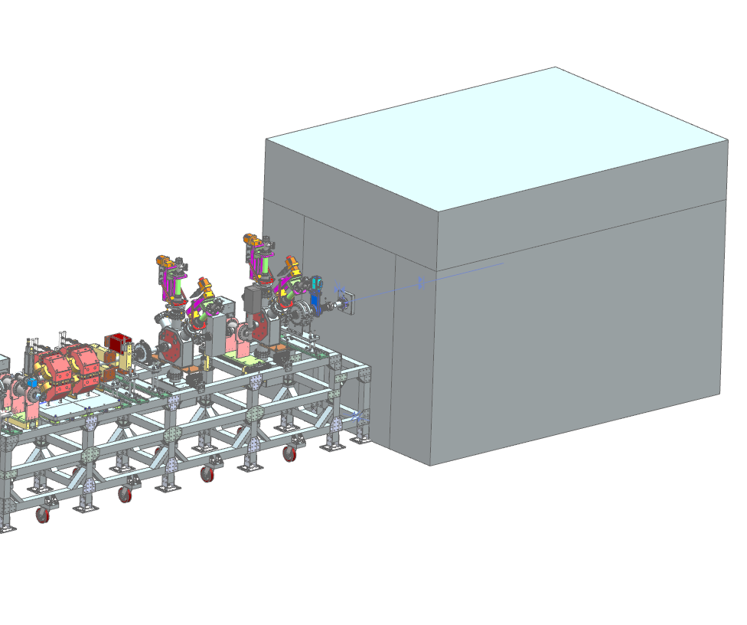
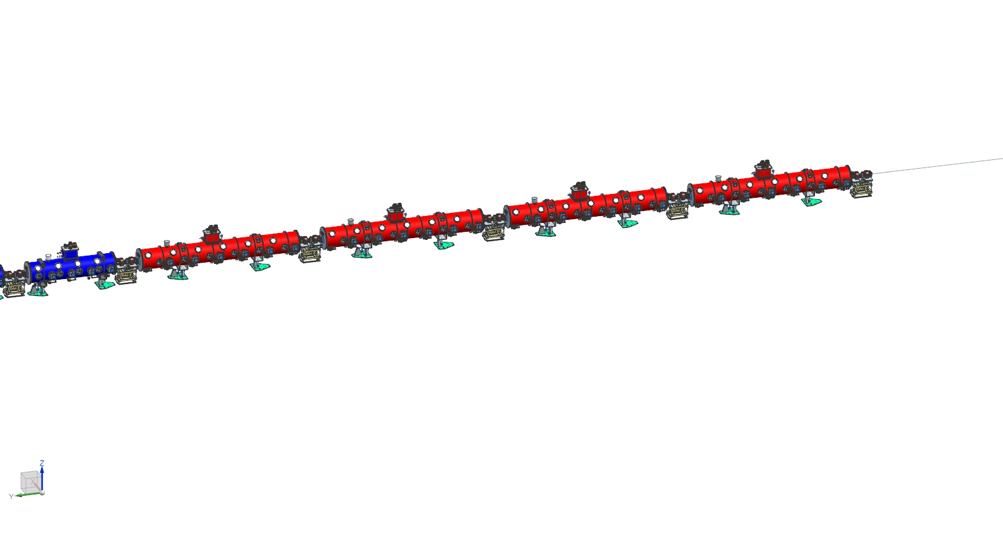
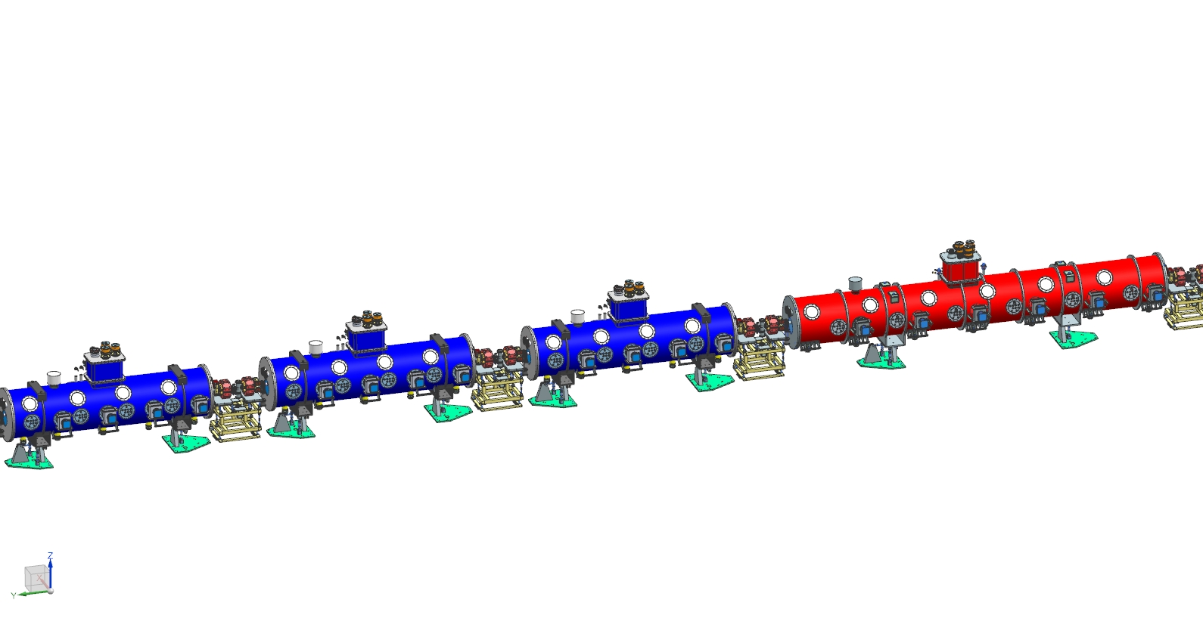
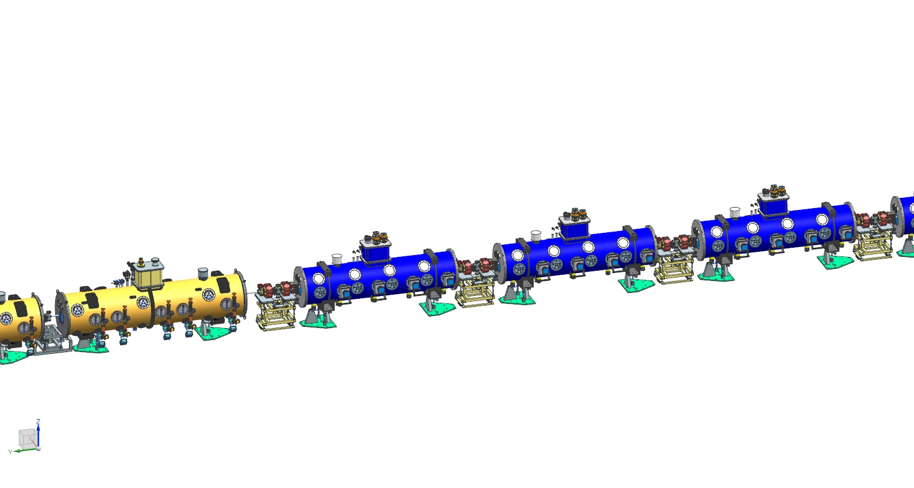
Staged Commissioning Approach – LB650, HB650, 2 kW Absorber
Charge #1
STAGE 4
Upon completion of Stage 3 the 1.15 kW absorber will be moved to its final location and upgraded with additional shielding.
The cart will be removed from the tunnel, and CM LB650-1 will be installed.
Beam will be commissioned through the LB and HB650 cryomodules, up to 800 MeV.
Parameter | Acceptance Criteria | Design Parameters
Beam Energy [MeV] | 700 | 800
Particles per pulse | 1.3E12 H⁻ | 6.7E12 H⁻
Repetition Rate with beam [Hz] | 20 | 20

Slide 13
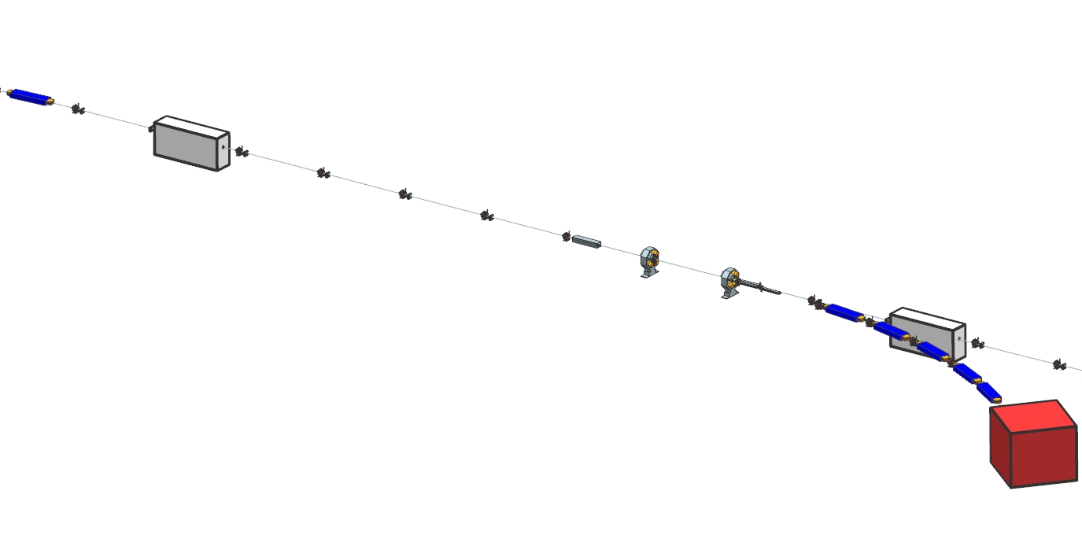
Staged Commissioning Approach – BTL to 25 kW Absorber
Charge #1
STAGE 5
Beam will be extracted to the BTL and commissioned to the 25 kW absorber.
Parameter | Acceptance Criteria | Design Parameters
Beam Energy [MeV] | 700 | 800
Particles per pulse | 1.3E12 H⁻ | 6.7E12 H⁻
Repetition Rate with beam [Hz] | 20 | 20

Slide 14
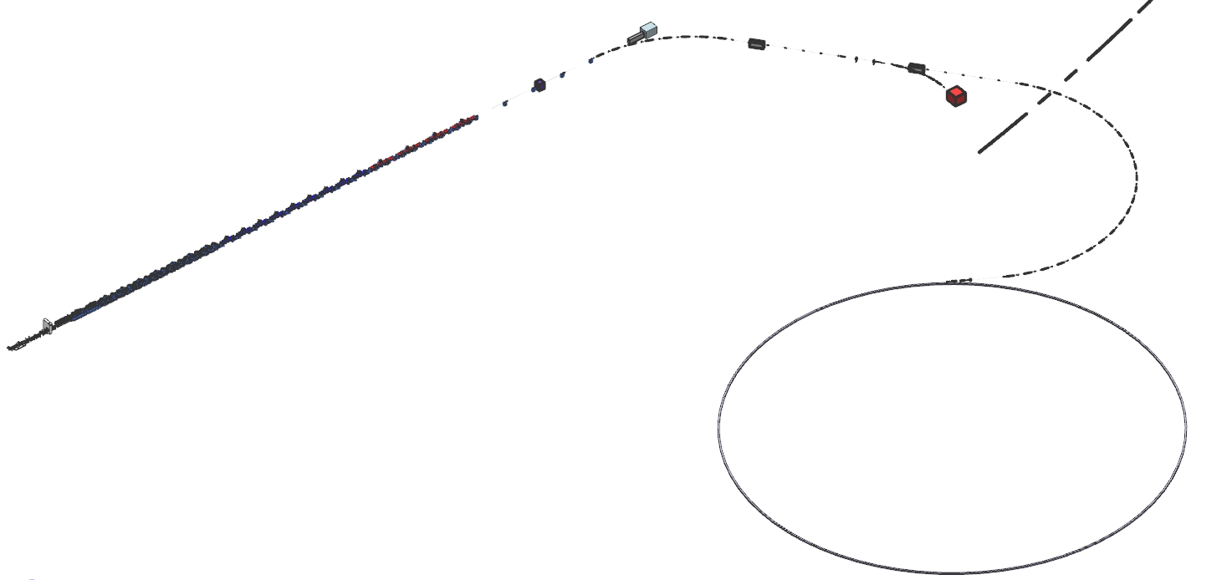
Staged Commissioning Approach – BTL to Booster
Charge #1
Arc 1
ARR3
STAGE 6
BTL to Booster (injection and circulation)
Arc 2
Booster
Parameter | Acceptance Criteria | Design Parameters
Beam Energy [MeV] | 700 | 800
Particles per pulse | Circulate beam | 6.7E12 H⁻
Repetition Rate with beam [Hz] | N/A | 20
Repetition Rate for Booster [Hz] | 20 | 20

Slide 15
Summary
Once the need for an instrumentation cart was determined a strategy was developed to utilize the PIP2IT HEBT layout
Layout of cart equipment for both energies was optimized
Installation of the cart is incorporated into the PIP-II schedule
Completion of PIP-II beam commissioning stages allows the Project to transfer systems to Lab Operations

Slide 16
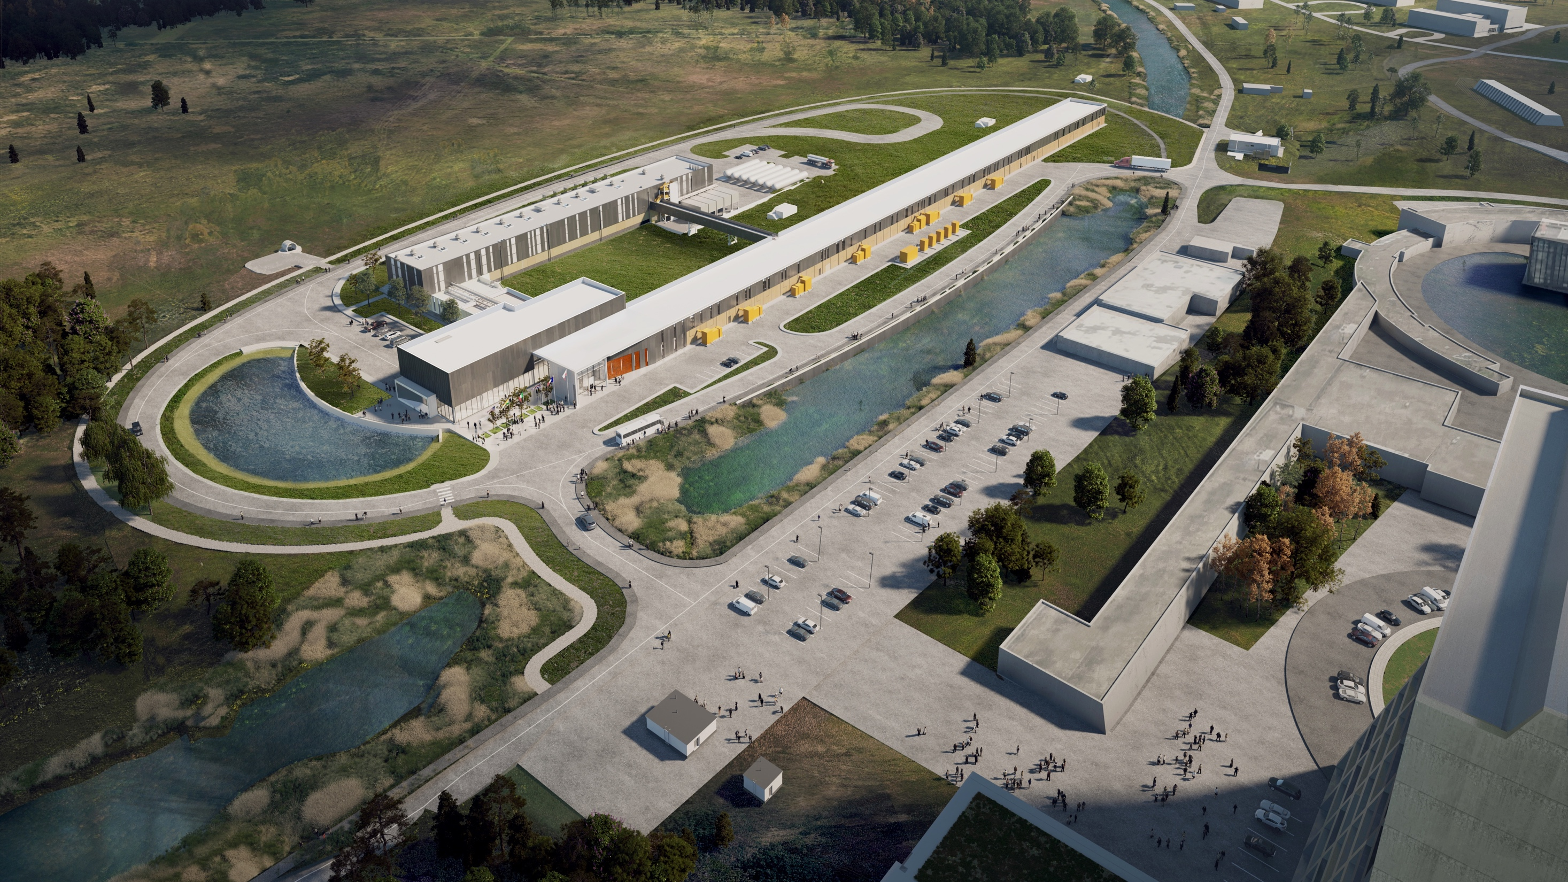
THE FUTURE OF FERMILAB
Follow us:
http://pip2.fnal.gov/
@PIP2accelerator
/showcase/pip-ii/

Slide 17
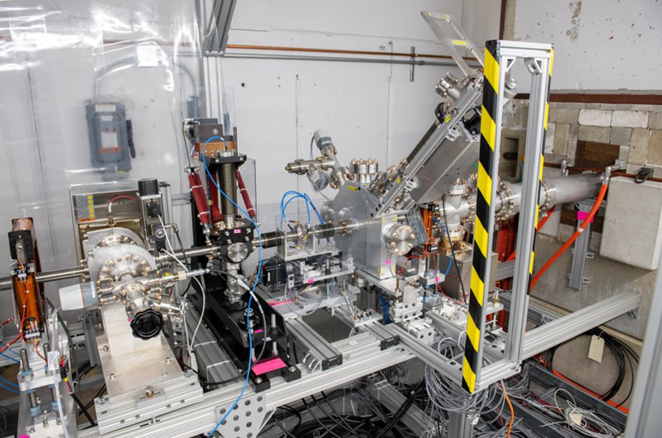
Backup Slide – PIP2IT HEBT

