Slide 1
Thermal Modeling of Wire-coil Insert
Chuqiao (Vicky) Yang
Aug 10, 2012
Mentors:
Jeff Collins
Advance Photon Source Engineering Support Division (AES), ANL;
Paul Fischer
Mathematics and Computer Science Division (MCS), ANL.
Acknowledgements:
Jason Carter (AES); Katie Heisey (MCS)

Slide 2
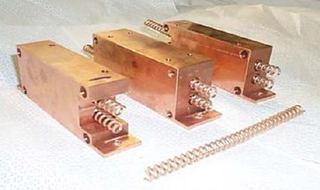
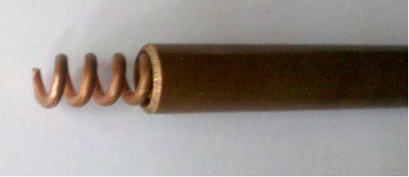
What is wire-coil insert?
Enhances heat transfer, up to 4 times efficiency of plain tube
Used in APS front end and beamline
Restricted in flow rate and size for APS
Geometry described by wire diameter, coil diameter, and pitch
Notes:
2

Slide 3
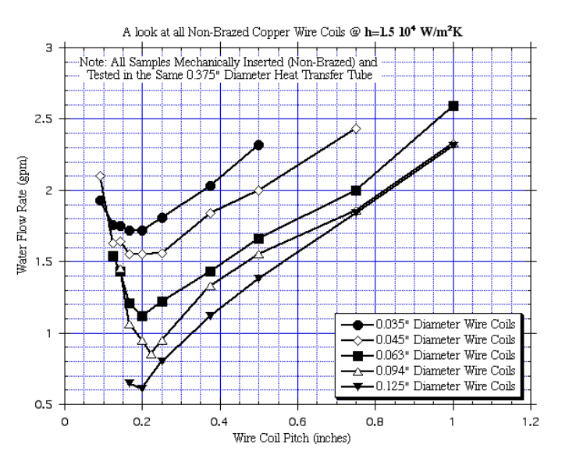
Previous experiments
Optimal geometry found for fixed heat transfer coefficient
Goal:
Simulate heat transfer and validate with experimental data
J.T. Collins, C.M. Conley, J.N. Attig & M.M. Baehl, “Enhanced heat transfer using wire-coil inserts for high-heat load applications”, 2nd International Workshop on Mechanical Engineering Design of Synchrotron Radiation Equipment and Instrumentation
Notes:
3

Slide 4
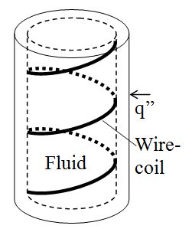
Approaching the problem
3D conjugate heat transfer (Nek5000 fluid dynamics solver):
Navier-Stoke equation
(turbulent flow, periodic boundary condition)
Convection-diffusion equation
(prescribed heat flux)
Uses Spectral Element Method
Calculate Nusselt number to
validate model
Notes:
4

Slide 5
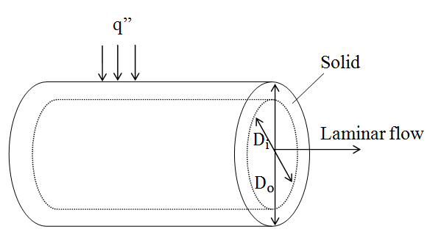

Testing conjugate heat transfer and Nusselt number
Inner wall of wire-coil insert is difficult
Nusselt number expressed in outer wall properties:
Simulation Solution = Analytic Solution*, Nu = 4.36
* Incropera, Frank P.; DeWitt, David P. (2002). Fundamentals of Heat and Mass Transfer (5th ed.). Hoboken: Wiley. pp. 486, 487.
Notes:
5

Slide 6
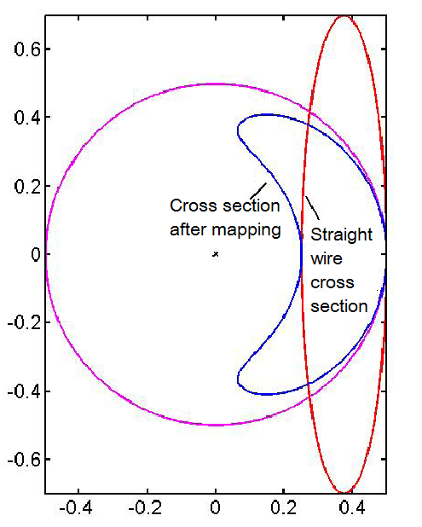
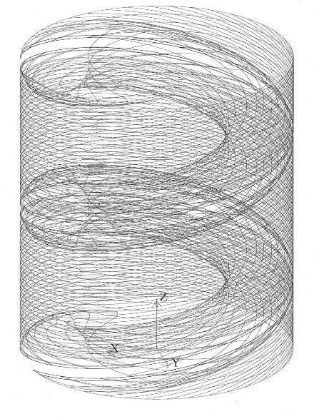

Mesh
R: Outer radius of coil
Notes:
6

Slide 7
Results
http://www.mcs.anl.gov/~fischer/collins/g05300_t2.gif
Notes:
7

Slide 8
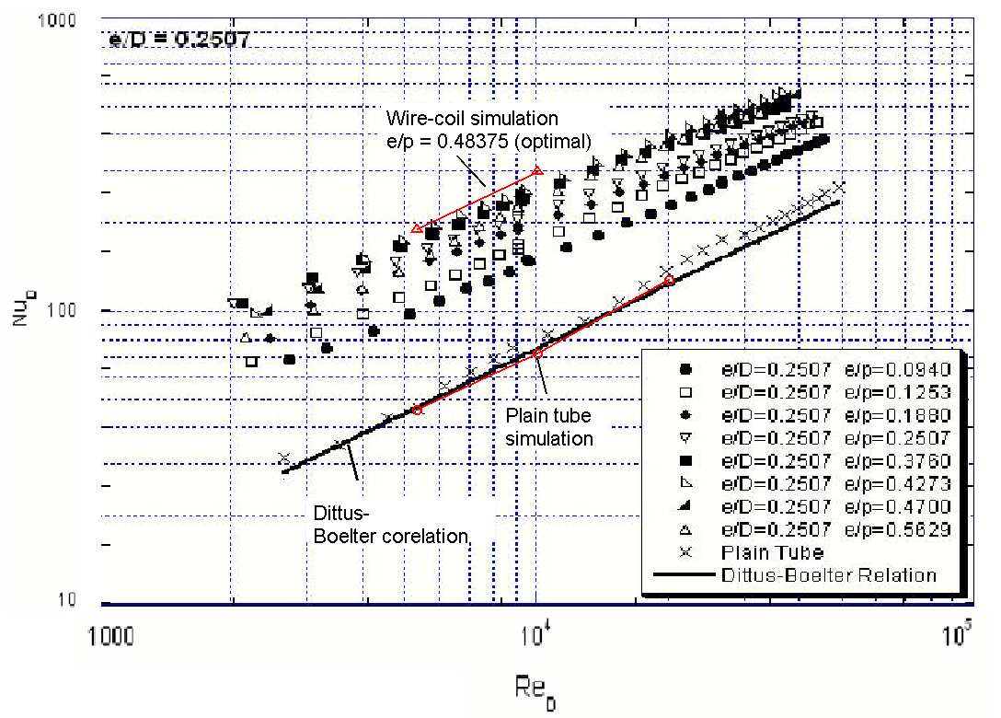

Notes:
8

Slide 9
Conclusions
Successfully generate wire-coil geometry
Simulation results match Dittus-Boelter and experimental data
Future work
Simulations for the exact parameters in experiments and compare with data
Study mechanism of heat transfer enhancement (vary thermal properties)
Notes:
9

