Slide 1
Characterization of Electron Gun for Hollow Electron Beam Collimation (HEBC)
Siqi Li
Supervisor: Giulio Stancari
Notes:
Tevatron last year, possibly LHC in the future

Slide 2
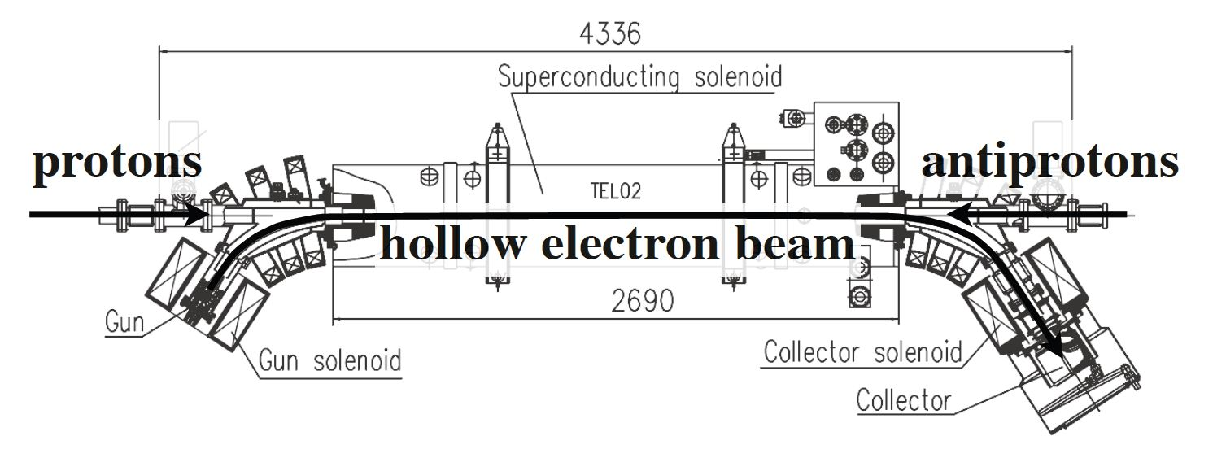
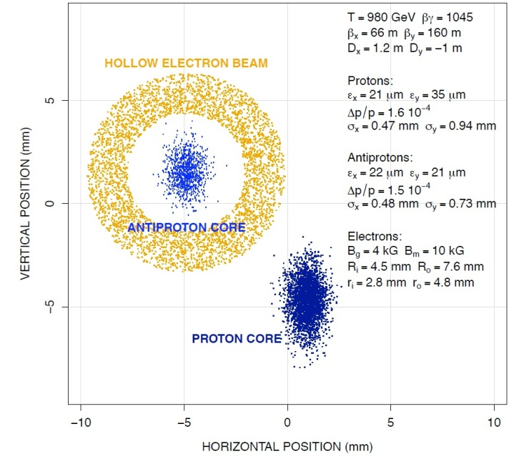
Hollow Electron Beam Collimation (HEBC)
The main experimental apparatus
consists of a pulsed electron gun,
a straight beamline, and a
water-cooled collector.

Slide 3
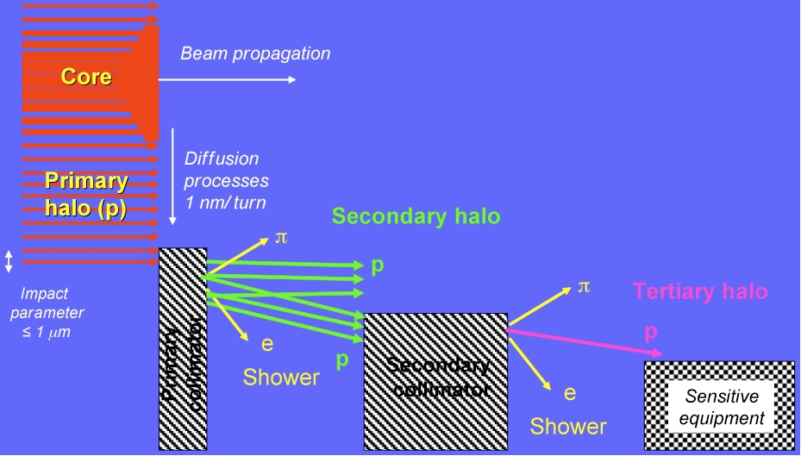
Conventional collimation system
Conventional collimation system consists of a primary and a secondary collimator.
Collimator must not be placed too close to the beam.
Beam jitter.

Slide 4
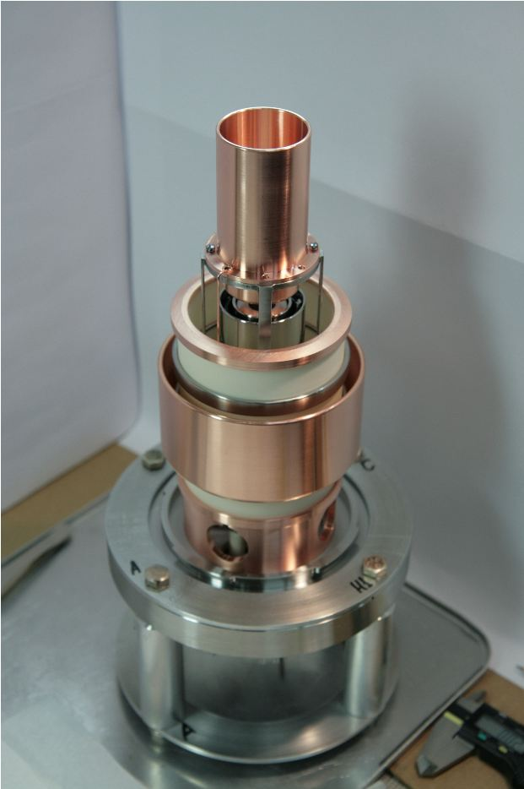
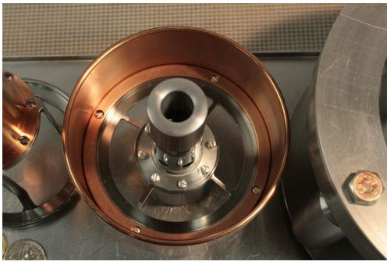
1-Inch Hollow Electron Gun
Thermionic dispenser cathode: as we increase the temperature, electrons are emitted from the cathode surface.

Slide 5
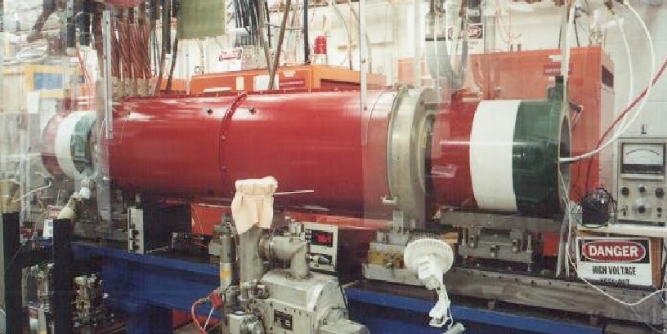
Project overview: characterization of the hollow electron gun
We measured the cathode yield as a function of cathode-anode voltage and temperature.
We measured the electron beam profile.

Slide 6
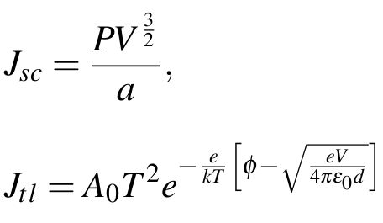
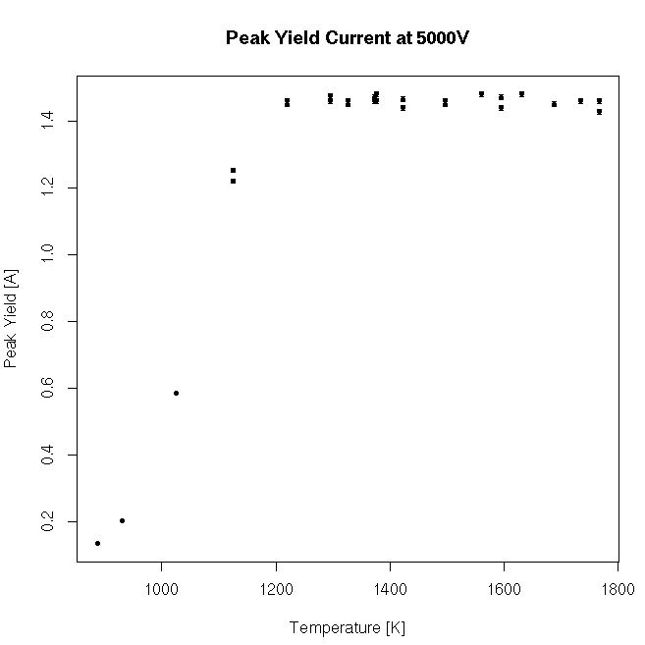
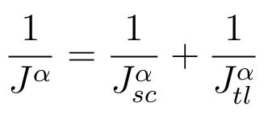
Theory background
Space-charge regime and temperature-limited regimes
Temperature limited regime
Space-charge limited regime
shape factor

Slide 7
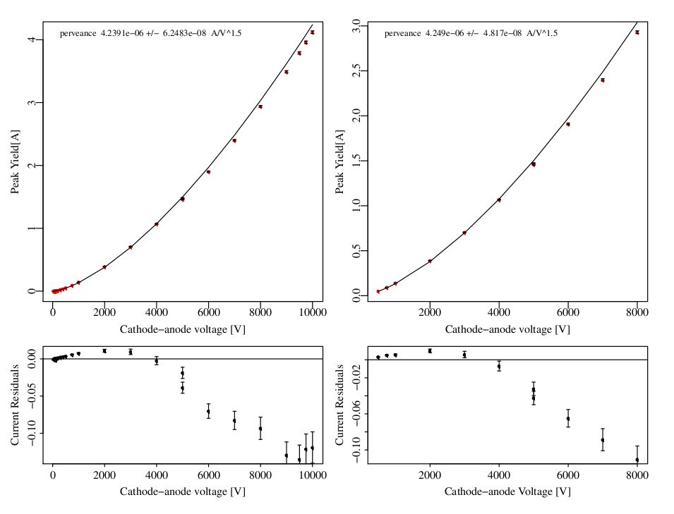
Perveance measurement
Measured
current vs. voltage
curves to
characterize gun yield.

Slide 8
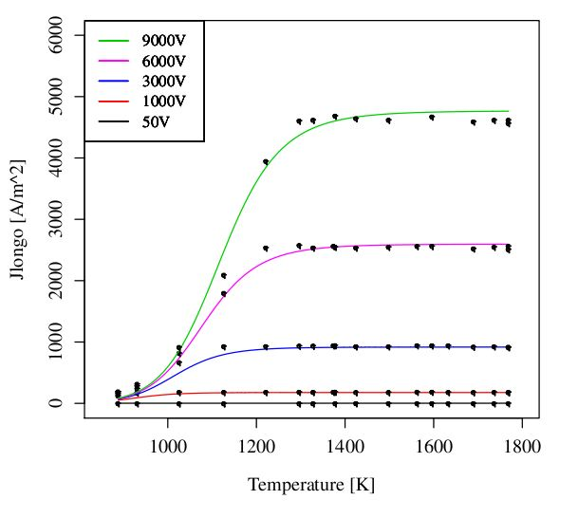
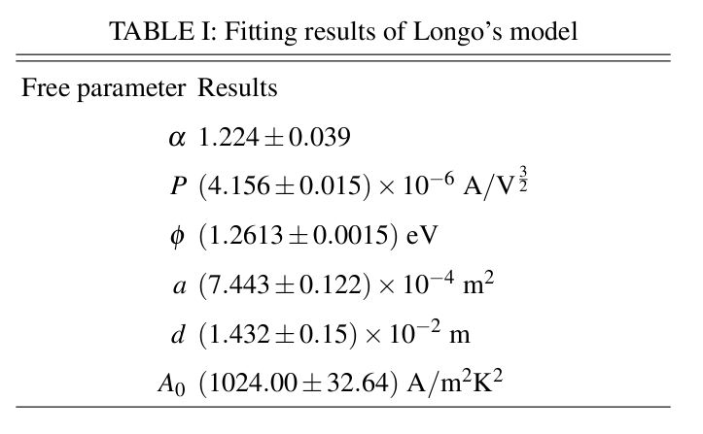
Longo’s Model fitting
We fitted our data with Longo’s model. Below are the fitting results for free parameters.
Notes:
Residual standard error : 31.84 on 468 DOF, 31.84/468~68mA, corresponding to the standard deviation of the residual distribution.

Slide 9
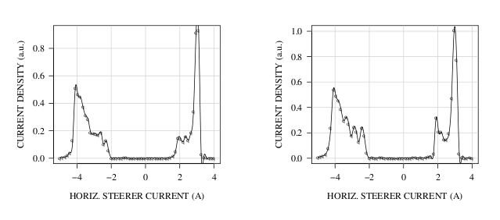
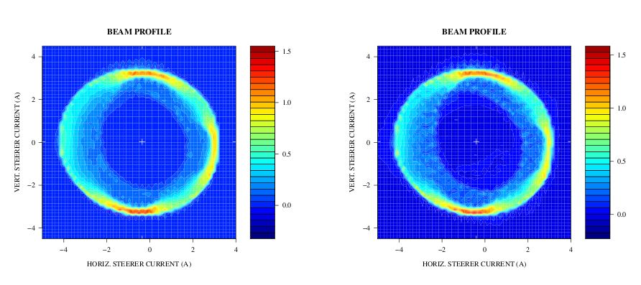
Beam profile measurements
Measured 1-D and 2-D scan of beam profile.
This can be seen in profile measurements at different currents. => cathode off-center
Notes:
0.2-mm diameter pinhole, sweeping electron beam in small steps

Slide 10
Conclusion
We have characterized a new 1-inch hollow electron gun for HEBC.
Current work and next step:
- gun geometry
- re-measuring the test stand

Slide 11
Thank you for listening!

Slide 12
Back up slides

Slide 13
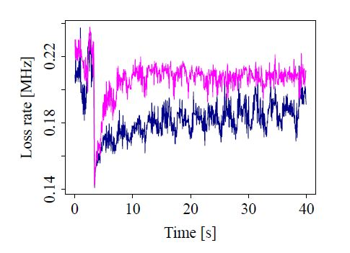
Diffusion measurement
HEBC increases the halo beam diffusion rate, so the halo tails are suppressed. The beam and the sensitive components in the machine become less vulnerable to beam jitter.
G. Stancari et al. IPAC 11
Notes:
The correlation is due to beam jitter – bunches oscillating coherently. The effect of HEBC reduces the correlation, and even introduces a negative correlation.

Slide 14
1-inch hollow gun diagram

Slide 15
3D profile scan

Slide 16
Filament heating

Slide 17
Shape factor alpha
$$α=−\frac{λ}{β}\frac{\log\left(2\right)}{\log\left(q\left(\frac{1−θ}{θ}\right)\right)}$$
$$λ$$
Proportional to the barium pressure.
$$β$$
e/kT
q partition function for the internal properties of the
absorbed atoms.
$$θ$$
Barium coverage on the cathode surface.

Slide 18
Longo Model Residuals

Slide 19
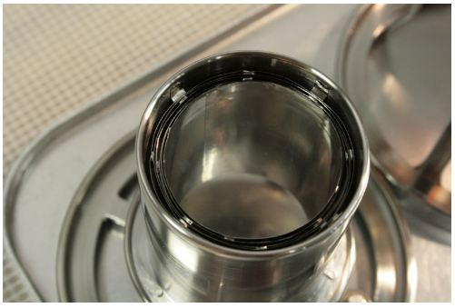
Electron Gun
Heat shield
Cathode
Cathode and electrode

Slide 20
Space-charge and temperature-limited regimes
Measured current yield vs. temperature to determine gun working point

Slide 21
Longo model fitting residuals

Slide 22
Oscilloscope signal for perveance measurement

Slide 23
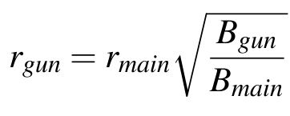
Design considerations
Halo particles / hollow electron beam spams 4σ ~ 8σ, 1.2 mm~2.4 mm
~ 6mm

Slide 24
Perveance vs. Voltage

