Slide 1
Bunch Compression and CSR Study in ASTA
Dhruv Kedar
Fermilab
University of Chicago
July 24th, 2012

Slide 2
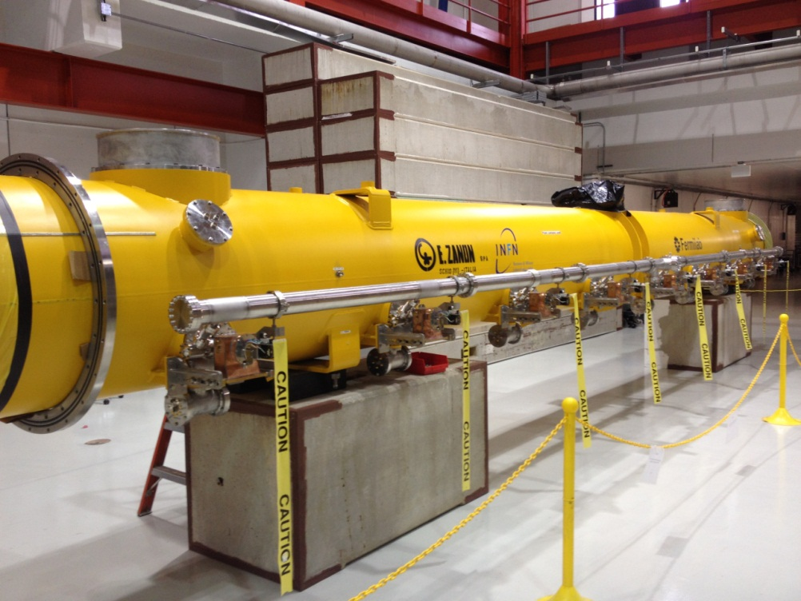
Overview
ASTA (Advanced Superconducting Test Accelerator)
Develop SRF technology
International Linear Collider component design
Beams with ILC parameters
Goals:
Optimize two-stage bunch compression
Minimize emittance distortions due to CSR effects

Slide 3
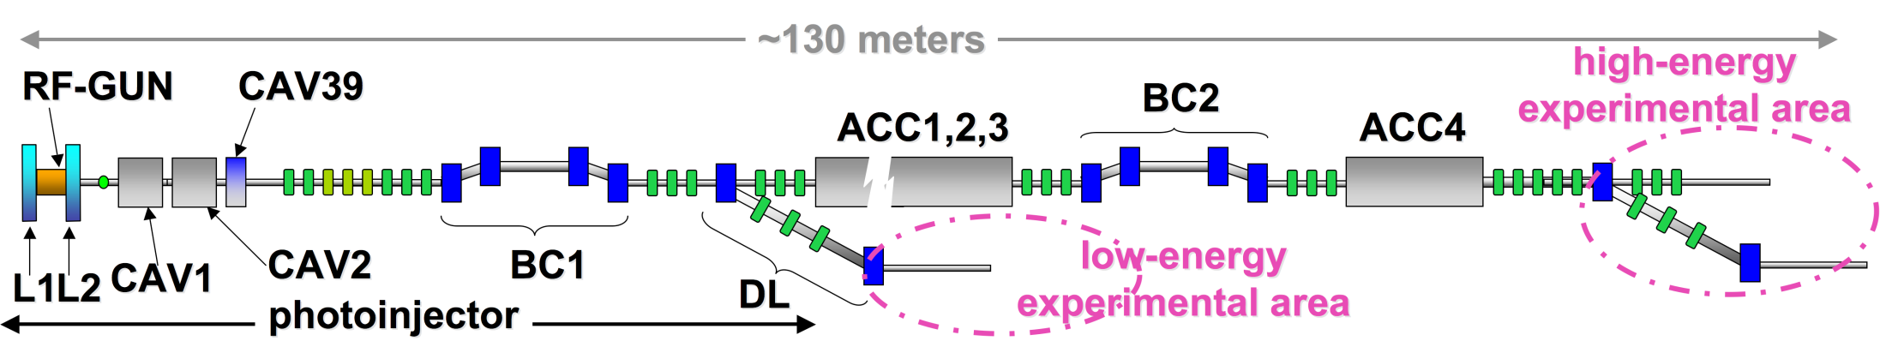
Beamline
Credit P. Piot, C. Prokop, NIU
Two stage bunch compression
Compression from differences in path length

Slide 4
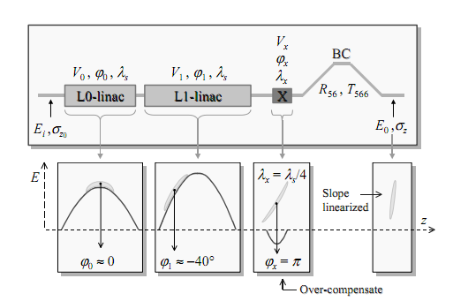
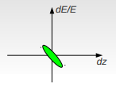
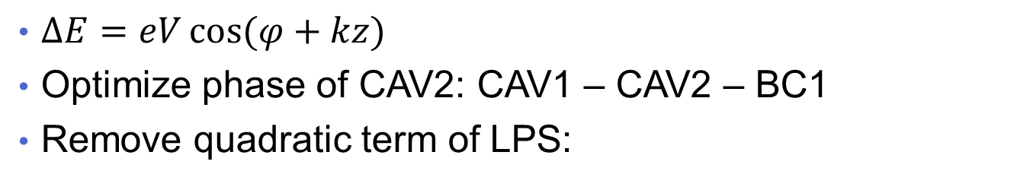
Linearization Procedure
$∆E=eV\cos{(φ+kz)}$
Optimize phase of CAV2: CAV1 – CAV2 – BC1
Remove quadratic term of LPS:
  CAV1 – CAV2 – CAV39 – BC1
  Voltage optimization: CAV2, CAV2, CAV39 phase on-crest
  Phase optimization: CAV2 on phase, scan CAV39
Credit E. Kim, KNU

Slide 5
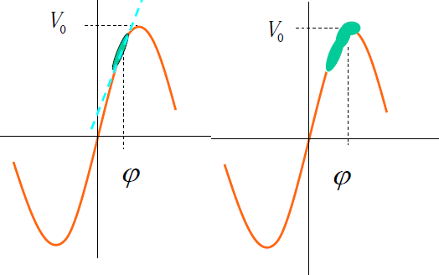
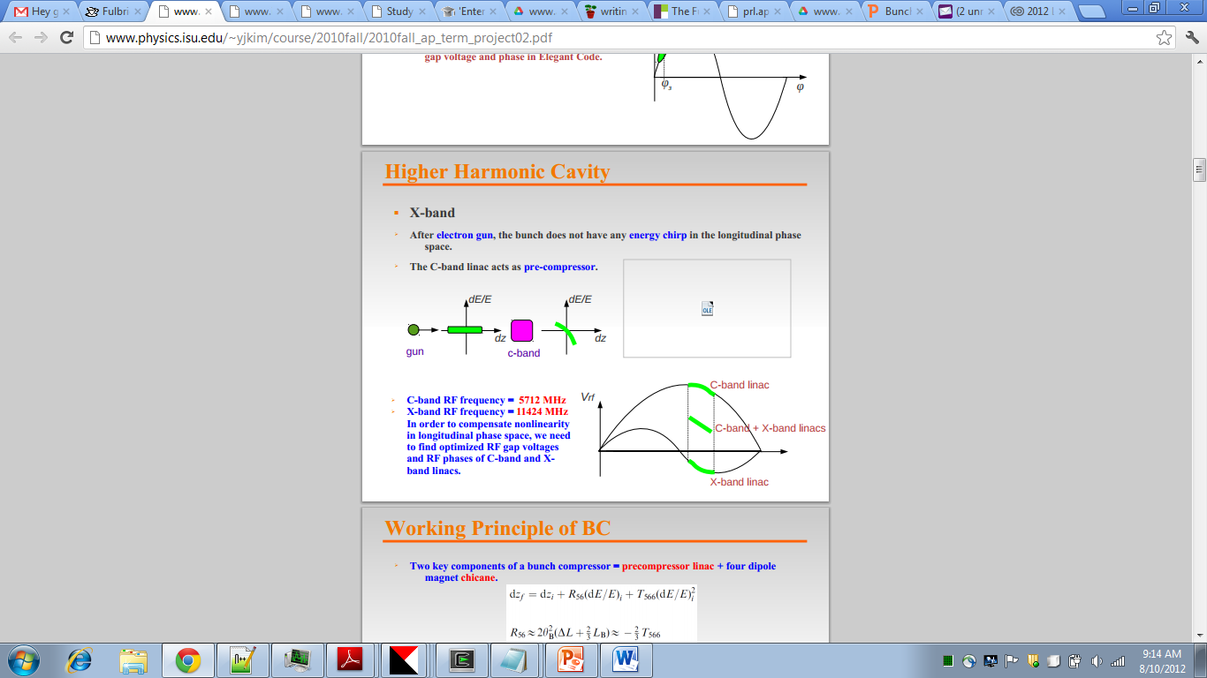
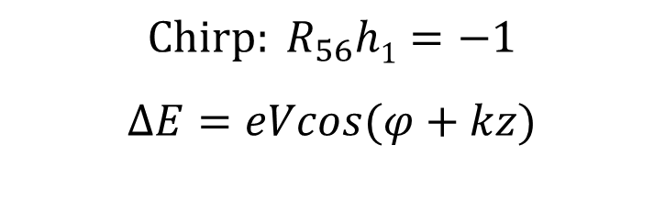
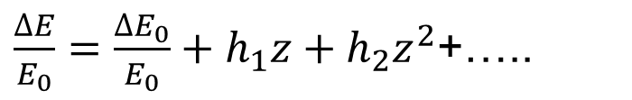
Linearization of phase space
$$Chirp: R_{56}h1=−1$$
$$∆E=eVcos(φ+kz)$$
$\frac{∆E}{E_{0}}=\frac{{∆E}_{0}}{E_{0}}+h_{1}z+h_{2}z^{2}$+…..
Credit M. Mamtinim, ISU
ELEGANT simulation code
6D particle tracking
Simulation of tracking errors
Computations of CSR, space charge, wakefields

Slide 6
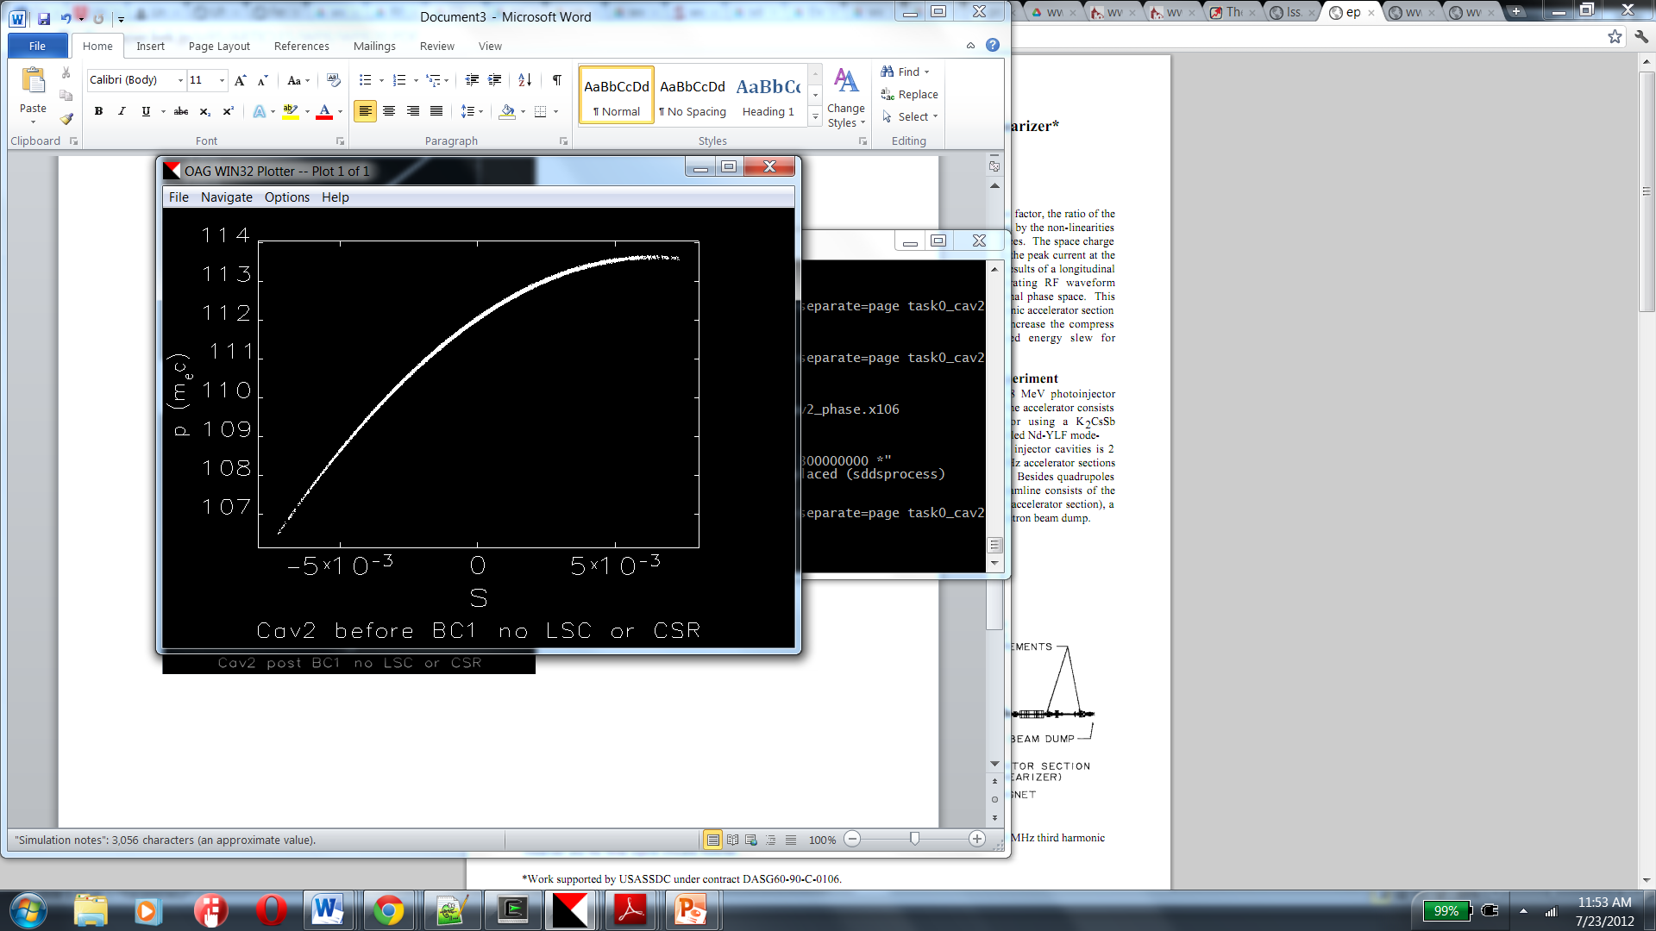
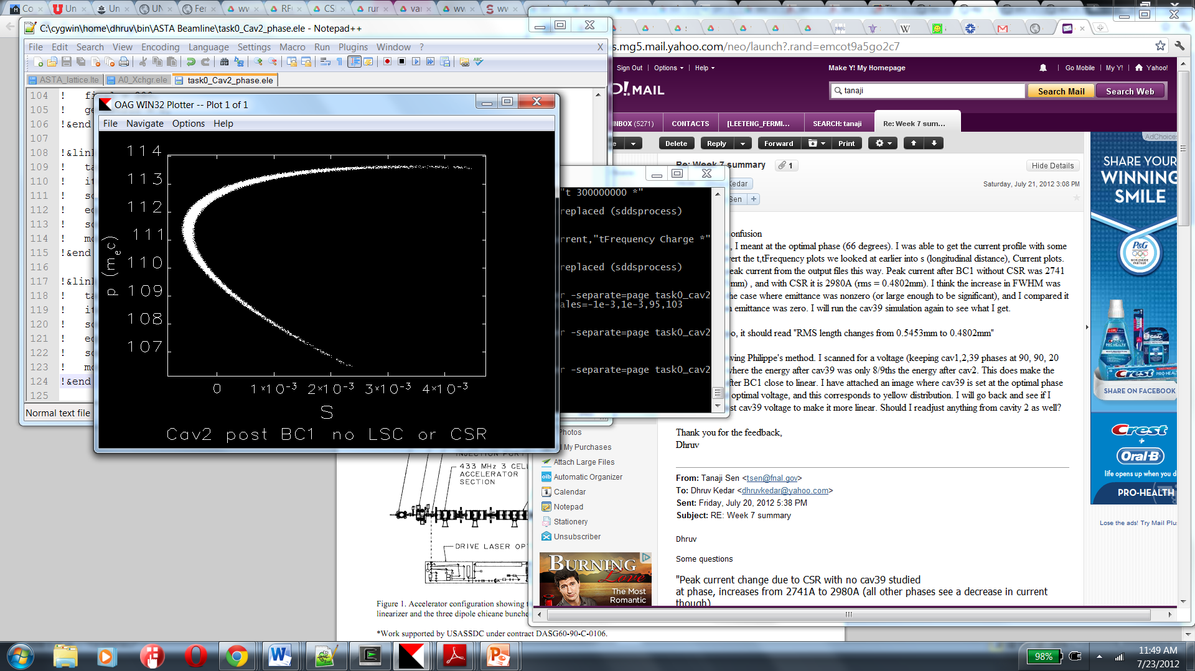
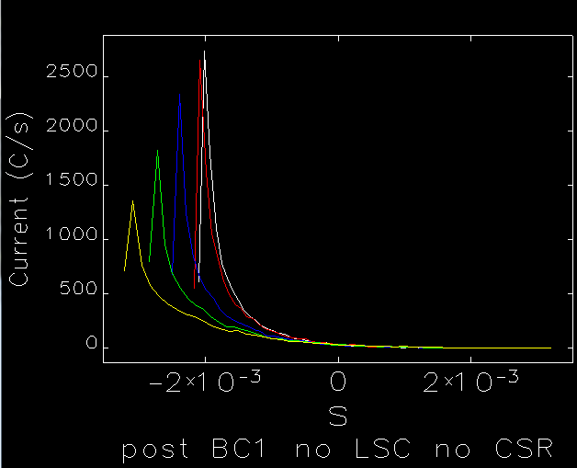
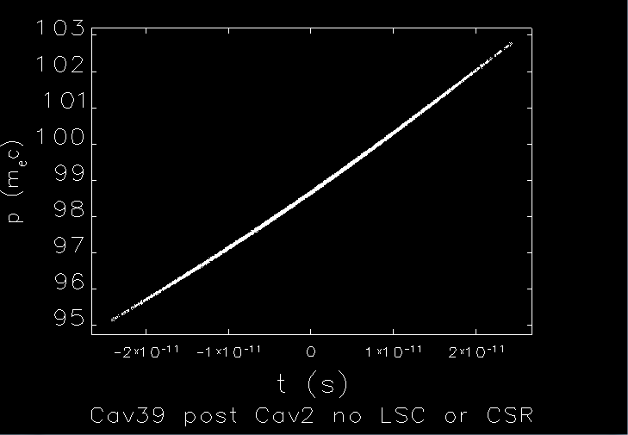
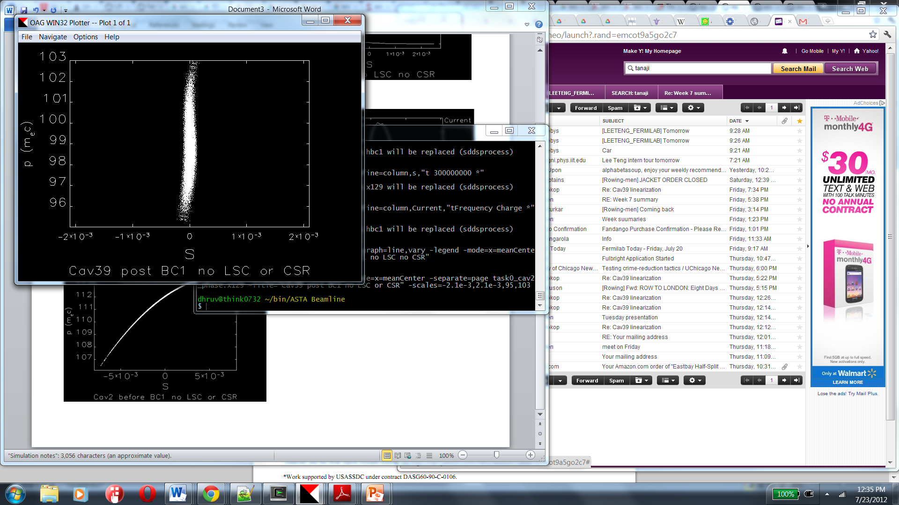
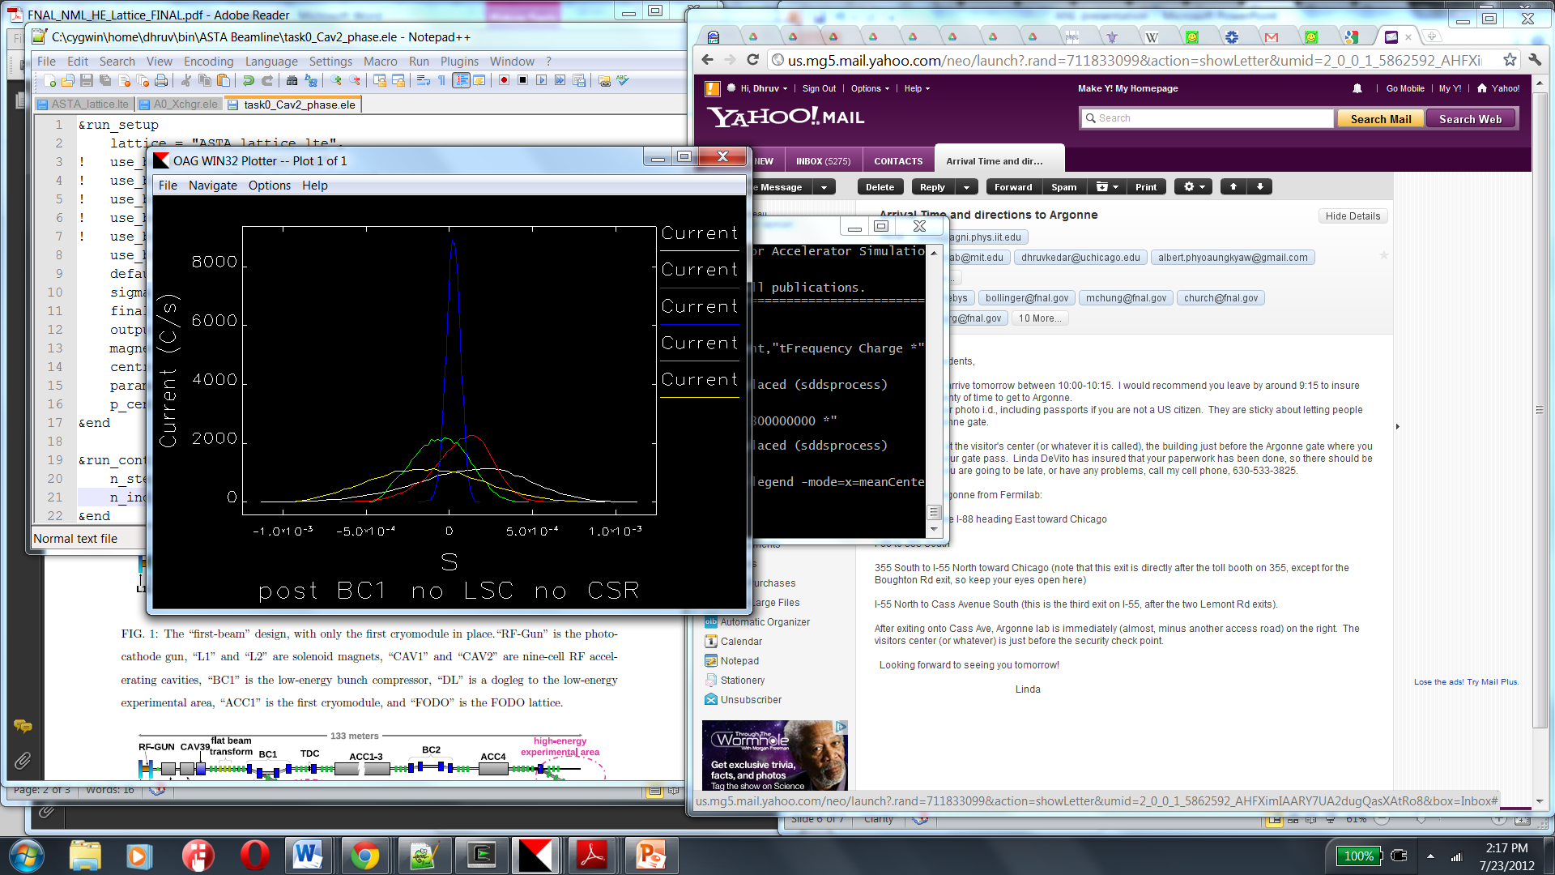
1D Simulation with ELEGANT
Cav2
Cav39
Before BC1
After BC1
Profile

Slide 7
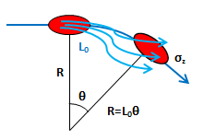
CSR Complications
Charged particles in dipole emit synchrotron radiation in phase
Coherent Synchrotron Radiation generates energy spread (tail interacts with head)

Slide 8
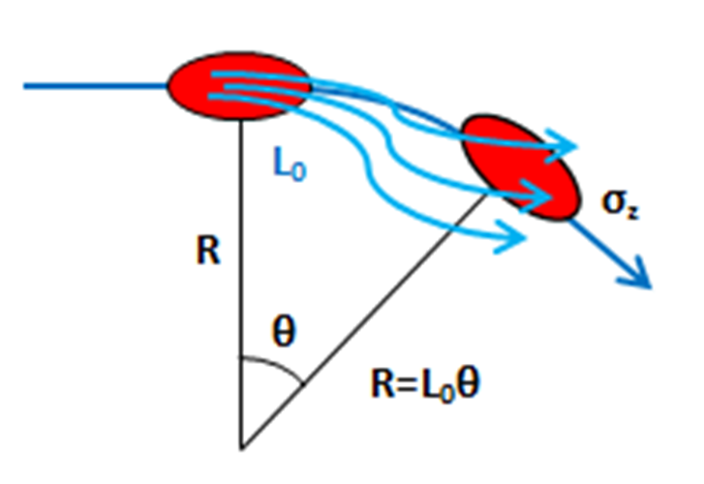
CSR Complications
Charged particles in dipole emit synchrotron radiation in phase
CSR generates energy spread (tail interacts with head)
Benefits of two-stage compression
Reduce bending angle
    (R₅₆)
Stronger harmonic cavity

Slide 9
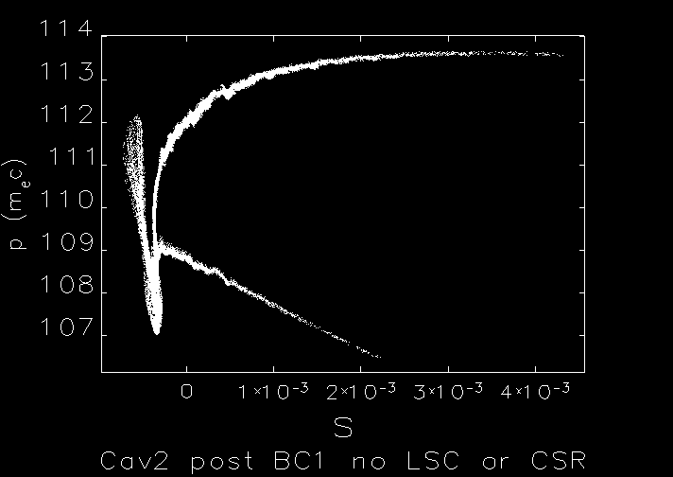
Bunch Compressor CSR
Nonlinearities introduced to LPS
Readjust optimal CAV2 phase
  Phase closer to on-crest
Without Cav39

Slide 10
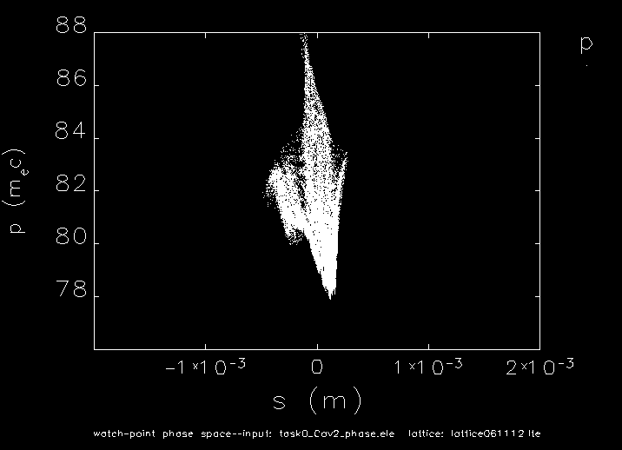
Bunch Compressor CSR
Nonlinearities introduced to LPS
Readjust optimal CAV2 phase
  Phase closer to on-crest
Without Cav39
With Cav39

Slide 11
Conclusion & Next steps
BC1 compression from 2.4mm to 0.07mm
CSR increases RMS size to 0.2mm
Study CSR effects in BC2
With addition of BC2, optimize:
  CM1 phase
  R₅₆ of BC2
  Cav39 phase

Slide 12
Acknowledgements
Tanaji Sen
Chris Prokop and Philippe Piot
Eric Prebys and Carol Angarola

Slide 13
Questions

Slide 14
1D Simulation
Longitudinal dynamics with ELEGANT
Cav2
Cav39

Slide 15
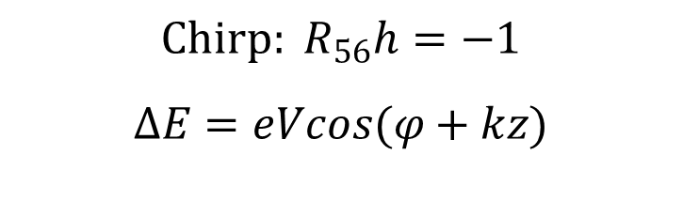
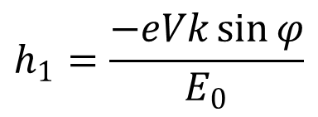
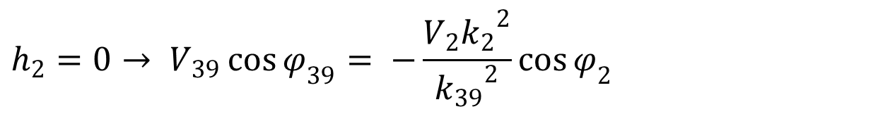
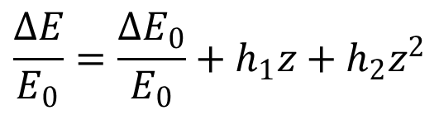
Linearization of phase space
$$Chirp: R_{56}h=−1$$
$$∆E=eVcos(φ+kz)$$
$$\frac{∆E}{E_{0}}=\frac{{∆E}_{0}}{E_{0}}+h_{1}z+h_{2}z^{2}$$
$$h_{1}=\frac{−eVk\sin{φ}}{E_{0}}$$
$$h_{2}=0→ V_{39}\cos{φ_{39}= −\frac{V_{2}{k_{2}}^{2}}{{k_{39}}^{2}}}\cos{φ_{2}}$$

Slide 16
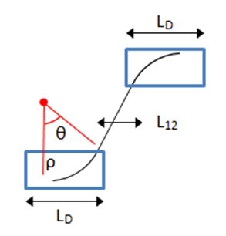

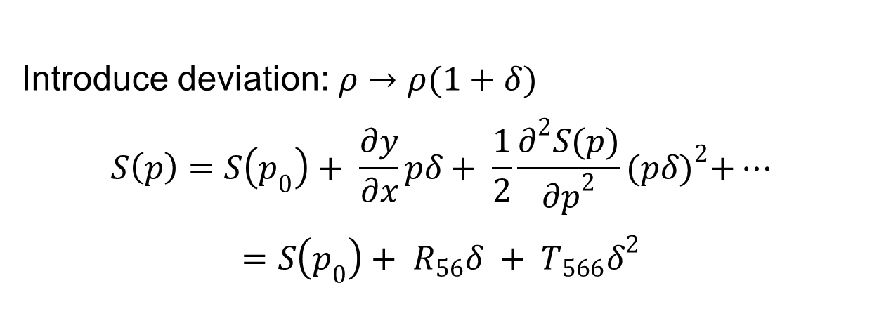
Linearization of phase space
$$S=2ρθ+\frac{L_{12}}{cosθ}$$
$$ρ= \frac{p}{eB}$$
$$θ=\sin^{−1}\frac{L_{B}eB}{p}$$
Introduce deviation: $ρ→ρ(1+δ)$
$$S\left(p\right)=S\left(p_{0}\right)+ \frac{∂y}{∂x}pδ+ \frac{1}{2}\frac{∂^{2}S(p)}{{∂p}^{2}}{(pδ)}^{2}+…$$
$$=S\left(p_{0}\right)+ R_{56}δ + T_{566}δ^{2}$$

Slide 17
1D Simulation
Longitudinal dynamics with ELEGANT
More compression equates with higher peak current
Cav2
Cav39

Slide 18
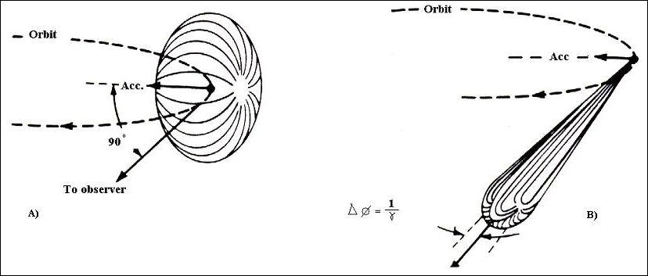
Nonlinear effects on LPS
Unwanted emittance growth
  Collective space charge effects (LE)
  Falls as 1/ɣ²
  Coherent Synchrotron Radiation (HE)

