Slide 1
Muon Campus Operation Report
Dean Still
Friday 09:00 Operation Meeting
Week of January 23, 2023

Slide 2
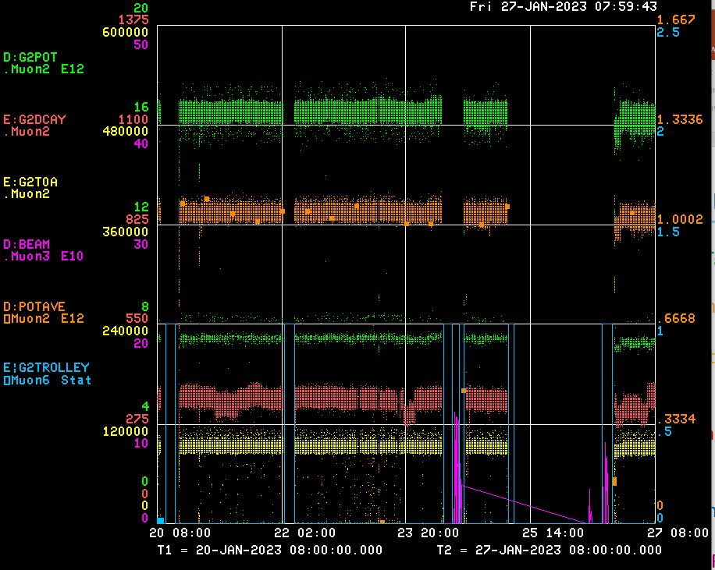
Performance for the Past Week
Protons On Target
Avg Protons on Target
Particles to Entrance of G-2 Ring
Decay Positrons in G-2 Ring
G-2 Trolley Run
8Gev Delivery Ring beam
R:KPS4A repair & Trolley Run
Trolley Run
← BPM Studies – Time in 20 & 50 House
← M4 Beamline Studies
← Booster Study Day – No beam to g-2
<- g-2 off ->
Cryo work
<-------Weekend ------→
<------------Week Days -------------------→

Slide 3
Activities for the Past Week
G-2 Status:
Delivered beam to g-2
Work completed:
Diagnosed M40 to gain BLM aborts for M3, DR and M4 beamlines. Still needs more work.
Replaced digitizer for D:ICABT (DR abort ion chamber)
Reversed the polarity D:Q106 back to nominal.
Target Blower maintenance & replaced a pressure transducer for air pressure D:TRMP
Replaced a dead chipmunk at AP50.
RF water cooling skid at AP50 is fixed!! RF is ON. Thanks to MSD, Dez and ISD for making the modifications to the water skid.
ESS2 (mu2e electrostatic septa) Power Supply Installation to be completed in 1-2 weeks.
New DR BPM 100% Installed and 66% timed in.
8Gev Studies: (2 days)
BPM 8Gev beam studies. Installed & trouble shoot the 20 & 50 house BPM's. (Patel +)
Delivering Ring work to tune up RF system with beam and diagnose new BPM data.
M4 beamline instrument calibration study. (Werkema, Drendel)

Slide 4
Machine Downtime for the Week
Muon: (Total 0.0 hours)
- (0.0 hr)
- 8Gev Studies – (13.6 hr)
Upstream Machine: (Total 14.3 hours)
Preacc- ( 0.0 hr )
LINAC ( 0.3 hr )
MI ( 0.0 hr )
Booster ( 1.3 hr )
RR –KPS4A ( 3.9 hr)
Booster Studies (8.8 hr)
G-2 Experiment: (Total 26.5 hours)
Trolley run (3.6 hr )
No beam request (2.25 hr)
Cryo Work (*18.2hr)
Total Downtime: (40.8 hours*)
Downtime % : 24 %
Uptime % : 76 %
AD Downtime : 8.5 %
Experiment Downtime: 15.5* %
*Adjusted for conducting beam studies & g-2 downtime
Reporting Period from 0800 Friday Jan 20 to 0800 Friday Jan 27 -- 168 hours per week potential operation

Slide 5
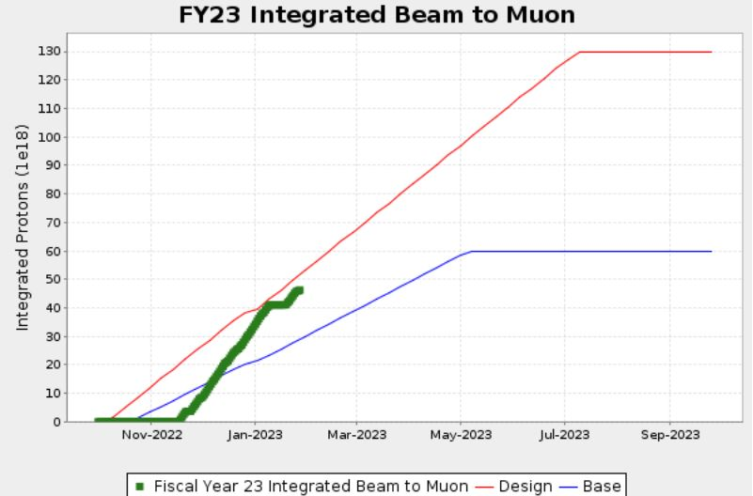
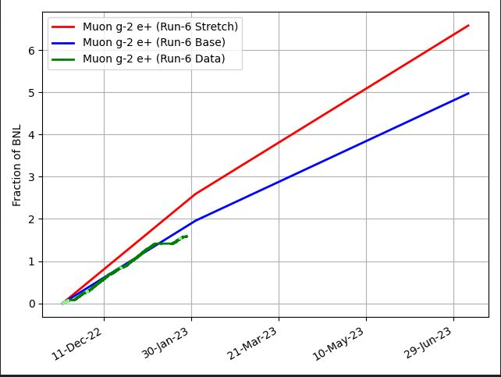
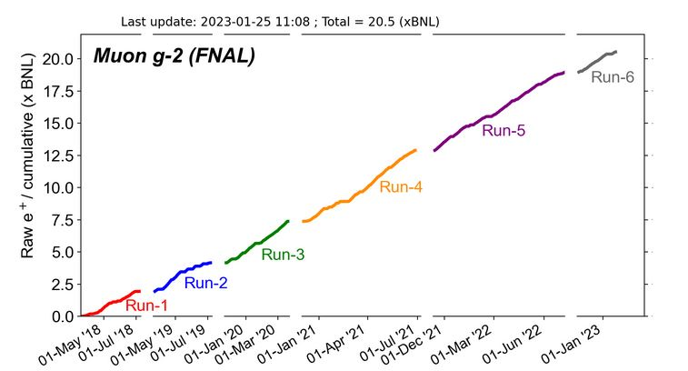
G-2 Performance – Integrated for Run 6
G-2 Experiment POT Run Goal
~4.2E20 POT
Run 6 period is Nov 2022 – June 2023
Run 6: Goal of ~x 6 BNL
Total Run: goal of x 21 BNL
Run 6 # POT Delivered ~ 4.5E20
Run 6 Integrated ~ x 1.59 BNL
0.14 for the week
Total Integrated ~ x 20.5 BNL
Start of
Summer
Shutdown
2023
Plots as of 1/27/2023

Slide 6
Plan for Next Week
g-2 operation:
Deliver Beam to g-2
Muon Campus Study Plans : (3 day shifts of 8Gev studies)
Friday – BPM data path trouble shooting.
Saturday – Deliver beam to g-2
Sunday – Deliver beam to g-2
Monday – Deliver beam to g-2
Tuesday - BPM timing studies. Time in 30 & 40 house.
Wednesday - BPM data path trouble shooting.
Thursday – Deliver beam to g-2
Friday – Deliver beam to g-2
Future Planning :
Heads up: We are starting the discussion about AC installation at AP0. This will have an impact on g-2 beam delivery and mu2e studies. Length of work ~ month.
G-2 line
Mu2e M4
line

Slide 7
AP-0 A/C units
Jim Morgan
January 27, 2023

Slide 8
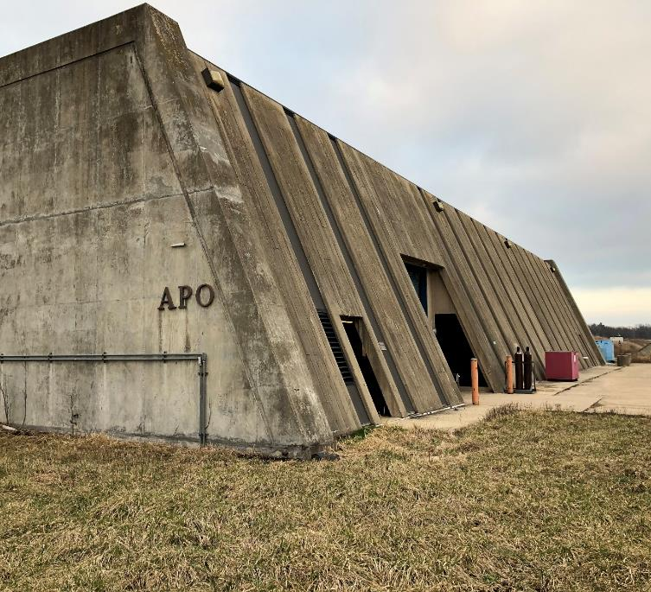
AP-0 Target Station Air Conditioning replacement
AP-0 A/C hasn’t worked for several years and is being replaced
One 30-Ton main A/C unit south of AP-0
Two 5-Ton units behind AP-0, dedicated to blowing directly into Vault area
Contract bid accepted last March
Delay getting 7-Ton unit
Contractor now wants to start ASAP
Checking if work can be delayed
Numerous radiological issues
AP-0 is Radiation Area
Vault A/C equipment is behind AP-0 and in Water Cage, a High Radiation Area
During g-2 Operation, Rad Detector near Dump RAW system reads 2,850 mR/Hr

Slide 9
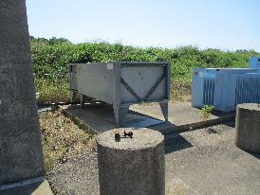
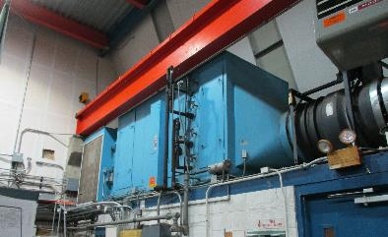
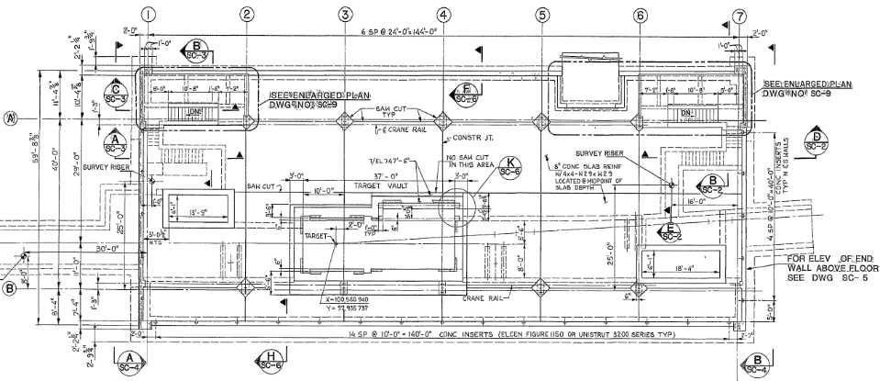
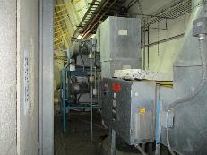
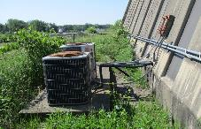
AP-0 Air Condition components
North
AHU-1
Main A/C unit
Water Cage
A/C units behind AP-0

Slide 10
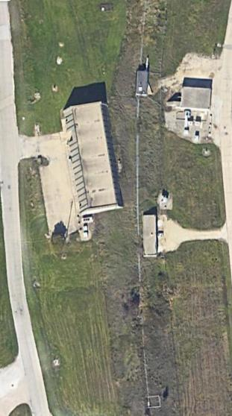
AP-0 A/C replacement
Working with Radiation Safety and ISD on plan
Clearly can’t be running beam to g-2 when work is going on in Water Cage
RAW systems cool to ~30 mR/Hr 2 hours after g-2 beam is off, but much lower where A/C work will be going on
Work is projected to take up to a month, beginning sometime in February
Prefer to put off start if possible (contract may not allow) to align with next g-2 cryo warm-up
Rad Fence area behind AP-0
Vault A/C units located in fenced area
Fenced area may be Tevatron legacy, SY120 and Muon Shielding Assessments show adequate passive shielding
Peak rate near back of AP-0 when running beam to g-2 should be around 20 mR/Hr, not far from A/C units
Proposal under consideration
Do Mu2e studies during workdays (13W beam power), run beam at night and on weekends
Run beam to g-2 on days that work isn’t in water cage or (maybe) rad fence area
Vault Units
Rad Fence Area
Main Unit

