Slide 1
IOTA Proton Injector Update
Dean (Chip) Edstrom
01/27/2023

Slide 2
IPI Summary
Source
HV Enclosure work continues
Extractor Modulator Circuit Tested*
Auxiliary Electronics Shelf In Progress*
Mechanical
Cable Procurement Summary*
RF Penetration…
RF
Engineering review of variable coupler stand expected Feb/March
Ordering circulator stand kit separately

Slide 3
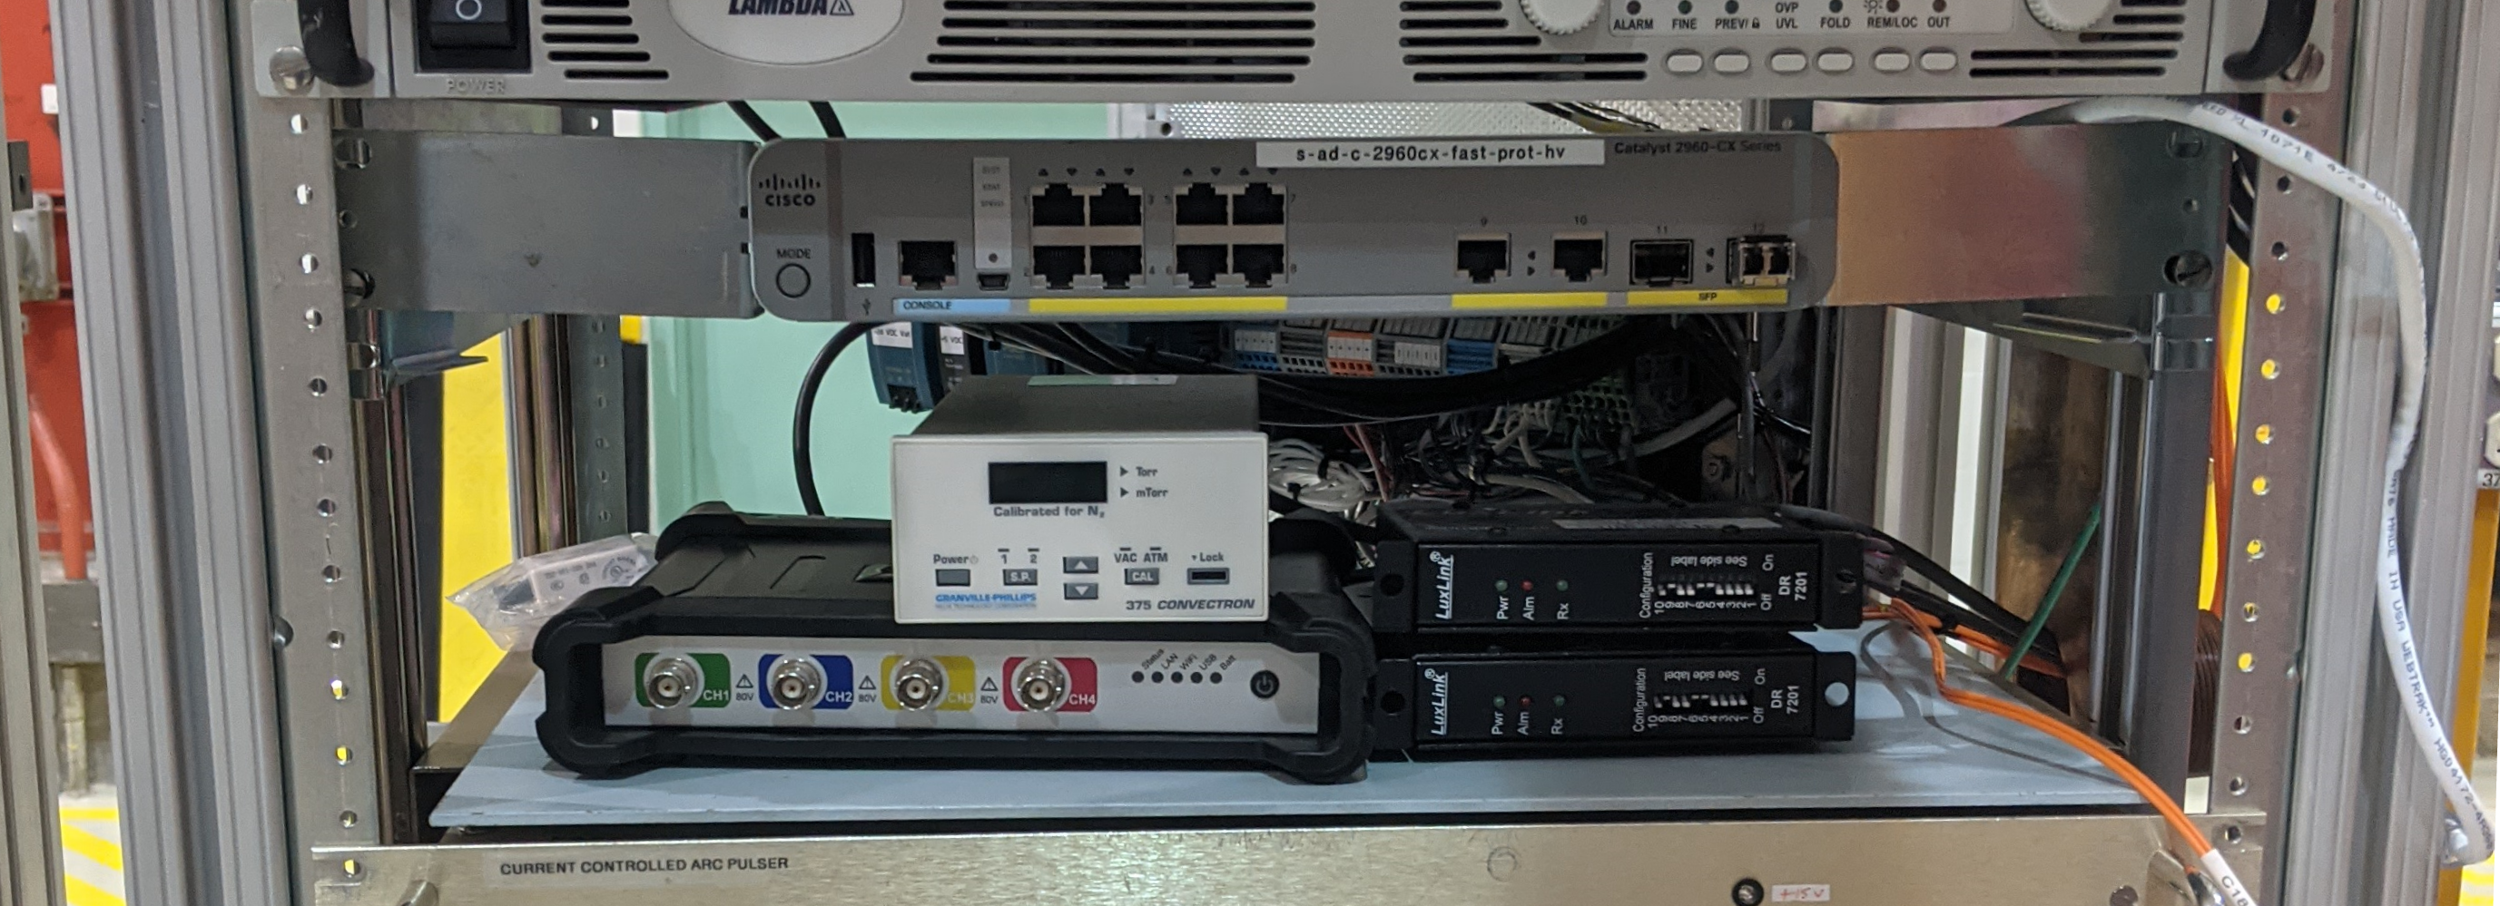
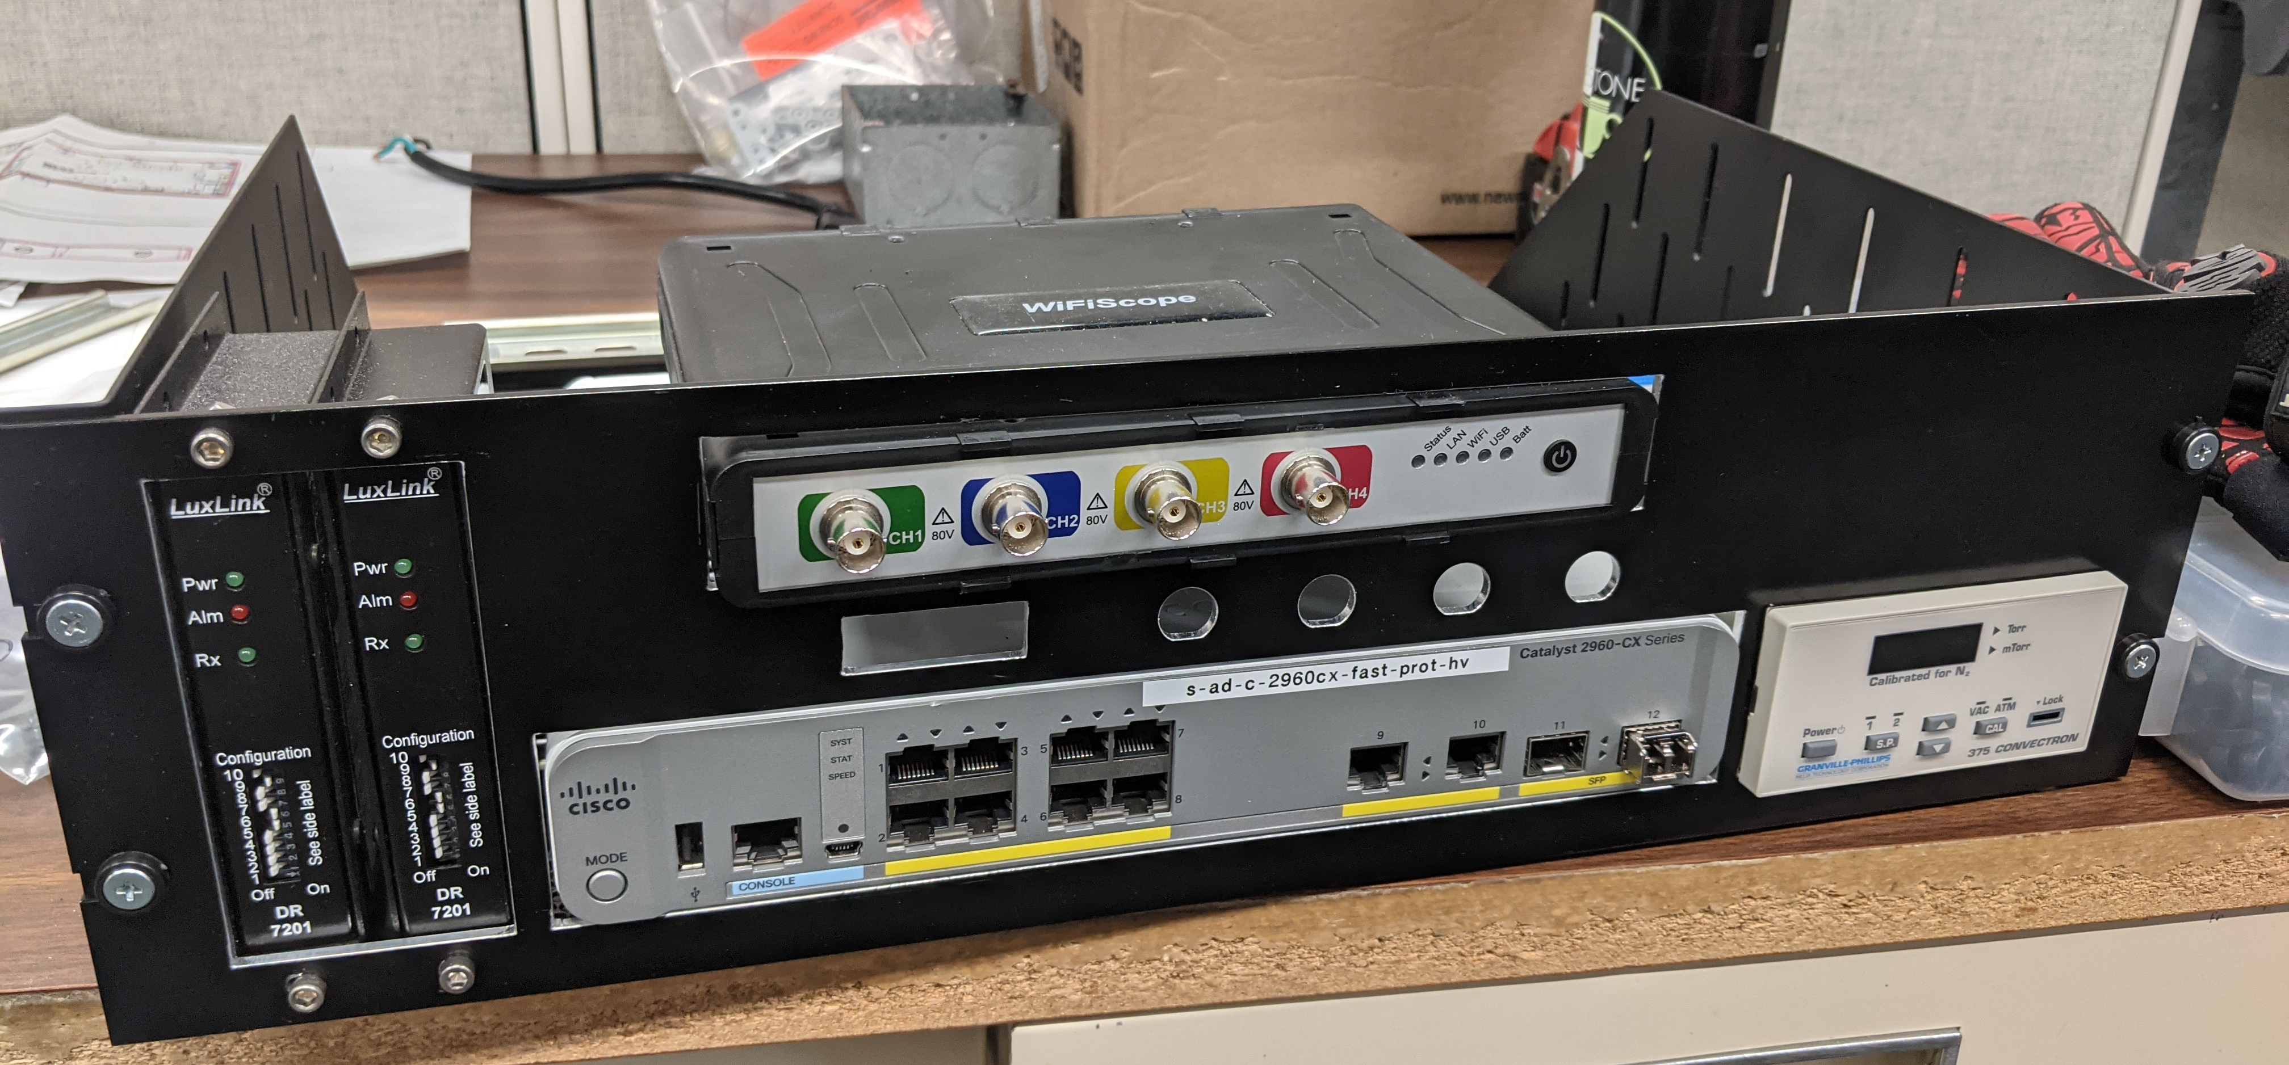
HV Enclosure Auxiliary Electronics Shelf
TTL Fiber Receiver Modules
Cisco Fiber Network Switch
375 Convectron Vacuum Gauge
WS6 200MHz TiePie Oscilloscope
120 VAC Distribution
Thanks Dave Franck & Tom Kelly

Slide 4
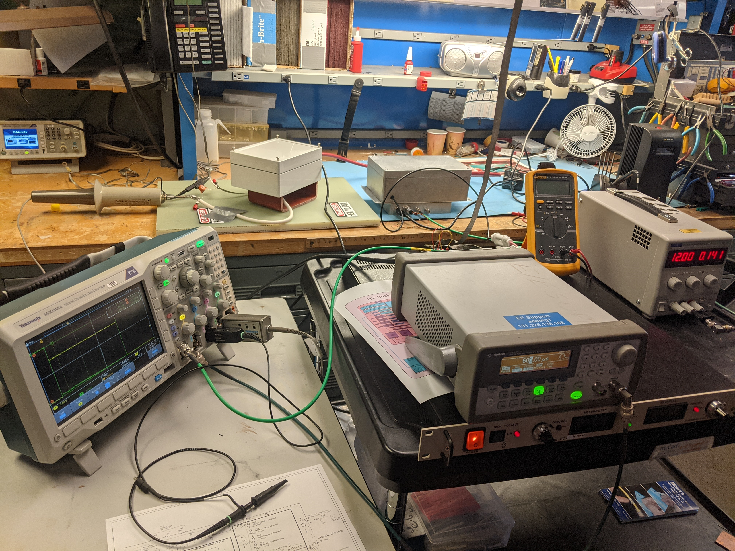
Extractor Modulator & Spark Protection
Circuit Tested!
Thanks Greg Saewert & Jeff Simmons!
MOVs in protection circuit nudged into conductance resulting in a ~5% voltage droop
1.8μs needed for IOTA
600μs estimated for neutralization of beam in the LEBT (Саша Ш.)

Slide 5
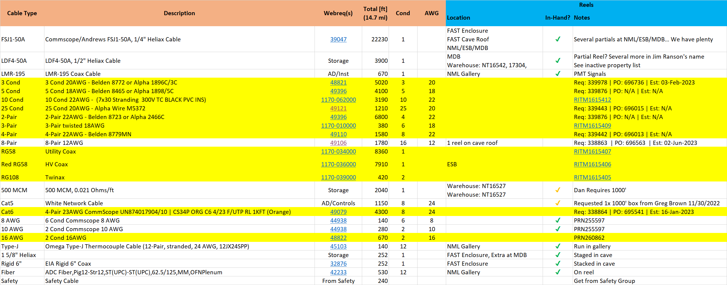
Cable Procurement Summary
Longest Leads (so far…)
10 Cond: 06/12/2023 (Backordered)
8-Pair: 06/02/2023

