Slide 1


MQXFA14
Coil Pack and Shimming Proposal
Dan Cheng, Katherine Ray, Paolo Ferracin, Mike Solis
07-Feb-2023
LBNL

Slide 2
Outline
Coil Selection Review Recap
Coil CMM Summary
Coil Matrix
Proposed Coil Pack and shimming
Summary

Slide 3
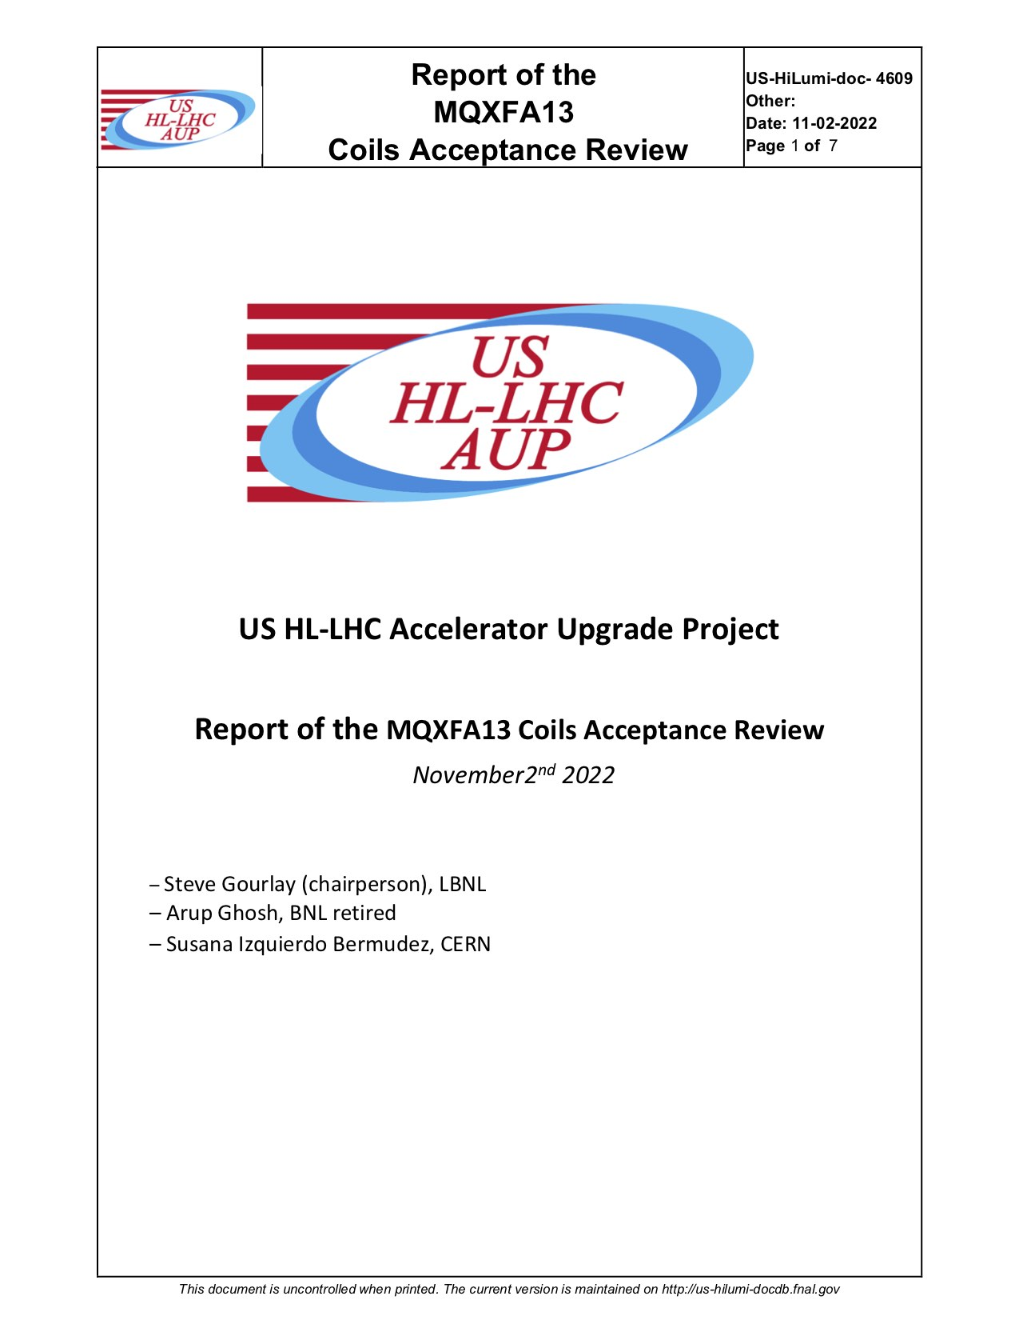
Coil Selection Review Report Summary
MQXFA14 Coil Selection Review was held 16-Dec-2022
  Coils 142, 143, 230, 231 reviewed, plus Coil 220 as spare
  See https://indico.fnal.gov/event/57433/
All coils are approved for use; a few notes
  All coils have b6 correction
  All electrical QC passed
  Fabrication reports and CMM reported

Slide 4
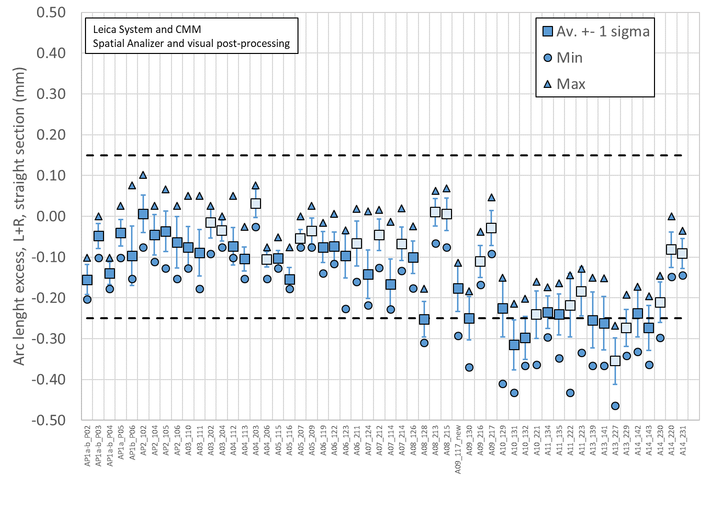
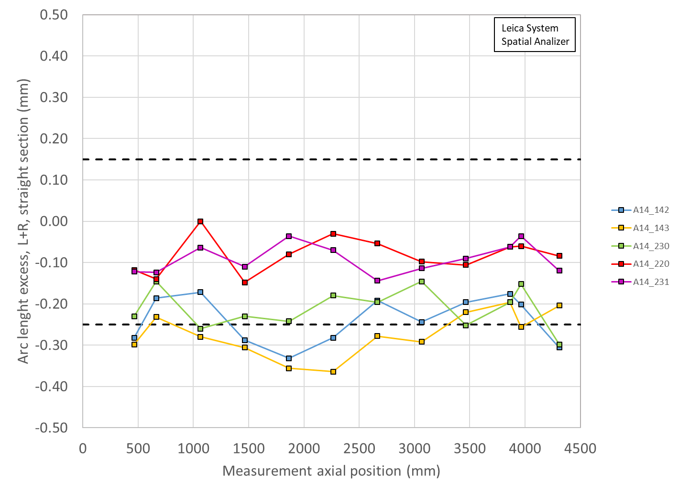
Total Arc Length Excess (Leica)
Coil 143 smaller than spec
3965 mm is location of SG:
142 ~-200 µm (~-238 µm avg)
143 ~-250 µm (~-273 µm avg)
220 ~-60 µm (~-82 µm avg)
230 ~-150 µm (-210 µm avg)
231 ~-35 µm (-91 µm avg)

Slide 5
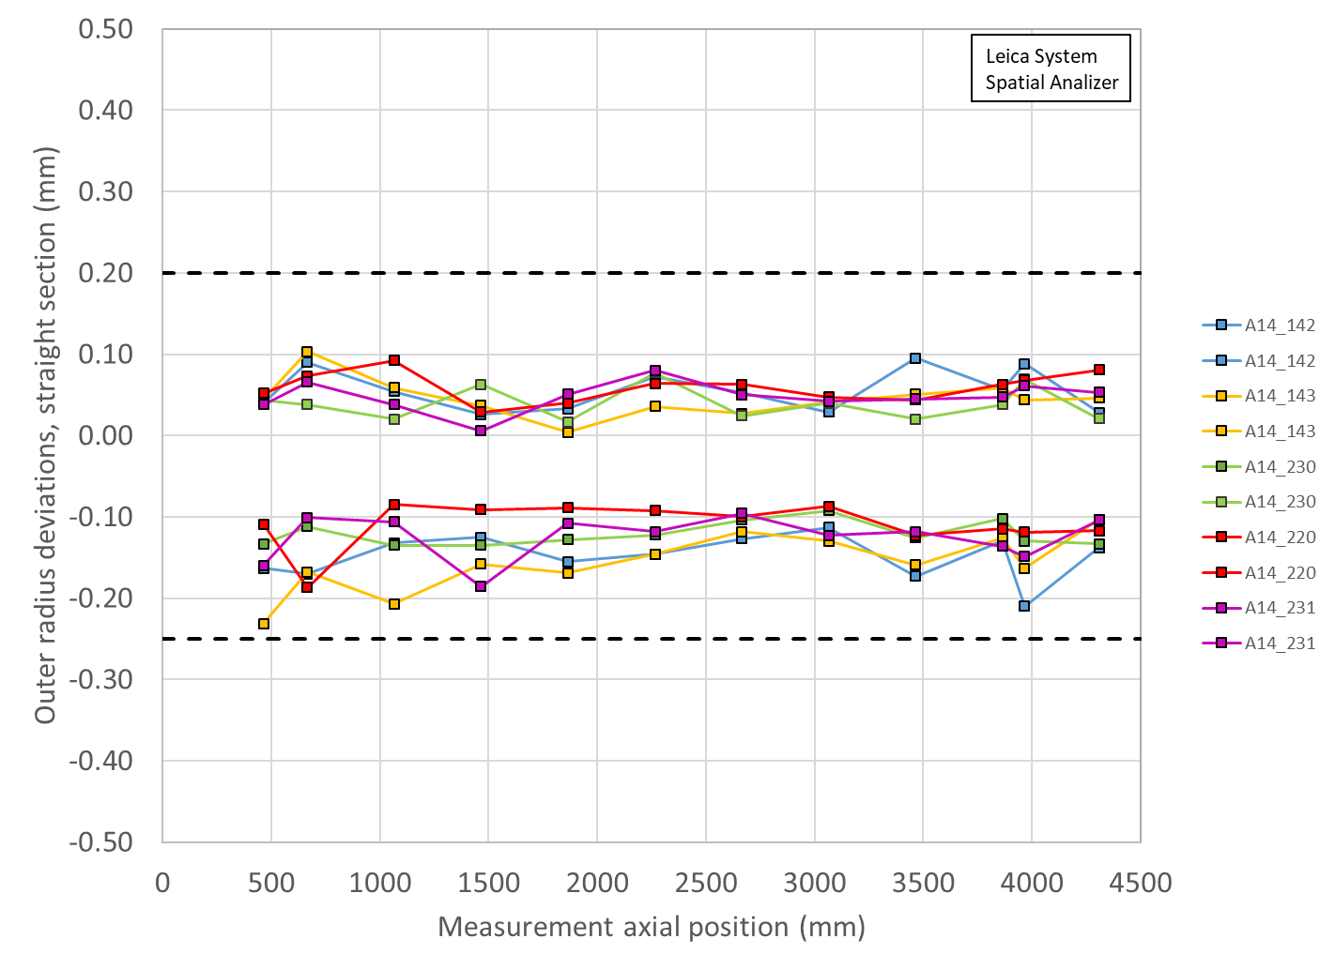
Outer Radius Profile Deviations (Leica)
All Coils avg. within spec
  But mostly smaller overall
Outer Radius deviation ranges are all similar among the coils

Slide 6
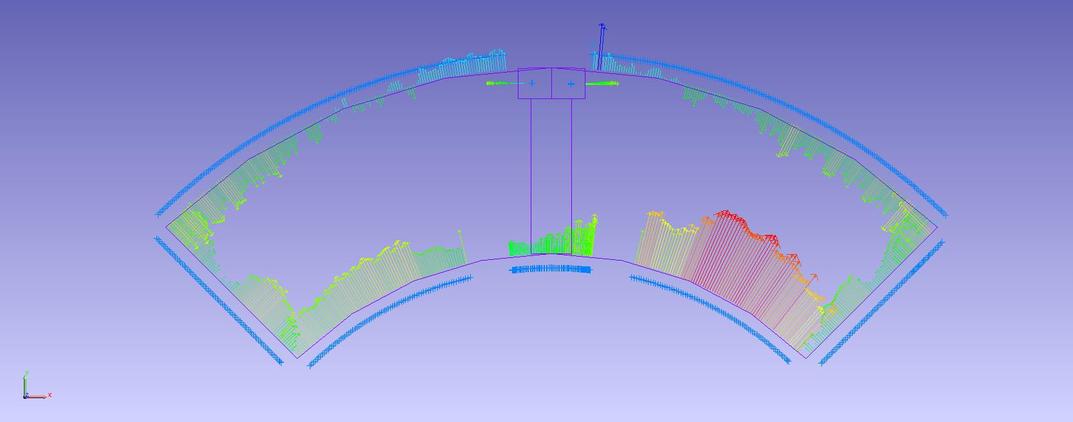
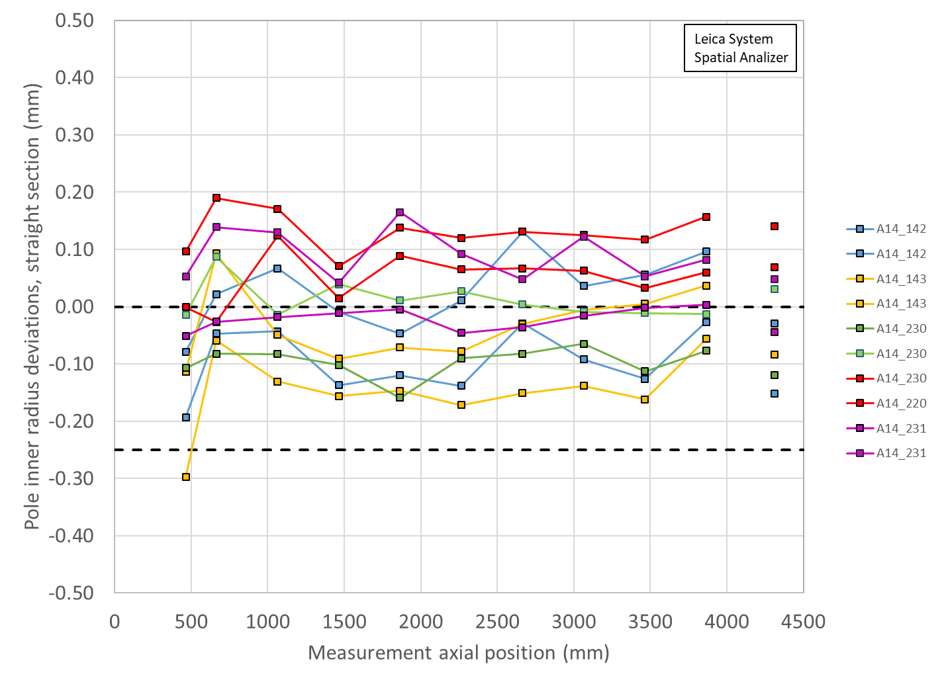
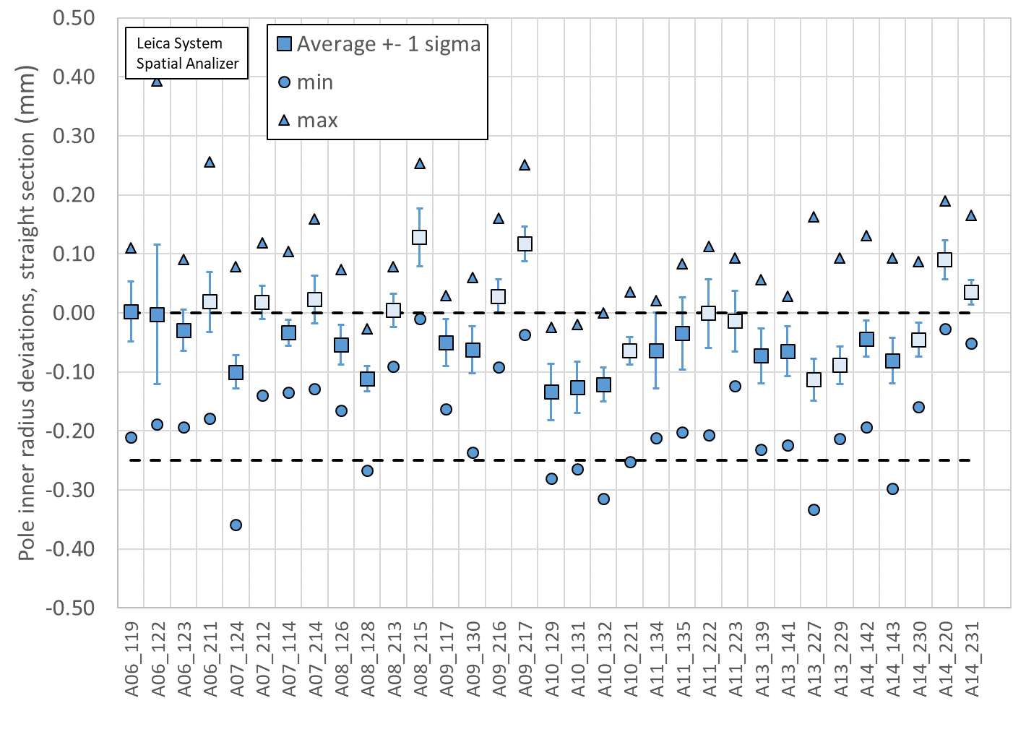
Pole Inner Radius Deviations (Pion Locations)
Inner Radius of the pole key is small (deviation into the bore)

Slide 7
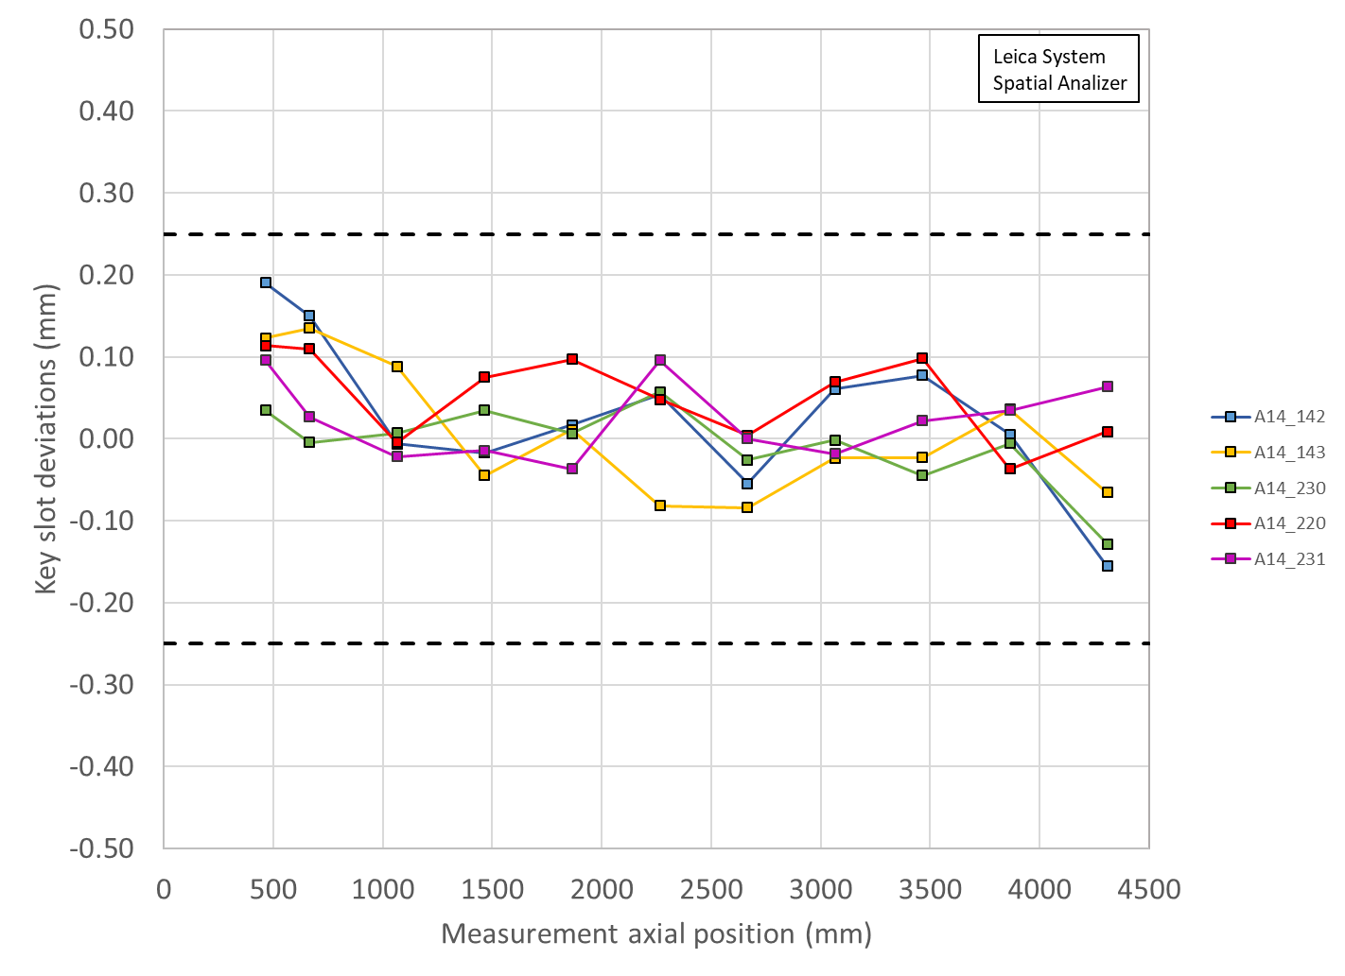
Key Slot Deviations
All Coils within spec
No keyslots out of spec

Slide 8
MQXFA14 Coils Matrix
Coil | b6 Corr. | Keyway shift | Avg. Pole Inner R Dev | Avg R Dev. | Avg. Midpl Dev.
142 | Yes | Ok | ~nominal | ~-46 µm | ~-119 µm
143 | Yes | Ok | ~nominal | ~-52 µm | ~-137 µm
220 | Yes | Ok | ~90 µm over | ~-18 µm | ~-41 µm
230 | Yes | Ok | ~nominal | ~-40 µm | ~-105 µm
231 | Yes | Ok | ~nominal | ~-18 µm | ~-46 µm
OD: all coils are slightly undersized
Midplane: all coils are undersized, will require extra midplane shims
Most coils pole inner radii show deviations into the bore; pions will need to be machined in these locations
LBNL measurements are using Leica system data

Slide 9
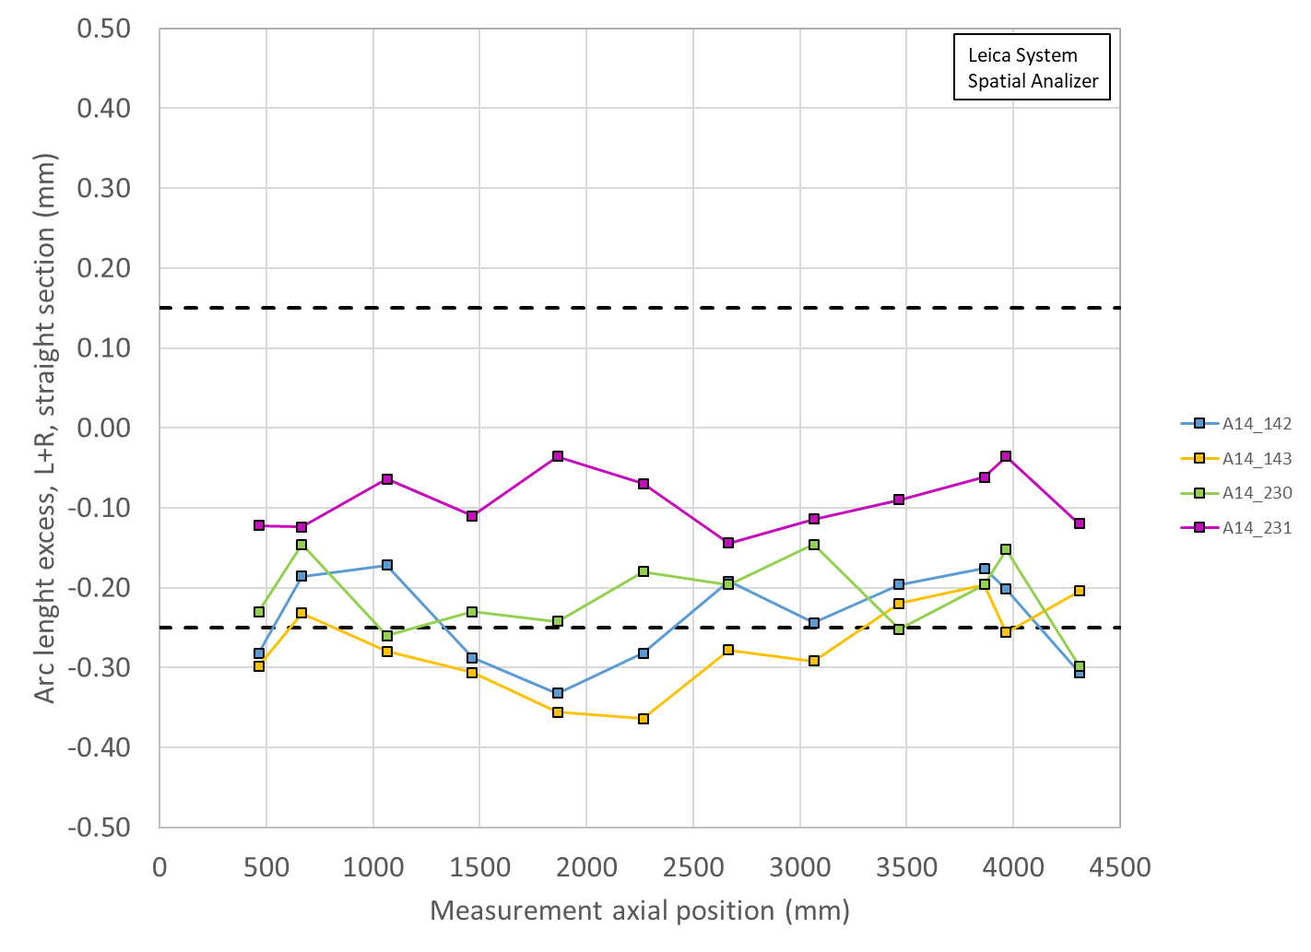
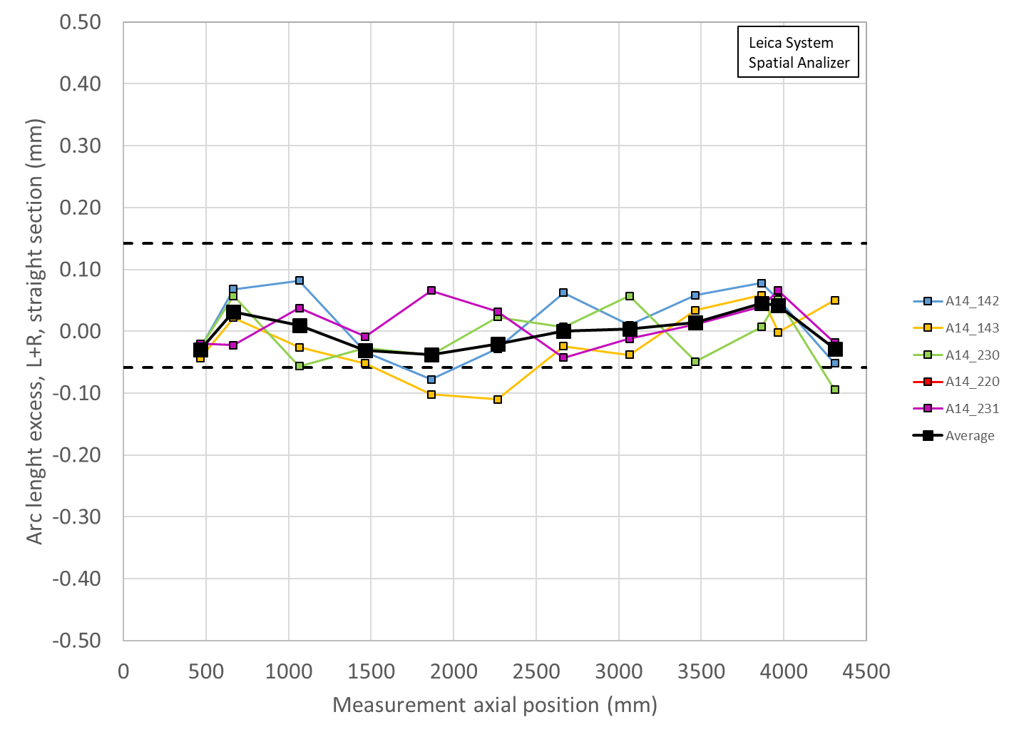
Coil Size estimates with midplane shims
Coil measurement plots created to show the effect of adding shims to both midplanes of Coils 142, 143, 230, 231
Limited by thicknesses of Kapton midplane shim availalble
Shimmed
0.005” on Coil 142
0.005” on 143
0.002”+0.002” on 230
0.002” on 231
Unshimmed

Slide 10
MQXFA14 Acceptable coil ordering
There are 69 acceptable coil orderings with voltage < 353 V that are common for both rolled and minor edge RRR values (values reported for rolled RRR)
P1 | P2 | P3 | P4 | Volt
142 | 143 | 220 | 230 | 344
220 | 143 | 230 | 142 | 344
230 | 143 | 142 | 220 | 345
230 | 220 | 142 | 143 | 345
143 | 142 | 230 | 220 | 345
143 | 220 | 142 | 230 | 345
220 | 142 | 230 | 143 | 345
143 | 230 | 142 | 220 | 346
220 | 230 | 142 | 143 | 346
220 | 143 | 142 | 230 | 346
230 | 231 | 143 | 220 | 347
142 | 231 | 230 | 143 | 347
142 | 231 | 230 | 220 | 347
220 | 231 | 230 | 142 | 347
143 | 231 | 230 | 142 | 348
142 | 220 | 230 | 231 | 348
231 | 220 | 230 | 142 | 349
230 | 231 | 142 | 143 | 349
230 | 231 | 142 | 220 | 349
142 | 231 | 143 | 220 | 349
142 | 143 | 230 | 231 | 349
220 | 231 | 142 | 230 | 349
230 | 220 | 142 | 231 | 350
143 | 231 | 142 | 230 | 350
143 | 142 | 230 | 231 | 350
220 | 142 | 230 | 231 | 350
231 | 142 | 230 | 143 | 351
231 | 142 | 230 | 220 | 351
231 | 220 | 142 | 230 | 351
230 | 143 | 142 | 231 | 351
231 | 230 | 142 | 143 | 352
231 | 230 | 142 | 220 | 352
143 | 230 | 142 | 231 | 352
220 | 230 | 142 | 231 | 352
220 | 231 | 230 | 143 | 353
P1 | P2 | P3 | P4 | Volt
230 | 142 | 143 | 231 | 333
230 | 142 | 143 | 220 | 333
230 | 142 | 220 | 143 | 333
143 | 230 | 220 | 142 | 333
143 | 142 | 220 | 230 | 333
142 | 230 | 143 | 231 | 333
142 | 230 | 143 | 220 | 333
142 | 230 | 220 | 231 | 333
142 | 230 | 220 | 143 | 333
230 | 142 | 220 | 231 | 334
143 | 231 | 220 | 230 | 334
220 | 230 | 143 | 231 | 334
143 | 231 | 220 | 142 | 335
143 | 230 | 220 | 231 | 335
143 | 142 | 220 | 231 | 335
220 | 230 | 143 | 142 | 335
220 | 142 | 143 | 231 | 335
220 | 142 | 143 | 230 | 335
220 | 231 | 143 | 230 | 338
220 | 231 | 143 | 142 | 338
231 | 230 | 143 | 220 | 340
231 | 230 | 220 | 143 | 340
231 | 142 | 143 | 220 | 340
231 | 142 | 220 | 143 | 340
231 | 230 | 220 | 142 | 342
231 | 142 | 220 | 230 | 342
230 | 231 | 220 | 143 | 343
230 | 220 | 143 | 142 | 343
142 | 220 | 230 | 143 | 343
142 | 220 | 143 | 230 | 343
230 | 143 | 220 | 142 | 344
143 | 220 | 230 | 142 | 344
142 | 231 | 220 | 143 | 344
142 | 143 | 230 | 220 | 344
Coils are reported in mechanical order
Coils reported in mechanical ordering from CSR
Peak voltages evaluated in usual failure scenarios
Removed spare 220 from options
Preserved opposing quadrants for FNAL/BNL coils
  FNAL in Q1/Q3; BNL in Q2/Q4
Three cases available, lowest voltage picked

Slide 11
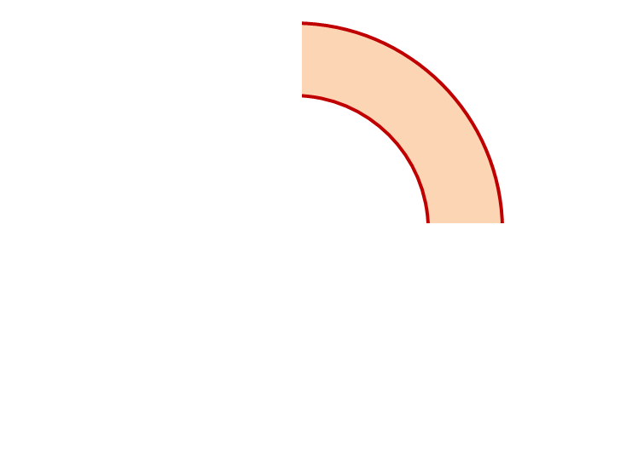
MQXFA14 Proposed Coil Arrangement
8 x δ_{midplane} = 2 π x δR_{OR}
~0.002” Undersized R
neglected
~.004” Undersized per Midpl.
Add 0.002” + 0.002” shim per side
~0.002” Undersized R
Neglected
~0.005” Undersized per Midpl.
Add 0.005” shim per side
230
142
Q2
Q1
Q3
Q4
143
231
~0.002” Undersized R
Neglected
~0.005” Undersized per Midpl.
Add 0.005” shim per side
~.001” Undersized R
Neglected
~0.002” Undersized per midpl.
Add 0.002” shim per side
Coil Electrical Order: A :142 – 231 – 230 – 143: B
Conforms to a favorable order based on RRR data

Slide 12
MQXFA14 Coil Pack Build 1 (Fuji)
Nominal Collar R: 114 mm
Nominal Coil R: 113.376 mm
Nominal Radial shim = 0.025” (0.624 mm)
  But we still target ~0.020”
Fuji radial stack up is ~0.021” (~0.54 mm)
  0.0045” Coil GPI + 0.007” Fuji + 0.005” Kapton & 0.005” G11
Add Kapton to various midplanes
 | 142 | 230 | 143 | 231
Kapton Ground plane insulation | 0.0045” (0.114 mm)
Coil Specific Radial Shim | 0 | 0 | 0 | 0
Coil-specific midplane shim | 0.005” 0.125 mm | 0.004” 0.100 mm | 0.005” 0.125 mm | 0.002” 0.050 mm
Fuji paper | 0.007” (0.175 mm)
Radial Shim | 0.005” Polyimide + 0.005” G11 (~0.25 mm)

Slide 13
MQXFA13 Coil Pack Build (Final)
Nominal Collar R: 114 mm
Nominal Coil R: 113.376 mm
Nominal Radial shim = 0.025” (0.624 mm)
  But we still target ~0.020”
Actual radial stack up is ~0.020” (~0.51 mm)
  0.0045” Coil GPI + 0.005” Kapton + 0.005” Kapton & 0.005” G11
Add Kapton to various midplanes
 | 142 | 230 | 143 | 231
Kapton Ground plane insulation | 0.0045” (0.114 mm)
Coil Specific Radial Shim | 0 | 0 | 0 | 0
Coil-specific midplane shim | 0.005” 0.125 mm | 0.004” 0.100 mm | 0.005” 0.125 mm | 0.002” 0.050 mm
Fuji paper | 0.000” (0.0 mm)
Radial Shim | 0.005” Polyimide + 0.005” Polyimide + 0.005” G11 (~0.38 mm)

Slide 14
Summary
Coils 142, 143, 230, 231 chosen for the MQXFA14 magnet
  Midplane shimming determined to be added:
    Coil 142 will have 0.005” per side added
    Coil 143 will have 0.005” per side added
    Coil 230 will have 0.002”+0.002” per side added
    Coil 231 will have 0.002” per side added
  Coil 142, 230 will be upper coils
    Most coils will require a number of Pions to be machined, even for the lower coils
Coil circuit order is 142-231-230-143
  Conforms to a favorable order based on RRR data

Slide 15
Additional Slides

