Slide 1
The First Muon Collider (?)
125.5 GeV Higgs
David Neuffer
July 2012

Slide 2
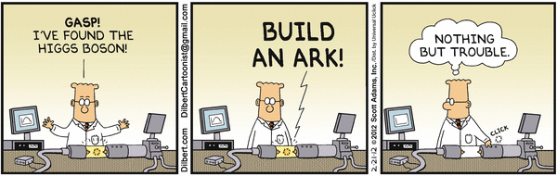
Outline
Introduction
  Motivation
Scenario Outline and Features
  Parameters -cooling
  Proton Driver, Front End, Accelerator, Collider
    Features-spin precession
Upgrade Path(s)
  to High-Energy High Luminosity Muon Collider

Slide 3
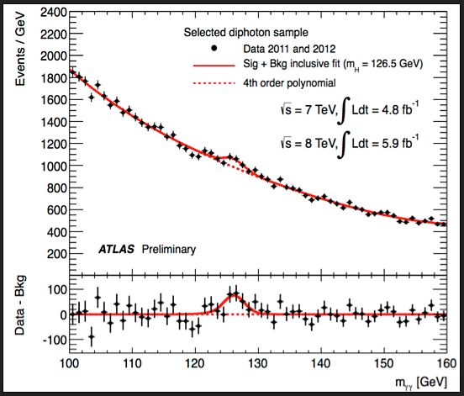
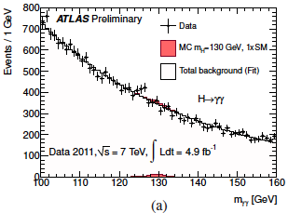
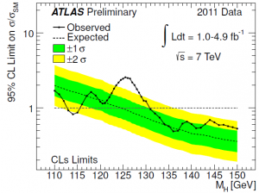
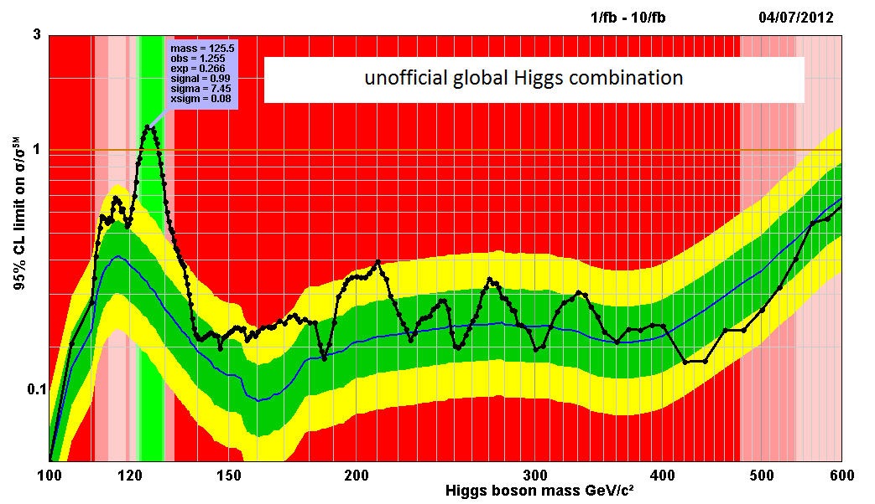
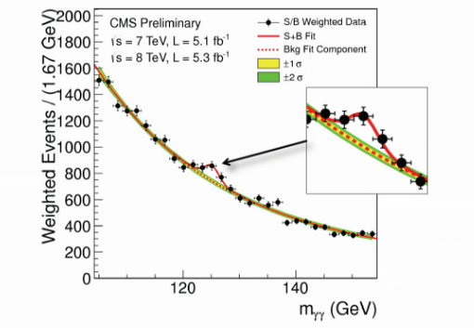
125 GeV Higgs?
Low Mass Higgs ?
  Observed at ATLAS-CMS
    ~125GeV
    ~”4+σ”
  cross-section H→γγ larger than MSM
    ~<2× in LHC measurement
      a bit “beyond standard model” ?

Slide 4
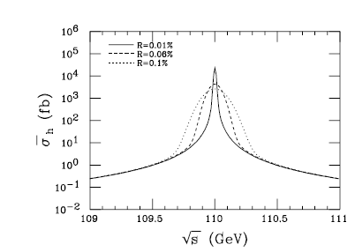
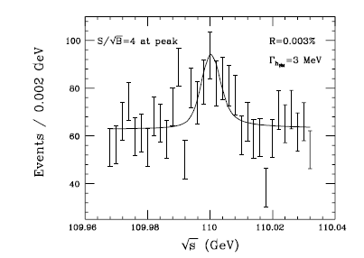
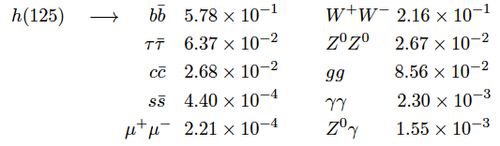
  μμ → H cross-section, width?
  Barger, Berger, Gunion, Han, Physics Reports 286, 1-51 (1997)
Cross section expected to be ~40pb
  μ⁺μ⁻ → H
  σ ∝ m_{μ}²
  width ~4MeV
at L=10³¹, t=10⁷s
→4000 H
  Beyond SM may be larger
    In SSM can be much wider
Could scan over peak to get M_{H}, δE
  H → b ̅b mostly
0.01%
=6 MeV
δE = 0.003% =2 MeV
~10³⁶/pt

Slide 5
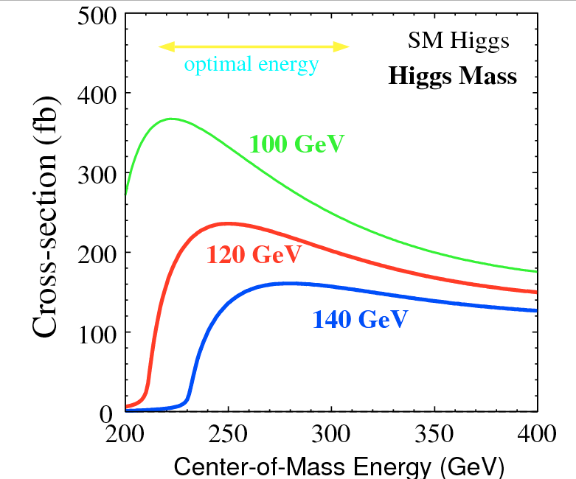
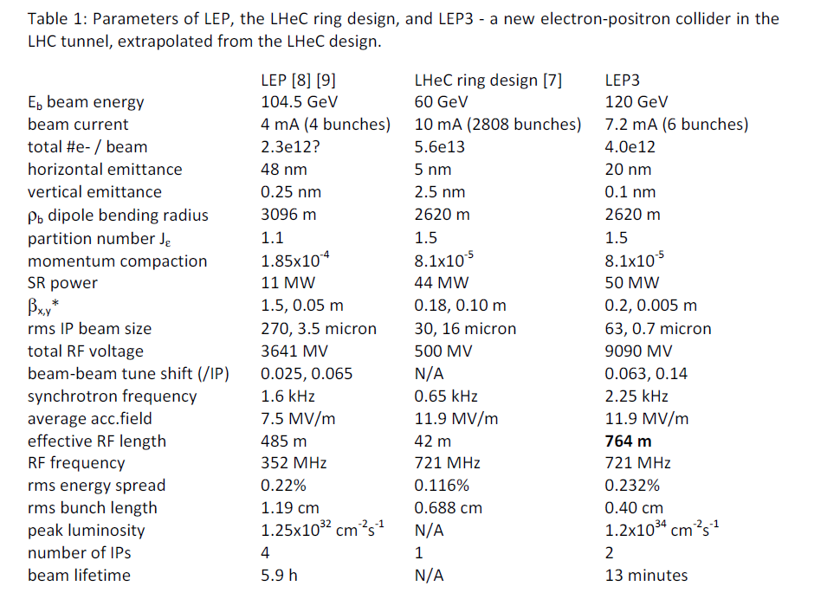
Compare to e⁺-e⁻ Collider
No direct H production in e⁺-e⁻
  No narrow resonance
    associated production Z +H
e⁺-e⁻ → ZH
  ~0.2pb at 250GeV
    background is ~10pb
  200/year at L =10³² (~LEP)
  20000/year at L =10³⁴
Z + H not as cleanly separated from background
  H width cannot be resolved
But do not have to sit on resonance to see H

Slide 6
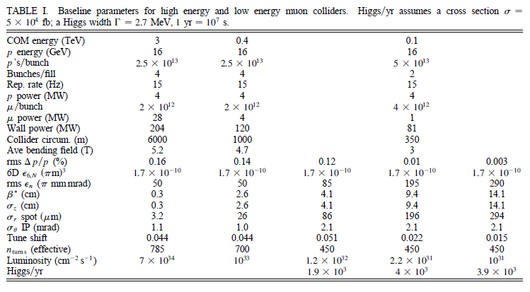
Collider Parameters
0.1~ →0.4 →3 + TeV Collisions
Parameters from 2003 STAB (+ Snowmass 2001)
    C. Ankenbrandt et al., Physical Review STAB 2, 081001 (1999), M. Alsharo’a et al., Physical Review STAB 6, 081001 (2003).
→0.125

Slide 7
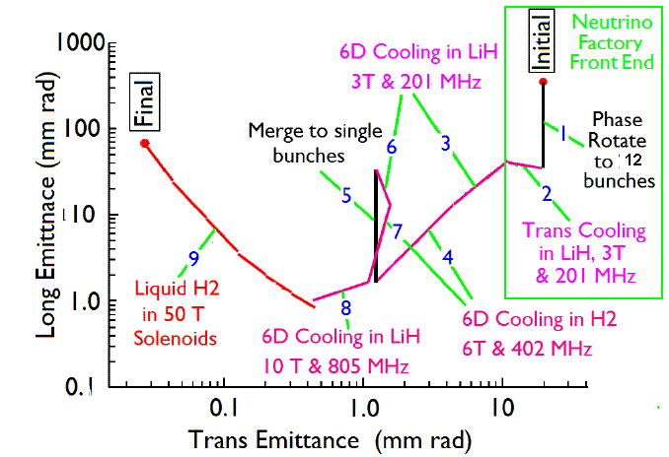
Natural emittance of cooled Muons
є_{T} = 0.0003m
є_{L} = 0.001m
  σ_{E}= 1MeV→ σ_{z}=0.1m
  σ_{E}= 3MeV→ σ_{z}=0.03m
  σ_{E}= 10MeV→ σ_{z}=0.01m
Emittance obtained with 6-D cooling + bunch merge
  no final cooling
Initial derated values
  є_{T} = 0.001m
  є_{L} = 0.002m

Slide 8
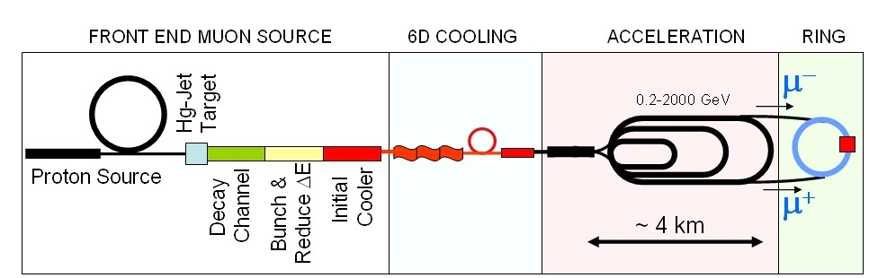
Higgs MC Parameters
Parameter | Symbol | Value
Proton Beam Power | P_{p} | 4 MW
Bunch frequency | F_{p} | 60 Hz
Protons per bunch | N_{p} | 5×10¹³
Proton beam energy | E_{p} | 8 GeV
Number of μ bunches | n_{B} | 1
μ^{+/-}/ bunch | N_{μ} | 2×10¹²
Transverse emittance | ε_{t,N} | 0.001m
Energy spread | δE | 2MeV
Collision β* | β* | 0.1 m
Collision β_{max} | β* | 500m
Beam size at collision | σ_{x,y} | 0.04cm
Beam size (arcs) | σ_{x,y} | 1.0cm
Beam size IR quad | σ_{max} | 5.4cm
Collision Beam Energy | E_{μ+},E_{μ_} | 62.5GeV (125GeV total)
Storage turns | N_{t} | 1000
Luminosity | L₀ | 10³¹
π→μ Source
Hg target
μ Cooling
Linac
RLAs
Accelerator
to 63 GeV
Collider Ring

Slide 9
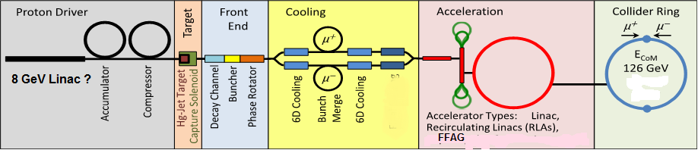
Proton Driver
Proton Driver is variant of Project X
  Other variations possible
  8 GeV at Fermilab
8 GeV SRF linac , 15 Hz
  2×10¹⁴/cycle
Accumulate, Bunch to form 4 bunches
  5×10¹³/bunch
    ε_{N6π} =200π mm-mrad, B_{F} = 0.005
    δν = 0.4
  extract at 60Hz
  Recombine in trombone for 15 Hz (upgrade?)

Slide 10
Project X Upgrade to 4MW
Upgrade cw Linac to 5ma
  15 MW peak power
  run at 10% duty cycle
Increase pulsed linac duty cycle to ~10%
  8GeV × 5ma × 10% = 4MW
Run at 15 Hz (6.7ms injection/cycle)
  matches NF/MC scenarios
Chop at 50% for bunching
  source/RFQ →10ma
Need Accumulator,
Compressor to bunch beam
  + bunch combiner “trombone”

Slide 11
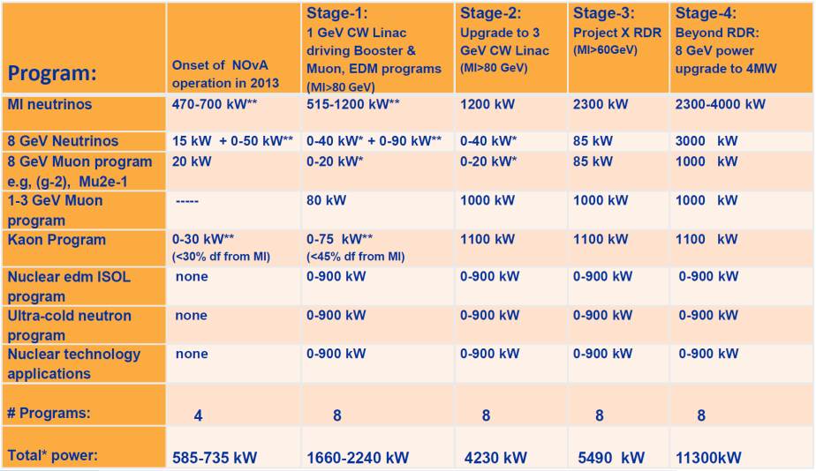
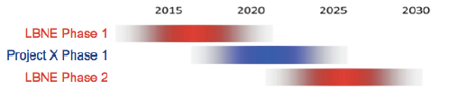
Alternative “Low-Budget” Proton driver?
Proton driver delayed …
  many stage f scenario
    20+ year ….
  Is there a shorter path to X MW ?
2MW Main Injector?
  60GeV – 1.5Hz
    ~10¹⁴/pulse
    divide into 10 bunches
      ~0.5 μ/p
    ~15 Hz, 10¹³p
  Must rotate to short bunches (~1m rms)

Slide 12
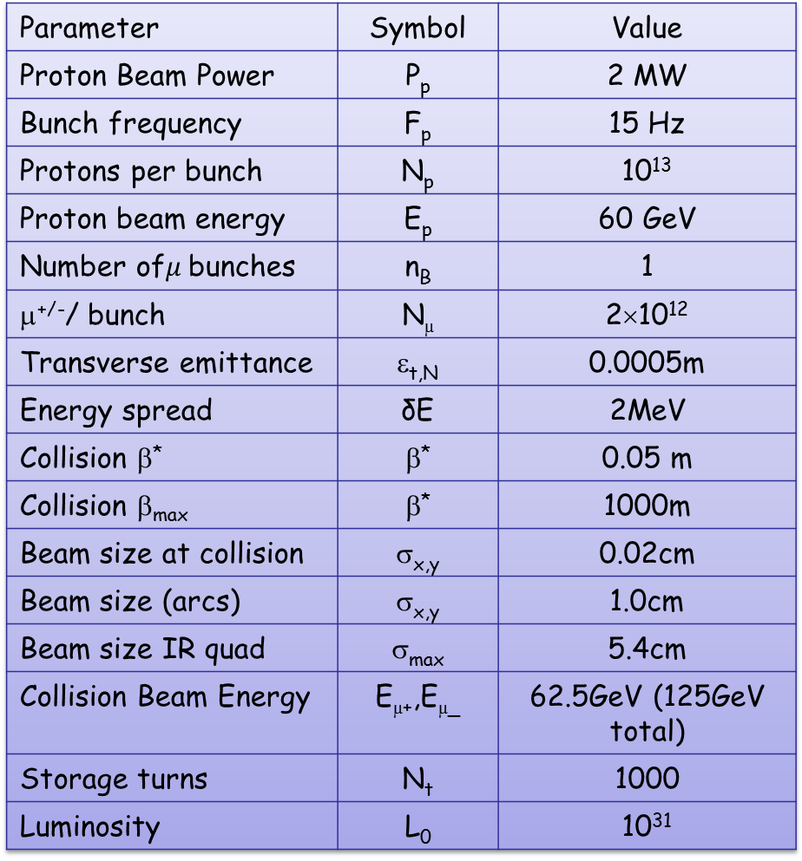
Higgs MC Parameters
PX _ MI 60 GeV
Parameter | Symbol | Value
Proton Beam Power | P_{p} | 2 MW
Bunch frequency | F_{p} | 15 Hz
Protons per bunch | N_{p} | 10¹³
Proton beam energy | E_{p} | 60 GeV
Number of$μ$bunches | n_{B} | 1
μ^{+/-}/ bunch | N_{μ} | 2×10¹²
Transverse emittance | ε_{t,N} | 0.0005m
Energy spread | δE | 2MeV
Collision β* | β* | 0.05 m
Collision β_{max} | β* | 1000m
Beam size at collision | σ_{x,y} | 0.02cm
Beam size (arcs) | σ_{x,y} | 1.0cm
Beam size IR quad | σ_{max} | 5.4cm
Collision Beam Energy | E_{μ+},E_{μ_} | 62.5GeV (125GeV total)
Storage turns | N_{t} | 1000
Luminosity | L₀ | 10³¹
MI,
Buncher
Hg target
Drift, Bunch, Cool
Linac
RLAs
Detector
Collider Ring

Slide 13
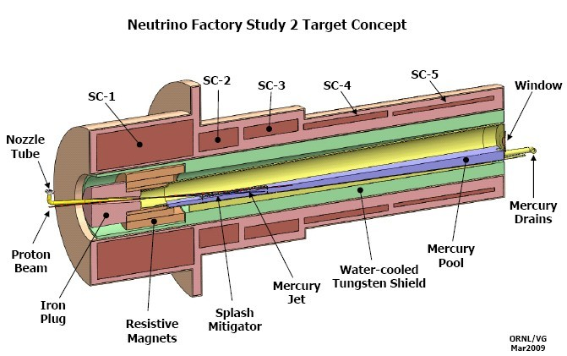
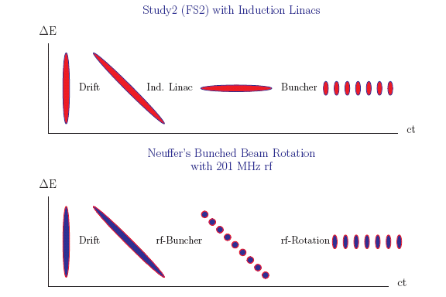
Solenoid lens capture
Target is immersed in high field solenoid
Particles are trapped in Larmor orbits
  B= 20T -> ~2T (15T → 1.8T)
  Particles with p⊥ < 0.3 B_{sol}R_{sol}/2=0.225GeV/c are trapped
  π→μ
  Focuses both + and – particles
  Drift, Bunch and phase-energy rotation
π→μ

Slide 14
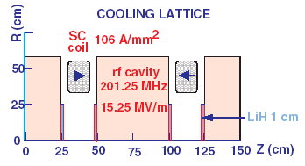
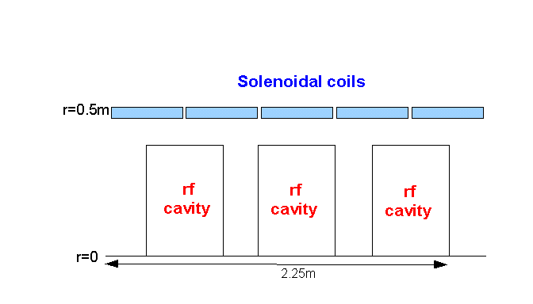
High-frequency Buncher and φ-E Rotator
Drift (π→μ)
“Adiabatically” bunch beam first (weak 320 to 240 MHz rf)
Φ-E rotate bunches – align bunches to ~equal energies
  240to 202 MHz, 15MV/m
Cool beam 201.25MHz
Captures both μ⁺ and μ⁻
  born from same proton bunch
p
π→μ
FE Target
Solenoid
Drift
Buncher
Rotator
Cooler
10 m
~50 m
~30m
36m
~80 m

Slide 15
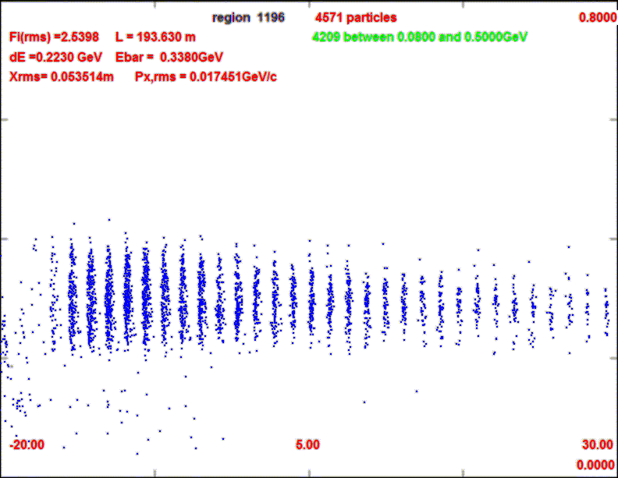
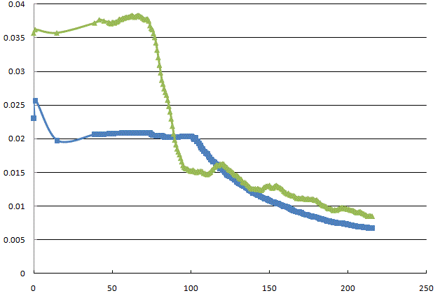
Beam at end of μ Source
Shorter bunch train
    15 → 12 bunches
  Bunch phase space larger
Obtains ~0.1 μ/p₈
  A_{t} < 0.03, A_{L} <0.2
  Choose best 12 bunches
    ~0.008 μ/p₈ per bunch
    ~0.005 μ/p₈ in acceptance
800 MeV/c
0
0.3
µ⁻/p
ε_{L}/10
0.2
ε_{T}

Slide 16
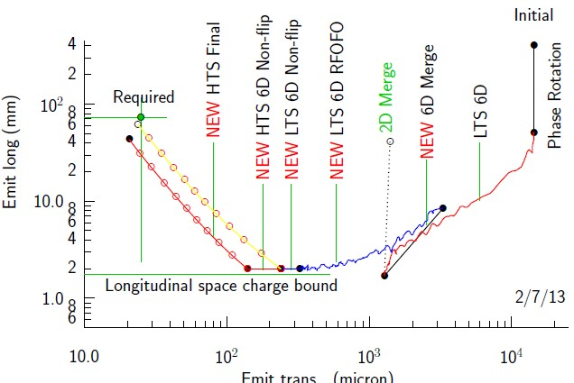
Cooling Scenario for 125 GeV
Use much of baseline cooling scenarios
  need initial 200/400 Mhz cooling sections
  need bunch merge
  and initial recooler
Do not need final cooling (high field section)
  final transverse cooling sections for luminosity upgrade
  high-field cooling not needed (B < ~12T)

Slide 17
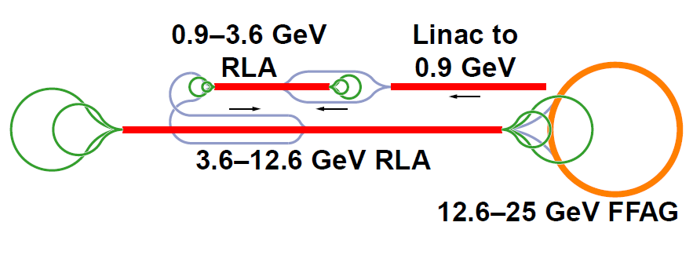
Acceleration - scenario
Small longitudinal emittance can make acceleration much easier (S. Berg)
  higher-frequency rf 400/600 MHz
  much smaller beams for FFAG
25-63 GeV FFAG

Slide 18
Collider Ring
1 bunches of μ⁺ and μ⁻
  2×10¹² μ/bunch
β* = 10 cm
  σ= 0.04cm
β_{max} = 600m
  σ=3cm (62.5GeV)
  IR quads are large aperture (15cm radius)
ε_{L} =0.012 eV-s
  δE ~0.03 GeV if σ_{z} = 12cm
  δE/E < 10⁻⁴
Collider is not beam-beam limited
  r_{μ}=1.36*10⁻¹⁷m
  Δν=0.002
R=40m
at B_{ave}= 5T

Slide 19
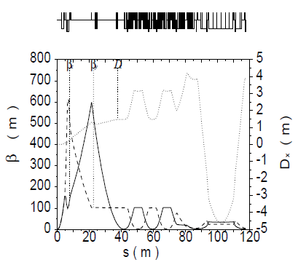
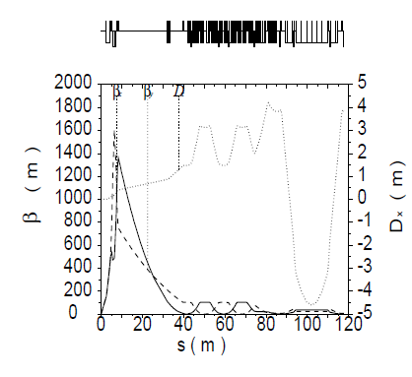
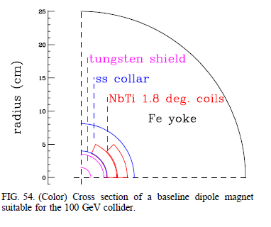
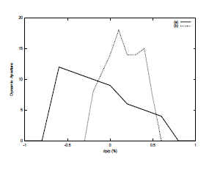
62.5 GeV Collider lattice
based on earlier 50×50 Lattices
  Johnstone, Wan, Garren
    PAC 1999, p. 3066
  single IR; C = 350m
  isochronous
  β* =13cm and β* = 4cm modes
  Also FMC lattice
    Trbojevic et al.
    Y. Alexahin
IR
Collimation

Slide 20
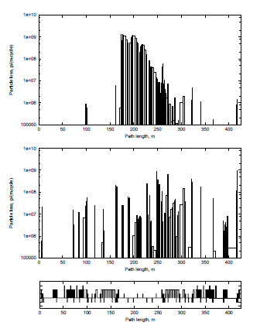
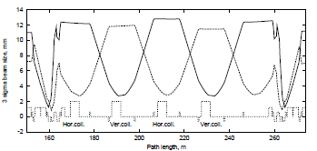
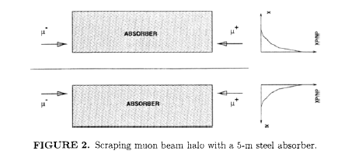
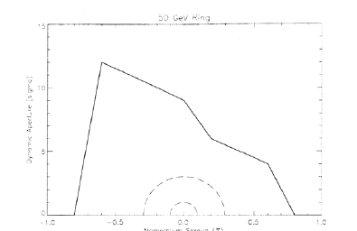
Losses/Background
Major Problem is μ-decay
  electrons from decay in detectors
  also beam halo control
Collimation
  remove beam halo by absorbers in straight section (opposite IR)
    Drozhdin, Mokhov et al.

Slide 21
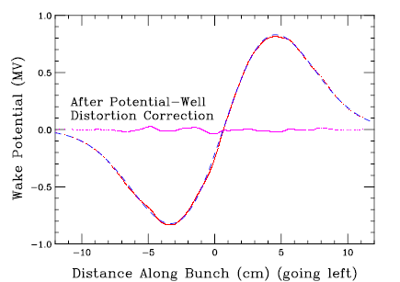
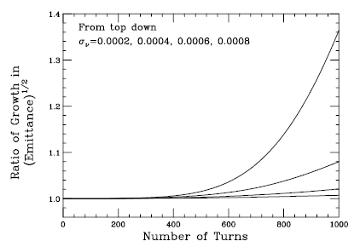
Beam Instability Issues
Studied in some detail by K.Y Ng (1999)
  PhysRevSTAB 2, 091001
    “Beam Instability Issues of the 50x50 GeV Muon Collider Ring”
  Potential well distortion
    compensated by rf cavities
  Longitudinal microwave instability
    ~isochronous lattice, small lifetime
  Transverse microwave Instability
    damped by chromaticity (+ octupoles)
  Beam Breakup
    BNS + δν damping

Slide 22
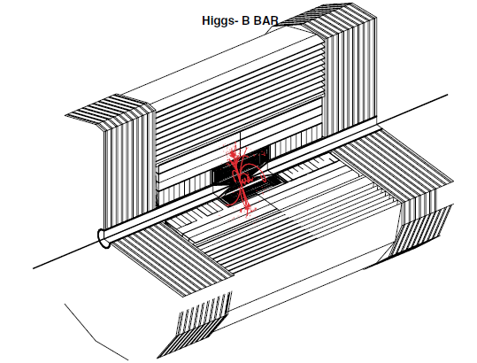
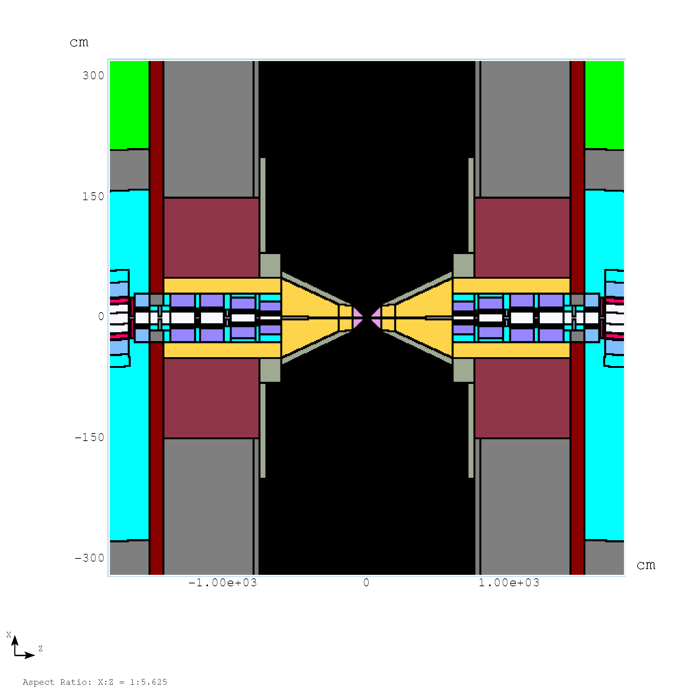
125 GeV Detector
μ-Decay Background reduced by “traveling gate trigger”
    Raja -Telluride
  Detector active for 2 ns gate from bunch collision time
  H→b b*

Slide 23
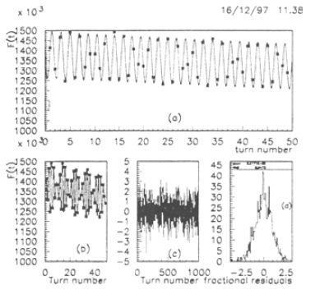


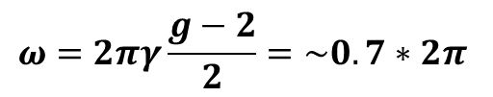
Polarization & Energy measurement
Raja and Tollestrup (1998) Phys. Rev. D 58 013005
Electron energy (from decay) depends on polarization
  polarization is ~25% → 10%
  Measure ω from fluctuations in ΣE_{e} from decay in a calorimeter
    10⁶ decays/m
  E_{μ} depends on Frequency
  Frequencies can be measured very precisely
  E, δE to 0.1 MeV or better (?)
$$ω=2πγ\frac{g−2}{2}=\sim 0.7∗2π$$

Slide 24
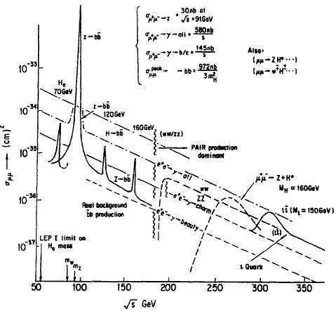
μ⁺μ⁻→Z (90 GeV) = “Training Wheels”
Run on Z until luminosity established
  easier starting point
  σ = ~30000 pb
    3000 Z/day at L=10³⁰
  Debug L, detectors, background suppression, spin precession, at manageable parameters
  Useful Physics at Z ?
    E, ΔE to ~0.1 MeV or less
    μ⁺μ⁻ → Z₀
  Then move up to 125 GeV
    energy sweep to identify H
    δE ~ 10MeV → 3MeV

Slide 25
Higgs MC Parameters -Upgrade
Proton Linac 8 GeV
Reduce transverse emittance to 0.0002m
More Protons/pulse
Accumulator,
Buncher
Parameter | Symbol | Value
Proton Beam Power | P_{p} | 4 MW
Bunch frequency | F_{p} | 15 Hz
Protons per bunch | N_{p} | 4×5×10¹³
Proton beam energy | E_{p} | 8 GeV
Number of muon bunches | n_{B} | 1
μ^{+/-}/ bunch | N_{μ} | 5×10¹²
Transverse emittance | ε_{t,N} | 0.0002m
Collision β* | β* | 0.05m
Collision β_{max} | β* | 1000m
Beam size at collision | σ_{x,y} | 0.02cm
Beam size (arcs) | σ_{x,y} | 0.3cm
Beam size IR quad | σ_{max} | 4cm
Collision Beam Energy | E_{μ+},E_{μ_} | 62.5(125geV total)
Storage turns | N_{t} | 1000
Luminosity | L₀ | 10³²
+4→1 bunch combiner
Hg target
Drift, Bunch, Cool
Linac
RLAs
Collider Ring
δν_{BB} =0.027

Slide 26
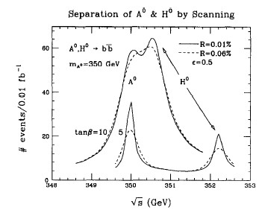
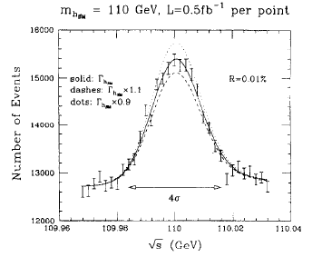
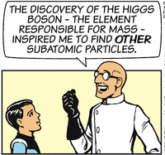
Upgrade to higher L, Energy
higher Luminosity
extended Higgs
  A, H at 500 GeV ?
  larger cross sections
  larger energy widths
TeV new physics ?

Slide 27
Upgrade path (E and L)
More cooling
  ε_{t,N}→ 0.0002, β*→1cm
Bunch recombination
  60Hz → 15 ?
  L →10³²
More cooling
  low emittance
  ε_{t,N}→ 0.00003, β*→0.3cm
  L→10³³
More Protons
  4MW → 8 → 40 ?
  15Hz
  L→10³⁴
more Acceleration
  →4 TeV or more …
  L→10³⁵

Slide 28
Comments
125.5 GeV Higgs is not easy
  small cross section, small width
Need high-luminosity (> ~10³¹ cm⁻²s⁻¹)
  Need high-intensity proton Driver
    N MW, 5—50 GeV, pulsed mode (10—60 Hz)
  Need MW target, π→μ collection
  Need ionization cooling by large factors
    ε_{L} → 0.002 m
  acceleration, collider ring, detector
    spin precession energy measurement
  can get precision energy and width
Not extremely cheap
  Most of what we need for high-L high-E μμ Collider

Slide 29
Conclusions
An Initial Muon Collider (125 GeV) could be constructed, L>~10³¹cm⁻²s⁻¹
  L -> 10³² cm⁻²s⁻¹
  needs less transverse cooling
  does need front end (captures both μ⁺ and μ⁻)
  can be initiated on the Z₀
  Need more design development for Snowmass 2013
Could be upgraded to high-energy
  more cooling, reverse emittance exchange
  more acceleration

Slide 30
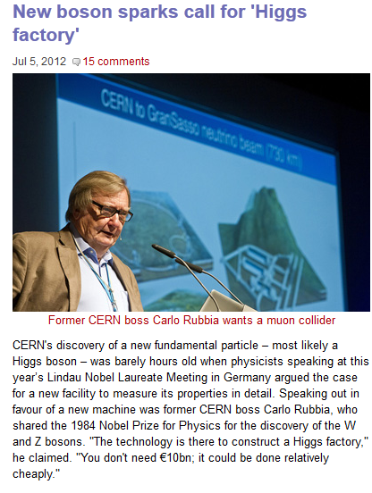

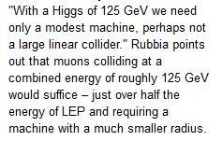
Professional endorsement

