Slide 1
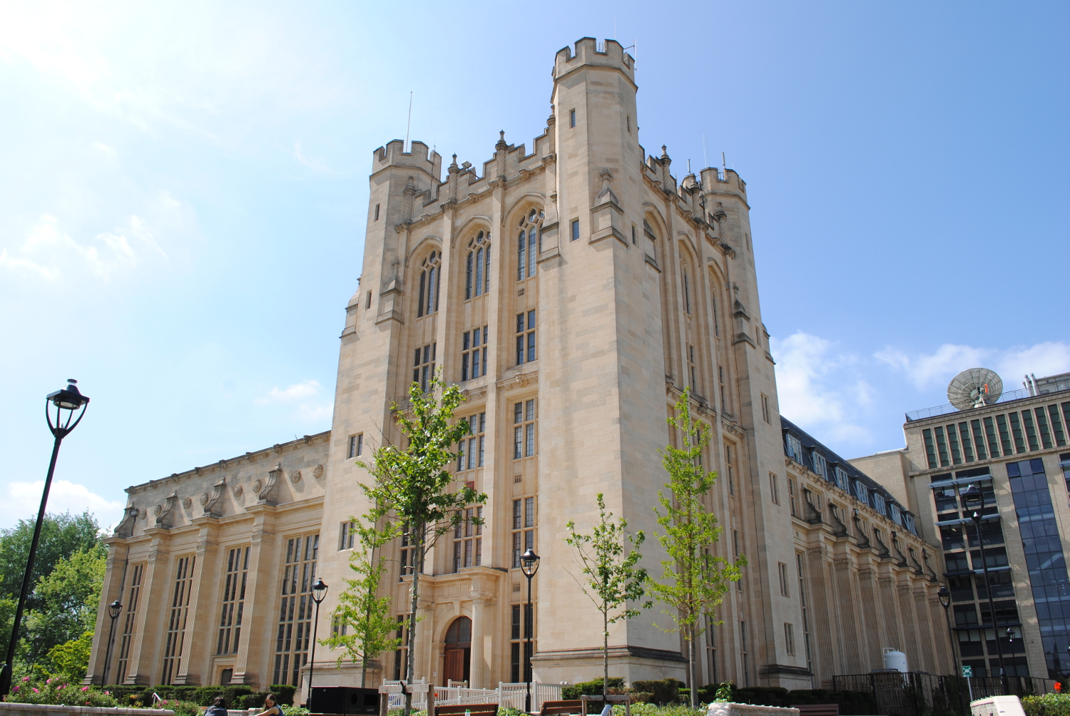
Welcome to the LBNF/DUNE UK Project meeting
Jarek Nowak, 3-4 July 2023

Slide 2
Report from the IB
The IB met a few times since the last LBNF/DUNE UK meeting.
It was mainly due to feedback from the STFC on the mid-term review.
No significant changes to the Target project.
For the PIP II Jon Lewis will step down and Mike Ellis will be the PM. Huge thanks to John and welcome to Mike.
* The actual name is a bit longer and

Slide 3
Report from the IB
Significant changes to the structure of the DUNE project (see G. Barker’s talk).
The most important changes approved by the IB
Split the DUNE project into three projects: Reconstruction and Computing*, DAQ and APA.
Each project has a new PI: R&C (A.Blake), DAQ (J. Brooke) and APA (J. Evans).
The proposal for R&C will be submitted at the end of July and DAQ in October. The APA proposal procedures are to be agreed with STFC.
The bridging funds were approved (Oct’23-Mar’24) and are being processed.
Gary’s official title change to the LBNF/DUNE UK Spokesperson.
Huge thanks to Morgan for serving at the DUNE PI for last few years

Slide 4
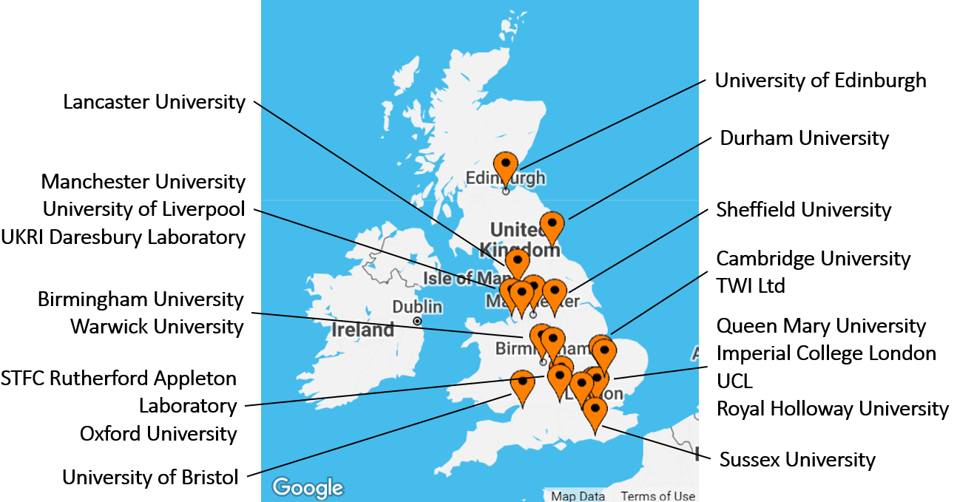
LBNF/DUNE UK meetings
Since the start of the project, our meetings were hosted by Warwick, Daresbury, Lancaster and Zoom.
The next meeting will be at Oxford with dates TBC.
Please let me know if you would like to host one of the upcoming meetings.

Slide 5
LBNF/DUNE UK meeting@Bristol
Huge thanks to the Bristol group to hosting us.
The agenda is packed with lots of interesting talks, including talks on physics from the MINERvA experiment and report from the Phase II DUNE ND workshop.
Have a enjoyable and productive project meeting.

