Slide 1
DAQ: Ethernet Readout
3rd July 2023
LNBF/DUNE UK Project Meeting
Adam Barcock

Slide 2
Network Architecture

Slide 3
Ethernet Readout Team’s Deliverables
Two Epics:
Front-end support
Switch Testing & Procurement
Agile project management using GitLab tools.
https://gitlab.cern.ch/dune-daq/readout/deimos

Slide 4
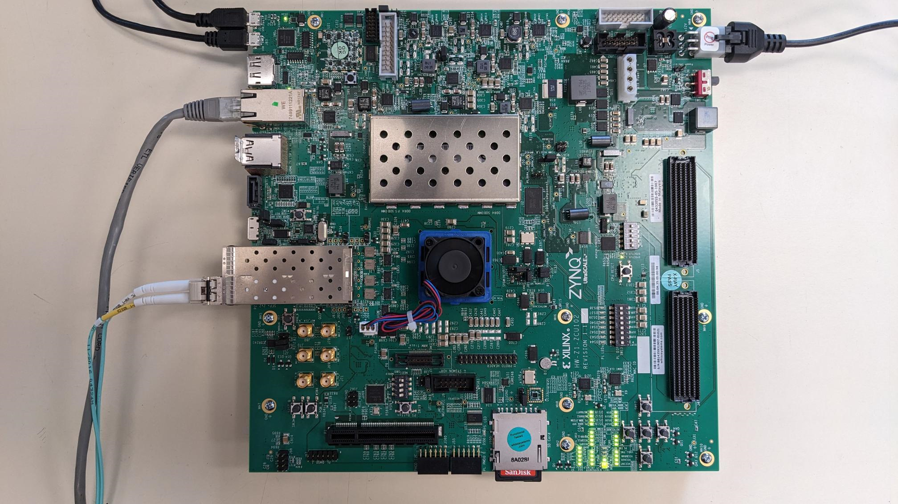
Front End Support
RAL ZCU102 DAQ Lab
Delivered firmware in April.
Lower priority than other epic.
Refactor & DHCP

Slide 5
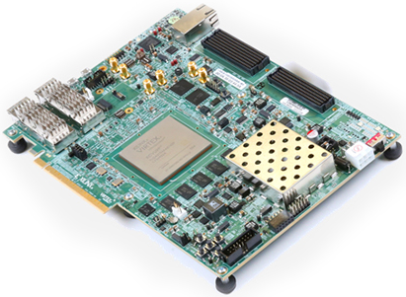
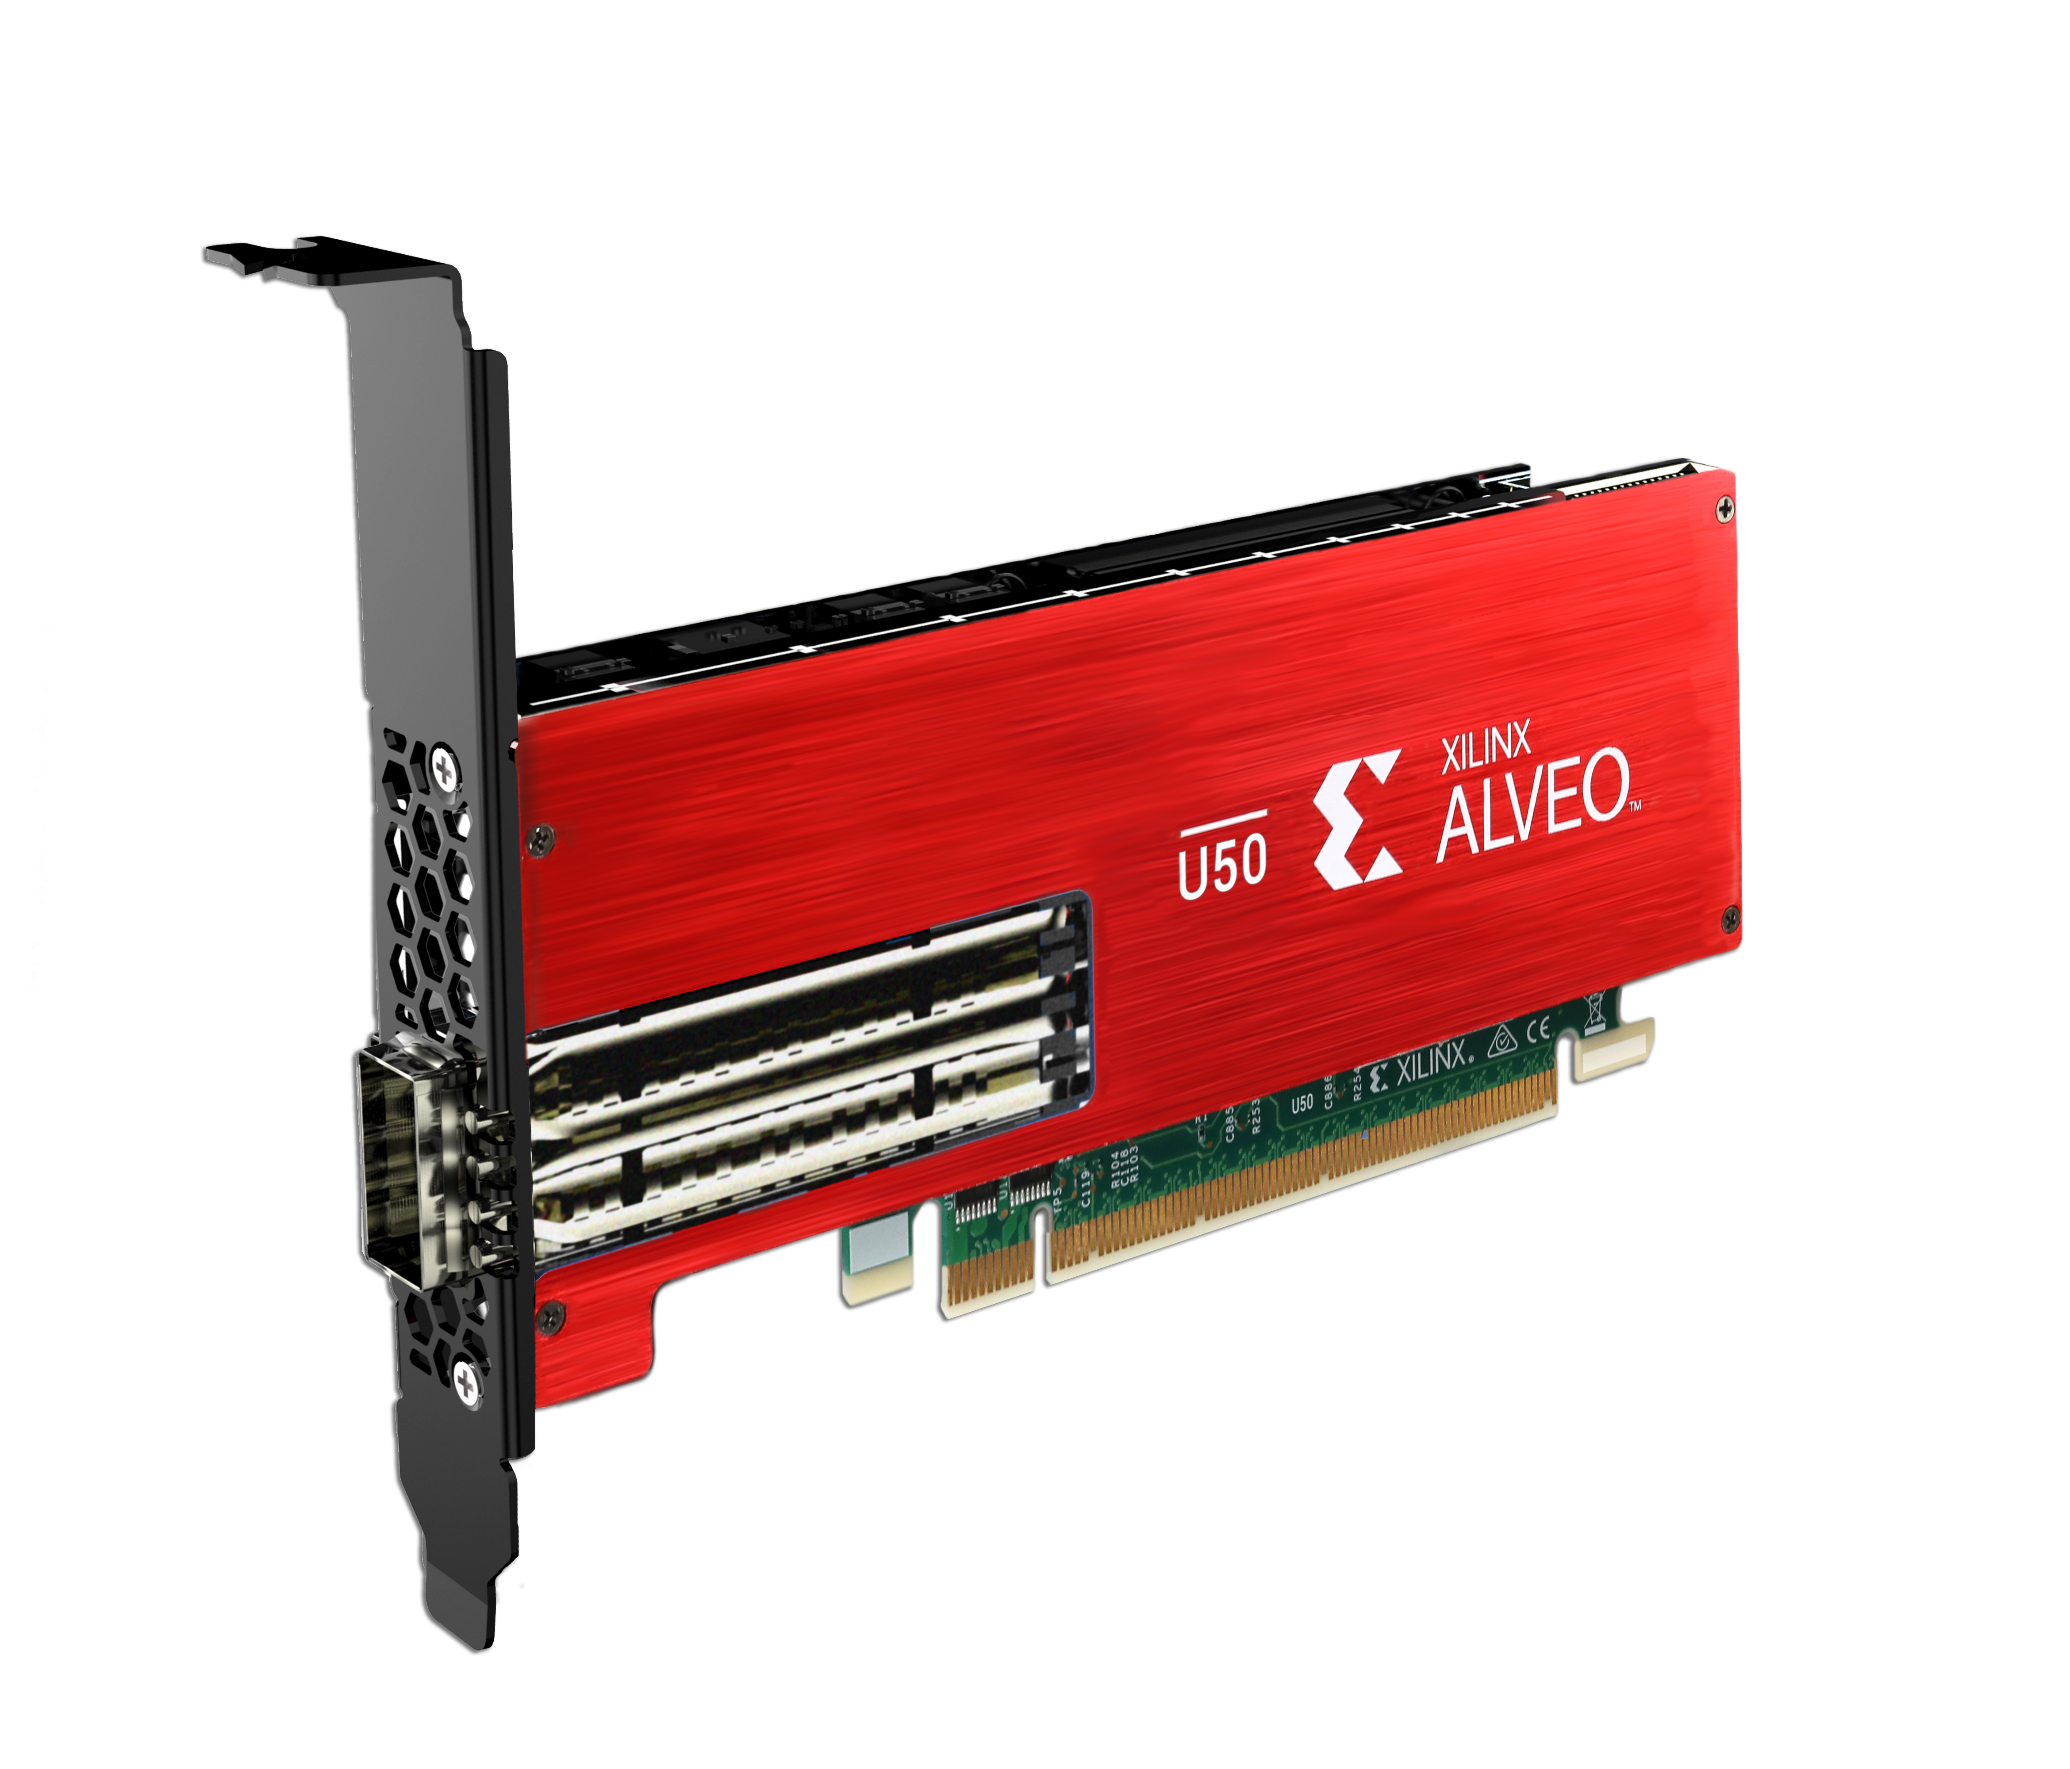
Switch Testing & Procurement
HTG 6x100G QSFP FMC
Xilinx VCU188
Xilinx Alveo U50
MP7, patch panels and switches

Slide 6
Intermediate Milestones (Sprints)
10 GbE Design
12 link | 23rd June
48 links | 28th July
Modification for synchronising two MP7 | 11th August
40 GbE Design
1 link over 100 GbE on u50 | 23rd June
1 link over 100 GbE on VCU118 | 28th July
6 links of 40 GbE with 40 GbE IP core on VCU118 | 11th August

