Slide 1

ArgonCube 2x2 Cryogenics
Mike Zuckerbrot
ArgonCube 2x2 Cryogenics
February 6 2023

Slide 2
Cryogenic Status Update
Internal Cryogenics
  Demaco feedthroughs – in hand
  Piping and LAr pump stand
    Prints being modified per request – should be ready this week
    Last parts just arrived
    Ryan (weld shop) agreed to take the job in full, will bring prints/parts over when prints are released in TC
  Combined feedthrough (contains LAr pump connection)
    Prints being finalized (add vent hole and modifications similar to internal piping) – maybe this week
    Last parts for flange to show up in ~a week, connecting components on order or in progress
    Need to purchase conduit/compression fittings (off the shelf)
    Internal RTD’s (recent addition) – Need to purchase and identify an electrical feedthrough

Slide 3
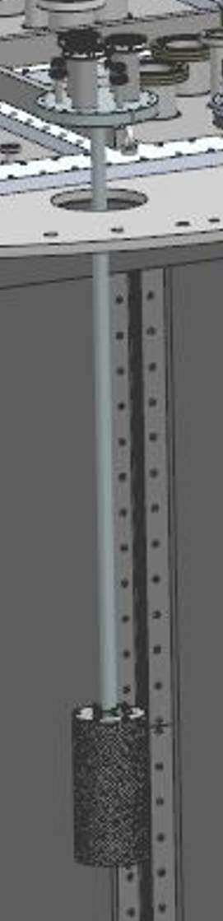
Cryogenic Status Update
Purity Monitor
  Flange and mounting design complete
  Drawings nearly complete (purge holes being added to mounting tube – thanks Alan)
  All parts ordered – last should be here in ~a week
Gas analyzer system
  Will be removing the rack and panel from LArTF this month
    Need to decommission and remove devices
  Process design being finalized
  Many small fittings still to order for this and many other small components throughout the system

Slide 4
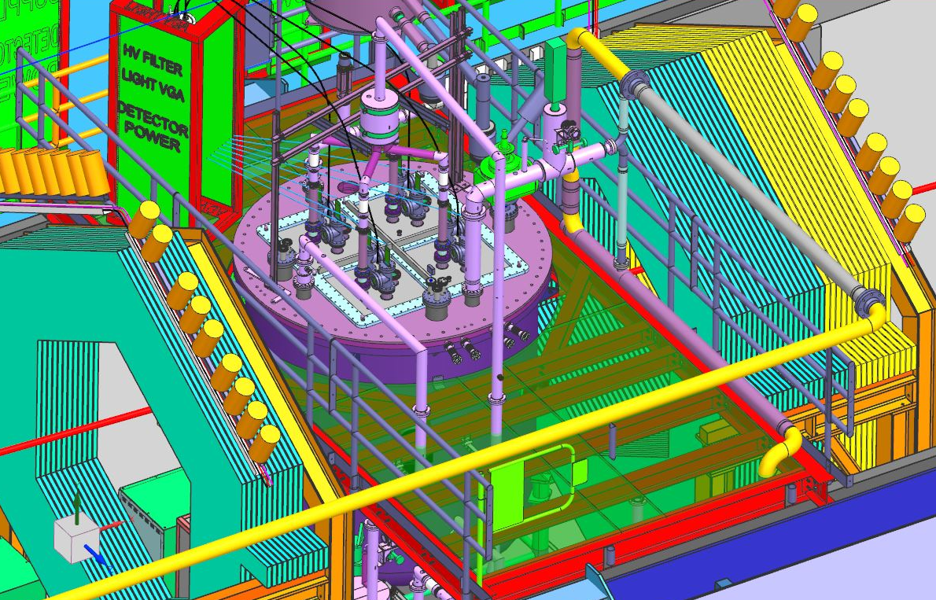
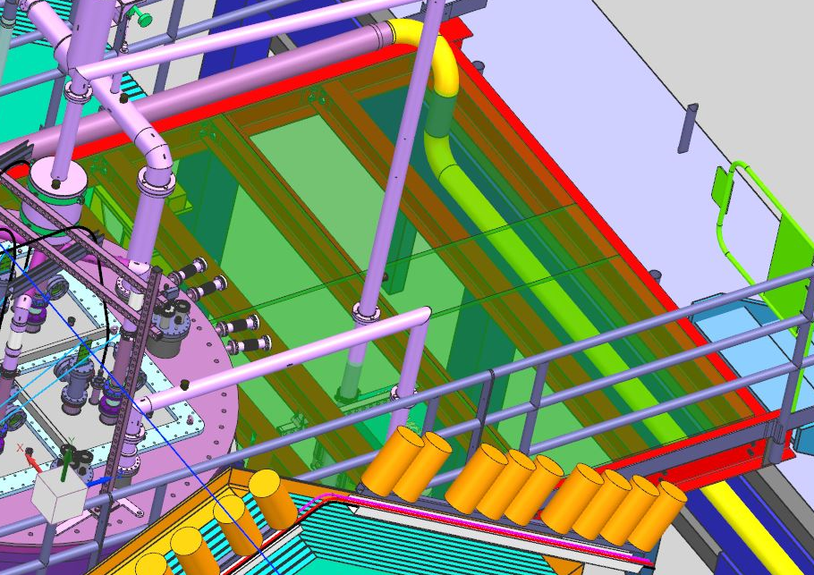
Cryogenic Status Update
Vent piping
  Basic routing being worked out
  Proposed path to run near the grating and under the catwalk
Proposed route

Slide 5
Cryogenic Status Update
Water cooling system
  Tap point identified in CHW system near compressors
  To be built in the field with PVC piping and soft tubing
Instrument air system
  Needs design work and procurement
  Compressor’s generally available, check PC4 compressor
  Parts should all be off the shelf

Slide 6
Cryogenic Status Update
Condenser and Transfer Lines
    Transfer lines
      Design ~complete
      Prints being worked on, at ~85%
      Long lead parts ordered
      Remaining parts off the shelf, will order off BOM
    Condenser vessel
      Cryomech did not provide complete documentation
      This was required as part of the PO and is required to operate
      Procurement/accounting/legal all involved at this point
      Cryomech basically unresponsive

