Slide 1
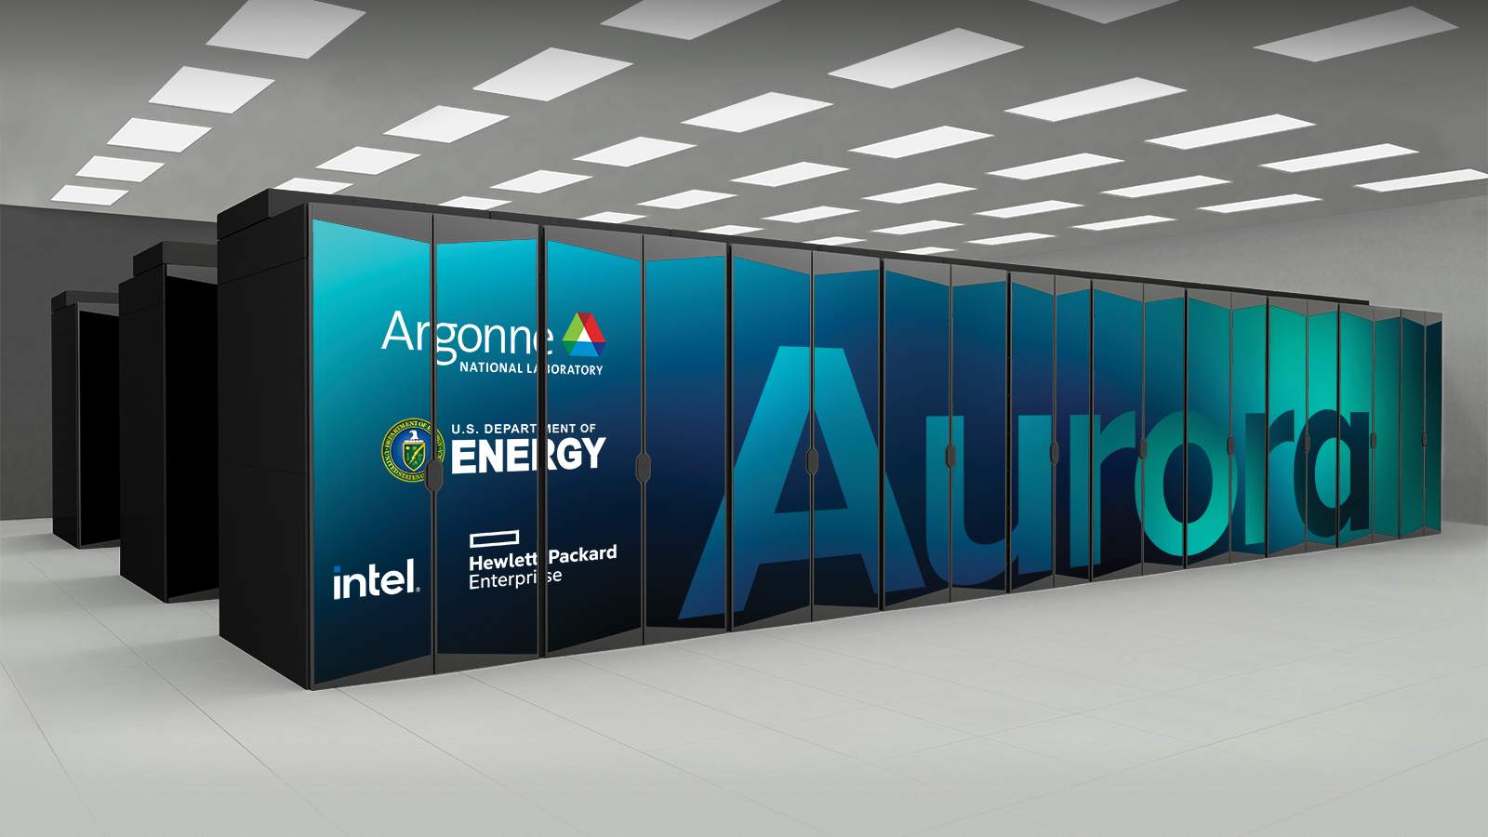
HEP-CCE I/O Strategies
Introduction
We start with yes, DATA
Peter van Gemmeren
Rob Ross
HEP-CCE/IOS
April 11th, 2023

Slide 2
HEP-CCE/IOS: Activities
Recall: What we do/did.
Darshan for ROOT I/O in HEP workflows on HPC
  Shane will show overview of the tool developments
  Rui will present example studies of ATLAS Simulation and Derivation use-cases
    For Doug, Ken, Rob, Patrick
Investigate HDF5 as intermediate event storage for HPC processing
  Saba will give a detailed presentation on this effort
    For Amit, Chris, John, Kyle, Peter, Suren
Investigate HPC/GPU friendly data model (joined with PPS)
  Amit will show us the latest developments and an overview of experiments’ efforts
    For Ken, Kyle, Peter (plus PPS)
Plus: Liz, Philippe, (and others, who haven’t registered in the author list)

Slide 3
HEP-CCE/IOS: Experiment Questions, IOS
Are you familiar with HEP-CCE’s I/O and storage (IOS) activities? These include
  an experiment-agnostic mini-app that mimics HEP application I/O patterns,
  measuring and understanding I/O patterns of HEP applications with Darshan, and
  an HPC-friendly HDF5 mechanism to write HEP data originally serialized using ROOT I/O. Are these relevant to your I/O issues? Can you suggest other directions that will be useful for you?
Our work activities: Saba, Rui and Shane will give details

Slide 4
HEP-CCE/IOS: Experiment Questions, IOS
What are we going to do?
The HEP-CCE IOS effort started two study groups dedicated to
  HEP event data models that are efficient for both disk I/O and accelerator offloading and
  "intelligent" data compression (domain-specific, guaranteed precision, and recoverable precision). Are these directions relevant to your experiment R&D plans? Are there other I/O projects that CCE should focus on?
Newer investigations, Amit will give details on 1. and Peter will mention 2.
There are R&D activities in the HPC and HEP communities on Object Stores (e.g., HEPnOS, RNTuple/DAOS). HEP-CCE IOS has relevant expertise in this area. Would you be interested in an “event object store” R&D activity?
Future activity, to be discussed tomorrow.

