Slide 1
IOTA Proton Injector Update
Dean (Chip) Edstrom
01/27/2023

Slide 2
IPI Summary
Source
HV Enclosure work continues
Extractor Modulator Circuit Tested– Installation Soon™
Auxiliary Electronics Shelf In Progress*
Mechanical
Cable Procurement Summary*
IPI Penetration*
RF
Engineering review of variable coupler stand expected Feb/March...?
Req submitted for circulator stand kit
Req submitted for penetration stand material

Slide 3
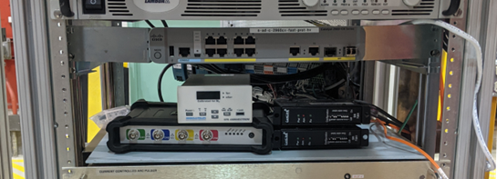
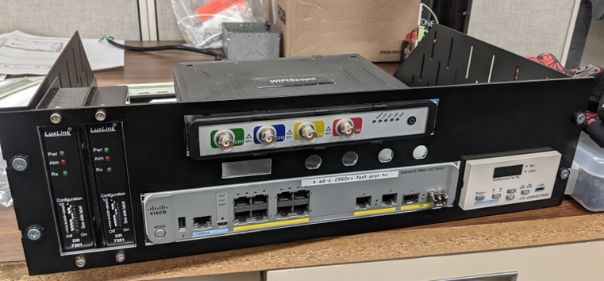
HV Enclosure Auxiliary Electronics Shelf
TTL Fiber Receiver Modules
Cisco Fiber Network Switch
375 Convectron Vacuum Gauge
WS6 200MHz TiePie Oscilloscope
120 VAC Distribution
Interconnects

Slide 4
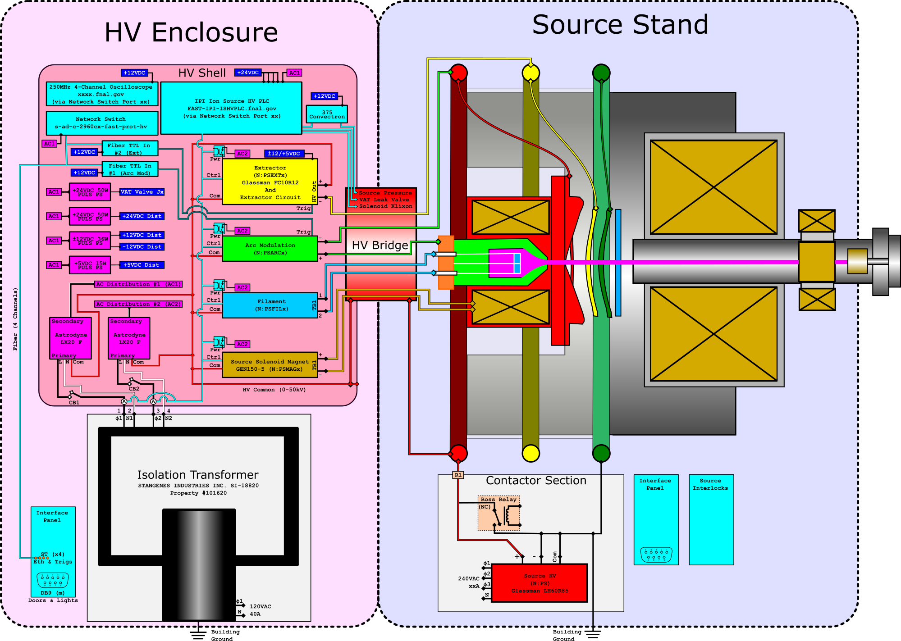

Slide 5
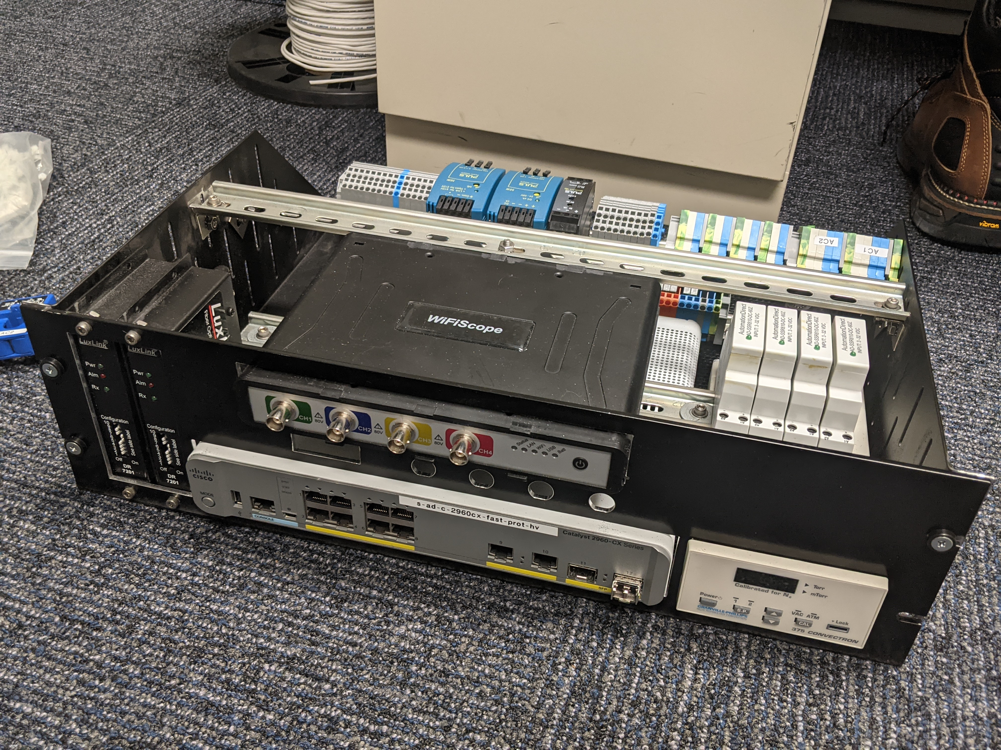
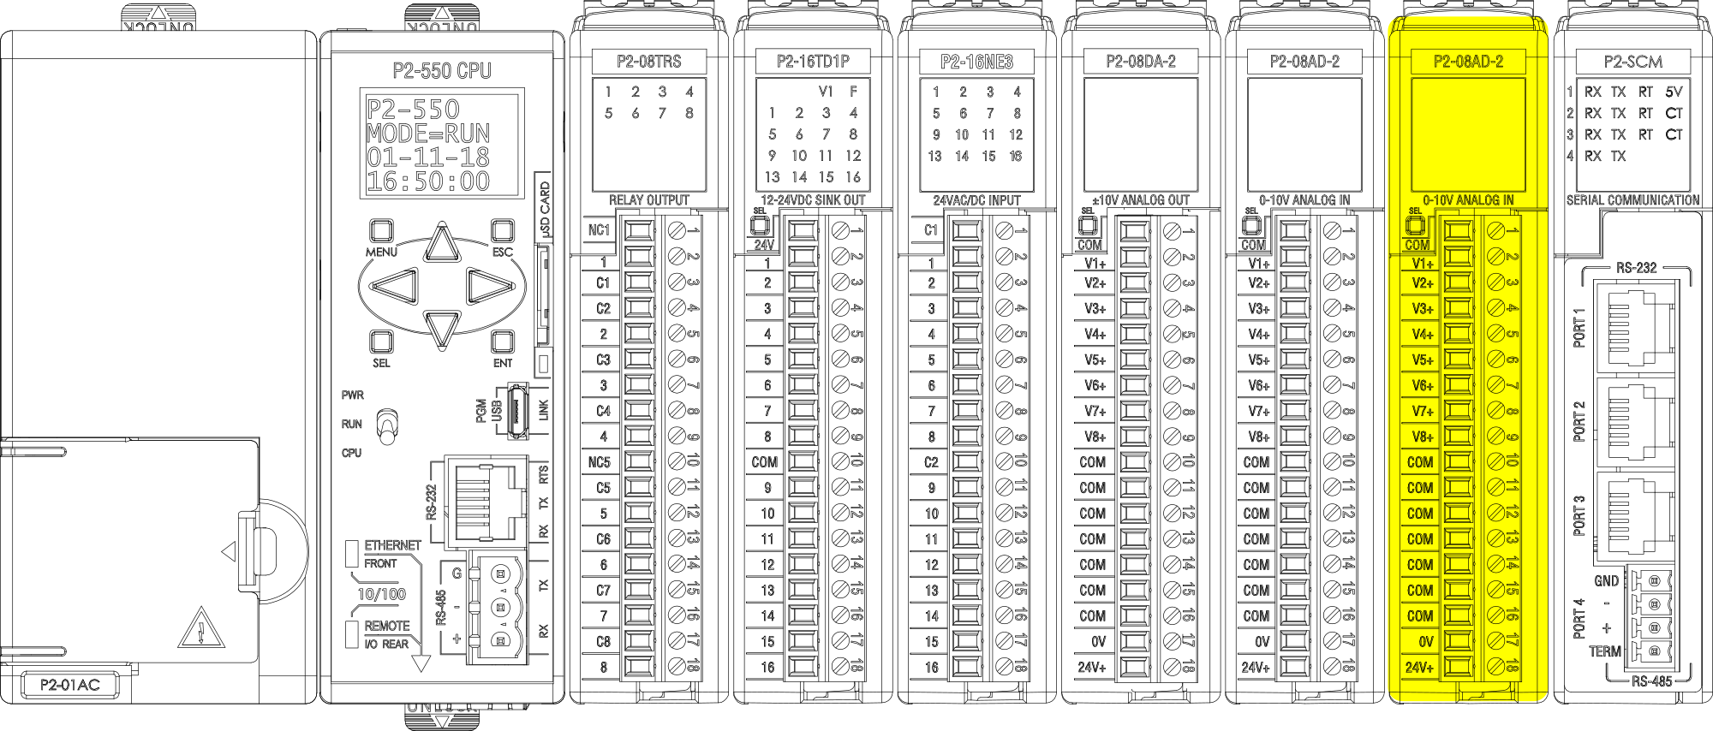
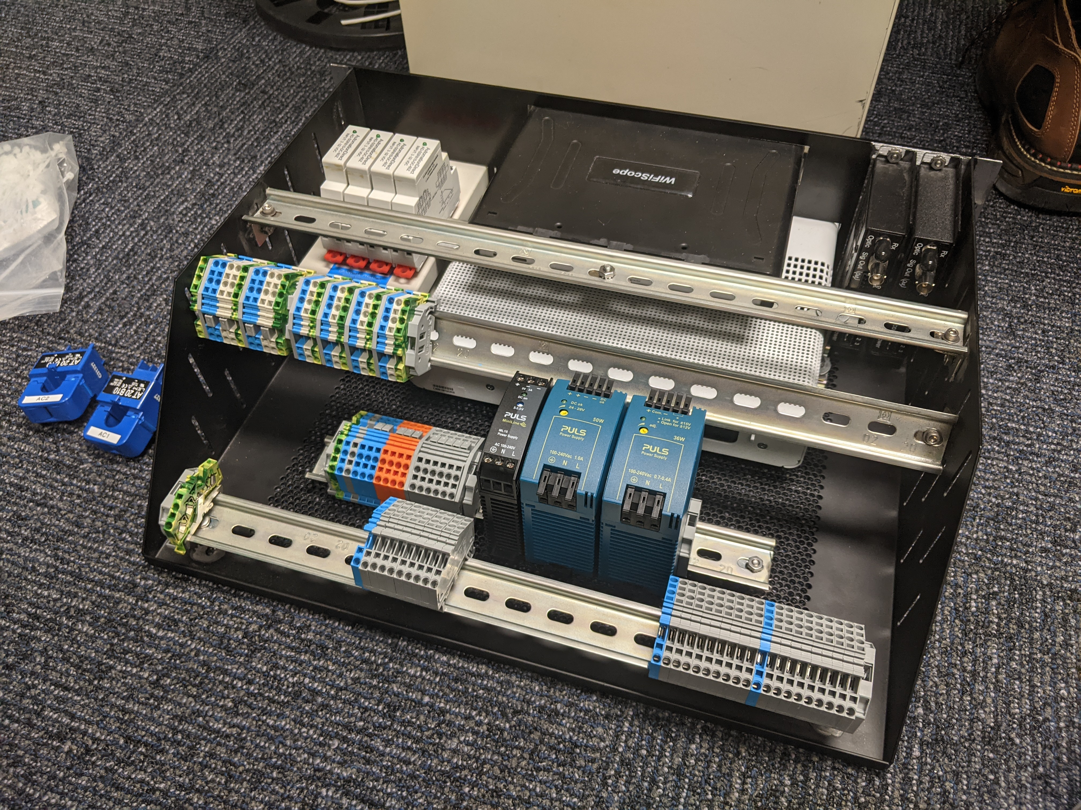
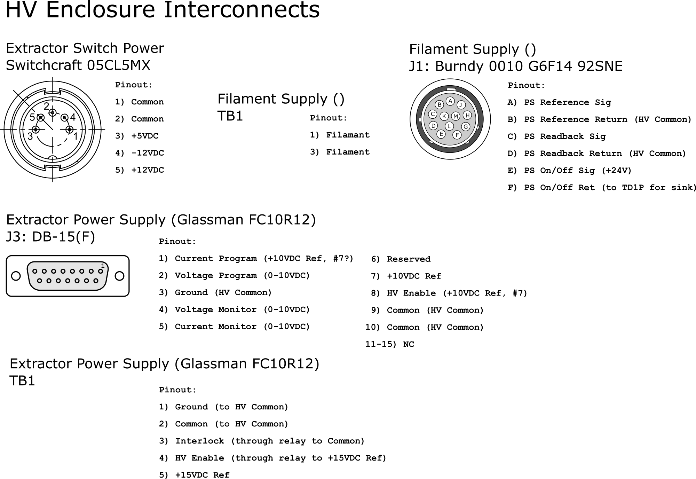
HV Enclosure Auxiliary Electronics Shelf & PLC
AC
DC
Interconnects Block

Slide 6
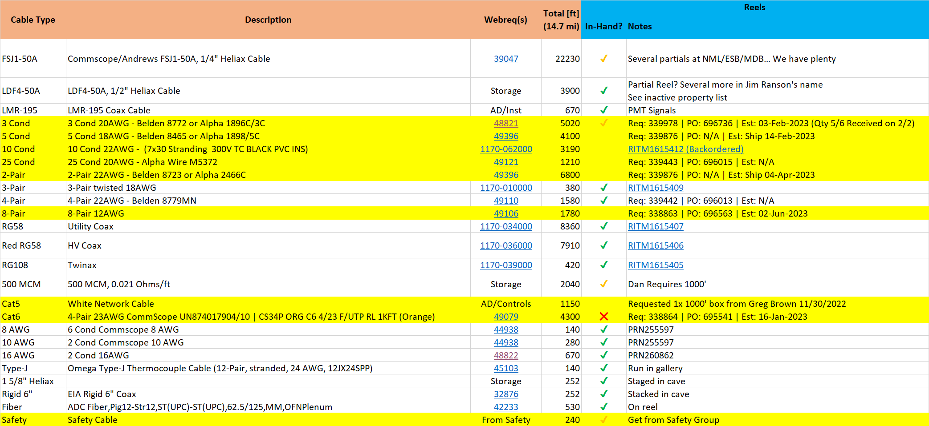
Cable Procurement Summary
Longest Leads (so far…)
10 Cond: 06/12/2023 (Backordered)
8-Pair: 06/02/2023

Slide 7
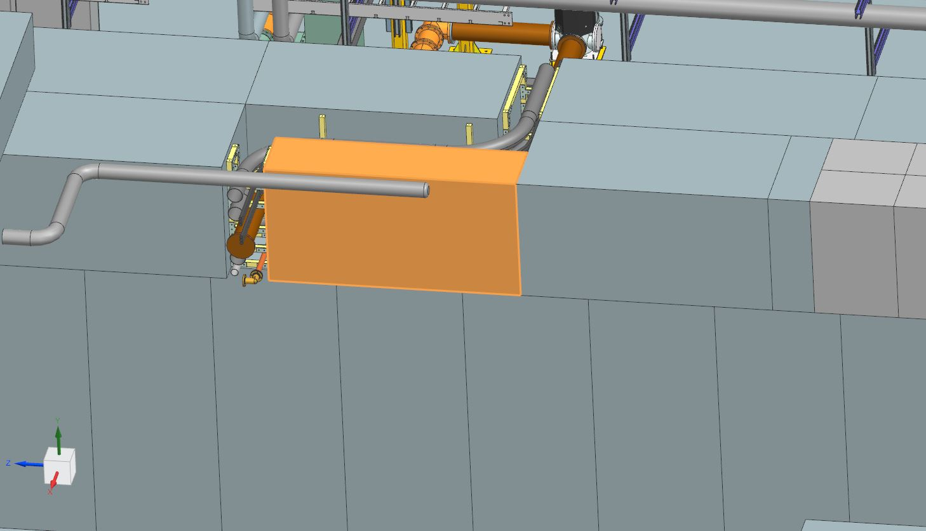
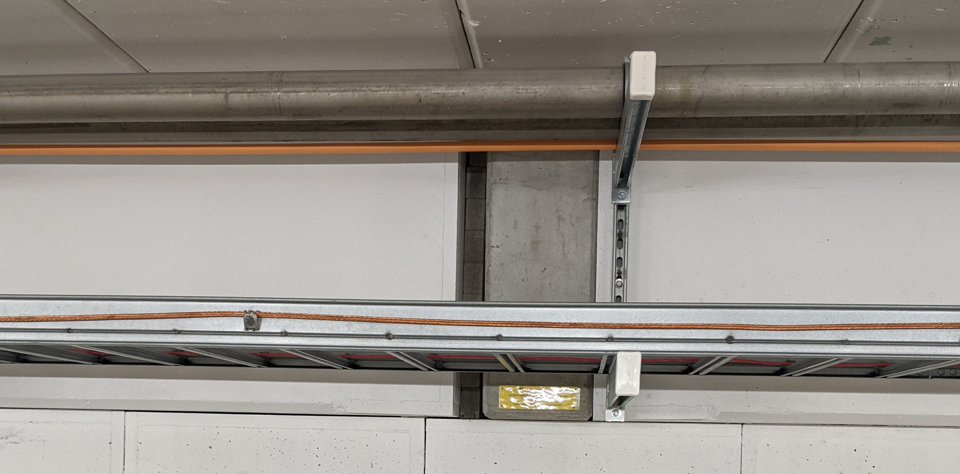
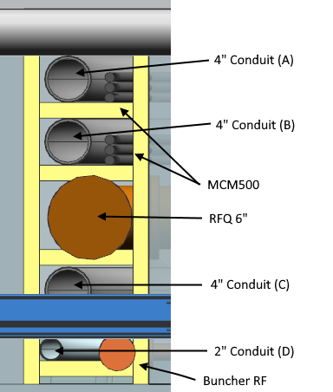
IPI Penetration
Would like access to labyrinth
To secure structure
Two Supports to be moved
(Unloaded) Cable Tray
Tray will be cut during cable pull
LCW / Fire Protection
Shifting support should be innocuous.

