Slide 1
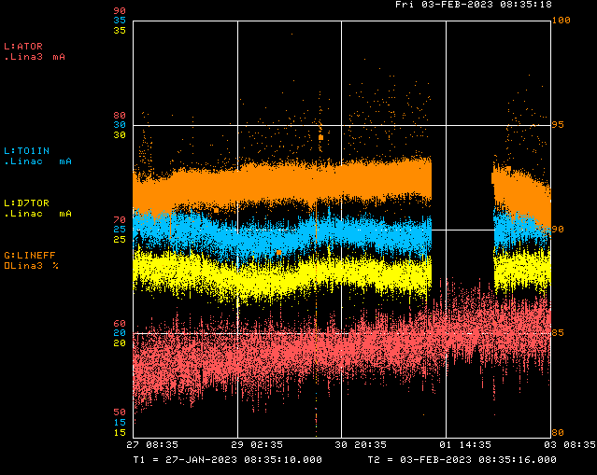
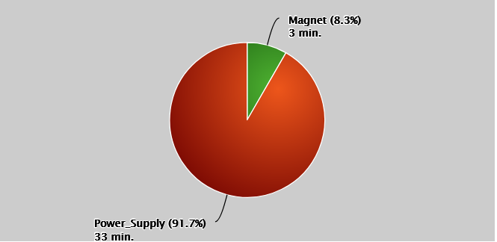
Linac/Preacc Operation (Jan 27 – Feb 2, 2023)
PREACC: (36 min)
KRF5
LINAC: (25 hr 37 min)
Issues:
Sa: Source A Tube Heater Trip
T: L:RF7SRM bad SRM4 Timers bit, Source A Tube Heater Trip, QPS 301 reg
W: CS Boiler Temp Loop mis-regulation, KRF5 failure(s)
Th: KRF5 failure(s)
All Week: Minor LRF/KRF trips quickly reset
Downtime Requests:
~15 min daily for Preacc collimator scans
Half day access for Tank 5 vacuum investigation
Thanks:
EE Support for KRF5 failure resolution
ISD for fixing Preacc control room AC unit
Dean A. for SRM removal

