Slide 1
Muon Campus Report
Jim Morgan
February 3, 2023

Slide 2
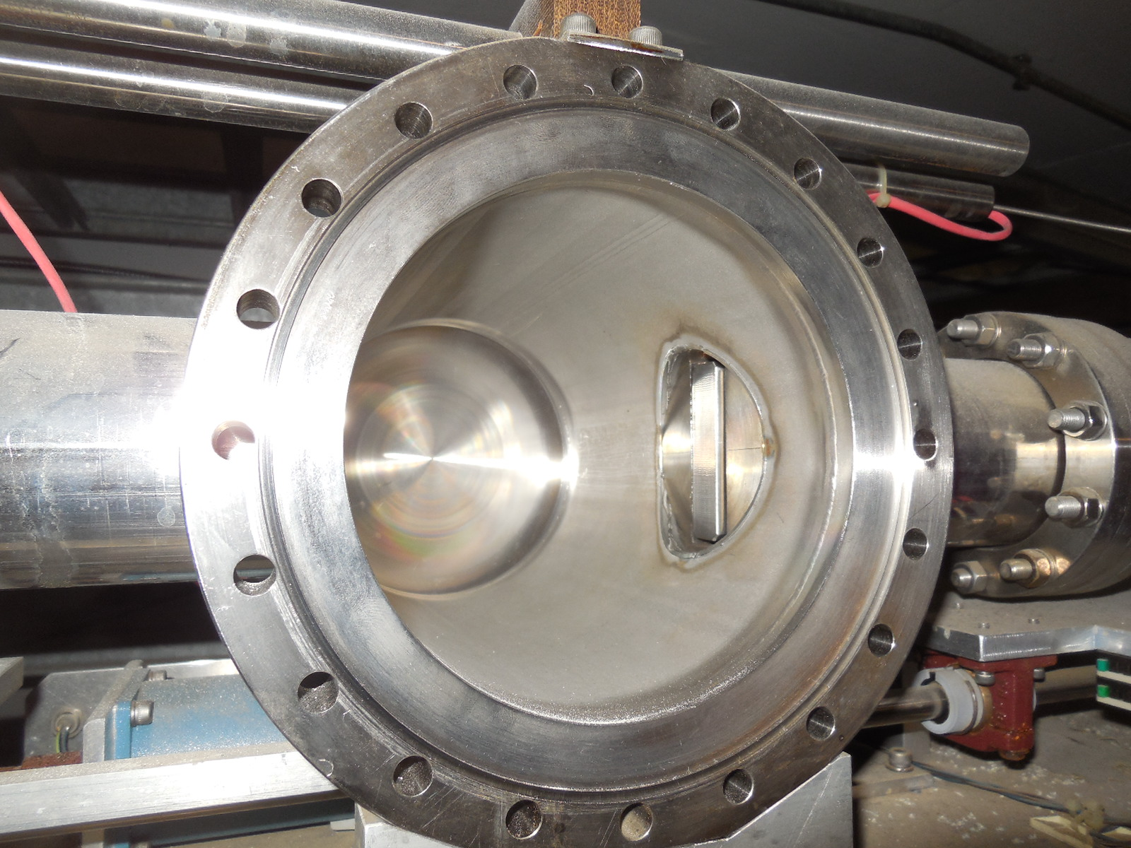
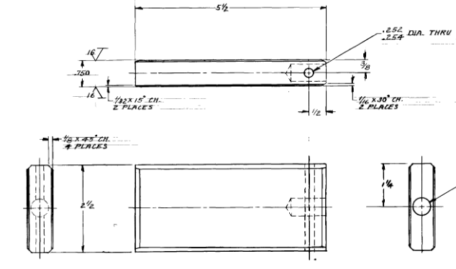
Weekly overview and current issues
Working with controls on understanding Sequencer issue
Line open or close commands has caused aggregate to vanish
Mu2e studies shifts last Friday, Monday and Thursday
1/27 BPM timing, resolving array issues and checking data consistency
1/30 BPM system work-out, large data set collection, investigation of injection tune-shift versus TBT
2/2 (shortened) BPM, 50 house timed in and fixed digitizer problems
Beam to g-2 when requested
Assisted with a lost muon study using the DR momentum scraper to select lowest and highest 20% of CTAGs
DR momentum scraper
Intentional Accelerator
Standby Period
Downstream D30 Crossover Pipe

Slide 3
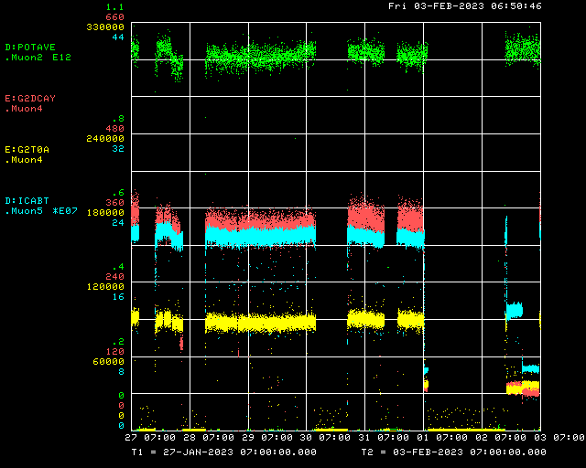
Beam to g-2 this week
Beam to AP-0 target
KRF5
g-2 ramp off for repairs
Main Injector access
g-2 kicker problems
Lost muon study
Lost muon study
Trolley Run
Decay Positrons
Mu2e Studies
Mu2e Studies
Mu2e Studies
Delivery Ring
g-2 T0 Detector

Slide 4
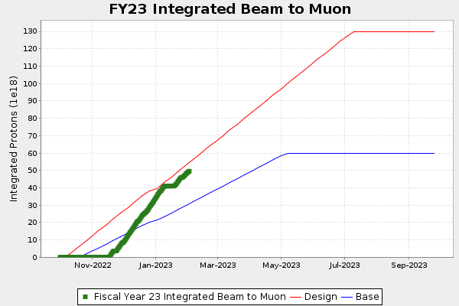
g-2 Run 6 Protons on Target
Detectors shifted upstream

Slide 5
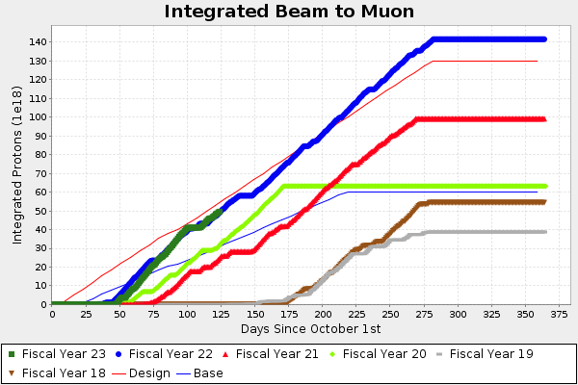
g-2 Protons on Target by Run
Detectors shifted upstream

Slide 6
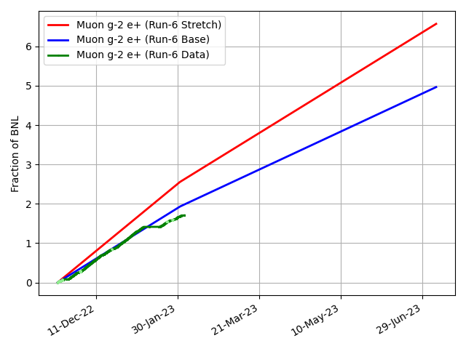
g-2 Performance this run
1.71 BNL

Slide 7
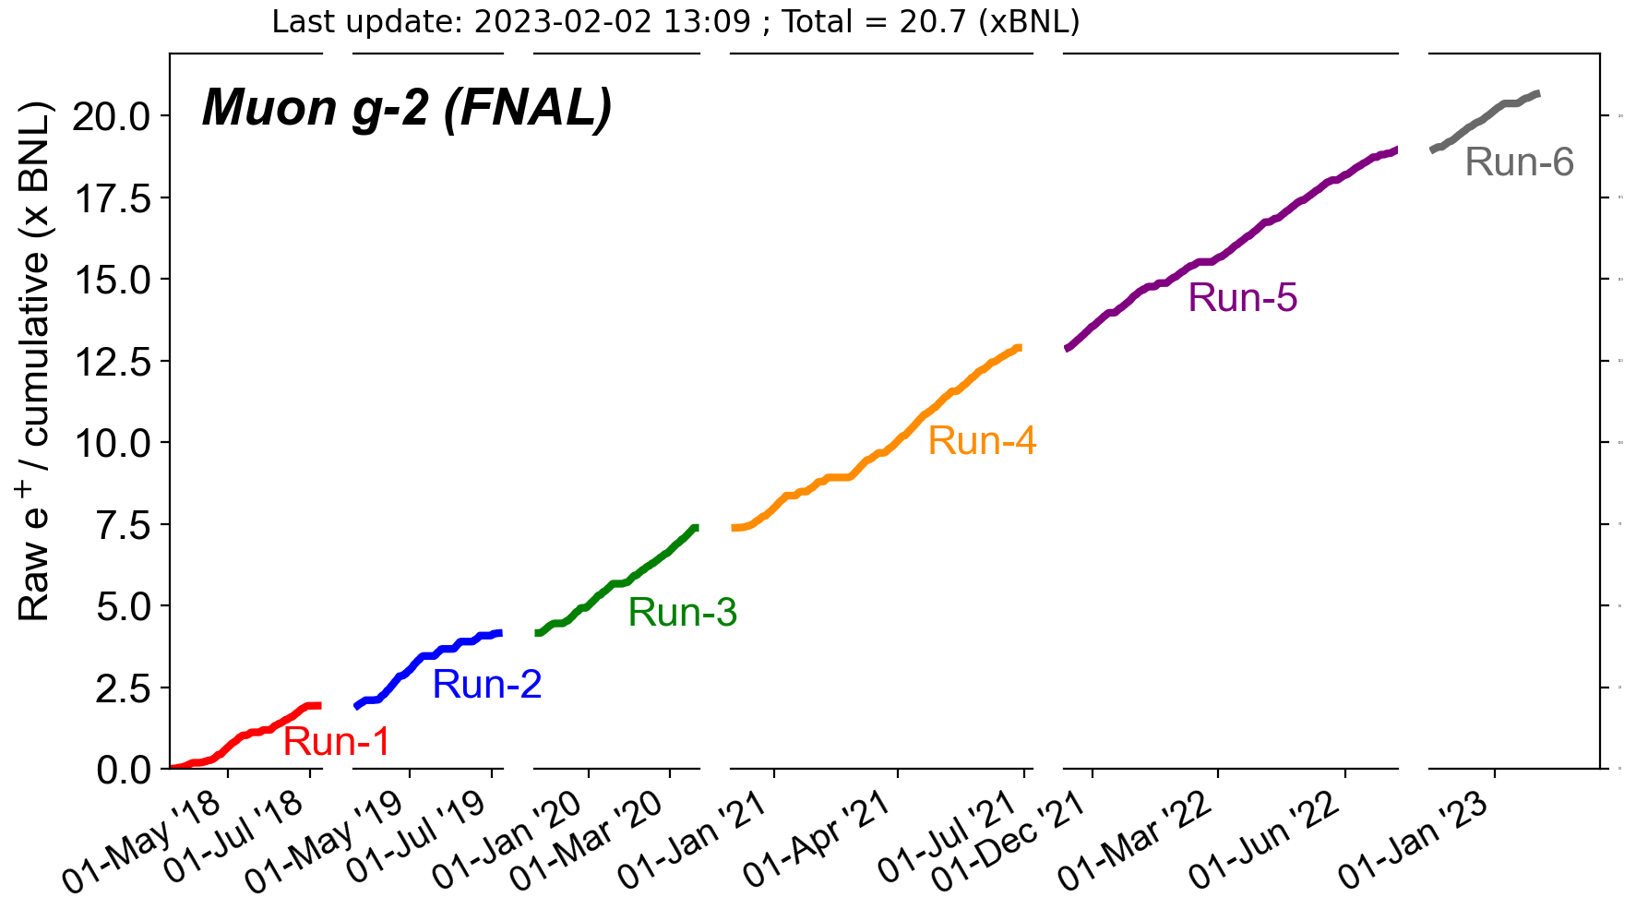
g-2 Overall Performance
Approaching 21 BNL
1.71 BNL
6.06 BNL
5.51 BNL
3.22 BNL
2.21 BNL
1.94 BNL

Slide 8
Short term plan
Mu2e studies shifts approximately three times per week
Delivery Ring BPM system commissioning
Other studies related to preparing for resonantly extracting beam
M4 Line instrumentation intensity calibration
Delivery beam to g-2
Support systematic studies that require beam modification
Gearing up for Electrostatic Septa power supply ORC
Expect significant conditioning period, once cleared to power
Look for opportunity for ISD to test LCW pump LP7
Working on plan for AP-0 A/C installation with ISD and Rad. Safety
We would like to overlap AP-0 work with planned Mu2e cryo testing, which keeps g-2 magnet off for up to a month
Would require clear understanding of starting date of Mu2e cryo testing (March 1?) and flexibility from contractor to begin work then

