Slide 1

AIDA TASD and MIND Detectors
E. Noah - 21.09.2012
On behalf of AIDA WP8.5.2 co-workers

Slide 2
Outline
The AIDA project
Planned neutrino facilities
AIDA TASD and MIND detectors
MIND Magnetisation
Plastic scintillators
SiPM characterisation
Electronics – EASIROC
UNIGE MICE EMR experience

Slide 3
The AIDA project
Advanced European Infrastructures for Detectors at Accelerators:
  Part EU-funded 4-yr project under FP7 Research Infrastructures programme.
  Timeline: 02/2011 – 01/2015
Aim:
  Upgrade, improve and integrate key European research infrastructures.
  Develop advanced detector technologies for future particle accelerators.

Slide 4
Accelerator-based neutrinos
Two recent proposals (in Europe):
  One short-baseline experiment at CERN-SPS (SPSC-P-347: 15th March 2012): neutrino beam to search for sterile neutrinos with the ICARUS T600 Lar TPC @ 1600m + T150 @ 300m from proton target.
  One long-baseline experiment at CERN-SPS (SPSC-EOI-007-LBNO: 28th June 2012): Investigate all flavour oscillations (ν_{μ} to ν_{μ}, ν_{μ} to ν_{τ}, ν_{μ} to ν_{e}) with neutrinos and antineutrinos, explicitely testing the existence of CP-violation and conclusively determining mass hierarchy for any value of δ_{CP}.
Both instrumented with liquid argon detectors and magnetised iron detectors.

Slide 5
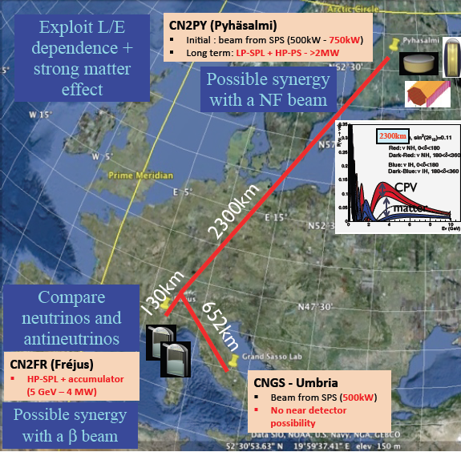
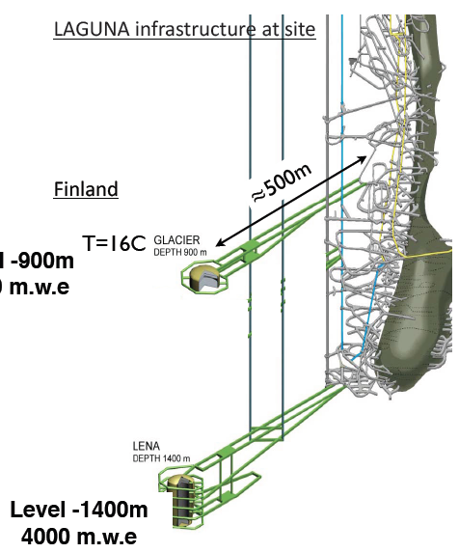
CN2PY
Mine closure 2018

Slide 6
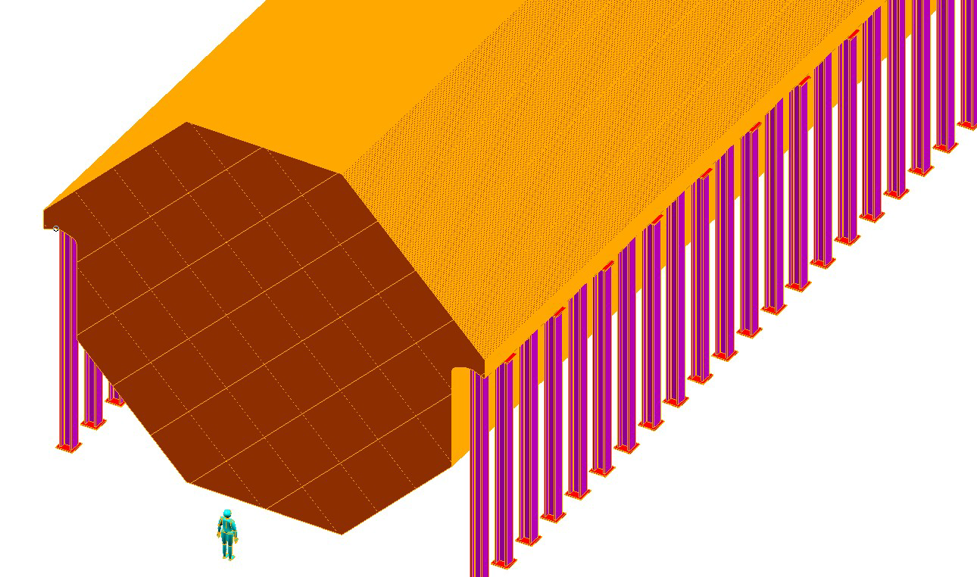
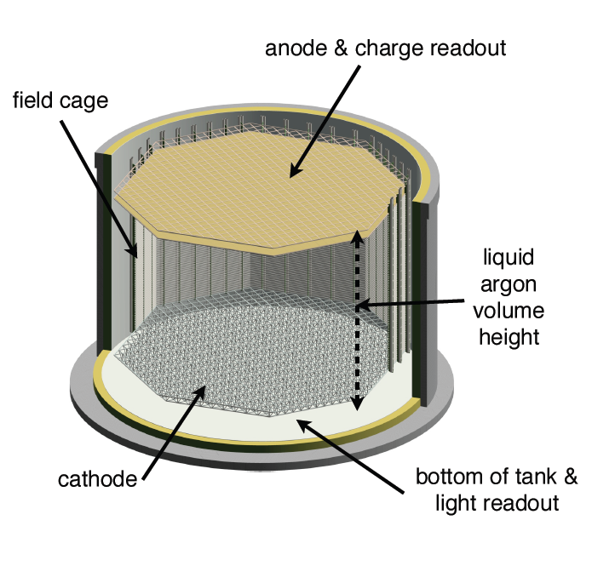
LBNO Detectors
MIND detector =
Neutrino Factory baseline detector
as of the NF-IDR
(Interim Design Report)
100kton Magnetized Iron detector
(1.5 T toroidal field)
Scintillator read out with
Wave Length Shifting fibers and SiPMTs
20kton Glacier detector
Liquid Argon TPC
with 2-phase readout (LEM)

Slide 7
LBNO Far Detectors: Top View
v
v
30m
neutrino beam
Liquid Argon Fiducial
40m
20m
10m

Slide 8
THE CN2PY NEAR DETECTOR SKETCH
MIND
(SC) coil
B
TASD volume
2m
MIND
4m
Tracking volume:
10 bar Ar gas TPC
1m
MIND

Slide 9
Excerpt from LBNO SPSC-EOI-007
Based on the expertise present at CERN and in European and in international research groups, and building upon the results of several years of EU-funded design studies, we are confident that the technology for the beam and detectors is sufficiently mature to allow for an early start to realizing the facility. We are calling on CERN to promptly support and engage in the prototyping of the near and far detector components, to investigate options for campaigns of detector performance characterization and calibration with test beams in the North Area, and engage in a collaborative effort with the LBNO Collaboration that should lead to a full engineering design of the CN2PY beam and to an LBNO Proposal by the end of 2014.

Slide 10
AIDA TASD and MIND
Totally Active Scintillating Detector
  Stopping properties of pions and muons up to 200 MeV/c (MICE EMR)
  Electron and muon charge separation inside a magnetic field, in particular electron charge ID in electron neutrino interaction for the platinum channel at a NF: 0.5 – 5 GeV/c (AIDA – MORPURGO).
Magnetised Iron Neutrino Detector
  Muon charge identification, for wrong sign muon signature of a neutrino oscillation event: golden channel at a NF: requires correct sign background rejection of 1 in 10⁴: test beam 0.8 to 5 GeV/c (AIDA – baby-MIND).
  Hadronic shower reconstruction for identification of charged current neutrino interactions and rejection of neutral current n.i.: test beam protons/pions 0.5 to 9 GeV/c (AIDA – baby-MIND).

Slide 11
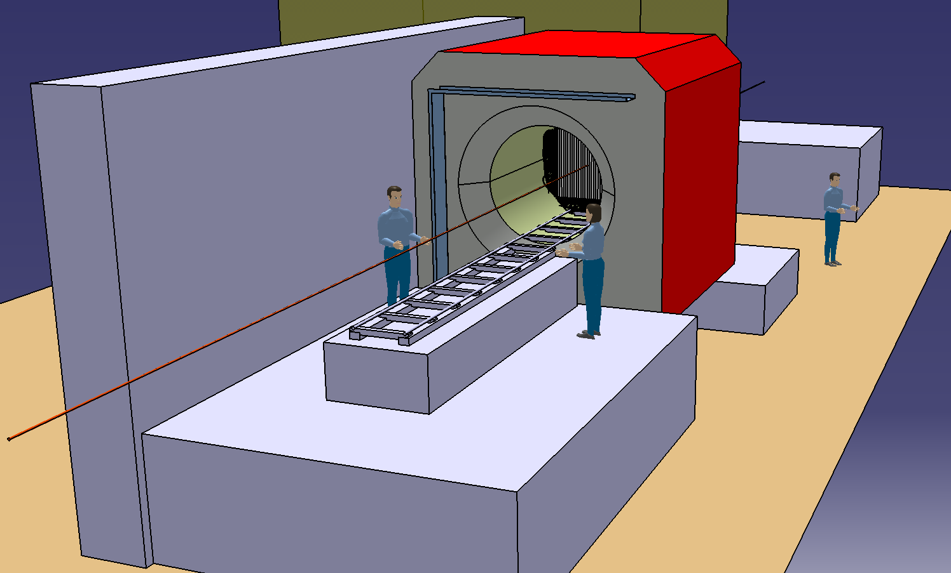
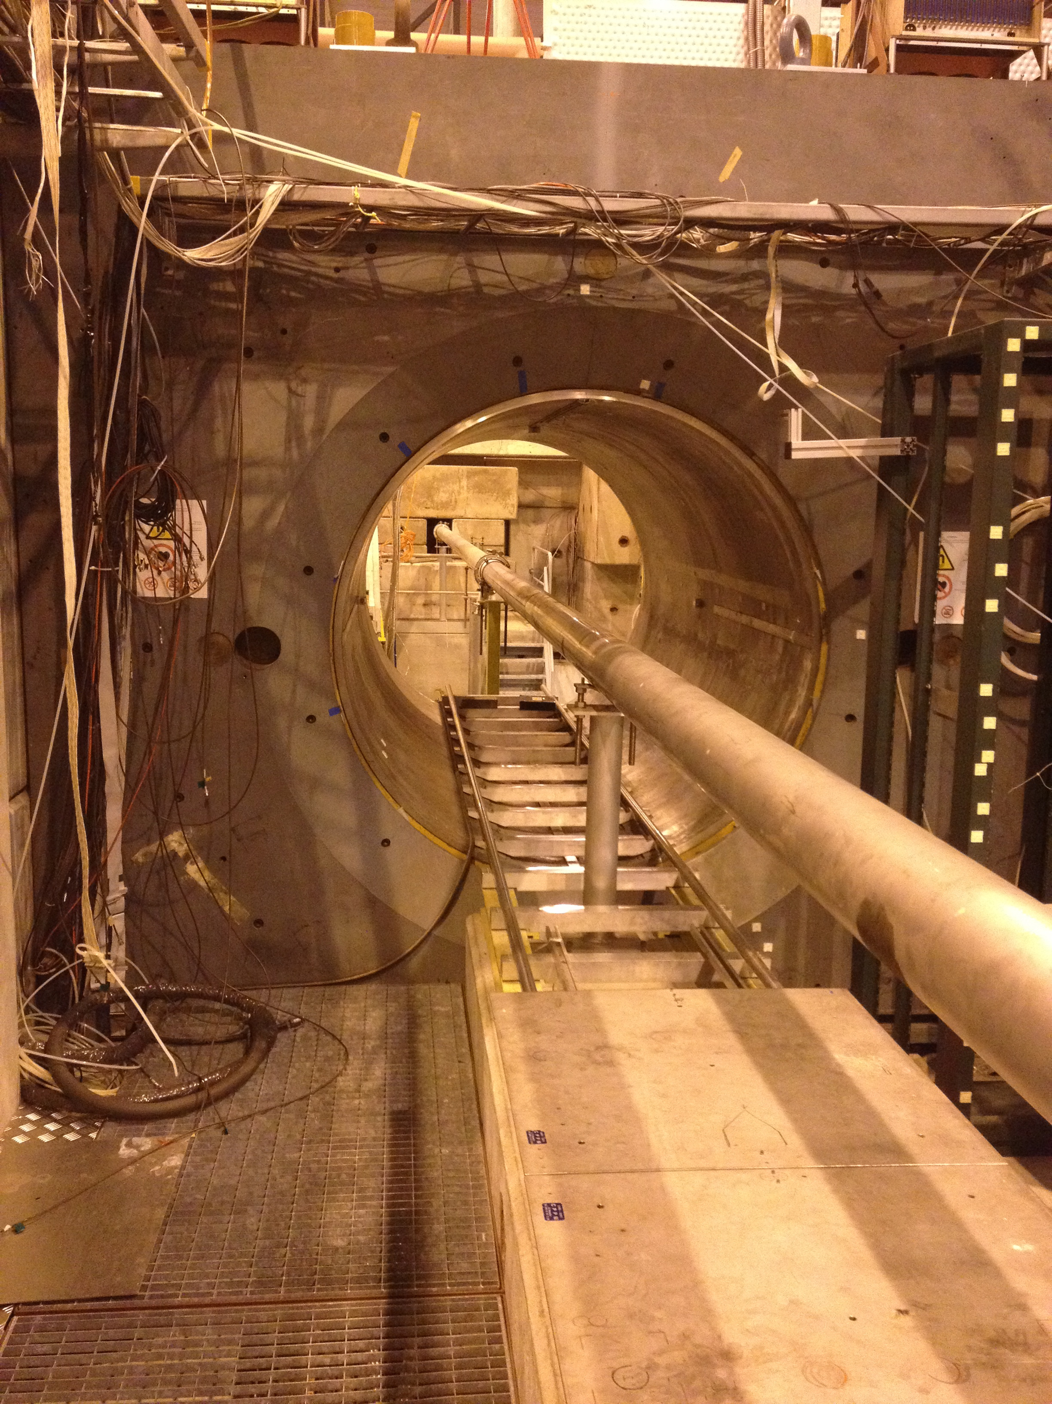
General layout: TASD
MORPURGO magnet
TASD
(1 module shown)

Slide 12
TASD Parameters
Parameter | Symbol | Unit | Nominal Value | Range Min | Range Max
Detector global dimensions
Detector width | w_{det} | m | 1.0 | 0.9 | 1.1
Detector height | h_{det} | m | 1.0 | 0.9 | 1.1
Detector depth | d_{det} | m | 0.75 | - | -
Detector depth with gaps | d_{gap} | m | 197.5 | - | -
Plastic scintillator
Number of planes per module (xy or uv) | - | - | 2 | 1 | 2
Number of modules | n_{module} | - | 50
Gap between planes within module |  | cm | 0 | 0 | 0.05
Module envelope thickness | t_{env} | cm | 0.05 | 0 | 0.05
Scintillator bar length | l_{sci} | cm | 90.0 | 80.0 | 100.0
Scintillator bar width | w_{sci} | cm | 1.0 | 1.0 | 3.0
Scintillator bar height | h_{sci} | cm | 0.7 | 0.6 | 1.0
Bars per module | n_{bars_mod} | - | 180
Total number of bars | n_{bars_tot} | - | 9000

Slide 13
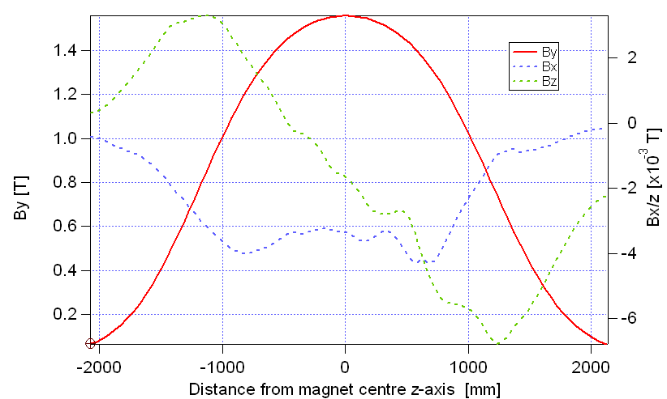
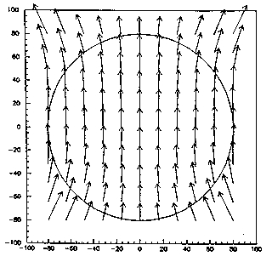
Morpurgo magnet B-field
X-Y slice

Slide 14
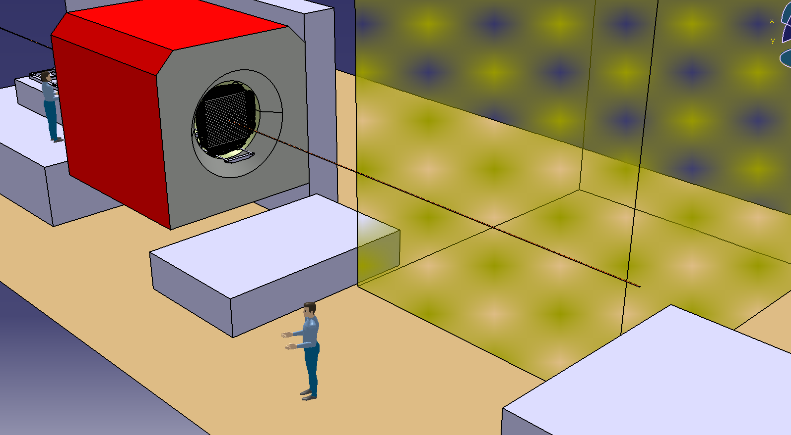
General Layout: Baby-MIND
MIND area 1
MIND area 2

Slide 15
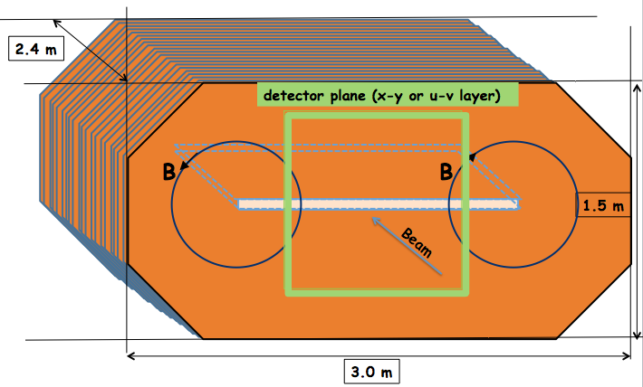
Baby-MIND Dimensions

Slide 16
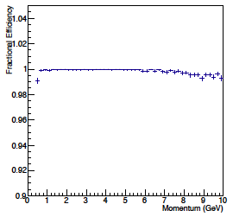
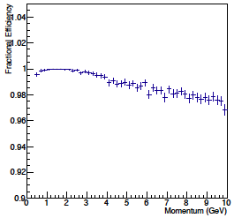
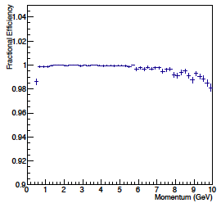
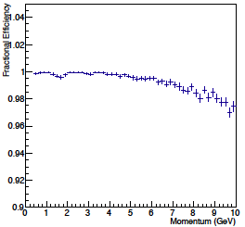
Baby-MIND Steel Selection
R. Bayes
Muon reconstruction efficiencies are good for all scenarios considered here, slightly better for 3.0 cm steel, 1.5 cm scintillator.
Charge I.D. efficiencies are identical for all scenarios.
Cost...
  ARMCO: 5.4 CHF/kg.
  AISI1010
  AISI1006 (MINOS)
3.0 cm steel
1.5 cm scintillator
2.0 cm steel
1.5 cm scintillator
3.0 cm steel
3.5 cm scintillator
2.0 cm steel
3.5 cm scintillator

Slide 17
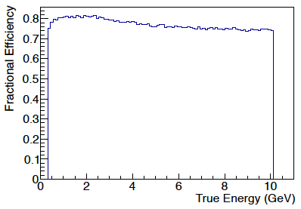
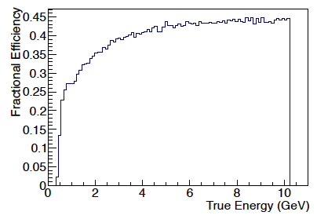
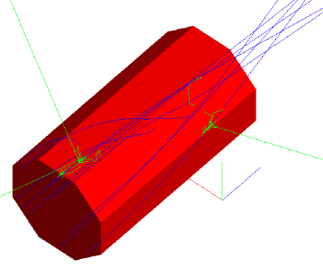
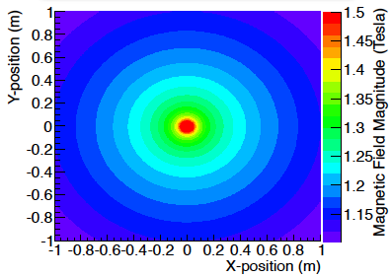
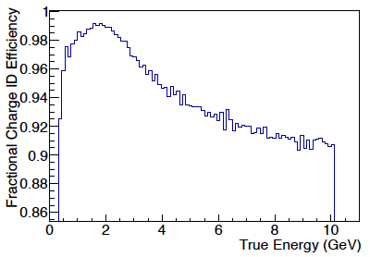
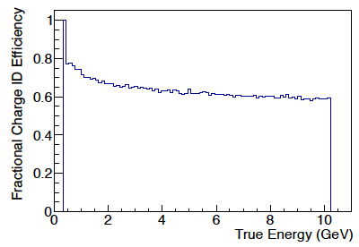
MIND Proto Simulations
R. Bayes
MIND Prototype
1 m × 1 m × 2 m
3 cm Fe
2 cm scintillator
7 cm dia. copper STL (for scattering)
Toroidal B-field 100 kA
μ⁺
π⁺
10 μ⁺ events ⬆:
Generated at random on X-Y plane at Z=L/2
1 million events per simulation
μ⁺
π⁺
Particle | Detector - MIND | Reconstruction efficiency | Charge identification efficiency
μ⁺ | Prototype | 80% (1GeV) 75% (10GeV) | 99% (1GeV) 91% (10GeV)
μ⁺ | Far | 81% (Flat 1 to 25GeV) | 99.5% (1GeV) 98% (25GeV)
μ⁻ | Prototype | 60% (1GeV) to 64% (10GeV) | 92% (1GeV) to 83% (10GeV)
π⁺ | Prototype | 13% (1GeV) to 45% (10GeV) | 80% (1GeV) to 60% (10GeV)
π⁻ | Prototype | 11% (1GeV) to 42% (10GeV) | 75% (1GeV) to 55% (10GeV)

Slide 18
Baby-MIND Magnetisation
Magnetic field requirements:
  field nominal value: 1.5 T ± 20%.
  knowledge of field in volume of interest to precision of 1e-4.
  Bx component < 1% of By within steel, along projection of plas. sci.
  field uniformity within steel along projection of plastic scintillator vol.: 10%.
  field value outside MIND volume: maximum = 100 Gauss.
Power supply parameters:
  if possible should match existing power supplies at CERN that could be borrowed for this application,
  if above point not possible, then optimise for cost (purchase and operation).
Ongoing evaluation by CERN TE-MSC-MNC:
  Study A: First optimisation of basic parameters
  Study B: One coil vs. Two coils
  Study C: Normal conducting vs superconducting.

Slide 19
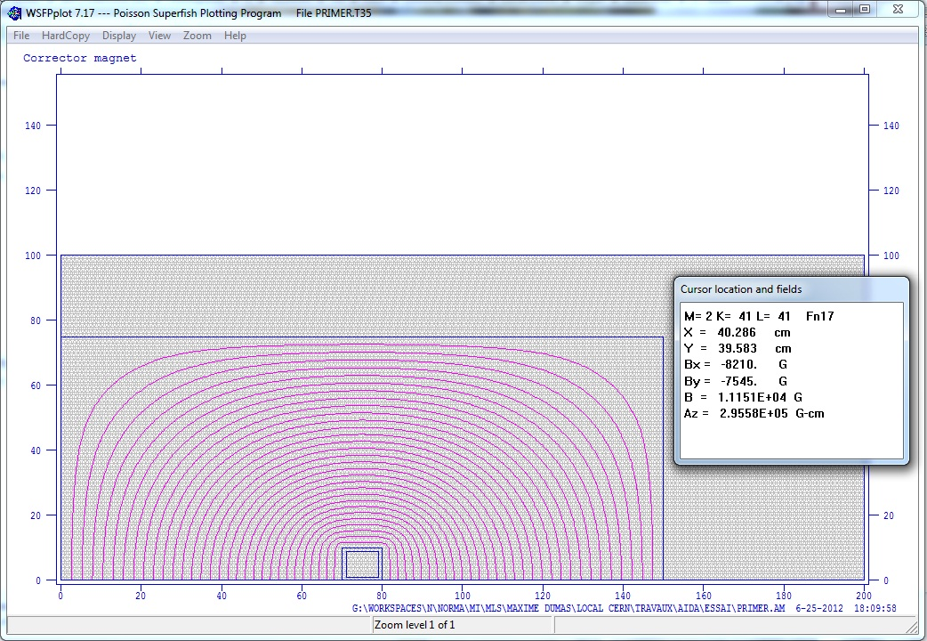
One coil – no slots
¼ of detector
M. Dumas, J. Bauche

Slide 20
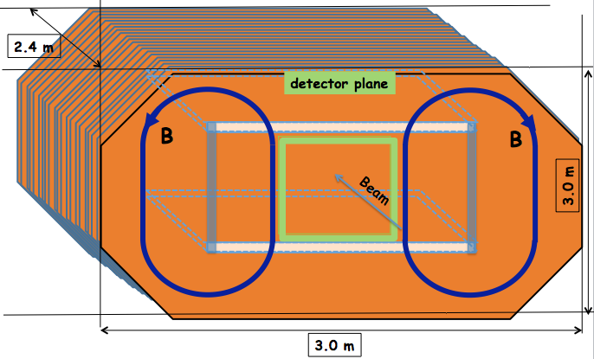
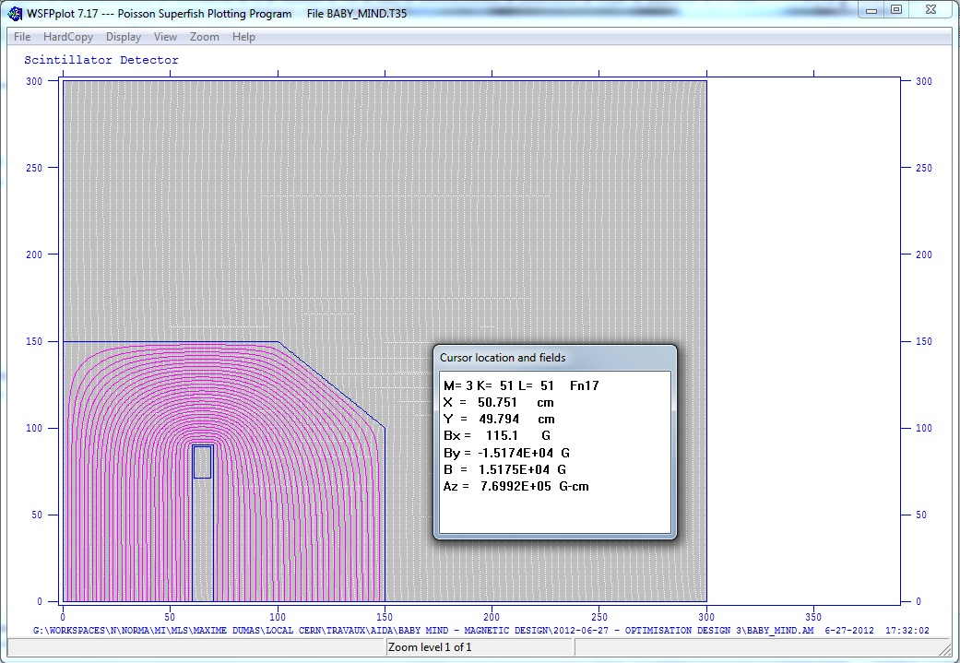
Two coils - with slot
¼ of detector
B_{x} < 1% B_{y} But:
Double steel height: × 2 cost!
Not representative of big MIND
M. Dumas, J. Bauche

Slide 21
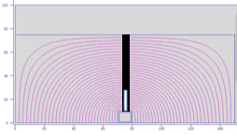
Measuring B-field
Slit in steel, few mm...
fill with non-magnetic material (e.g. SS316L).
Insert probe to measure field at various points along slit.
Small distortion of field lines.
Use measurements to cross-check and validate simulated field across whole detector.
~23000 At with slot c.f. 4000 At without slot.
M. Dumas, J. Bauche

Slide 22
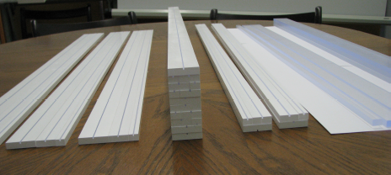
Plastic scintillators
Prototyping at INR RAS:
Extruded scintillator slabs produced at Uniplast company, Vladimir, Russia
  polysterene based, 1.5% of paraterphenyl (PTP) and 0.01% of POPOP
Plastics initially used for T2K SMRD detector counters production
Counter surface is etched with a chemical agent (Uniplast) to create a 30-100 μm layer that works as diffusive reflector
Counters of three different sizes:
  895 × 7 × 10 mm³
  895 × 7 × 20 mm³
  895 × 7 × 30 mm³
2 mm deep grooves to embed fibers:
  three different types of fiber
  Fiber diameter: 1.0 mm, 1.2 mm, 1.5 mm
  Groove width: 1.1 mm, 1.3 mm, 1.7 mm
A. Izmaylov, A. Khotjantzev, Y. Kudenko, O. Mineev

Slide 23
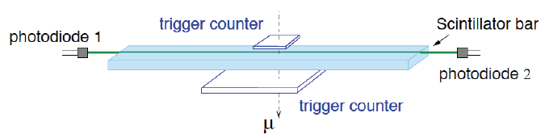
Cosmic telescope tests
Light collection:
Kuraray WLS fiber (200 ppm, S-type, 1.0 mm dia)
Toshiba TSF451-50M silicone grease used to embed fiber
Photosensors (two-sided readout): 667-pixel avalanche photo-diodes Hamamatsu MPPC (~55k MPPCs used in T2K ND)
HV from Hamamatsu, gain of 7.5 × 10⁵ for 25°C
Note!: no correction for cross-talk + after-pulses (~15% in total)
Cosmic telescope:
  two trigger counters
  upper one: 7 × 7 cm² (L.Y. checks) and 2 × 2 cm² (timing)
  lower one: 10 x 24 cm²
  measurements at counter center: L.Y. per cosmic MIPs

Slide 24
Light yield with no chemical reflector
Counter width | MPPC 1 L.Y. [pe] | MPPC 2 L.Y. [pe] | ΣL.Y. [pe]
No chemical reflector/ No Tyvek
10 mm | 15.7 | 15.8 | 31.5
20 mm | 15.5 | 13.6 | 29.1
30 mm | 12.8 | 11.5 | 24.3
No chemical reflector/ Tyvek reflector 100-120 μm
20 mm | 41.8 | 34.8 | 76.6
Tyvek effect
× 2.5
Light attenuation length in bars ~8 cm.
T2K SMRD experience: L.Y. > 12 p.e. (sum of both ends) allows to achieve 99% detection efficiency.
Highest L.Y. for smallest width.

Slide 25
Light yield with chemical reflector
Counter width | MPPC 1 L.Y. [pe] | MPPC 2 L.Y. [pe] | ΣL.Y. [pe]
Chemical reflector/ Optical grease
10 mm | 46.0 | 36.8 | 82.8
20 mm | 39.7 | 35.7 | 75.4
30 mm | 31.2 | 26.6 | 57.8
Chemical reflector/ no optical grease
20 mm | 25.7 | 22.1 | 47.8
Chemical reflector/optical grease/Tyvek reflector
20 mm | 49.3 | 44.0 | 93.3
× 2.5 effect of chemical reflector compared with no chemical reflector.
60% effect of optical grease (same expected with optical glue).
20% effect of additional Tyvek reflector.

Slide 26
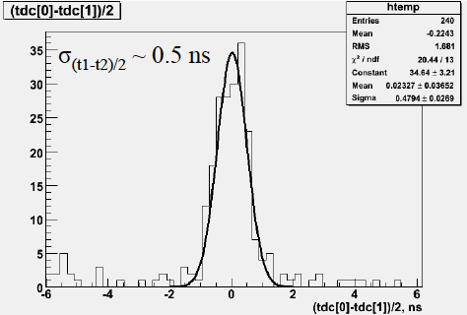
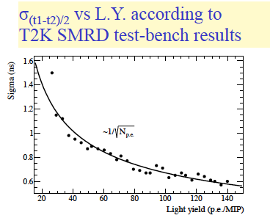
Timing characteristics
Timing dominated by fiber decay constant: τ_{fiber} ~ 12 ns.
0.5 p.e. TDC threshold to suppress timewalk effects.
Two-sided readout ➔ (t₁-t₂)/2 combination to estimate timing.

Slide 27
SiPM Characterisation
Have a basic modelling approach to:
  Compare experimental measurements with semi-empirical processes – fitting of raw data...
  Extract parameters from experimental measurements for digitisation
Steps:
  Response of SiPM to single photon
  Estimate number of photoelectrons produced
  Combine single photon response with multi-photon input
  SiPM output and path to digitisation

Slide 28
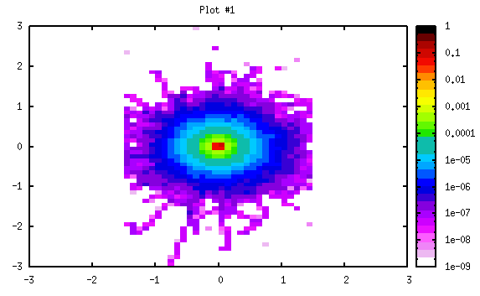
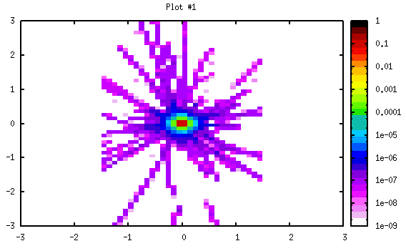
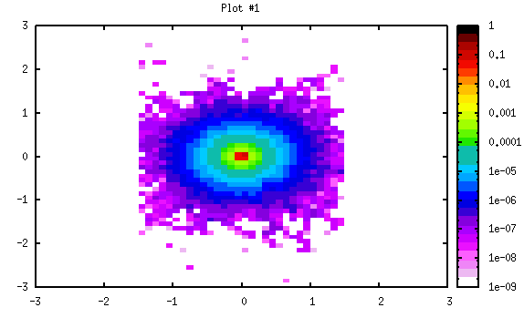
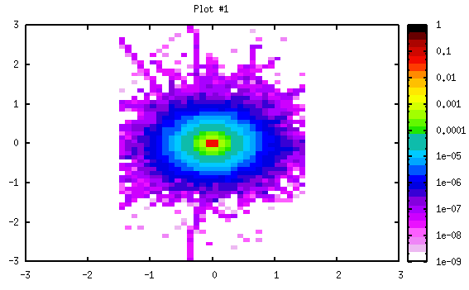
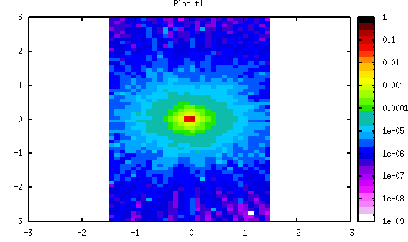
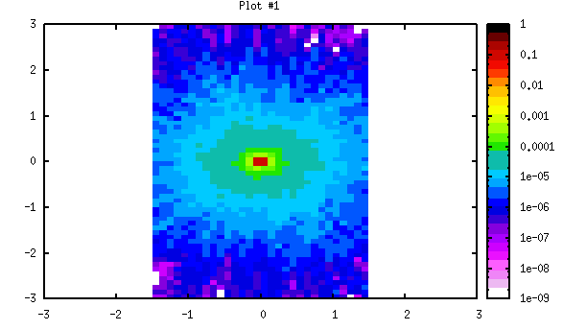
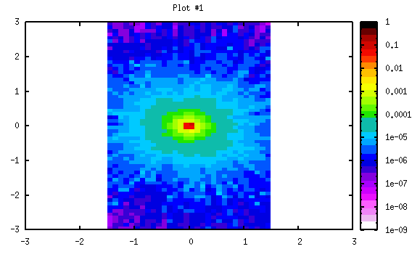
Energy deposition in scintillator
10 GeV/C
0.1 GeV/C
μ
e
π
p

Slide 29
L.Y. estimates
Parameter | Unit | AIDA [Perpendicular] | AIDA [MAX]
Energy deposition
Track length | [cm] | 0.70 | 1.00
Peak Edep/cm | [MeV/cm] | 8.82 | 8.82
Peak Edep | [MeV] | 6.17 | 8.82
Edep/MIP/cm | [MeV/MIP/cm] | 2.00 | 2.00
Edep/MIP | [MeV/MIP] | 1.40 | 2.00
Photon conversion
Photon yield | [ph/MeV] | 1.25E+04 | 1.25E+04
Photon yield per bar | [ph] | 7.72E+04 | 1.10E+05
Photon efficiency | % | 5.00E-03 | 5.00E-03
Photons on SiPM | [ph] | 3.86E+02 | 5.51E+02
MRS APD case (PDE = 35%)
Light yield | [p.e./MeV] | 21.4 | 21.4
Total light yield | [p.e./bar] | 132.1236 | 188.748

Slide 30
Processes leading to SiPM output
Charged particle
WLS fibre
SiPM
Energy deposition
Photon generation in p.s.
Hit probability p.s. to WLS
Plastic scintillator
Blue/green conversion in WLS
Transmission in WLS
Photo-electron conversion
SiPM output

Slide 31
Number of photons incident on SiPM
Initial photon yield ~ 1.25e4/MeV
Integral of SiPM
quantum efficiency
~ 20% (check)
Probability that blue photon from p.s. hits WLS
Probability that green photon propagates in
WLS by total internal reflection

Slide 32
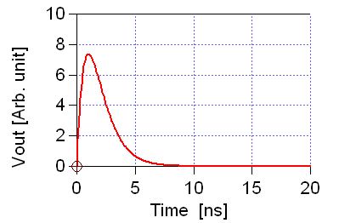
SiPM Single photon response
Assume for time being that SiPM circuit is similar to PMT circuit (later derive more appropriate approximation) i.e.:
  Single high-pass filter τ₁=C₁R₁
  Series of low-pass filters τ₂=C₂R₂

Slide 33
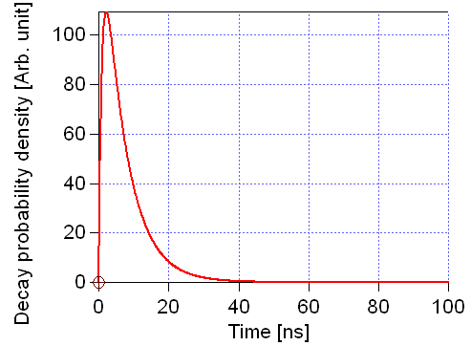
Time distribution
Three main contributions:
  Decay times in scintillator and WLS
  Propagation delay
  Internal SiPM transit time
Decay time distribution:
  Random variable that is the sum of independent random times
  Characteristic decay times: t_{p} and t_{f}

Slide 34
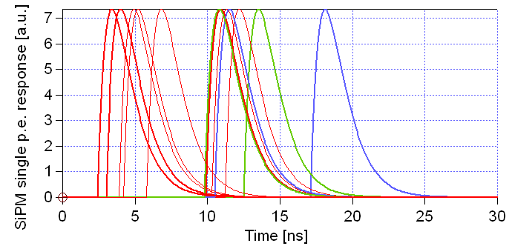
SiPM Output
Sum over all photoelectrons of SiPM response to single photoelectron.

Slide 35
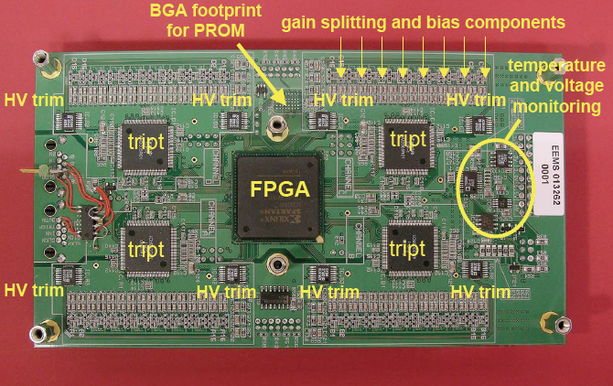
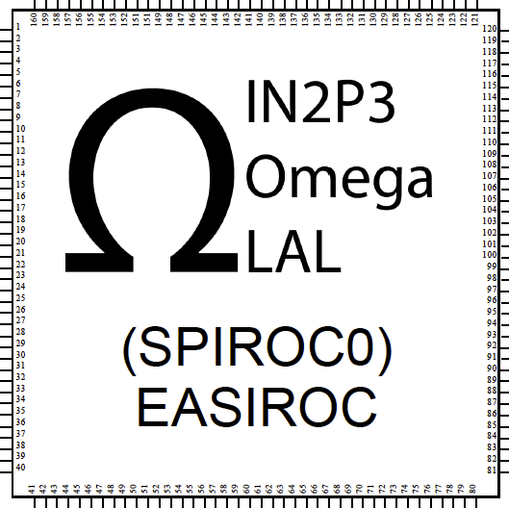
TASD and baby-MIND Electronics
Secondary/Tertiary beam from SPS:
  Slow extraction: < 100000 particles/(10s spill) every 60s
Electronics: 1000-10000 samples/s
Dynamic range: estimate 500 p.e. (100 p.e./MIP)
Number of channels: ~10000 ch.
Allowable noise level: 0.5 p.e.
Timing res.: TBD
Cost: 15 CHF/channel
Options:
  DRS4/5 (PSI, NA61 development)
  MAROC/EASIROC (MICE EMR)
  TRIP-t (T2K ND280)
DRS4

Slide 36
DRS4
S. Bravar
Fabricated in 0.25 μm
1P5M MMC process
(UMC), 5 x 5 mm2,
radiation hard
8+1 ch. each 1024 bins,
4 ch. 2048, …, 1 ch. 8192
Passive differential
inputs/outputs
Sampling speed
700 MHz … 5 GHz
On-chip PLL stabilization
Readout speed
30 MHz, multiplexed
or in parallel
SiPM
Ampli
DRS
ADC
FPGA

Slide 37
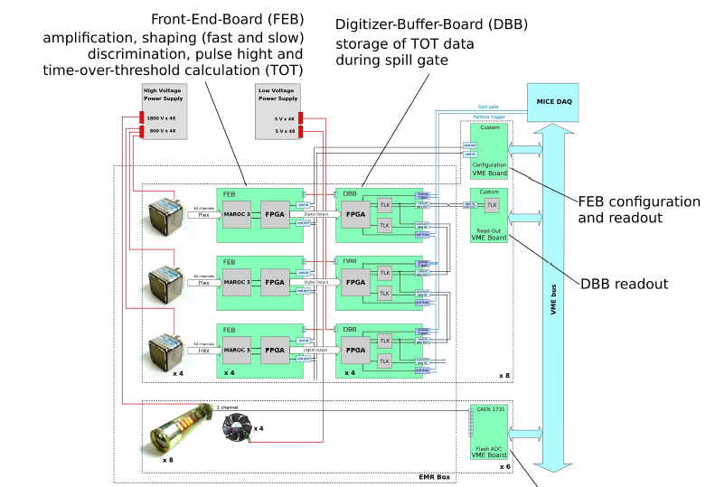

MICE EMR Electronics
MAROC/EASIROC
Option

Slide 38
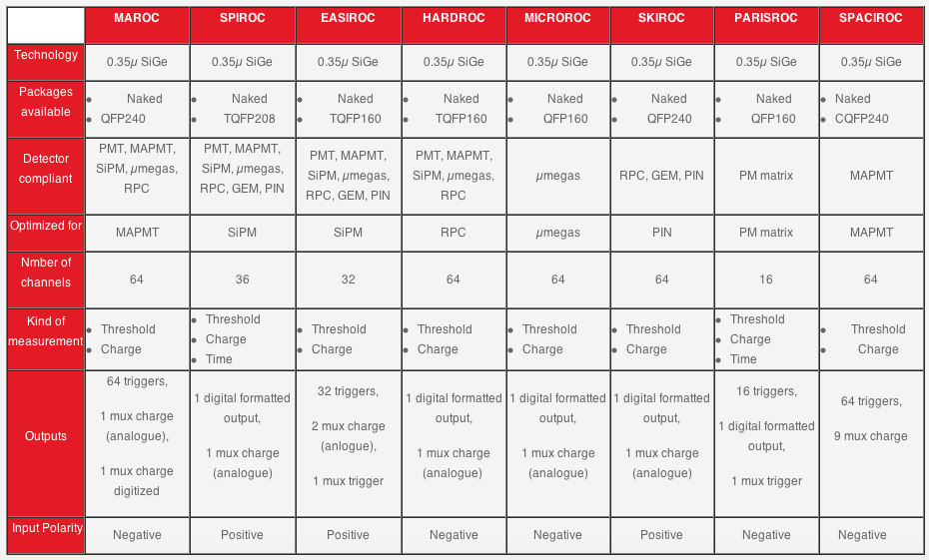
Omega Micro Chips - LAL

Slide 39
EASIROC Description
Number of channels: 32
Analogue core :
  Internal input 8-bit DAC (0-4.5V) for individual SiPM gain adjustment
  Individually addressable calibration injection capacitance
  Energy measurement : 14-bit dynamic range
    2 tuneable gains followed by 2 adjustable shapers
    Analogue memory (Track & Hold cell) for low gain and high gain
    Common 10-bit DAC for threshold adjustment
    Variable shaping time: from 25 ns to 175 ns
    from 160 fC →320 pC (ie. 1 pe →2000 pe @ SiPM gain = 10⁶)
    pe/noise ratio : ~10 @ SiPM gain 10⁶
  Trigger output
    pe/noise ratio on trigger channel : ~ 25
    Fast shaper : ~15ns
    Trigger on 50 fC (ie. 1/3 pe @ SiPM gain = 10⁶)

Slide 40
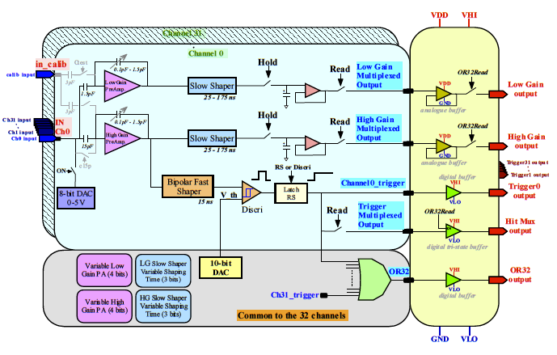
EASIROC Schematic

Slide 41
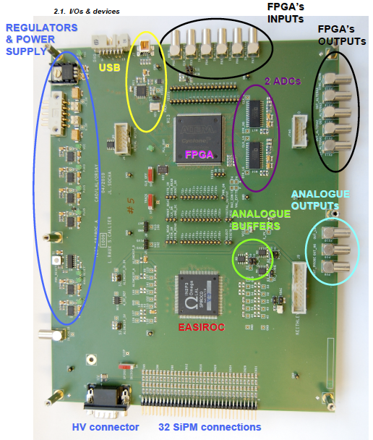
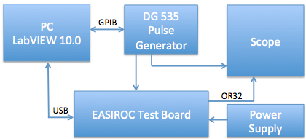
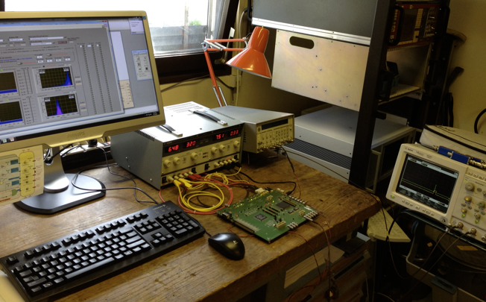
EASIROC Evaluation Board
Enables tests of most of the functionality of the EASIROC.
Full access to slow control 456 bits.
Pins on I/O allow for easy monitoring.
External ADCs for analogue signal tests.

Slide 42
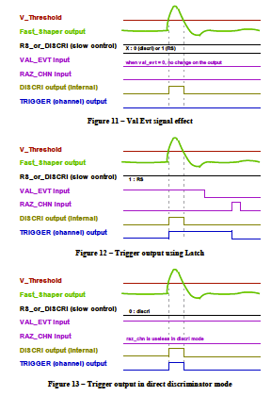
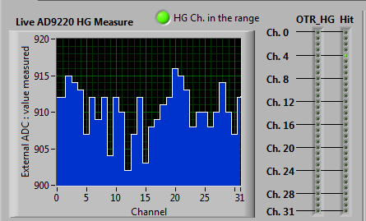
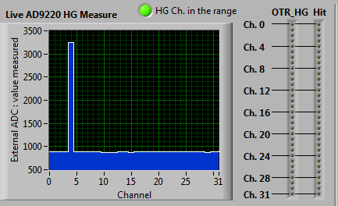
Trigger Output
Latch
Val Evt signal effect
Trigger output using latch
Direct
Trigger output in direct discriminator mode

Slide 43
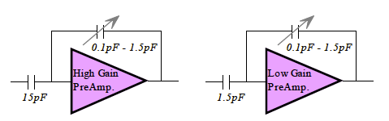
Preamp Feedback Tests

Slide 44


Shaper Tests
T&H is OR32 with programmable delay through FPGA

Slide 45

Shaper Tests
50 ns time constant
80ns
12.5ns
50ns
125ns

Slide 46


Discriminator DAC Scan

Slide 47

Muon Ionisation Cooling Experiment (MICE)

Slide 48

MICE EMR

Slide 49

EMR construction/commissioning
R. Asfandiyarov

Slide 50
Outlook
Work ongoing to “freeze” a number of parameters for production:
  Magnetisation of MIND (steel Oct. 2012)
  Scintillator slabs (Dec. 2012)
  SiPMs (April 2013)
  Electronics (Aug. 2013)
Simulations:
  Baby-MIND Geant4: similar methodology to MIND/SuperBIND.
  TASD Geant4: similar environment to MICE EMR.
  MIND and TASD Fluka: planned for comparison...

Slide 51
Summary: what we are here for...
Discuss collaboration on:
Construction of TASD and MIND-type detectors:
  Magnetisation of the MIND (STL?, in-situ measurement of B-field, cost of steel, mechanics).
  SiPM procurement/integration (novel approaches e.g. digital SiPM, connector design, cost/ch).
  Electronics (options, cost/ch).
Simulation:
  Simulation framework.
  Methodology (e.g. hadronic shower reconstruction in B-field).
Use of AIDA detectors as test beds for nuSTORM detector activities (in the spirit of the MINOS CalDet experiments...).

Slide 52
Back-up slides

Slide 53

General Layout: Baby MIND

Slide 54
Baby-MIND parameters I/II

Slide 55
Baby-MIND parameters II/II

Slide 56
Basic parameters for magnetisation
Coil and P.S. parameters | Units | AIDA baby-MIND | INO Full | INO Prototype
Coil dimension 1 | cm | 2.6 | 20 | 2.6
Coil dimension 2 | cm | 10 | 100 | 10
Coil height | m |  | 15
Total single turn length | m | 8 | 46 | 4.7 x 2
Total coil length | m | 800 | 92000 | 940
Density of copper | kg/m3 | 8940 | 8940 | 8940
Coil volume | m3 | 0.021 | 9.2 | 0.024
Coil weight | kg | 185.952 | 82248 | 218
Amp-turns | Amp-turns |  | 40000 | 4000x2
Number of turns |  | 20 x 5 | 20 x 100 x 2 | 5 x 20 x 2
Conductor size | cm | 0.5 x 0.5 | 1 x 1 | 0.5 x 0.5
Current 10 A | Amps | 40 | 10 | 40
Resistance | Ohm | 0.5376 | 15.6 | 0.64
Voltage | Volts | 21.504 | 156 | 25.6
Power dissipation | kW | 0.86016 | 3.1 | 1.02
Coil inductance | Henry |  | 1710 | 10
Rise in temperature of coil | oC |  | 4
Rise in temperature of iron surface | oC |  | 2
Stored magnetic energy | MJ |  | 5.3 | 0.01
Characteristic magnetisation time | s |  | 110 | 16

Slide 57

Baby-MIND scintillator modules

Slide 58


Example outputs
Yield=1.25e4/MeV
2 MeV/MIP
n_{clad}=1.6
n_{core}=1.49
t_{s}=1ns
t_{f}=6.5ns
P_{Q}=20%
w_{s}=2cm
h_{s}=3cm
d_{f}=0.15cm
Edep=6MeV
P_{H}=13%
P_{Trans}=3.7%
W_{s}=1cm
H_{s}=0.6cm
d_{f}=0.10cm
Edep=1.2MeV
P_{H}=43%
P_{Trans}=3.7%

