Slide 1
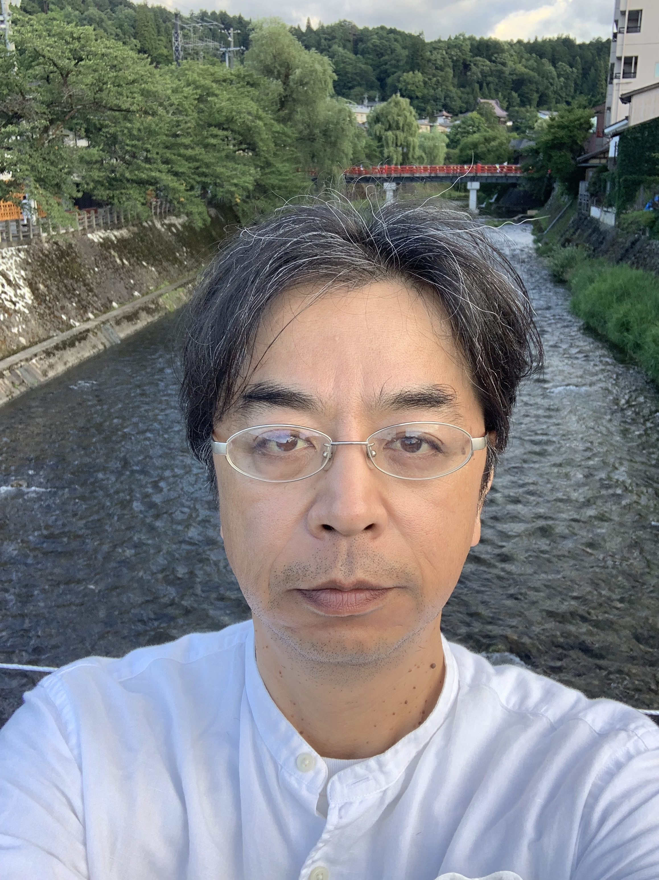


HyperK
Masato Shiozawa
Co-spokesperson, Hyper-Kamiokande Collaboration
Director, Kamioka Observatory, Institute for Cosmic Ray Research, The University of Tokyo
21st March 2023, P5 Townhall Meeting FNAL/ANL
Notes:
I would like to thank organizers for the invitation to give this presentation on the Hyper-Kamiokande project.

Slide 2
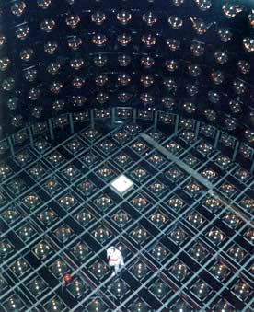
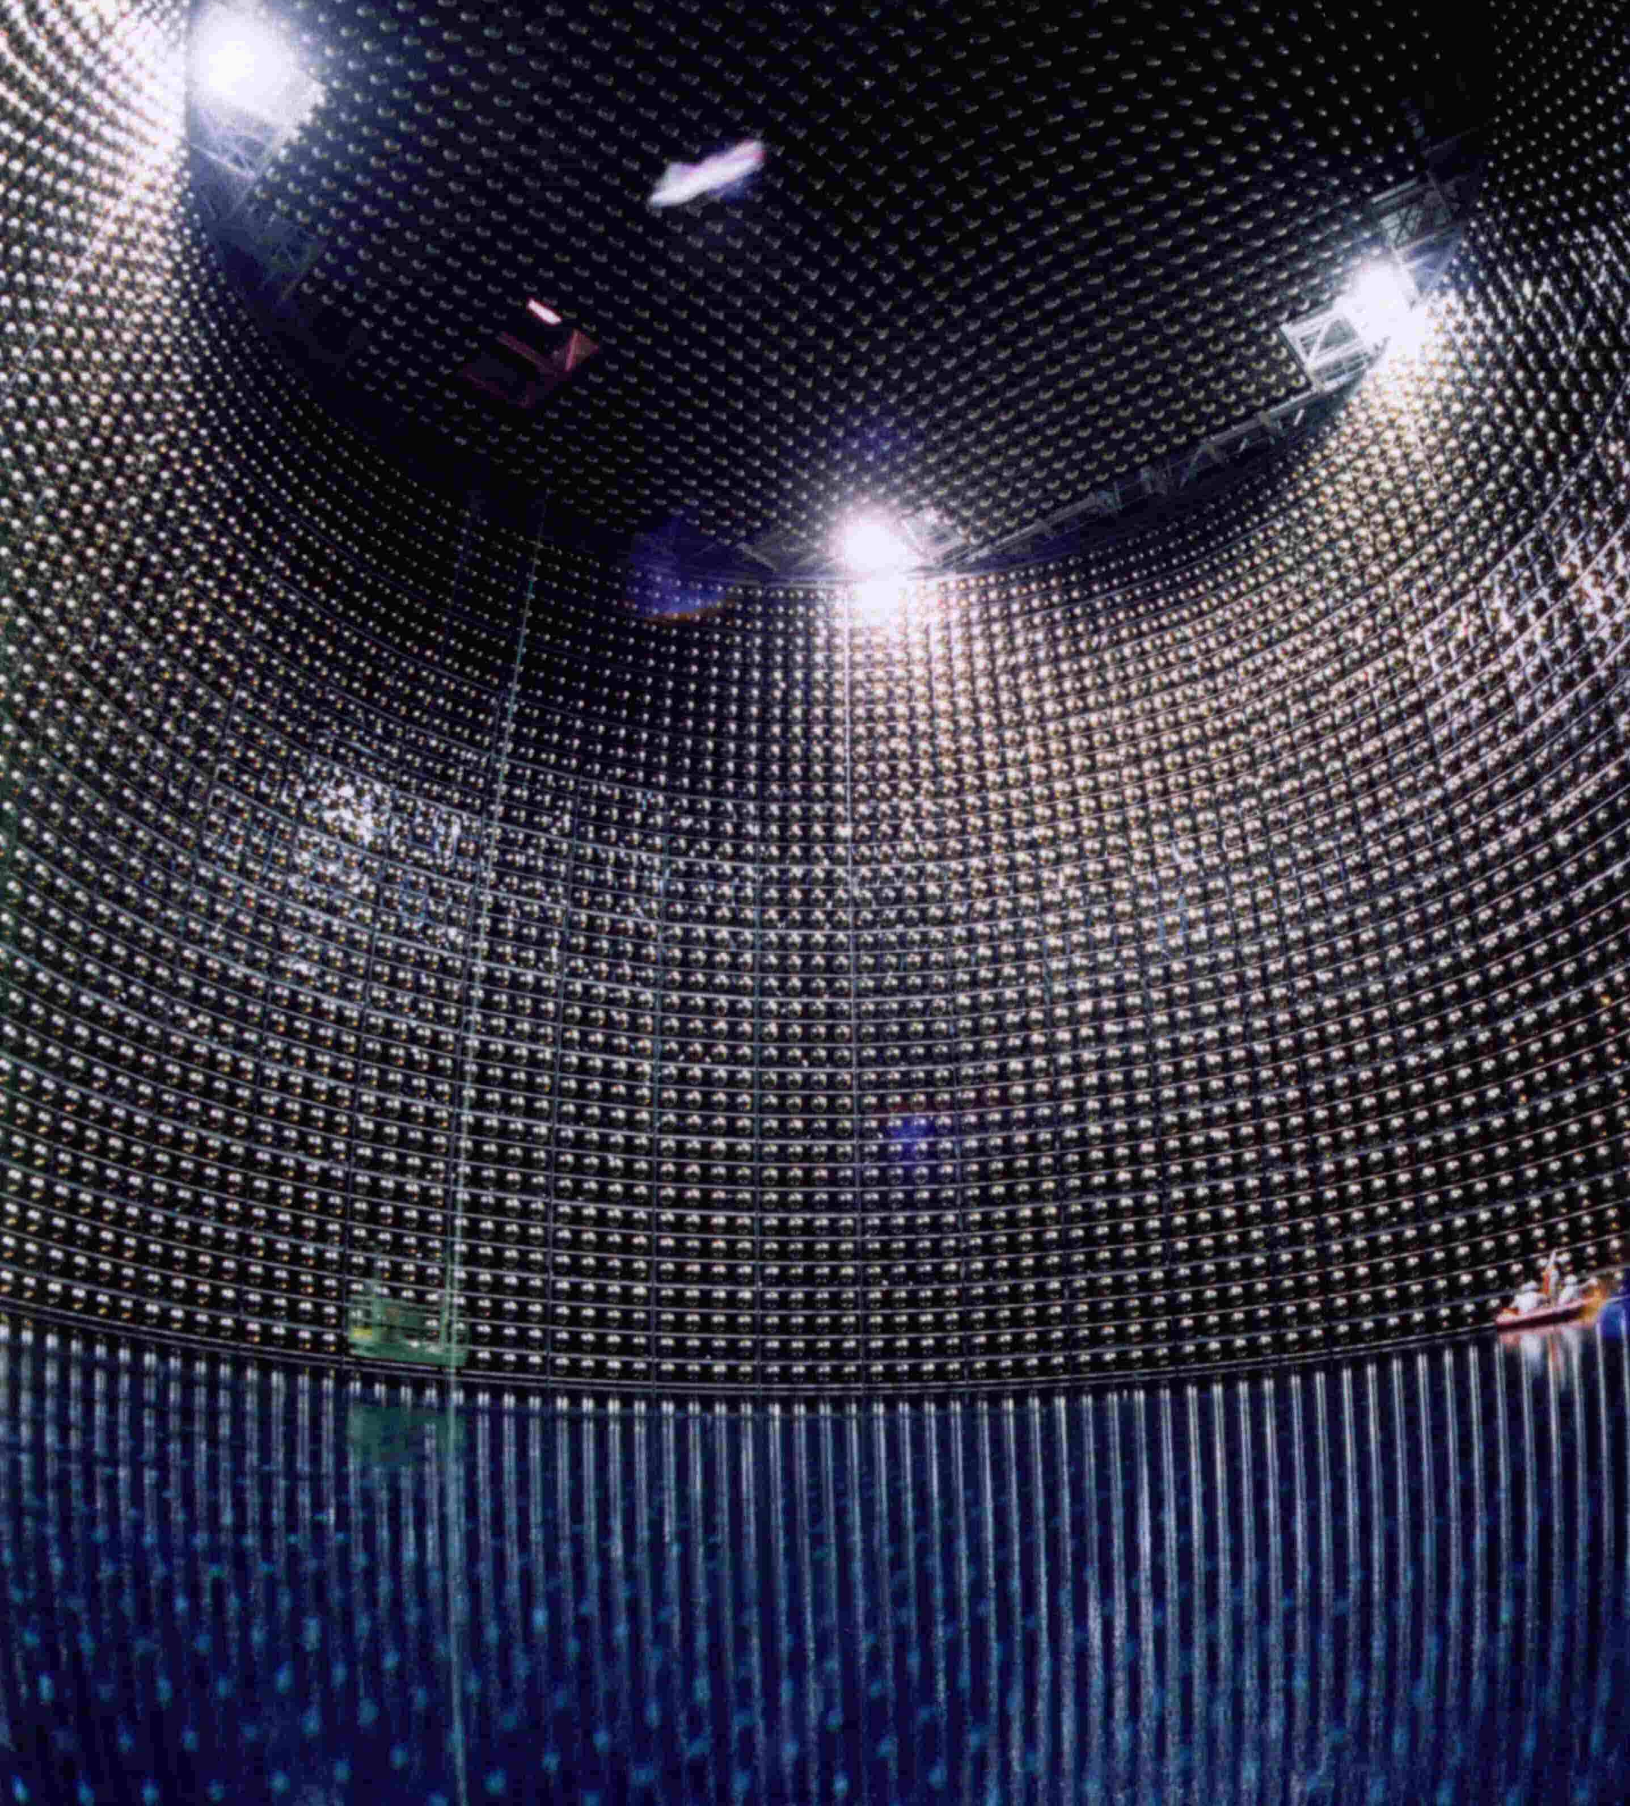
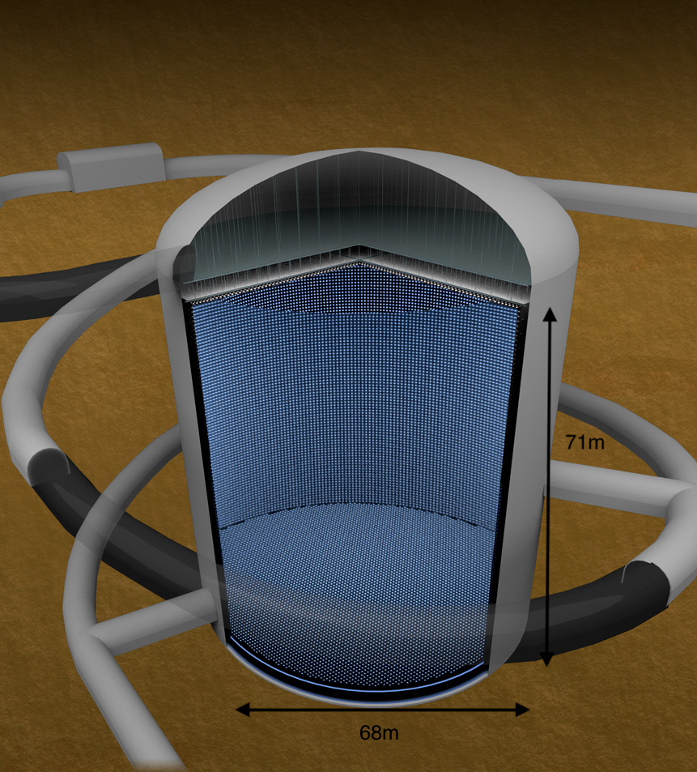
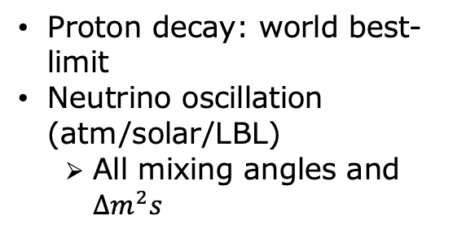
THREE GENERATIONS OF WATER CHERENKOV DETECTOR IN KAMIOKA:
Kamiokande
Super-Kamiokande
Hyper-Kamiokande
(1983-1996)
(1996 - ongoing)
(start operation in 2027)
Atmospheric and solar neutrino “anomaly”
Supernova 1987A
Proton decay: world best-limit
Neutrino oscillation (atm/solar/LBL)
  All mixing angles and $∆m^{2}s$
Extended search for proton decay
Precision measurement of neutrino oscillation including CPV and MO
Neutrino astrophysics
Birth of neutrino astrophysics
Discovery of neutrino oscillations
Explore new physics
Notes:
The Hyper-Kamiokande project will be 3rd generation of water Cherenkov detectors in Kamioka and aims at long-standing unresolved issues and new issues after the discovery of neutrino oscillations.

Slide 3
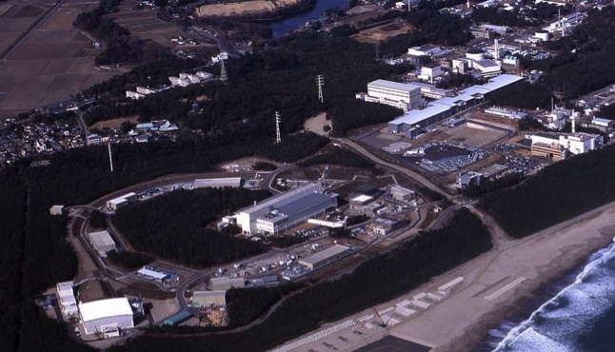
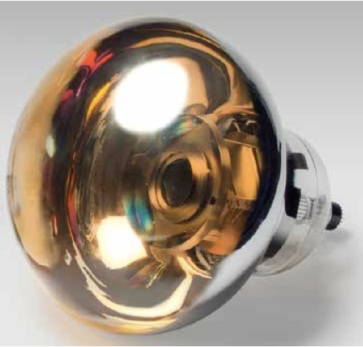
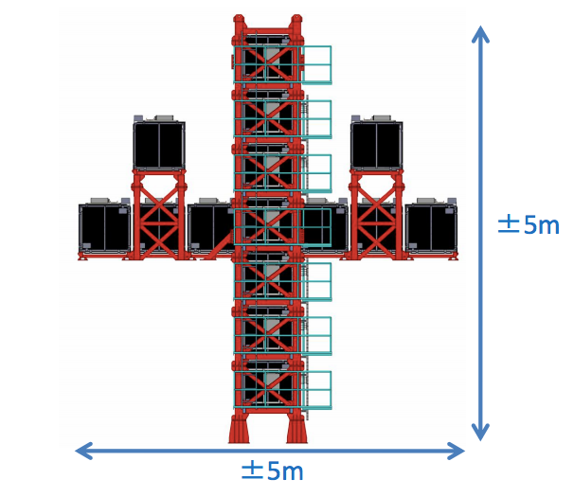
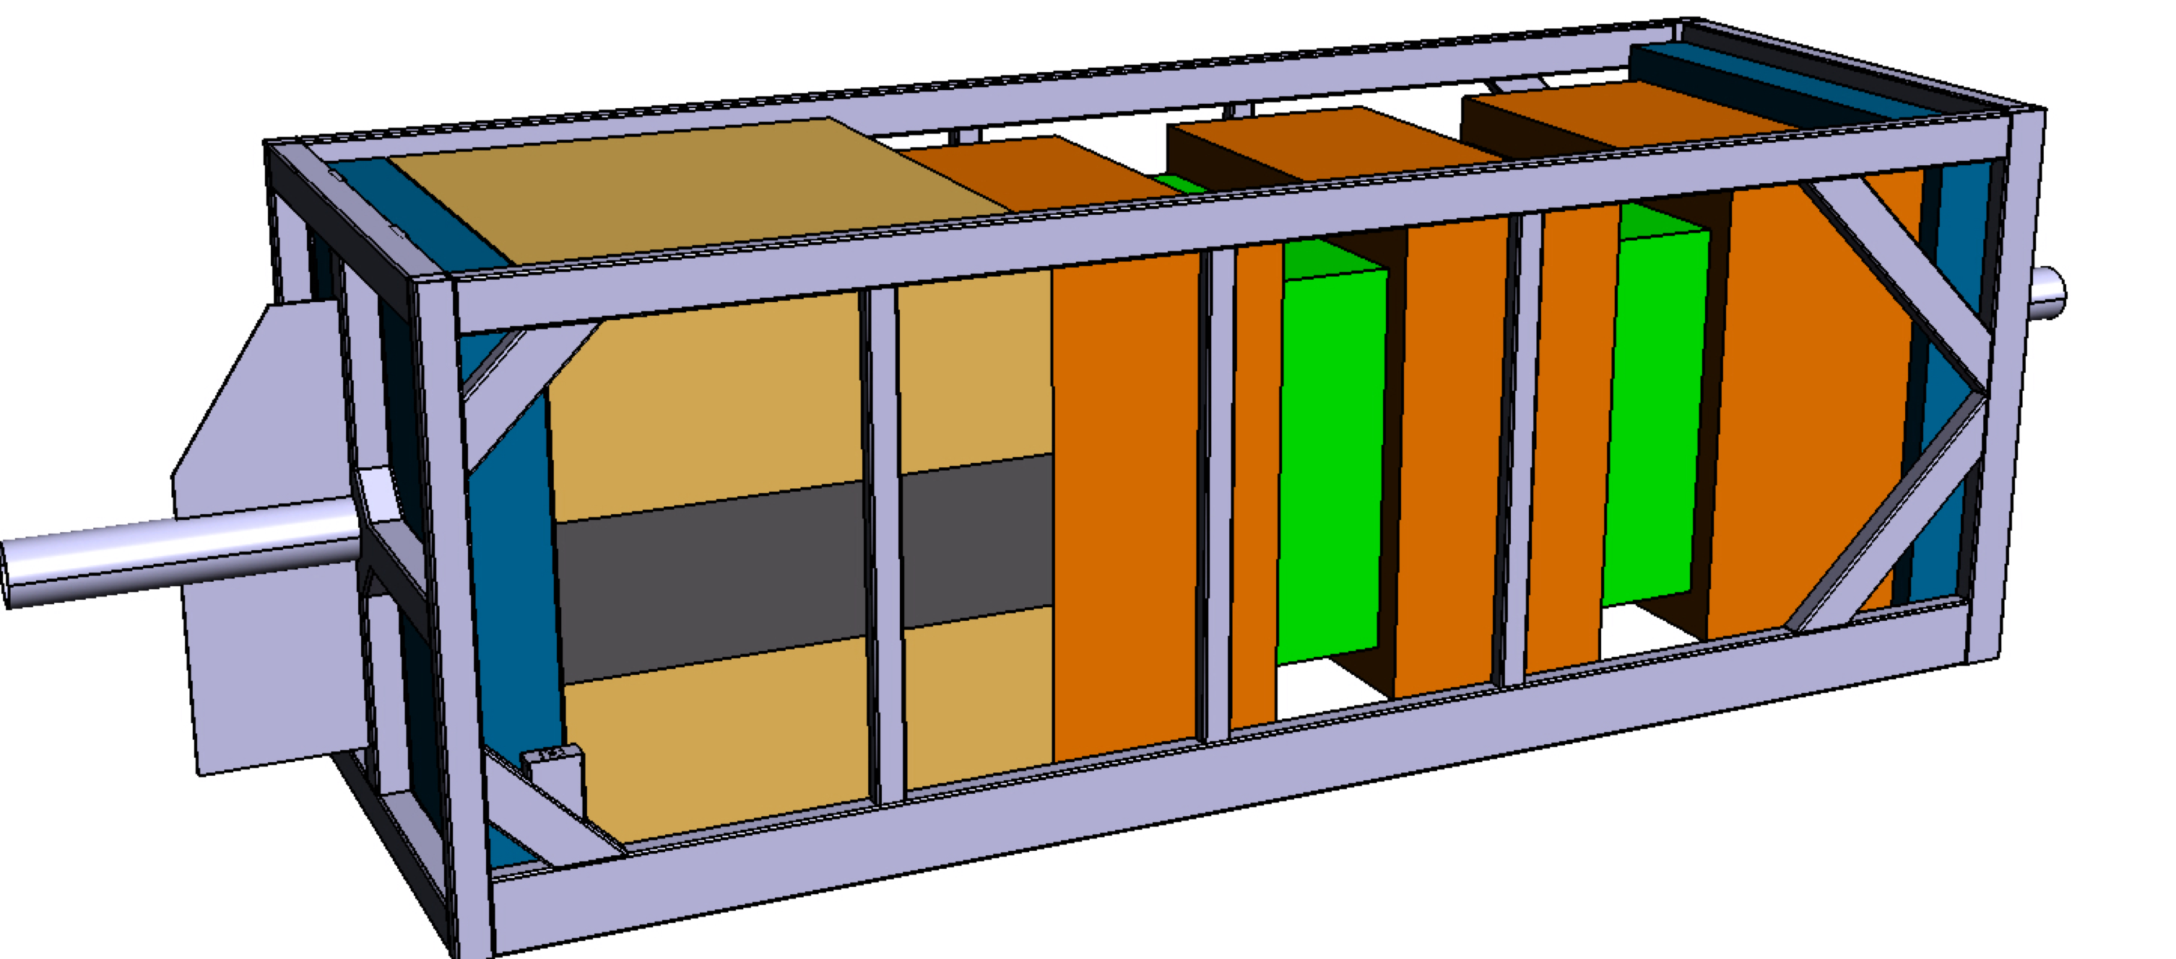
PROJECT IN A NUTSHELL:
Operation start in 2027
For Accelerator/Atmospheric/Solar/ Supernova neutrinos, and proton decays
High power proton beams
J-PARC
(hosted by KEK)
Double-sensitivity PMTs
295 km
~0.6GeV neutrinos
Hyper-Kamiokande
(hosted by the University of Tokyo)
1. World-largest detector for Nucleon-decay and Neutrino experiment
to be built with 190 kiloton fiducial mass (8.4 times larger than Super-K) and to be instrumented with double-sensitivity PMTs
2. World most-intense neutrino beam
J-PARC neutrino beam of 1.3 Mega Watt
  3. New and upgraded near detectors to control systematic errors
  Global science by state-of-the-art technologies w/ international partners
3

Slide 4
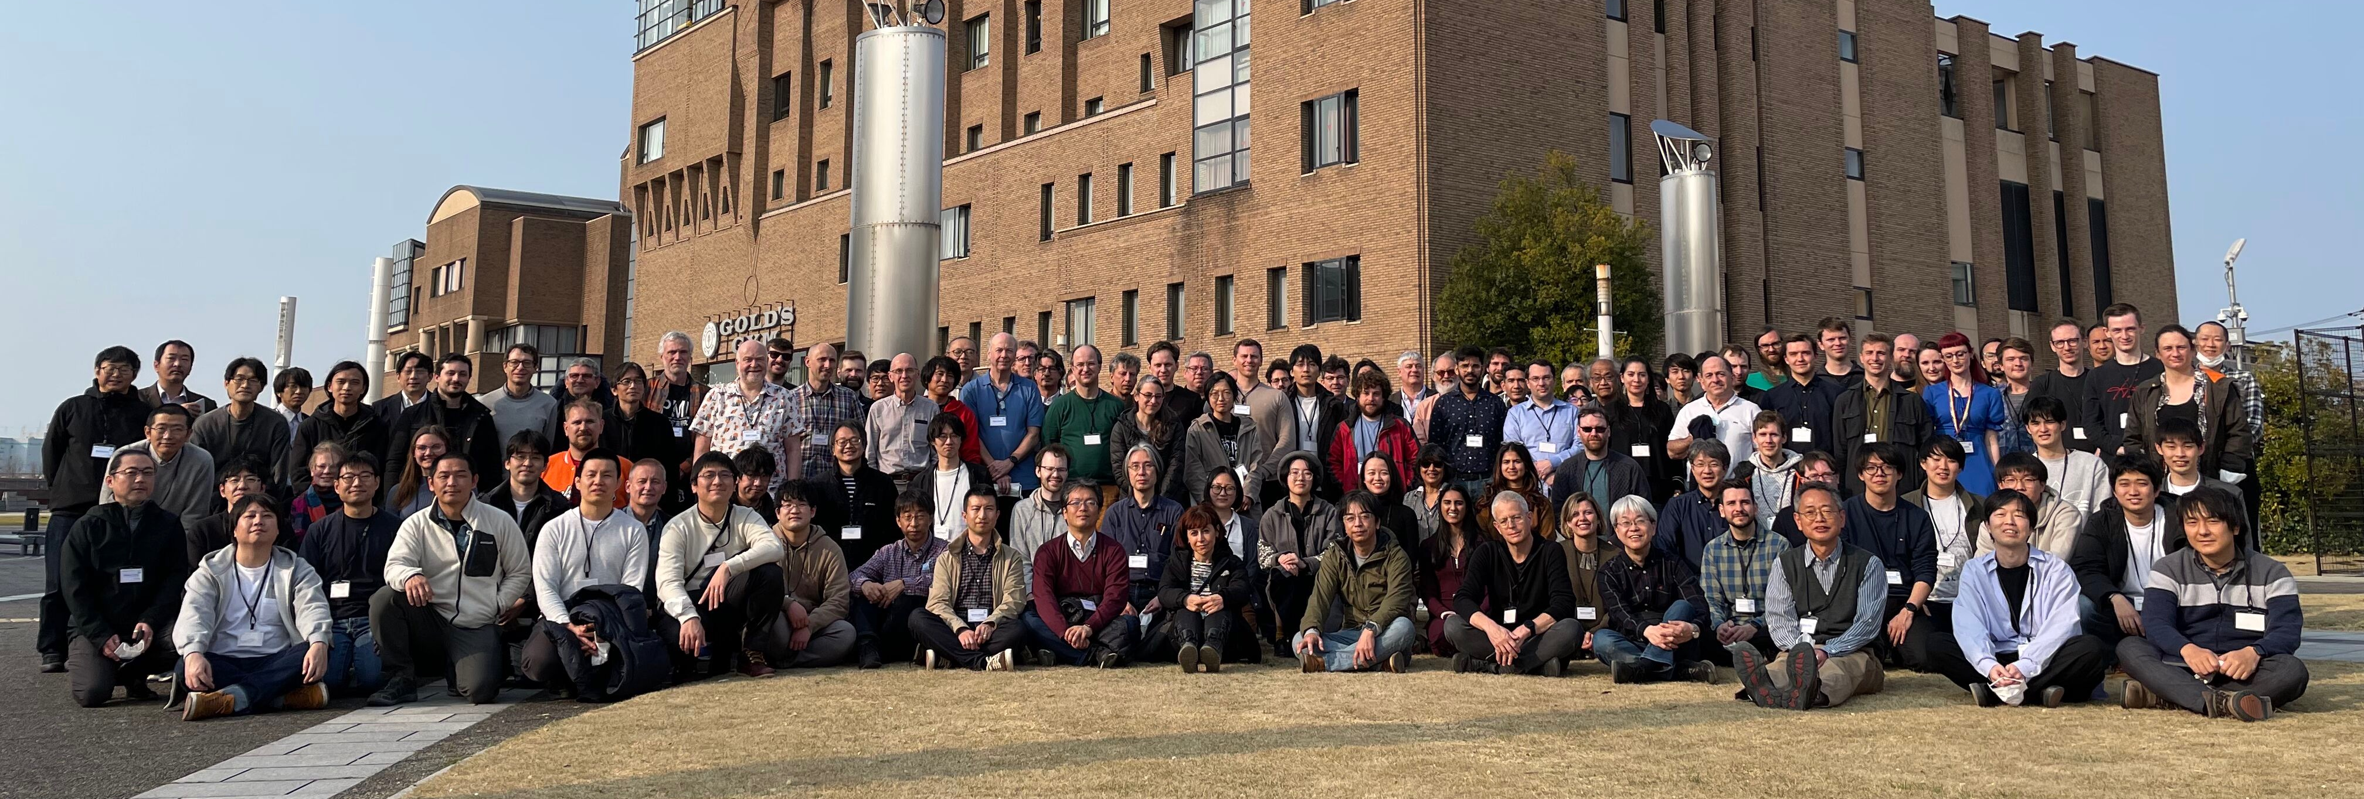
HYPER-K COLLABORATION
>500 collaborators from ~20 countries , 25% Japanese/75% non-Japanese
Univ. of Tokyo and KEK host the project
March 8, 2023 Collaboration Meeting @ Toyama
4

Slide 5
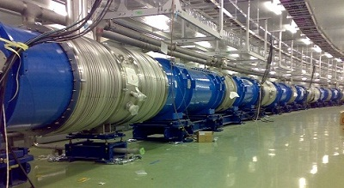
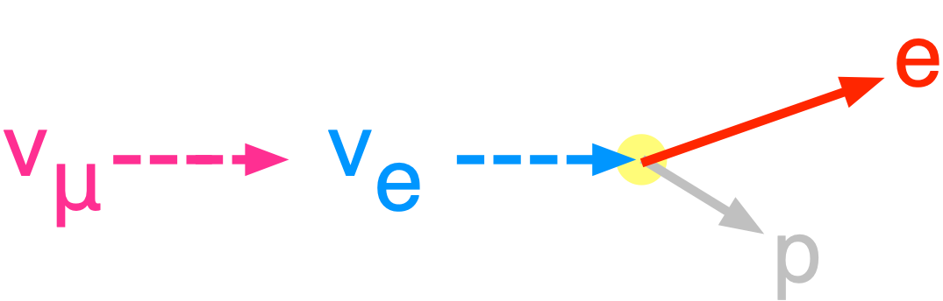
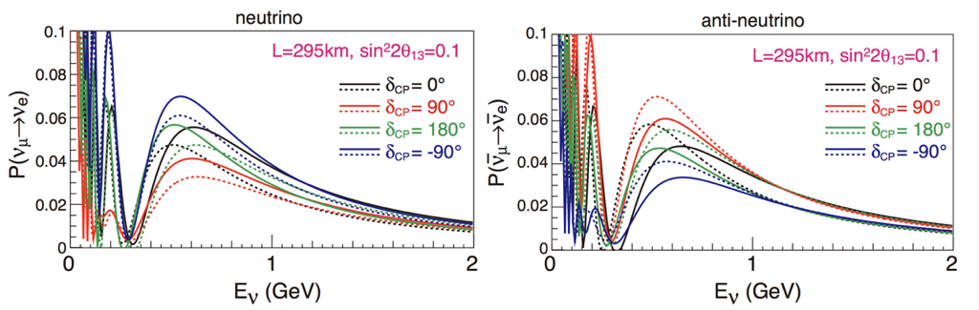
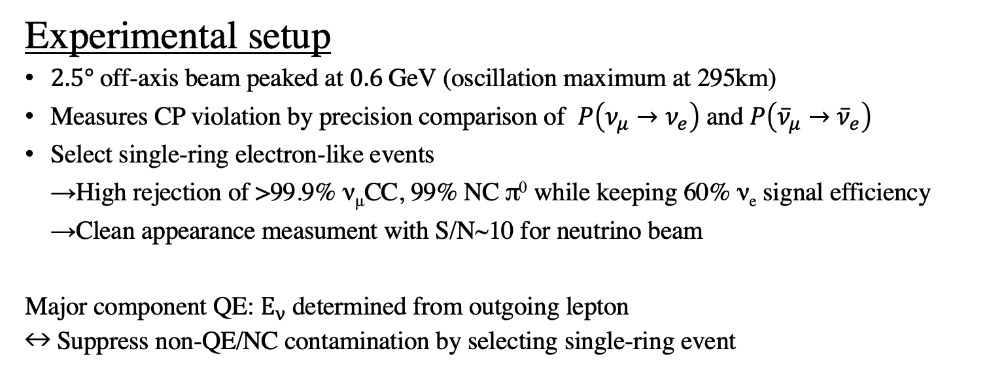
LONG-BASELINE MEASUREMENT WITH J-PARC NEUTRINO BEAM
Experimental setup
$2.5°$ off-axis beam peaked at $0.6 \text{GeV}$ (oscillation maximum at 295km)
Measures CP violation by precision comparison of $P\left(ν_{μ}→ν_{e}\right)$ and $P\left({\overline{ν}}_{μ}→{\overline{ν}}_{e}\right)$
Select single-ring electron-like events
→High rejection of >99.9% ν_{μ}CC, 99% NC π⁰ while keeping 60% ν_{e} signal efficiency
→Clean appearance measument with S/N~10 for neutrino beam
Major component QE: $E_{ν}$ determined from outgoing lepton
$↔$Suppress non-QE/NC contamination by selecting single-ring event
CCQE : νe + n → e + p
(dominant process at J-PARC beam energy)
Normal MO
Inverted MO
0.6
0.6
A few % statistical uncertainties after 10 years operation with >1000 $ν_{e}$ and ${\overline{ν}}_{e}$ signals
Projected sensitivity based on T2K systematics uncertainties + improvements for HK
5

Slide 6


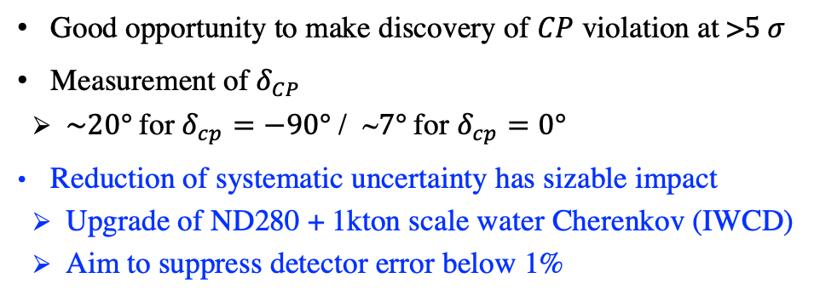



PRECISION MEASUREMENT OF NEUTRINO OSCILLATIONS
$$\text{1.3}\text{MW}, 10 \text{years}$$
$$δ_{CP}$$
Projected sensitivity to CPV
Fraction of $δ_{CP}$to exclude $\sin{δ_{CP}=0}$
Precision of $δ_{CP}$ measurement
Impact of syst.
after 10yr
Good opportunity to make discovery of $CP$ violation at >$5 σ$
Measurement of $δ_{CP}$
  $\sim 20°$for $δ_{cp}=−90°$ / ~$7°$for $δ_{cp}=0°$
Reduction of systematic uncertainty has sizable impact
  Upgrade of ND280 + 1kton scale water Cherenkov (IWCD)
  Aim to suppress detector error below 1%
$θ_{23}$ octant
6

Slide 7
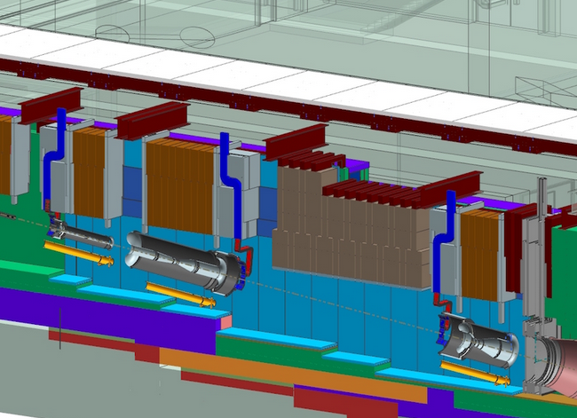
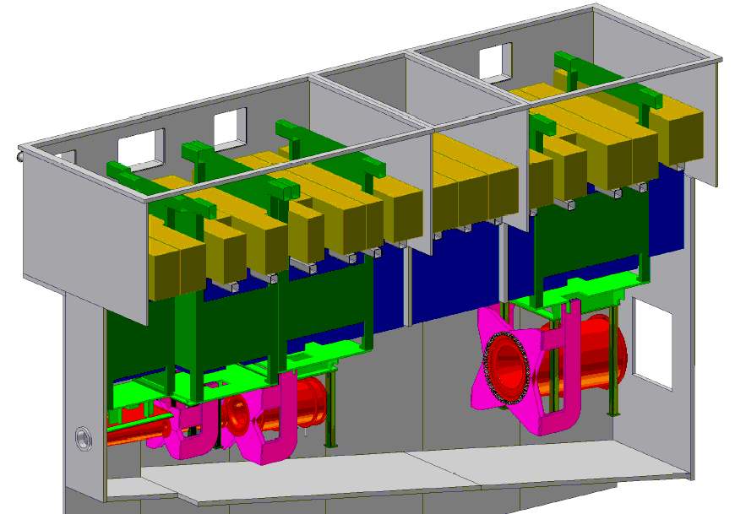
SYNERGY BTW HK AND DUNE:
Common scientific goals
  promoting neutrino oscillation science
    essential for the two programs to work together
High intensity proton accelerator and beamline
  beam dynamics, suppression of beam loss
  beam window, target and horn
    on-going collaboration under US-Japan program
Additional measurements and Analysis
  Neutrino cross section measurements
  Hadron production experiments for neutrino flux
    NA61(CERN) and EMPHATIC(Fermilab)
  Collaboration in analysis
    T2K-NOvA supported under US-Japan program
HK and DUNE can work together for common challenges.
7

Slide 8
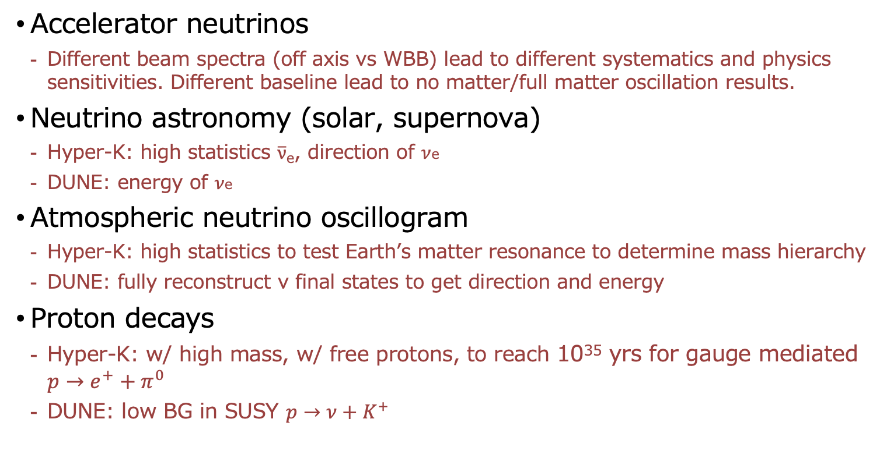
COMPLEMENTARITY:
Accelerator neutrinos
  Different beam spectra (off axis vs WBB) lead to different systematics and physics sensitivities. Different baseline lead to no matter/full matter oscillation results.
Neutrino astronomy (solar, supernova)
  Hyper-K: high statistics $\overline{ν}$_{e}, direction of $ν$e
  DUNE: energy of $ν$e
Atmospheric neutrino oscillogram
  Hyper-K: high statistics to test Earth’s matter resonance to determine mass hierarchy
  DUNE: fully reconstruct ν final states to get direction and energy
  Proton decays
  Hyper-K: w/ high mass, w/ free protons, to reach 10³⁵ yrs for gauge mediated $p→e^{+}+π^{0}$
  DUNE: low BG in SUSY $p→ν+K^{+}$
Need success of both experimenmts to get concrete results.
8

Slide 9
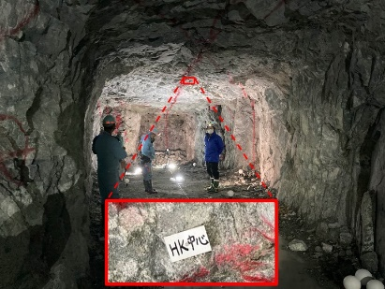
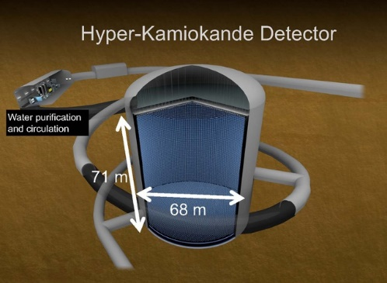
HYPER-K SCHEDULE:
The Hyper-K project has officially started in 2020.
Operation start in 2027.
JFY2020 | JFY2021 | JFY2022 | JFY2023 | JFY2024 | JFY2025 | JFY2026 | JFY2027 | JFY2028
PMT
installation
Preparation
Tunnel const.
Cavern
excavation
Tank
Const.
Operation
PMT production
PMT cases, Electromics etc.
Filling water
Water system
Power-upgrade of J-PARC and Neutrino Beam-line
Near Detector Facility, R&D, production
ND construction
9

Slide 10
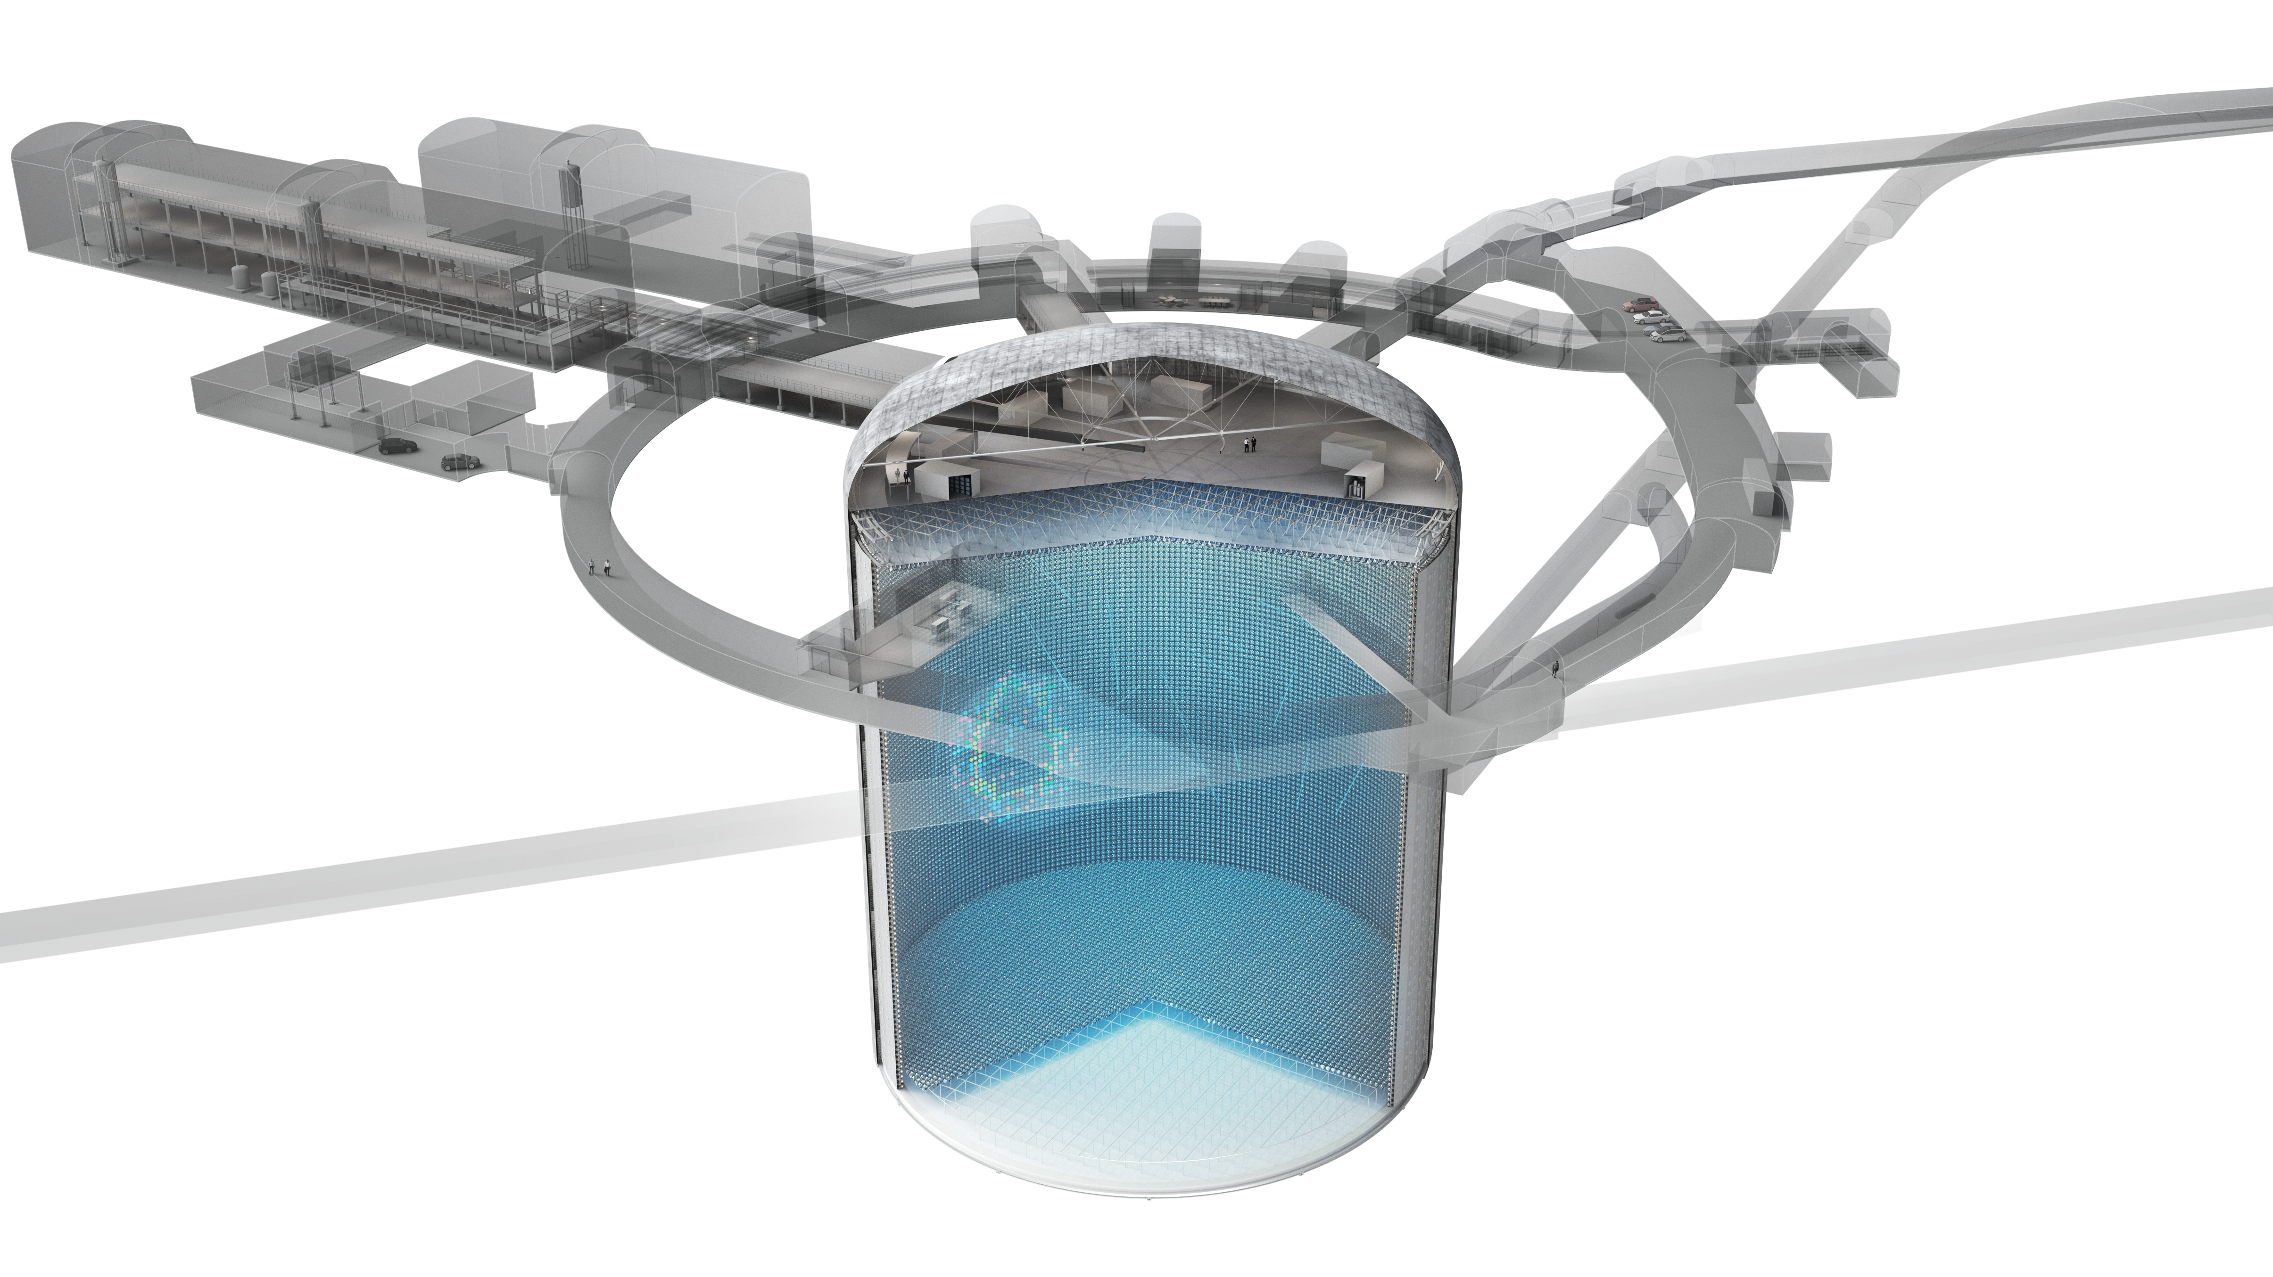
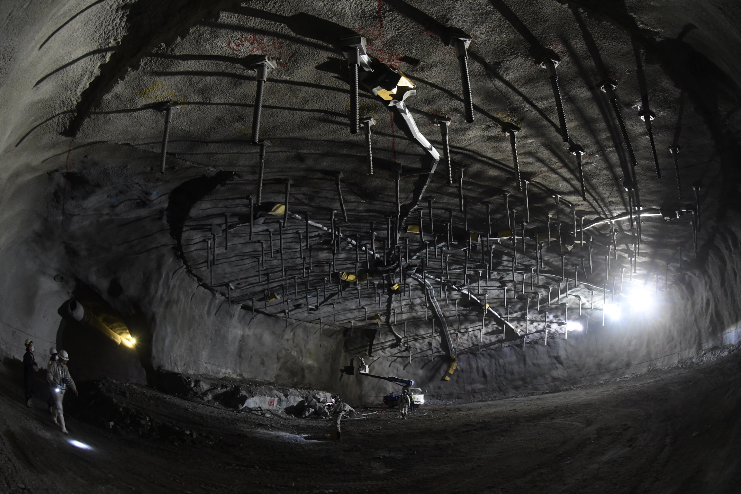
Good News:
Detector Cavern Excavation has started on schedule
FY2020 | FY2021 | FY2022 | FY2023 | FY2024 | FY2025 | FY2026 | FY2027 | FY2028
PMT
installation
Commissioning
Operation
Geo. survey
Tunnel const.
Cavern
excavation
Tank
Const.
71m (H)
Total Mass of Water
260 kiloton
69m (D)
Notes:
Today I am happy to share good news with you. That is detector cavern excavation has started on schedule at the very top of the cavern.

Slide 11
Top of the Detector Cavern
40m (D)
Top of the Detector Cavern
(14th March 2023)
11
Notes:
This photo was taken last week at the top of the detector cavern. This 40m diameter dome section is already comparable with the Super-K and will be extended to 70m within a year.

Slide 12
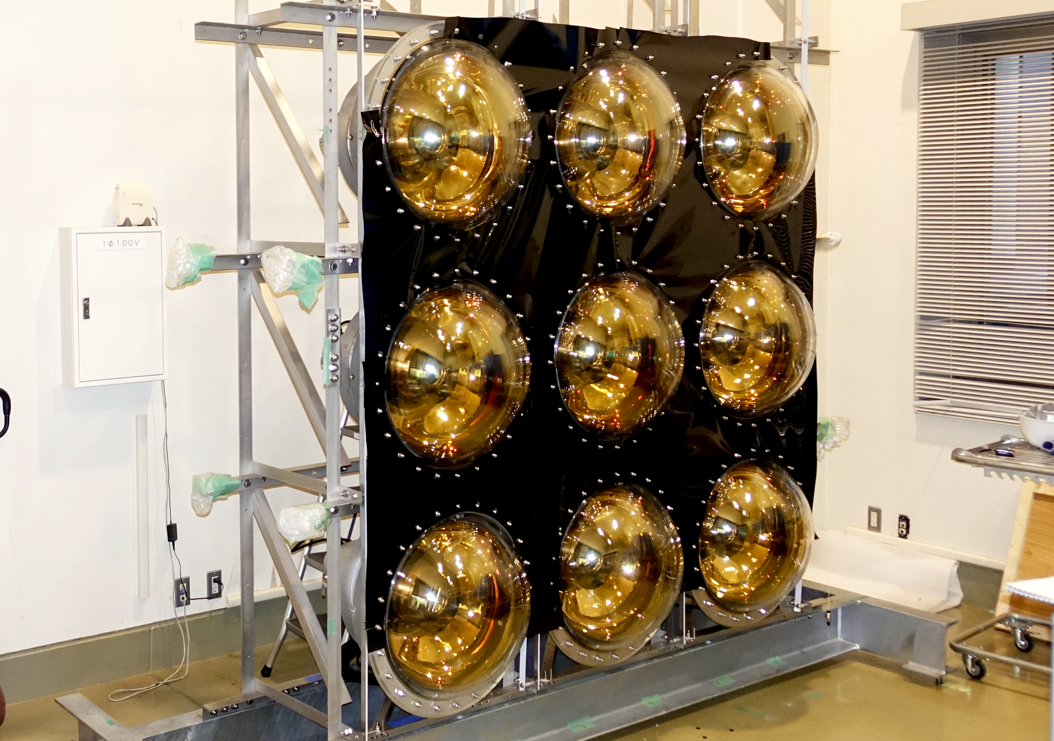
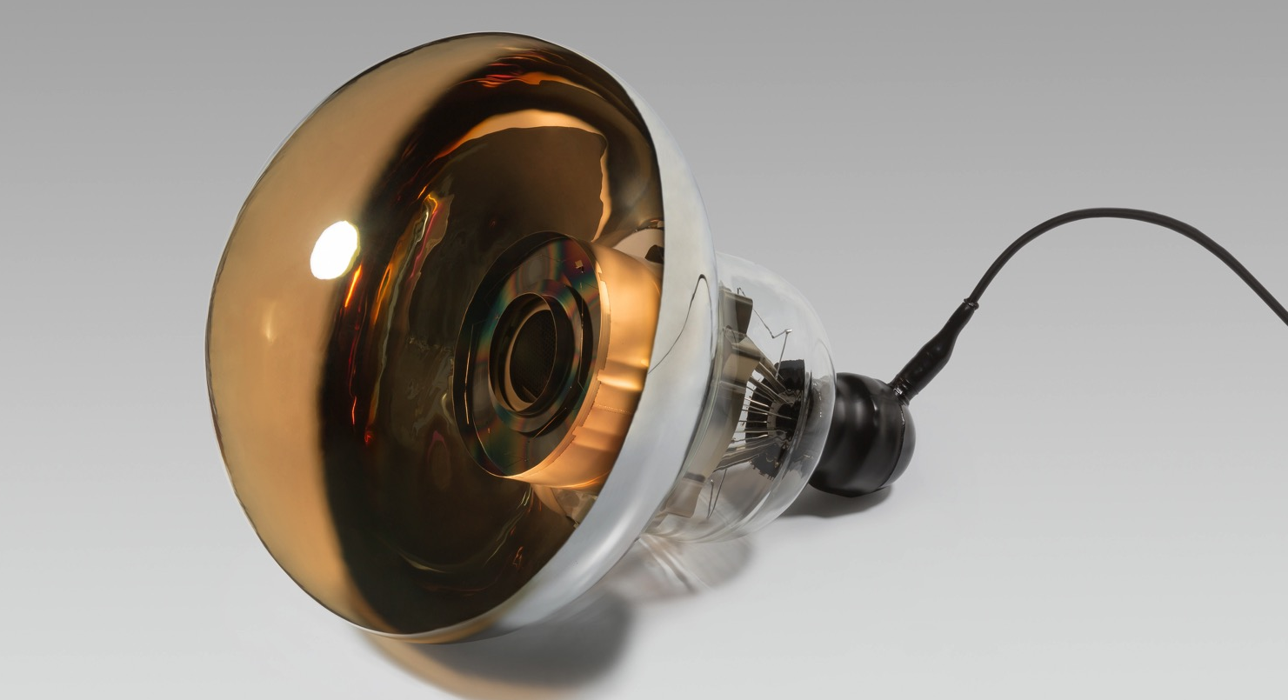
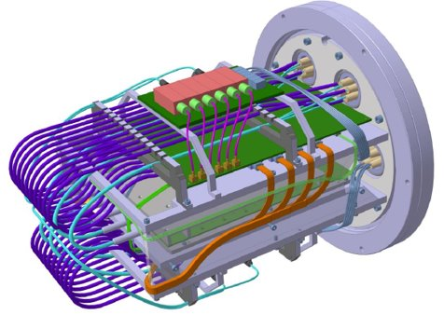
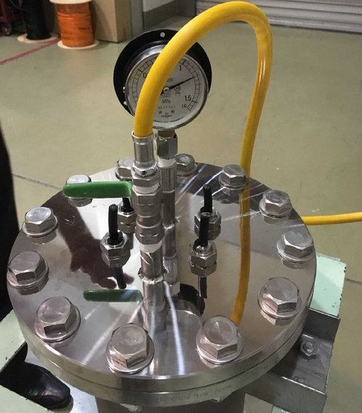
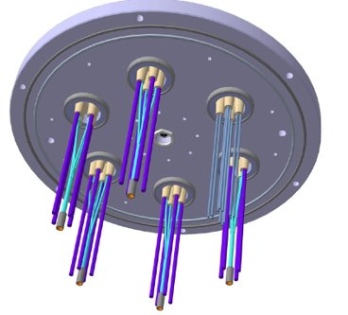
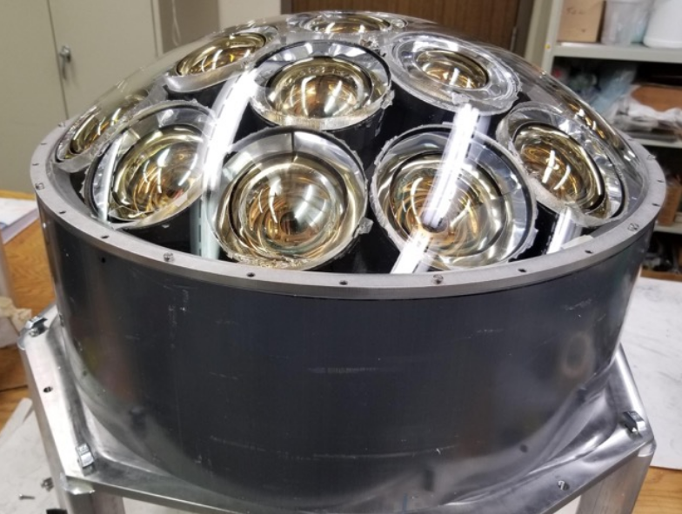
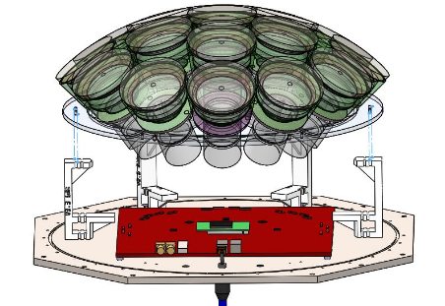
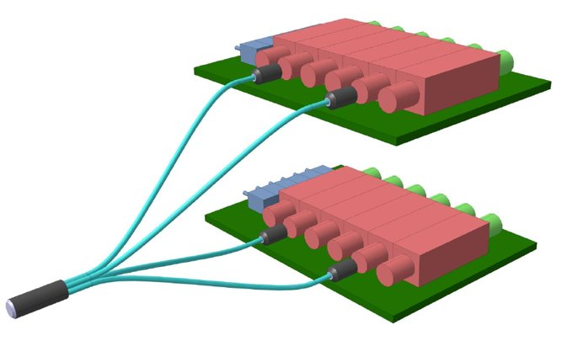
DETECTOR COMPONENT PRODUCTION ARE STARTING
PMT cover
X2 photon-yield than SK
ID mockup
Underwater electronics:
20 x 50 cm ID PMTs + 12 x OD PMTs
PMT cover
Feedthroughs
for ID and OD
Multi-PMT module:
(ref. KM3NeT)
OD signal + HV splitter
12

Slide 13
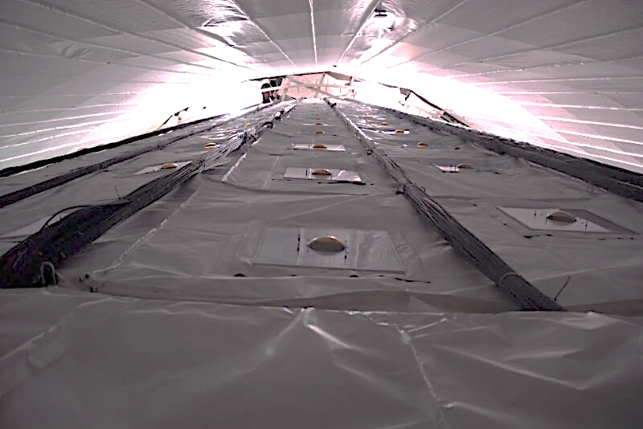
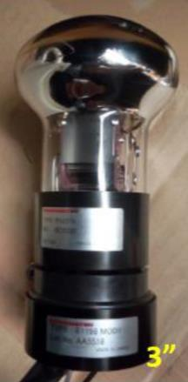
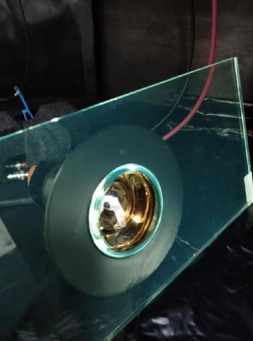
Outer Detector, example of where international contributions are expected
Outer detector: PMT+WLS plate
Outer Detector of Super-Kamiokande
Notes:
This is the photo of the Super-Kamiokande. The Outer Detector of Hyper-K will be wider and taller than this picture.

Slide 14
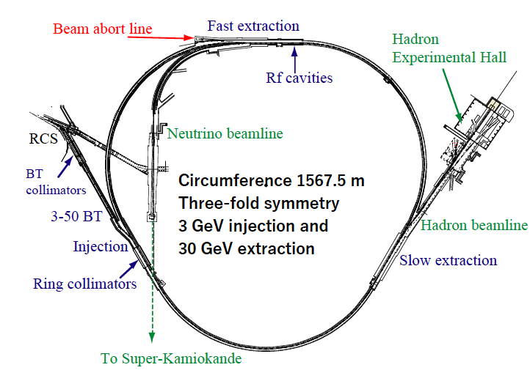
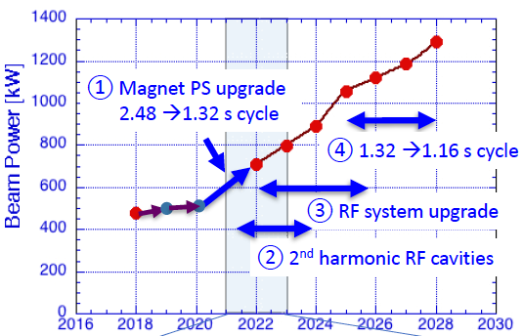
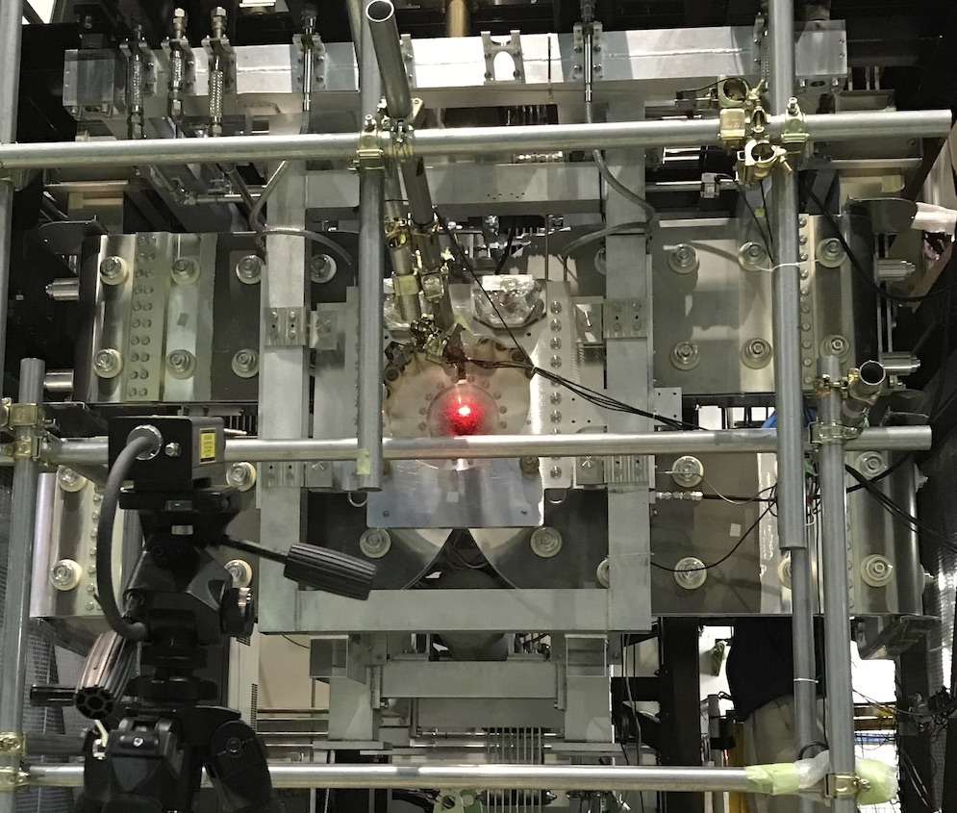
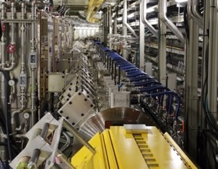
J-PARC upgrade
Beam Power upgrade from ~0.5 to 1.3 MW
J-PARC MR & neutrino beam-line upgrade towards 1.3MW are parts of HK project.
J-PARC-MR:
  MR magnet power supply upgrade
  ← Commissioning has been started in 2022.
  MR RF upgrade
  MR Fast Extraction Kicker upgrade, …
Neutrino beam-line:
  Upgrade of target, horn (250kA→320kA), beam monitors, …
  Facility upgrade (cooling, radiation protection, …)
J-PARC MR
& Hyper-Kamiokande
Upgraded horns for
neutrino beamline built
with US-JP collaboration
New main magnet PS for high rep. rate
MR-RF cavities
14
Notes:
intensity upgrade of J-PARC is steadily progressing as part of the HyperK project

Slide 15
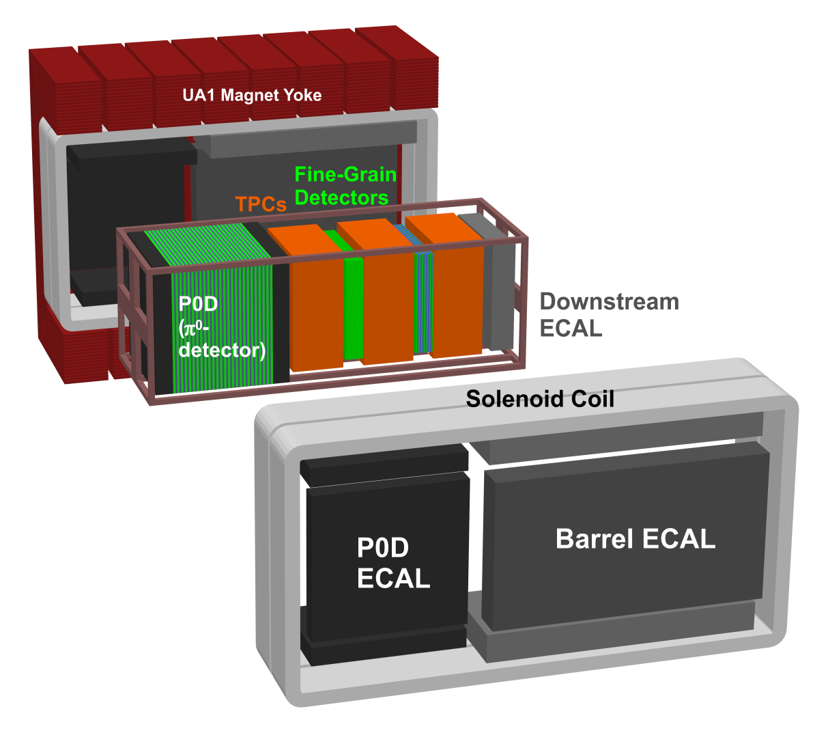
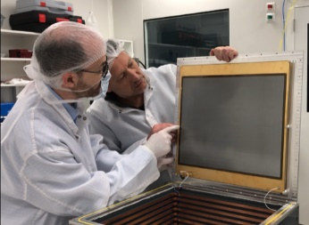
Near/Intermediate detectors
  Critical components to precisely understand J-PARC beam and neutrino interactions for lepton CPV search.
On-axis Detector
(INGRID)
Off-axis Magnetized Tracker
(ND280→Upgrade for T2K →Upgrade for HK)
Off-axis spanning intermediate water Cherenkov detector
(IWCD)
upgrade
HA TPC
3D neutrino detector
New for HK
On-axis detector: Measure beam direction and event rate
Off-axis magnetized tracker: Measure primary (anti)neutrino interaction rates, spectrum and properties. Charge separation to measure wrong-sign background
→ Upgrade by T2K experiment and Intensive discussion for further upgrade in HK-era is on-going.
Intermediate WC detector: H2O target with off-axis angle spanning orientation.
→ Detector site investigation and conceptual facility design is on-going.
Connection to FNAL and CERN: Beam test of prototype detectors, Hadron production measurements for precision determination of J-PARC neutrino flux, etc.
15

Slide 16
LOOKING FOR MORE FOREIGN CONTRIBUTIONS
Water system
  Pure water system adding up to 155 ton/hour (~30M USD)
  Gadolinium dope and its circulation system
Photosensors
  adding up to 20,000 50cm PMTs (~50M USD). Open to manufacturers other than Hamamatsu.
Outer Detector
  Critical to reject backgrounds in LBL, natural neutrinos, and proton decays
Calibration
  In-kind and intellectual contributions welcome to achieve better detector systematics than Super-K, e.g. energy uncertainty of <0.5%
Low-energy triggering
  Intelligent trigger to extend the lower energy end of solar neutrinos
Intermediate Water Cherenkov Detector
  Looking for movable tank mechanism, tank itself, water system, and outer detector (6M USD)
Accelerator (J-PARC) and beamline intensity upgrade
  history of accelerator lab collaboration
Notes:
We are looking for more foreign contributions to the HyperK, for example additional water system, additional photosensors, outer detector, precision calibration strategy, ltriggering, IWCD, beam upgrade, and so on.

Slide 17
US PARTICIPATION HISTORY
There is long and successful US-Japan partnership
  Merged IMB and Kamiokande forces on Super-K and we also collaborated on K2K and T2K. US participation in SK and T2K is continuing.
  US contributions to SK, K2K and T2K:
    outer detector
    calibration
    electronics
    low energy trigger system
    radon free air system
    T2K near detector and horns
    K2K near detectors and water system
  Successful collaboration in KamLAND
US participation and leadership in the Hyper-K are truly welcome

Slide 18
Snowmass LOI “The Hyper-Kamiokande Experiment” (arXiv:2009.00794)
*
*
*
*
*
*
*
J. Bian, F. Di Lodovico, S. Horiuchi, J. G. Learned, C. Mariani, J. Maricic, J. Pedro Ochoa Ricoux, C. Rott, M. Shiozawa, M. B. Smy, H. W. Sobel, R. B. Vogelaar (on behalf of the Hyper-Kamiokande Collaboration)
*
*
*
* interests from US
Snowmass White Paper “Hyper-Kamiokande Experiment” (arXiv:2203.02029)
Hyper-Kamiokande Collaboration: K. Abe, P. Adrich, H. Aihara, R. Akutsu, I. Alekseev, A. Ali, F. Ameli, L.H.V. Anthony, A. Araya, Y. Asaoka, V. Aushev, I. Bandac, M. Barbi, G. Barr, M. Batkiewicz-Kwasniak, M. Bellato, V. Berardi, L. Bernard, E. Bernardini, L. Berns, S. Bhadra, J. Bian, A. Blanchet, A. Blondel, A. Boiano, S. Bolognesi, L. Bonavera, S. Borjabad, T. Boschi, D. Bose, S .B. Boyd, C. Bozza, A. Bravar, C. Bronner, A. Bubak, A. Buchowicz, M. Buizza Avanzini, F. S. Cafagna, N. F. Calabria, J. M. Calvo-Mozota, S. Cao, M. G. Catanesi, S. Chakraborty, J. H. Choi, S. Choubey, M. Cicerchia, J. Coleman, G. Collazuol, S. Cuen-Rochin, M. Danilov, E. De la Fuente, P. de Perio, G. De Rosa, T. Dealtry, C. J. Densham, A. Dergacheva, N. Deshmukh, M. M. Devi, F. Di Lodovico, P. Di Meo, I. Di Palma, T. A. Doyle, E. Drakopoulou, O. Drapier, J. Dumarchez, L. Eklund, S. El Hedri, J. Ellis, S. Emery, A. Esmaili, S. Fedotov, J. Feng, E. Fernández-Martinez, P. Ferrario, B. Ferrazzi, A. Finch, C. Finley, G. Fiorillo, M. Fitton, M. Friend, Y. Fujii, Y. Fukuda, G. Galinski, J. Gao, C. Garde, A. Garfagnini, S. Garode, L. Gialanella, C. Giganti, J. J. Gomez-Cadenas, M. Gonin, J. González-Nuevo, A. Gorin, R. Gornea, F. Gramegna, M. Grassi, G. Grella, M. Guigue, D. R. Hadley et al. (290 additional authors not shown)

Slide 19
SUMMARY:
Hyper-K has started its construction and is on schedule. Experiment will start in 2027.
Synergy and Complementarity between Hyper-K and DUNE.
We would like to contribute to the world-wide effort to make a strong particle physics and astronomy program.
US participation and leadership in the Hyper-K are truly welcome.
19

Slide 20
supplements

Slide 21

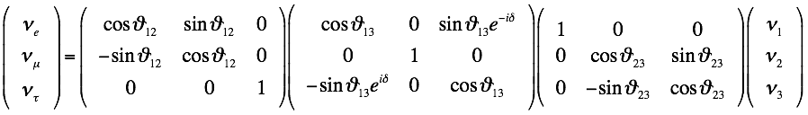
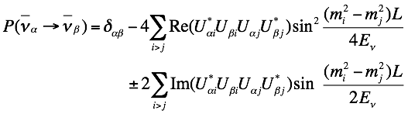
Neutrino Oscillations
U^{MNS}: Maki-Nakagawa-Sakata matrix
( )
( )
Matter-effect is omitted here
( )
Neutrino Oscillation Parameters: 6 = 4 matrix elements and 2 mass-squared differences
θ23~45±5º
Δm²23=2.4×10⁻³eV²
Atmospheric, Accelerator Neutrinos
θ12~34±3º
Δm²21=7.6×10⁻⁵eV²
Solar, Reactor Neutrinos
θ13~9º
Accelerator, Reactor Neutrinos
δ=unknown
Accelerator, Atmospheric Neutrinos
Mass Hierarchy or Mass Ordering (Δm²32=m²3-m²2>0 or Δm²32<0) is unknown
Octant of θ23 or θ23=π/2 is also interesting question
21

Slide 22
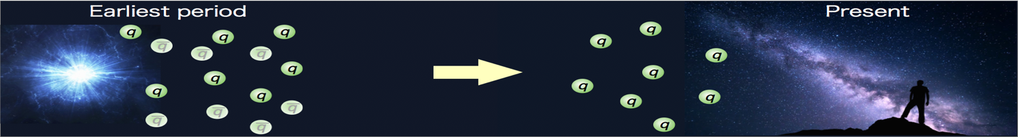
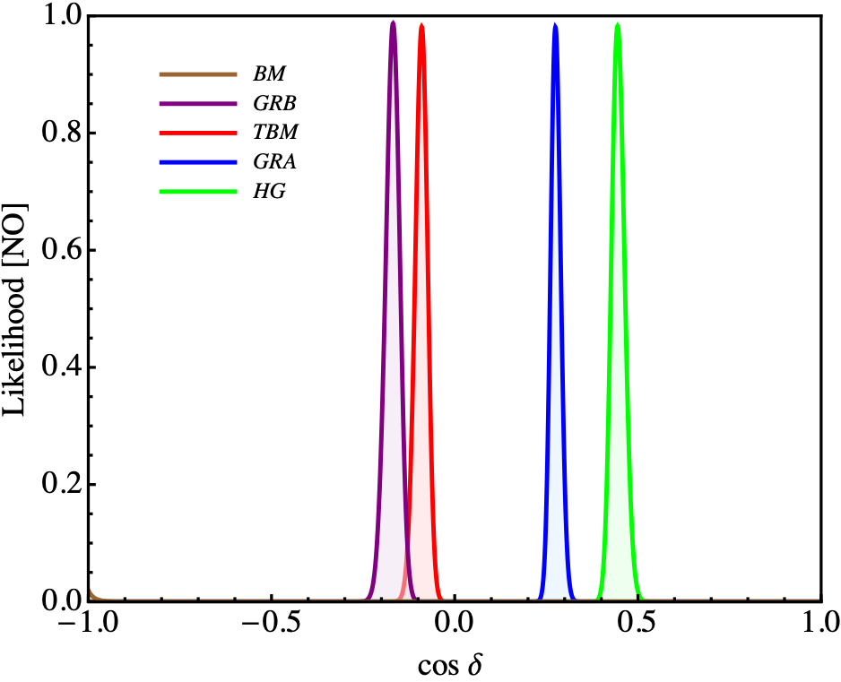
Only known CPV source=KM phase of quarks
Other CPV necessary for the matter-dominated universe
→ Search for CPV in lepton sector
Leptogenesis scenario only with ν’s Dirac CP phase
S. Pascoli et al., PRD 75, 083511 (2007)
PDG review 2014
|sinδCP| >~0.6
Flavor symmetry prediction on δCP
e.g. Petcov 1504.02402v1 (right plot)
Likelihood
We need not only CPV discovery, but also precision measurement to test hypotheses.
-1.0 -0.5 0.0 0.5 1.0
cosδ
22

Slide 23
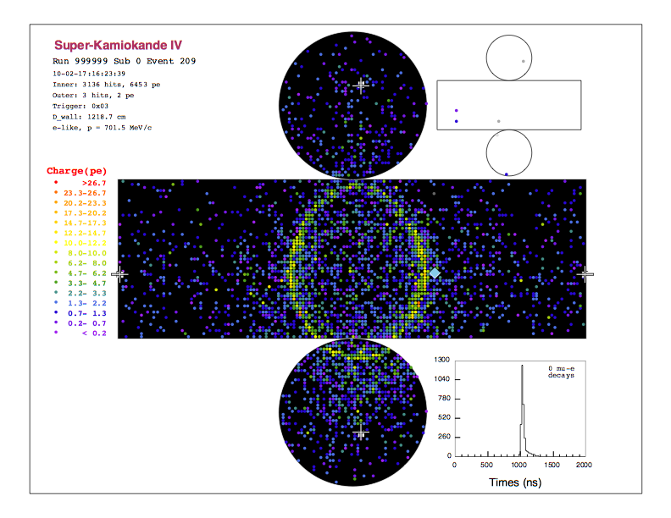
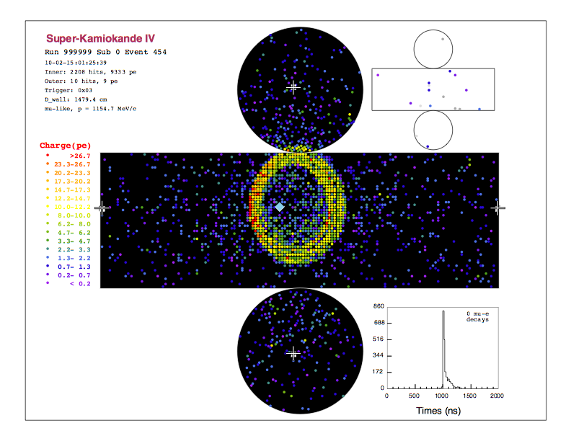
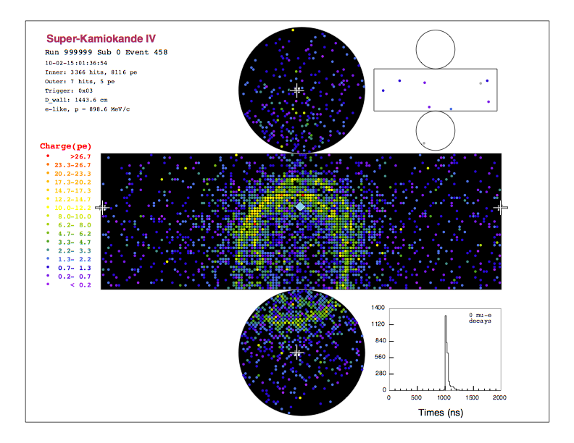
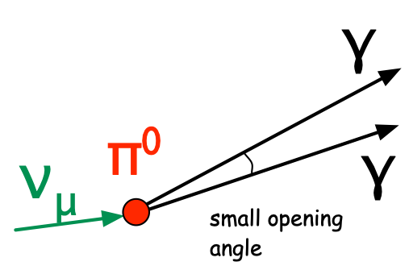
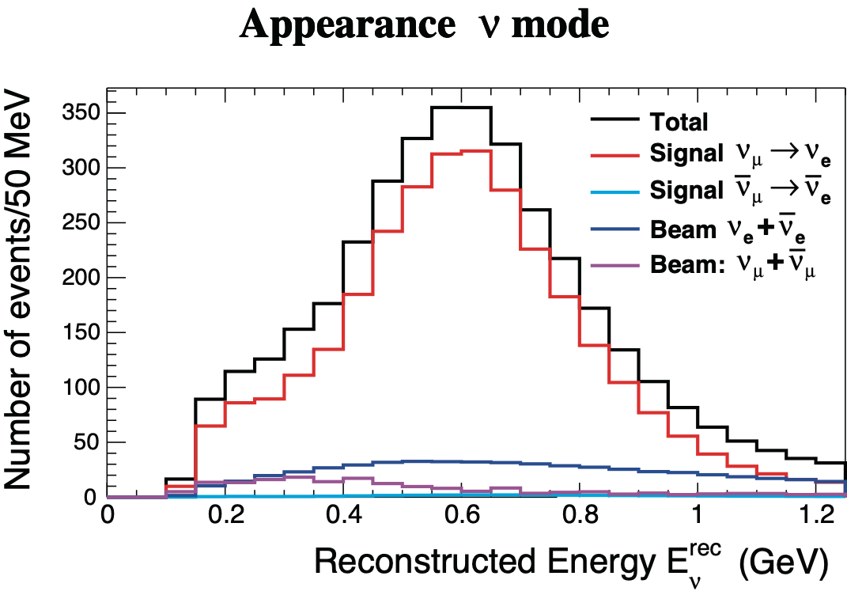
J-PARC νμ (νμ) beam (~0.6GeV)
νe appearance signal = single e event
CCQE : νe + n → e + p
(dominant process at J-PARC beam energy)
νe CC
simulation
νμ CC
simulation
NC 1π⁰
simulation
e
μ
π⁰→γγ
J-PARC νμ→νe
High background rejection
  >99.9% νμCC, 99% NC π⁰ rejection
  keeping 60% νe signal efficiency
Unique CPV measurement
  High statistical, clean (S/N~10)
  Simple Eν reconstruction by charged lepton kinematics (for CCQE)
  Less matter effect (fake CPV effect)
S/N~10

Slide 24
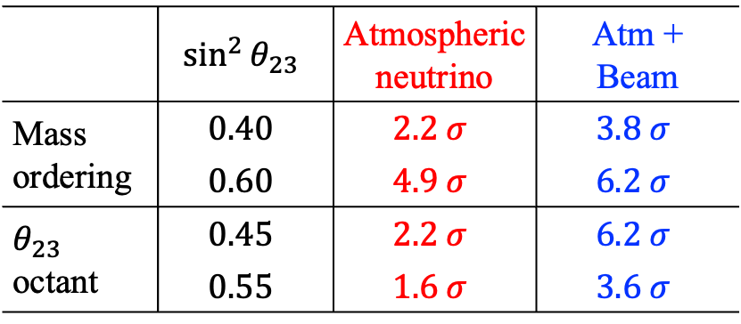

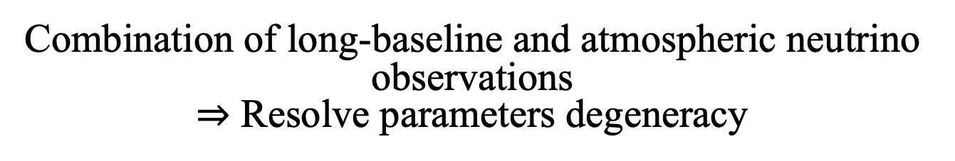

Strategy of oscillation measurement at Hyper-Kamiokande
Combination of long-baseline and atmospheric neutrino observations
$⇒$ Resolve parameters degeneracy
 | $$\sin^{2}{θ_{23}}$$ | Atmospheric neutrino | Atm + Beam
Mass ordering | $$0.40$$ | $$2.2 σ$$ | $$3.8 σ$$
 | $$0.60$$ | $$4.9 σ$$ | $$6.2 σ$$
$θ_{23}$ octant | $$0.45$$ | $$2.2 σ$$ | $$6.2 σ$$
 | $$0.55$$ | $$1.6 σ$$ | $$3.6 σ$$
Beam
Atm-$ν$
Atm-$ν$+Beam
$10 \text{years} \text{with} 1.3\text{MW}$, normal mass ordering is assumed
Atmospheric neutrino: sensitive to mass ordering by Earth’s matter effects
→ Constraints on mass ordering enhance sensitivity to CP violation by long-baseline
24

Slide 25






Precision measurement of neutrino oscillations
$$\text{1.3}\text{MW}, 10 \text{years}$$
$$δ_{CP}$$
Projected sensitivity to CPV
Fraction of $δ_{CP}$to exclude $\sin{δ_{CP}=0}$
Precision of $δ_{CP}$ measurement
Impact of syst.
after 10yr
Good opportunity to make discovery of $CP$ violation at >$5 σ$
Measurement of $δ_{CP}$
  $\sim 20°$for $δ_{cp}=−90°$ / ~$7°$for $δ_{cp}=0°$
Reduction of systematic uncertainty has sizable impact
  Upgrade of ND280 + 1kton scale water Cherenkov (IWCD)
  Aim to suppress detector error below 1%
$θ_{23}$ octant
25

Slide 26



Nucleon Decay Searches
Test of Grand Unified Theories (GUT)
  Look for direct transition of quarks to leptons→Direct test of GUT
  Unique (Unreachable by colliders)
Grand Unification?
p→e⁺π⁰: Dominant decay mode predicted by many general GUT
  HK’s high mass and unbound proton will enable us to reach (τproton / Br) ~10³⁵ years
Proton decays !
p→e⁺π⁰
Ambitious physics goals
  Determination of GUT scale
  Gauge symmetry group, test of SUSY models

Slide 27



WATER CHERENKOV DETECTOR:
Muon
Electron
Cherenkov ring
  Particle identification (>99% efficiency for $μ/e$ separation)
  Momentum reconstruction (energy and direction)
Unbound proton for high sensitivity proton decay searches
Scalable to larger mass $⇒$ rare process (proton decays and neutrinos)
Well established technology $→$ next slide

Slide 28




Motivation of Nucleon Decay Searches
Only way to directly prove GUT
Two major modes predicted by many models
Mediated by gauge bosons
SUSY mediated
p→e⁺π⁰
p→νK⁺
We need to pursue both decay modes for discovery, given the variety of predictions
※Searches for other modes are also important
28

Slide 29

Strong cases
We could identify details of unification picture, e.g. gauge group and other symmetries
  Γ(n→νπ⁰)/Γ(p→e⁺π⁰) depends on SU(5), SO(10), E6 (Y. Muramatsu)
Γ(p→μ⁺K⁰)/Γ(p→e⁺π⁰)
E6
SU(5)
SO(10)
Γ(n→νπ⁰)/Γ(p→e⁺π⁰)
P-decay Br. ratio could extract flavor structure of SUSY particles.
  Decay branches depends on the size of sfermion mixing. (N.Nagata and S.Shirai, JHEP 1403, 049 (2014))
10³⁵
10³⁴
1/Γ(p→νK+) [year]
Super-K
sfermon mixing
29

Slide 30




p→e⁺π⁰ discovery in Hyper-K
p→e⁺π⁰ Invariant Mass
Invariant proton mass would be a compelling evidence
Reach to 10³⁵ yrs
BG free search possible: 0.06 BG/Mton・year
τproton=1.7×10³⁴years (SK limit)
Signal
10 years
background
Invariant Proton Mass (MeV/c²)
p→e⁺π⁰ 3σ discovery
10³⁵
10³⁴
10³³
Hyper-K
 | ptot<100MeV/c |  | 100<ptot<250MeV/c
 | Sig. ε(%) | Bkg (/Mtyr) | Sig. ε(%) | Bkg (/Mtyr)
HK | 18.7 | 0.06 | 19.4 | 0.62
Super-K
Proton lifetime [years]
Liq-Ar 40kton
2020 2030 2040
years

Slide 31




p→νK⁺ discovery in Hyper-K
arXiv:1805.04163
τproton=6.6×10³³years (SK 90% CL limit)
K+ is invisible so signal signature are:
  236 MeV/c muon
  π⁺π⁰
Discovery reach to 3 ×10³⁴ years
monochromatic μ⁺
from K⁺→μ⁺ν
Number of events
BG
200 250 300 350
Muon momentum (MeV/c)
K⁺ mass from
K⁺→π⁺π⁰
 | prompt-γ & K⁺→μ⁺ν |  | K⁺→π⁺π⁰
 | Sig. ε(%) | Bkg (/Mtyr) | Sig. ε(%) | Bkg (/Mtyr)
HK | 12.7 | 0.9 | 10.8 | 0.7
Number of events
BG
400 500 600 700
Invariant Kaon mass (MeV/c2)

Slide 32







Neutrino astrophysics
Observation of $\sim 10 \text{MeV}$ neutrinos with the time, energy and direction
  Unique role in multi-messenger observation
  Sensitivities depend on the energy thresholds
Solar neutrinos (~130/day): up-turn at vacuum-MSW transition region, D/N, hep $ν$
Supernova burst (~50k/burst): explosion mechanism, BH/NS formation, alert with $1°$ pointing
Supernova Relic Neutrino (~10/yr): stellar collapse, nucleosynthesis and history of the universe
Up-turn
$\sim 3σ$ at 4.5MeV threshold
$\sim 5σ$ at 3.5MeV threshold
Modulation induced by SASI
statistical fluctuation in HK
SN direction
$\sim 70\text{k} ν^{′}s$ at 10kpc
M. Maltoni et al., Phys. Eur. Phys. J. A52, 87 (2016)

