Slide 1
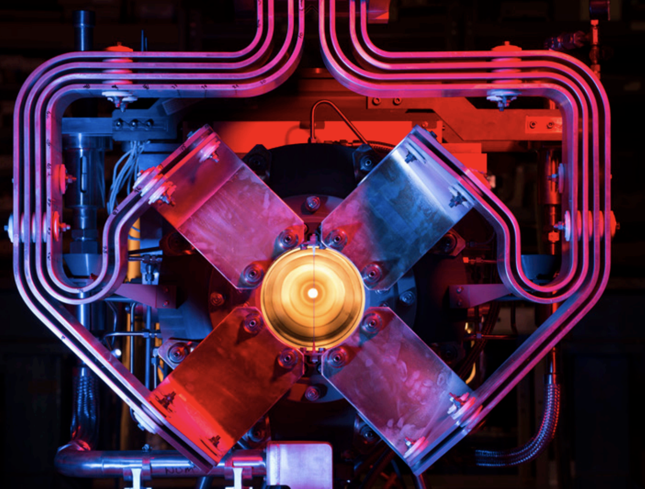
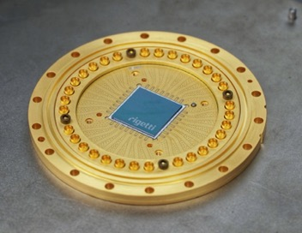
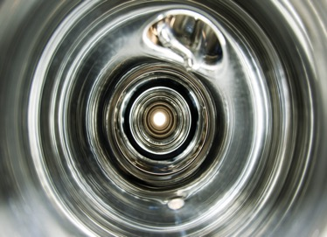
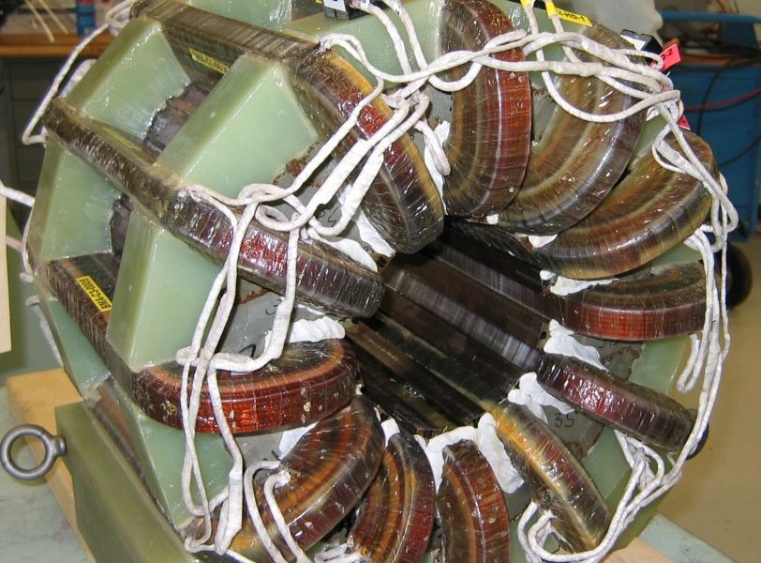
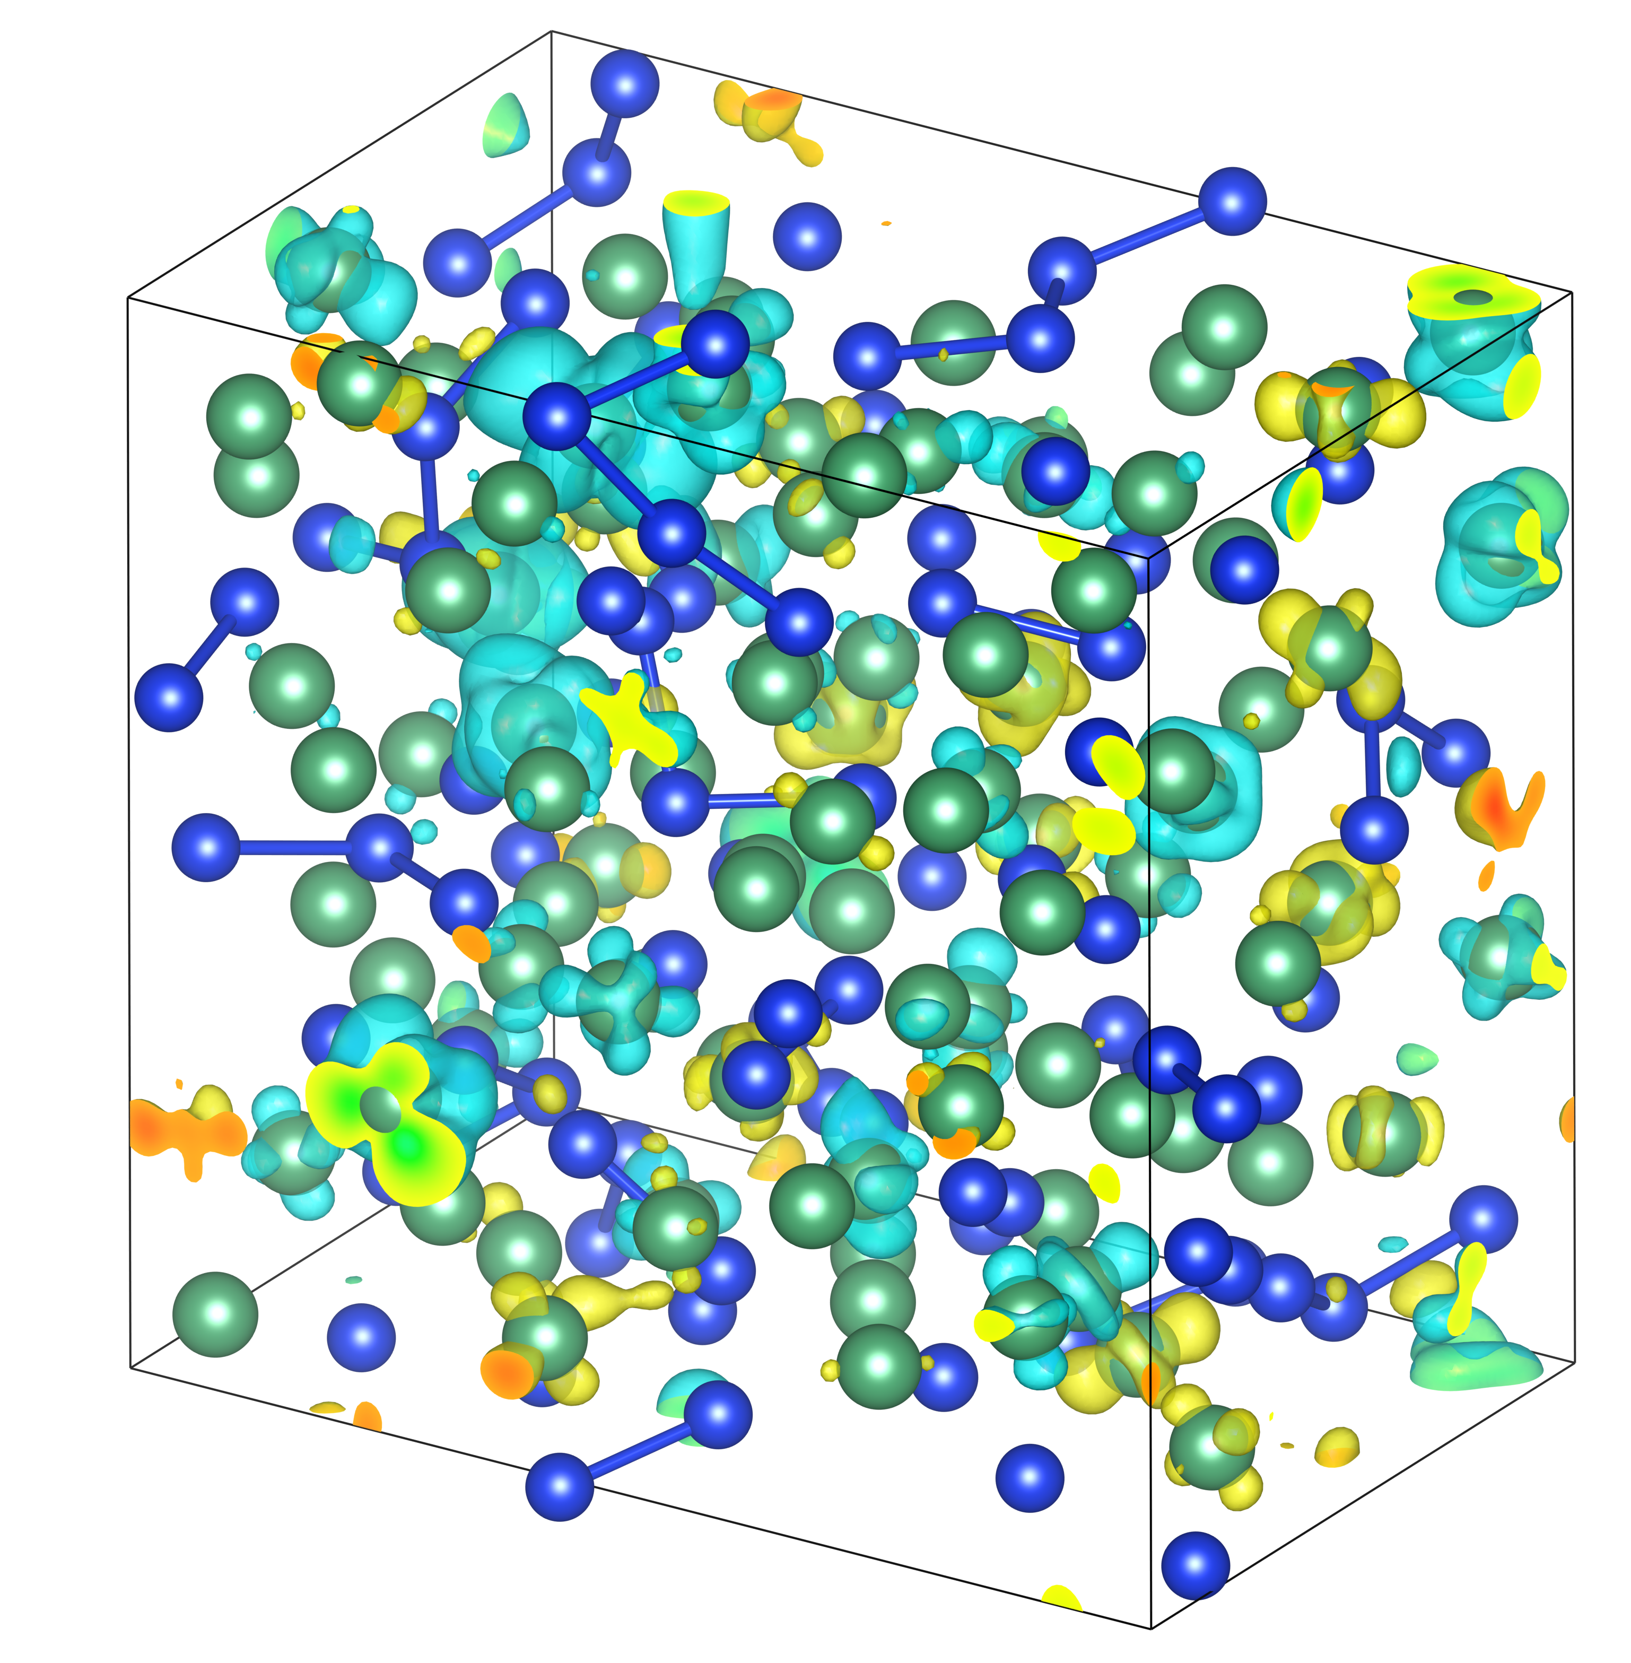
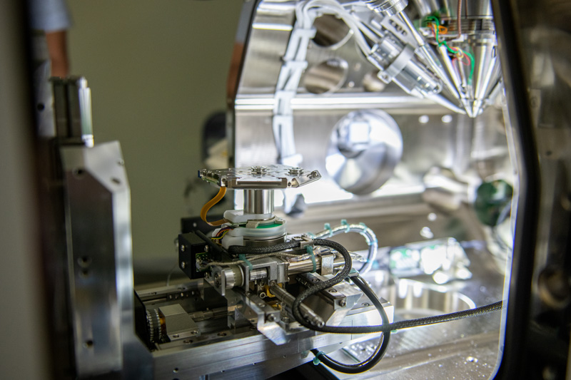
Understanding of Materials is Critical for Advancements in Particle Physics Technologies
Device
Performance
Systematic Improvements in Performance of Particle Physics Technologies
Materials
Theory
Materials
Characterization

Slide 2
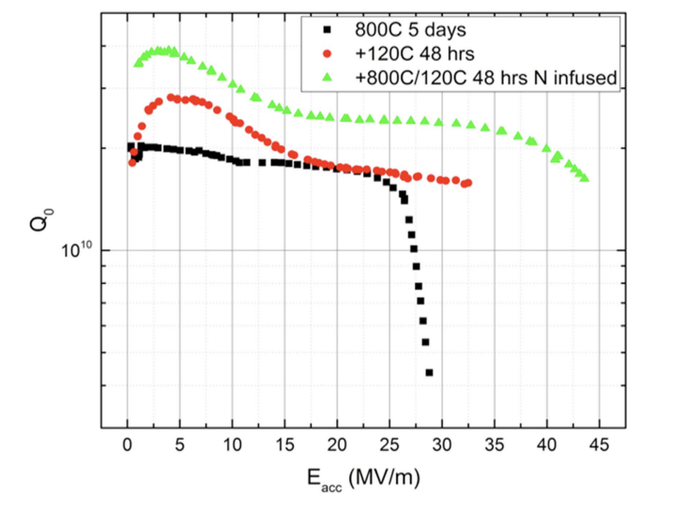
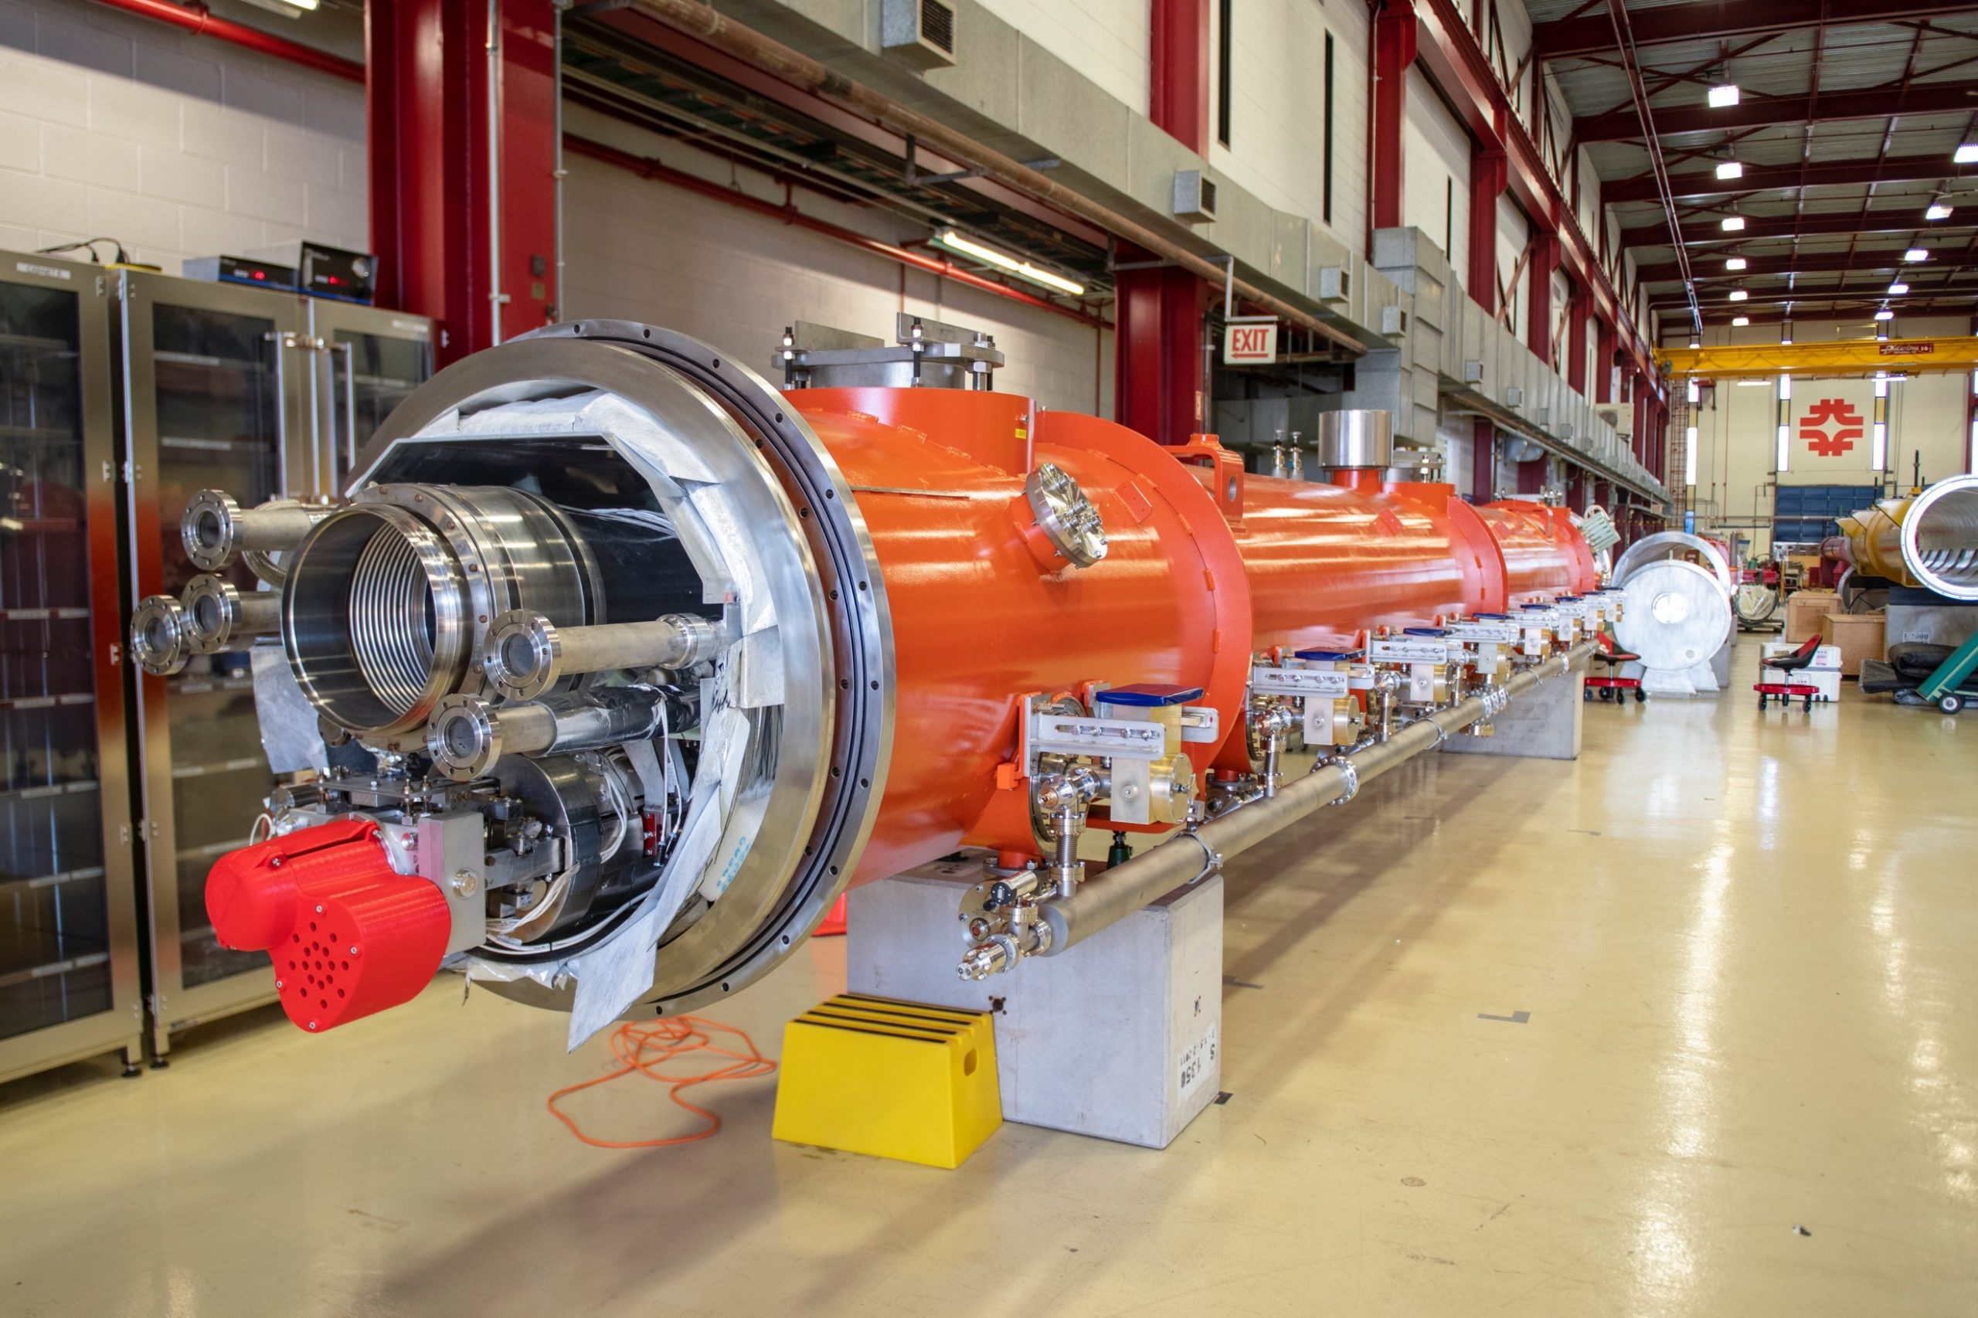

Impact of Materials Science on Accelerator Physics and Quantum Information Science
Heat treatment dissolves Nb₂O₅ hosting TLS
N doping leads to massive improvements in efficiency at high fields
QIS record
Materials science helped understand discovery → LCLS-II accelerator for world’s best light source
Materials science helped guide discovery →
World’s best qubits
A. Grassellino et al., Supercond. Sci. Technol. 30, 094004 (2017)
A. Romanenko et al., Phys. Rev. Appl. 13, 034032 (2020)

Slide 3
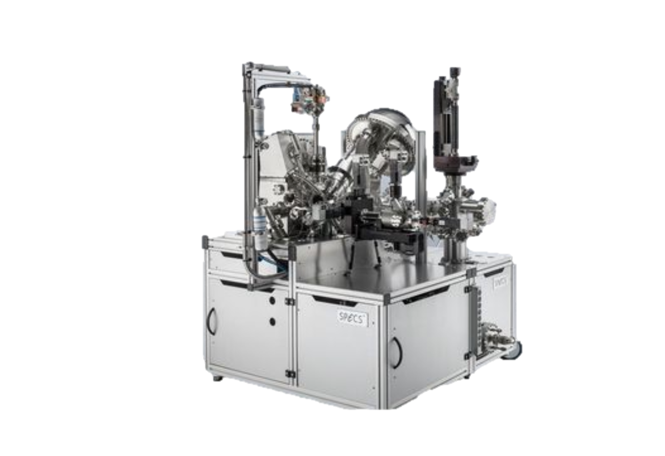
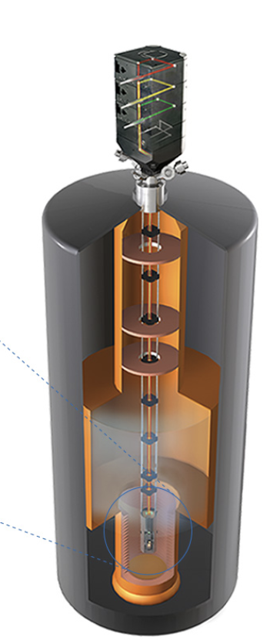
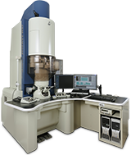
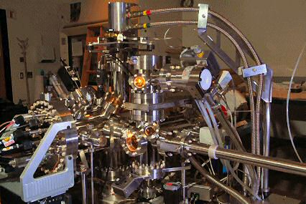
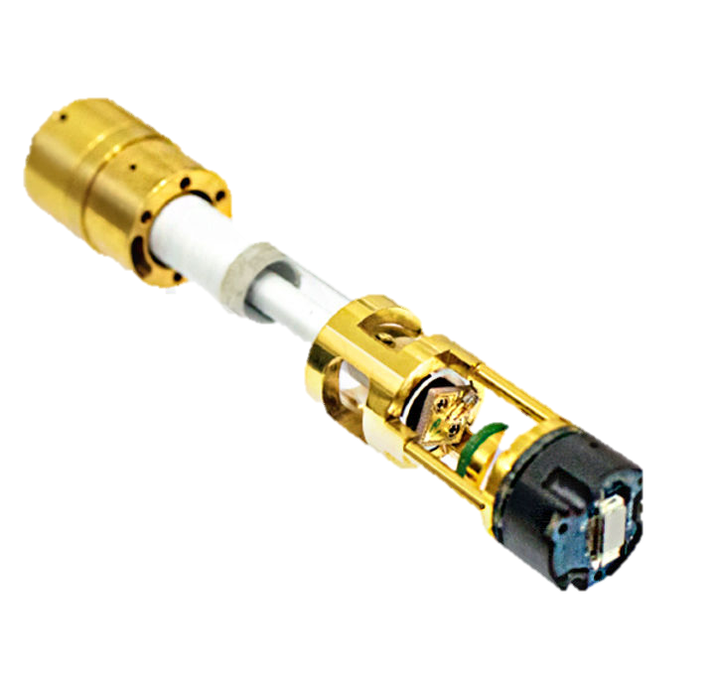
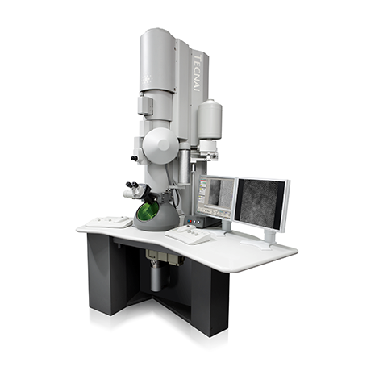
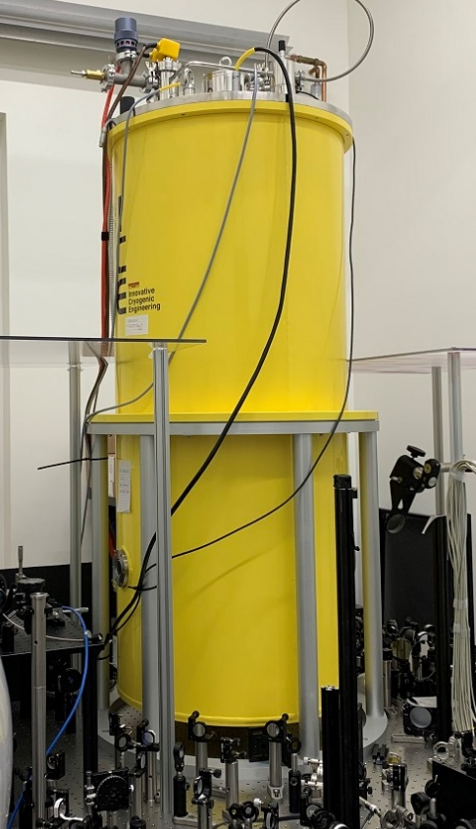
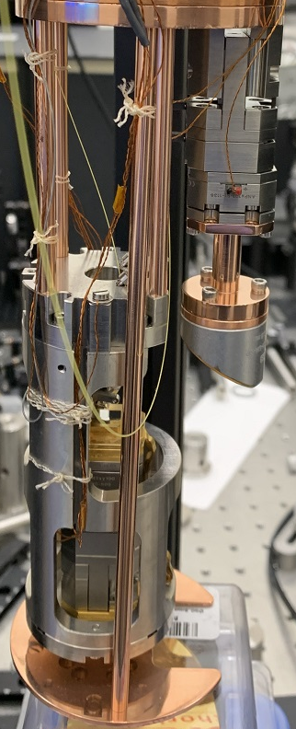
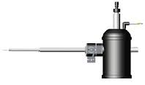


Unique Materials Science Hubs Enable Systematic Progress
We advocate for a strong research program and multidisciplinary centers focused on materials science for accelerators, detectors, quantum and microelectronics

