Slide 1
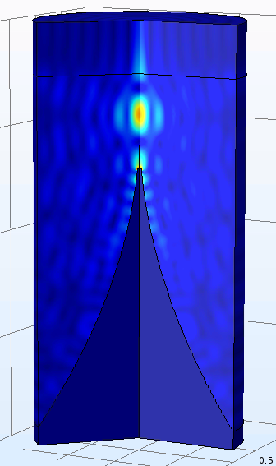
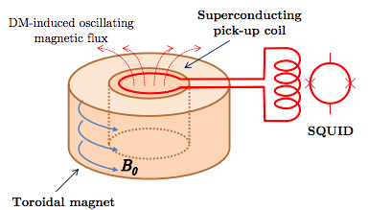
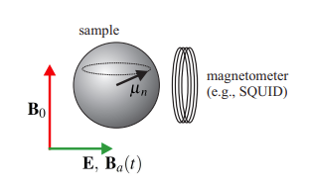
Support for a National Axion User Facility
Quest for dark matter rages on. Different proposed techniques to cover unexplored axion DM parameter space.
Cavities
Dish Antenna
LC Circuit
NMR

Slide 2
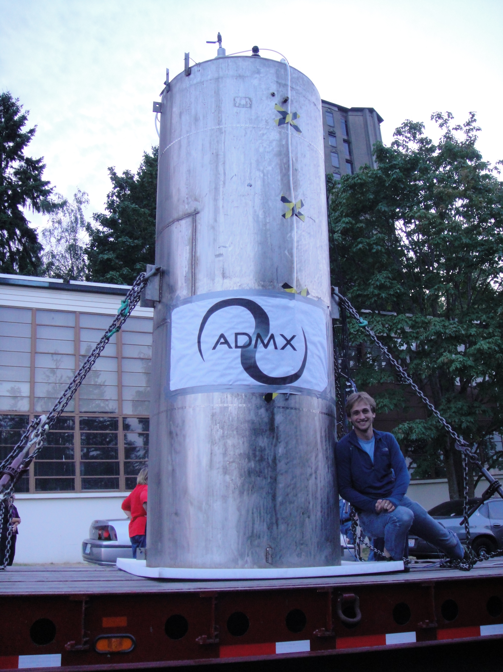
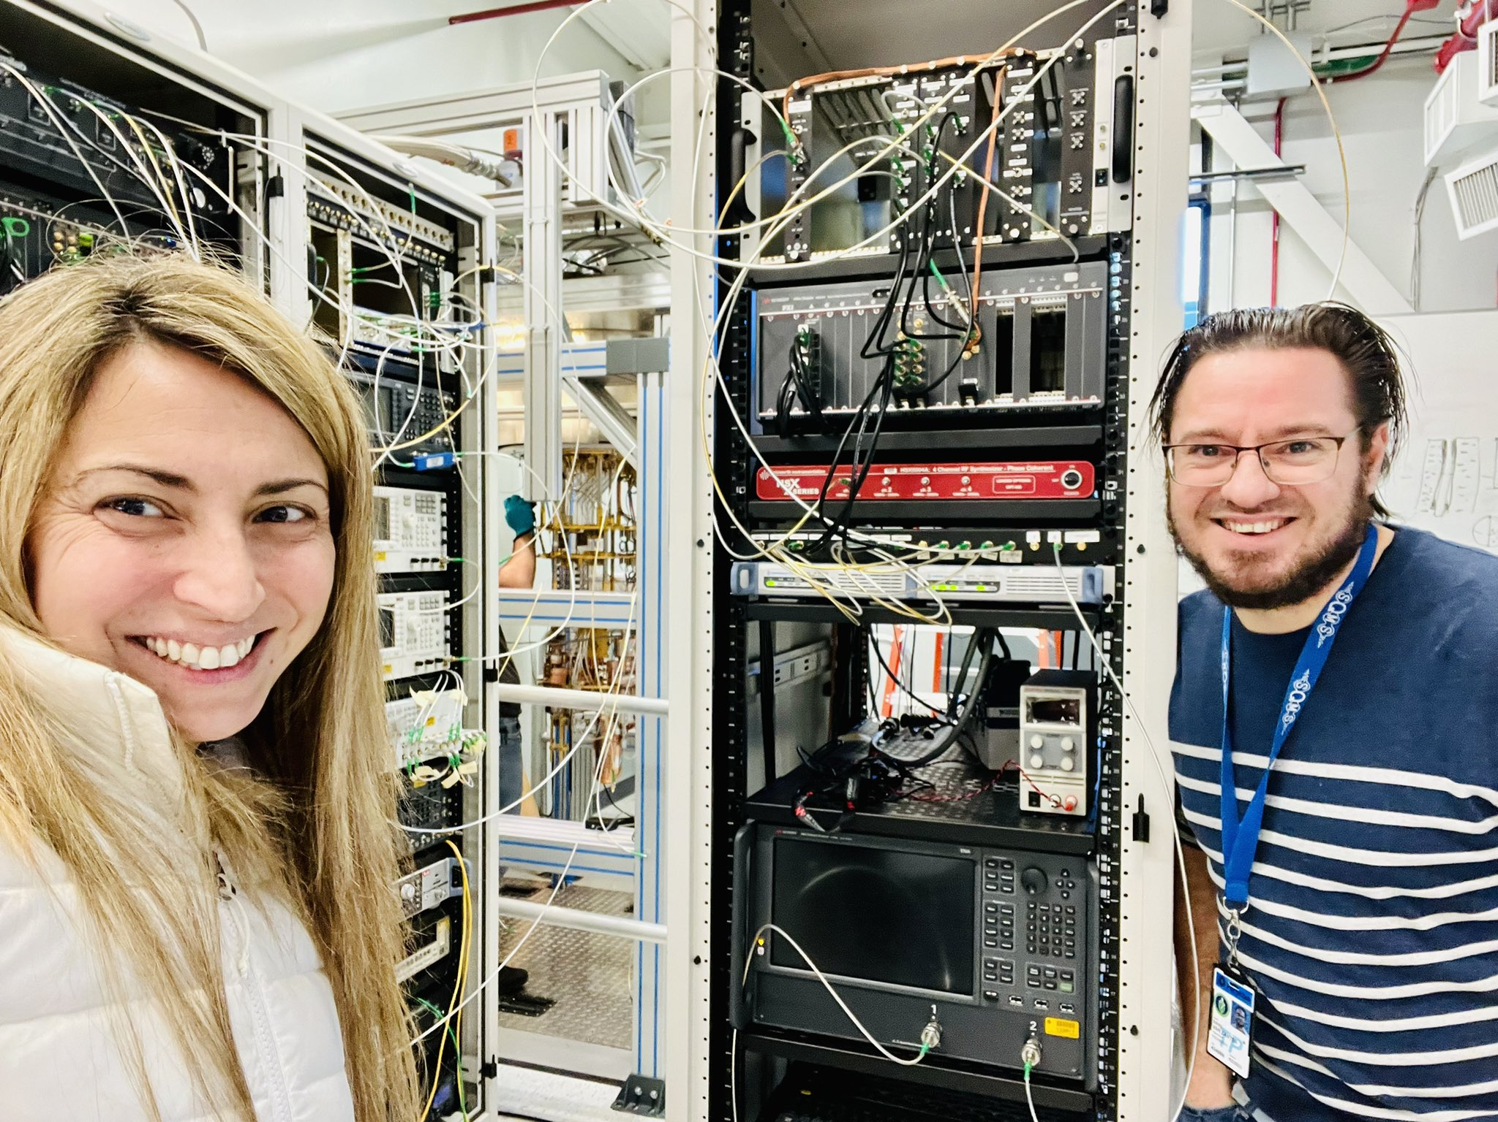
Support for a National Axion User Facility
Different axion detection schemes require the similar resources.
~ 10 mK fridges
with cryogenic infrastructure
Large ~10 T magnets
Low-noise quantum electronics
An axion user facility would allow the community to share engineering and infrastructure resources, leading to a larger and more efficient axion discovery program.

