Slide 1
EPICS IOC On SoC FPGA based LLRF Controllers
Shriraj Kunjir Radio Frequency Controls Engineer

Slide 2
Outline
LLRF Controller
LLRF Controller SoC FPGA
EPICS IOC Implementation
Test
Advantages
Challenges
Summary

Slide 3
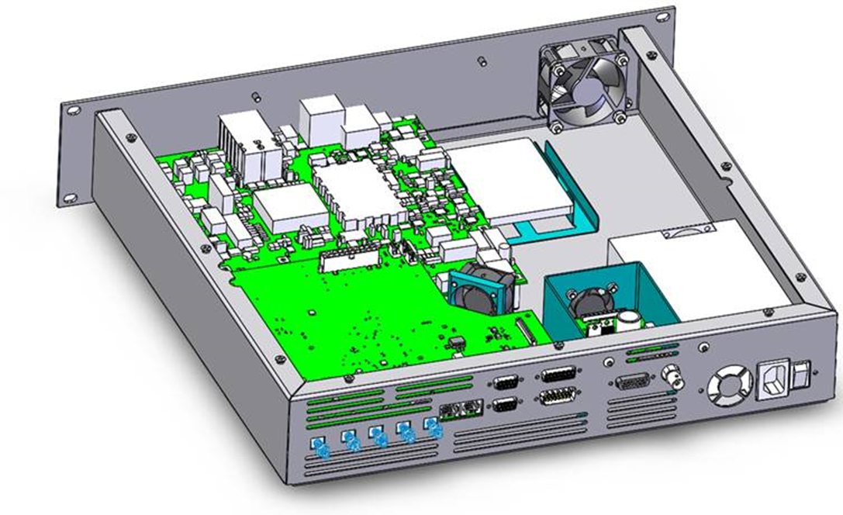
LLRF Controller
Designed and developed for
Future FRIB 644 MHz upgrade cavity
MSU ultra-fast electron microscopy UEM 1 GHz cavity
Currently installed and operational at MSU UEM lab.
Specs -
1x Xilinx FPGA board (1)
1x RF front-end board (2)
1x 500 GB solid-state drive (3)
1x 1U Power supply (4)
3
1
2
4

Slide 4
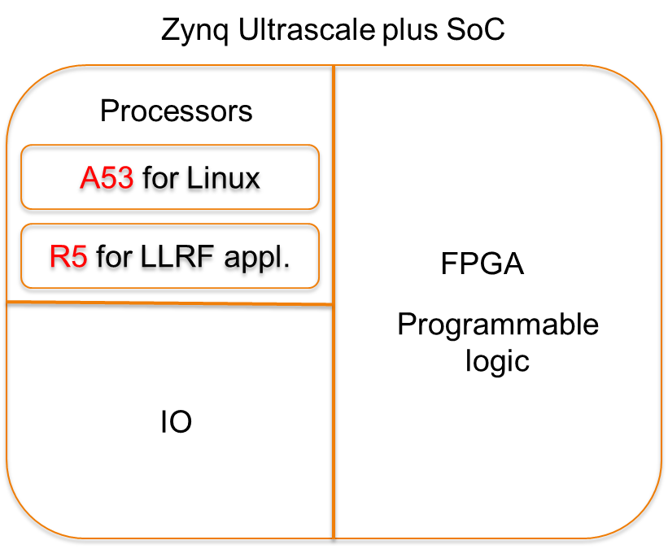
LLRF Controller SoC
Specs -
Arm Cortex A53 Quad-core processor
ARM v8 architecture
Total CPU frequency 1.2 GHz
4 GB RAM
Debian 11 Bullseye
Arm Cortex R5 dual-core real-time processing unit
IO peripherals
PCIe
Gigabit Ethernet
USB 3.0
SATA
SD
FPGA
600k LUTs
2520 DSP slices
24x 16.3 Gb/s Transceivers
328 I/O pins

Slide 5
EPICS IOC Implementation
In the current implementation, LLRF controllers communicate with IOC servers over UDP.
Added latency due to network traffic.
UDP connection is unreliable and lossy.
Asyn port driver that uses EPICS timers as its main communication mechanism.
In the new implementation, there’s no need for UDP since the IOC server runs on the LLRF controller.
Minimum latency since IOC server has access to FPGA registers via Linux userspace.
Asyn driver adapted from softGlue driver available inside synApps.

Slide 6
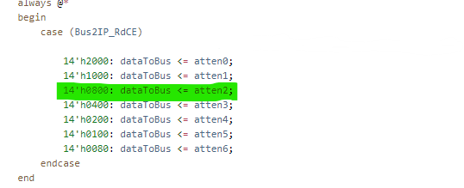
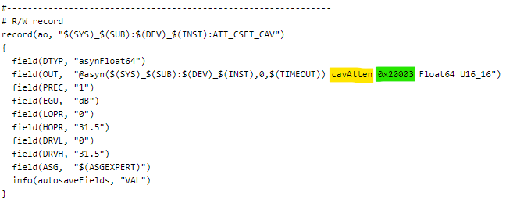
FPGA – IOC interface (old)
FPGA
UDP
IOC
Array

Slide 7
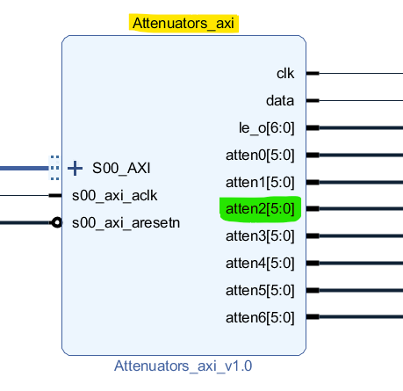
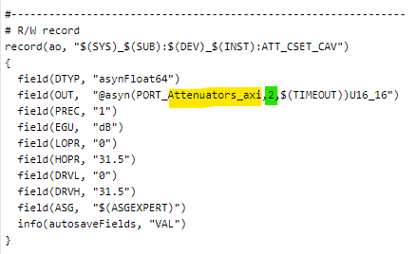
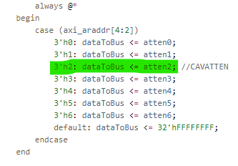
FPGA – IOC interface (new)
SoC
FPGA
Linux (IOC)
Device address space

Slide 8
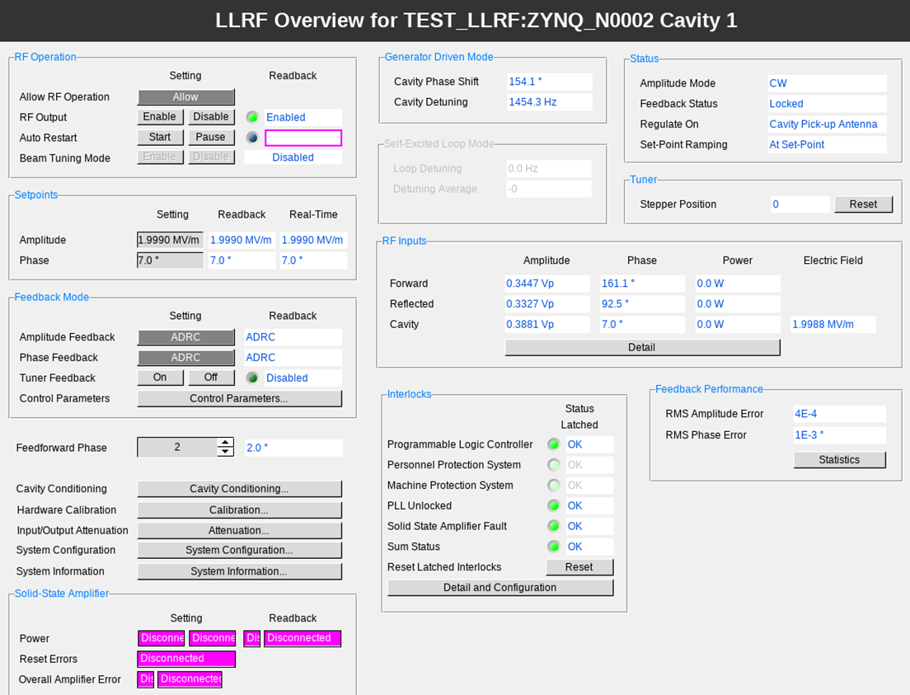
Test
LLRF controller on test network.
Work in progress to add more PVs, OPI pages, archiver support and features.
25 CS-Studio screens connected to IOC.
CPU load - ~ 0.02%
Memory utilization - ~ 0.03%
350 PVs connected.

Slide 9
Advantages
Useful in lab environments where it is difficult to have a standalone IOC server.
Targeted maintenance.
Reduce risk of affecting other devices and IOCs.
Distributed computing.
Split hardware computing resources.
Direct Memory Access (DMA) support for fast data capture and plotting.
Gives hardware-level access to data and allows for interrupts to the IOC from the FPGA.
Reduction in network traffic.
Eliminating unreliable UDP connection frees up network resources.
Reliable TCP connection.
Reliable fault tolerant fallback scenarios for boot mechanism.
Supports multiple fallback boot image files in case of primary boot image corruption.
Sufficient local storage for log files and data in case of remote archiver failure.

Slide 10
Challenges
Increase in total number of IOC servers under management.
Maintenance of spares.
Keep up-to-date with latest packages/versions.
Central configuration management system (Puppet) not supported for Debian on Arm 64-bit architecture yet.
Hopefully that changes in the future.
Develop alternate mechanism in the meanwhile.
Define network/system architecture with all stakeholders (controls group, business IT, system administrator).
Determine Arm 64-bit architecture support for all Debian packages currently installed on IOC virtual machines.

Slide 11
Summary
Proof of concept has been demonstrated.
Future work involves addressing challenges and taking advantage of interrupt and DMA support.
More discussions need to be done to determine maintenance of the LLRF controllers running IOCs.

