Slide 1
ALS control system status report
ALS controls and IT team:
G. Portmann, M. Dach, T. Ford,
S. Schofield, H. Huang, R. Lellinger, J. Jed, C. Lam

Slide 2
Contents
ALS-U upgrade project in brief
ALS Control system
Infrastructure and architecture
Hardware
Software (EPICS services and tools)
New Network Model

Slide 3
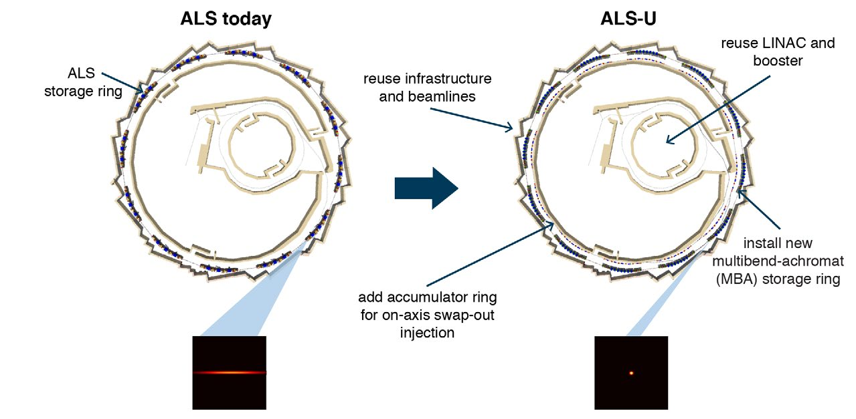
ALS-U upgrade project

Slide 4
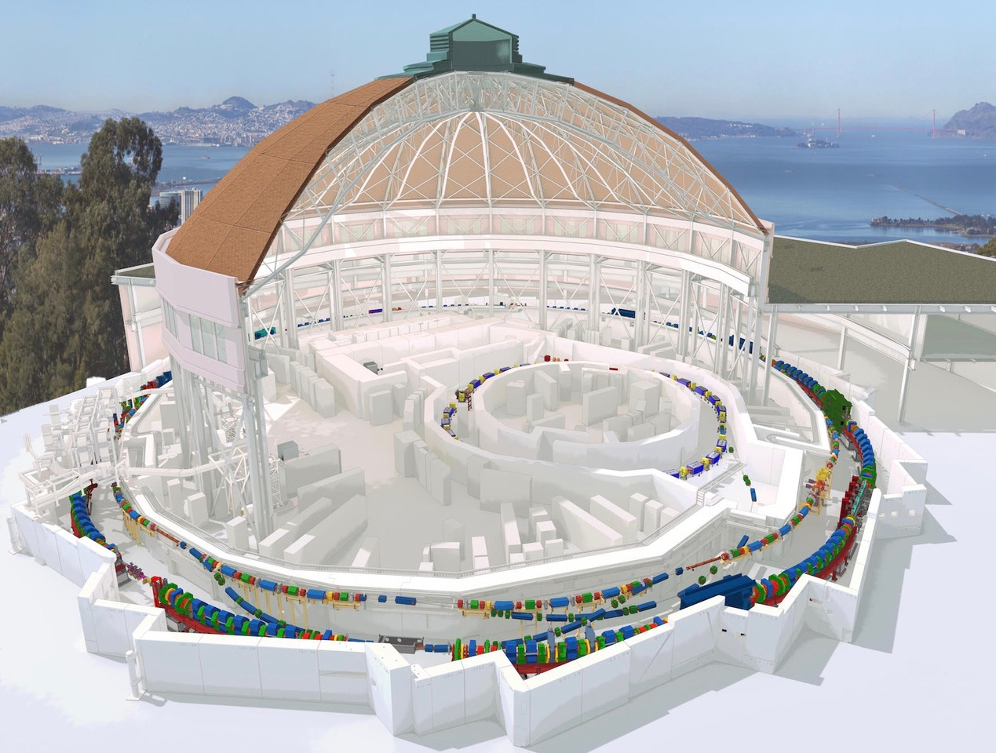
ALS-U upgrade project
LN
BR
AR
SR

Slide 5
ALS control system infrastructure
Extensive use of virtual hosts (VMWare cluster)
The primary OS is Linux (CentOS 7)
(migration to Rocky Linux 8 in progress)
Extensive use of virtual desktops (RealVNC)
(the only positive side effect of COVID pandemic)
ALS control room uses virtual desktops

Slide 6
ALS control system architecture
Level 2: Operator stations: Displays, Archiving, Alarm Management, Strip charts, Save/Restore Utility
Level 3: Physics or Science Application Using Stored Data
Events / Timing Data
Fast Orbit Feedback Network
Ethernet – pvAccess or Channel Access
Industrial IOCs
Level 1: SCADA support over a distributed network
SIOCs
CPU
EVG
NAD
EVR
Cell
Controllers
RF Control
Timing Master
(MRF)
Instr. IOCs
Controls Subnets
PS1
BPM1
PLC
CNET
I /O
I /O
PLC
CNET
I /O
PS2
BPM2
PS3
BPM3
PS4
Level 0: High Performance Systems over dedicated networks or slow control over industrial Ethernet
BPM4
…..
…..
PS5
BPM5
Field I/O
Field I/O
Field I/O
Field I/O
PLCS ,Slow I/O, High Reliability, Low Accuracy, High Density Vacuum, PPS, Slow MPS, Power, Supplies, Facility control
PSm
BPMn
Power Supplies
Beam Position Monitors

Slide 7
ALS control system hardware
Crate based systems: (will not be used in ALS-U)
VME (timing system MRF, Scrapers OMS) ,
cPCI (FOFB, Super Band Magnets, ..)
PLCs:
Modicon (EPS), -> migration to AB
WAGO (Temperature measurement, EPS), -> migration to AB
Horner (RF system), -> migration to AB
Allen-Bradley (MPS, EPS, New Scandinova modulators)

Slide 8
ALS control system hardware
Standalone (home made) Xilinx FPGA based:
BPMs, BCMs ,HSD scopes , IRMs, User Timing …
Standalone (Commercial): Power PMAC, BLM (ITech), CAEN PS and many others

Slide 9
ALS control system software
EPICS base
migration from V3.15 to V7 in progress
EPICS GUIs and higher level applications
Phoebus
qt and C# GUIs already migrated to phoebus
migration of EDM screens to phoebus in progress
Matlab

Slide 10
ALS control system software
EPICS services and tools
Channel finder
Archiver appliance
PV Web Socket (used by PV Info web application)
Legacy Alarm Handler (will be decommissioned)
New Alarm Handler and Alarm Logger (job in progress)
Name server (with channel finder connectivity) (planned)

Slide 11
ALS control system software
Channel finder use case
python script
EPICS IOC
Channel Finder
Archiver Appliance
record(stringin, "$(IOCNAME):STARTTOD")
{
field(DESC, "Time and date of startup")
field(DTYP, "Soft Timestamp")
field(INP, "@%m/%d/%Y %H:%M:%S")
info(archive,"VerySlow")
}

Slide 12
ALS control system software
Channel finder use case

Slide 13
ALS control system software
Channel finder use case
Channel finder in ALS contains the metadata to:
populate the Archiver Appliance
serve as backend for PV Info web application
auto generated Phoebus screens for group/categories of PVs (in progress)
to provide the Name Server with relevant information (planned)

Slide 14
New Network Model
The New Network Model was recently introduced in order to:
Increase the security when connecting to all ALS hosts
Decouple hosts used in operation from the ones used in development

Slide 15
New Network Model
ssh with 2FA
(VNC clients)
ALS controls subnets used in operation
DMZ
https with 2FA (web browsers)
DMZ
ssh with 2FA
(VNC clients)
EPICS read only
development subnets
DMZ
https with 2FA (web browsers)

Slide 16
Acknowledgement
ALS-U controls team
Unix team
LBLnet team: networking team
Cyber security team
Physics team
ALS operators
and many others

