Slide 1
EPICS Documentation update
Timo Korhonen

Slide 2
EPICS Documentation
For me, some of the most frequently asked questions are:
Where can I find documentation about EPICS7 / pvAccess
Where to find examples how to use PVA structured data
How to do X?
There are two main issues:
Documentation exists, but is scattered in different places and hard to find
Newer features lack coherent documentation
The issue has been recognized, but
People prefer coding to writing documentation, and
There is/was a lack of common concept how to do documentation…
And how to make it accessible

Slide 3
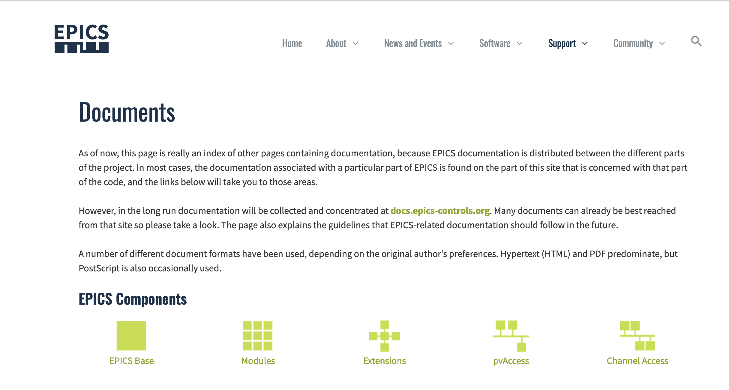
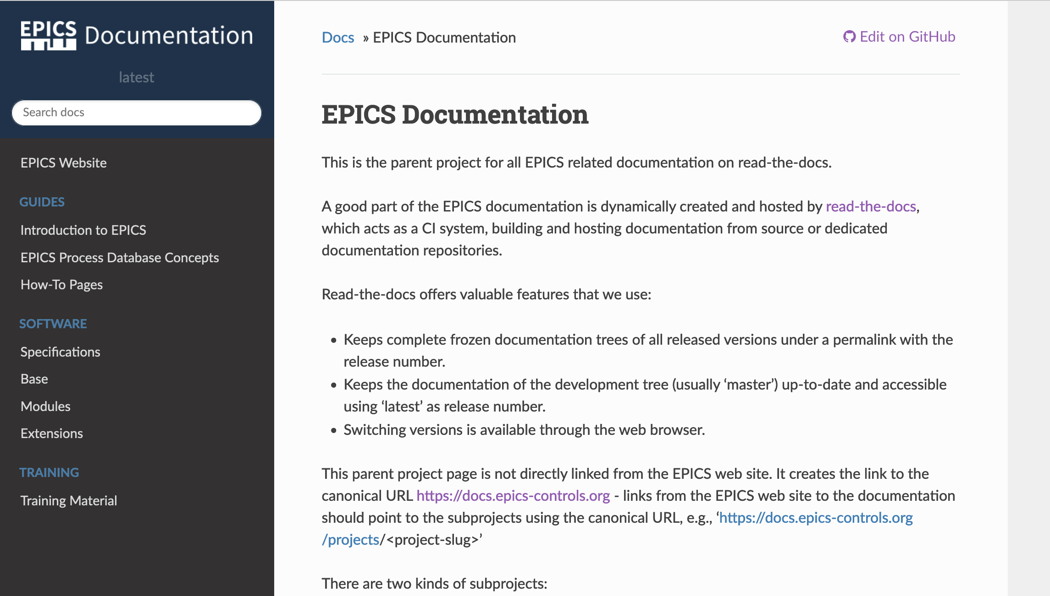
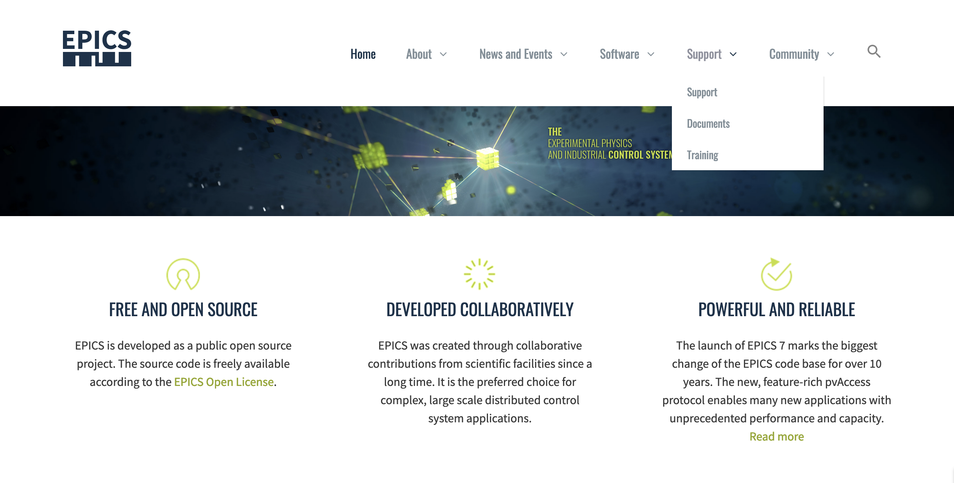
The (original) plan – and where we are now
I think all of you know the epics-controls.org website
If you look carefully, there is a barely recognizable link to docs.epics-controls.org
The idea was to collect there documentation that is cumbersome to put on the main site.
Work has progressed slowly, we hoped for enthusiastic people to jump in to contribute…
but did not make it exactly clear how.

Slide 4
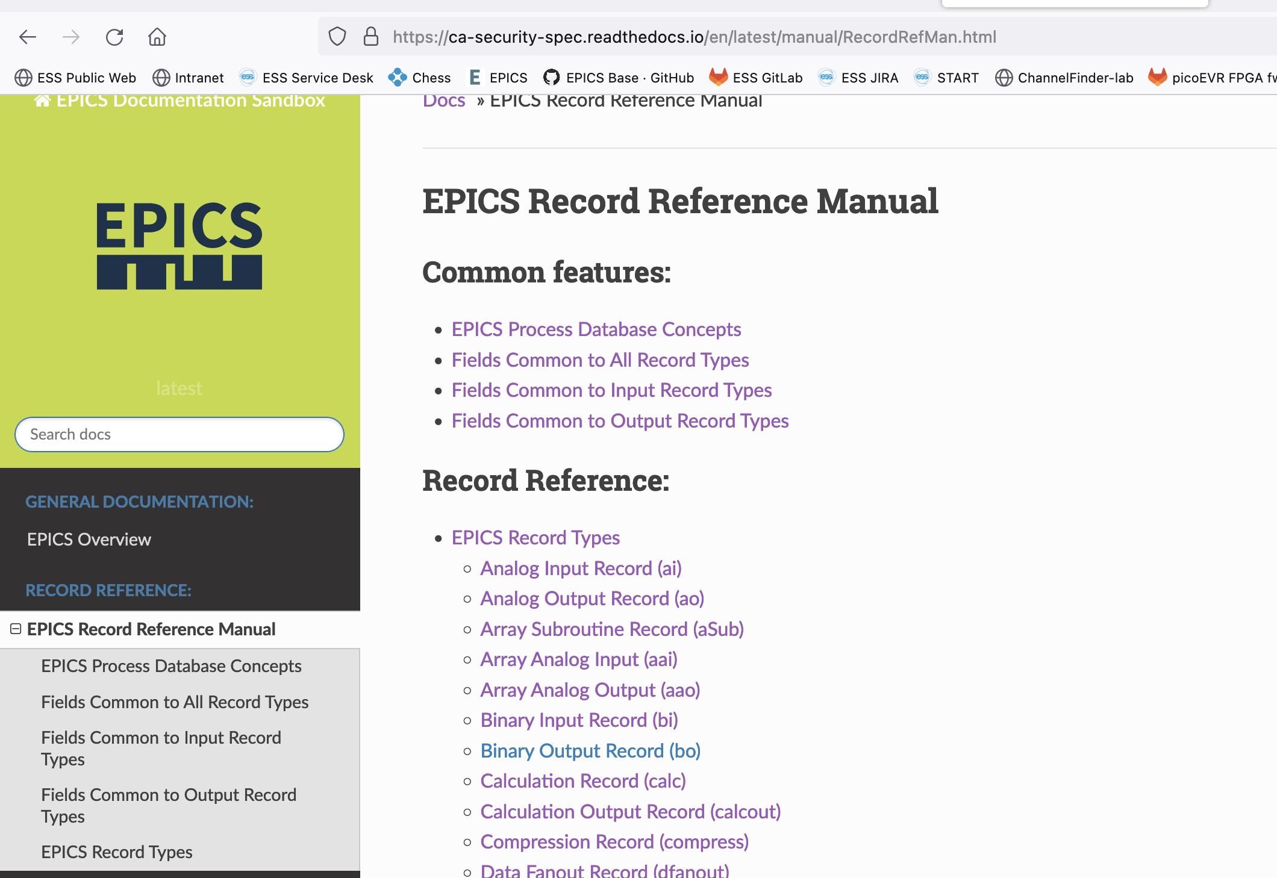
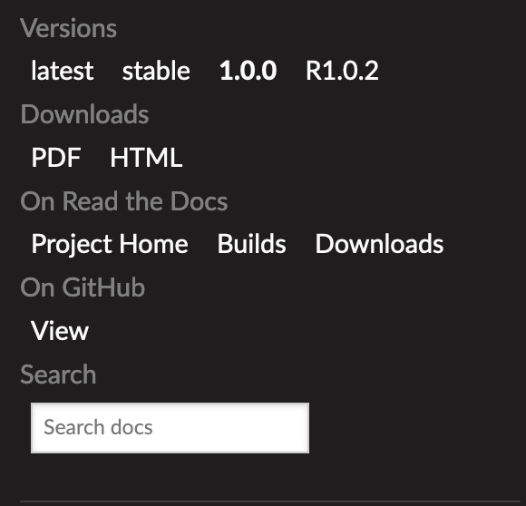
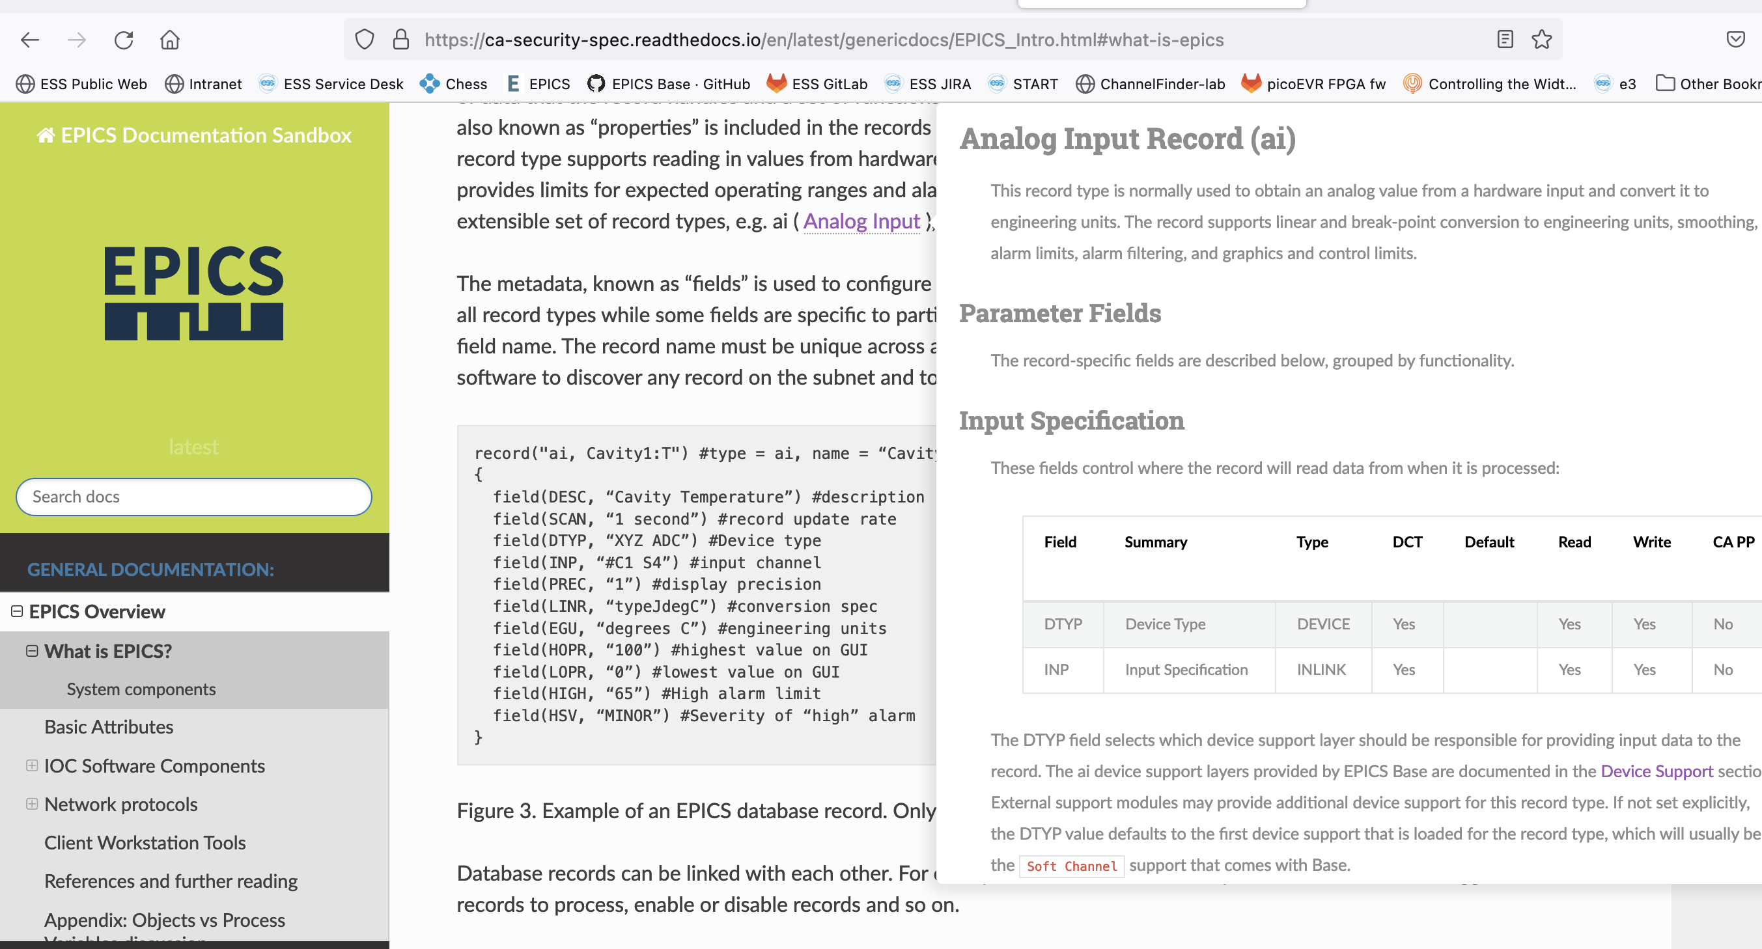
Updates to the plan
In the meantime…
I have studied the capabilities of readthedocs, Sphinx, intersphinx links, etc., and found out that we could:
Nicely link documentation to docs.epics-controls.org, keeping the originals together with the code…
Using a common look-and feel (mostly), if the documentation is using Sphinx + Markdown/RestructuredText
Use modern (and nice) features like tooltips, reference catalogs (unde the hood), etc.
Auto-create Record Reference manual, API documentation, etc…, nicely interlinked
Versioned and with additional formats, e.g pdf

Slide 5
Where to go from here?
There is a plan, but I do not have the time and capability to make all this happen
Help is needed, thus:
We are planning to have a Document-athon + Codeathon at European Spallation Source
I cannot promise 100% just yet, but preliminary we are thinking about week beginning 28. August (this year)
To be confirmed soon.
Documentation can be fun!
Please consider joining the fun (= the doc/code-athons)
And the output will help you, your colleagues and collaborators.
And me to answer the questions I get…

