Slide 1
Introduction to Machine Learning
Gopika Bhardwaj
EPICS-Collaboration Meeting

Slide 2
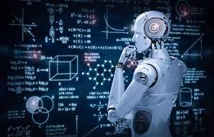
What is Machine Learning?
Machine Learning is a field of study that uses advanced algorithms and mathematical models to enable computers or machines to learn from data and make predictions or decisions without being explicitly programmed.
In ML, data is used as a basis for training algorithms or models, which then analyze the data and identify patterns or relationships within it.
These patterns are used to make predictions or decisions when presented with new, unseen data.
Write programs that improve themselves

Slide 3
A computer program is said to learn from experience with respect to some class of tasks and performance improves with experience E.
Here Experience = Data we collect,
Tasks = the decisions software needs to make
and Performance is how we will evaluate its results.
Experience
Performance

Slide 4
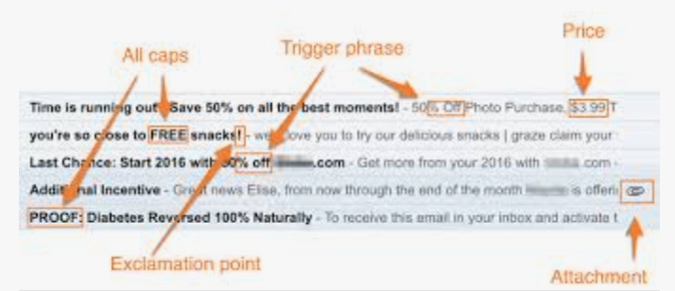
Why Machine Learning ?
Take the every-day case of the decision problem of discriminating spam email from non-spam email.
How would you write a program to filter emails as they come into your email account and decide to put them in the spam folder or the inbox folder?

Slide 5
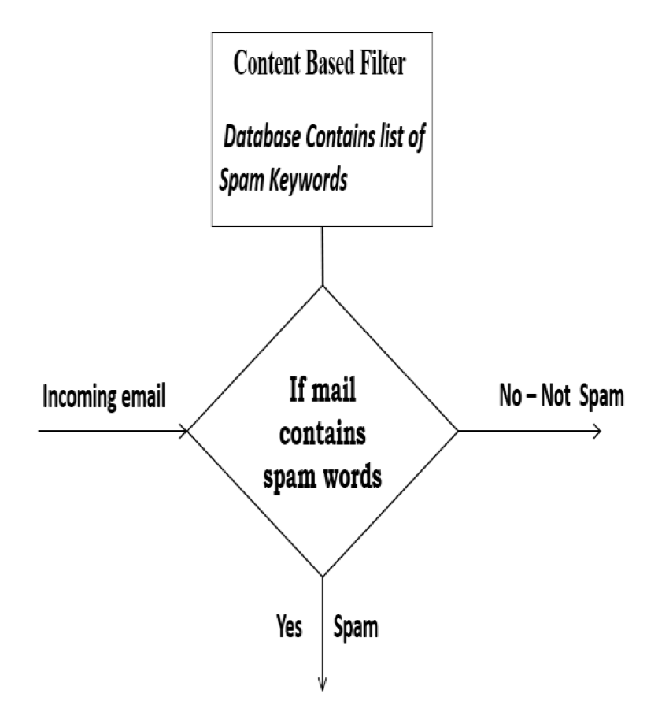
Collecting, Analyzing Samples and Look for patterns in spam emails and non-spam emails

Slide 6
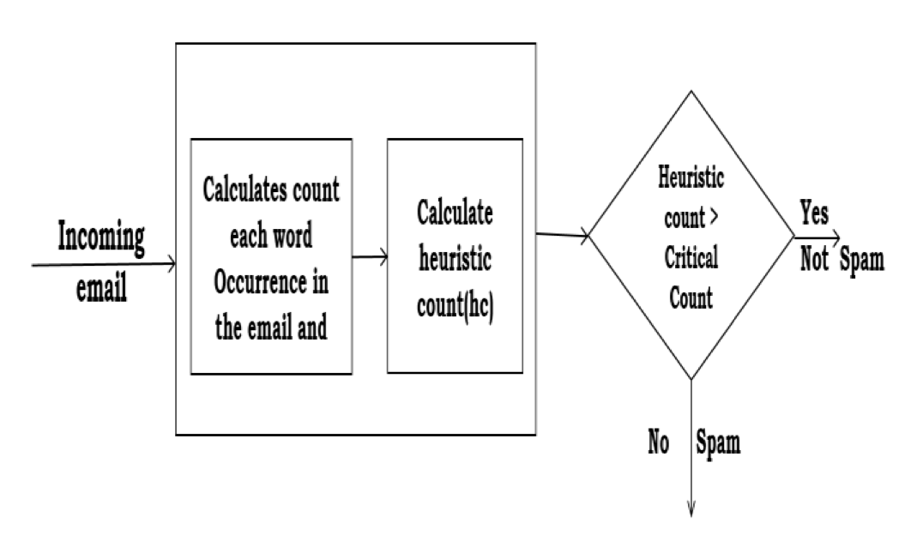
Abstract those patterns so your heuristics work on new cases getting easy wins for accuracy and craft special solutions for edge cases
Notes:
Heuristic filter is rule-based filters contains word list but here each word is assigned with priority. The words which are mostly used in spam messages are assigned with higher priority and the words mostly used in normal mails are assigned with lower priority. The filter should sum up all
priority values of words in mail to get total score. If total score is greater than the critical value then that mail is considered as spam else it is sent to inbox [3]. Heuristic filters work fast without any delay.
Review email frequently over time and think about abstracting new patterns to improve decision making.

Slide 7
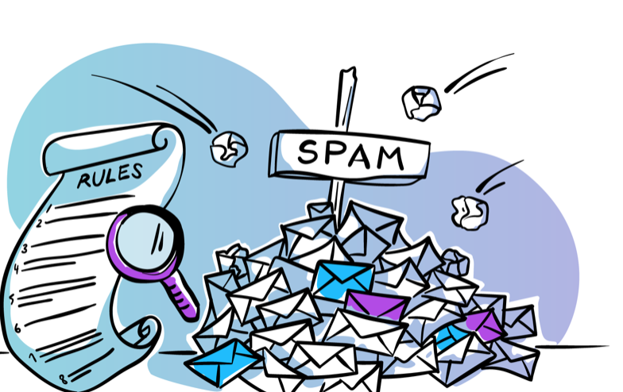
Traditional non-machine learning methods for spam detection have limitations in detecting new or evolving types of spam, as they require manual input to create rules that identify specific spam patterns.
They are limited by their reliance on predefined rules or lists of keywords, which can quickly become outdated or fail to detect new types of spam.
Notes:
This manually derived hardcoded system would only be as good as the programmer’s ability to extract rules from the data and implement them in the program.
It could be done, but it would take a lot of resources and be a maintenance nightmare.

Slide 8
Spam Detection as a Machine Learning Problem
Machine learning algorithms can learn patterns and characteristics of spam messages from large datasets and use that knowledge to classify new messages as either spam or not spam making them more accurate and robust.
Training - Preparing a decision-making program
Training Set - Collected examples
Model - the program
The model can continually improve by incorporating new training data over time and the system can adapt to changing spamming tactics and remain effective over long periods.
Notes:
The examples are emails we have collected.
The task was a decision problem (called classification) of marking each email as spam or not and putting it in the correct folder.
Our performance measure would be something like accuracy as a percentage (correct decisions divided by total decisions made multiplied by 100) between 0% (worst) and 100% (best).

Slide 9
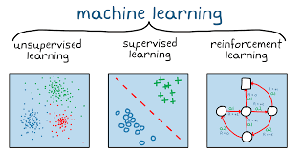
Types of Machine Learning

Slide 10
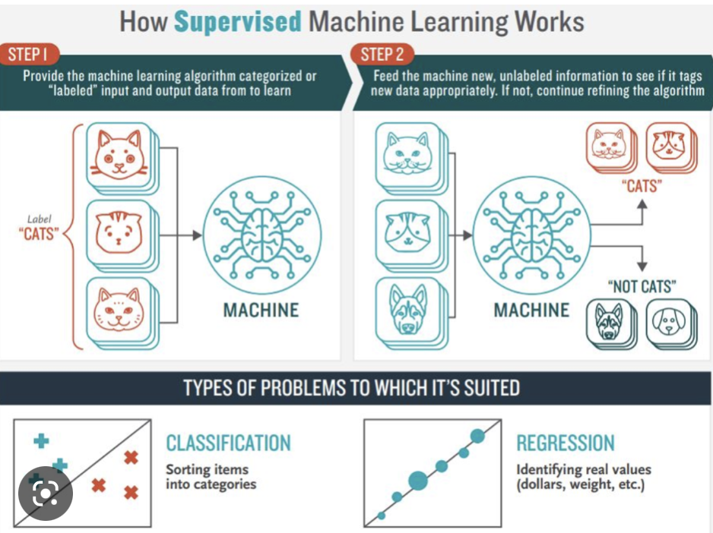
Supervised Learning
Algorithms are referred to as “supervised” because they learn by making predictions given examples of input data, and the models are supervised and corrected via an algorithm to better predict the expected target outputs in the training dataset.
Notes:
Supervised Learning describes a class of problem that involves using a model to learn a mapping between input examples and the target variable.
Models are fit on training data comprised of inputs and outputs and used to make predictions on test sets where only the inputs are provided and the outputs from the model are compared to the withheld target variables and used to estimate the skill of the model.
Algorithms are referred to as “supervised” because they learn by making predictions given examples of input data, and the models are supervised and corrected via an algorithm to better predict the expected target outputs in the training dataset.
There are some very practical applications of supervised learning algorithms in real life, including:
Text categorization, Face Detection, Signature recognition, Customer discovery, Spam detection, Weather forecasting, Predicting housing prices based on the prevailing market price, Stock price predictions, among others.

Slide 11
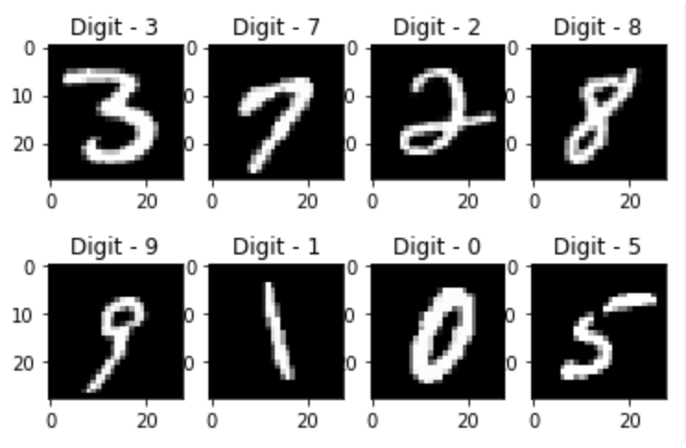
Types of Supervised Learning
Classification: Supervised learning problem that involves predicting a class label.
Example - MNIST handwritten digits dataset where the inputs are images of handwritten digits (pixel data) and the output is a class label for what digit the image represents (numbers 0 to 9).

Slide 12
2) Regression: Supervised learning problem that involves predicting a numerical label. An example of a regression problem would be the Boston house prices dataset where the inputs are variables that describe a neighborhood, and the output is a house price in dollars.
This dataset concerns the housing prices in the housing city of Boston. The dataset provided has 506 instances with 13 features.
Notes:
CRIM – per capita crime rate
ZN – proportion of residential land zone for lots over 25k sqft
INDUS – proportion of non-retail business acres per town
CHAS – Charles River dummy variable (=1 if tract bounds river; 0 o/w)
NOX – nitric oxides concentration ppm
RM – avg no of rooms per dwelling
AGE – proportion of owner-occupied units built prior to 1940
DIS – weighted distances to five Boston employment centres
RAD – index of accessibility to radial highways
TAX – full value property tax rate per $10k
PTRATIO – pupil-teacher ratio by town
B – proportion of blocks by town

Slide 13
Unsupervised Learning
Unsupervised learning describes a class of problems that involves using a model to describe or extract relationships in data.
Suppose a supermarket wants to increase its revenue. It decides to implement a machine learning algorithm on its sold products’ data. It was observed that the customers who bought cereals more often tend to buy milk or those who buy eggs tend to buy bacon. Thus, redesigning the store and placing related products side by side can help them understand consumer mindset and increase revenue.
Notes:
Compared to supervised learning, unsupervised learning operates upon only the input data without outputs or target variables. As such, unsupervised learning does not have a teacher correcting the model, as in the case of supervised learning.
Applications - clustering, visualization, dimensionality reduction, finding association rules, and anomaly detection

Slide 14
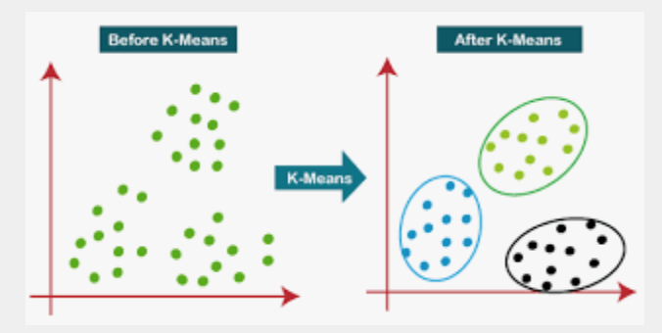
Types of Unsupervised Learning
Clustering: Unsupervised learning problem that involves finding groups in data. An example of a clustering algorithm is k-Means where k refers to the number of clusters to discover in the data
For example, if you have customer data, you might want to create sets of similar customers and then target each group with different types of marketing.
Notes:
The most common unsupervised learning task is clustering: detecting potentially useful clusters of input examples. For example, a taxi agent might gradually develop a concept of “good traffic days” and “bad traffic days” without ever being given labeled examples of each by a teacher.

Slide 15
Density Estimation: Unsupervised learning problem that involves summarizing the distribution of data.
An example of a density estimation algorithm is Kernel Density Estimation that involves using small groups of closely related data samples to estimate the distribution for new points in the problem space.
Density Estimation is used to learn about the patterns in data and determine the distribution of data within the input space.
For example, a taxi agent might gradually develop a concept of “good traffic days” and “bad traffic days” without ever being given labeled examples of each by a teacher.

Slide 16
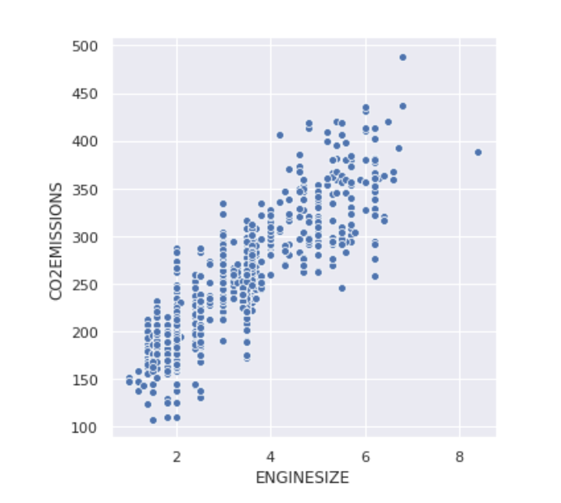
Visualization: Unsupervised learning problem that involves creating plots of data.
An example of a visualization technique would be a scatter plot matrix that creates one scatter plot of each pair of variables in the dataset.

Slide 17
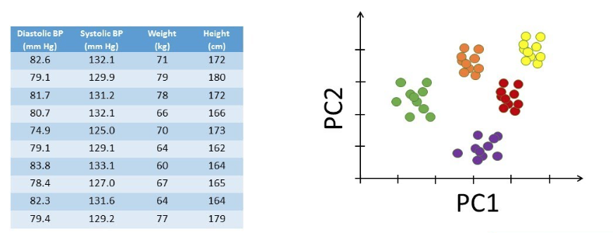
Projection: Unsupervised learning problem that involves creating lower-dimensional representations of data.
An example of a projection method would be Principal Component Analysis that involves summarizing a dataset in terms of eigenvalues and eigenvectors, with linear dependencies removed.

Slide 18
Reinforcement Learning
Lets consider recommendations on Youtube. After watching a video, the platform will show you similar titles that you believe you will like. However, suppose you start watching the recommendation and do not finish it. In that case, the machine understands that the recommendation would not be good and will try another approach next time.
Reinforcement learning describes a class of problems where an agent operates in an environment and must learn to operate using feedback.
Notes:
The use of an environment means that there is no fixed training dataset, rather a goal or set of goals that an agent is required to achieve, actions they may perform, and feedback about performance toward the goal.
An example of a reinforcement problem is playing a game where the agent has the goal of getting a high score and can make moves in the game and received feedback in terms of punishments or rewards.

Slide 19
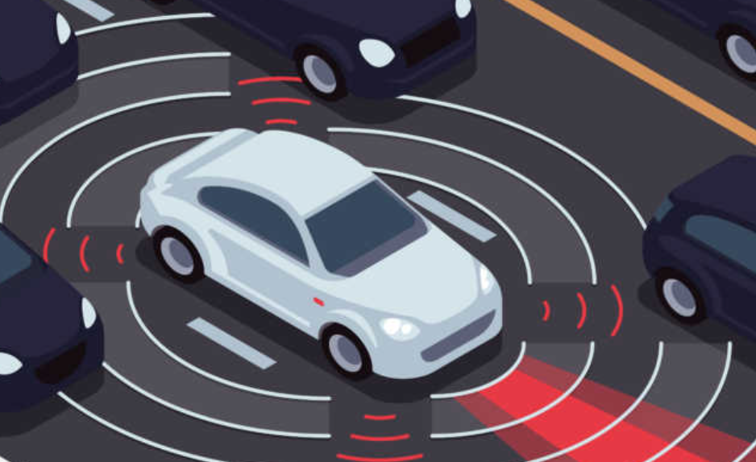
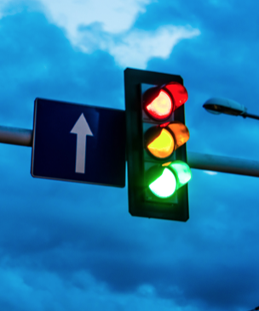
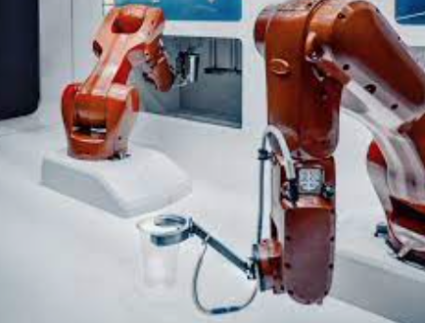
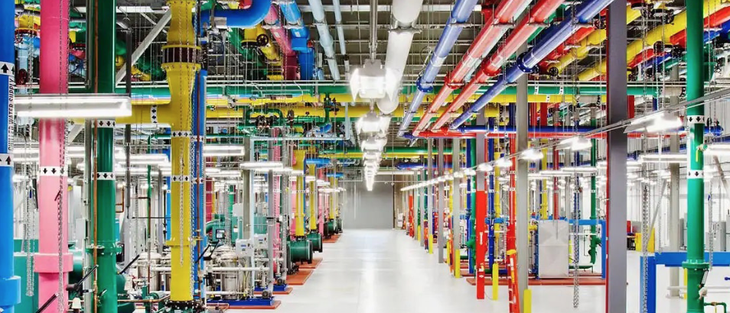
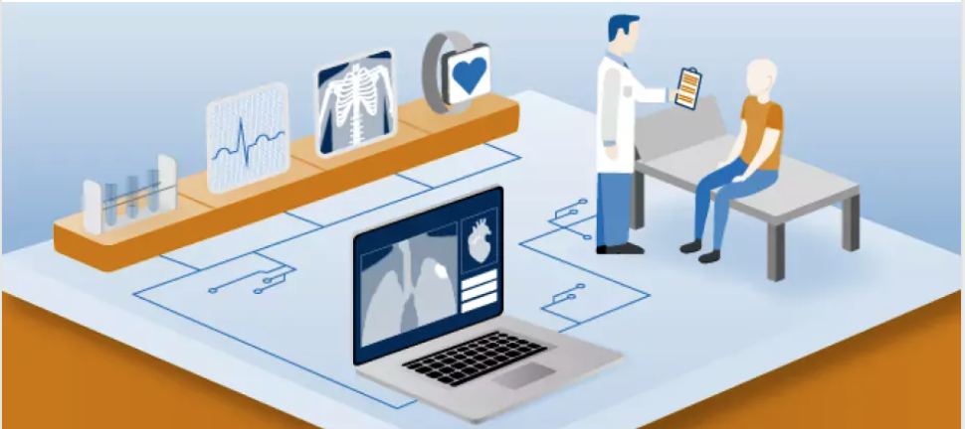
Some Real-Life Applications - Autonomous cars, Datacenters cooling, Traffic light control, Healthcare
Notes:
DeepMind AI Reduces Google Data Centre Cooling Bill by 40%

Slide 20
Machine Learning at Fermilab

Slide 21
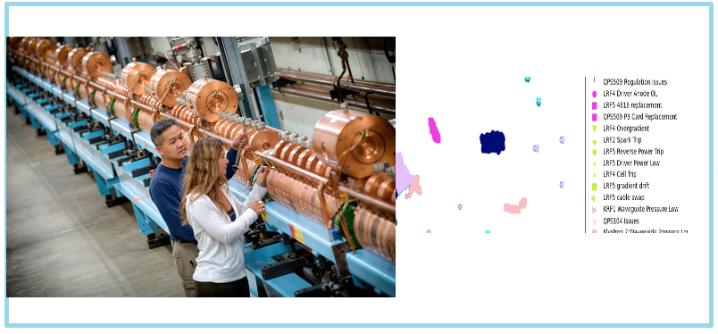
Linac Conditional Anomaly Prediction of Emergence
LCAPE - The ‘L-CAPE’ effort is to use ML to automate accelerator operations which will result in higher efficiencies and cost savings. For example, predicting beam down-time. (Classification and Anomaly Detection)
Using over one year’s worth of FNAL Linac data (2022), we have been able to train performant ML models to predict beam down-time.
Notes:
Motivation: This project focused on unplanned downtimes, maximizing both the science yield of the accelerator complex while conserving energy and operational cost. Focusing entirely on Linac maximizes benefit to all downstream machines.
Description: Predict unplanned machine downtime, Categorize downtime causes, and Forecast downtime durations. Automatically, reliably, and continuously. Lay the groundwork for scaling to other machines in the accelerator complex.

Slide 22
Accelerator Real-time Edge AI for Distributed Systems (READS)
Using machine learning on fast hardware (FPGA) to make real-time inferences from remote distributed readings
Two sub-projects
Beam Loss Deblending for Main Injector and Recycle - Disentangle Main Injector tunnel beam loss monitor (BLM) readings between Main Injector and Recycler accelerators – Regression
Mu2e Spill Regulation - Use spill simulator to train ML models – RL
Optimize traditional PID loop gains
Potentially replace PID loop controller with ML direct controller
Notes:
Jose and Aisha will be sharing more about this later on…

Slide 23
Thank you
Any questions?

