Slide 1
EPICS in Context of Machine Learning, Beam Tuning and Offline Scientific Computing
Greg White,
19 April, 2023, SLAC
For EPICS Collaboration Meeting, Fermilab Spring 2023.
Greg White, for Auralee Edelen, Alberto Lutman, Chris Mayes, Bob Dalesio, Kay Kasemir, Jacqueline Garrahan, Michael Davidsaver, Matej Sekoranja, Murali Shankar, EPICS 7 Development Team, and many others.

Slide 2
Talk Outline: EPICS is changing to include AI/ML and HPC
Scope: Controls → += Physics
EPICS Version: 3 → 7
Network: Controls → += HPC

Slide 3
Physics ML / Modelling EPICS Drivers
Beam Optimization no longer only on ad-hoc “correlation plots” and Singular Value Decomposition. Rather continuous multi-parametric and NN online, and big-data offline, informing online in real time
Models no longer linear only. Space charge, RF kicks, magnet errors, dynamic initial conditions, will have to be included. That implies large HPC and ML, reading and writing to online PVs!
Tuning on Pulse identified data. Pulse Synchronous Archiving All pulses, (soft) Real time pulse synch accelerator-detector optimization, Continuous image acq/store, Pulse based Modeling
EPICS implications. Move and support physics analysis on fast networks off production; Control system moves into HPC -> Cyber security extends from HPC to Control Sys.

Slide 4
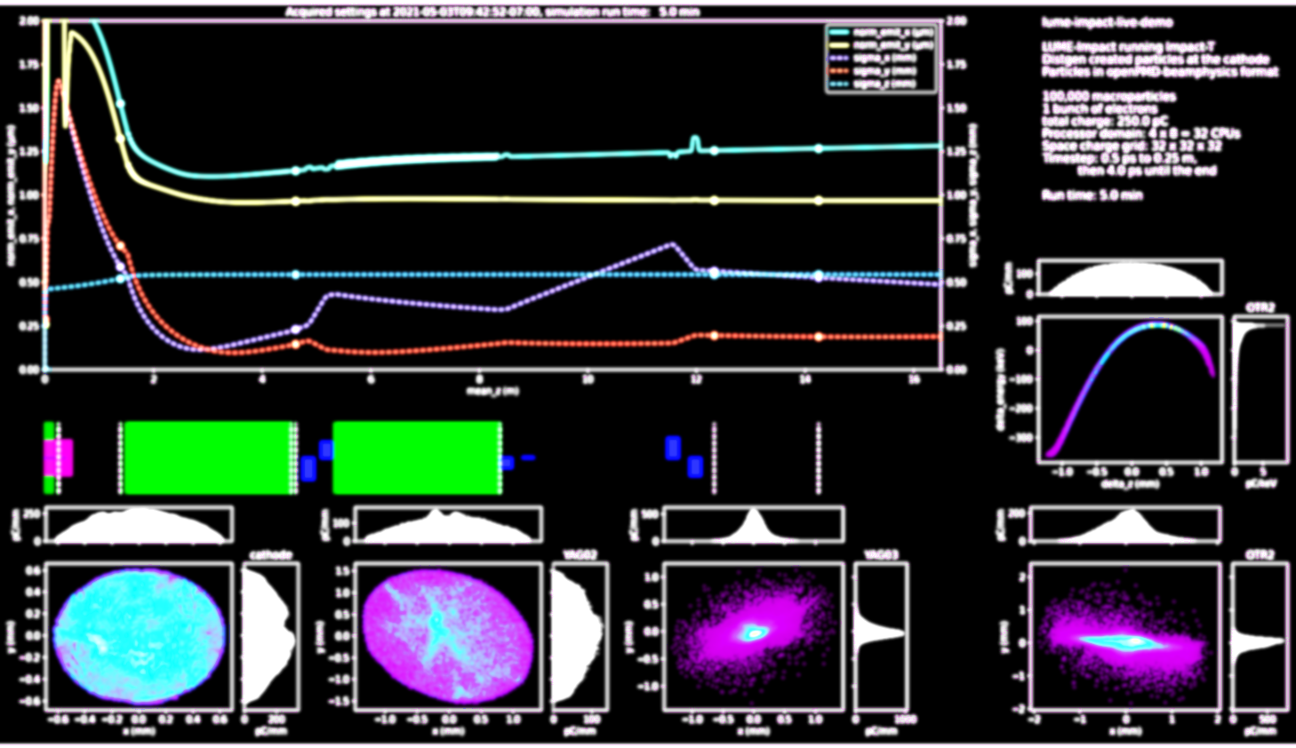
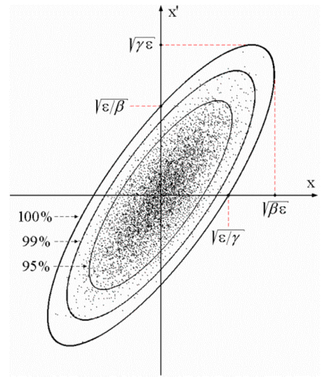
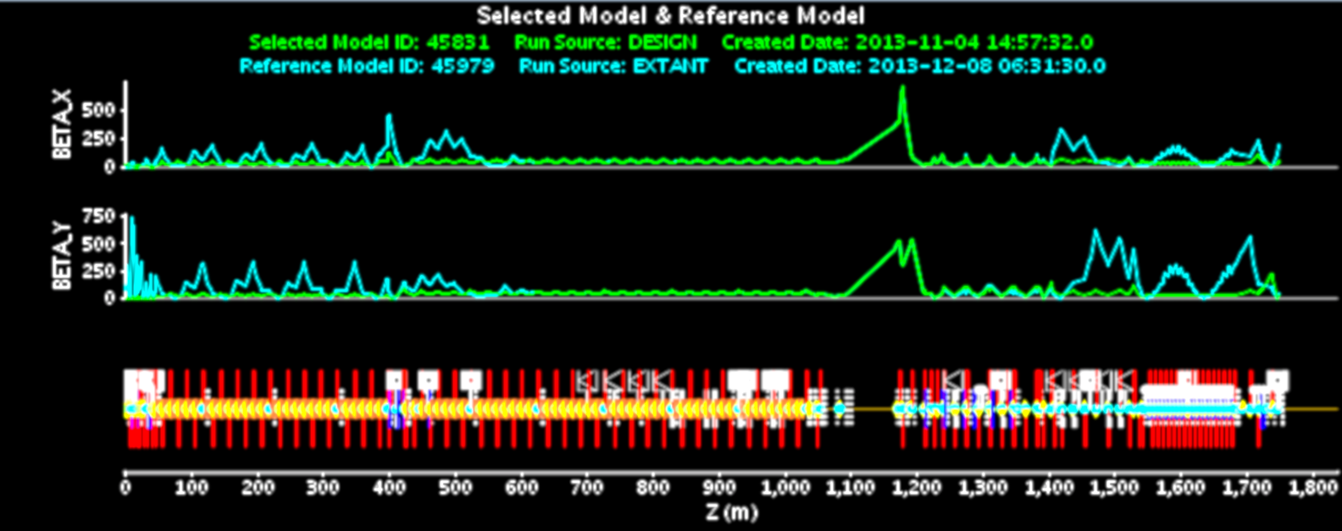
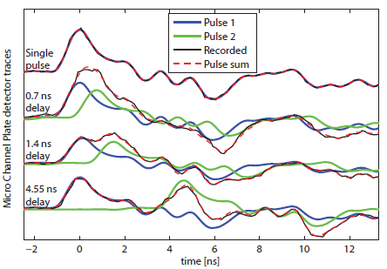
Emerging EPICS Ecosystem Roles in AI/ML & Physics Applications
Device Abstraction, Data Measurement & Transport | Online non-linear optimization | Collection & Event Building / Big Data | Online Linear Modeling | Offline big modeling and ML
 |  |  |  | Online Multi-particle simulation (Impact-T). ML real time optimization.
 |  |  | Online linear model of whole machine, from pulse sync data
 |  | Beamline - Accelerator Synchronous tuning
 |  | Bunch resolved mass data archived w/ meta data
 |  | Sync Camera data
 | Ad-hoc Bunch sync ML regression analysis / ML. Non-linear Model. Gaussian Process. Gradient decent
EPICS 7 Structured data. EPICS Security
EPICS 7 gateway. New network protocol. Process Variables of Structured data. EPICS Security
PV carries many signals/records. E.g. NTNDArray image | PVs carry physics measurements & tuning results | 1 PV carries whole synchronous orbit data etc. | 1 PV carries whole lattice, all Twiss etc. | PVs from offline HPC carry tuning for immediate use online.

Slide 5
EPICS Version 7 in a Nutshell
New Fast Protocol, “pvAccess” replaces CA
Structured data
Python and MATLAB APIs (and C++ and Java)
Data Services (Process variables with arguments)
Standardized Scientific Types
Dynamic typing
Introspection interface
New smart process database
$ pvget XCOR:LI24:900:TWISS
structure
double energy 5.00512
double psix 37.7625
double alphax 13.6562
double betax -2.78671
double etax -0.00698294
double etaxp 0.00107115
double psiy 31.9488
double alphay 116.762
double betay 5.2592
double etay 0
double etayp 0
Figure: pvAccess getting PV of a structure of optics parameters. In this case a standard “Normative Type” type was not used, so the raw
structure is displayed
Faster. Structured data. Metadata. Easier.

Slide 6
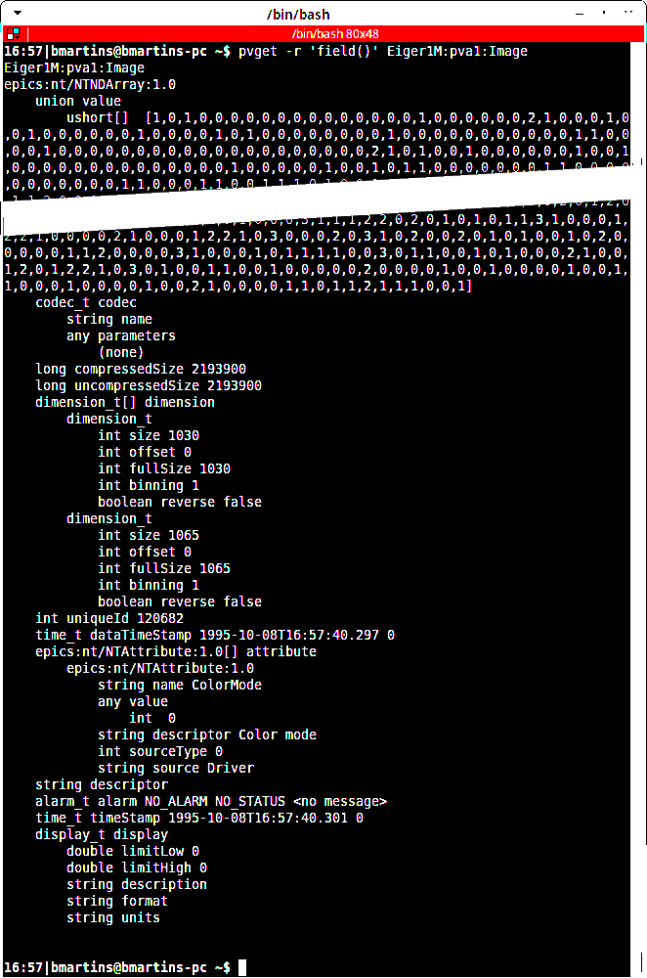
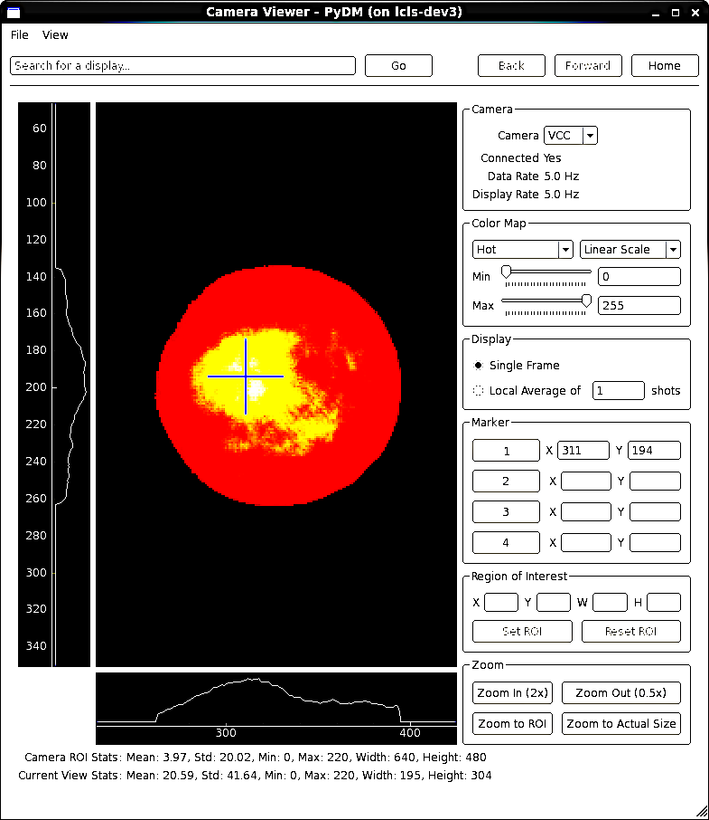
EPICS 7 Image Type (NTNDArray) Example Helping ML answer e.g. – What does the cathode look like when the photon flux intensity is high
Command line request for a given image PV by name.
Data Type Identifier
A lot of data snipped
Raw image data.
Widget learns how to display image from metadata
The image meta data; giving parameters to interpret data in the value field, and other information.
Figure: A screenshot of the output of the EPICS 7 “pvget” command, for an image.
Figure: A screenshot of PyDM displaying a beam profile image.
B. Martins, BNL, M. Gibbs SLAC

Slide 7
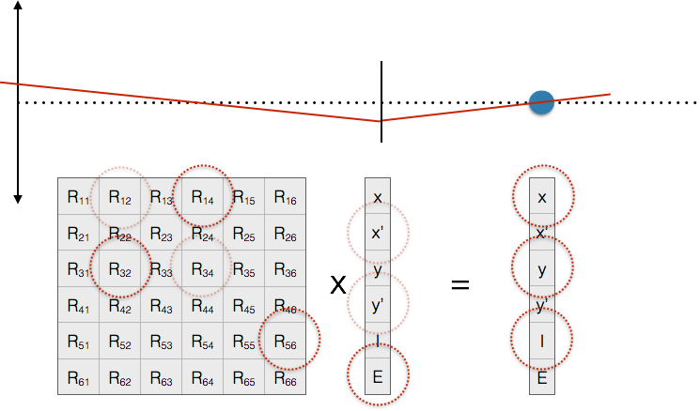
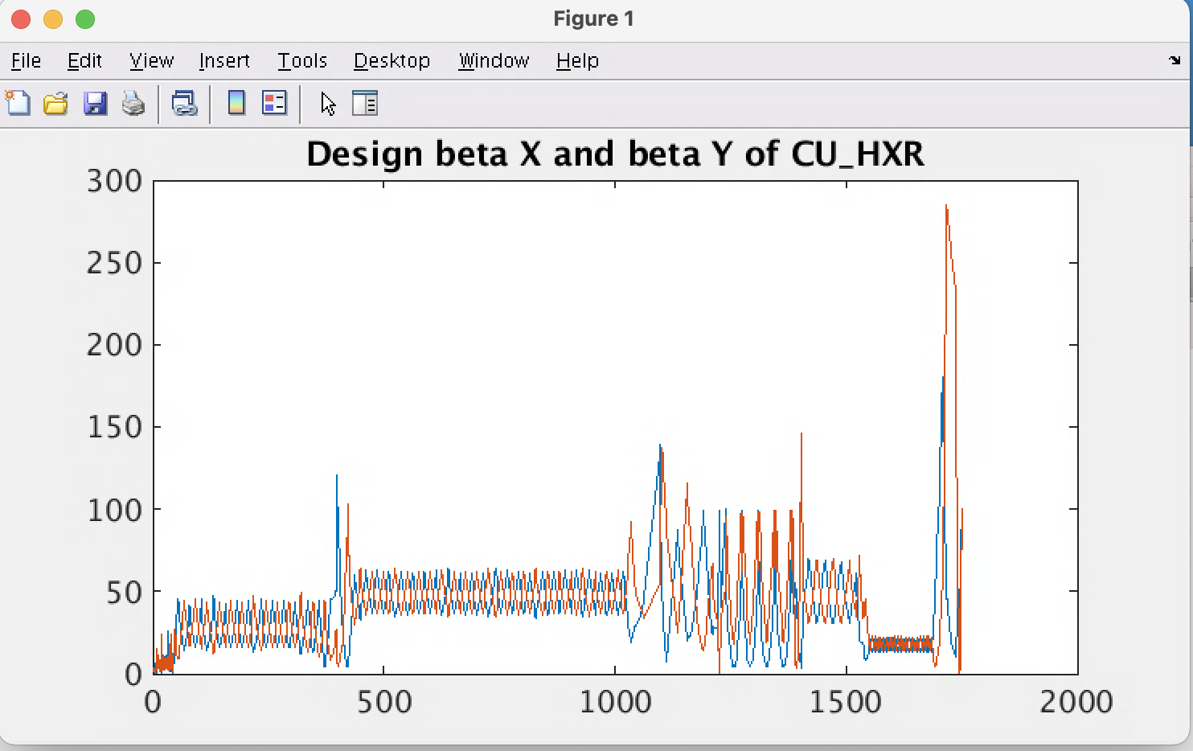
Model Data through EPICS 7 Control System
Examples: SLAC Modelling Beam Dynamics. FRIB and APS have similar.
Twiss Parameters
Transfer Matrices, example shows A to B
>> twiss_d=eget('BMAD:SYS0:1:CU_HXR:DESIGN:TWISS',{'provider','pva'}); >> plot(twiss_d.s, twiss_d.beta_x);
>> hold on
>> plot(twiss_d.s, twiss_d.beta_y);
>> title('Design beta X and beta Y of CU\_HXR');
“A”
“B”
Transverse
beam offset
Z
Process Variable value, computed subject to user’s arguments
$ eget -s XCOR:IN20:491:RMAT -a b BPMS:IN20:525
0.669591 0.694604 0 0 -3.08532e-19 2.41325e-19
-0.570851 0.901275 0 0 -1.23627e-19 1.45491e-19
0 0 1.33379 0.966896 0 0
0 0 0.358415 1.00957 0 0
-2.29302e-24 8.92892e-20 0 0 1 1.20724e-05
1.00974e-28 0 0 0 0 1
>> twiss_l = eget('BMAD:SYS0:1:CU_HXR:LIVE:TWISS',{'provider','pva'}); >> twiss_l(find(strcmp(twiss_l.device_name,'BPMS:LI21:233’)), …
[2,6,7,11,12])
ans =
1x5 table
device_name alpha_x beta_x alpha_y beta_y
_______________ _______ ______ ________ ______
"BPMS:LI21:233" 1.9887 7.9179 -0.20858 4.8231
Figures: EPICS 7 modelling service giving orbit response matrices and Twiss parameters for given devices - the basis of 90% of emittance minimization applications like feedback, steering, bumps, etc.
Structured data, presented as table by EPICS
Notes:
SLAC and ESS are collaborating on a system of EPICS Version 4 services that help accelerator physicists write commissioning applications.
The two examples in this slide show use of an EPICS service to compute the optics of accelerator lattice elements.
The Left Hand Side shows the response matrix computed between a corrector and a BPM. Two things to note:
1. The use of RPC style argument – the name of the second device – given as an argument to the first.
2. That the response matrix self identified as the Normative Type NTMatrix, so eget (and any other client) knows to display it as a matrix
The Right Hand Side shows the acquisition of the Twiss – aka Courant-Snyder – parameters of a corrector.
Other PVs can also return the optics of the whole accelerator, returned as a very large table – in an NTTable.

Slide 8
Accelerator Infrastructure data through EPICS
Examples
Data Services now trivial to implement in EPICS. In Python, Java, C++, even MATLAB
# Regular expression (restrict to sectors LI25-LI29)
$ eget -s ds -a regex='XCOR:LI2[5-9]:.*:BDES’
…
# Device names of the instruments in the laser heater region
$ eget -s ds -a etype INST -a tag LSRHTR -a show dname
…
# A recent search for invalid data in corrector PVs
$ eget -tTs ds -a name %COR:LTU%:%:%DES | \ eget -p ca -f - | grep nan
XCOR:LTU1:558:BDES nan
XCOR:LTU1:558:IDES nan
…
Directory Services
# The names of PVs, by device name pattern:
$ eget -s ds -a name=XCOR:LI21:135:%
name
XCOR:LI21:135:ABORT
XCOR:LI21:135:ACCESS
XCOR:LI21:135:ALLFUNCGO
XCOR:LI21:135:BACT
XCOR:LI21:135:BACTFO
… (many rows snipped)
Oracle Database accessed through Control System:
Figure: Access to Oracle gives device infrastructure, magnet calibrations, drawing names, etc. Will be used in LCLS-II for such things as cryogenic plant system hierarchy etc.
Greg White, Murali Shankar SLAC
Notes:
SLAC and ESS are collaborating on a system of EPICS Version 4 services that help accelerator physicists write commissioning applications.
The two examples in this slide show use of an EPICS service to compute the optics of accelerator lattice elements.
The Left Hand Side shows the response matrix computed between a corrector and a BPM. Two things to note:
1. The use of RPC style argument – the name of the second device – given as an argument to the first.
2. That the response matrix self identified as the Normative Type NTMatrix, so eget (and any other client) knows to display it as a matrix
The Right Hand Side shows the acquisition of the Twiss – aka Courant-Snyder – parameters of a corrector.
Other PVs can also return the optics of the whole accelerator, returned as a very large table – in an NTTable.

Slide 9
EPICS 7 network performance (pvAccess)
Performance and Reliability
Comparison of new data protocol included in EPICS 7 compared to EPICS 3
pvAccess is significantly faster than EPICS 3 at big data. CA is faster at many small ops in parallel.
Use Cases Indication: Use pvAccess for machine beam synchronous accelerator data, experimental data, camera data, structured data or data & metadata. Maybe use CA for very full synoptic displays and compatibility with legacy display mgr.
Matej Sekoranja, Cosylab
Notes:
So, as you can see, for many parallel gets, of small data object sizes (like scalar), CA is faster than PvAccess.
But for larger datasizes, like images, and modern beam data, PvAccess is faster. Much faster in the sequential case – eg camera acq, RPC.

Slide 10
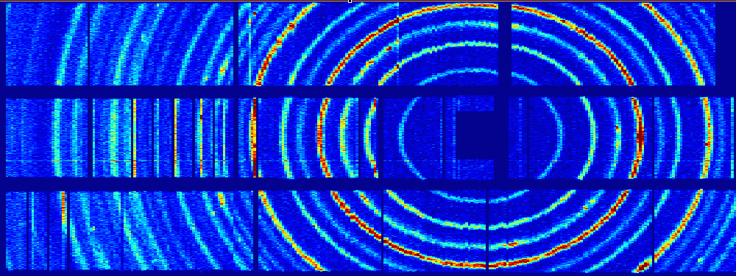
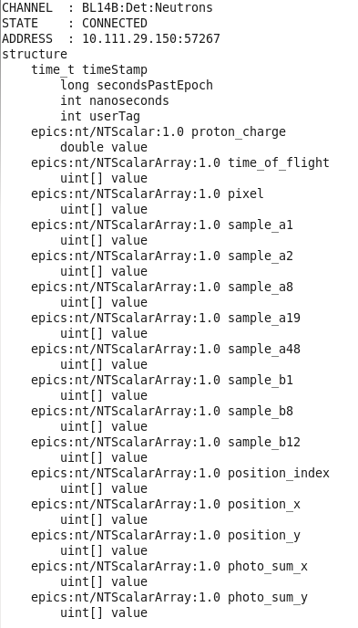
SNS uses EPICS v7 for high throughput event readout, of structured PV data.
ORNL SNS Deployment: Neutron event data aggregation and transport
Neutron Detector
CS-Studio
pvAccess streams event data at 80 Mbytes / sec
SNS SEQUOIA detector ray consisting of >800 ³He tubes covering a solid angle of 0.8 steradian
Diffraction rings of a powder sample at SEQUOIA
ADnED
SNS/HFIR Outcomes:
v7 in use at 21 Beamlines
10M events/s
Excellent reliability.
nED
pvAccess Server
CA Server
pvDatabase
areaDetector data processing
Classic EPICS IOC
pvAccess Client
nED provides the driver interface to the detector electronics and streams experiment data using pvAccess
ADnED, a pvAccess client, generates online histograms and counting statistics from the nED data stream and serves them using the CA protocol to clients including CS-Studio
The EPICS 7 data structure includes an array of pixels and a corresponding array of times of flight for neutron event. Additional fields record accelerator metadata e.g. pulse information and detector diagnostic information.
M. Pearson, K. Kasemir, S. Hartman, ORNL
Notes:
EPICS V4 is used at SNS in data acquisition and processing of Neutron scattering experiments. [Timo, you may want to say more here on ESS too]
Neutron scattering can be used to help in the understanding of the structure and properties of materials; it is a technique complementary to x-ray scattering. Neutrons, with a neutral charge, are highly penetrating and are an effective probe for locating light atoms such as hydrogen.
nED provides the interface to the detector
nED streams experiment data using the V4 network protocol, pvAccess
ADnED, built on EPICS AreaDetector, is the V4 client
ADnED produces data histograms for online user display along with counting statistics for experiment control.
Presently the histogram and image data are still distributed as CA data.
Long term plan is to extend pvAccess to user client side, though that depends on pvAccess gateway and CSS-widget support
However, good that pvAccess areaDetector driver and plugin are about to be distributed with areaDetector (2-5)

Slide 11
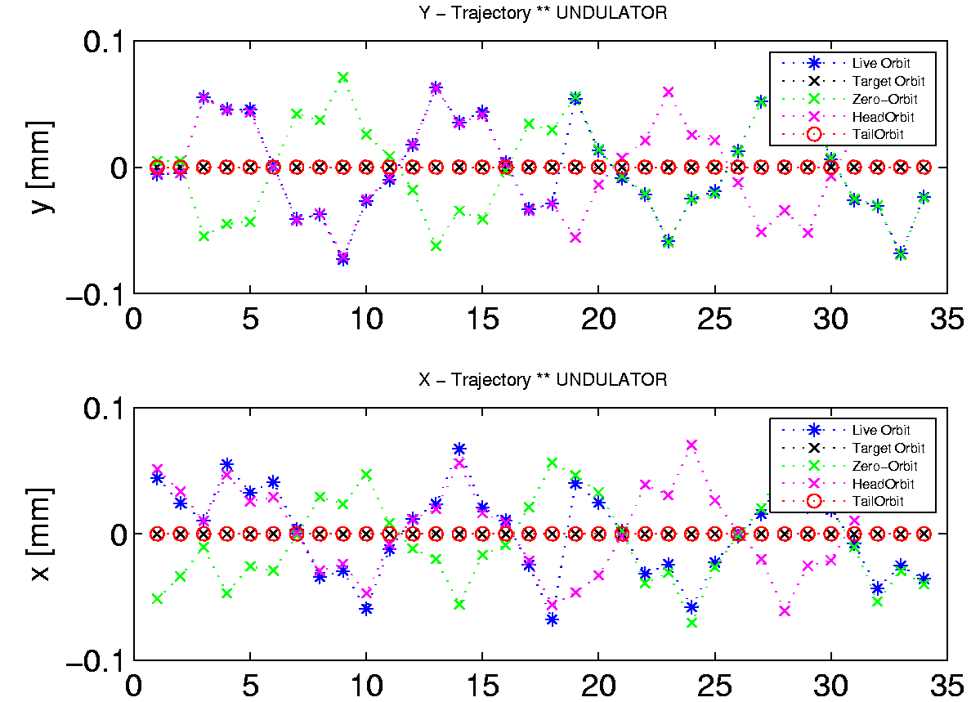
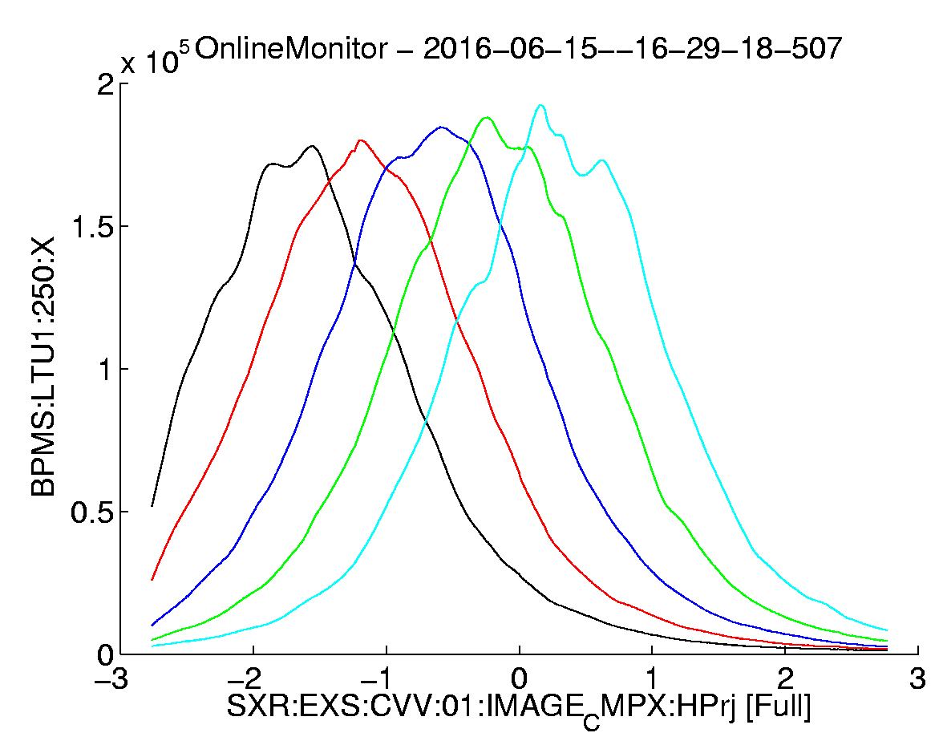
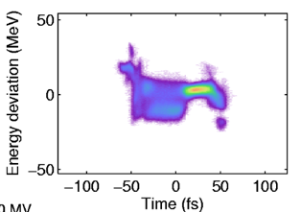
EPICS 7 – Beam Synchronous Data – and Event building
A. Lutman
Problem: assemble pulse synchronous data & machine meta data. Complex, incomplete.
In Accelerator – Beam Synchronous Acquisition system (BSA).
In Experimental support controls, Beam Line Data System (BLD).
Requirement: Make it easy. Support Regression Analysis and ML (BSA Service), and event build for FEL tuning
Objective: Fast transfer of pulse identified data as atomic structures of the measured data and their “meta-data” for analysis, experiment tuning, and ML.
Alberto Lutman, SLAC

Slide 12
“All the data, all the time” at SLAC’s LCLS
Figure: Accelerator Event Building Service collects all bunch-by-bunch data, lines up by bunch ID, tags with accelerator meta data, stream to clients, and archives for Machine Learning and diagnostics. ~2.5 GB/hr to HDF5 continuously
Physics Software Apps (HLAs)
Displays (pyDM)
SRF diagnostics
Regression Analysis & ML
PVA
EPICS 7 p4p
EPICS 7 p4p
BSA Service listens to ALL Beam Synchronous PVs (TSA -2), collates and publishes. Impl in p4p.
Pulse Synchronous Data Archive
BSA Event Building Service Collector
PVA
BSA Service PVA Writer
PVA
CA
All ~3000 PVs 1 kHz single pulse data
1 MHz aggregate
All ~3000 PVs 120 Hz single pulse data
1 EPICS 7 NTTable PV of all Beam Synchronous BSA PVs in beampath, for every pulse <= 1 kHz. Statistics for pulse rates > 1 kHz.
LCLS-II SC Beam Synchronous Acquisition
LCLS-I Cu
Beam Synchronous Acquisition (BSA)
(Complete)
EPICS 7 IOCs
EPICS 3 IOCs
12
https://www.slac.stanford.edu/grp/ad/docs/model/matlab/bsd.html, M. Davidsaver, G. White

Slide 13
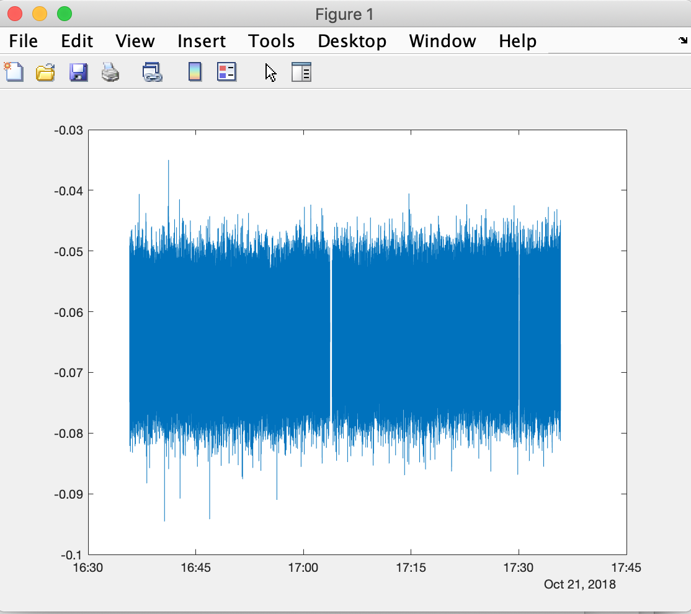
All past beam synchronous data, available to Matlab
>> % Load data of all beam synchronous PVs, for hour following Oct 22 2018, 00:35.49
>> load('~/Development/bsd/CU_HXR_20181022_003549.h5','-mat’);
>> % Make a single vector of real seconds POSIX time, and convert to local time
>> ts=double(secondsPastEpoch)+double(nanoseconds)*1e-9;
>> t=datetime(ts,'ConvertFrom','posixtime','TimeZone','America/Los_Angeles’);
>> % E.g. Plot every pulse at one BPM PV over the hour
>> plot(t,BPMS_IN20_525_X);
All the data of every beam synchronous device, at every pulse, continuously 24x7, for post-facto ML and other numerical analysis.
https://www.slac.stanford.edu/grp/ad/docs/model/matlab/bsd.html, M. Davidsaver, G. White

Slide 14
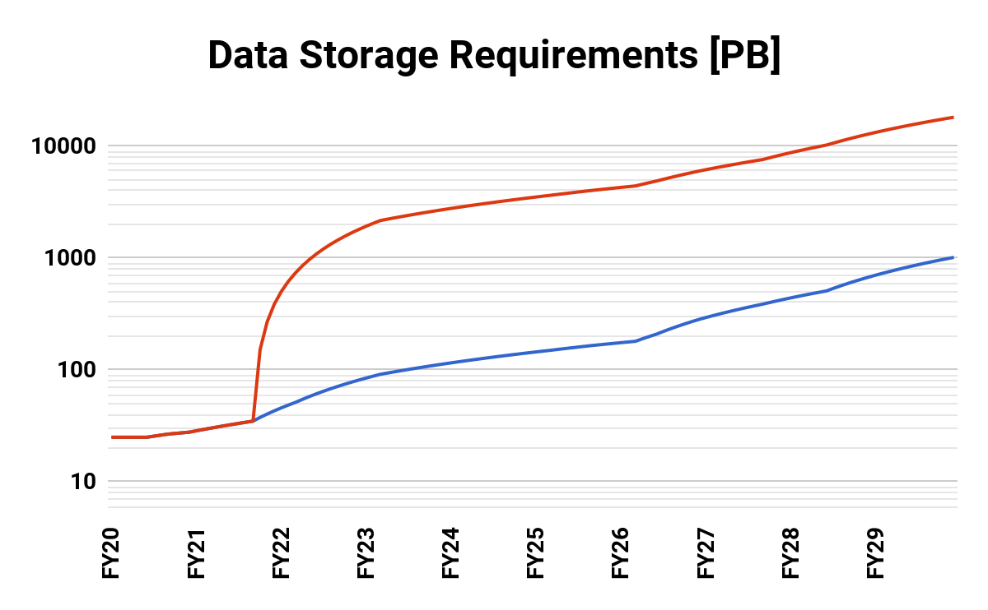
Data will drive analytics. Both data generated and storage requirement are set to grow enormously
1 TB/s
Detector Output
250 GB/s
Processed Data
LCLS Accelerator Data
LCLS Experiment Data
G. White, AD
Jana Thayer, LCLS
Optimistic: Assumes continuous 24/7 data recording and file format does include data summary tuple for characterizing data >1 kHz
Data roll-up DOES NOT Include LCLS-HE assumed coming after 2026
Data roll-up DOES NOT include Camera image data
Accelerator data storage size will be large for us, but small compared to LCLS experiment (300 TB << 1000 PB)

Slide 15
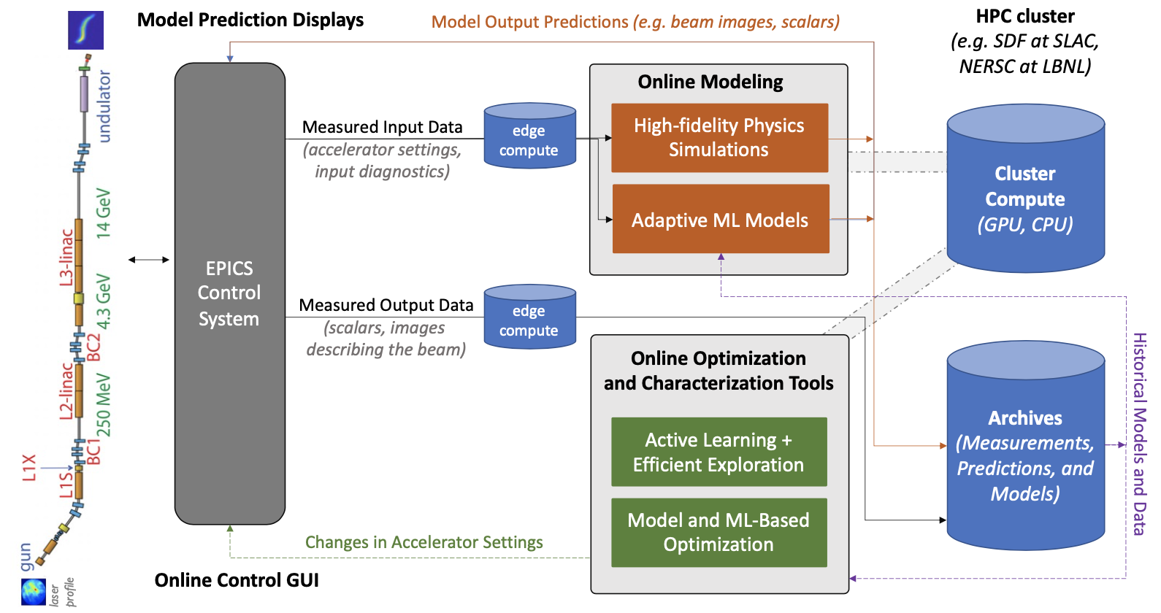
Machine Learning and Multi-particle simulation computing pipeline in development at SLAC
Online modeling beyond Twiss and R-mat.
Figure: Computer architecture of ML and physics simulation for modelling and tuning the online accelerator in real time.
Figure: Screenshot of dashboard of LCLS LUME start-to-end multiparticle simulation. FY23-34 productize for active tuning, identify loss sources, plan transport strategies.
A. Edelen, C. Mayes, J. Garrahan, SLAC

Slide 16
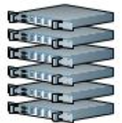
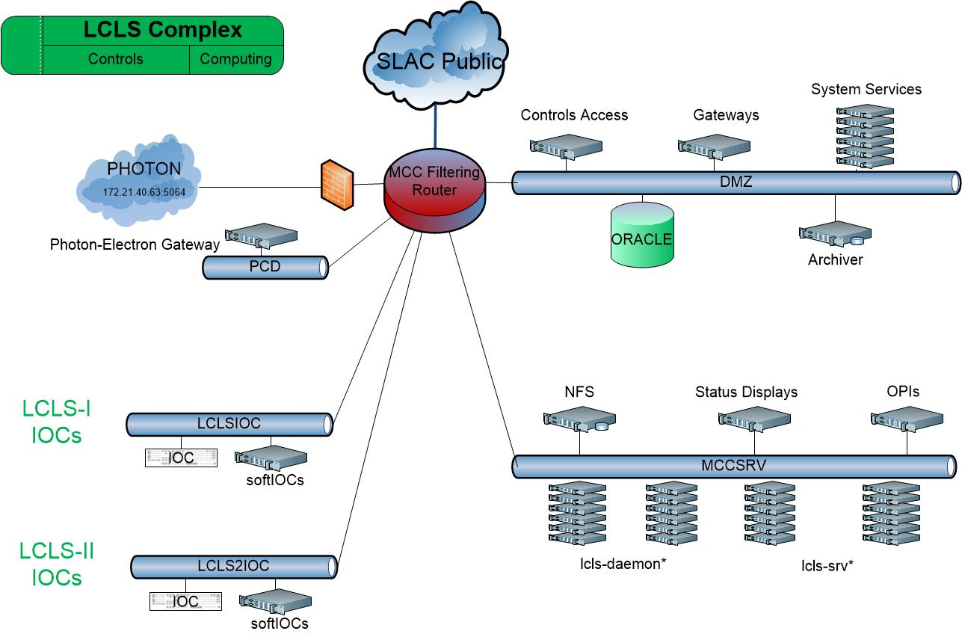
Accelerator Computing Architecture Early 2023
Big Data stores
High Performance Computing Network
Experiment Data Analysis
Office Network
Science Data Facility
SLAC Network
SDF Disk
SDF Disk
Accelerator Physics Analysis
Documents, Engineering Drawings
Oracle, People-soft etc
Multi-particle Tracking (s-2-e)
Machine Learning Training
Data Systems Analysis Network
Experiment Network
Non-critical Data Services
Simulation
Software development
Controls Network
Production Services and Control Room Network
Control room displays
High Level Apps execution
Online modeling
Critical Data Services
Optimization, ML and slow feedback
EPICS Input Output Controllers (IOCs) - 100s
At SLAC, legacy AFS computing system (Accelerator Data Systems) being phased out, and being replaced by Stanford SLAC Science Data Facility (S3DF).
Accelerator devices

Slide 17
Accelerator Computing Architecture Late 2023
Big Data stores
High Performance Computing Network
Experiment Data Analysis
Office Network
Science Data Facility
SLAC Network
SDF Disk
SDF Disk
Accelerator Physics Analysis
Documents, Engineering Drawings
Oracle, People-soft etc
Multi-particle Tracking (s-2-e)
Machine Learning Training
Non-critical Data Services
Data Systems Analysis Network
Simulation
Experiment Network
Software development
Controls Network
Production Services and Control Room Network
Control room displays
High Level Apps execution
Online modeling
Critical Data Services
Optimization, ML and slow feedback
EPICS Input Output Controllers (IOCs) - 100s
Note how far EPICS physics is from the traditionally sequestered control system
Accelerator devices

Slide 18
Summary: EPICS is changing to include AI/ML and HPC
Scope: Controls → += Physics
SCADA, optimized control, synoptic display → AI/ML, linear modelling, multi-particle modeling, physics applications and daemons
EPICS Version: 3 → 7
Scalars & waveforms, get/set/monitor → Structured data, fast protocol for complex data, RPC services, (relatively) big data & datastores
Network: Controls → += HPC
ML needs HPC, especially training. Multiparticle needs HPC. HPC tends to be offline, away from controls. Results PV write → Authentication and Authorization.

Slide 19
EPICS 2023 ML intro talk ends.

Slide 20
New Data Sizes, ML and Online Multi-particle Model, their Implications and Requirements on Architecture
1 TB/s
Detector Output
250 GB/s
Processed Data
Premise: Future accelerator will be optimized by Data Systems, ML and HPC Model Systems
Implications
Data Science driven accelerator tuning. BSA Data store, ML on SDF. ML on prod -> network, Physics Analysis Env & documentation
Complicates requirement to produce quick ”feedback” to experiment
Many controls and physics processes, not just IOCs --> PVA gateways, EPICS 7 IOCs, production HLAs online
Production at >1 network. Dev and SDF now incl.
Development in DMZ and SDF networks, not prod
New maths and algorithms to be prototyped -> Matlab from home, PVA matlab, python env
Data access across networks (prod, dev/AFS, SDF)
Large amount of data to be stored, managed, understood
Fast and easy to use.
Consequent Requirements
Production architecture that includes S3DF.
Simple, fast, automated Workflows and Data Flows

