Slide 1
EPICS Collaboration Meeting Closeout
April 27, 2023

Slide 2
We are collaborating more in person again
After a break from in person meetings due to COVID, it is fantastic to see so many people attending EPICS meetings in person again
Collaboration meetings
Cosylab in Ljubljana September 2022 – hybrid, first meeting with in-person participation since the pandemic began - ~100 participants
Fermilab April 2023, hybrid but more in person - 182 participants
Code-a-thons
Diamond Light Source – March 2023 – 32 participants
SLAC – May 2022 – 53 participants

Slide 3
Some meeting highlights
FNAL will use EPICS for PIP-II, considering options for legacy system upgrades – Welcome to the collaboration and thank you for hosting this meeting
BNL will use EPICS for the EIC, some hybrid for legacy RHIC system
Very successful meeting, largest in person EPICS meeting post COVID
Emerging themes (topics we have not discussed too much before)
ML/AI, ipv6, cyber security
Upgrades due hardware/software obsolescence, performance
VME, VxWorks
Eclipse -> Phoebus
Legacy systems look to EPICS for modernization

Slide 4
How do we pay for EPICS?
EPICS is open source but not free, but also not funded
The EPICS Collaboration does not receive any specific funding to maintain and improve the software, but this work is essential to ensure future viability
The collaboration relies on donated labor from organizations using EPICS software
The collaboration provides an incredible community of support (free)

Slide 5
You and your organization can should help
If your organization benefits from EPICS, consider how you can help
New projects are well positioned to fund new capabilities
Tell your boss EPICS needs your organization to donate time/money to help with maintenance, testing, support, development or documentation
You can donate labor or fund a contract developer

Slide 6
How can you get involved?
Opportunities to join working groups such as EPICS core, CS-Studio
Send someone to a code-a-thon or document-a-thon
Many of the talks this week mentioned opportunities to contribute:
Michael Davidsaver needs some testers
You can work with international experts => develop more advanced skills that benefit your professional development and your effectiveness for your home organization
“Win-win-win: Good for you, good for your lab, good for EPICS”
– Ralph Lange

Slide 7
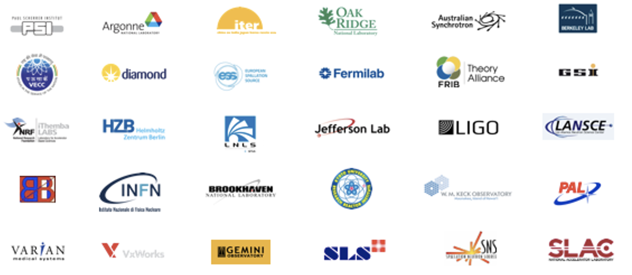
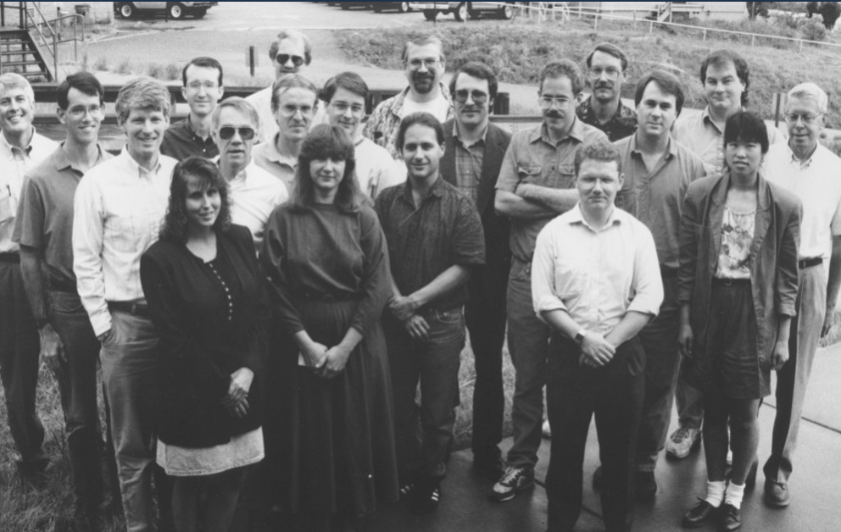
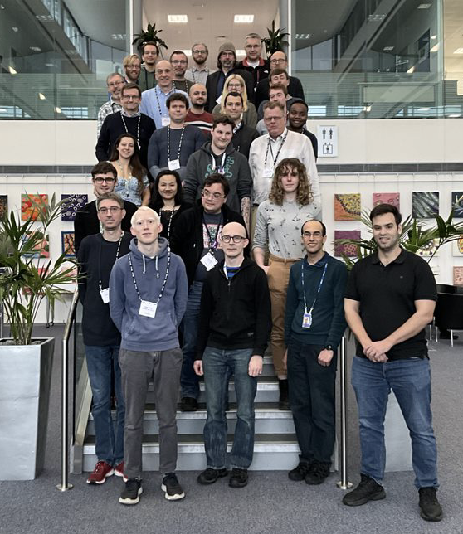
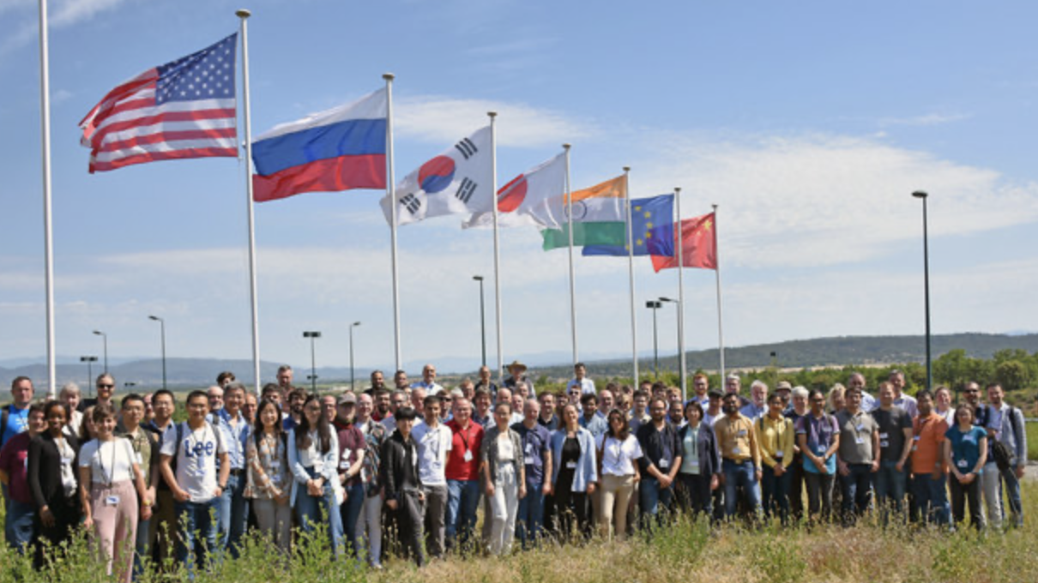
VOLUNTEERS

Slide 8
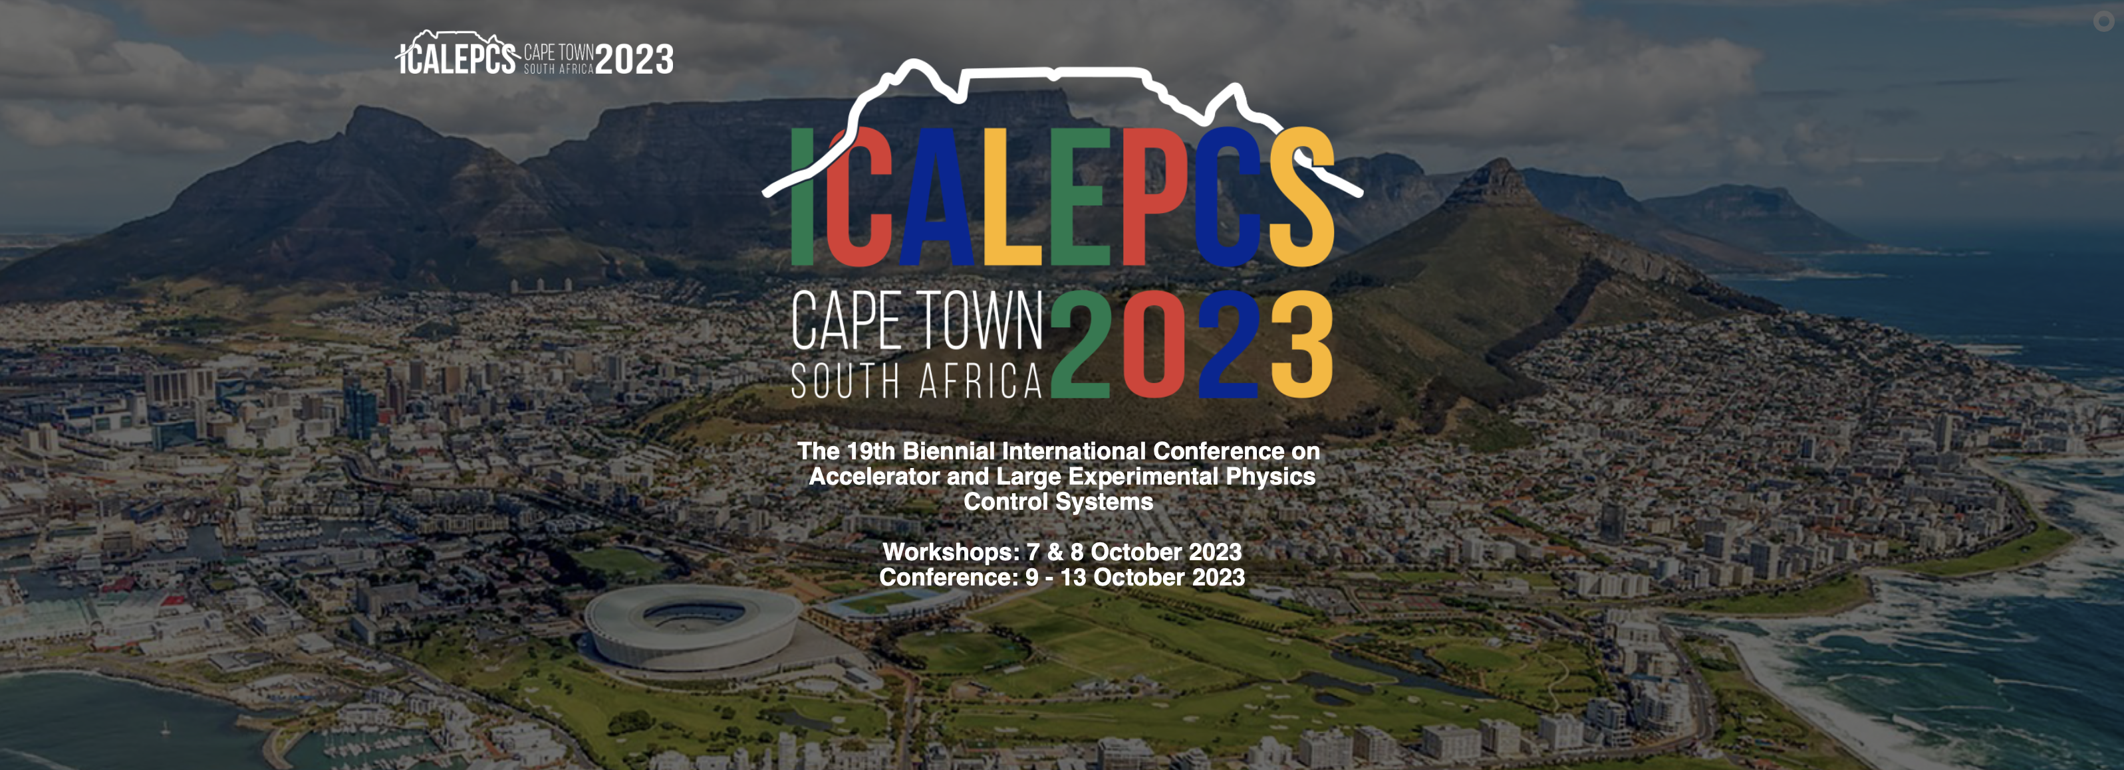
Next EPICS Collaboration Meeting one-day pre-conference workshop 10/7 or 10/8, 2023 Hosted by iThemba LABS
ICALEPCS 2023 abstracts due April 30, 2023

